Slide 1
Investigating Bug Prediction and Static Analysis Tools in the Cloud Context
Anna Jancso & Yasara Peiris

Slide 2
Overview
Context: Cloud computing
RQ1: Bug prediction
Methodology
Results & Discussion
RQ2: ASAT adoption
Methodology
Results & Discussion
Summary and Future Work

Slide 3
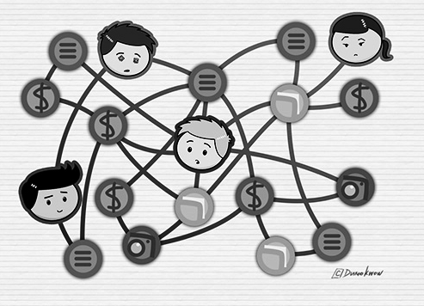
Context
Increasing complexity of modern software systems
Large codebases
More users
More instances
More
dependencies

Slide 4

Context
Increase use of cloud applications
But,
Software maintenance using existing tools is limited

Slide 5

What is cloud computing?
Use of hardware and software to deliver a service over a network .
On-demand availability of computer system resources.
No direct active management by the user.
More complex than simple, monolithic, single-server systems

Slide 6
RQ1: Bug Prediction

Slide 7

Bug Prediction
How to predict bugs in cloud applications?
Notes:
Increasing complexity of modern software systems
large codebases
more dependencies
more instances
more users
Makes software evolution & maintenance more challenging
Complexity in adding new features
Difficulties in maintaining the code - Locating defects

Slide 8

Defects in Contemporary Projects
Logic specific bugs (errors, functional)
Design issues (e.g. too much coupling)
Code style violations (e.g. bad indentation)
Optimisation Bugs
Data Loss or Data Corruption
Error Handling Bugs
Configuration Bugs

Slide 9
Defects in Contemporary Projects
Current Defect Detection Methods
Defect Detection |  | Positive | Negative
Manual | Code Reviews [7] |  | Time Consuming Expensive
Automatic | Testing [10] | Fast high precision | Expensive
 | Prediction Tools [11,12] (Based on historical analysis, using metrics as features for ML model) | Fast Cheap
 | Automatic Static Analysis Tools (Tools that analyze code without program execution) [8,9] | Fast Cheap | Low Precision

Slide 10
Motivation
Distributed computing has become backbone of computing. Cloud defects have different characteristics and are typically more difficult to detect.
Existing static analysis tools support in contemporary projects in different tasks.
Detection of defects
Design Issues
Code Style Violations
Prioritization of warnings depending on the development context
Notes:
Cloud systems value availability and reliability issues

Slide 11
Related Work - Classes of Bugs [2]
Classification | Labels
Aspect | Reliability, Performance, Availability,Security,Consistency, Scalability, Topology, Qos
Bug scope | Single Machine, Multiple Machines, Entire Cluster
Hardware | Core/Processor, Disk, Memory, Network
Notes:
Related work/paper
3000+ issues have been studied
Reliability, performance, availability largest set of bugs
Relates to any service system
Data consistency -> all nodes agree on same value of data
Elasticity of system usually not thouroughly tested -> leads to scalability issues like data size, request load issues
Topology issues -> cloud protocols might not work on some network layouts e.g. different number of nodes, racks, communication between nodes

Slide 12
Related Work - Classes of Bugs [2]
Classification | Labels
HW Failure | Corrupt, Limp, Stop
Software | Logic, Error Handling, Optimization, config, Race, Hang Space, Load
Implication | Failed Operation, Performance, Component Downtime, Data Loss,
Notes:
Related work/paper
3000+ issues have been studied
Reliability, performance, availability largest set of bugs
Relates to any service system
Data consistency -> all nodes agree on same value of data
Elasticity of system usually not thouroughly tested -> leads to scalability issues like data size, request load issues
Topology issues -> cloud protocols might not work on some network layouts e.g. different number of nodes, racks, communication between nodes

Slide 13

Classes of Cloud Bugs [2]
Topology
Data Consistency
New Layering Architecture, Rack Awareness
Killer Bugs
Scalability
Cascading Failure, No single point of failure, Time of faults
Scale of cluster size, Scale of data size,
Scale of Request load
Notes:
(TOF) bugs that only manifest when a node crashes at a special moment. Although challenging, detecting TOF bugs is fundamental to developing highly available distributed systems.
single-point-of-failure (SPoF) / killer bugs, which can simultaneously affect multiple nodes or the entire cluster;
distributed concurrency bugs, caused by nondeterministic distributed events such as
message reorderings and failure timings; read-write race

Slide 14

Classes of Cloud Bugs [2]
Crash Recovery Bugs
Performance Bugs
Throughput
Invocation Time
No of users impacted
Distributed Concurrency Bugs
Notes:
(TOF) bugs that only manifest when a node crashes at a special moment. Although challenging, detecting TOF bugs is fundamental to developing highly available distributed systems.
single-point-of-failure (SPoF) / killer bugs, which can simultaneously affect multiple nodes or the entire cluster;
distributed concurrency bugs, caused by nondeterministic distributed events such as
message reorderings and failure timings; read-write race

Slide 15
Research Question
What bugs affect cloud applications? Which metrics could be useful to predict them? Here we investigate the theories, metrics, and features enabling better bug prediction strategies.
Cloud bugs and their level of predictability
Investigate bugs and failures affecting the evolution of cloud application.
Investigating/experimenting potential metrics and criteria to predict such bugs
Notes:
Following those goals...
How to prioritize warnings for cloud systems

Slide 16
Methodology - RQ1 (defect prediction)
Find a cloud project
Investigate defects occurring between releases of these projects
Define metrics that could predict such defects
Compute source-code file-based metrics
Use basic bug prediction pipeline to figure out important features in bug prediction in cloud context.
Notes:
To answer research questions...

Slide 17

Metrics for Finding Cloud-Specific Bugs
CK Metrics
LOC (lines of code)
CBO (number of children)
WMC (Weighted methods per class)
RFC(Response for a class)
lCOM(Lack of cohesion of methods)
DIT(Depth Inheritence Tree)
Notes:
CBO (Coupling between objects): Counts the number of dependencies a class has.
DIT (Depth Inheritance Tree): It counts the number of "fathers" a class has. All classes have DIT at least 1 (everyone inherits java.lang.Object).
RFC (Response for a Class): Counts the number of unique method invocations in a class.
WMC (Weight Method Class) or McCabe's complexity. It counts the number of branch instructions in a class.
LOC (Lines of code): It counts the lines of count, ignoring empty lines. The number of lines here might be a bit different from the original file, as we use JDT's internal representation of the source code to calculate it.
LCOM (Lack of Cohesion of Methods): Calculates LCOM metric. This is the very first version of metric, which is not reliable. LCOM-HS can be better (hopefully, you will send us a pull request).

Slide 18
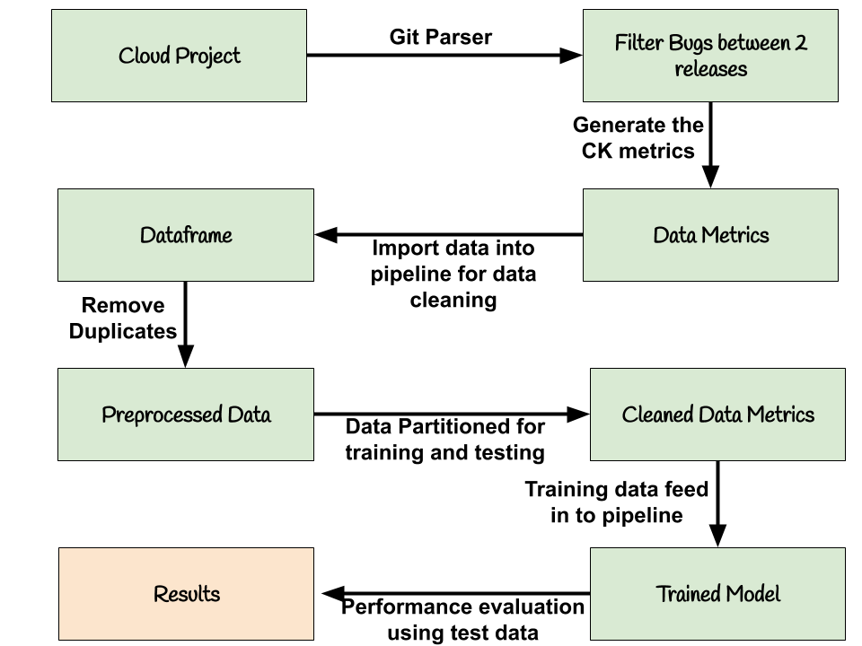

Defect Bug Prediction Process

Slide 19

Data Preparation
Notes:
CBO (Coupling between objects): Counts the number of dependencies a class has. The tools checks for any type used in the entire class (field declaration, method return types, variable declarations, etc). It ignores dependencies to Java itself (e.g. java.lang.String).
DIT (Depth Inheritance Tree): It counts the number of "fathers" a class has. All classes have DIT at least 1 (everyone inherits java.lang.Object). In order to make it happen, classes must exist in the project (i.e. if a class depends upon X which relies in a jar/dependency file, and X depends upon other classes, DIT is counted as 2).
RFC (Response for a Class): Counts the number of unique method invocations in a class. As invocations are resolved via static analysis, this implementation fails when a method has overloads with same number of parameters, but different types.
WMC (Weight Method Class) or McCabe's complexity. It counts the number of branch instructions in a class.
LOC (Lines of code): It counts the lines of count, ignoring empty lines. The number of lines here might be a bit different from the original file, as we use JDT's internal representation of the source code to calculate it.
LCOM (Lack of Cohesion of Methods): Calculates LCOM metric. This is the very first version of metric, which is not reliable. LCOM-HS can be better (hopefully, you will send us a pull request).

Slide 20
Data Ingestion
Hadoop Project was selected for the experiment.
JGit Java implementation of GIT version control system was used.
2 Releases of the project were selected and retrieved all the commits within the release.
Keywords were used to filter commits for bug fixes.
Notes:
CBO (Coupling between objects): Counts the number of dependencies a class has. The tools checks for any type used in the entire class (field declaration, method return types, variable declarations, etc). It ignores dependencies to Java itself (e.g. java.lang.String).
DIT (Depth Inheritance Tree): It counts the number of "fathers" a class has. All classes have DIT at least 1 (everyone inherits java.lang.Object). In order to make it happen, classes must exist in the project (i.e. if a class depends upon X which relies in a jar/dependency file, and X depends upon other classes, DIT is counted as 2).
RFC (Response for a Class): Counts the number of unique method invocations in a class. As invocations are resolved via static analysis, this implementation fails when a method has overloads with same number of parameters, but different types.
WMC (Weight Method Class) or McCabe's complexity. It counts the number of branch instructions in a class.
LOC (Lines of code): It counts the lines of count, ignoring empty lines. The number of lines here might be a bit different from the original file, as we use JDT's internal representation of the source code to calculate it.
LCOM (Lack of Cohesion of Methods): Calculates LCOM metric. This is the very first version of metric, which is not reliable. LCOM-HS can be better (hopefully, you will send us a pull request).

Slide 21
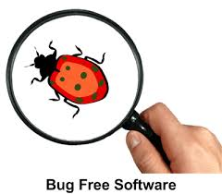
Keywords for commit filtering - General Keywords
Error
Failure
Bug
Fix
Unexpected
Crash
Wrong
Notes:
CBO (Coupling between objects): Counts the number of dependencies a class has. The tools checks for any type used in the entire class (field declaration, method return types, variable declarations, etc). It ignores dependencies to Java itself (e.g. java.lang.String).
DIT (Depth Inheritance Tree): It counts the number of "fathers" a class has. All classes have DIT at least 1 (everyone inherits java.lang.Object). In order to make it happen, classes must exist in the project (i.e. if a class depends upon X which relies in a jar/dependency file, and X depends upon other classes, DIT is counted as 2).
RFC (Response for a Class): Counts the number of unique method invocations in a class. As invocations are resolved via static analysis, this implementation fails when a method has overloads with same number of parameters, but different types.
WMC (Weight Method Class) or McCabe's complexity. It counts the number of branch instructions in a class.
LOC (Lines of code): It counts the lines of count, ignoring empty lines. The number of lines here might be a bit different from the original file, as we use JDT's internal representation of the source code to calculate it.
LCOM (Lack of Cohesion of Methods): Calculates LCOM metric. This is the very first version of metric, which is not reliable. LCOM-HS can be better (hopefully, you will send us a pull request).

Slide 22
Bug Filtering Keywords
cloud_specific_bugs = ['distributed concurrency ','performance','single-point-of-failure ']
cloud_concurrency_bugs = ['thread', 'blocked', 'locked', 'race', 'dead-lock', 'deadlock', 'concurrent', 'concurrency', 'atomic', 'synchronize', 'synchronous', 'synchronization', 'starvation', 'suspension', 'order violation', 'atomicity violation', 'single variable atomicity violation', 'multi variable atomicity violation', 'livelock, live-lock', 'multi-threaded', 'multithreading', 'multi-thread']
Notes:
CBO (Coupling between objects): Counts the number of dependencies a class has. The tools checks for any type used in the entire class (field declaration, method return types, variable declarations, etc). It ignores dependencies to Java itself (e.g. java.lang.String).
DIT (Depth Inheritance Tree): It counts the number of "fathers" a class has. All classes have DIT at least 1 (everyone inherits java.lang.Object). In order to make it happen, classes must exist in the project (i.e. if a class depends upon X which relies in a jar/dependency file, and X depends upon other classes, DIT is counted as 2).
RFC (Response for a Class): Counts the number of unique method invocations in a class. As invocations are resolved via static analysis, this implementation fails when a method has overloads with same number of parameters, but different types.
WMC (Weight Method Class) or McCabe's complexity. It counts the number of branch instructions in a class.
LOC (Lines of code): It counts the lines of count, ignoring empty lines. The number of lines here might be a bit different from the original file, as we use JDT's internal representation of the source code to calculate it.
LCOM (Lack of Cohesion of Methods): Calculates LCOM metric. This is the very first version of metric, which is not reliable. LCOM-HS can be better (hopefully, you will send us a pull request).

Slide 23
Cloud Specific Keywords
optimization_bugs = ['optimization','optimize']
logical_bugs = ['logic','logical','programming logic','wrong logic']
performance_bugs = ['performance','load balancing','cloud bursting', 'performance implications']
configuration_bugs = ['configuration']
error_handling_bugs = ['error handling', 'exception', 'exceptions']
hang_bugs = ['hang','freeze','unresponsive''blocking','deadlock','infinite loop', 'user operation error']
Notes:
CBO (Coupling between objects): Counts the number of dependencies a class has. The tools checks for any type used in the entire class (field declaration, method return types, variable declarations, etc). It ignores dependencies to Java itself (e.g. java.lang.String).
DIT (Depth Inheritance Tree): It counts the number of "fathers" a class has. All classes have DIT at least 1 (everyone inherits java.lang.Object). In order to make it happen, classes must exist in the project (i.e. if a class depends upon X which relies in a jar/dependency file, and X depends upon other classes, DIT is counted as 2).
RFC (Response for a Class): Counts the number of unique method invocations in a class. As invocations are resolved via static analysis, this implementation fails when a method has overloads with same number of parameters, but different types.
WMC (Weight Method Class) or McCabe's complexity. It counts the number of branch instructions in a class.
LOC (Lines of code): It counts the lines of count, ignoring empty lines. The number of lines here might be a bit different from the original file, as we use JDT's internal representation of the source code to calculate it.
LCOM (Lack of Cohesion of Methods): Calculates LCOM metric. This is the very first version of metric, which is not reliable. LCOM-HS can be better (hopefully, you will send us a pull request).

Slide 24
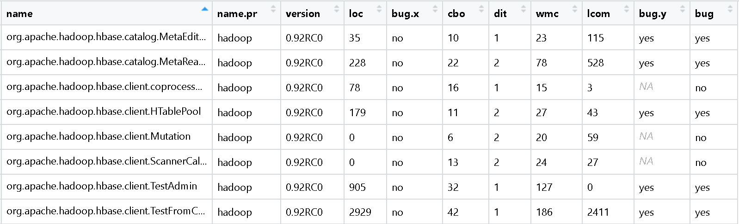
Traditional Bug Prediction Pipeline
Notes:
Based on historical analysis, using metrics as features for ML model
Wmc - Weighted Method Count - more methods -> more bugs
DIT - Depth of Inheritance Tree - increase complexity / deeper hierarchy more methods
NOC - Number Of Children - NOC equals the number of immediate child classes derived from a base class. - high reuse - fewer bugs
CBO- Coupling Between Objects method declared in one class used by other
LCOM -Lack of Cohesion in Methods
CK - Many bug prediction approaches are based on metrics
LOC - Number of lines of code

Slide 25
Traditional Bug Prediction Pipeline - Process
Python Weka wrapper
Machine Learning Algorithms
Logistic Regression
Naive Bayes
Random Forest
Notes:
The random forest algorithm combines multiple algorithm of the same type i.e. multiple decision trees, resulting in a forest of trees, hence the name "Random Forest". The random forest algorithm can be used for both regression and classification tasks.

Slide 26
Evaluation
Precision - Fraction of the relevant instances among retreived instances - True Positive/(False Positive + True Positive)
Recall - Fraction of total amount of relevant instances were that were actually retrieved. - True Positive/(False Negative + True Positive)
F Measure - F1 score is the weighted average of precision and recall - 2/((1/Recall) + (1/Precision))

Slide 27
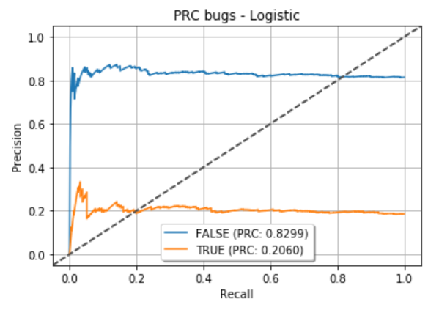
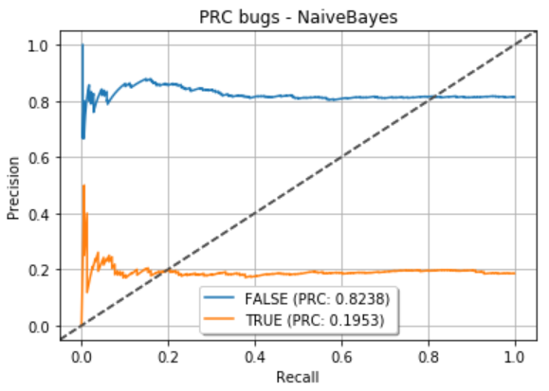
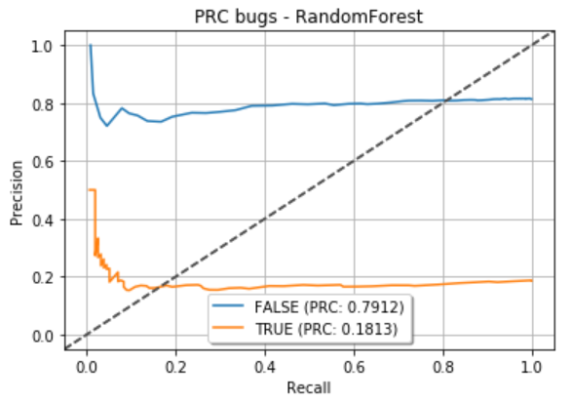
Experiment Results - all type of bugs - 2 Releases
ML Algorithm | Precision | Recall | F Score
Naive Bayes | 0.210525 | 0.025641 | 0.045714
Random Forest | 0.238095 | 0.032051 | 0.056497
Logistic | NaN | 0.0 | NaN

Slide 28
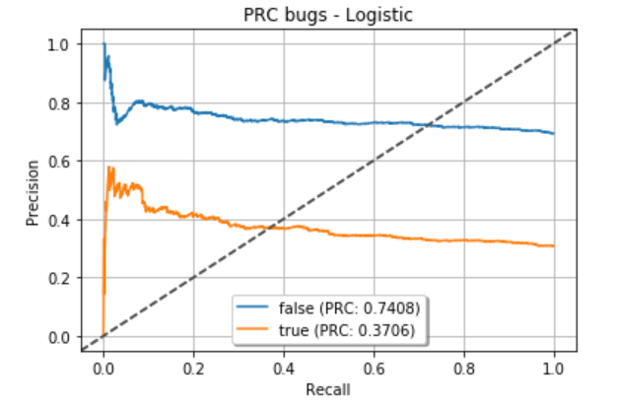
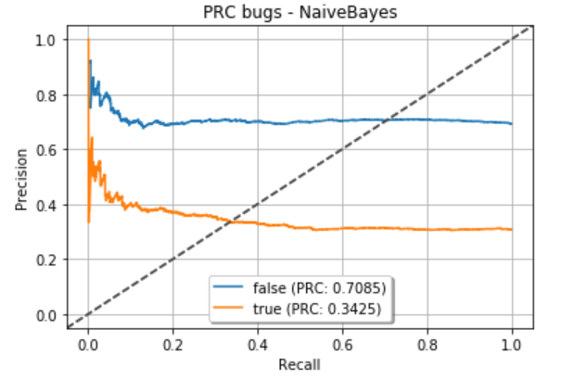
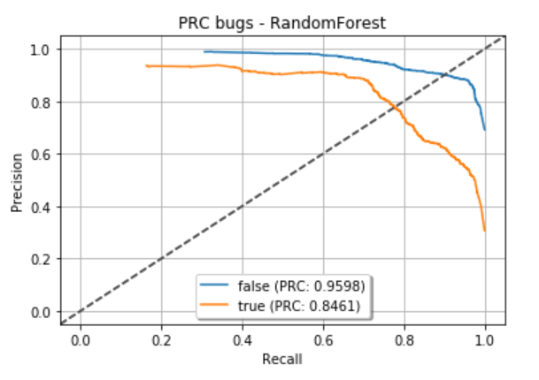
Experiment Results - all type of bugs - 10 Releases
ML Algorithm | Precision | Recall | F Score
Logistic | 0.024636 | 0.5 | 0.04695
Naive Bayes | 0.81166 | 0.032051 | 0.056497
Random Forest | 0.811684 | 0.748040 | 0.77855
Notes:
The random forest algorithm is not biased, since, there are multiple trees and each tree is trained on a subset of data.
Random forest is a type of supervised machine learning algorithm
a type of learning where you join different types of algorithms or same algorithm multiple times to form a more powerful prediction model.
The random forest algorithm combines multiple algorithm of the same type i.e. multiple decision trees, resulting in a forest of trees, hence the name "Random Forest".

Slide 29
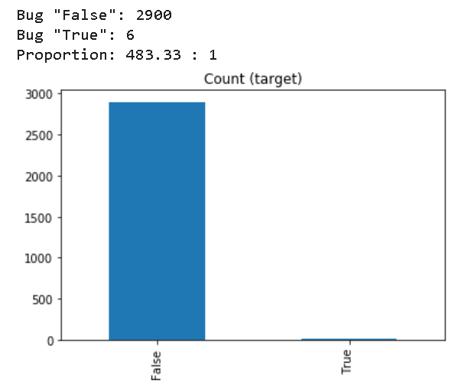
Results - Cloud Specific Bugs
["distributed concurrency","performance","single-point-of-failure"]
Data Imbalance Technique - imblearn.over_sampling.SMOTE
Class to perform over-sampling using SMOTE.
This object is an implementation of SMOTE - Synthetic Minority Over-sampling Technique

Slide 30
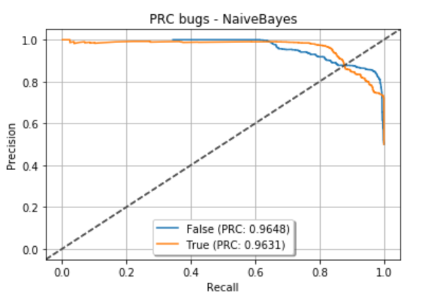
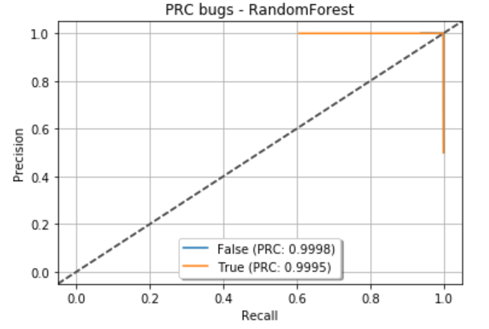
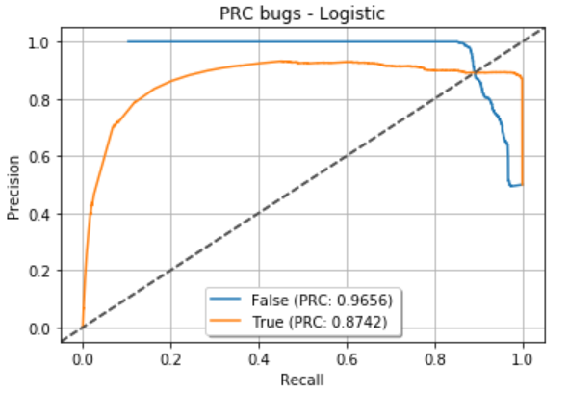
Results - Cloud Specific Bugs
ML Algorithm | Precision | Recall | F Score
Logistic | 0.88265 | 0.99344 | 0.93478
Naive Bayes | 0.73876 | 0.99172 | 0.84675
Random Forest | 0.99690 | 0.99965 | 0.99827
Notes:
Strange behaviour due to resampling.

Slide 31
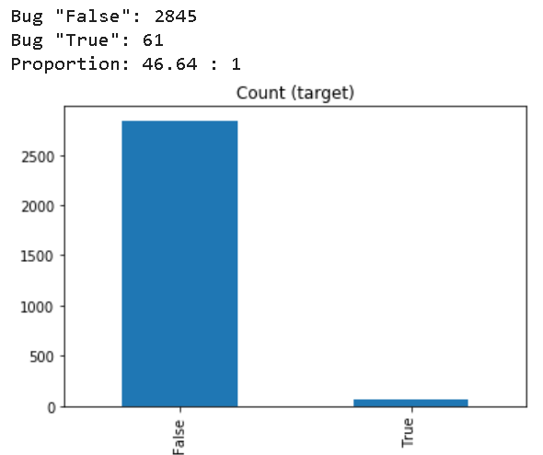
Results - Cloud Concurrency Bugs
[ 'blocked', 'locked', 'race', 'dead-lock', 'deadlock',, 'atomic',,,, 'starvation', 'suspension', 'order violation', 'atomicity violation', 'single variable atomicity violation', 'multi variable atomicity violation', 'livelock’, ‘live-lock']
Dataset is imbalance. Cannot accept to giv better results. Need more analysis on

Slide 32
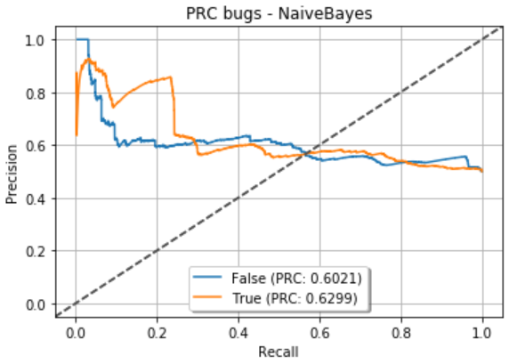
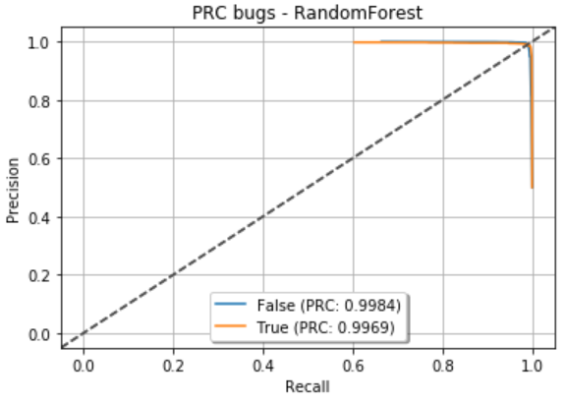
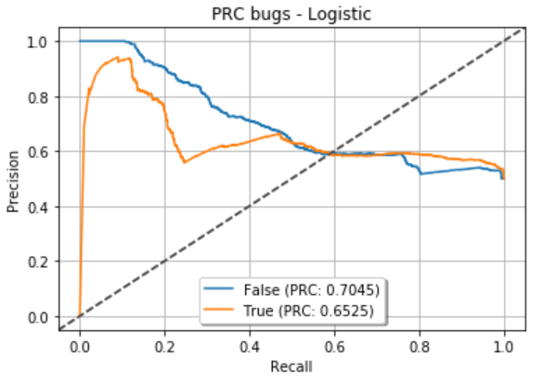
Results - Cloud Concurrency Bugs
ML Algorithm | Precision | Recall | F Score
Logistic | 0.64829 | 0.47557 | 0.54866
Naive Bayes | 0.51747 | 0.90544 | 0.65857
Random Forest | 0.98572 | 0.99507 | 0.99037

Slide 33
Limitations and Future Work
Experiment was carried out only for one cloud project "Hadoop" and in the future we plan to increase the sample project size and analyse the performance to get a better idea on the results.
In the current context, commit filtering was done using manually selected keywords and next step of the project is to use natural language processing help on commit filtering.
Complement to filtering bugs through keywords, from recent studies it is observed that analysing system log of the cloud environment would be a better choice to find defected modules but from higher architecture level except of class level.

Slide 34
RQ2: ASAT adoption

Slide 35
ASATs
Automatic static analysis tools (ASATs)
Analysis of code without executing it
Find defects, style violations, security issues, inefficiencies, …
Automated: fast
Low precision
Notes:
Low Precision due to
Some warnings not perceived as problematic
Some warnings do matter less in some contexts (locally, CI, code review)
Overall only around 10% of warnings are removed during bug fixing [5]
To improve precision -> prioritization

Slide 36

Research Question
How do developers use ASATs for cloud applications?
What kind of ASATs are used in cloud apps (compared to non-cloud apps)?
How are ASATs configured in cloud apps?

Slide 37
Methodology
ASAT collection
ASAT classification
Cloud and non-cloud projects sampling
ASAT usage extraction in the projects

Slide 38
ASAT Collection
~ 50 active ASATs for Go
Mostly highly specialized
2 linter aggregators
Notes:
Active -> not deprecated, archived
E.g. detection of deadlocks vs. unused arguments in function declarations
Only a few ASATs cover a variety of code issues
Linter aggregators: which linters to enable/disable

Slide 39
ASAT Classification
4 categories:
Readability
Efficiency
Correctness
Security
Notes:
Readabiliy: flag code that is not easy to understand, code that impacts clarity in a negative way, also concerned with coding style issues
Efficiency: improve speed and memory usage
Correctness linters: find actual defects/bugs
Security: find vulnerabilities

Slide 40
ASAT Classification
Readability
wsl (enforcing empty lines at the right places)
whitespace (unnecessary new lines)
nakedret (unused function arguments)
misspell (misspelled words)
lll (file line length)
gosimple (simplifying code)
golint (coding style issues)
gofmt (code formatting)
gocyclo (cyclomatic complexities)
goconst (Repeated strings that could be replaced by a constant)
flen (function length)
errcheck (error return values)
dupl (duplicated code)
Efficiency
varcheck (unused global variables and constants)
unused (unused constants, variables, functions and types)
unconvert (unnecessary type conversions)
structcheck (unused struct fields)
prealloc (slice declarations that could be preallocated)
nargs (unused function arguments)
ineffassign (ineffectual assignments)
deadcode (unused code)
Security
gosec (security problems)
safesql (SQL injections)
Correctness
govet (code correctness)
goimports (missing or unreferenced package imports)
Notes:
Most belong to readability category
Whitespaces
Length of functions/files
Misspelled words
Second largest efficiency:
Unused code
Smalles categories: security and correctness

Slide 41
Project Sampling
GitHub’s search functionality
Go projects
>500 stars
15 cloud projects
query words: cloud, PaaS/SaaS
12 non-cloud projects (initially 15, but 3 did not use ASATs)
Notes:
manually checked whether a given project really represented a cloud system by reading the repository’s description

Slide 42
ASAT usage extraction
Clone projects and scan files for ASAT commands
Filtering:
comments, installation instructions, strings
Common words: ‘unused’, ‘misspell’
Text files (READMEs, txt files, html files)
Parsing GolangCI configuration files
Name, arguments, files

Slide 43
Results
Cloud projects
12
Non-cloud projects
5
ASATs on average per project

Slide 44
Results
Cloud projects
None: 1.3
Correctness: 1.7
Readability: 5.5
Efficiency: 3.7
Security: 0.2
Non-cloud projects
None: 0.5
Correctness: 0.7
Readability: 2.3
Efficiency: 1.5
Security: 0.0
ASATs on average per project (by category)

Slide 45
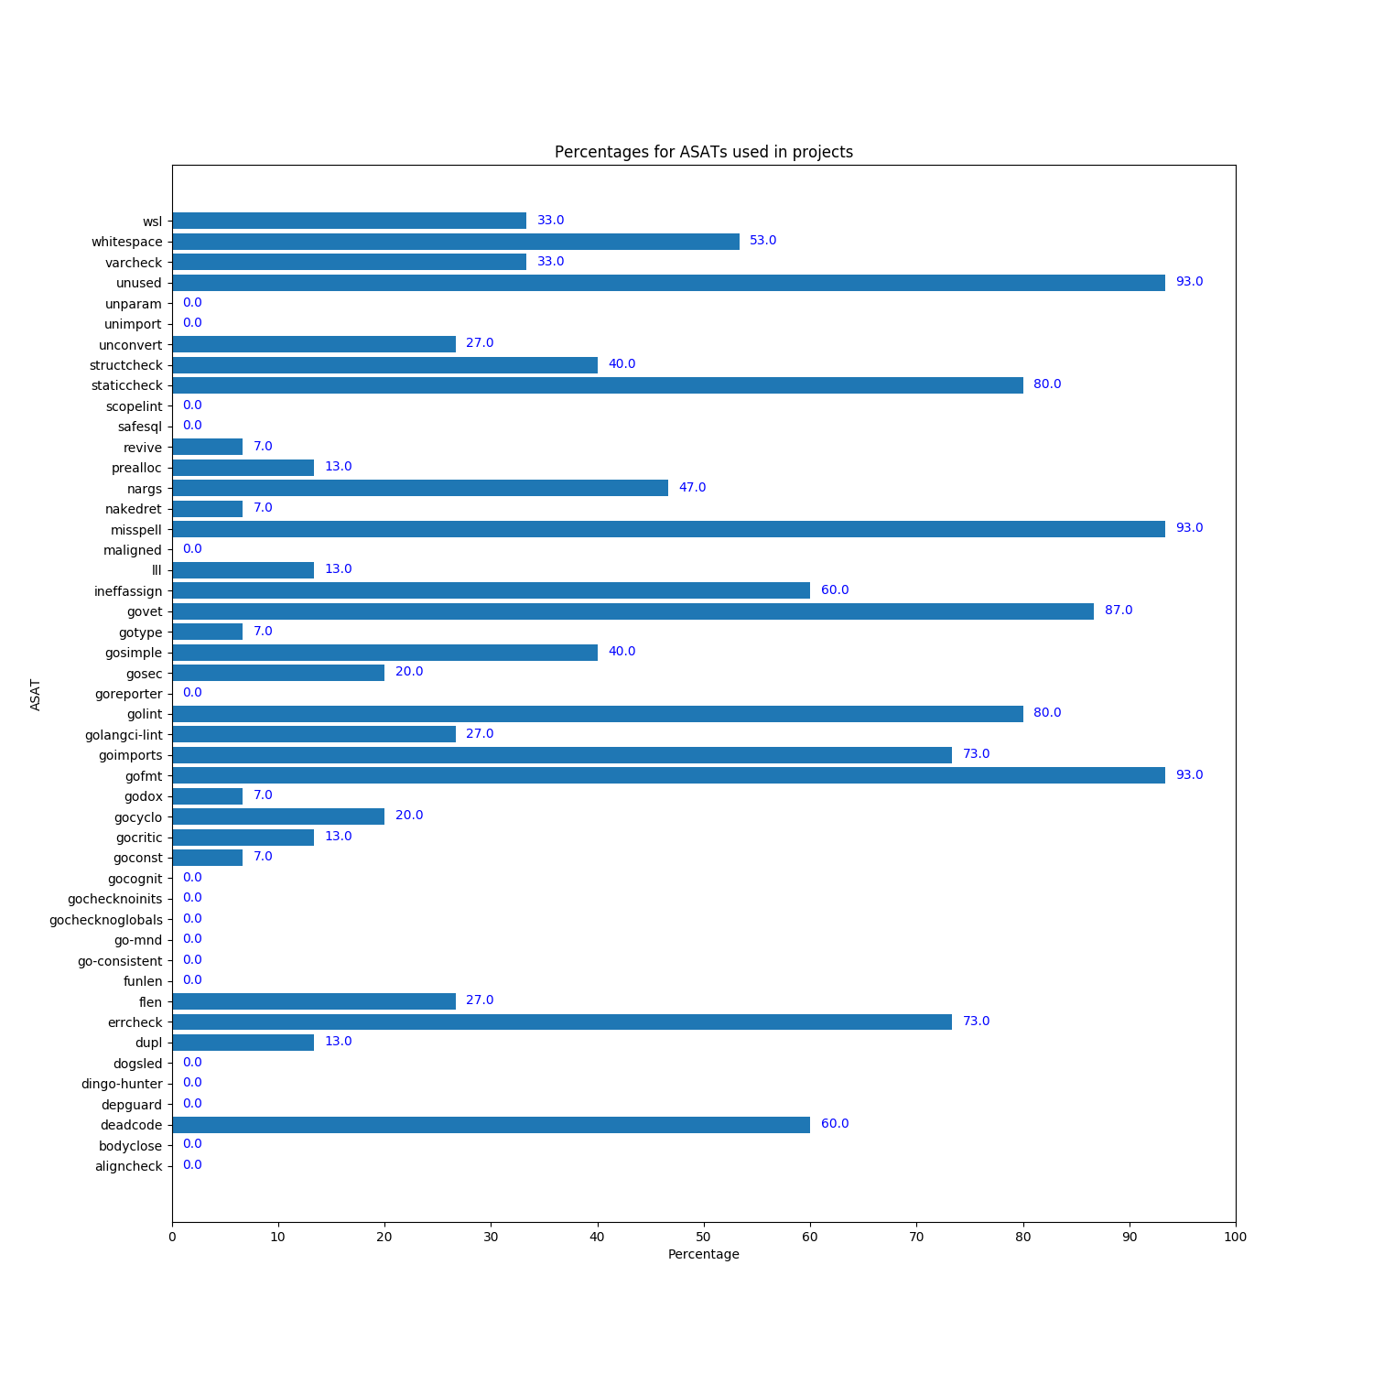
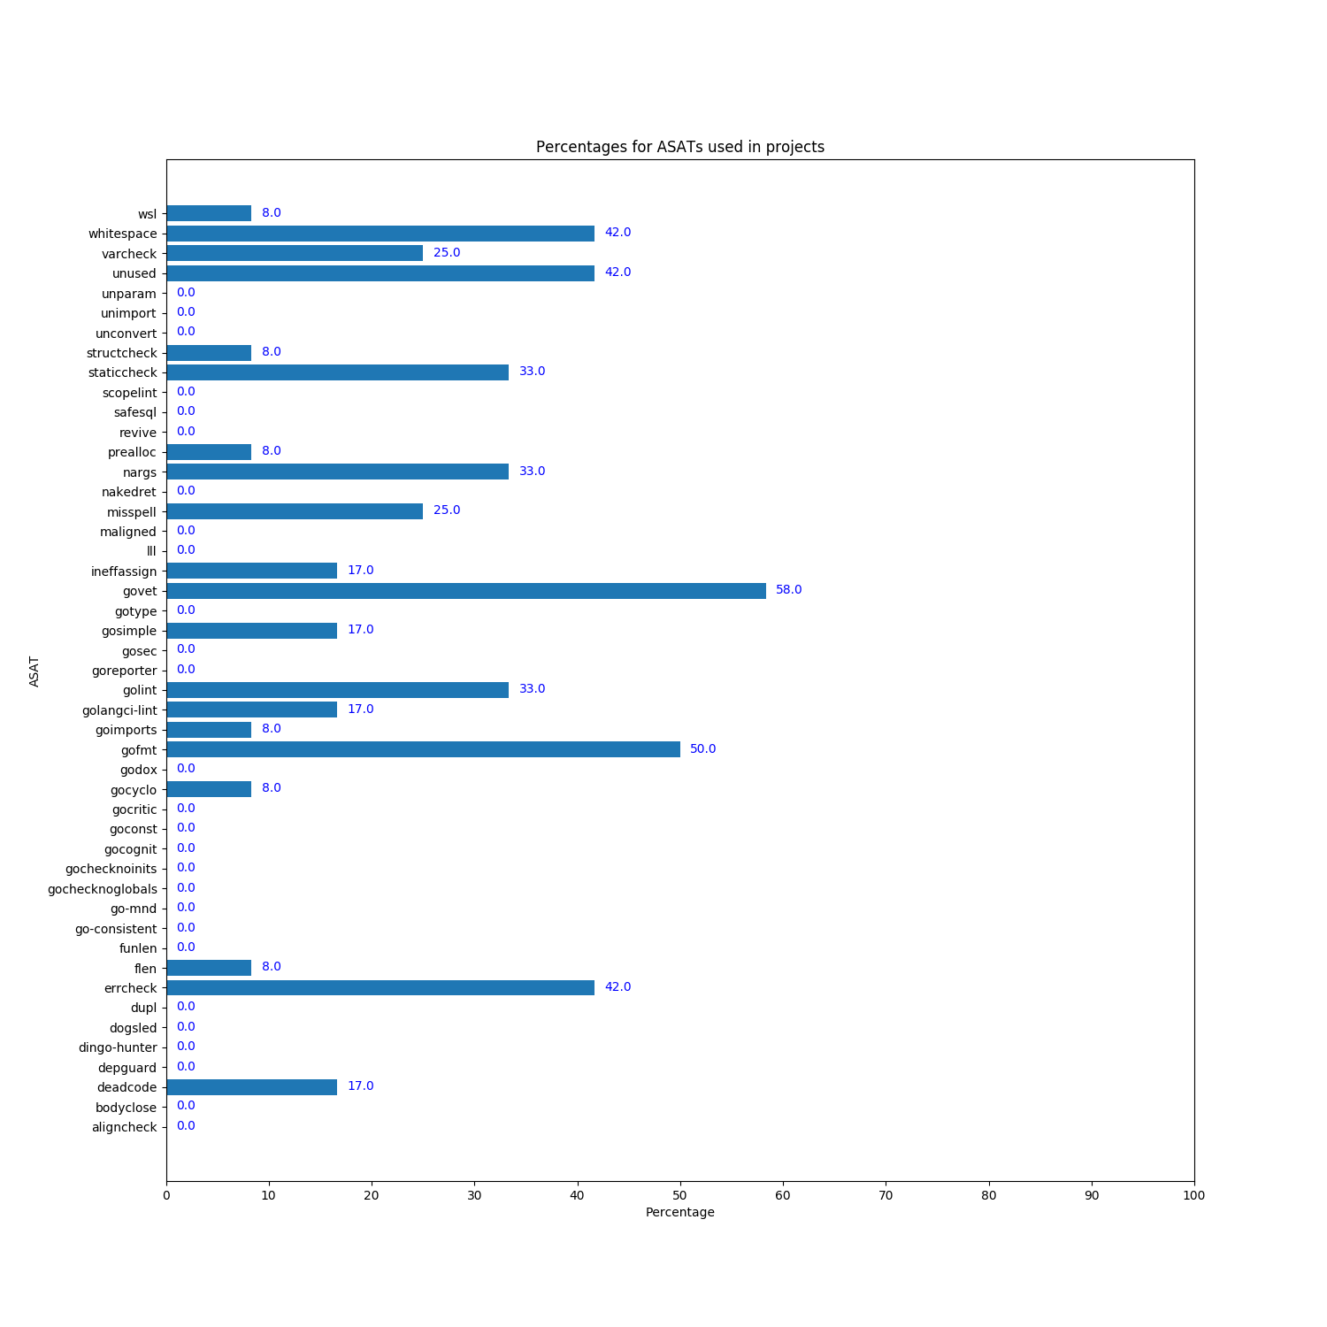
Cloud projects
Non-cloud projects
Notes:
As can be seen from the figures, some ASATs are not used in any of the projects such as ’safesql’
(SQL injections) or ’dingo-hunter’ (deadlocks).
Most commonly used are ’unused’ (unused code),
’govet’ (code correctness) and ’gofmt’ (code formatting) (>=70%).
Wider variety of ASATs
More ASATs

Slide 46
Percentage of projects using a specific ASAT
Non-cloud vs. cloud
wsl (empty lines): 8 vs. 33 %
unused (unused code): 42 vs. 93 %
unconvert (unnecessary type conversions): 0 vs. 27 %
misspell (misspellings): 25 vs. 93 %
ineffassign (ineffectual assignments): 17 vs. 60 %
govet (code correctness): 58 vs. 87 %
gosimple (simplifying code): 17 vs. 40 %
gosec (security issues): 0 vs. 20 %
golint (coding style issues): 33 vs. 80 %
goimports (package import issues): 8 vs. 73 %
gofmt (formatting issues): 50 vs. 93 %
errcheck (error return values): 42 vs. 73 %
deadcode (unused code): 17 vs. 60 %

Slide 47
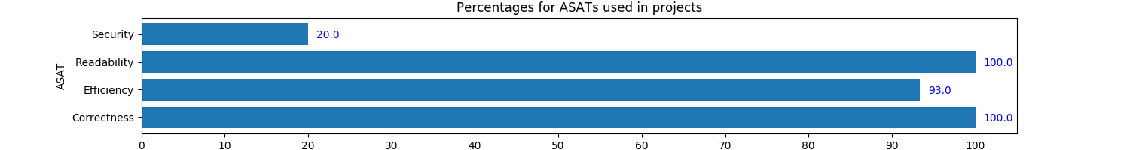
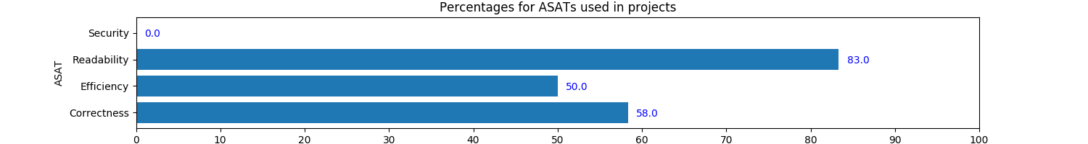
Percentage of projects using a ASAT category
Cloud projects
Non-cloud projects

Slide 48
ASAT configuration in cloud projects
ASAT: deadcode
ASAT: dupl
Parameter: -files, 1/2
ASAT: errcheck
Parameter: -ignorepkg, 3/11
Parameter: -ignore, 2/11
ASAT: flen
ASAT: goconst
ASAT: gocritic
ASAT: gocyclo
Parameter: -over, 1/3
ASAT: godox
ASAT: golint
Parameter: -go..., 3/12
Parameter: -vE, 5/12
Parameter: -set_exit_status, 6/12
Parameter: -min_confidence, 1/12
Parameter: -v, 3/12
Parameter: --invert-match, 1/12
Parameter: -E, 1/12
Parameter: -f, 1/12
Parameter: -a, 1/12
ASAT: gofmt
Parameter: -w, 12/14
Parameter: -s, 12/14
Parameter: -l, 10/14
Parameter: -,,$@)/*.go, 1/14
Parameter: -d, 8/14
Parameter: -q, 1/14
Parameter: -type, 3/14
Parameter: -print, 1/14
Parameter: -store/*, 1/14
Parameter: -not, 1/14
Parameter: -path, 2/14
Parameter: ->, 2/14
Parameter: -r, 2/14
Parameter: -v, 2/14
Parameter: -name, 3/14
Parameter: -z, 1/14
Parameter: -o, 1/14
Parameter: -print));, 1/14
Parameter: -prune, 1/14
Parameter: -e, 2/14
ASAT: goimports
Parameter: -w, 5/11
Parameter: -vE, 4/11
Parameter: -l, 6/11
Parameter: --enable, 1/11
Parameter: --vendor, 1/11
Parameter: -d, 2/11
Parameter: -eq, 1/11
Parameter: -e, 1/11
Parameter: -name, 1/11
ASAT: staticcheck
Parameter: -go, 4/12
Parameter: -ignore, 5/12
Parameter: -ST1015, 4/12
Parameter: -checks, 4/12
Notes:
How ASTs are configured on the command line
Most configuration options are rarely used
Some ASATs not configuration at all
Most configuration options are not about disabling or enabling certain warnings
Mostly about specifying which files/packages to ignore)
How to ouput the warnings

Slide 49
ASAT standard configuration
Cloud projects
65.8
Non-cloud projects
68.3
Percentage of ASATs for which projects use default configuration

Slide 50
Conclusion and Future Work
Cloud projects
use more ASATs
use a larger variety of ASATs
typically use default configuration
Future work:
Increase project sample
Configuration config files

Slide 51
Thank You

Slide 52
References
[1] G. Canfora, A. D. Lucia, M. D. Penta, R. Oliveto, A. Panichella, and S. Panichella. Defect prediction as a multiobjective optimization problem. Softw.Test., Verif. Reliab., 25(4):426–459, 2015.
[2] H. S. Gunawi, M. Hao, T. Leesatapornwongsa, T. Patana-anake, T. Do, J. Adityatama, K. J. Eliazar, A. Laksono, J. F. Lukman, V. Martin, and A. D. Satria. What bugs live in the cloud? a study of 3000+ issues in cloud systems. In Proceedings of the ACM Symposium on Cloud Computing, SOCC ’14, pages 7:1–7:14, New York, NY, USA, 2014. ACM.
[3] H. Liu, X. Wang, G. Li, S. Lu, F. Ye, and C. Tian. Fcatch: Automatically detecting time-of-fault bugs in cloud systems. SIGPLAN Not., 53(2):419–431, Mar. 2018.

Slide 53
[4] A. Panichella, C. V. Alexandru, S. Panichella, A. Bacchelli, and H. C. Gall. A search-based training algorithm for cost-aware defect prediction. In Proceedings of the 2016 on Genetic and Evolutionary Computation Conference, Denver, CO, USA, July 20 - 24, 2016, pages 1077–1084, 2016.
[5] S. Panichella, V. Arnaoudova, M. D. Penta, and G. Antoniol. Would static analysis tools help developers with code reviews? In 22nd IEEE International Conference on Software Analysis, Evolution, and Reengineering, SANER 2015, Montreal, QC, Canada, March 2-6, 2015, pages 161–170, 2015.
[6] C. Vassallo, S. Panichella, F. Palomba, S. Proksch, A. Zaidman, and H. C. Gall. Context is king: The developer perspective on the usage of static analysis tools.In 25th International Conference on Software Analysis, Evolution and Reengineering,SANER 2018, Campobasso, Italy, March 20-23, 2018, pages 38–49, 2018.

Slide 54
[7] A. Bacchelli and C. Bird. Expectations, outcomes, and challenges of modern code review. In Proceedings of the 2013 international conference on software engineering, pages 712–721. IEEE Press, 2013.
[8] C. Inc. Effective management of static analysis vulnerabilities and defects. 2009.
[9] M. Di Penta, L. Cerulo, and L. Aversano. The life and death of statically detected vulnerabilities: An empirical study. Information & Software Technology, 51(10):1469–1484, 2009.
[10] B. Johnson, Y. Song, E. R. Murphy-Hill, and R. W. Bowdidge. Why don’t software developers use static analysis tools to find bugs? In D. Notkin, B. H. C. Cheng, and K. Pohl, editors, 35th International Conference on Software Engineering, ICSE ’13, San Francisco, CA, USA, May 18-26, 2013, pages 672–681. IEEE Computer Society, 2013.

Slide 55
[11] G. Canfora, A. D. Lucia, M. D. Penta, R. Oliveto, A. Panichella, and S. Panichella. Defect prediction as a multiobjective optimization problem. Softw. Test., Verif. Reliab., 25(4):426–459, 2015.
[12] A. Panichella, C. V. Alexandru, S. Panichella, A. Bacchelli, and H. C. Gall. A search-based training algorithm for cost-aware defect prediction. In Proceedings of the 2016 on Genetic and Evolutionary Computation Conference, Denver, CO, USA, July 20 - 24, 2016, pages 1077–1084, 2016.

