Slide 1
Abdullah Amin Chotani- 18658 A/B testing assignment

Slide 2
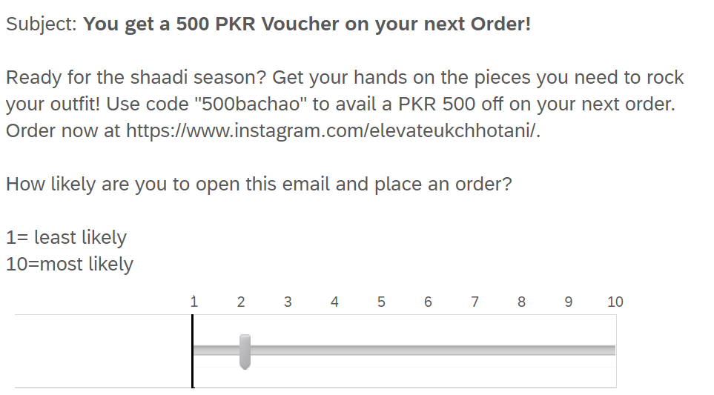
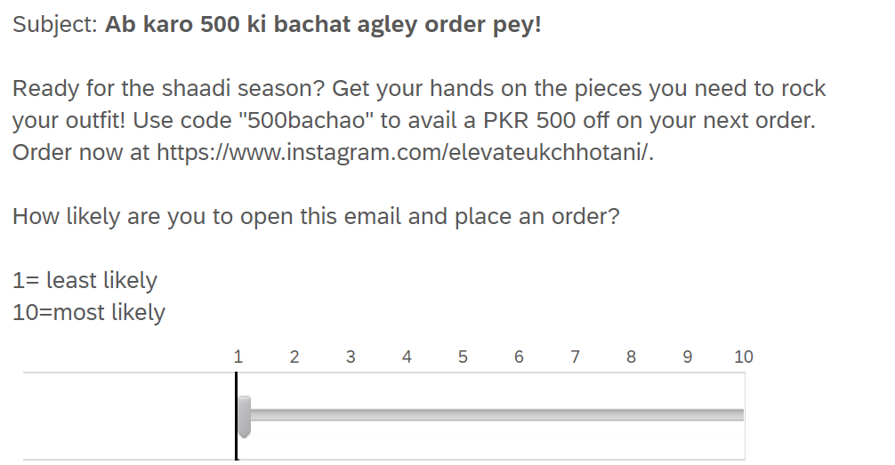
Survey creation
In our A/B test, we are testing how subject lines effect click rates for an online silver jewellery store. We are testing two subject lines, one in English and the other in Roman Urdu.
Urdu Subject: Ab karo 500 ki bachat agley order pey!
English Subject: You get a 500 PKR voucher on your next order!
We gave the users a scale of 1 to 10 to decide if they would click the link and place an order.
We recorded 30 responses for each version.

Slide 3
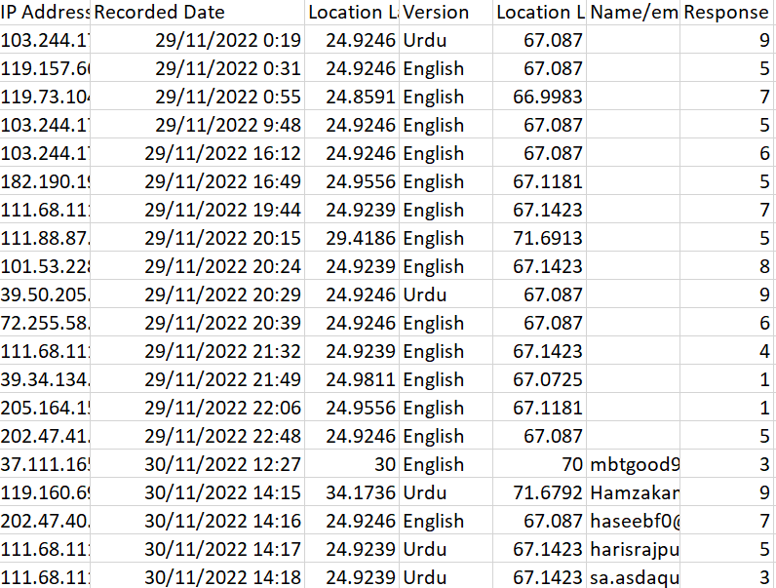
Prepared data
We created a “Version” column that has two categorical variables, English and Urdu which signify the version of the survey.
The “Response” column has the responses from 1 to 10.
Columns such as IP Address, Location, Email and Date tell us about the information of the response. The rows with no email have a unique IP Address which signify their validity.

Slide 4
Hypothesis testing
Step 1: State the hypothesis
H0 : There no difference in the number of clicks of both the English and Urdu subject line.
H1: There is a difference in the number of clicks of both the English and Urdu subject line.
Step 2: Determine the type of test
Is it one sided or two sided?
It is a two tailed test as we are only concerned about the significance and not the direction.
Is this an independent sample test?
Yes. since there are two groups involved independent of each other
Step 3: Determine the test statistics
r = t.test(Response ~ Version, data = mydata, var.equal= TRUE, paired = FALSE)

Slide 5
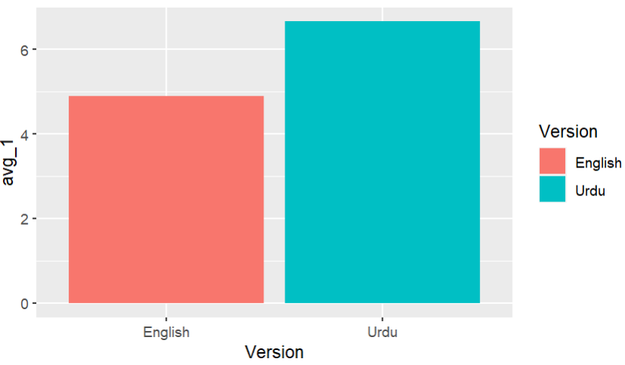
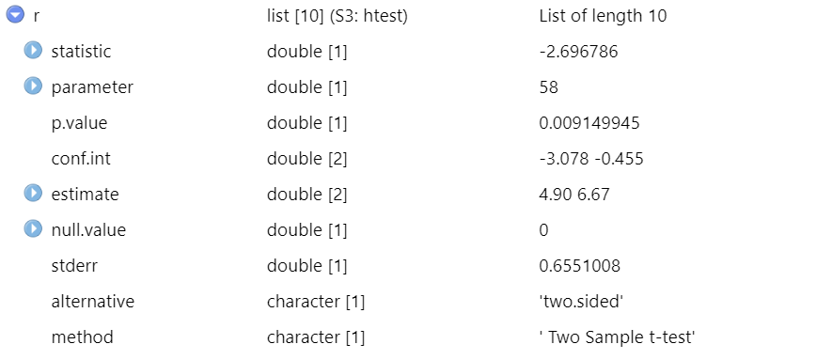
Step 4: Conclusion: A P value is 0.009 and less than 0.05. It is significant; therefore we reject the null hypothesis and establish that there is a difference in the click rates of the Urdu subject . The alternate hypothesis is therefore accepted.
As the reponses with the email subject in urdu have the higher mean, the jewellery store could use the Urdu subject line to increase the click rate and better their sales.

