Slide 1
Dynamic Hand Gesture Recognition
組長：M11002129 蕭丞軒
組員：M10907429 黃鈺哲
M11002130 薛仲軒
B10702229 范鎧丞

Slide 2

01
Problem Statement
Agenda
02
Proposed Framework
03
Project Scope
04
Processing System
05
Programmable Logic
06
Conclusion

Slide 3
Problem Statement
Context:
Gesture recognition has been paid more and more attention as a new generation of human-computer interaction and visual input mode.
In motion sensing games and other applications, gesture recognition is used as the input interface.
Issue:
CNN leads to extremely high latency because of its high computational costs.
The overhead of input images from PS side leads to high latency.
Image pre-processing leads to visible latency on PYNQ Z2.
Objective:
We’d like to directly conduct high-latency tasks on PL to achieve more fluent results.

Slide 4
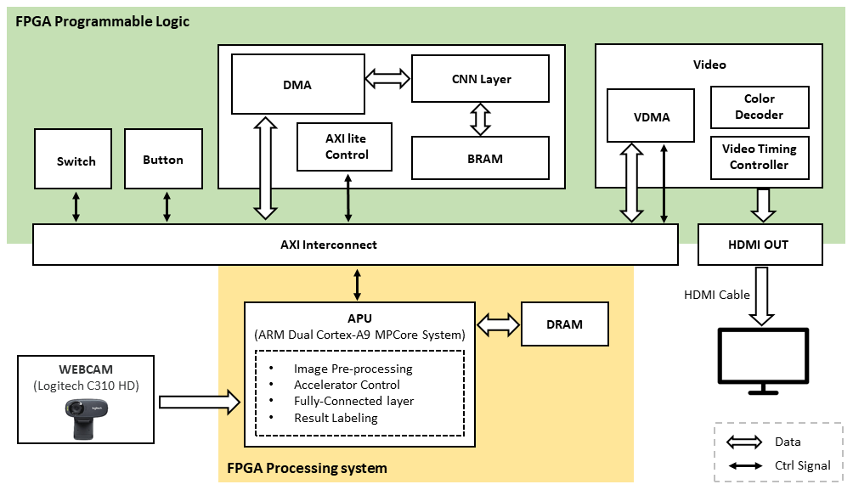
Related Work
In Lab5, as the framework shows below, most high computational tasks except CNN layers are conducted on PS. Thus, the output video is a little jerky due to its low CPU.

Slide 5



Proposed Framework
DRAM
Processing
System
Use Webcam to input images and output images to PYNQ Z2 through HDMI.
Memory
Interfaces
ARM
Dual Cortex-A9
MPCore System
Video In
HDMI IN
Video Out
HDMI OUT
HLS IP
Gray
…
Max Connected Component
The monitor shows the output results from PYNQ Z2.
Image Pre-processing IP
DMA
NN IP
Customer IP
Convolutional Layer
Max pooling Layer
Fully Connected Layer
Programmable
Logic
BRAM

Slide 6
Proposed Framework
DRAM
Processing
System
The monitor shows the output results from PYNQ Z2.
Memory
Interfaces
Video Out
HDMI OUT
ARM
Dual Cortex-A9
MPCore System
Video In
HDMI IN
Customer IP
Convolutional Layer
Max pooling Layer
Fully Connected Layer
Use Webcam to input images and output images to PYNQ Z2 through HDMI.
DMA
HLS IP
Gray
…
Max Connected Component
Programmable
Logic
NN IP
Image Pre-processing IP

Slide 7



Project Scope
Image Processing Flow
RGB Images
We design several IPs with Vitis HLS. Image processing comprises Gray, Difference, Binarization, Dilation, and Max Connected Component.
Gray
Difference
Kernel(IPs)
Processor
Control Signal
Image Processing
Convolutional Layer
Max pooling Layer
Fully Connected Layer
Result Labeling
Allocate memory
Accelerator Control
DMA control
Binarization
Image Map
Dilation
Max Connected Component
Feature Maps

Slide 8
Model Architecture
The neural network shows below.
: Convolution Layer
32
: Max Pooling Layer
0.9
0.08
0.02
0.00
‘S’
‘O’
‘V’
32
‘W’
Flatten
Fully
Connected
Softmax

Slide 9
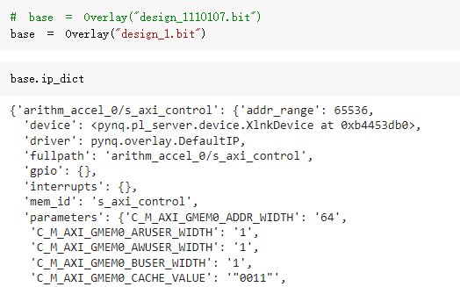
Host Program
Loading an Overlay
A bitstream to configure the FPGA fabric.
A Vivado design HWH file to determine the available IP.
Python API that exposes the IPs as attributes.

Slide 10

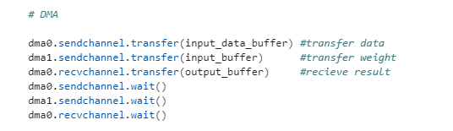
Host Program
Accelerator control
DMA control

Slide 11
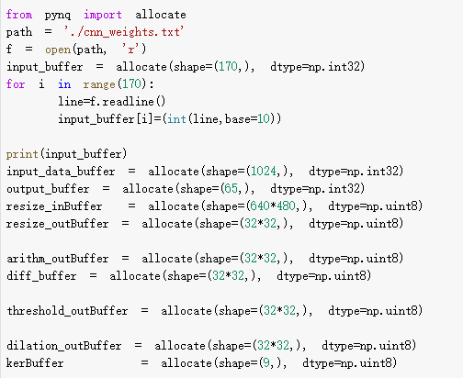
Host Program
Memory allocation

Slide 12
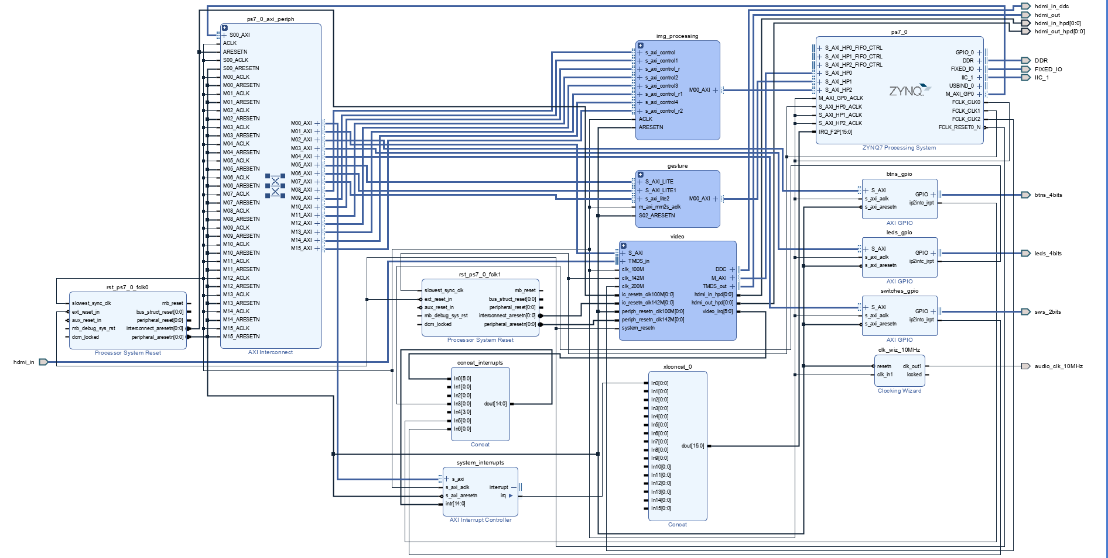
Block Design

Slide 13
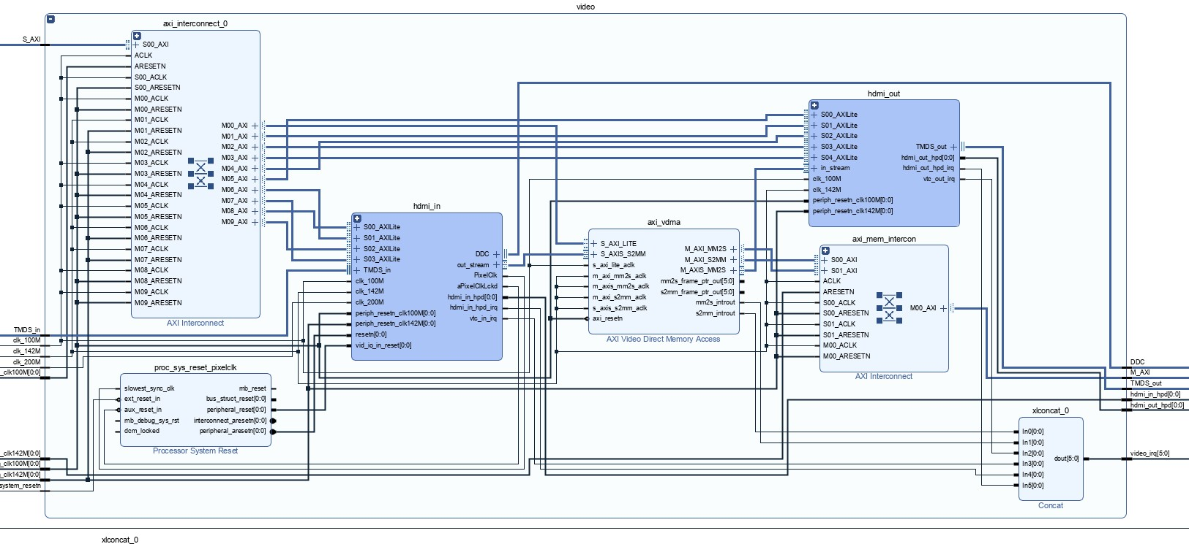
HDMI IN & HDMI OUT
PYNQ Z2 supplies several useful APIs, including HDMI input and output. We adjust it and use it as our I/O interface.

Slide 14
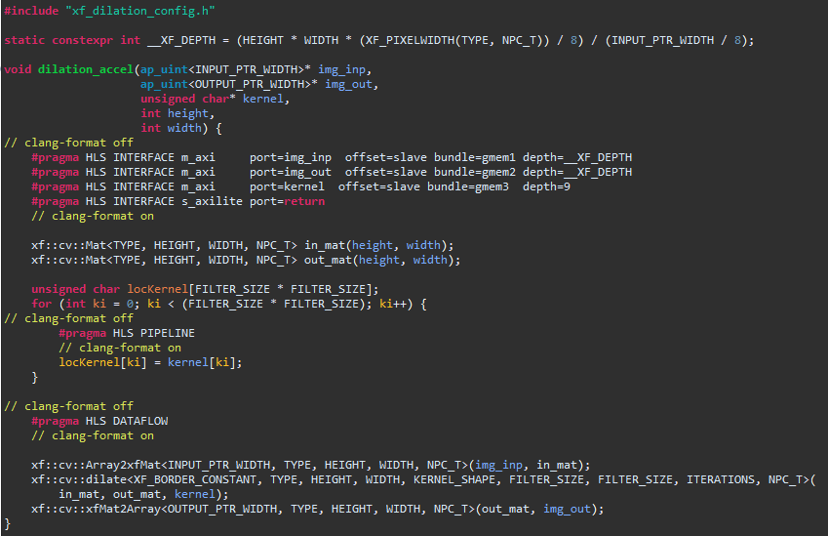
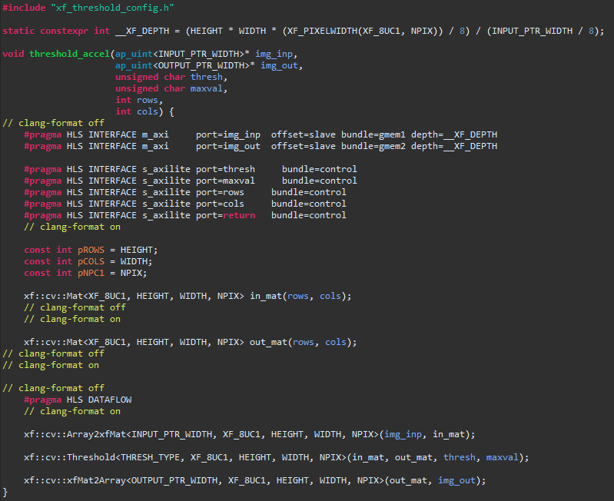
Vitis Vision Library
The Vitis Vision Library has been designed to work in the Vitis development environment, and provides a software interface for computer vision functions accelerated on an FPGA device.
We refer to the examples to design our custom IP cores for image processing.

Slide 15
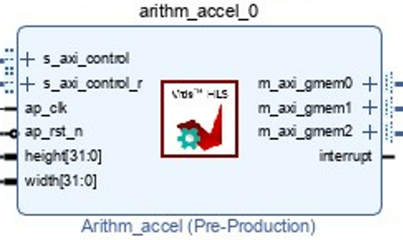

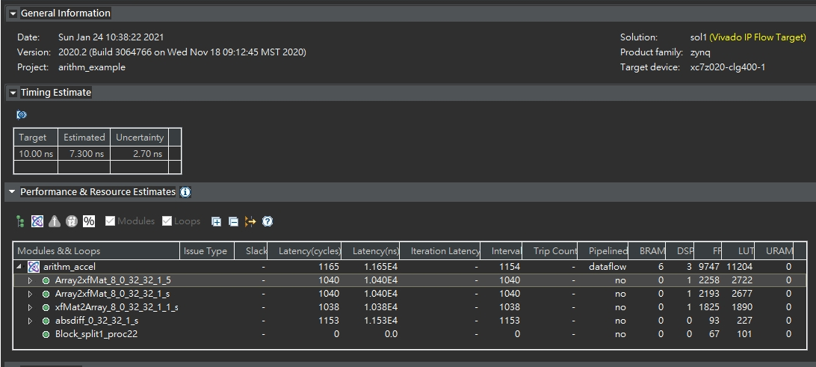
Difference
PS⬄PL
Synthesis Summary

Slide 16
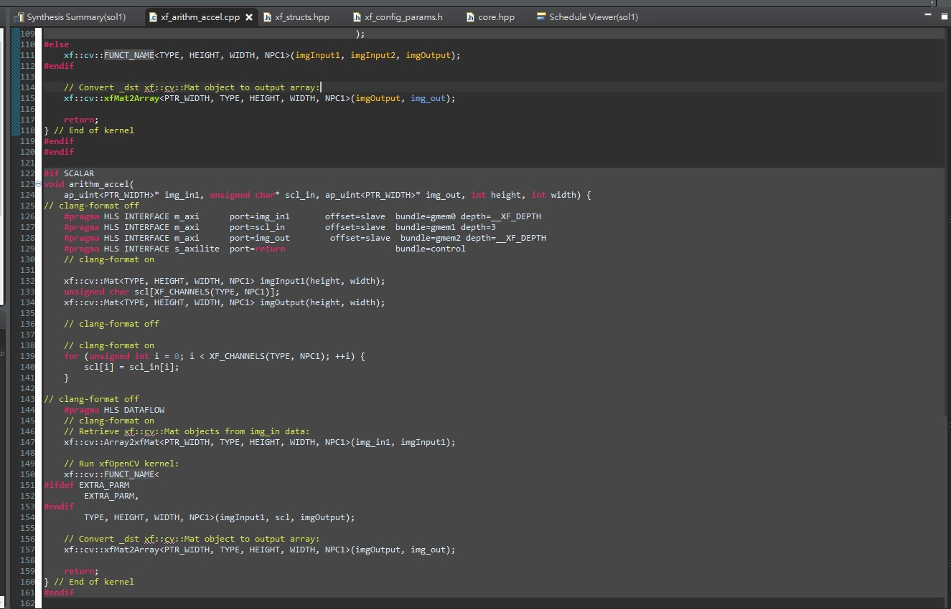
Difference
The function absdiff computes the absolute difference between each individual pixels of an xf::cv::Mat and a cv::Mat, and returns the difference values in a cv::Mat.

Slide 17
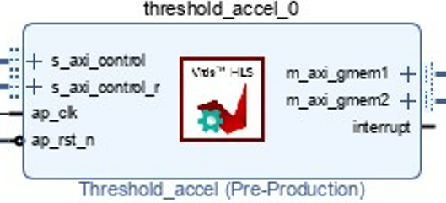

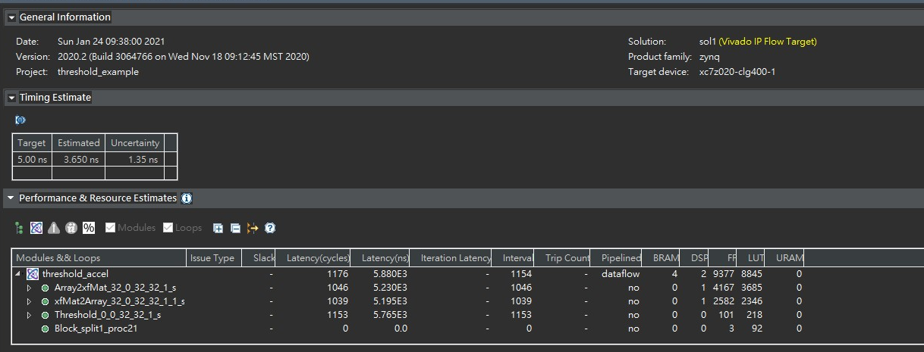
Threshold
PS⬄PL
Synthesis Summary

Slide 18
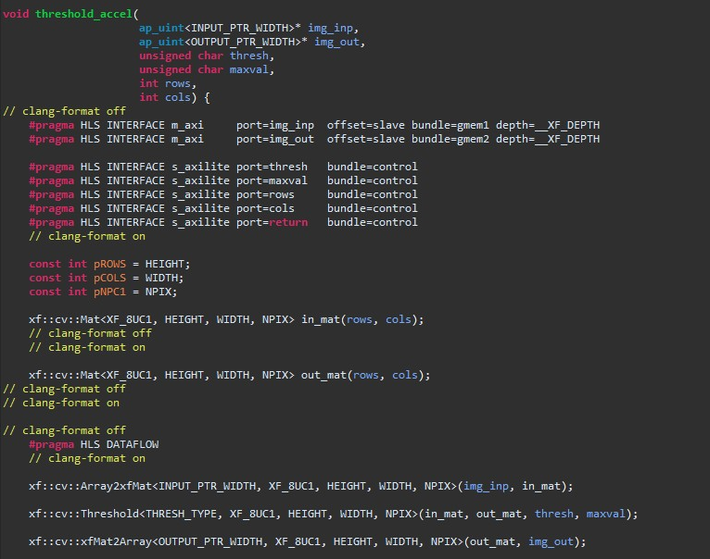
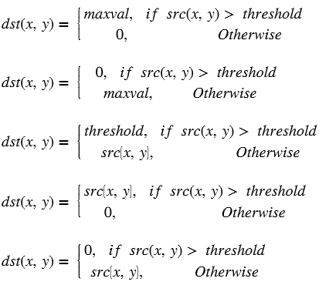
Threshold
The Threshold function performs thresholding operation on the input image.

Slide 19
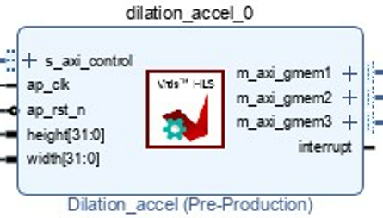

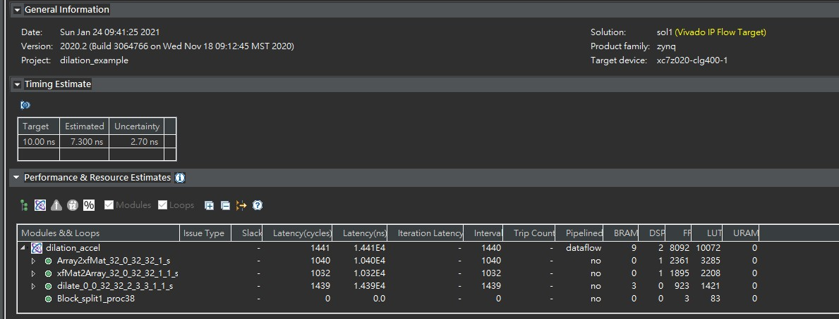
Dilation
PS⬄PL
Synthesis Summary

Slide 20
Dilation
During a dilation operation, the current pixel intensity is replaced by the maximum value of the intensity in a n x n neighborhood of the current pixel.

Slide 21
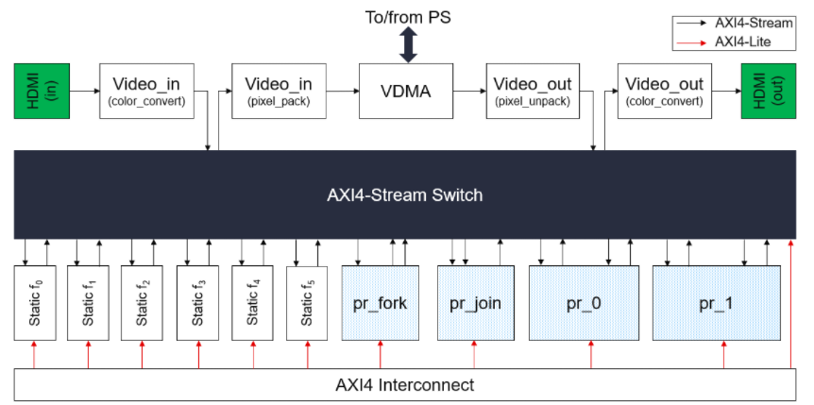
Composable Pipeline
The composable pipeline is an overlay with a novel and clever architecture that allows us to adapt how the data flows between a series of IP cores.
We integrate the CNN network designed by Vitis Hls with the image preprocessing functions from Vitis Vision Library in PYNQ Composable Pipeline.

Slide 22
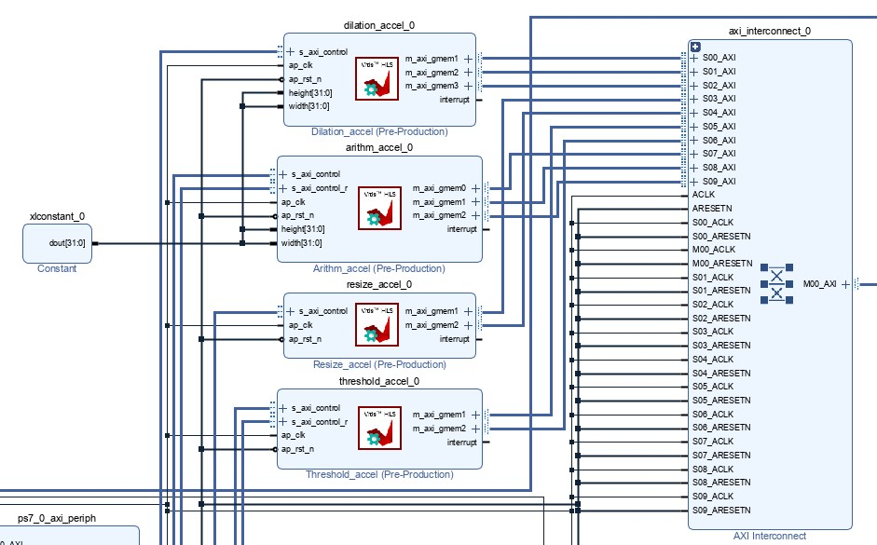
AXI4-Stream Switch IP
The AXI4-Stream Switch provides the runtime routing of how the data flows from one IP core to another.

Slide 23
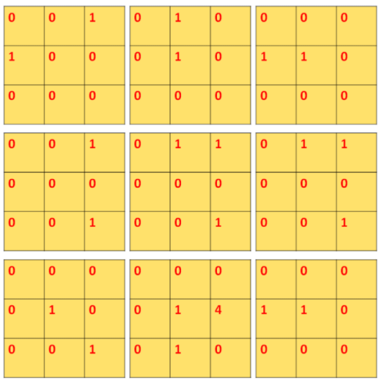
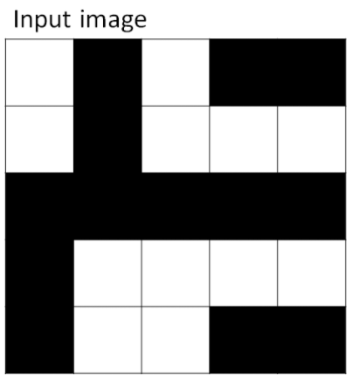
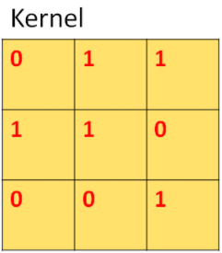
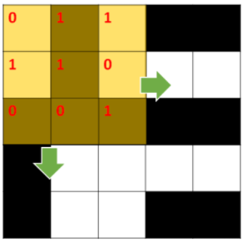


Convolutional Layer
A convolutional layer contains a set of filters whose parameters need to be learned, preserves the spatial arrangement of images, and obtains local images as input features.
Step 1:
Use kernels to convolve the input images to get different maps.
Input image$∗$Kernel
*
$$Kernel=3×3$$
$$Stride=1$$

Slide 24
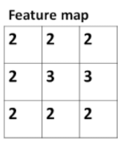
Convolutional Layer
Step 2:
Use ReLU to obtain Feature maps.
Rectified Linear Unit (ReLU): A piecewise linear function that will output the input directly if it is positive, otherwise, it will output zero.
ReLU

Slide 25
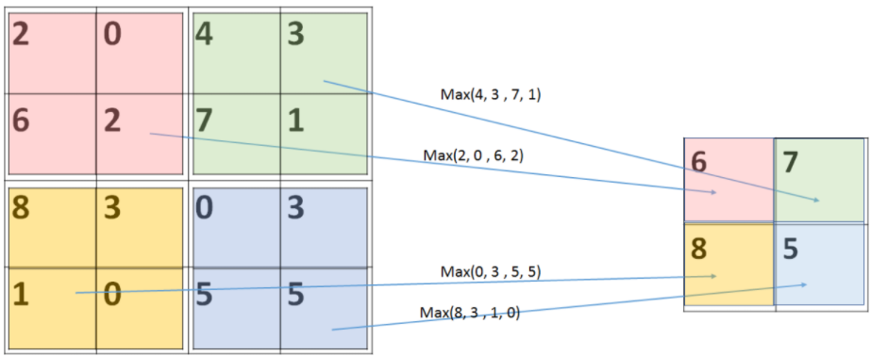
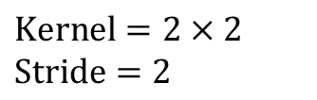
Max Pooling Layer
Pooling layers are used to reduce the dimensions of the feature maps.
Pros:
Reduce the number of parameters to learn and the amount of computation performed in the network.
Make the model more robust to variations in the position of the features in the input image.
Max pooling:
Select the maximum element from the region of the feature map covered by the filter.
$$Kernel=2×2$$
$$Stride=2$$

Slide 26
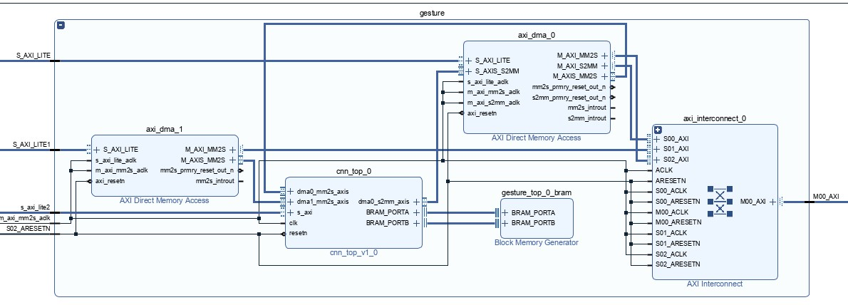
CNN Structure
The convolutional layers apply 3 x 3 kernels and stride 2.
The max pooling layers apply 2 x 2 kernels and stride 2.

Slide 27
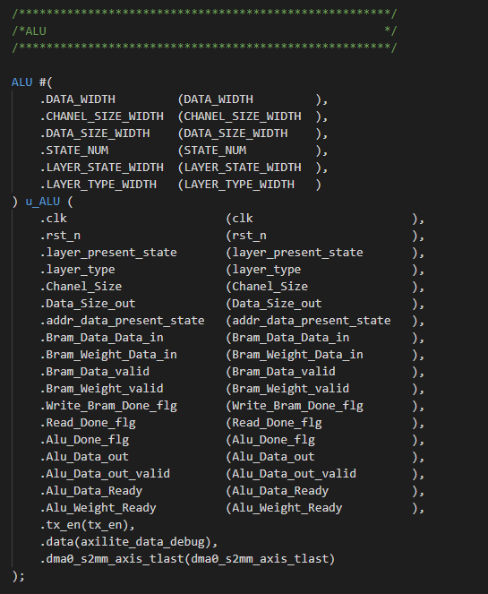
CNN IP Implementation
Process Element(PE):

Slide 28
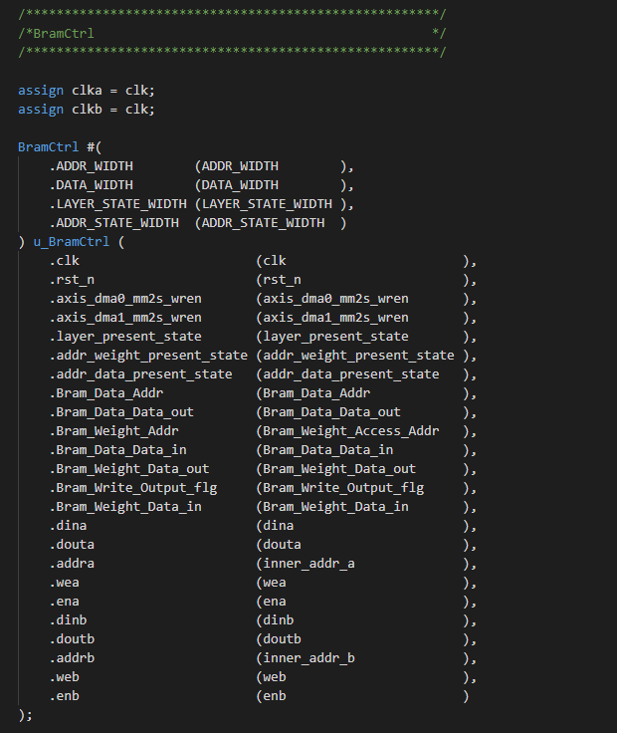
CNN IP Implementation
Block Random Access Memory(BRAM) control:

Slide 29
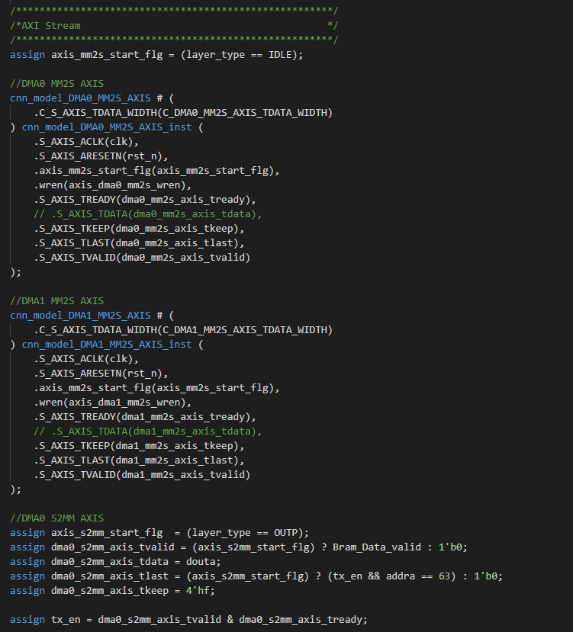
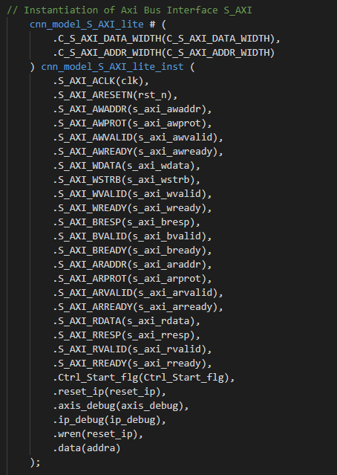
CNN IP Implementation
AXI stream control:
AXI lite control:

Slide 30
Conclusion
We try to use Vitis Vision Library to do custom image pre-processing IP cores and improve the performance by porting programs that were running on the PS side to the PL side.
The experimental results show that because the pragma HLS interface is not optimized, although there is a pre-processing kernel running on the PL side, there is a latency in the communication and buffer transfer between each kernel, which is the performance bottleneck caused by IO and data transfer.
In the future, we can continue to optimize the pragma HLS interface and connect each custom IP to achieve the Dataflow of gesture tracking at the PL side and continue to reduce the overall system latency.

Slide 31
Reference
Efficient Hand Gesture Recognition System based on Computer Vision: An Overview
https://ieeexplore.ieee.org/document/9602880
HLS Textbook
https://boledu-next-chakra.vercel.app/textbooks/hls-textbook
Xilinx Vitis-Tutorials
https://github.com/Xilinx/Vitis-Tutorials/tree/2021.1
Vitis Vision Library
https://xilinx.github.io/Vitis_Libraries/vision/2020.2/index.html

Slide 32
THANK YOU

