Slide 1
GIS in R
－Basic Introduction of GIS
Shaun Chu 2025/01/29

Slide 2
GIS： Geographic Information System
A framework for gathering, managing, analyzing, and visualizing spatial and geographic data.

Slide 3
A framework for gathering, managing, analyzing, and visualizing spatial and geographic data.
Layers
Visualize & Analyze
Geo-information
Notes:
Geo-information: data that is linked to a specific location on Earth

Slide 4
A framework for gathering, managing, analyzing, and visualizing spatial and geographic data.
Vector data
Raster data
Coordinate reference system (CRS)
Layers

Slide 5
Vector Data
Feature | Example and Attribute
Point | Vegetation plot；Elevation of the plot
Line | Transect；Length of the transect
Polygon | Watershed；Area of the watershed
Multipoint | Vegetation plots；Elevation of each plot
Multiline | Transects；Length of each transect
Multipolygon | Watersheds；Area of each watershed
Geometrycollection | Collection of abovementioned features
(per layer)

Slide 6
Vector Data
File type | Content
*.shp | Geometric data (shape and location of feature)
*.shx | Index to features in *.shp
*.dbf | Attributes of features in *.shp
*.prj | Coordinate reference system (CRS) of *.shp

Slide 7
A framework for gathering, managing, analyzing, and visualizing spatial and geographic data.
Vector data
Raster data
Coordinate reference system (CRS)
Layers

Slide 8
Raster Data
Grid / pixel
Attribute(s)

Slide 9
Raster Data
File type | Example and Attribute(s)
*.tiff | Land use map；Land use type (categories) Climate map；Temperature (continuous numbers) Elevation map；Elevation (continuous numbers) Satellite image；Intensity of each band (multiple continuous numbers)
*.asc | Transect；Length of the transect
*.png | Watershed；Area of the watershed
*.jpg | Vegetation plots；Elevation of each plot
*.grd | Transects；Length of each transect

Slide 10
A framework for gathering, managing, analyzing, and visualizing spatial and geographic data.
Vector data
Raster data
Coordinate reference system (CRS)
Layers

Slide 11
Coordinate reference system
Feature
Attributes
X | Y
25.1 | 121.5
Where is the point feature?
How to interpret the attributes?

Slide 12
Coordinate reference system
Referenced globe: The shape of the Earth (mathematical model)
Datum: How to align referenced globe and real Earth
Notes:
Earth: ellipse

Slide 13
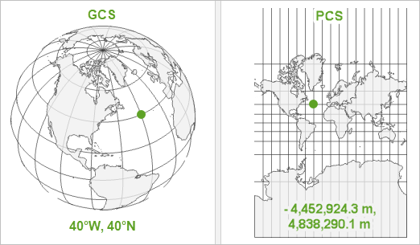
Coordinate reference system
Geographic Coordinate System (GCS)
Coordinate system
Projected Coordinate System (PCS)
(From ERSI ArcGIS blog, by Heather Smith)

Slide 14
Coordinate reference system
Projection
Projection point
Reference globe and Datum
Standard point / line
Projection surface
Notes:
變形：Distortion

Slide 15
Coordinate reference system
EPSG: European Petroleum Survey Group
EPSG code: Code for different CRS
Common EPSG code and CRS in Taiwan
3826: TWD97 TM2 zone 121 projected coordinate system
3824: TWD97 geographical coordinate system
4326: WGS84 geographical coordinate system
3857: Web Mercator projected coordinate system

Slide 16





A framework for gathering, managing, analyzing, and visualizing spatial and geographic data.
Geo-processing
R Language
Python
QGIS
ArcGIS
SAGA GIS

