Slide 1
Activity
Prepare By: You Tithrottanak

Slide 2
What is Activity?
An activity represents a single screen with a user interface just like window or frame of Java.
Android activity is the subclass of ContextThemeWrapper class.
Activity class takes care of creating a window for you in which you can place your UI with setContentView(View).
Prepare By: You Tithrottanak

Slide 3
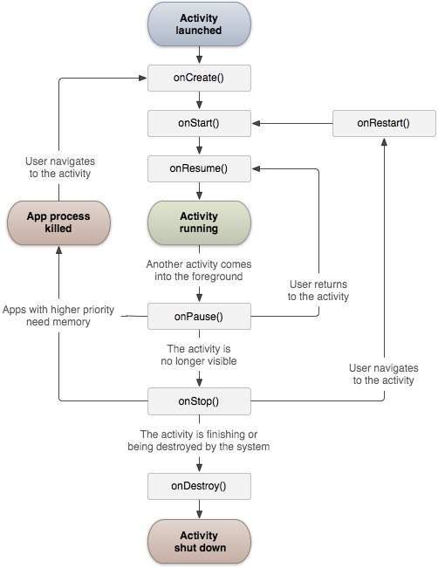
Activity Lifecycle
Prepare By: You Tithrottanak

Slide 4
Activity Lifecycle
Callback | Description
onCreate() | This is the first callback and called when the activity is first created.
onStart() | This callback is called when the activity becomes visible to the user.
onResume() | This is called when the user starts interacting with the application.
onPause() | The paused activity does not receive user input and cannot execute any code and called when the current activity is being paused and the previous activity is being resumed.
onStop() | This callback is called when the activity is no longer visible.
onDestroy() | This callback is called before the activity is destroyed by the system.
onRestart() | This callback is called when the activity restarts after stopping it.
Prepare By: You Tithrottanak

Slide 5
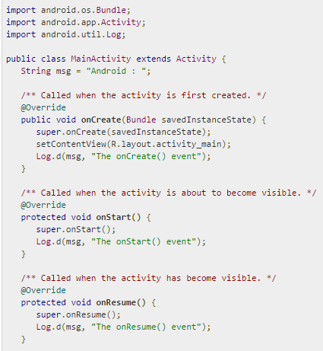
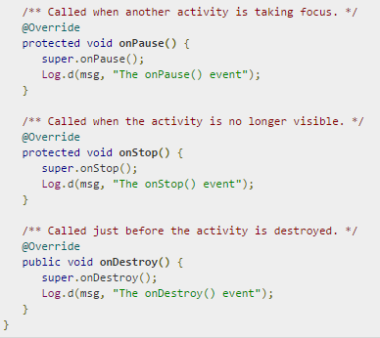
Example
Prepare By: You Tithrottanak

Slide 6
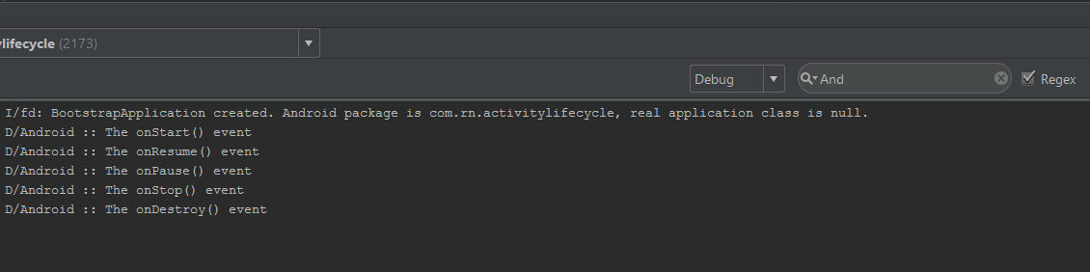
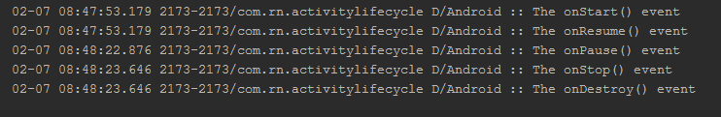
Result in Android Monitor
View -> Tools Window -> Android Monitor
Prepare By: You Tithrottanak

Slide 7
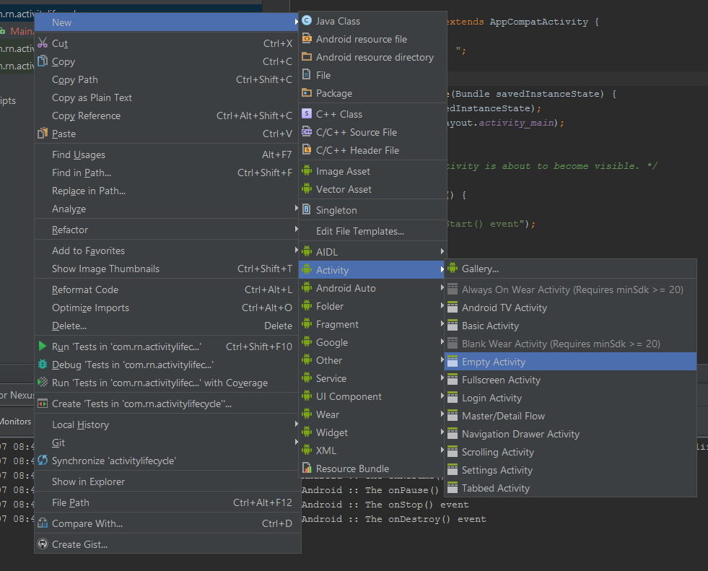
Create New Activity
Right Click on your
Package Name
New
Activity
Empty Activity
Prepare By: You Tithrottanak

Slide 8
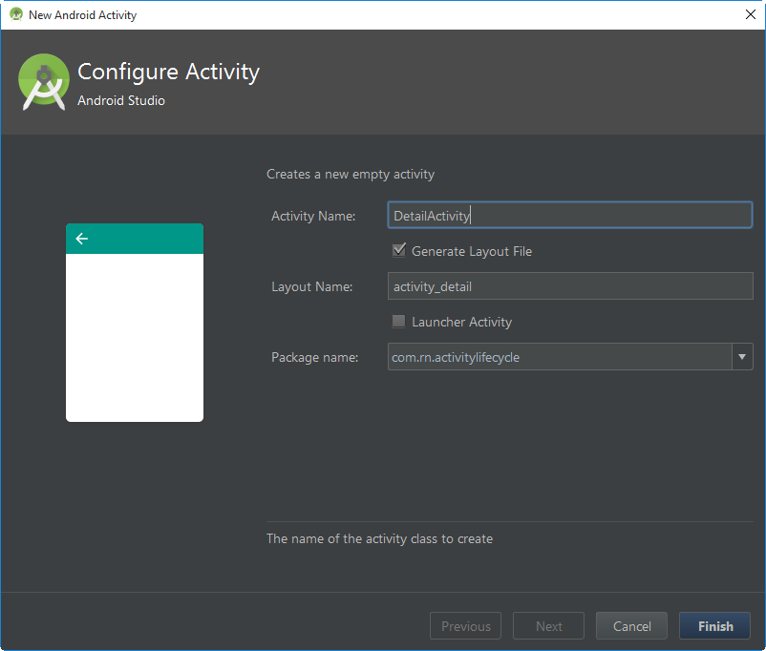
Create New Activity
Given name to your Activity
Layout Name
  Screen xml
Launcher Activity
  First activity of start up program
Which package you want to put this file in.
Finish
Prepare By: You Tithrottanak

Slide 9
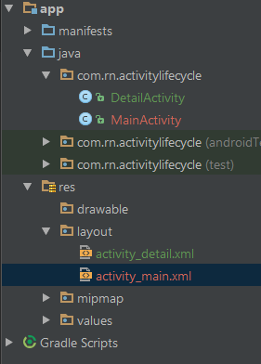
Create New Activity
Prepare By: You Tithrottanak

Slide 10
Open New Screen
In order to call other screen you:
Intent detailActivityScreen = new Intent(this, DetailActivity.class);
startActivity(detailActivityScreen);
Prepare By: You Tithrottanak

