Slide 1
Layout
Prepare By: You Tithrottanak

Slide 2
Layout
A layout defines the visual structure for a user interface or Group of view.
You can declare a layout in two ways:
Declare UI elements in XML
Instantiate layout elements at runtime
There are 3 main type of Layout:
Linear Layout
Relative Layout
Grid Layout
Prepare By: You Tithrottanak

Slide 3
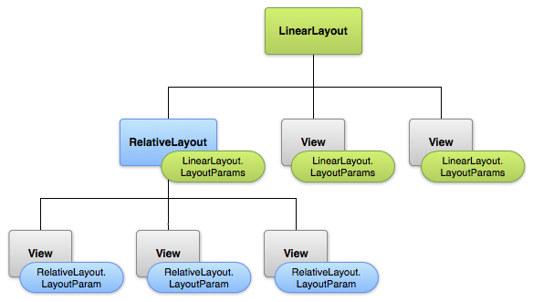
Layout
Prepare By: You Tithrottanak

Slide 4
Layout Parameters
XML layout attributes named layout_something define layout parameters for the View that are appropriate for the ViewGroup in which it resides.
All view groups include a width and height (layout_width and layout_height)
Many LayoutParams also include optional margins and borders.
layout_width and layout_height has two values:
wrap_content
match_parent
<LinearLayout android:layout_width="wrap_content" android:layout_height="wrap_content"> </LinearLayout>
Prepare By: You Tithrottanak

Slide 5
Layout Attribute
Attribute | Description
android:id | This is the ID which uniquely identifies the view.
android:layout_width | This is the width of the layout.
android:layout_height | This is the height of the layout
android:layout_marginTop | This is the extra space on the top side of the layout.
android:layout_marginBottom | This is the extra space on the bottom side of the layout.
android:layout_marginLeft | This is the extra space on the left side of the layout.
android:layout_marginRight | This is the extra space on the right side of the layout.
android:layout_gravity | This specifies how child Views are positioned.
android:layout_weight | This specifies how much of the extra space in the layout should be allocated to the View.
android:layout_x | This specifies the x-coordinate of the layout.
android:layout_y | This specifies the y-coordinate of the layout.
android:layout_width | This is the width of the layout.
android:layout_width | This is the width of the layout.
android:paddingLeft | This is the left padding filled for the layout.
android:paddingRight | This is the right padding filled for the layout.
android:paddingTop | This is the top padding filled for the layout.
android:paddingBottom | This is the bottom padding filled for the layout.
Prepare By: You Tithrottanak

Slide 6

Linear Layout
<LinearLayout android:layout_width="wrap_content" android:layout_height="wrap_content“
android:android:orientation="vertical“> </LinearLayout>
View group that aligns all children in a single direction, vertically or horizontally.
Vertical : android:orientation="vertical“
Horizontal : android:orientation="horizontal“
Horizontal
Vertical
Prepare By: You Tithrottanak

Slide 7
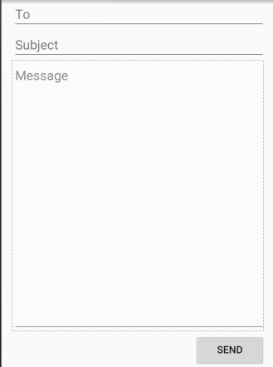
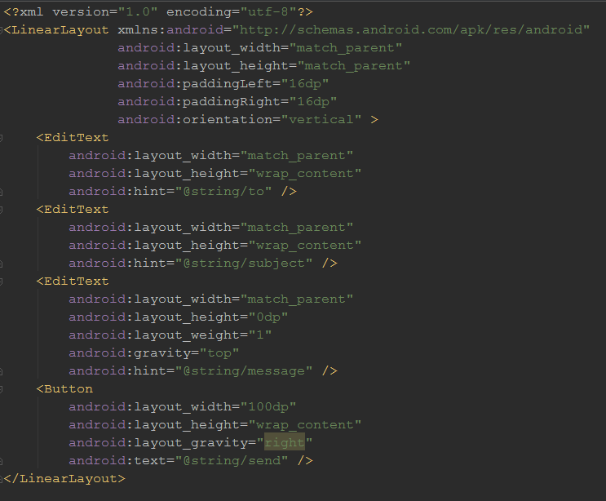
Linear Layout
android:layout_weight: value allows it to expand to fill any remaining space in the parent view.
Prepare By: You Tithrottanak

Slide 8

Relative Layout
View group that displays child views in relative positions.
The position of each view can be specified as relative to sibling elements (such as to the left-of or below another view) or in positions relative to the parent RelativeLayout area (such as aligned to the bottom, left or center).
Prepare By: You Tithrottanak

Slide 9
Positioning Views
android:layout_alignParentTop
If "true", makes the top edge of this view match the top edge of the parent.
android:layout_centerVertical
If "true", centers this child vertically within its parent.
android:layout_below
Positions the top edge of this view below the view specified with a resource ID.
android:layout_toRightOf
Positions the left edge of this view to the right of the view specified with a resource ID.
Prepare By: You Tithrottanak

Slide 10
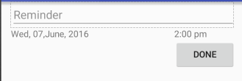
Relative Layout Example
<?xml version="1.0" encoding="utf-8"?> <RelativeLayout xmlns:android="http://schemas.android.com/apk/res/android" android:layout_width="match_parent" android:layout_height="match_parent" android:paddingLeft="16dp" android:paddingRight="16dp" > <EditText android:id="@+id/name" android:layout_width="match_parent" android:layout_height="wrap_content" android:hint="@string/reminder" /> <TextView android:id="@+id/dates" android:layout_width="0dp" android:layout_height="wrap_content" android:layout_below="@id/name" android:layout_alignParentLeft="true" android:layout_toLeftOf="@+id/times" android:text="@string/date"/> <TextView android:id="@id/times" android:layout_width="96dp" android:layout_height="wrap_content" android:layout_below="@id/name" android:text="@string/time" android:layout_alignParentRight="true" /> <Button android:layout_width="96dp" android:layout_height="wrap_content" android:layout_below="@id/times" android:layout_alignParentRight="true" android:text="@string/done" /> </RelativeLayout>
Prepare By: You Tithrottanak

Slide 11
Grid View
android:layout_alignParentTop
If "true", makes the top edge of this view match the top edge of the parent.
android:layout_centerVertical
If "true", centers this child vertically within its parent.
android:layout_below
Positions the top edge of this view below the view specified with a resource ID.
android:layout_toRightOf
Positions the left edge of this view to the right of the view specified with a resource ID.
Prepare By: You Tithrottanak

