Slide 1
Android Overview

Slide 2
What is Android?
An open source and Linux-based Operating System
Mobile devices: smartphones and tablet
Beta version of the Android Software Development Kit (SDK) was released by Google in 2007

Slide 3
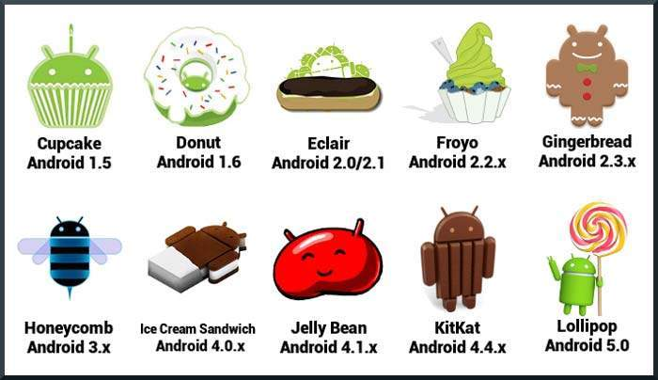
History

Slide 4
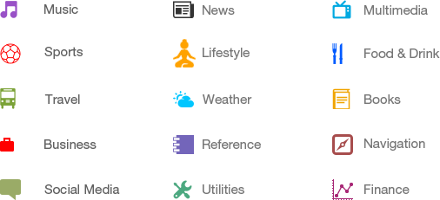
Categories of Applications

Slide 5
What is API level?
Platform Version | API Level | VERSION_CODE
Android 5.1 | 22 | LOLLIPOP_MR1
Android 5.0 | 21 | LOLLIPOP
Android 4.4W | 20 | KITKAT_WATCH | KitKat for Wearables Only
Android 4.4 | 19 | KITKAT
Android 4.3 | 18 | JELLY_BEAN_MR2
Android 4.2, 4.2.2 | 17 | JELLY_BEAN_MR1
Android 4.1, 4.1.1 | 16 | JELLY_BEAN
Android 4.0.3, 4.0.4 | 15 | ICE_CREAM_SANDWICH_MR1
Android 4.0, 4.0.1, 4.0.2 | 14 | ICE_CREAM_SANDWICH

Slide 6
What is API level?
Android 3.2 | 13 | HONEYCOMB_MR2
Android 3.1.x | 12 | HONEYCOMB_MR1
Android 3.0.x | 11 | HONEYCOMB
Android 2.3.4 Android 2.3.3 | 10 | GINGERBREAD_MR1
Android 2.3.2 Android 2.3.1 Android 2.3 | 9 | GINGERBREAD
Android 2.2.x | 8 | FROYO
Android 2.1.x | 7 | ECLAIR_MR1
Android 2.0.1 | 6 | ECLAIR_0_1
Android 2.0 | 5 | ECLAIR
Android 1.6 | 4 | DONUT
Android 1.5 | 3 | CUPCAKE
Android 1.1 | 2 | BASE_1_1
Android 1.0 | 1 | BASE

Slide 7
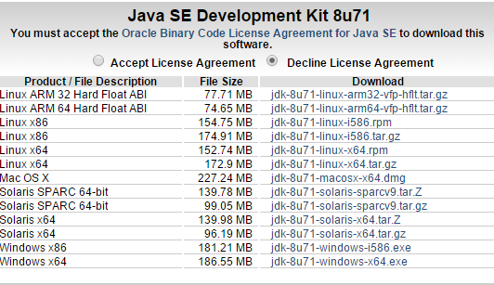
Android Development
Java SDK
Download: http://goo.gl/YgPXDI

Slide 8
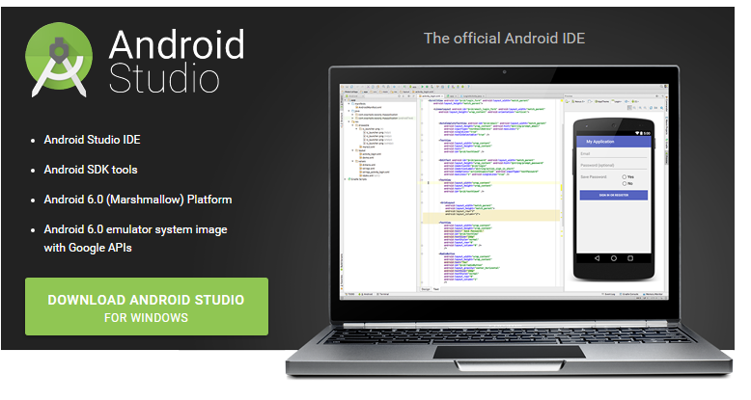
Android Development
Android Studio
Download: http://developer.android.com/sdk/index.html

Slide 9
To set up Android Studio on Windows
Launch the .exe file you just downloaded.
Follow the setup wizard to install Android Studio and any necessary SDK tools.
On some Windows systems, the launcher script does not find where Java is installed. If you encounter this problem, you need to set an environment variable indicating the correct location.
Open Explorer -> Right click on My Computer ( win 7) or This PC ( win 8) -> Properties -> Advance System Settings -> Advance Tab -> Environment Variable
SDK Directory after installing : \Users\<user>\sdk\

Slide 10
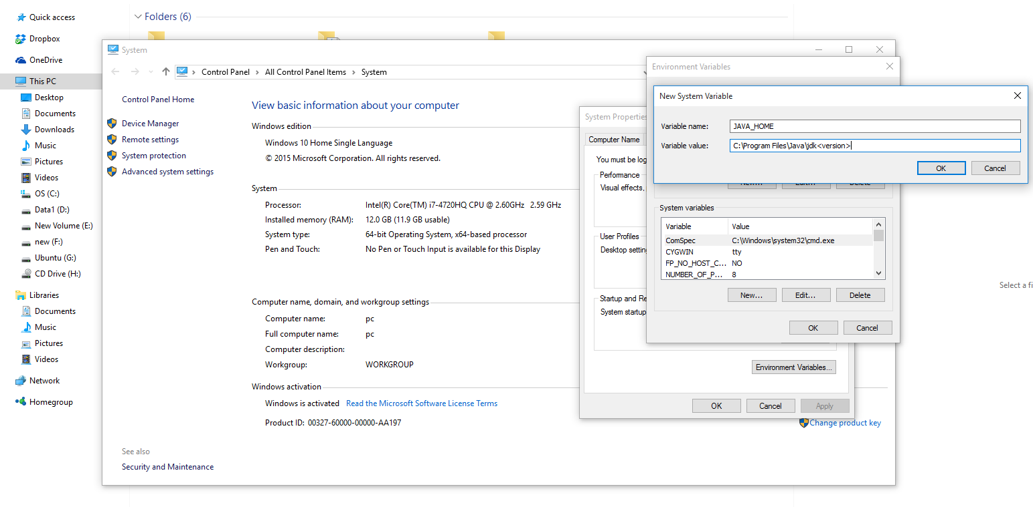
To set up Android Studio on Windows
1
5
2
4
3

Slide 11
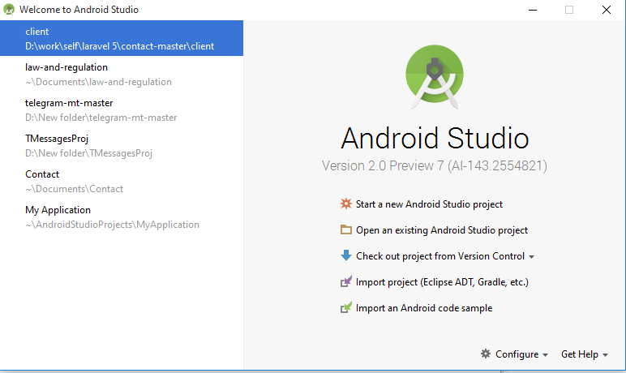
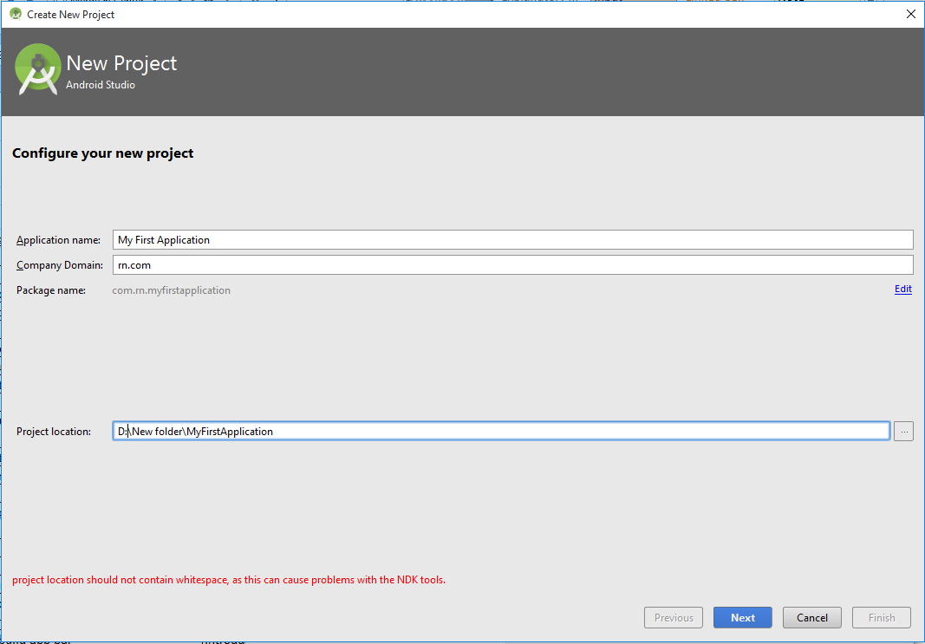
Creating an Android Project

Slide 12
Creating an Android Project

Slide 13
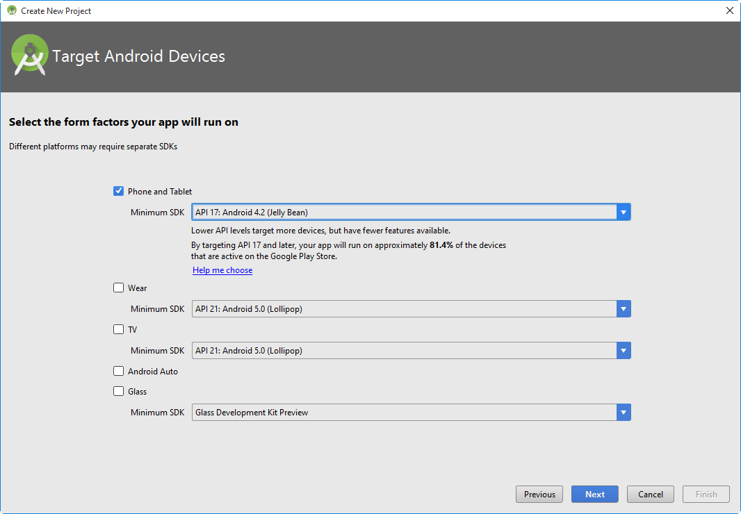
Creating an Android Project

Slide 14
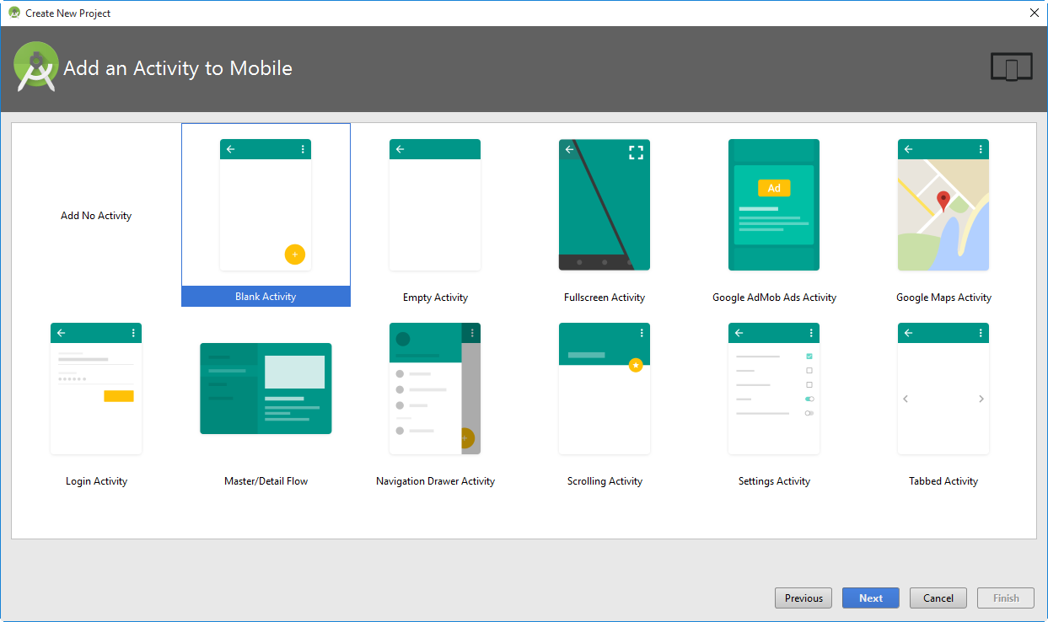
Creating an Android Project

Slide 15
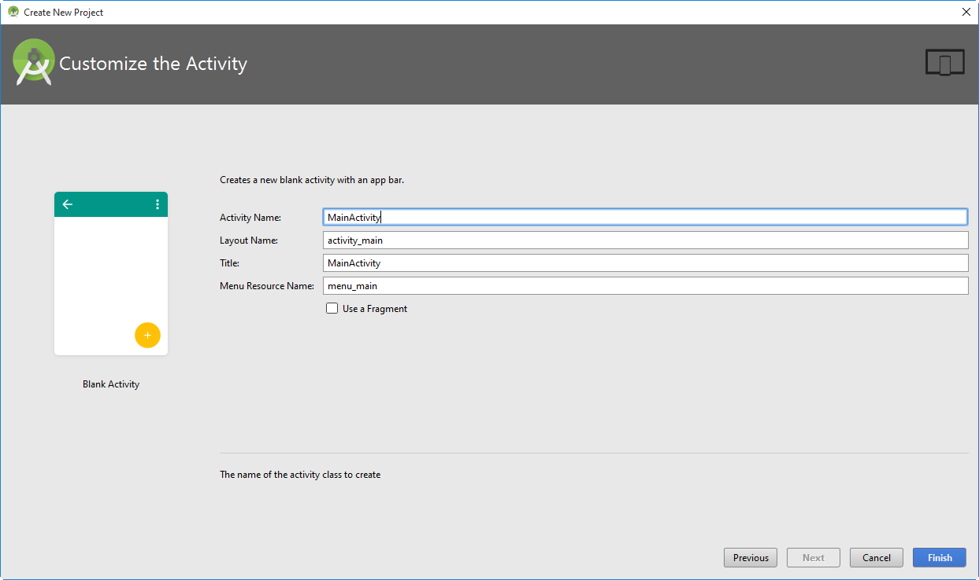
Creating an Android Project

Slide 16
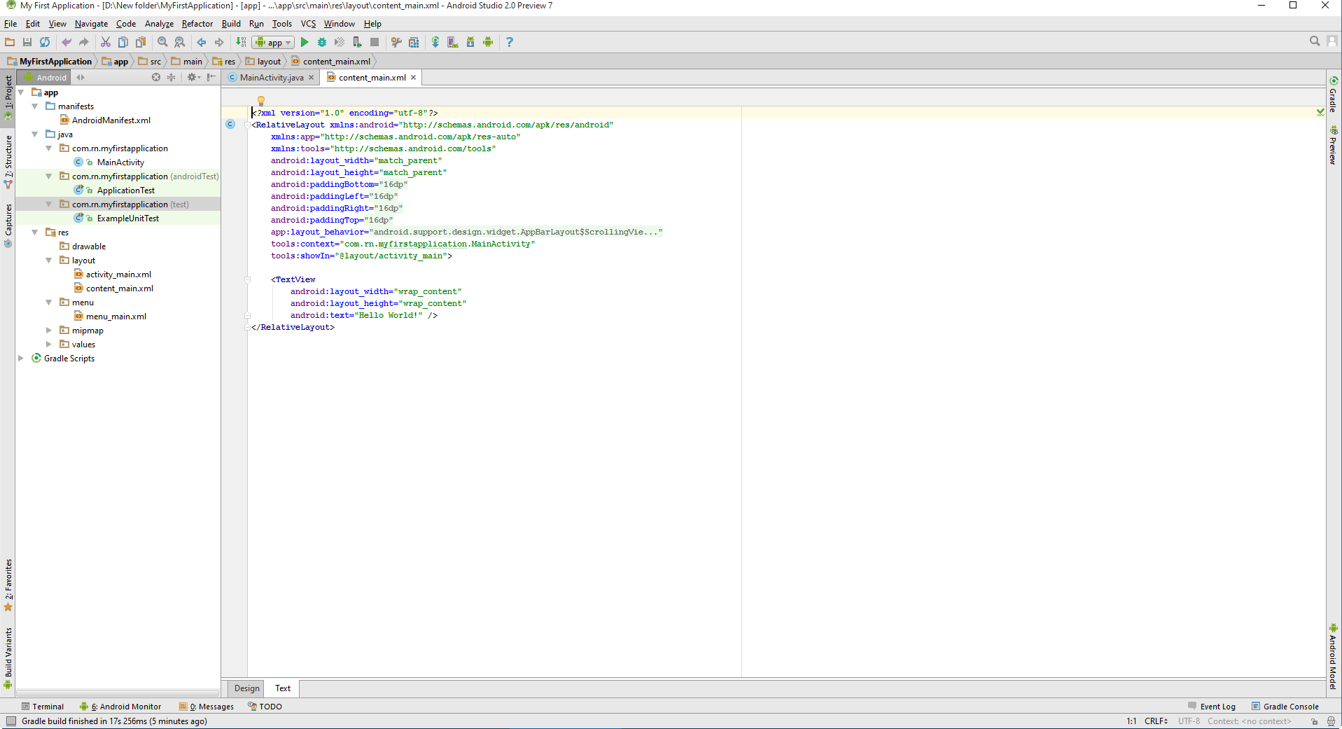
Creating an Android Project

Slide 17

Run on a Real Device
Plug in your device to your development machine with a USB cable.
If you can’t connect to via USB you can check in folder SDK\Driver
Enable USB debugging on your device
Settings > Applications > Development.
Click Run from the toolbar

Slide 18
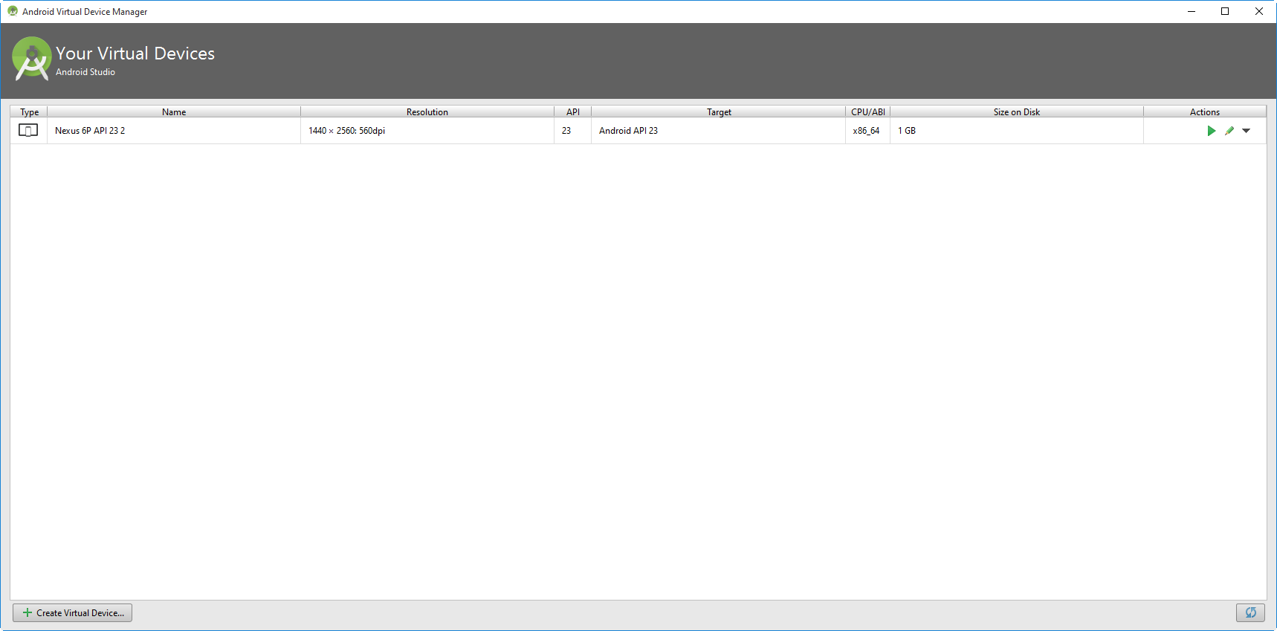
Run on the Emulator
select Tools > Android > AVD Manager, or click the AVD Manager icon in the toolbar.

Slide 19
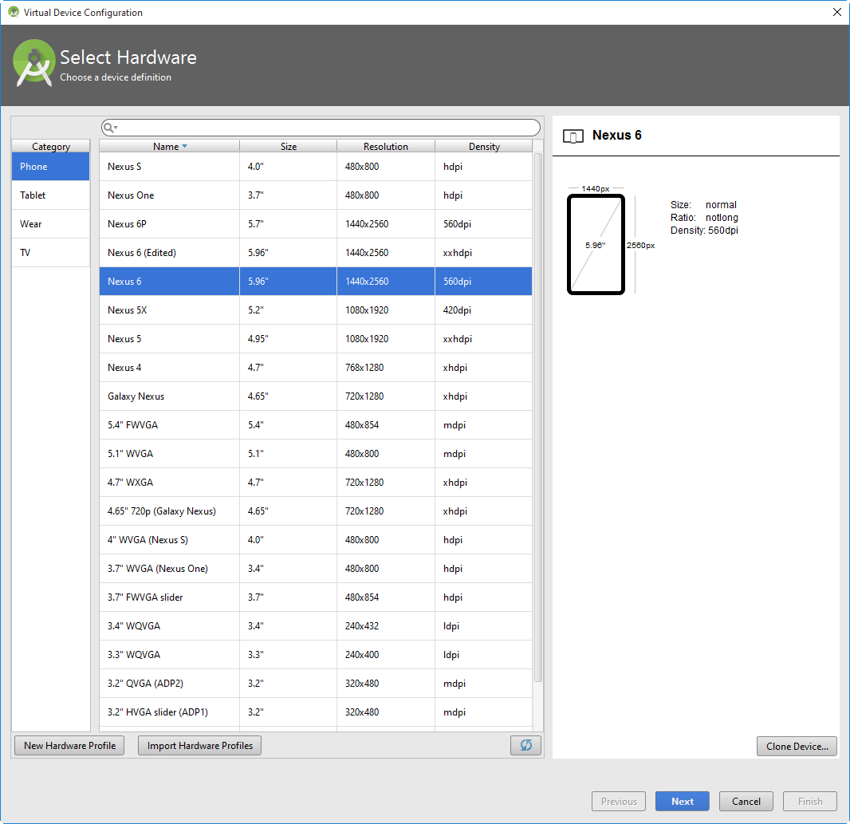
Run on the Emulator

Slide 20
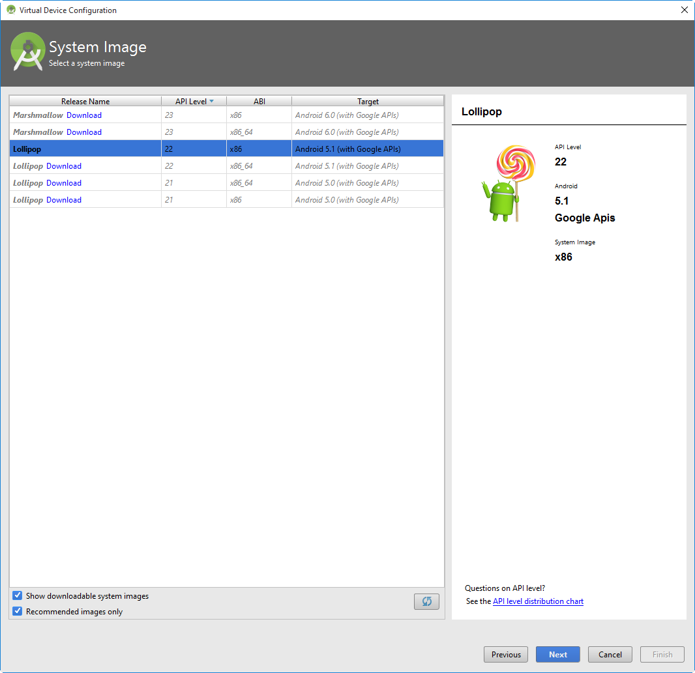
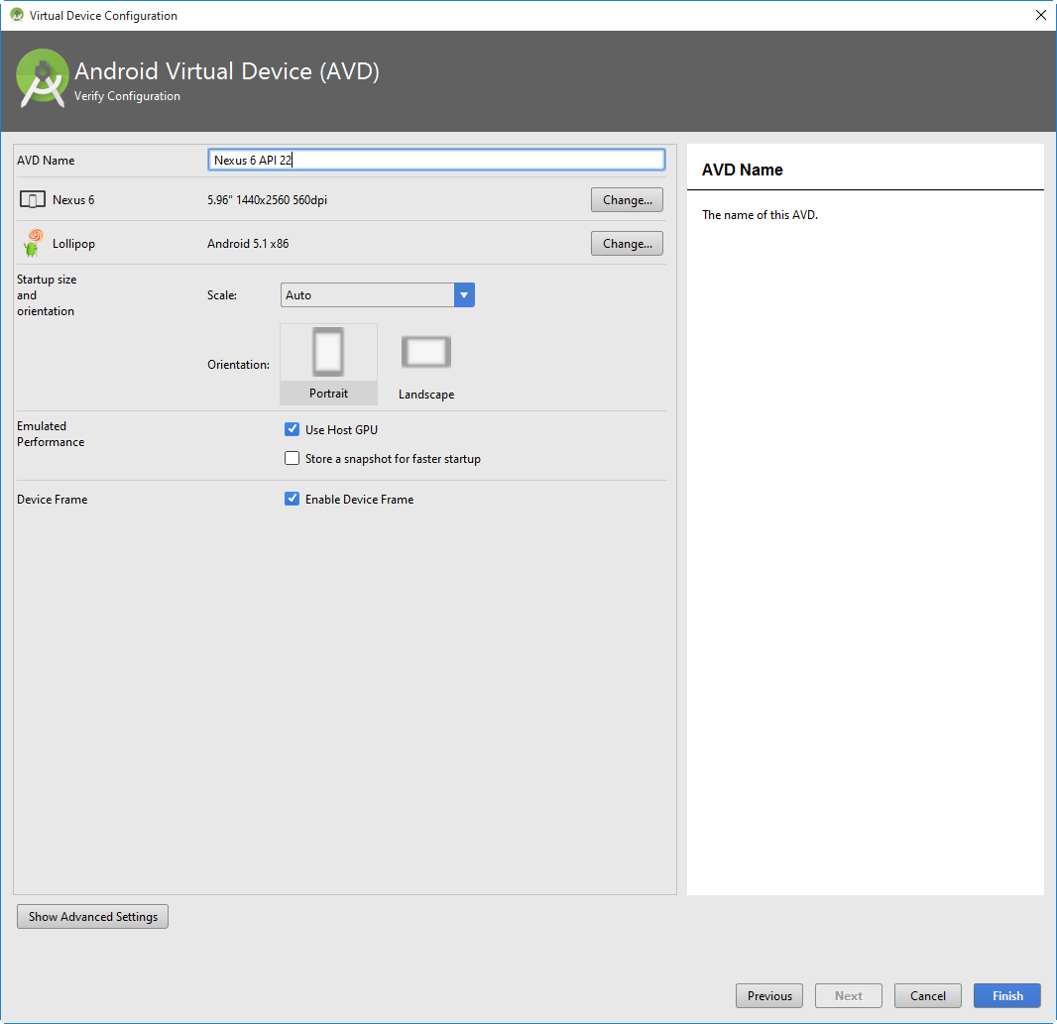
Run on the Emulator

Slide 21
Run on the Emulator
RUN

