Slide 1
Version Control
Prepare By: You Tithrottanak

Slide 2
What is Version Control?
Version control is a system that records changes to a file or set of files over time so that you can recall specific versions later.
There are many type of Version Controll such as:
Apache Subversion (SVN)
Git
Prepare By: You Tithrottanak

Slide 3
SVN
The management of changes to information(physical: files)
Allow concentrating and sharing file over the network
Support authority and security
Cooperate member’s changes
Manage files with version, allow recovering of desired version
Allow checking the modification
Support CM process
Prepare By: You Tithrottanak

Slide 4
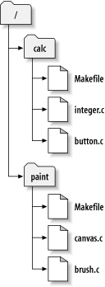
SVN
Subversion (abbreviated SVN) is a free open-source version control system.
Managed folders/files are placed into a repository. A repository is much like an ordinary file server.
Subversion allows you to recover old versions of your data, or examine the history of how your data changed.
checkout
Working copy
SVN Repository
Prepare By: You Tithrottanak

Slide 5
SVN
Why use SVN
Sufficient features
Free
Support Windows, UNIX, Linux
Large community: many clients/shells (TortoiseSVN, Syncro, SmartSVN…), many plugins (VS .NET, Eclipse, XCode IDE…)
Plain file formats: allow to recover data when repository broken
Good performance (on-debate)
Prepare By: You Tithrottanak

Slide 6
SVN Clients and Plugins
Company
server
SVN Client for Windows:
http://tortoisesvn.tigris.org
SVN Plugin for Eclipse:
http://subclipse.tigris.org/
SVN Plugin for Visual Studio .NET:
http://ankhsvn.tigris.org/
SVN
Repository
Checkout / Commit
TortoiseSVN
TortoiseSVN
TortoiseSVN
Working
copy
Working
copy
Working
copy
Member 1 desktop
Member 2 desktop
Member n desktop
Prepare By: You Tithrottanak

Slide 7
Common functions in TortoiseSVN
Create rep
Merge
Browse
Add file
Checkout
Commit
Update
Export
Lock
Prepare By: You Tithrottanak

Slide 8
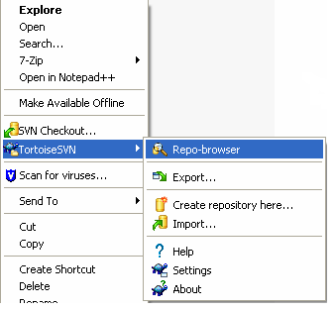
Setup TortoiseSVN, grant access right (1/2)
Find the latest TortoiseSVN at: http://tortoisesvn.tigris.org/download.html
Download and install the package: TortoiseSVN-xxx.msi
After installing, TortoiseSVN is integrated into Windows Explorer:
- Open Windows Explorer
- Right click, popup menu opened
- Select TortoiseSVN
Note: for stand-alone PC, TortoiseSVN can be used as a source control system, it’s not necessary to setup a SVN server.
Prepare By: You Tithrottanak

Slide 9
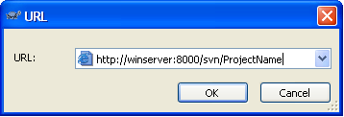
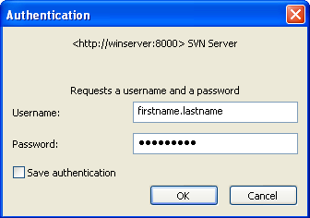
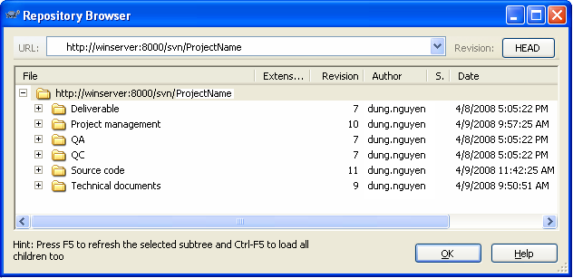
Setup TortoiseSVN, grant access right
In Windows Explorer, right click>TortoiseSVN>Repo-browser
Put the repository URL into the dialog box
Login with given username and password
The Repo-browser opened
Prepare By: You Tithrottanak

Slide 10
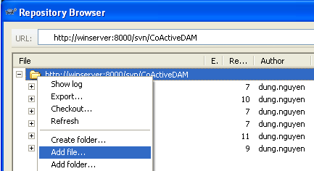
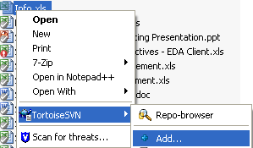
Add file/folder to repository
A. Without (local) working copy folder
In Repo-browser, right click>Add folder…
Select source file/folder to be added
=> New files/folders will be added under current
selected folder.
B. With (local) working copy folder (recommended)
Copy new file/folder to the working copy folder
In Windows Explorer, select new file/folder, right click>TortoiseSVN>Add…
TortoiseSVN>Commit… => New file/folder has a check mark.
Prepare By: You Tithrottanak

Slide 11
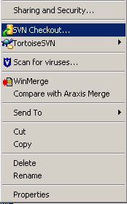
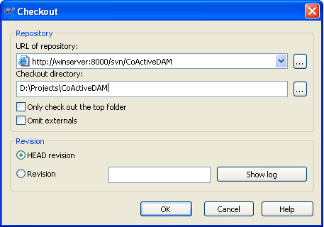
Check out a working copy
In Windows Explorer, select working folder, right click>SVN Checkout… OR
In Repo-browser, select the folder to check out, right click>Checkout…
Desired revision
Prepare By: You Tithrottanak

Slide 12
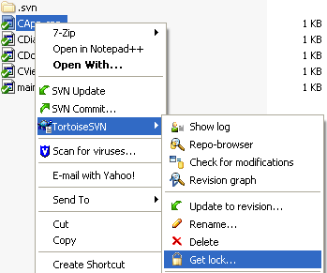
Lock/Release repository files
This is to avoid the conflict when another user updates the repository while you are working on your working copy.
How to:
In the working copy, select file to lock, right-click>TortoiseSVN>Get lock…
=> Locked file has a lock-icon mark.
Other users will not be able to commit until you release the locked files.
Prepare By: You Tithrottanak

Slide 13
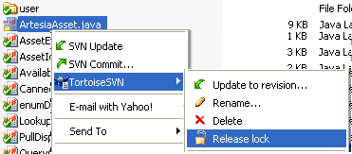
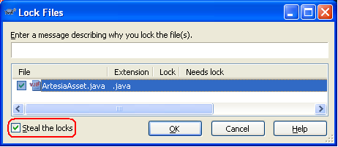
Lock/Release repository files
This is to release the locked files for others to commit.
How to:
Select locked file>TortoiseSVN>
Release lock
Steal the locks:
- Select locked file>TortoiseSVN>
Get lock…
- Check Steal the locks
This way will steal other’s lock and replace by your lock. Not recommended. It’d be better to ask the author to release his lock.
Prepare By: You Tithrottanak

Slide 14
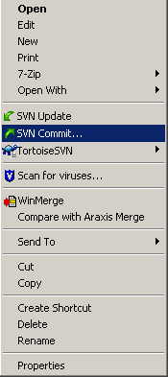
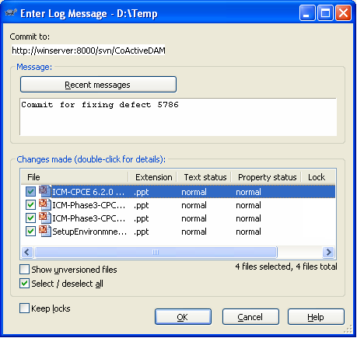
Commit to repository
SVN: Commit = VSS: Check-in
This is to send the changes you made on working copy to the repository.
How to:
On the working copy, right click>SVN Commit…
Before committing, you should make sure that your working copy is up-to-date.
Should give comments
Prepare By: You Tithrottanak

Slide 15
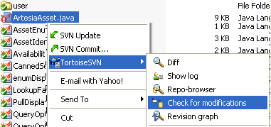

Check modification
This is to know the modification status of selected file in comparison with that file on the repository.
How to:
- On working copy, select modified file
- right click>TortoiseSVN>Check for modifications
The Working Copy dialog shows the status of the selected files in comparison with that file on the repository.
Prepare By: You Tithrottanak

Slide 16
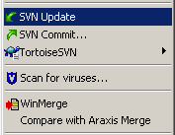
Update working copy
SVN: Update = VSS: Get latest version
This is to update your working copy with new changes on the repository.
Periodically, you should ensure that changes done by others get incorporated in your working copy.
How to: On the working copy, select folder to be updated, right click>SVN Update…
Prepare By: You Tithrottanak

Slide 17
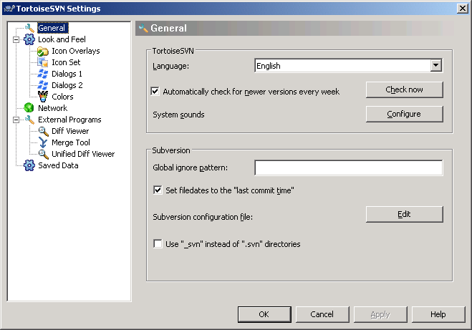
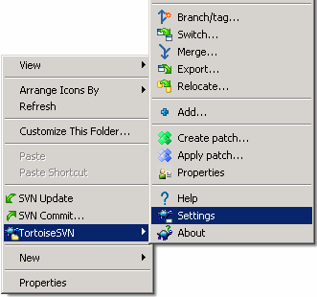
Update working copy
To make date time of local files match with date time of files at SVN.
How to:
TortoireSVN>Settings to open TortoiseSVN Settings dialog.
Turn on option [Set filedates to “last commit time”].
Prepare By: You Tithrottanak

Slide 18
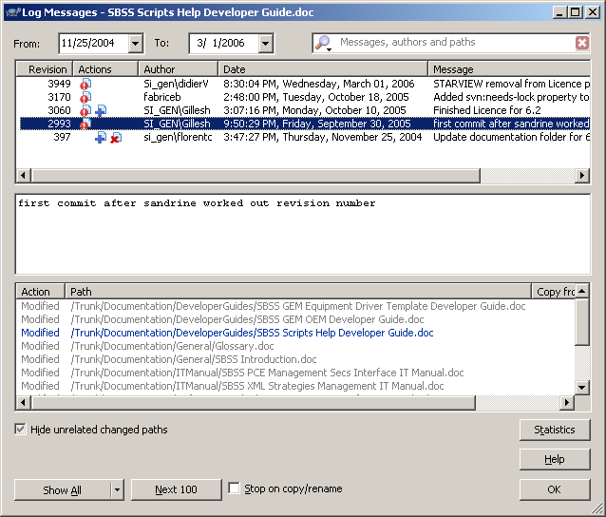
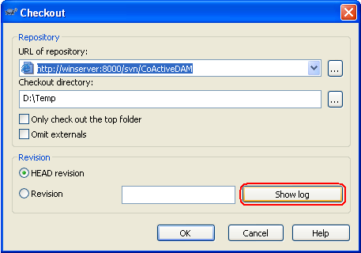
Show Revision Log message
For every change you make and commit, should provide a log message describes the meaning of your change.
The Log Messages dialog retrieves all those log messages and allows you to select the desired revision.
Revision number is applied for the
whole repository.
Prepare By: You Tithrottanak

Slide 19
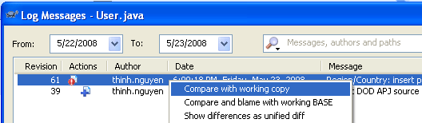
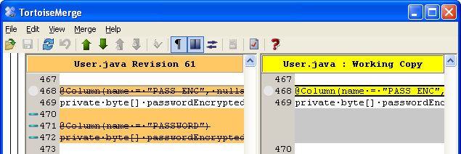
View differences
Compare working copy with a given SVN revision.
How to:
On working copy, select file to compare
Right click>Show log => Log messages dialog opened
Select the revison to compare, right click>Compare with local copy
Prepare By: You Tithrottanak

Slide 20

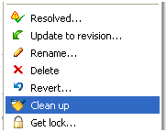
Clean up
If a Subversion command cannot complete successfully, perhaps due to server or network problems, your working copy can be left in an inconsistent state.
It is a good idea to do “clean up” at the top level of the working copy.
Prepare By: You Tithrottanak

Slide 21







Status of version controlled files/folders
Green checkmark: normal status, under control
Red exclamation: file has been modified since last update and needs to be committed.
Yellow exclamation: a conflict occurs during an update.
Grey checkmark: this file needs to be locked first before editing.
Locked lock: file is locked. Need to unlock for other to commit.
Red deletion: missing file or file to be deleted under version control.
Blue plus: File to be added to version control.
Prepare By: You Tithrottanak

Slide 22
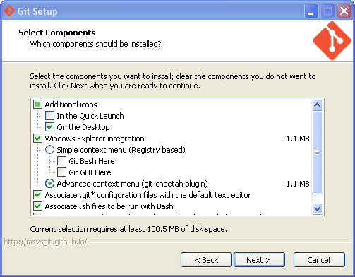
Git Installation
Go to http://git-scm.com/ and download git 1.9.4 for Windows.
Then, go to the download directory, and run Git-1.9.4-preview20140815.exe to setup Git.
We need to check git-cheetah plugin:
Next => Next
On the "Adjusting your Path Environment", we may want to choose "Use git and optional Unix tools from the Windows Command Prompt" =>
Next => Next => Finish.
That's it.
Prepare By: You Tithrottanak

Slide 23
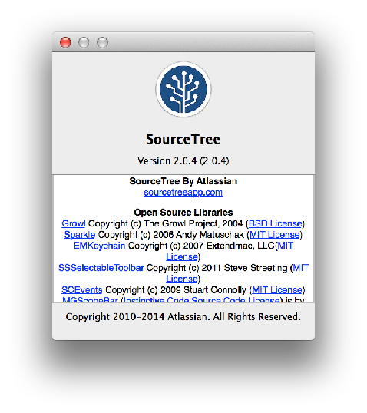
Git with Source Tree
Git is version control that take care version of your file.
The popular tool that use with Git is Source Tree.
Prepare By: You Tithrottanak

Slide 24
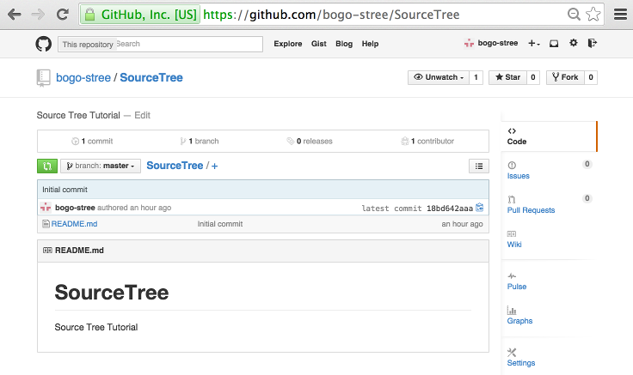
GitHub
GitHub is git public repository.
There are million of applications for free.
Prepare By: You Tithrottanak

Slide 25
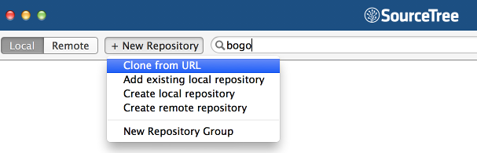
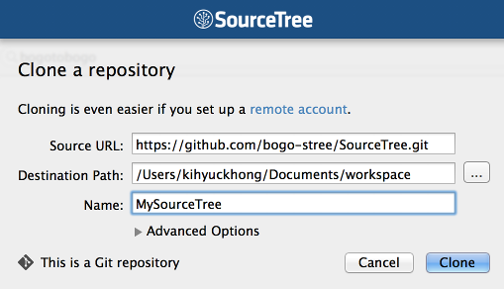
Cloning from GitHub
Prepare By: You Tithrottanak

Slide 26
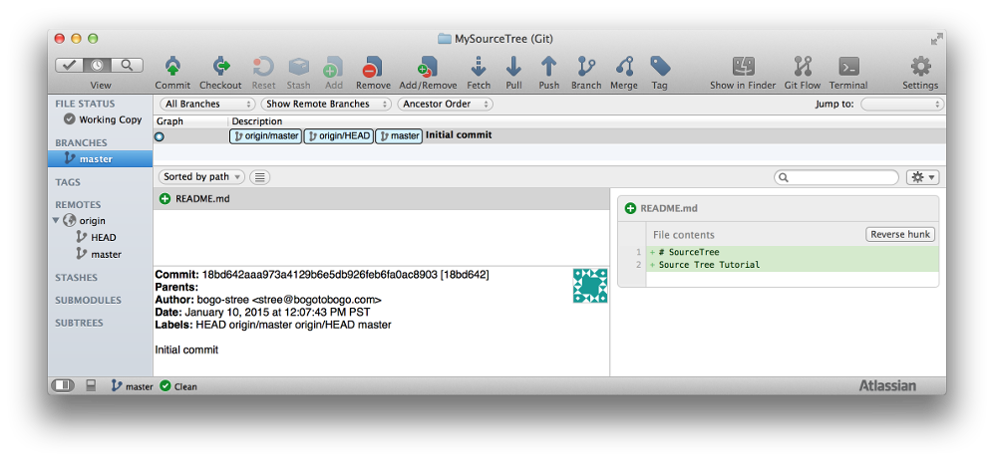
Cloning from GitHub
Prepare By: You Tithrottanak

Slide 27
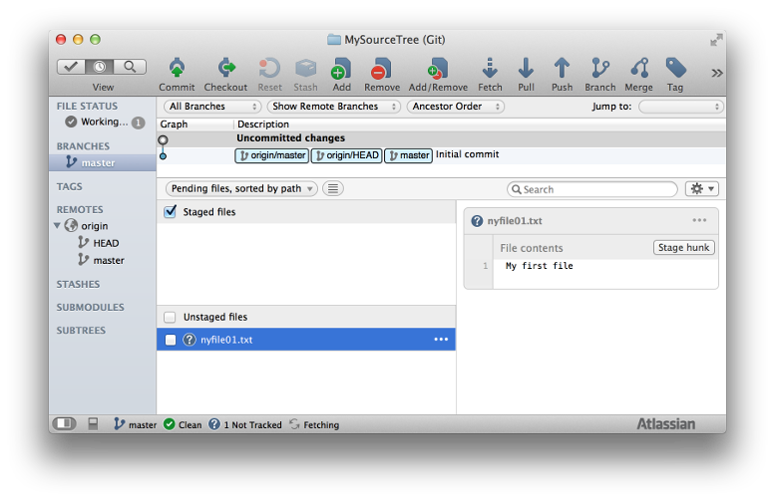
Staged & Unstaged
If we make a new file on our local machine, we'll have "Uncommited" changes:
Prepare By: You Tithrottanak

Slide 28
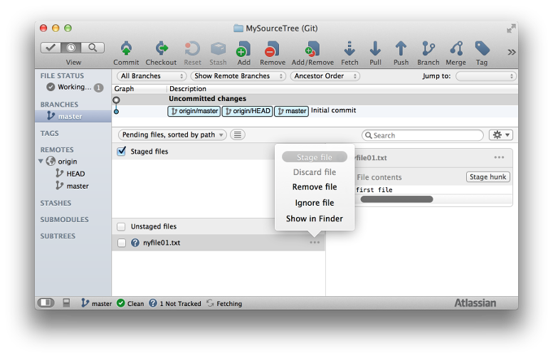
Staged & Unstaged
We can put the file into staging either by checking "Unstaged files" or:
Prepare By: You Tithrottanak

Slide 29
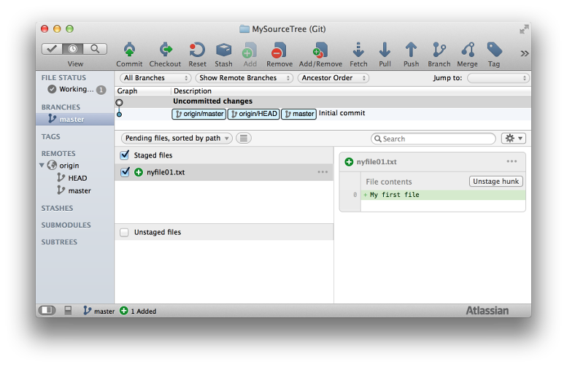
Staged & Unstaged
Prepare By: You Tithrottanak

Slide 30
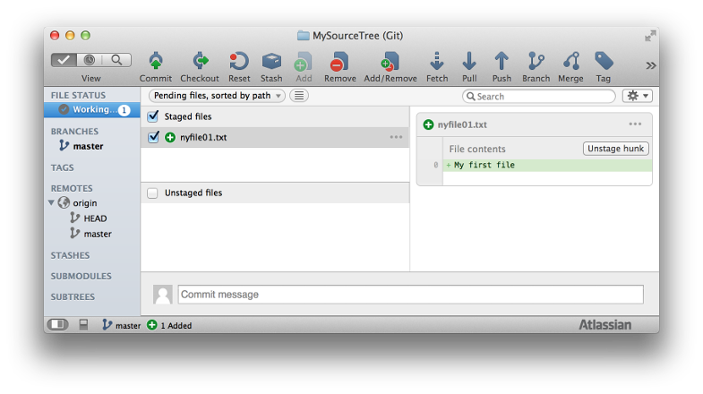
Commit to a local repo
Now commit the file in the staging area:
Prepare By: You Tithrottanak

Slide 31
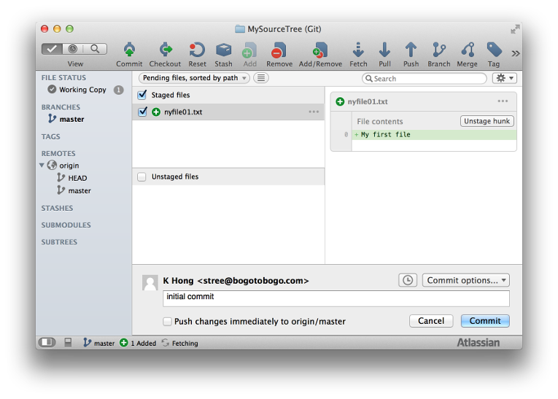
Commit to a local repo
If we press "Commit" on the top menu, we get the following:
Fill in out comment, and the hit "Commit" button:

Slide 32
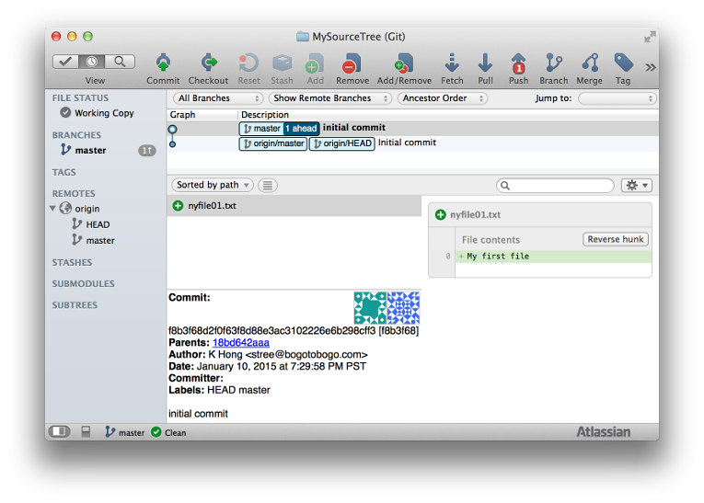
Commit to a local repo
Prepare By: You Tithrottanak

Slide 33
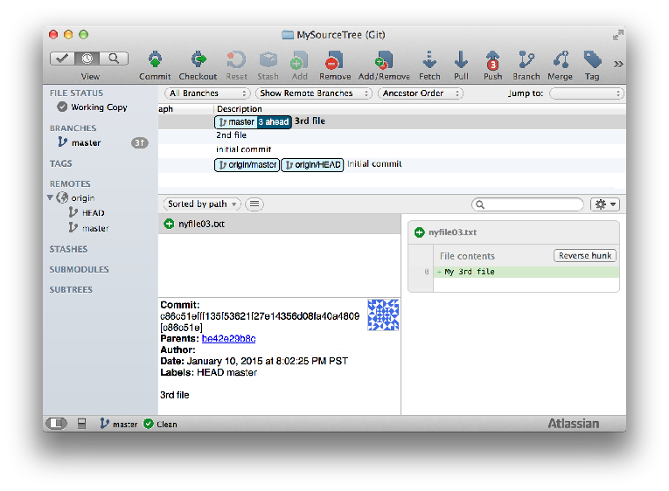
Pushing to GitHub
After adding two more files to our local repo, we want to push to a remote repo:
Prepare By: You Tithrottanak

Slide 34
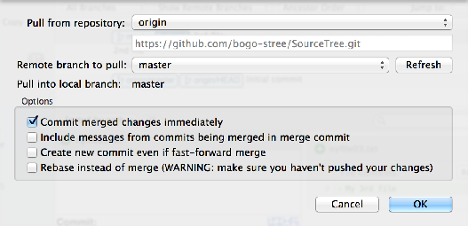
Pushing to GitHub
Before we do Push, we need to Pull first, so hit the Pull on the top menu:
Prepare By: You Tithrottanak

Slide 35

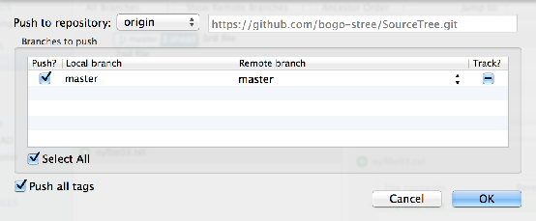
Pushing to GitHub
Now, press "Push" on the top menu:
Prepare By: You Tithrottanak

Slide 36
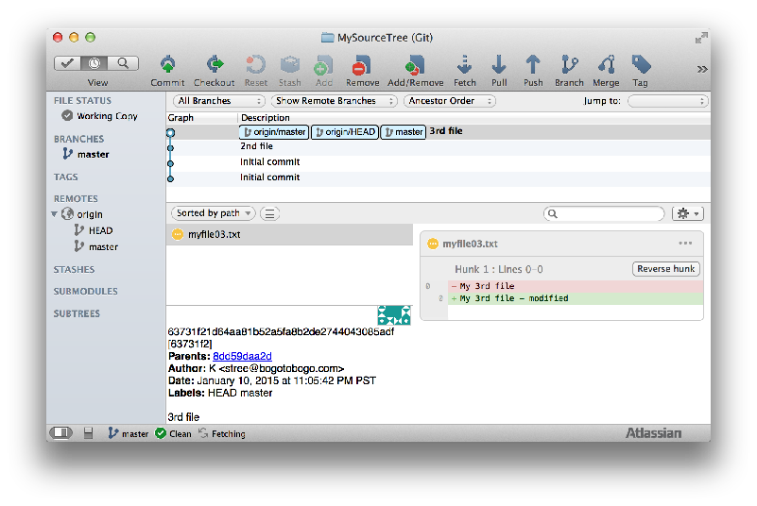
Pushing to GitHub
Prepare By: You Tithrottanak

Slide 37
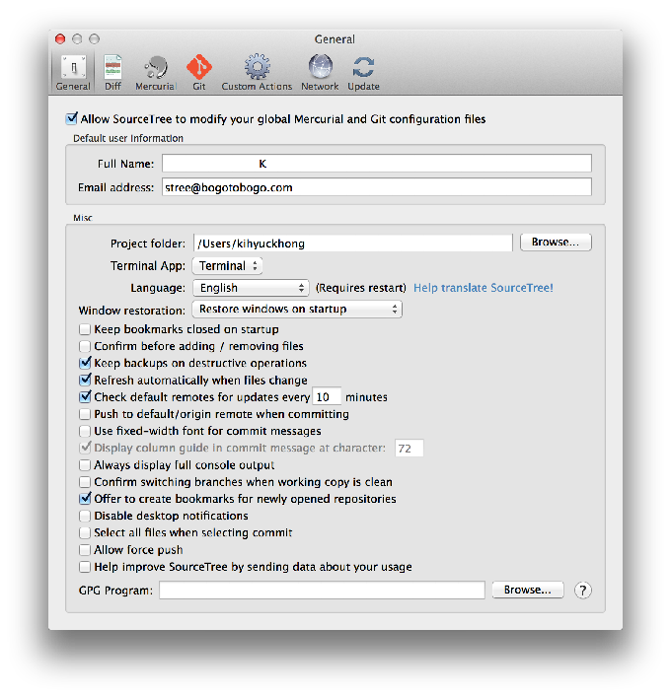
Source Tree Preferences
In this tutorial, we used the preferences as shown below:
Prepare By: You Tithrottanak

