Slide 1
Dialogs
Prepare By: You Tithrottanak

Slide 2
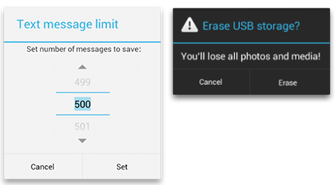
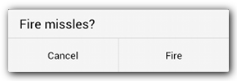
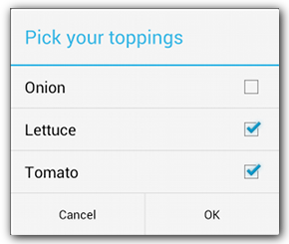
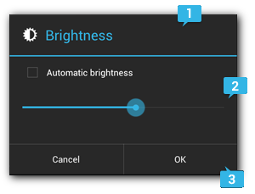
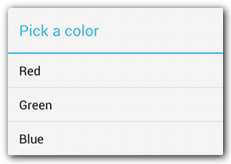
Dialogs
A dialog is a small window that prompts the user to make a decision or enter additional information.
Prepare By: You Tithrottanak

Slide 3
Dialogs
// 1. Instantiate an AlertDialog.Builder with its constructor AlertDialog.Builder builder = new AlertDialog.Builder(getActivity()); // 2. Chain together various setter methods to set the dialog characteristics builder.setMessage(R.string.dialog_message) .setTitle(R.string.dialog_title); // 3. Get the AlertDialog from create() AlertDialog dialog = builder.create();
dialog.show();
Prepare By: You Tithrottanak

Slide 4
Dialogs
Sr.No | Method type & description
1 | setIcon(Drawable icon)This method set the icon of the alert dialog box.
2 | setCancelable(boolean cancel able)This method sets the property that the dialog can be cancelled or not
3 | setMessage(CharSequence message)This method sets the message to be displayed in the alert dialog
4 | setMultiChoiceItems(CharSequence[] items, boolean[] checkedItems, DialogInterface.OnMultiChoiceClickListener listener)This method sets list of items to be displayed in the dialog as the content. The selected option will be notified by the listener
5 | setOnCancelListener(DialogInterface.OnCancelListener onCancelListener)This method Sets the callback that will be called if the dialog is cancelled.
6 | setTitle(CharSequence title)This method set the title to be appear in the dialog
Prepare By: You Tithrottanak

Slide 5
Adding Button
A dialog is a small There are three different action buttons you can add:
Positive
You should use this to accept and continue with the action (the "OK" action).
Negative
You should use this to cancel the action.
Neutral
You should use this when the user may not want to proceed with the action, but doesn't necessarily want to cancel. It appears between the positive and negative buttons. For example, the action might be "Remind me later”.
Prepare By: You Tithrottanak

Slide 6
Adding Button
AlertDialog.Builder builder = new AlertDialog.Builder(this); builder.setMessage(R.string.dialog_message) .setTitle(R.string.dialog_title) .setPositiveButton("YES", new DialogInterface.OnClickListener() { @Override public void onClick(DialogInterface dialogInterface, int i) { } }) .setNegativeButton("No", new DialogInterface.OnClickListener() { @Override public void onClick(DialogInterface dialogInterface, int i) { } }); AlertDialog dialog = builder.create(); dialog.show();
Prepare By: You Tithrottanak

Slide 7
Adding a list
There are three kinds of lists available with the AlertDialog APIs:
A traditional single-choice list
A persistent single-choice list (radio buttons)
A persistent multiple-choice list (checkboxes)
Prepare By: You Tithrottanak

Slide 8
Adding a list
To create a single-choice list
final String[] values = new String[] { "Android", "iPhone", "WindowsMobile", "Blackberry", "WebOS", "Ubuntu", "Windows7", "Max OS X", "Linux", "OS/2" }; AlertDialog.Builder builder = new AlertDialog.Builder(this); builder.setTitle("Choose Operating System") .setItems(values, new DialogInterface.OnClickListener() { @Override public void onClick(DialogInterface dialogInterface, int i) { // Do something here } }); AlertDialog dialog = builder.create(); dialog.show();
Prepare By: You Tithrottanak

Slide 9
Adding a list
To create a multi-choice list
final List<String> mSelectedItems = new ArrayList(); final String[] values = new String[] { "Android", "iPhone", "WindowsMobile", "Blackberry", "WebOS", "Ubuntu", "Windows7", "Max OS X","Linux", "OS/2" }; AlertDialog.Builder builder = new AlertDialog.Builder(this); builder.setTitle("This is list choice dialog box"); builder.setMultiChoiceItems(values, null,new DialogInterface.OnMultiChoiceClickListener() { @Override public void onClick(DialogInterface dialog, int which, boolean isChecked) { if (isChecked) { // If the user checked the item, add it to the selected items mSelectedItems.add(values[which]); } else if (mSelectedItems.contains(which)) { // Else, if the item is already in the array, remove it mSelectedItems.remove(values[which]); } } }) .setPositiveButton("OK", null); AlertDialog dialog = builder.create(); dialog.show();
Prepare By: You Tithrottanak

Slide 10
Custom Layout Dialogs
Create Layout
Create class extends from DialogFragment
Overide method onCreateDialog
Calling by:
SignInFragmentDialog dialog = new SignInFragmentDialog(); dialog.show(getSupportFragmentManager(),"Sing In");
Prepare By: You Tithrottanak

Slide 11
Dialogs
<LinearLayout xmlns:android="http://schemas.android.com/apk/res/android" android:orientation="vertical" android:layout_width="wrap_content" android:layout_height="wrap_content"> <EditText android:id="@+id/username" android:inputType="textEmailAddress" android:layout_width="match_parent" android:layout_height="wrap_content" android:layout_marginTop="16dp" android:layout_marginLeft="4dp" android:layout_marginRight="4dp" android:layout_marginBottom="4dp" android:hint="UserName" /> <EditText android:id="@+id/password" android:inputType="textPassword" android:layout_width="match_parent" android:layout_height="wrap_content" android:layout_marginTop="4dp" android:layout_marginLeft="4dp" android:layout_marginRight="4dp" android:layout_marginBottom="16dp" android:fontFamily="sans-serif" android:hint="Password"/> </LinearLayout>
Create Layout .xml.
Prepare By: You Tithrottanak

Slide 12
public class SignInFragmentDialog extends DialogFragment { @Override public Dialog onCreateDialog(Bundle savedInstanceState) { AlertDialog.Builder builder = new AlertDialog.Builder(getActivity()); // Get the layout inflater LayoutInflater inflater = getActivity().getLayoutInflater(); // Inflate and set the layout for the dialog // Pass null as the parent view because its going in the dialog layout builder.setView(inflater.inflate(R.layout.dialog_signin, null)) // Add action buttons .setPositiveButton("Login", new DialogInterface.OnClickListener() { @Override public void onClick(DialogInterface dialog, int id) { // sign in the user ... } }) .setNegativeButton("Cancel", new DialogInterface.OnClickListener() { public void onClick(DialogInterface dialog, int id) { SignInFragmentDialog.this.getDialog().cancel(); } })
.setCancelable(false); return builder.create(); } }
Prepare By: You Tithrottanak

