Slide 1
ListView
Prepare By: You Tithrottanak

Slide 2
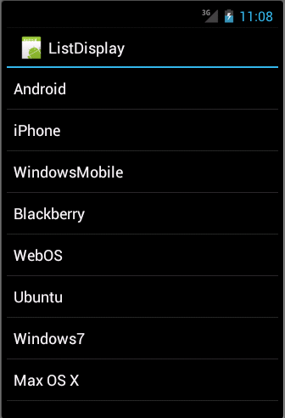
ListView
Android ListView is a view which groups several items and display them in vertical scrollable list.
The list items are automatically inserted to the list using an Adapter that pulls content from a source such as an array or database.
<ListView
android:id="@+id/mobile_list"
android:layout_width="match_parent"
android:layout_height="wrap_content" >
</ListView>
Prepare By: You Tithrottanak

Slide 3
ListView
Attribute | Description
android:id | This is the ID which uniquely identifies the layout.
android:divider | This is drawable or color to draw between list items. .
android:dividerHeight | This specifies height of the divider. This could be in px, dp, sp, in, or mm.
android:entries | Specifies the reference to an array resource that will populate the ListView.
android:footerDividersEnabled | When set to false, the ListView will not draw the divider before each footer view. The default value is true.
android:headerDividersEnabled | When set to false, the ListView will not draw the divider after each header view. The default value is true.
Prepare By: You Tithrottanak

Slide 4
ArrayAdapter
You can use this adapter when your data source is an array.
By default, ArrayAdapter creates a view for each array item by calling toString() on each item and placing the contents in a TextView.
ArrayAdapter<String> adaper = new ArrayAdapter<String>(this,android.R.layout.simple_dropdown_item_1line, values);
Here are arguments for this constructor
First argument this is the application context. Most of the case, keep it this.
Second argument will be layout defined in XML file and having TextView for each string in the array.
Final argument is an array of strings which will be populated in the text view.
Prepare By: You Tithrottanak

Slide 5
ArrayAdapter
Once you have array adapter created, then simply callsetAdapter() on your ListView object as follows
ListView listView = (ListView) findViewById(R.id.listview);
listView.setAdapter(adapter);
Prepare By: You Tithrottanak

Slide 6
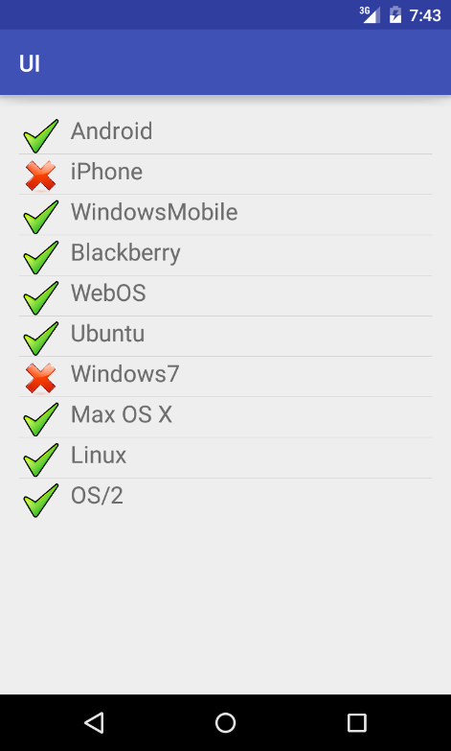
Custom Adapter
An adapter manages the data model and adapts it to the individual entries in the widget.
An adapter extends the BaseAdapter class.
Prepare By: You Tithrottanak

Slide 7
Custom Adapter Practice
Create Layout row_layout.xml in res/drawable folder
<?xml version="1.0" encoding="utf-8"?> <LinearLayout xmlns:android="http://schemas.android.com/apk/res/android" android:layout_width="wrap_content" android:layout_height="wrap_content" > <ImageView android:id="@+id/icon" android:layout_width="30dp" android:layout_height="30dp" android:layout_marginLeft="4dp" android:layout_marginRight="10dp" android:layout_marginTop="4dp" android:src="@mipmap/ic_launcher" > </ImageView>
<TextView android:id="@+id/label" android:layout_width="wrap_content" android:layout_height="wrap_content" android:textSize="20sp" > </TextView> </LinearLayout>
Prepare By: You Tithrottanak

Slide 8
Custom Adapter Practice
Create class MySimpleAdapter extend from BaseAdapter
import android.app.Activity; import android.view.LayoutInflater; import android.view.View; import android.view.ViewGroup; import android.widget.BaseAdapter; import android.widget.ImageView; import android.widget.TextView; public class MySimpleAdapter extends BaseAdapter { private final Activity context; private final String[] names; static class ViewHolder { public TextView text; public ImageView image; }
Prepare By: You Tithrottanak

Slide 9
Custom Adapter Practice
public MySimpleAdapter(Activity context, String[] names) { this.context = context; this.names = names; } @Override public int getCount() { return names.length; } @Override public Object getItem(int i) { return names[i]; } @Override public long getItemId(int i) { return 0; }
Prepare By: You Tithrottanak

Slide 10
Custom Adapter Practice
@Override public View getView(int position, View convertView, ViewGroup parent) { View rowView = convertView; // reuse views if (rowView == null) { LayoutInflater inflater = context.getLayoutInflater(); rowView = inflater.inflate(R.layout.rowlayout, null); // configure view holder ViewHolder viewHolder = new ViewHolder(); viewHolder.text = (TextView) rowView.findViewById(R.id.label); viewHolder.image = (ImageView) rowView.findViewById(R.id.icon); rowView.setTag(viewHolder); } // fill data ViewHolder holder = (ViewHolder) rowView.getTag(); String s = names[position]; holder.text.setText(s); if (s.startsWith("Windows7") || s.startsWith("iPhone") || s.startsWith("Solaris")) { holder.image.setImageResource(R.drawable.no); } else { holder.image.setImageResource(R.drawable.ok); } return rowView; } }
Prepare By: You Tithrottanak

Slide 11
Custom Adapter Practice
Create layout activity_uilist_view.xml
<?xml version="1.0" encoding="utf-8"?> <RelativeLayout xmlns:android="http://schemas.android.com/apk/res/android" xmlns:tools="http://schemas.android.com/tools" android:layout_width="match_parent" android:layout_height="match_parent" android:paddingBottom="@dimen/activity_vertical_margin" android:paddingLeft="@dimen/activity_horizontal_margin" android:paddingRight="@dimen/activity_horizontal_margin" android:paddingTop="@dimen/activity_vertical_margin" tools:context="com.rn.ui.UIListViewActivity"> <ListView android:layout_width="match_parent" android:layout_height="wrap_content" android:id="@+id/listview1"> </ListView> </RelativeLayout>
Prepare By: You Tithrottanak

Slide 12
Custom Adapter Practice
public class UIListViewActivity extends AppCompatActivity { ListView lst; @Override protected void onCreate(Bundle savedInstanceState) { super.onCreate(savedInstanceState); setContentView(R.layout.activity_uilist_view); lst = (ListView) findViewById(R.id.listview1); final String[] values = new String[] { "Android", "iPhone", "WindowsMobile", "Blackberry", "WebOS", "Ubuntu", "Windows7", "Max OS X", "Linux", "OS/2" }; MySimpleAdapter adapter = new MySimpleAdapter(this, values); lst.setAdapter(adapter); lst.setOnItemClickListener(new AdapterView.OnItemClickListener() { @Override public void onItemClick(AdapterView<?> adapterView, View view, int i, long l) { Toast.makeText(UIListViewActivity.this, values[i], Toast.LENGTH_LONG).show(); } }); } }
Prepare By: You Tithrottanak

