Slide 1
About the Presentations
The presentations cover the objectives found in the opening of each chapter.
All chapter objectives are listed in the beginning of each presentation.
You may customize the presentations to fit your class needs.
Some figures from the chapters are included. A complete set of images from the book can be found on the Instructor Resources disc.

Slide 2
Principles of Information Systems, Tenth Edition
Chapter 1
An Introduction to Information Systems

Slide 3
Principles and Learning Objectives
The value of information is directly linked to how it helps decision makers achieve the organization’s goals
  Discuss why it is important to study and understand information systems
  Distinguish data from information and describe the characteristics used to evaluate the value of data
Principles of Information Systems, Tenth Edition

Slide 4
Principles and Learning Objectives (continued)
Computers and information systems help make it possible for organizations to improve the way they conduct business
  Name the components of an information system and describe several system characteristics
Principles of Information Systems, Tenth Edition

Slide 5
Principles and Learning Objectives (continued)
Knowing the potential impact of information systems and having the ability to put this knowledge to work can result in a successful personal career and in organizations that reach their goals
  List the components of a computer-based information system
  Identify the basic types of business information systems and discuss who uses them, how they are used, and what kinds of benefits they deliver
Principles of Information Systems, Tenth Edition

Slide 6
Principles and Learning Objectives (continued)
System users, business managers, and information systems professionals must work together to build a successful information system
  Identify the major steps of the systems development process and state the goal of each
Principles of Information Systems, Tenth Edition

Slide 7
Principles and Learning Objectives (continued)
Information systems must be applied thoughtfully and carefully so that society, businesses, and industries can reap their enormous benefits
  Describe some of the threats that information systems and the Internet can pose to security and privacy
  Discuss the expanding role and benefits of information systems in business and industry
Principles of Information Systems, Tenth Edition

Slide 8
Why Learn About Information Systems?
Information systems used by:
  Sales representatives
  Managers
  Financial advisors
Information systems:
  Indispensable tools to help you achieve your career goals
Principles of Information Systems, Tenth Edition

Slide 9
Introduction
Information system (IS):
  A set of interrelated components that collect, manipulate, and disseminate data and information and provide feedback to meet an objective
Businesses:
  Can use information systems to increase revenues and reduce costs
Principles of Information Systems, Tenth Edition

Slide 10
Information Concepts
Information:
  One of an organization’s most valuable resources
  Often confused with the term data
Principles of Information Systems, Tenth Edition

Slide 11
Data, Information, and Knowledge
Data:
  Raw facts
Information:
  Collection of facts organized in such a way that they have value beyond the facts themselves
Process:
  Set of logically related tasks
Knowledge:
  Awareness and understanding of a set of information
Principles of Information Systems, Tenth Edition

Slide 12
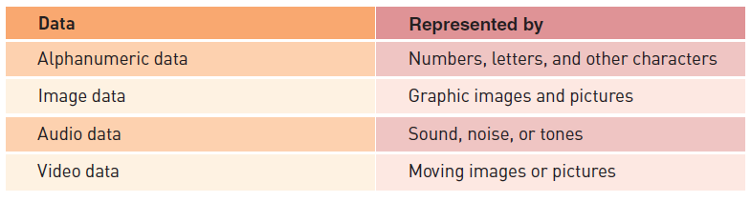

Data, Information, and Knowledge (continued)
Principles of Information Systems, Tenth Edition

Slide 13
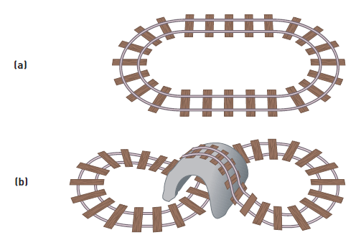
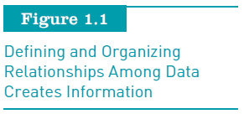
Data, Information, and Knowledge (continued)
Principles of Information Systems, Tenth Edition

Slide 14
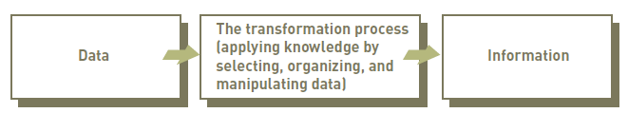
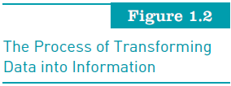
Data, Information, and Knowledge (continued)
Principles of Information Systems, Tenth Edition

Slide 15
The Characteristics of Valuable Information
If an organization’s information is not accurate or complete:
  People can make poor decisions, costing thousands, or even millions, of dollars
Depending on the type of data you need:
  Some characteristics become more important than others
Principles of Information Systems, Tenth Edition

Slide 16
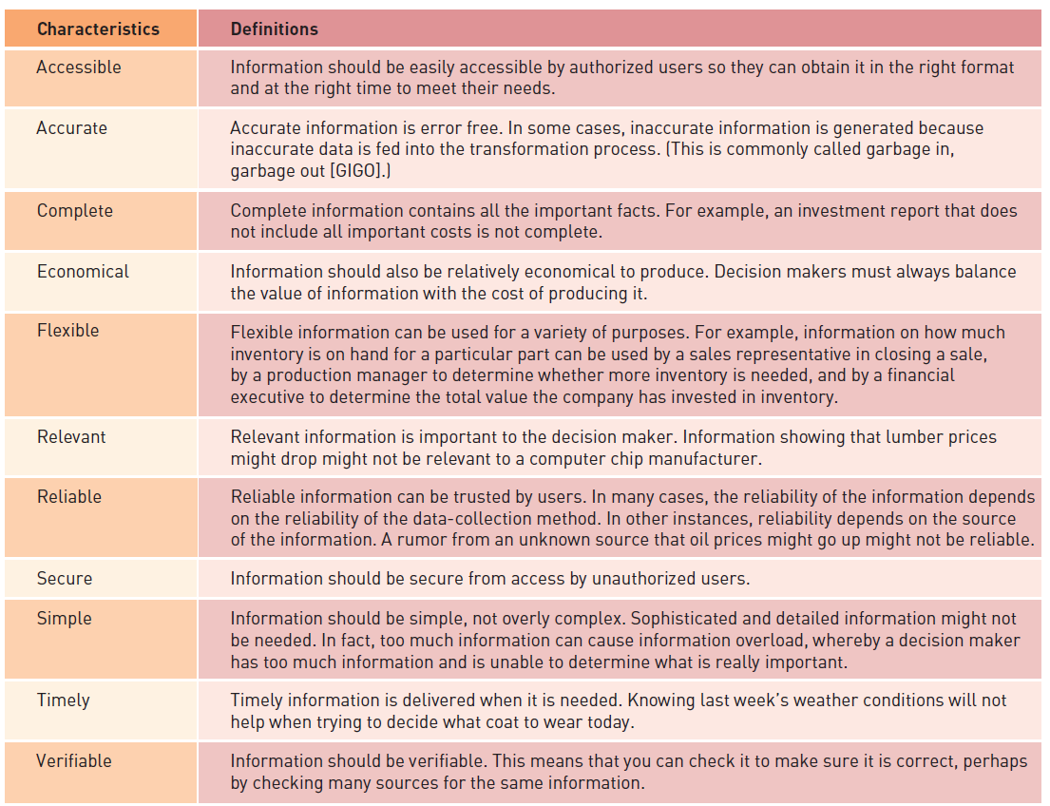
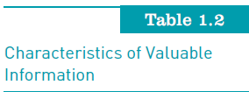
The Characteristics of Valuable Information (continued)
Principles of Information Systems, Tenth Edition

Slide 17
The Value of Information
Directly linked to how it helps decision makers achieve their organization’s goals
Valuable information:
  Can help people and their organizations perform tasks more efficiently and effectively
Principles of Information Systems, Tenth Edition

Slide 18
System Concepts
System:
  Set of elements or components that interact to accomplish goals
Components of a system:
  Inputs
  Processing mechanisms
  Outputs
  Feedback
Principles of Information Systems, Tenth Edition

Slide 19
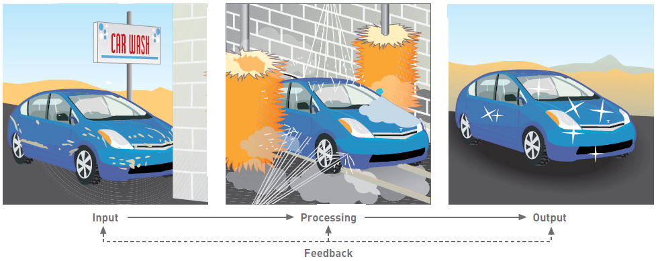
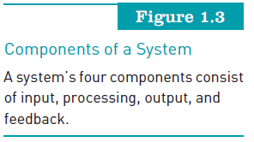
System Concepts (continued)
Principles of Information Systems, Tenth Edition

Slide 20
System Performance and Standards
Efficiency:
  Measure of what is produced divided by what is consumed
Effectiveness:
  Measure of the extent to which a system attains its goals
System performance standard:
  Specific objective of the system
Principles of Information Systems, Tenth Edition

Slide 21
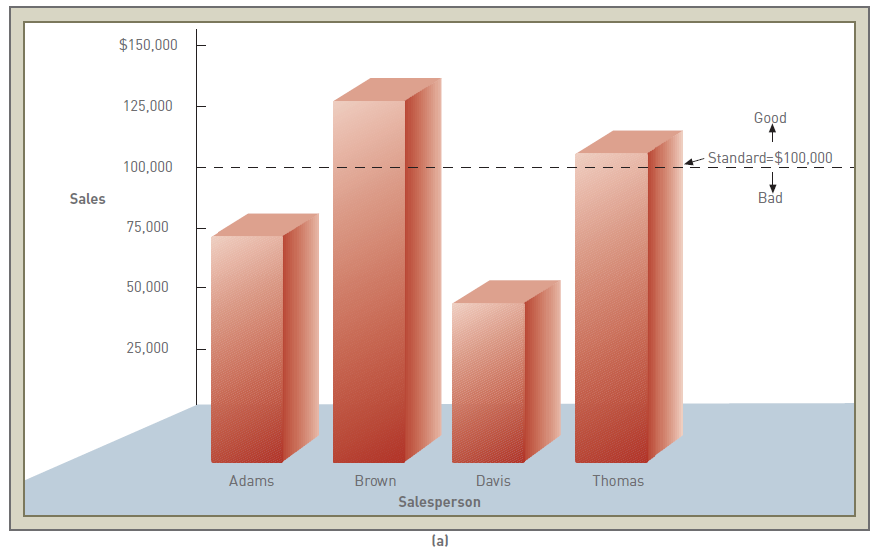
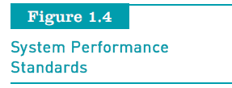
System Performance and Standards (continued)
Principles of Information Systems, Tenth Edition

Slide 22
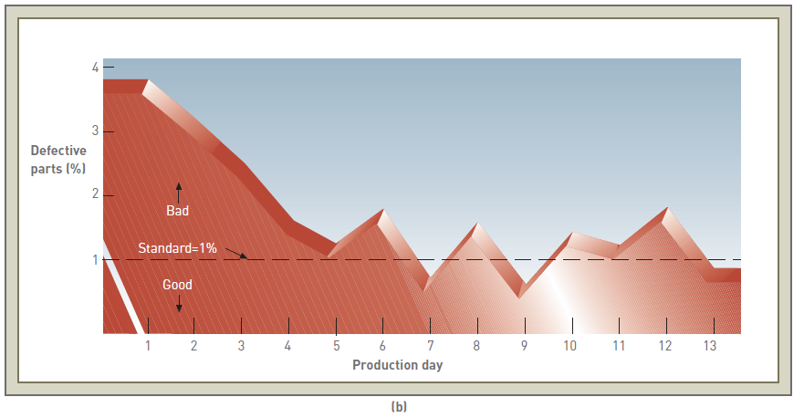
System Performance and Standards (continued)
Principles of Information Systems, Tenth Edition

Slide 23
What is an Information System?
Information system (IS) is a set of interrelated elements that:
  Collect (input)
  Manipulate (process)
  Store
  Disseminate (output) data and information
  Provide a corrective reaction (feedback mechanism) to meet an objective
Principles of Information Systems, Tenth Edition

Slide 24
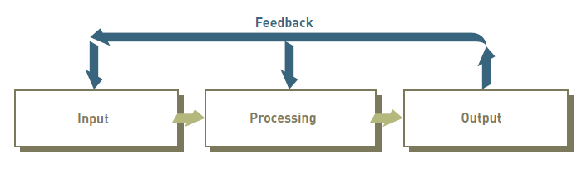
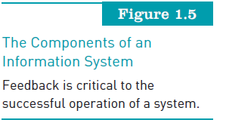
What is an Information System? (continued)
Principles of Information Systems, Tenth Edition

Slide 25
Input, Processing, Output, Feedback
Input:
  Activity of gathering and capturing raw data
Processing:
  Converting data into useful outputs
Output:
  Production of useful information, usually in the form of documents and reports
Feedback:
  Information from the system that is used to make changes to input or processing activities
Principles of Information Systems, Tenth Edition

Slide 26
Manual and Computerized Information Systems
An information system can be:
  Manual or computerized
Example:
  Investment analysts manually draw charts and trend lines to assist them in making investment decisions
Computerized information systems:
  Follow stock indexes and markets and suggest when large blocks of stocks should be purchased or sold
Principles of Information Systems, Tenth Edition

Slide 27
Computer-Based Information Systems
Single set of hardware, software, databases, telecommunications, people, and procedures:
  That are configured to collect, manipulate, store, and process data into information
Technology infrastructure:
  Includes all hardware, software, databases, telecommunications, people, and procedures
    Configured to collect, manipulate, store, and process data into information
Principles of Information Systems, Tenth Edition

Slide 28
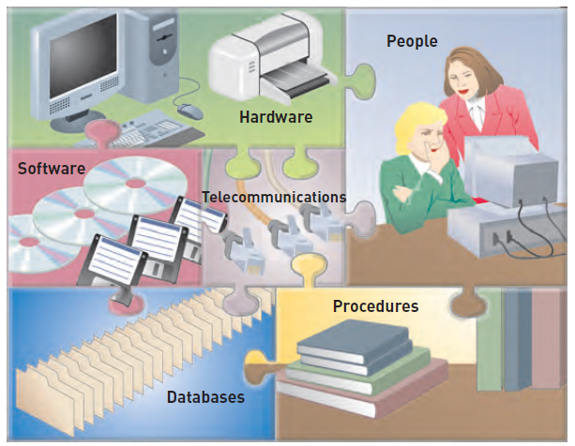
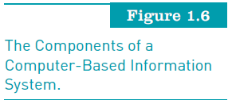
Computer-Based Information Systems (continued)
Principles of Information Systems, Tenth Edition

Slide 29
Computer-Based Information Systems (continued)
Hardware:
  Consists of computer equipment used to perform input, processing, and output activities
Software:
  Consists of the computer programs that govern the operation of the computer
Database:
  Organized collection of facts and information, typically consisting of two or more related data files
Principles of Information Systems, Tenth Edition

Slide 30
Computer-Based Information Systems (continued)
Telecommunications, networks, and the Internet
  The electronic transmission of signals for communications
Networks
  Connect computers and equipment to enable electronic communication
Internet
  World’s largest computer network, consisting of thousands of interconnected networks, all freely exchanging information
Principles of Information Systems, Tenth Edition

Slide 31
Computer-Based Information Systems (continued)
Intranet:
  Internal network that allows people within an organization to exchange information and work on projects
Extranet:
  Network that allows selected outsiders, such as business partners and customers, to access authorized resources of a company’s intranet
Principles of Information Systems, Tenth Edition

Slide 32
Computer-Based Information Systems (continued)
People:
  The most important element in most computer-based information systems
Procedures:
  Include strategies, policies, methods, and rules for using the CBIS
Principles of Information Systems, Tenth Edition

Slide 33
Business Information Systems
Most common types of information systems:
  Those designed for electronic and mobile commerce, transaction processing, management information, and decision support
Some organizations employ:
  Special-purpose systems, such as virtual reality, that not every organization uses
Principles of Information Systems, Tenth Edition

Slide 34
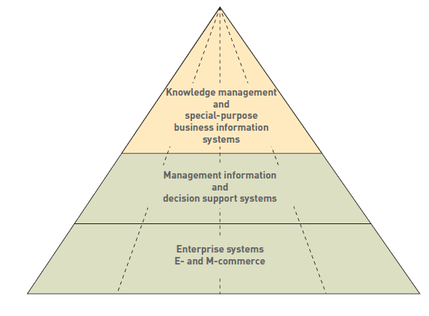
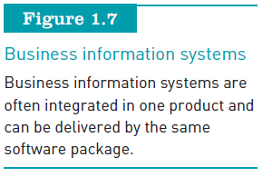
Business Information Systems (continued)
Principles of Information Systems, Tenth Edition

Slide 35
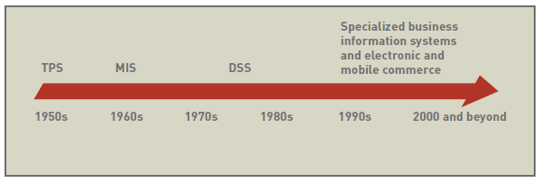
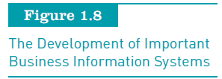
Business Information Systems (continued)
Principles of Information Systems, Tenth Edition

Slide 36
Electronic and Mobile Commerce
E-commerce:
  Any business transaction executed electronically between:
    Companies (business-to-business, B2B)
    Companies and consumers (business-to-consumer, B2C)
    Consumers and other consumers (consumer-to-consumer, C2C)
    Business and the public sector
    Consumers and the public sector
Principles of Information Systems, Tenth Edition

Slide 37
Electronic and Mobile Commerce (continued)
Mobile commerce (m-commerce):
  The use of mobile, wireless devices to place orders and conduct business
E-commerce:
  Can enhance a company’s stock prices and market value
Electronic business (e-business):
  Uses information systems and the Internet to perform all business-related tasks and functions
Principles of Information Systems, Tenth Edition

Slide 38
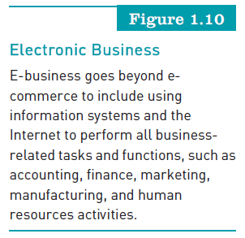
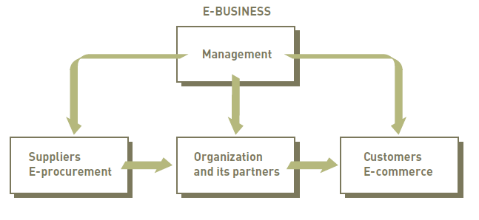
Electronic and Mobile Commerce (continued)
Principles of Information Systems, Tenth Edition

Slide 39
Enterprise Systems: Transaction Processing Systems and Enterprise Resource Planning
Transaction:
  Any business-related exchange, such as payments to employees and sales to customers
Transaction processing system (TPS):
  Organized collection of people, procedures, software, databases, and devices used to record completed business transactions
Principles of Information Systems, Tenth Edition

Slide 40
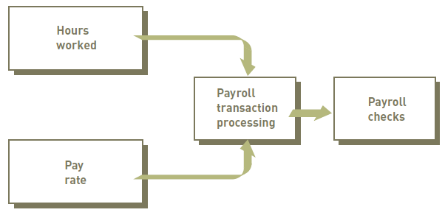
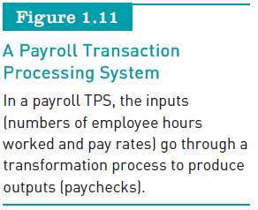
Enterprise Systems: Transaction Processing Systems and Enterprise Resource Planning (continued)
Principles of Information Systems, Tenth Edition

Slide 41
Enterprise Systems: Transaction Processing Systems and Enterprise Resource Planning (continued)
Enterprise resource planning:
  Set of integrated programs that:
    Manages the vital business operations for an entire multisite, global organization
  Most systems provide integrated software to support manufacturing and finance
Principles of Information Systems, Tenth Edition

Slide 42
Information and Decision Support Systems
Management information system (MIS):
  Organized collection of people, procedures, software, databases, and devices that:
    Provides routine information to managers and decision makers
Principles of Information Systems, Tenth Edition

Slide 43
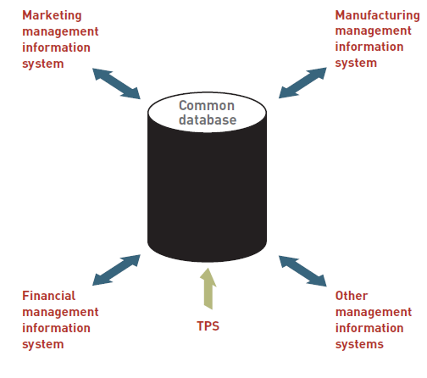
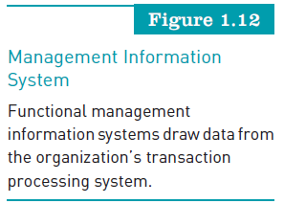
Information and Decision Support Systems (continued)
Principles of Information Systems, Tenth Edition

Slide 44
Information and Decision Support Systems (continued)
Decision support system (DSS):
  Organized collection of people, procedures, software, databases, and devices that support problem-specific decision making
  Used when problem is complex and information needed to determine appropriate action is difficult to obtain
Principles of Information Systems, Tenth Edition

Slide 45
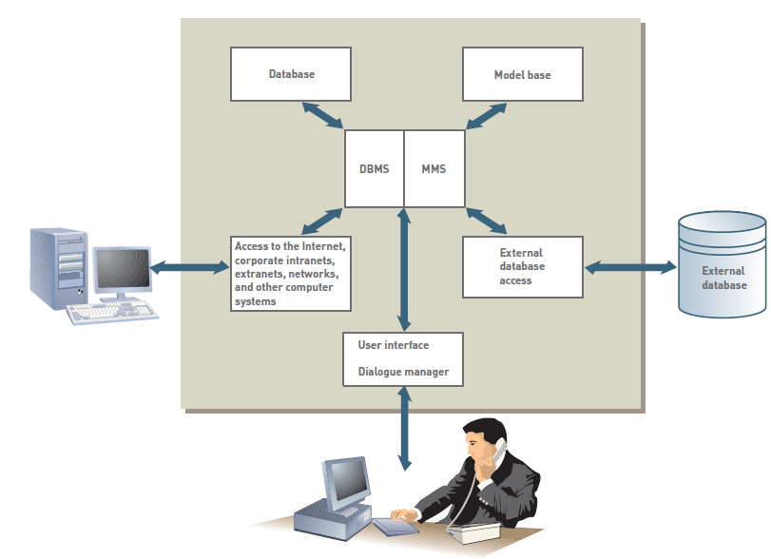

Information and Decision Support Systems (continued)
Principles of Information Systems, Tenth Edition

Slide 46
Specialized Business Information Systems: Knowledge Management, Artificial Intelligence, Expert Systems, and Virtual Reality
Knowledge management systems (KMSs):
  Organized collection of people, procedures, software, databases, and devices to:
    Create, store, share, and use the organization’s knowledge and experience
Artificial intelligence (AI):
  Computer system takes on characteristics of human intelligence
Principles of Information Systems, Tenth Edition

Slide 47
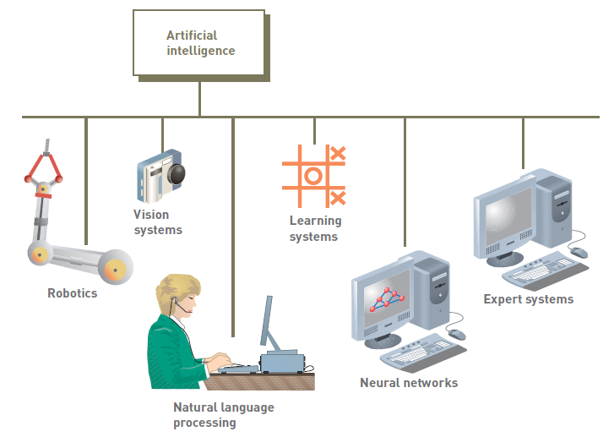
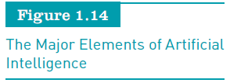
Specialized Business Information Systems (continued)
Principles of Information Systems, Tenth Edition

Slide 48
Specialized Business Information Systems (continued)
Expert systems:
  Give computer ability to make suggestions and function like an expert in a particular field
Virtual reality:
  Simulation of a real or imagined environment that can be experienced visually in three dimensions
Principles of Information Systems, Tenth Edition

Slide 49
Systems Development
Systems development:
  The activity of creating or modifying existing business systems
Outsourcing:
  Allows a company to focus on what it does best and delegate other functions to companies with expertise in systems development
Principles of Information Systems, Tenth Edition

Slide 50
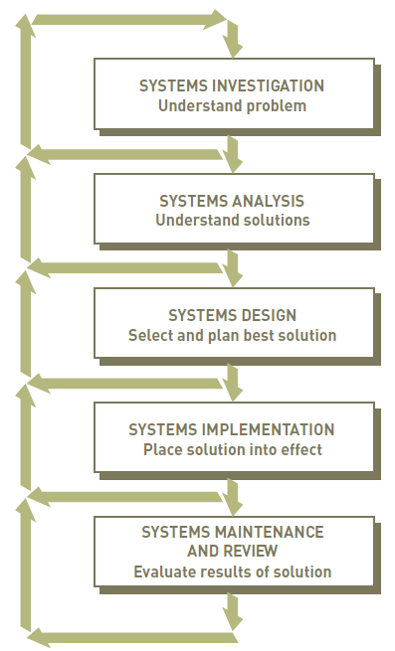
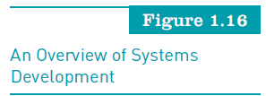
Systems Development (continued)
Principles of Information Systems, Tenth Edition

Slide 51
Systems Investigation and Analysis
Goal of systems investigation:
  To gain clear understanding of the problem to be solved or opportunity to be addressed
Systems analysis:
  Defines the problems and opportunities of the existing system
Principles of Information Systems, Tenth Edition

Slide 52
Systems Design, Implementation, and Maintenance and Review
Systems design:
  Determines how new system will work to meet business needs defined during systems analysis
Systems implementation:
  Acquiring various system components defined in design step, assembling them, and putting the new system into operation
Systems maintenance and review:
  Checks and modifies the system so that it continues to meet changing business needs
Principles of Information Systems, Tenth Edition

Slide 53
Information Systems in Society, Business, and Industry
Information systems:
  Have been developed to meet the needs of all types of organizations and people
  Speed and widespread use opens users to a variety of threats from unethical people
Principles of Information Systems, Tenth Edition

Slide 54
Security, Privacy, and Ethical Issues in Information Systems and the Internet
Drawbacks of information systems:
  Personal data, including Social Security and credit card numbers, can be lost or stolen
To protect against threats to your privacy and data:
  Install security and control measures
Use of information systems:
  Raises work concerns, including job loss through increased efficiency
Principles of Information Systems, Tenth Edition

Slide 55
Computer and Information Systems Literacy
Computer literacy:
  Knowledge of computer systems and equipment and the ways they function
Information systems literacy:
  Knowledge of how data and information are used by individuals, groups, and organizations
Principles of Information Systems, Tenth Edition

Slide 56
Information Systems in the Functional
Areas of Business
Functional areas and operating divisions of business:
  Finance and accounting
  Sales and marketing
  Manufacturing
  Human resource management
  Legal information systems
Principles of Information Systems, Tenth Edition

Slide 57
Information Systems in Industry
Industries:
  Airline industry
  Investment firms
  Banks
  Transportation industry
  Publishing companies
Principles of Information Systems, Tenth Edition

Slide 58
Information Systems in Industry (continued)
Industries (continued):
  Healthcare maintenance organizations (HMOs)
  Retail companies
  Power management and utility companies
  Professional services
  Management consulting firms
Principles of Information Systems, Tenth Edition

Slide 59
Global Challenges in Information Systems
Cultural challenges
Language challenges
Time and distance challenges
Infrastructure challenges
Currency challenges
Principles of Information Systems, Tenth Edition

Slide 60
Global Challenges in Information Systems (continued)
Product and service challenges
Technology transfer issues
State, regional, and national laws
Trade agreements
Principles of Information Systems, Tenth Edition

Slide 61
Summary
Data:
  Raw facts
System:
  Set of elements that interact to accomplish a goal
Components of an information system:
  Input, processing, output, and feedback
Components of a computer-based information system (CBIS) include:
  Hardware, software, databases, telecommunications and the Internet, people, and procedures
Principles of Information Systems, Tenth Edition

Slide 62
Summary (continued)
E-commerce involves:
  Any business transaction executed electronically between parties such as companies (business-to-business), companies and consumers (business-to-consumer), business and the public sector, and consumers and the public sector
Transaction processing system (TPS):
  Handles the large volume of business transactions that occur daily within an organization
Principles of Information Systems, Tenth Edition

Slide 63
Summary (continued)
Decision support system (DSS):
  Organized collection of people, procedures, software, databases, and devices that help make problem-specific decisions
Systems development:
  Creating or modifying existing business systems
Computer and information systems literacy:
  Prerequisites for numerous job opportunities, not only in the IS field
Principles of Information Systems, Tenth Edition

