Slide 1
Principles of Information Systems, Tenth Edition
Chapter 3
Hardware: Input, Processing, and
Output Devices

Slide 2
Principles and Learning Objectives
Computer hardware must be carefully selected to meet the evolving needs of the organization and of its supporting information systems
  Describe the role of the central processing unit and main memory
  State the advantages of multiprocessing and parallel computing systems, and provide examples of the types of problems they address
Principles of Information Systems, Tenth Edition

Slide 3
Principles and Learning Objectives (continued)
  Describe the access methods, capacity, and portability of various secondary storage devices
  Identify and discuss the speed, functionality, and importance of various input and output devices
  Identify the characteristics of and discuss the usage of various classes of single-user and multiuser computer systems
Principles of Information Systems, Tenth Edition

Slide 4
Principles and Learning Objectives (continued)
The computer hardware industry is rapidly changing and highly competitive, creating an environment ripe for technological breakthroughs
  Describe Moore’s Law and discuss its implications for future computer hardware developments
  Give an example of recent innovations in computer CPU chips, memory devices, and input/output devices
Principles of Information Systems, Tenth Edition

Slide 5
Principles and Learning Objectives (continued)
The computer hardware industry and users are implementing green computing designs and products
  Define the term green computing and identify the primary goals of this program
  Identify several benefits of green computing initiatives that have been broadly adopted
Principles of Information Systems, Tenth Edition

Slide 6
Why Learn About Hardware?
Organizations invest in computer hardware to:
  Improve worker productivity
  Increase revenue, reduce costs
  Provide better customer service
  Speed up time-to-market
  Enable collaboration among employees
Managers:
  Are expected to help define the business needs that the hardware must support
Principles of Information Systems, Tenth Edition

Slide 7
Computer Systems: Integrating the Power of Technology
Hardware components:
  Central processing unit (CPU):
    Arithmetic/logic unit, the control unit, and the register areas
  Arithmetic/logic unit (ALU):
    Performs mathematical calculations and makes logical comparisons
  Control unit :
    Sequentially accesses program instructions, decodes them, and coordinates the flow of data in and out of the ALU, registers, primary storage, and even secondary storage and various output devices
Principles of Information Systems, Tenth Edition

Slide 8
Computer Systems: Integrating the Power of Technology (continued)
  Registers:
    High-speed storage areas
    Used to temporarily hold small units of program instructions and data
  Primary storage:
    Also called main memory
    Closely associated with the CPU
Principles of Information Systems, Tenth Edition

Slide 9
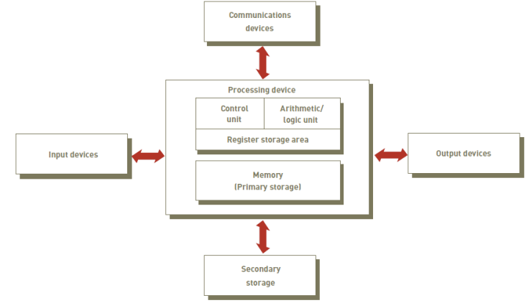
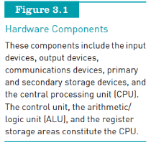
Computer Systems: Integrating the Power of Technology (continued)
Principles of Information Systems, Tenth Edition

Slide 10
Hardware Components in Action
Step 1: Fetch instruction
Step 2: Decode instruction
Step 3: Execute instruction
Step 4: Store results
Principles of Information Systems, Tenth Edition

Slide 11
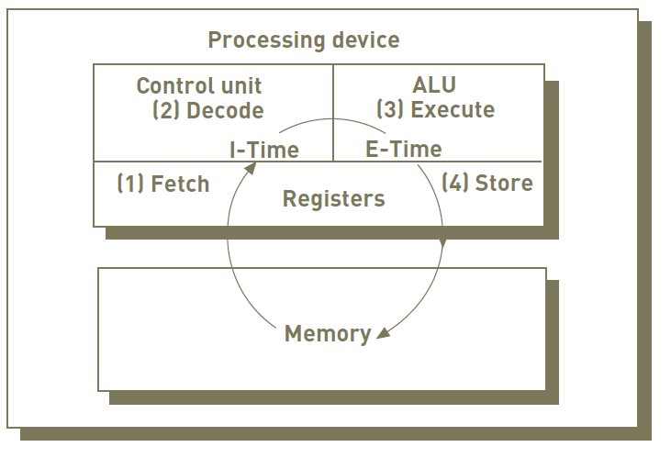
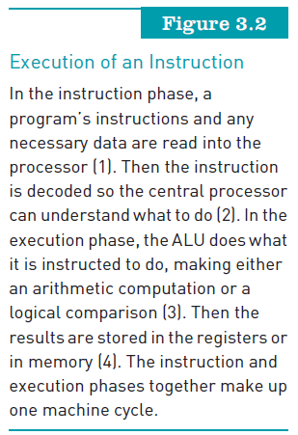
Hardware Components in Action (continued)
Principles of Information Systems, Tenth Edition

Slide 12
Processing and Memory Devices: Power, Speed, and Capacity
System unit:
  Houses the components responsible for processing (the CPU and memory)
All other computer system devices are:
  Linked either directly or indirectly into the system unit housing
Principles of Information Systems, Tenth Edition

Slide 13
Processing Characteristics and Functions
Machine cycle time is measured in:
  Nanoseconds (1 billionth of a second)
  Picoseconds (1 trillionth of a second)
  MIPS (millions of instructions per second)
Principles of Information Systems, Tenth Edition

Slide 14
Processing Characteristics and Functions (continued)
Clock speed:
  Series of electronic pulses produced at a predetermined rate that affects machine cycle time
  Often measured in:
    Megahertz (MHz): millions of cycles per second
    Gigahertz (GHz): billions of cycles per second
Microcode:
  Predefined, elementary circuits and logical operations that the processor performs when it executes an instruction
Principles of Information Systems, Tenth Edition

Slide 15
Processing Characteristics and Functions (continued)
Physical characteristics of the CPU:
  Most CPUs are:
    Collections of digital circuits imprinted on silicon wafers, or chips, each no bigger than the tip of a pencil eraser
  Moore’s Law:
    Hypothesis stating that transistor densities on a single chip will double every two years
Principles of Information Systems, Tenth Edition

Slide 16
Memory Characteristics and Functions
Main memory
  Provides the CPU with a working storage area for programs and data
  Rapidly provides data and instructions to the CPU
Storage capacity
  Eight bits together form a byte (B)
  Bit= Binary digit (b)
  Binary= base 2 (0 or 1) on or off
  What is a nibble?
Principles of Information Systems, Tenth Edition

Slide 17
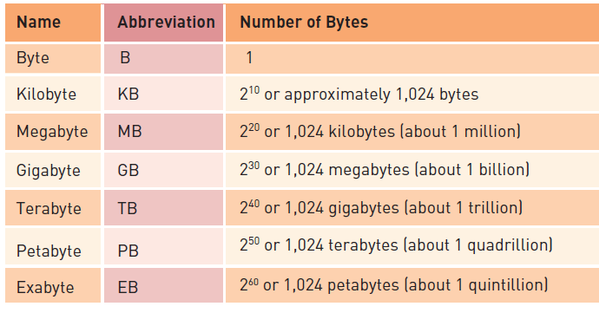

Memory Characteristics and Functions (continued)
Principles of Information Systems, Tenth Edition

Slide 18
Memory Characteristics and Functions (continued)
Types of memory:
  Random access memory (RAM):
    Temporary and volatile
  Types of RAM:
    DRAM (Dynamic RAM)
    DDR2 SDRAM and DDR3 SDRAM
    Static Random Access Memory (SRAM)
    Double Data Rate Synchronous Dynamic Random Access Memory (DDR SDRAM)
Principles of Information Systems, Tenth Edition

Slide 19
Memory Characteristics and Functions (continued)
Types of memory (continued):
  Read-only memory (ROM):
    Nonvolatile
    Provides permanent storage for data and instructions that do not change
  Cache memory:
    High-speed memory that a processor can access more rapidly than main memory
Principles of Information Systems, Tenth Edition

Slide 20
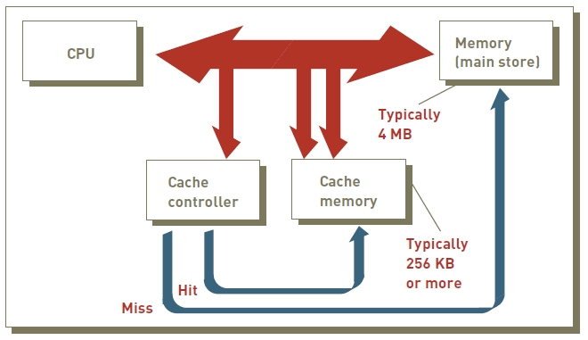
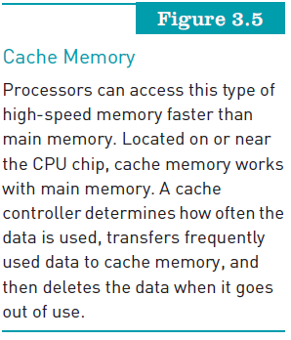
Memory Characteristics and Functions (continued)
Principles of Information Systems, Tenth Edition

Slide 21
Multiprocessing
Multiprocessing:
  Simultaneous execution of two or more instructions at the same time
Coprocessor:
  Speeds processing
Multicore microprocessor:
  Combines two or more independent processors into a single computer
Principles of Information Systems, Tenth Edition

Slide 22
Multiprocessing (continued)
Graphics processing unit (GPU):
  A specialized processor that offloads the tasks associated with 3D graphics rendering from the CPU
  Can also be used in certain applications that require massive vector operations to provide performance several orders of magnitude higher than a traditional CPU
Principles of Information Systems, Tenth Edition

Slide 23
Parallel Computing
Parallel computing:
  Simultaneous execution of the same task on multiple processors to obtain results faster
Massively parallel processing:
  Links hundreds or thousands of processors to operate at the same time
Grid computing:
  Use of a collection of computers to work in a coordinated manner to solve a common problem
Principles of Information Systems, Tenth Edition

Slide 24
Secondary Storage
Compared with memory, offers the advantages of nonvolatility, greater capacity, and greater economy
On a cost-per-gigabyte basis:
  Secondary storage is considerably less expensive than primary memory
Determined by the information system’s objectives:
  The access methods, storage capacities, and portability required of secondary storage media
Principles of Information Systems, Tenth Edition

Slide 25
Access Methods
Sequential access:
  Data must be retrieved in the order in which it is stored
  Devices used called sequential access storage devices (SASDs)
Direct access:
  Records can be retrieved in any order
  Devices used are called direct access storage devices (DASDs)
Have you ever had to rewind a DVD?
Principles of Information Systems, Tenth Edition

Slide 26
Secondary Storage Devices
Magnetic tapes:
  Primarily for storing backups of critical organizational data
Magnetic disks:
  Direct-access storage device
Redundant array of independent/inexpensive disks (RAID):
  Method of storing data that generates extra bits of data from existing data
Virtual tape:
  Storage technology for less frequently needed data
Principles of Information Systems, Tenth Edition

Slide 27
Secondary Storage Devices (continued)
Optical secondary storage devices:
  Use special lasers to read and write data
  Compact disc read-only memory (CD-ROM):
    Storage capacity is 740 MB
  Digital video disc (DVD):
    Looks like a CD but can store about 135 minutes of digital video
    Data transfer rate is 1.352 MB per second
Principles of Information Systems, Tenth Edition

Slide 28
Secondary Storage Devices (continued)
Solid state secondary storage devices:
  Store data in memory chips rather than magnetic or optical media
  Have few moving parts, so they are less fragile than hard disk drives
  Disadvantages of SSD
    High cost per GB of data storage
    Lower capacity compared to current hard drives
Principles of Information Systems, Tenth Edition

Slide 29
Enterprise Storage Options
Attached storage:
  Methods include the tape, hard disks, and optical devices
Network-attached storage (NAS):
  Hard disk storage that is set up with its own network address rather than being attached to a computer
Storage area network (SAN):
  Special-purpose, high-speed network that provides direct connections among data-storage devices and computers
Principles of Information Systems, Tenth Edition

Slide 30
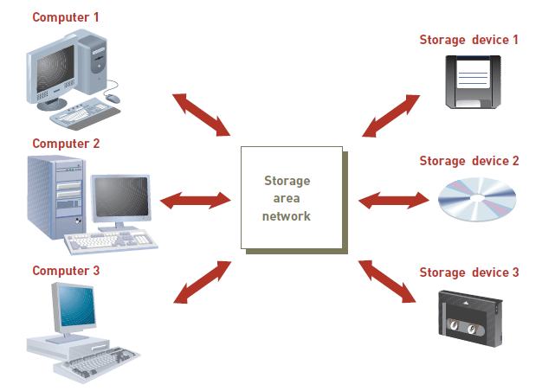
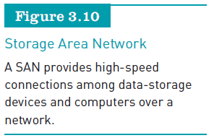
Enterprise Storage Options (continued)
Principles of Information Systems, Tenth Edition

Slide 31
Enterprise Storage Options (continued)
Storage as a service:
  A data storage model where a data storage service provider rents space to people and organizations
  Providers:
    AT&T, Aviva, Amazon.com
    EMC, Google, Microsoft, and ParaScale
Principles of Information Systems, Tenth Edition

Slide 32
Input and Output Devices: The Gateway to Computer Systems
Input and output devices:
  Gateways to the computer system
  Part of a computer’s user interface
Organizations:
  Should keep their business goals in mind when selecting input and output devices
Principles of Information Systems, Tenth Edition

Slide 33
Characteristics and Functionality
Data can be human-readable or machine-readable
Data entry:
  Converts human-readable data into machine-readable form
Data input:
  Transfers machine-readable data into system
Source data automation
  Capturing and editing data where the data is initially created and in a form that can be directly input to a computer
Principles of Information Systems, Tenth Edition

Slide 34
Input Devices
Devices used to input general types of data:
  Personal computer input devices
  Speech recognition technology
  Digital cameras
  Terminals
  Scanning devices
  Optical data readers
  Magnetic ink character recognition (MICR) devices
  Magnetic stripe card
Principles of Information Systems, Tenth Edition

Slide 35
Input Devices (continued)
Devices used to input general types of data (continued):
  Chip-and-PIN cards
  Point-of-sale devices
  Contactless cards
  Automated teller machine (ATM) devices
  Pen input devices
  Touch-sensitive screens
  Bar-code scanners
  Radio frequency identification
Principles of Information Systems, Tenth Edition

Slide 36
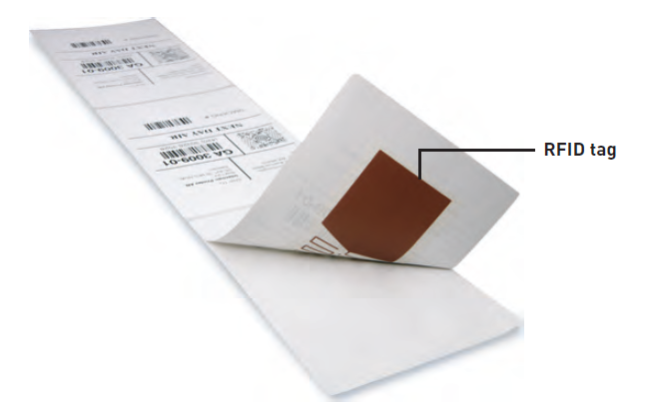
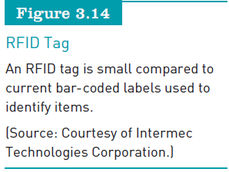
Input Devices (continued)
Principles of Information Systems, Tenth Edition

Slide 37
Output Devices
Display monitors:
  Used to display the output from the computer
Plasma display:
  Uses thousands of smart cells (pixels) consisting of electrodes and neon and xenon gases that are electrically turned into plasma to emit light
LCD displays:
  Flat displays that use liquid crystals
Digital audio player:
  Can store, organize, and play digital music files
Principles of Information Systems, Tenth Edition

Slide 38
Output Devices (continued)
Organic light-emitting diodes (OLEDs):
  Uses a layer of organic material sandwiched between two conductors
Printers and plotters:
  Two main types of printers are laser printers and inkjet printers
  Plotters are a type of hard-copy output device used for general design work
E-books:
  Digital media equivalent of a conventional printed book
Principles of Information Systems, Tenth Edition

Slide 39
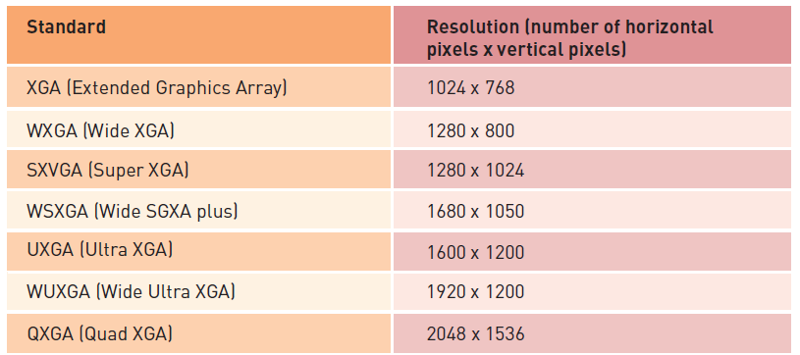
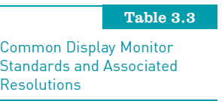
Output Devices (continued)
Principles of Information Systems, Tenth Edition

Slide 40
Computer System Types
Special-purpose computers:
  Used for limited applications by military and scientific research groups such as the CIA and NASA
General-purpose computers:
  Used for a wide variety of applications
Principles of Information Systems, Tenth Edition

Slide 41
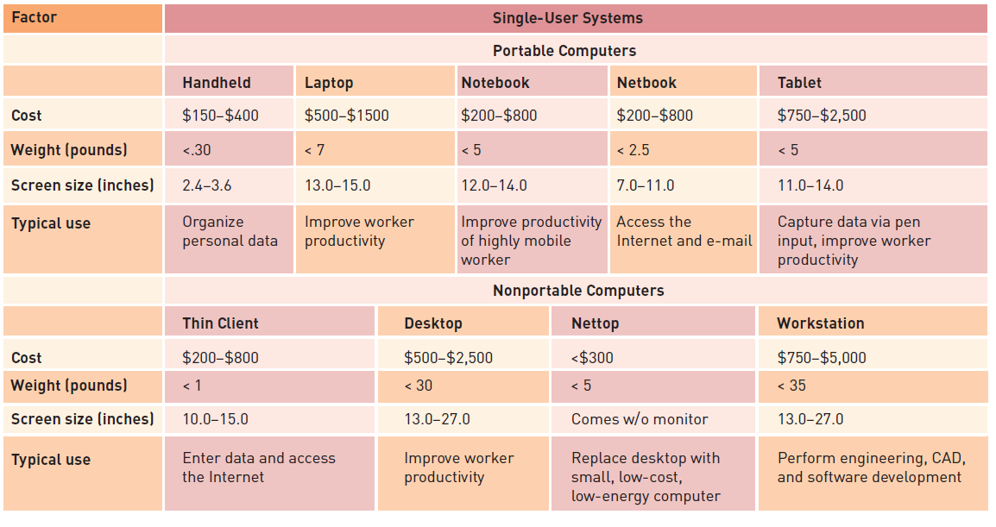
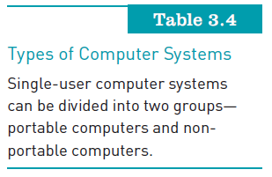
Computer System Types (continued)
Principles of Information Systems, Tenth Edition

Slide 42
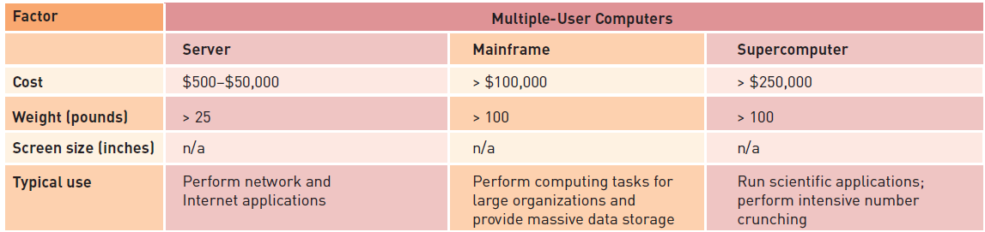
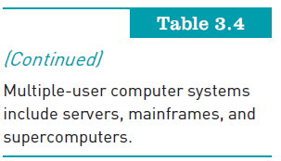
Computer System Types (continued)
Principles of Information Systems, Tenth Edition

Slide 43
Portable Computers
Handheld computers:
  Single-user computers that provide ease of portability because of their small size
Laptop computer:
  Personal computer designed for use by mobile users
Notebook computer:
  Lightweight computer that weighs less than 5 pounds
Principles of Information Systems, Tenth Edition

Slide 44
Portable Computers (continued)
Netbook computer:
  The smallest, lightest, least expensive member of the laptop computer family
Tablet computers:
  Portable, lightweight computers with no keyboard
Wearable Computer
  Sixth Sense
Principles of Information Systems, Tenth Edition

Slide 45
Nonportable Single-User Computers
Thin client:
  Low-cost, centrally managed computer with no extra drives
Desktop computers:
  Single-user computer systems that are highly versatile
Principles of Information Systems, Tenth Edition

Slide 46
Nonportable Single-User Computers (continued)
Nettop computer:
  Inexpensive desktop computer designed to be smaller, lighter, and consume much less power than a traditional desktop computer
Workstations:
  More powerful than personal computers but still small enough to fit on a desktop
Principles of Information Systems, Tenth Edition

Slide 47
Multiple-User Computer Systems
Server:
  Used by many users to perform a specific task, such as running network or Internet applications
Scalability:
  The ability to increase the processing capability of a computer system so that it can handle more users, more data, or more transactions
Blade server:
  Houses many computer motherboards
Principles of Information Systems, Tenth Edition

Slide 48
Multiple-User Computer Systems (continued)
Mainframe computer:
  Large, powerful computer shared by dozens or even hundreds of concurrent users connected to the machine over a network
Supercomputers:
  The most powerful computers with the fastest processing speed and highest performance
Principles of Information Systems, Tenth Edition

Slide 49
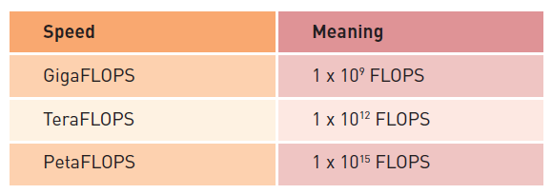
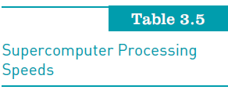
Multiple-User Computer Systems (continued)
Principles of Information Systems, Tenth Edition

Slide 50
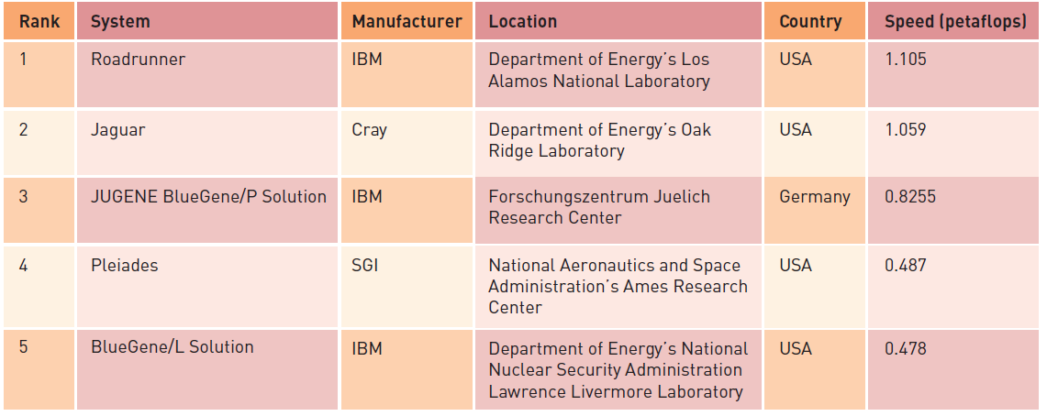
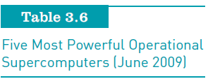
Multiple-User Computer Systems see Top500
Principles of Information Systems, Tenth Edition

Slide 51
Green Computing
Concerned with the:
  Efficient and environmentally responsible design, manufacture, operation, and disposal of IS-related products
Goals:
  Reduce the use of hazardous material
  Enable companies to lower their power-related costs
  Enable the safe disposal or recycling of some 700,000 tons of computers each year
Principles of Information Systems, Tenth Edition

Slide 52
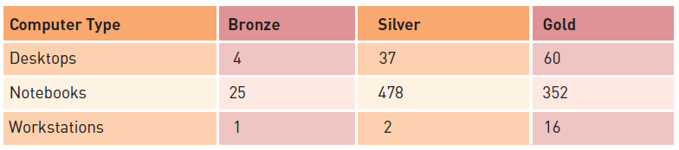
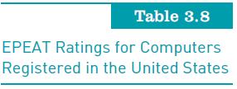
Green Computing (continued)
Principles of Information Systems, Tenth Edition

Slide 53
Summary
Computer hardware:
  Should be selected to meet specific user and business requirements
Random access memory (RAM):
  Temporary and volatile
ROM (read-only memory):
  Nonvolatile
  Contains permanent program instructions for execution by the CPU
Principles of Information Systems, Tenth Edition

Slide 54
Summary (continued)
Multicore microprocessor:
  Combines two or more independent processors into a single computer so they can share the workload
Computer systems:
  Can store larger amounts of data and instructions in secondary storage
Overall trend in secondary storage is toward:
  Direct access methods
  Higher capacity, increased portability
  Automated storage management
Principles of Information Systems, Tenth Edition

Slide 55
Summary (continued)
Computer systems categories:
  Single user and multiple users
CPU processing speed:
  Limited by physical constraints such as the distance between circuitry points and circuitry materials
Green computing:
  Concerned with the efficient and environmentally responsible design, manufacture, operation, and disposal of IT related products
Principles of Information Systems, Tenth Edition

