Slide 1
Principles of Information Systems, Tenth Edition
Chapter 9
Enterprise Systems

Slide 2
Principles and Learning Objectives
An organization must have information systems that support routine, day-to-day activities and that help a company add value to its products and services
  Identify the basic activities and business objectives common to all transaction processing systems
  Describe the transaction processing systems associated with the order processing, purchasing, and accounting business functions
Principles of Information Systems, Tenth Edition

Slide 3
Principles and Learning Objectives (continued)
A company that implements an enterprise resource planning system is creating a highly integrated set of systems, which can lead to many business benefits
  Discuss the advantages and disadvantages associated with the implementation of an enterprise resource planning system
  Identify the challenges that multinational corporations face in planning, building, and operating their enterprise systems
Principles of Information Systems, Tenth Edition

Slide 4
Why Learn About Enterprise Systems?
In our service-oriented economy:
  Outstanding customer service has become a goal of virtually all companies
Effective use of enterprise systems:
  Will be essential to raise the productivity of your firm, improve customer service, and enable better decision making
Principles of Information Systems, Tenth Edition

Slide 5
An Overview of Transaction Processing Systems
Transaction processing systems (TPSs):
  Capture and process detailed data necessary to update records about fundamental business operations
  Include order entry, inventory control, payroll, accounts payable, accounts receivable, general ledger, etc.
  Provide valuable input to:
    Management information systems, decision support systems, and knowledge management systems
Principles of Information Systems, Tenth Edition

Slide 6
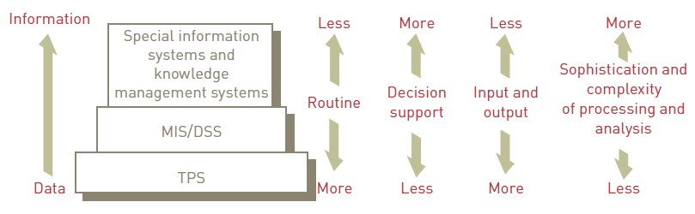
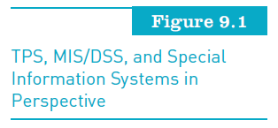
An Overview of Transaction Processing Systems (continued)
Principles of Information Systems, Tenth Edition

Slide 7
Traditional Transaction Processing
Methods and Objectives
Batch processing system:
  Data processing in which business transactions are:
    Accumulated over a period of time
    Prepared for processing as a single unit or batch
Online transaction processing (OLTP):
  Data processing in which each transaction is processed immediately
Principles of Information Systems, Tenth Edition

Slide 8
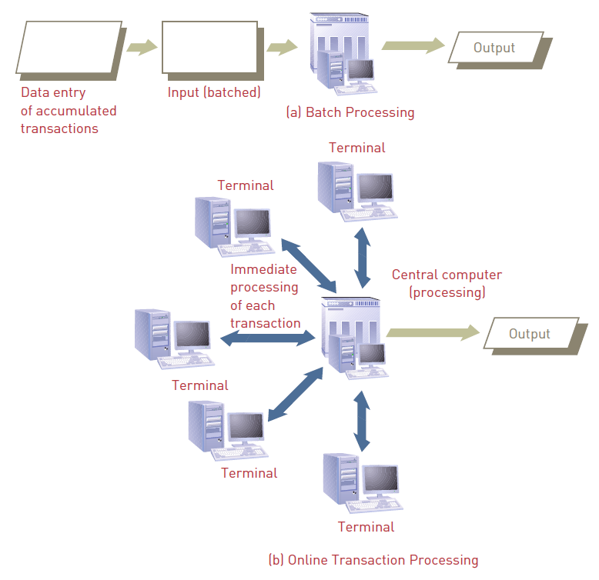
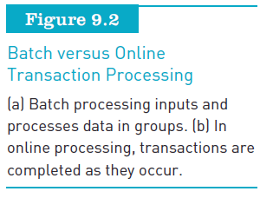
Principles of Information Systems, Tenth Edition

Slide 9
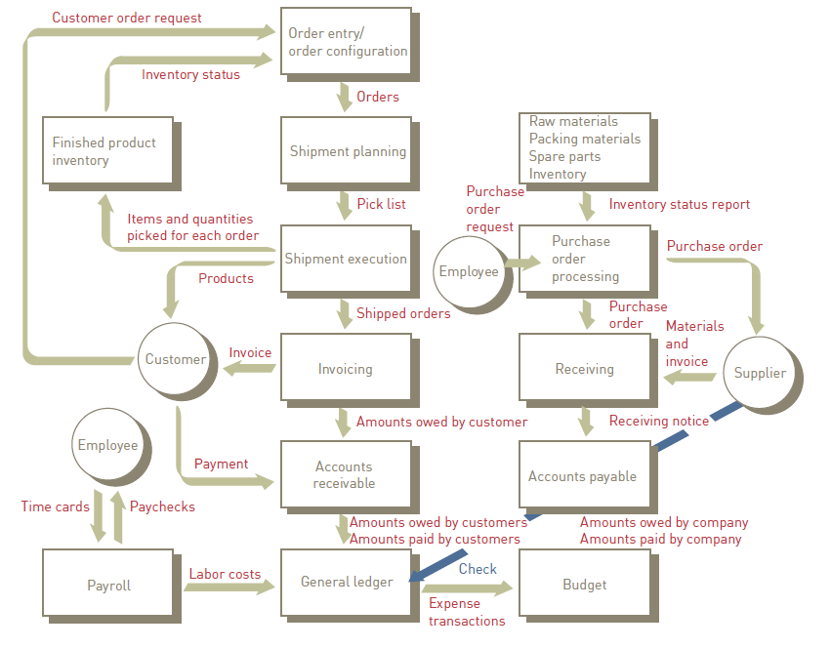

Principles of Information Systems, Tenth Edition

Slide 10
Traditional Transaction Processing Methods and Objectives (continued)
Organizations expect their TPSs to:
  Capture, process, and update databases of business data
  Ensure that the data is processed accurately and completely
  Avoid processing fraudulent transactions
  Produce timely user responses and reports
  Reduce clerical and other labor requirements
  Help improve customer service
  Achieve competitive advantage
Principles of Information Systems, Tenth Edition

Slide 11
Traditional Transaction Processing Methods and Objectives (continued)
A TPS typically includes the following types of systems:
  Order processing systems
  Accounting systems
  Purchasing systems
Principles of Information Systems, Tenth Edition

Slide 12
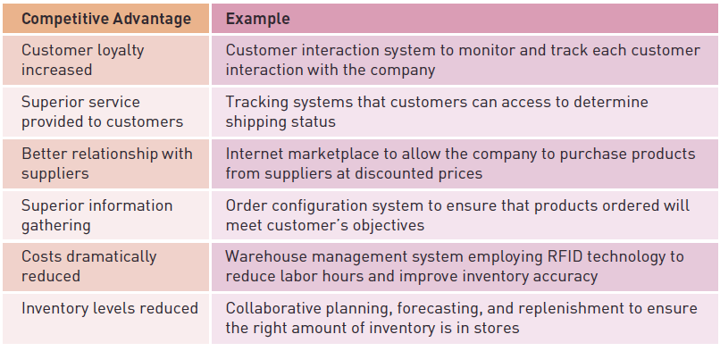
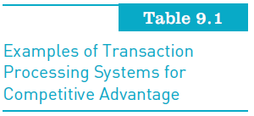
Traditional Transaction Processing Methods and Objectives (continued)
Principles of Information Systems, Tenth Edition

Slide 13
Transaction Processing Systems for Small and Medium-Size Enterprises (SMEs)
Many software packages:
  Provide integrated transaction processing system solutions for small and medium-size enterprises (SMEs)
Camp Logan Cement:
  Was able to get up and running in a month with Intuit Enterprise Solutions

Slide 14
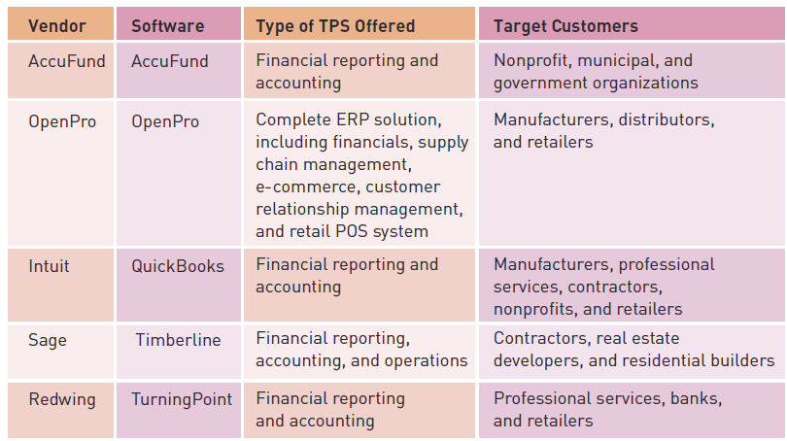
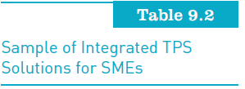
Transaction Processing Systems for SMEs (continued)
Principles of Information Systems, Tenth Edition

Slide 15
Transaction Processing Activities
TPSs:
  Capture and process data that describes fundamental business transactions
  Update databases
  Produce a variety of reports
Transaction processing cycle:
  The process of data collection, data editing, data correction, data manipulation, data storage, and document production
Principles of Information Systems, Tenth Edition

Slide 16
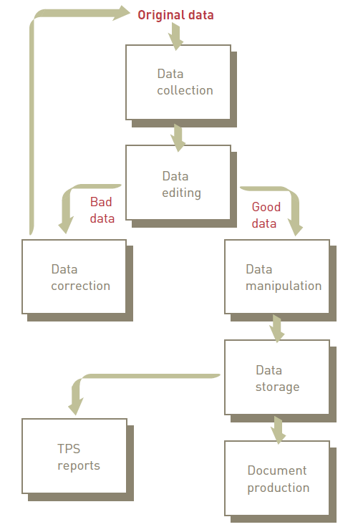
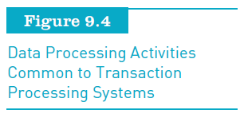
Transaction Processing Activities (continued)
Principles of Information Systems, Tenth Edition

Slide 17
Data Collection
Capturing and gathering all data necessary to complete the processing of transactions
Data collection can be:
  Manual
  Automated via special input devices
Data should be:
  Collected at source
  Recorded accurately, in a timely fashion
Principles of Information Systems, Tenth Edition

Slide 18
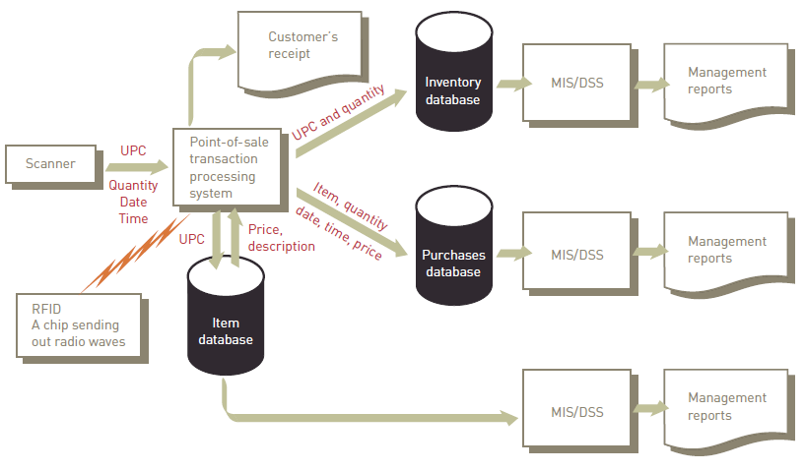
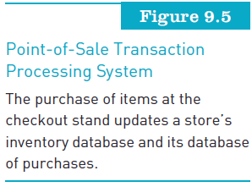
Data Collection (continued)
Principles of Information Systems, Tenth Edition

Slide 19
Data Editing
Checking data for validity and completeness to detect any problems
Examples:
  Quantity and cost data must be numeric
  Names must be alphabetic
Principles of Information Systems, Tenth Edition

Slide 20
Data Correction
Reentering data that was not typed or scanned properly
Error messages must specify the problem so proper corrections can be made
Principles of Information Systems, Tenth Edition

Slide 21
Data Manipulation
Performing calculations and other data transformations related to business transactions
Can include:
  Classifying data
  Sorting data into categories
  Performing calculations
  Summarizing results
  Storing data in the organization’s database for further processing
Principles of Information Systems, Tenth Edition

Slide 22
Data Storage
Updating one or more databases with new transactions
After being updated, this data can be further processed and manipulated by other systems
Principles of Information Systems, Tenth Edition

Slide 23
Document Production and Reports
Generating output records, documents, and reports:
  Hard-copy paper reports
  Displays on computer screens
Results from one TPS can be inputs to another system
Principles of Information Systems, Tenth Edition

Slide 24
Enterprise Resource Planning and Customer Relationship Management
Enterprise resource planning (ERP):
  Set of integrated programs that manage a company’s vital business operations for an entire organization
Business process:
  Set of coordinated and related activities that takes one or more kinds of input and creates an output of value to the customer of that process
Principles of Information Systems, Tenth Edition

Slide 25
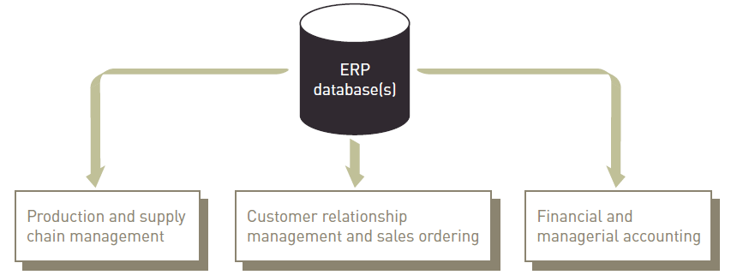
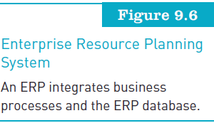
Enterprise Resource Planning and Customer Relationship Management (continued)
Principles of Information Systems, Tenth Edition

Slide 26
An Overview of Enterprise Resource Planning
ERP systems:
  Evolved from materials requirement planning systems (MRP) developed in the 1970s
Large organizations:
  The first to take on the challenge of implementing ERP
Principles of Information Systems, Tenth Edition

Slide 27
Advantages of ERP
Improved access to data for operational decision making
Elimination of costly, inflexible legacy systems
Improvement of work processes
Upgrade of technology infrastructure
Principles of Information Systems, Tenth Edition

Slide 28
Disadvantages of ERP Systems
Expense and time in implementation
Difficulty implementing change
Difficulty integrating with other systems
Difficulty in loading data into new ERP system
Risks in using one vendor
Risk of implementation failure
Principles of Information Systems, Tenth Edition

Slide 29
Leading ERP Systems
No one ERP software solution from a single vendor is “best” for all organizations
SAP:
  Largest and most-recognized ERP solution provider among Fortune 1000 and Global 5000 organizations
Microsoft and SAP:
  Partnered in the development of Duet
Principles of Information Systems, Tenth Edition

Slide 30
ERP for Small and Medium-Size Enterprises (SMEs)
Many SMEs elect to implement open-source ERP systems
Reasons for customization:
  Customization is needed for your other business systems to work with the ERP package
  You need additional data fields and/or different field sizes than what comes with the standard system
  Customization is needed to meet regulatory requirements

Slide 31
Supply Chain Management (SCM)
A system that includes:
  Planning, executing, and controlling all activities involved in raw material sourcing and procurement
  Converting raw materials to finished products, and warehousing and delivering finished product to customers
Principles of Information Systems, Tenth Edition

Slide 32
Supply Chain Management (SCM) (continued)
Process for developing a production plan:
  Sales forecasting
  Sales and operations plan (S&OP)
  Demand management
  Detailed scheduling
  Materials requirement planning (MRP)
  Purchasing
  Production
  Sales ordering
Principles of Information Systems, Tenth Edition

Slide 33
Financial and Managerial Accounting and ERP
ERP systems:
  Do not work directly with production machines, so they need a way to capture information about what was produced
Retailers as well as manufacturers:
  Use demand forecasting to match production to consumer demand and to allocate products to stores
Principles of Information Systems, Tenth Edition

Slide 34
Financial and Managerial Accounting and ERP (continued)
General ledger:
  Main accounting record of a business
ERP system:
  Captures transactions entered by workers in all functional areas of the business
  Creates associated general ledger record to track the financial impact of the transaction
Principles of Information Systems, Tenth Edition

Slide 35
Financial and Managerial Accounting and ERP (continued)
Financial accounting:
  Captures and records all transactions that affect a company’s financial state
  Uses these documented transactions to prepare financial statements to external decision makers
Managerial accounting:
  Provides data to enable the firm’s managers to make decisions about current and future operations
Principles of Information Systems, Tenth Edition

Slide 36
Business Intelligence and ERP
Business intelligence (BI):
  Gathering enough of the right information to shine a spotlight on the organization’s performance
  Essential component of an organization’s ERP system
BI tools are used to:
  Access all the operational data captured in the ERP database, analyze performance on a daily basis
  Highlight areas for improvement, and monitor the results of business strategies
Principles of Information Systems, Tenth Edition

Slide 37
Customer Relationship Management
Goal is to understand and anticipate the needs of current and potential customers
Used primarily by people in:
  The sales, marketing, and service organizations to capture and view data about customers and to improve communications
CRM software:
  Automates and integrates the functions of sales, marketing, and service in an organization
Principles of Information Systems, Tenth Edition

Slide 38
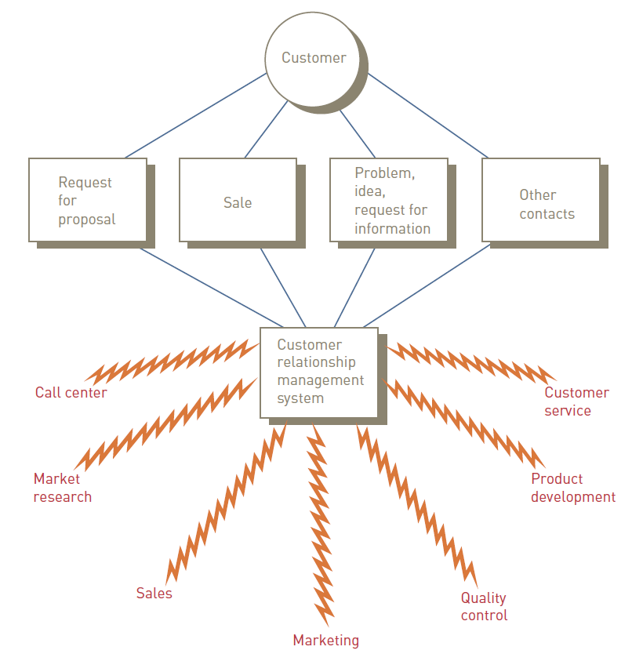
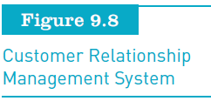
Customer Relationship Management (continued)
Principles of Information Systems, Tenth Edition

Slide 39
Customer Relationship Management (continued)
Key features of a CRM system:
  Contact management
  Sales management
  Customer support
  Marketing automation
  Analysis
  Social networking
  Access by smartphones
  Import contact data
Principles of Information Systems, Tenth Edition

Slide 40
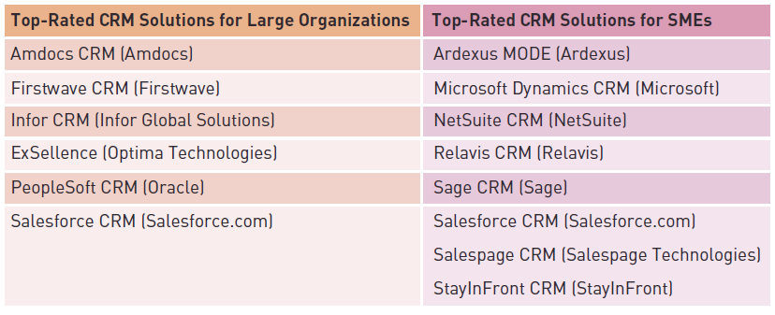
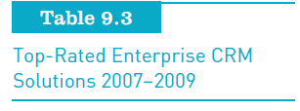
Customer Relationship Management (continued)
Principles of Information Systems, Tenth Edition

Slide 41
Hosted Software Model for Enterprise Software
Many business application software vendors:
  Are pushing the use of the hosted software model for SMEs
Using the hosted software model:
  Means the small business firm does not need to employ a full-time IT person to maintain key business applications
Principles of Information Systems, Tenth Edition

Slide 42
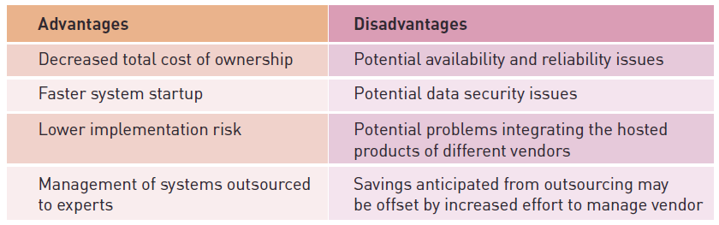
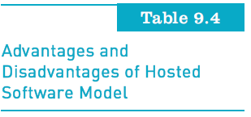
Hosted Software Model for Enterprise Software (continued)
Principles of Information Systems, Tenth Edition

Slide 43
International Issues Associated with Enterprise Systems
Challenges that must be met by an enterprise system of a multinational company include:
  Different languages and cultures
  Disparities in IS infrastructure
  Varying laws and customs rules
  Multiple currencies
Principles of Information Systems, Tenth Edition

Slide 44
Different Languages and Cultures
In some cultures, people do not routinely work in teams in a networked environment
Multinational companies:
  Can establish close connections with their business partners
  Roll out standard IS applications for all to use
Principles of Information Systems, Tenth Edition

Slide 45
Disparities in Information System Infrastructure
Lack of a robust or a common information infrastructure can create problems
Many countries’ telecommunications services are controlled by a central government or operated as a monopoly
  No incentives to provide fast and inexpensive customer service
Principles of Information Systems, Tenth Edition

Slide 46
Varying Laws and Customs Rules
Numerous laws can affect collection and dissemination of data
Examples:
  Labor laws in some countries prohibit recording of worker performance data
  Some countries have laws limiting the trans-border flow of data linked to individuals
Trade custom rules between nations:
  North American Free Trade Agreement (NAFTA)
Principles of Information Systems, Tenth Edition

Slide 47
Multiple Currencies
Enterprise system of multinational companies must conduct transactions in multiple currencies
Systems must:
  Be current with foreign currency exchange rates
  Handle reporting and other transactions
  Issue vendor payments and customer statements
  Record retail store payments
  Generate financial reports in the currency of choice
Principles of Information Systems, Tenth Edition

Slide 48
Summary
Transaction processing systems (TPSs):
  Are at the heart of most information systems in businesses today
Batch and online processing:
  The collection of transactions into batches
TPSs perform the following basic activities:
  Data collection, data editing, data correction
  Data manipulation, data storage, document production
Principles of Information Systems, Tenth Edition

Slide 49
Summary (continued)
Enterprise resource planning (ERP):
  Software that supports the efficient operation of business processes
Most firms use ERP systems to:
  Support financial and managerial accounting and business intelligence
Organizations are implementing CRM systems to manage all aspects of customer encounters
Principles of Information Systems, Tenth Edition

