Slide 1
Principles of Information Systems, Tenth Edition
Chapter 13
Systems Development: Design, Implementation, Maintenance, and Review

Slide 2
Principles and Learning Objectives
Designing new systems or modifying existing ones should always help an organization achieve its goals
  State the purpose of systems design and discuss the differences between logical and physical systems design
  Describe the process of design modeling and the diagrams used during object-oriented design
Principles of Information Systems, Tenth Edition

Slide 3
Principles and Learning Objectives (continued)
  Discuss the issues involved in environmental design
  Define the term RFP and discuss how this document is used to drive the acquisition of hardware and software
  Describe the techniques used to make systems selection evaluations
Principles of Information Systems, Tenth Edition

Slide 4
Principles and Learning Objectives (continued)
The primary emphasis of systems implementation is to make sure that the right information is delivered to the right person in the right format at the right time
  State the purpose of systems implementation and discuss the activities associated with this phase of systems development
  List the advantages and disadvantages of purchasing versus developing software
Principles of Information Systems, Tenth Edition

Slide 5
Principles and Learning Objectives (continued)
  Discuss the software development process and list some of the tools used in this process, including object-oriented program development tools
Principles of Information Systems, Tenth Edition

Slide 6
Principles and Learning Objectives (continued)
Maintenance and review add to the useful life of a system but can consume large amounts of resources; these activities can benefit from the same rigorous methods and project management techniques applied to systems development
  State the importance of systems and software maintenance and discuss the activities involved
  Describe the systems review process
Principles of Information Systems, Tenth Edition

Slide 7
Why Learn About Systems Development?
This chapter shows how:
  You can be involved in designing and implementing an information system that will directly benefit you on the job
  To avoid errors and how to recover from disasters
Principles of Information Systems, Tenth Edition

Slide 8
Systems Design
Answers the question:
  How will the information system solve a problem?
Results in a technical design that:
  Details system outputs, inputs, and user interfaces
  Specifies hardware, software, databases, telecommunications, personnel, and procedures
  Shows how these components are related
Principles of Information Systems, Tenth Edition

Slide 9
Logical and Physical Design
Logical design
  Describes functional requirements of a system
Physical design
  Specifies the characteristics of the system components necessary to put the logical design into action
Principles of Information Systems, Tenth Edition

Slide 10
Object-Oriented Design
Using the OO approach:
  You can design key objects and classes of objects in the new or updated system
  Process includes considering the problem domain, the operating environment, and the user interface
During design phase, consider the sequence of events that must happen for the system to function correctly
Principles of Information Systems, Tenth Edition

Slide 11
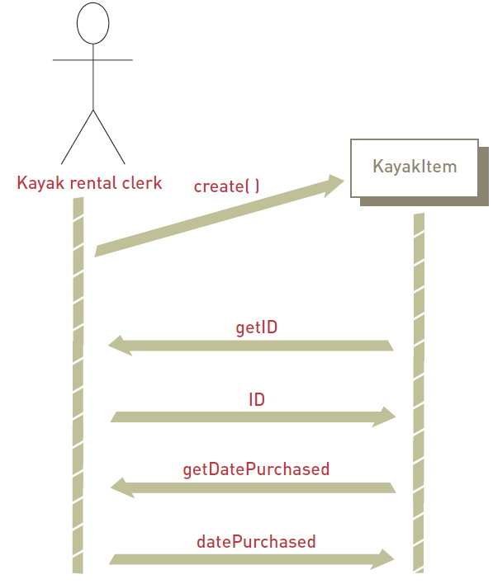
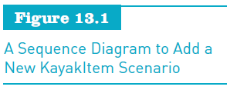
Principles of Information Systems, Tenth Edition

Slide 12
Interface Design and Controls
System characteristics:
  Sign-on procedure
  Menu-driven system
  Help facility
  Lookup tables
Principles of Information Systems, Tenth Edition

Slide 13
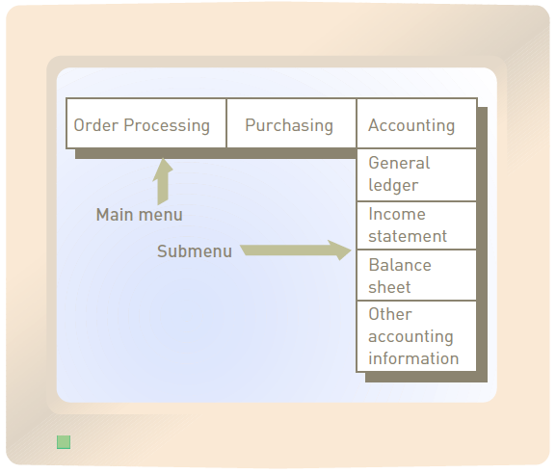
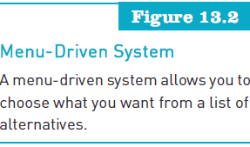
Interface Design and Controls (continued)
Principles of Information Systems, Tenth Edition

Slide 14
Design of System Security and Controls
Preventing, detecting, and correcting errors
  The most cost-effective time to deal with potential errors is early in the design phase
Disaster planning and recovery:
  Disaster planning
  Disaster recovery
Systems controls:
  Closed shops
  Open shops
  Deterrence controls
Principles of Information Systems, Tenth Edition

Slide 15
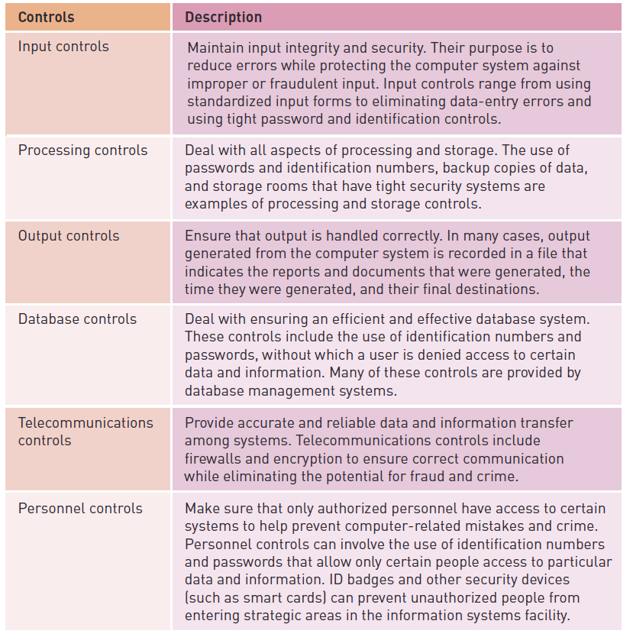
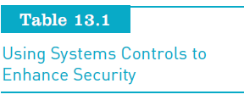
Principles of Information Systems, Tenth Edition

Slide 16
Environmental Design Considerations
Environmental design:
  Also called green design
  Involves systems development efforts that slash power consumption, require less physical space, and result in systems that can be disposed in a way that doesn’t negatively affect the environment
Principles of Information Systems, Tenth Edition

Slide 17
Generating Systems Design Alternatives
Request for proposal (RFP):
  Document that specifies required resources such as hardware and software in detail
Financial options:
  Purchase, lease, or rent
Evaluating and selecting a systems design
  Preliminary evaluation
  Final evaluation
Principles of Information Systems, Tenth Edition

Slide 18
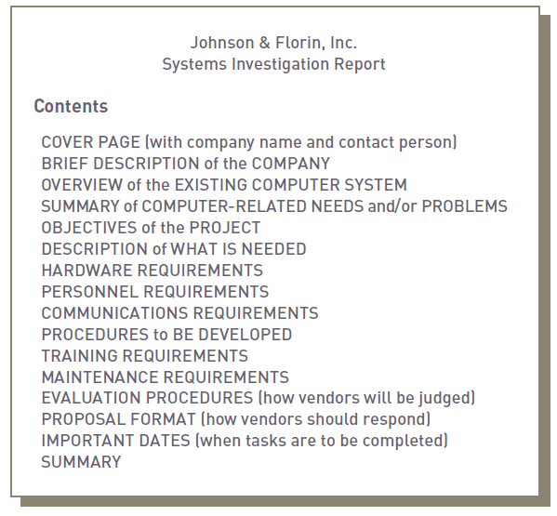
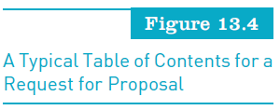
Generating Systems Design Alternatives (continued)
Principles of Information Systems, Tenth Edition

Slide 19
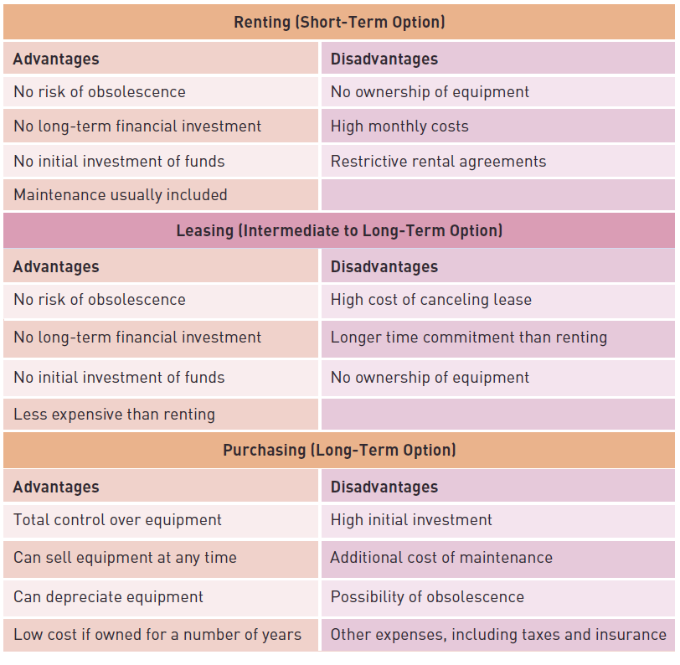
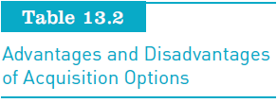
Generating Systems Design Alternatives (continued)
Principles of Information Systems, Tenth Edition

Slide 20
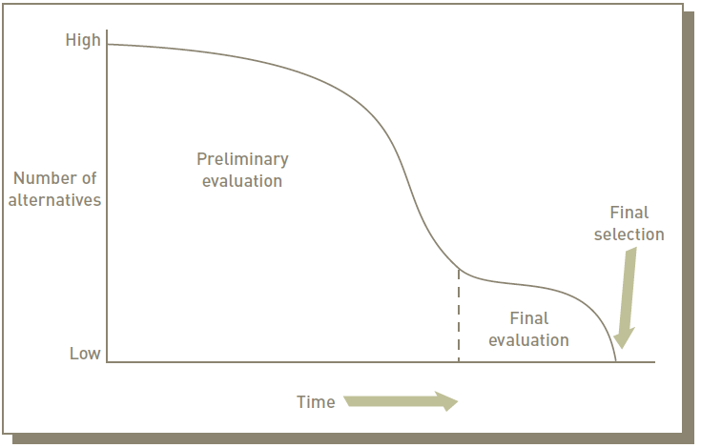
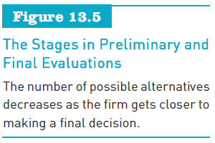
Generating Systems Design Alternatives (continued)
Principles of Information Systems, Tenth Edition

Slide 21
Evaluation Techniques
Group consensus:
  Decision-making group is appointed and given the responsibility of making the final evaluation and selection
Cost/benefit analysis:
  Lists the costs and benefits of each proposed system
Principles of Information Systems, Tenth Edition

Slide 22
Evaluation Techniques (continued)
Benchmark test:
  An examination that compares computer systems operating under the same conditions
Point evaluation:
  Evaluation process in which each evaluation factor is assigned a weight, in percentage points, based on importance
Principles of Information Systems, Tenth Edition

Slide 23
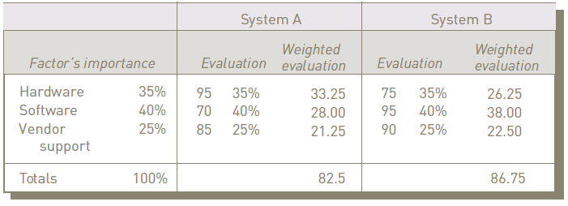
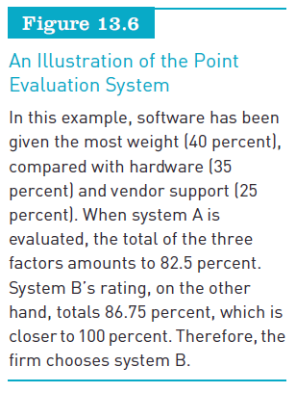
Principles of Information Systems, Tenth Edition

Slide 24
Freezing Design Specifications
User agrees in writing that the design is acceptable
Other organizations:
  Allow or even encourage design changes
Principles of Information Systems, Tenth Edition

Slide 25
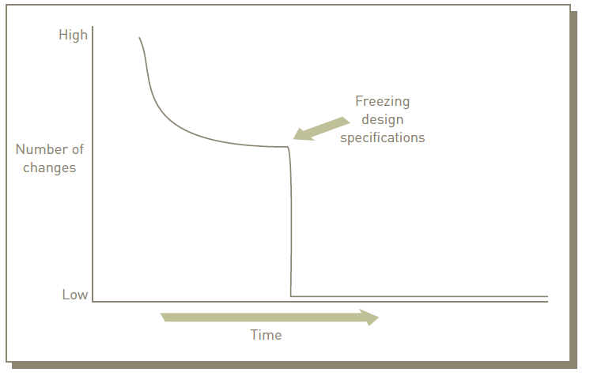

Principles of Information Systems, Tenth Edition

Slide 26
The Contract
Vendors provide standard contracts to protect themselves
Typically, the request for proposal becomes part of the contract
Principles of Information Systems, Tenth Edition

Slide 27
The Design Report
Primary result of systems design
Reflects decisions made and prepares the way for systems implementation
Principles of Information Systems, Tenth Edition

Slide 28
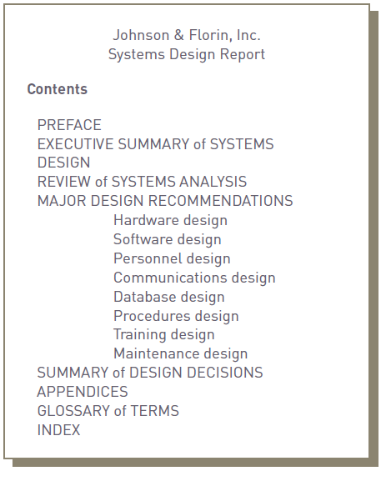
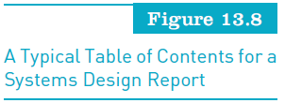
Principles of Information Systems, Tenth Edition

Slide 29
Systems Implementation
Includes:
  Hardware acquisition
  Programming and software acquisition or development
  User preparation
  Hiring and training of personnel
  Site and data preparation
  Installation, testing, start-up, and user acceptance
Principles of Information Systems, Tenth Edition

Slide 30
Acquiring Hardware from an IS Vendor
IS vendor:
  Company that offers hardware, software, telecommunications systems, databases, IS personnel, or other computer-related resources
Types of IS vendors include:
  General computer manufacturers
  Small computer manufacturers
  Peripheral equipment manufacturers
Principles of Information Systems, Tenth Edition

Slide 31
Acquiring Software: Make or Buy?
Make-or-buy decision:
  Whether to obtain software from external or internal sources
Externally acquired software and Software as a Service (SaaS)
  Commercial off-the-shelf (COTS) combines software from various vendors into a finished system
  Software as a Service (SaaS) allows businesses to subscribe to Web-delivered application software by paying a monthly service charge
Principles of Information Systems, Tenth Edition

Slide 32
Acquiring Software: Make or Buy? (continued)
In-house developed in-house software
  Techniques used:
    CASE and object-oriented approaches
    Cross-platform development
    Integrated development environment
    Documentation
Principles of Information Systems, Tenth Edition

Slide 33
Acquiring Database and Telecommunications Systems
Databases:
  A blend of hardware and software
Virtual databases and database as a service (DaaS):
  Popular ways to acquire database capabilities
Principles of Information Systems, Tenth Edition

Slide 34
User Preparation
Readying managers, decision makers, employees, other users, and stakeholders for new systems
Important but often ignored area of systems implementation
Principles of Information Systems, Tenth Edition

Slide 35
IS Personnel: Hiring and Training
Eventual success of any system depends on how it is used by the IS personnel within the organization
Training programs should be conducted for the IS personnel who will be using the computer system
  More detailed than user training in the technical aspects of the systems
Principles of Information Systems, Tenth Edition

Slide 36
Site Preparation
Preparing the location of a new system
Larger systems may require special equipment
Developing IS sites that are energy efficient is important
Principles of Information Systems, Tenth Edition

Slide 37
Data Preparation
Also called data conversion
Ensuring all files and databases are ready to be used with new computer software and systems
Principles of Information Systems, Tenth Edition

Slide 38
Installation
Process of physically placing computer equipment on the site and making it operational
Normally, manufacturer is responsible for installing computer equipment
Someone from the organization (usually IS manager) should oversee the process
Principles of Information Systems, Tenth Edition

Slide 39
Testing
Forms of testing:
  Unit testing
  System testing
  Volume testing
  Integration testing
  Acceptance testing
  Alpha testing
  Beta testing
Principles of Information Systems, Tenth Edition

Slide 40
Start-Up
Process of making the final tested information system fully operational
Approaches:
  Direct conversion (plunge, direct cutover)
  Phase-in approach (piecemeal)
  Pilot start-up
  Parallel start-up
Principles of Information Systems, Tenth Edition

Slide 41
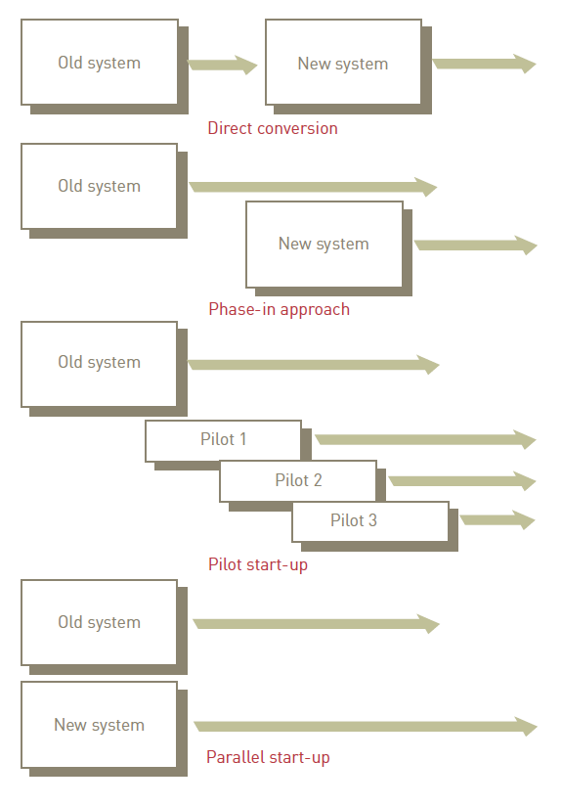

Principles of Information Systems, Tenth Edition

Slide 42
User Acceptance
Formal agreement signed by user that states that a phase of installation or the complete system is approved
Legal document that removes or reduces IS vendor’s liability
Principles of Information Systems, Tenth Edition

Slide 43
Systems Operation and Maintenance
Systems operation:
  Use of a new or modified system
Systems maintenance:
  Checking, changing, and enhancing the system to make it more useful in achieving user and organizational goals
Principles of Information Systems, Tenth Edition

Slide 44
Reasons for Maintenance
Some reasons for program maintenance:
  Changes in business processes
  New requests from stakeholders, users, and managers
  Bugs or errors in program
  Technical and hardware problems
  Corporate mergers and acquisitions
  Government regulations
  Changes in the operating system or hardware on which the application runs
Principles of Information Systems, Tenth Edition

Slide 45
Types of Maintenance
Slipstream upgrade:
  Usually requires recompiling all the code
Patch:
  Minor change to correct a problem
Release:
  Significant program change
Version:
  Major program change
Principles of Information Systems, Tenth Edition

Slide 46
The Request for Maintenance Form
Form authorizing modification of programs
Usually signed by a business manager
IS group:
  Reviews form
  Identifies programs to be changed
  Determines programmer to be assigned to task
  Estimates expected completion date
  Develops a technical description of change
Principles of Information Systems, Tenth Edition

Slide 47
Performing Maintenance
Maintenance team:
  Responsible for modifying, fixing, and updating existing software
Modernization Workbench from Micro Focus:
  Collection of tools that help organizations analyze the inner workings of legacy applications
Principles of Information Systems, Tenth Edition

Slide 48
The Relationship between Maintenance and Design
Programs are expensive to develop, but they are even more expensive to maintain
Determining factor in decision to replace a system:
  The point at which it is costing more to fix than to replace
Principles of Information Systems, Tenth Edition

Slide 49
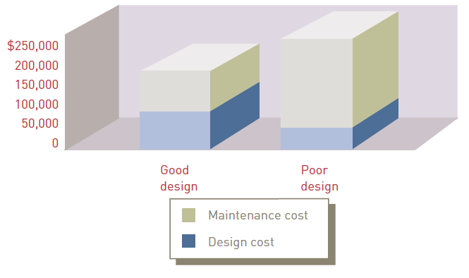
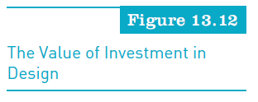
Principles of Information Systems, Tenth Edition

Slide 50
Systems Review
Final step of systems development
Analyzes systems to make sure that they are operating as intended
Can be used to uncover potential problems and solve them before they occur
Principles of Information Systems, Tenth Edition

Slide 51
Types of Review Procedures
Event-driven review:
  Triggered by a problem or opportunity
Time-driven review:
  Performed after a specified amount of time
Principles of Information Systems, Tenth Edition

Slide 52
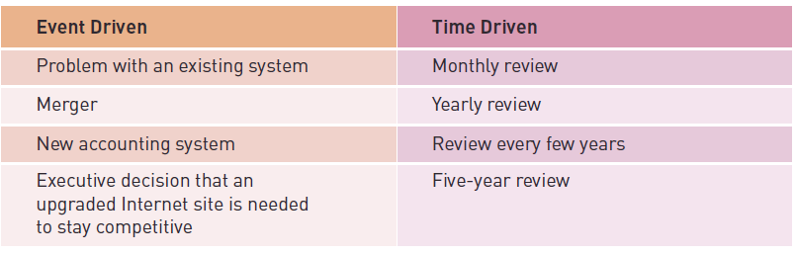

Types of Review Procedures (continued)
Principles of Information Systems, Tenth Edition

Slide 53
System Performance Measurement
Monitoring the system:
  Number of errors encountered
  Amount of memory required
  Amount of processing or CPU time needed
  Other problems
System performance products:
  Software that measures all components of the information system
Principles of Information Systems, Tenth Edition

Slide 54
Summary
Purpose of systems design:
  To prepare detailed design needs for a new system
Logical and physical design:
  Can be accomplished using the traditional systems development life cycle or the object-oriented approach
Disaster recovery:
  Important aspect of systems design
Principles of Information Systems, Tenth Edition

Slide 55
Summary (continued)
Purpose of systems implementation:
  To install the system and make everything, including users, ready for its operation
Software can be purchased from vendors or developed in-house
Cross-platform development and integrated development environments (IDEs):
  Make software development easier and more thorough
Principles of Information Systems, Tenth Edition

Slide 56
Summary (continued)
Systems operation:
  Use of a new or modified system
Maintenance:
  Can be as simple as a program patch to the more complex upgrading of software with a new release from a vendor
Systems review:
  Process of analyzing and monitoring systems to make sure that they are operating as intended
Principles of Information Systems, Tenth Edition

