Slide 1

ReStock AI
A Human-Governed Autonomous Purchasing Officer
The AI handles the volume. The human owns the judgment.
Agentika 2.0 · NaSCon 2026
Human + AI: Better Together
Team Chat GPTwo · Chaudhary Muhammad Huzaifa Ali · Umamah Nasir Khan
Notes:
ReStock AI — a human-governed autonomous purchasing officer, built for Agentika 2.0.

Slide 2
The problem
Thousands of restock decisions every week — and both naive answers fail
Full automation
Fully manual
One mispriced or oversized order silently burns the budget.
No human sees the risky calls before money is spent.
Errors scale as fast as the automation does.
The team drowns in routine approvals.
Reacting to demand changes is too slow.
Judgment is wasted on orders that need none.
The routine volume needs automation; the risky calls need human judgment.

Slide 3
The solution: one agent, three routes
A Q-Learning agent proposes; a dual safety gate governs; the human decides the exceptions.
1
2
3
Auto-execute
Escalate
Block
Routine, confident, affordable orders
Run automatically — stock replenished
A real purchase order is issued
Expensive / low-confidence / unfamiliar
LLM writes a plain-English rationale
Approve or reject — even from Discord
Over quantity cap, cost ceiling or budget
Refused outright — no spend
Recorded with its reasons
The LLM explains — it never decides.

Slide 4
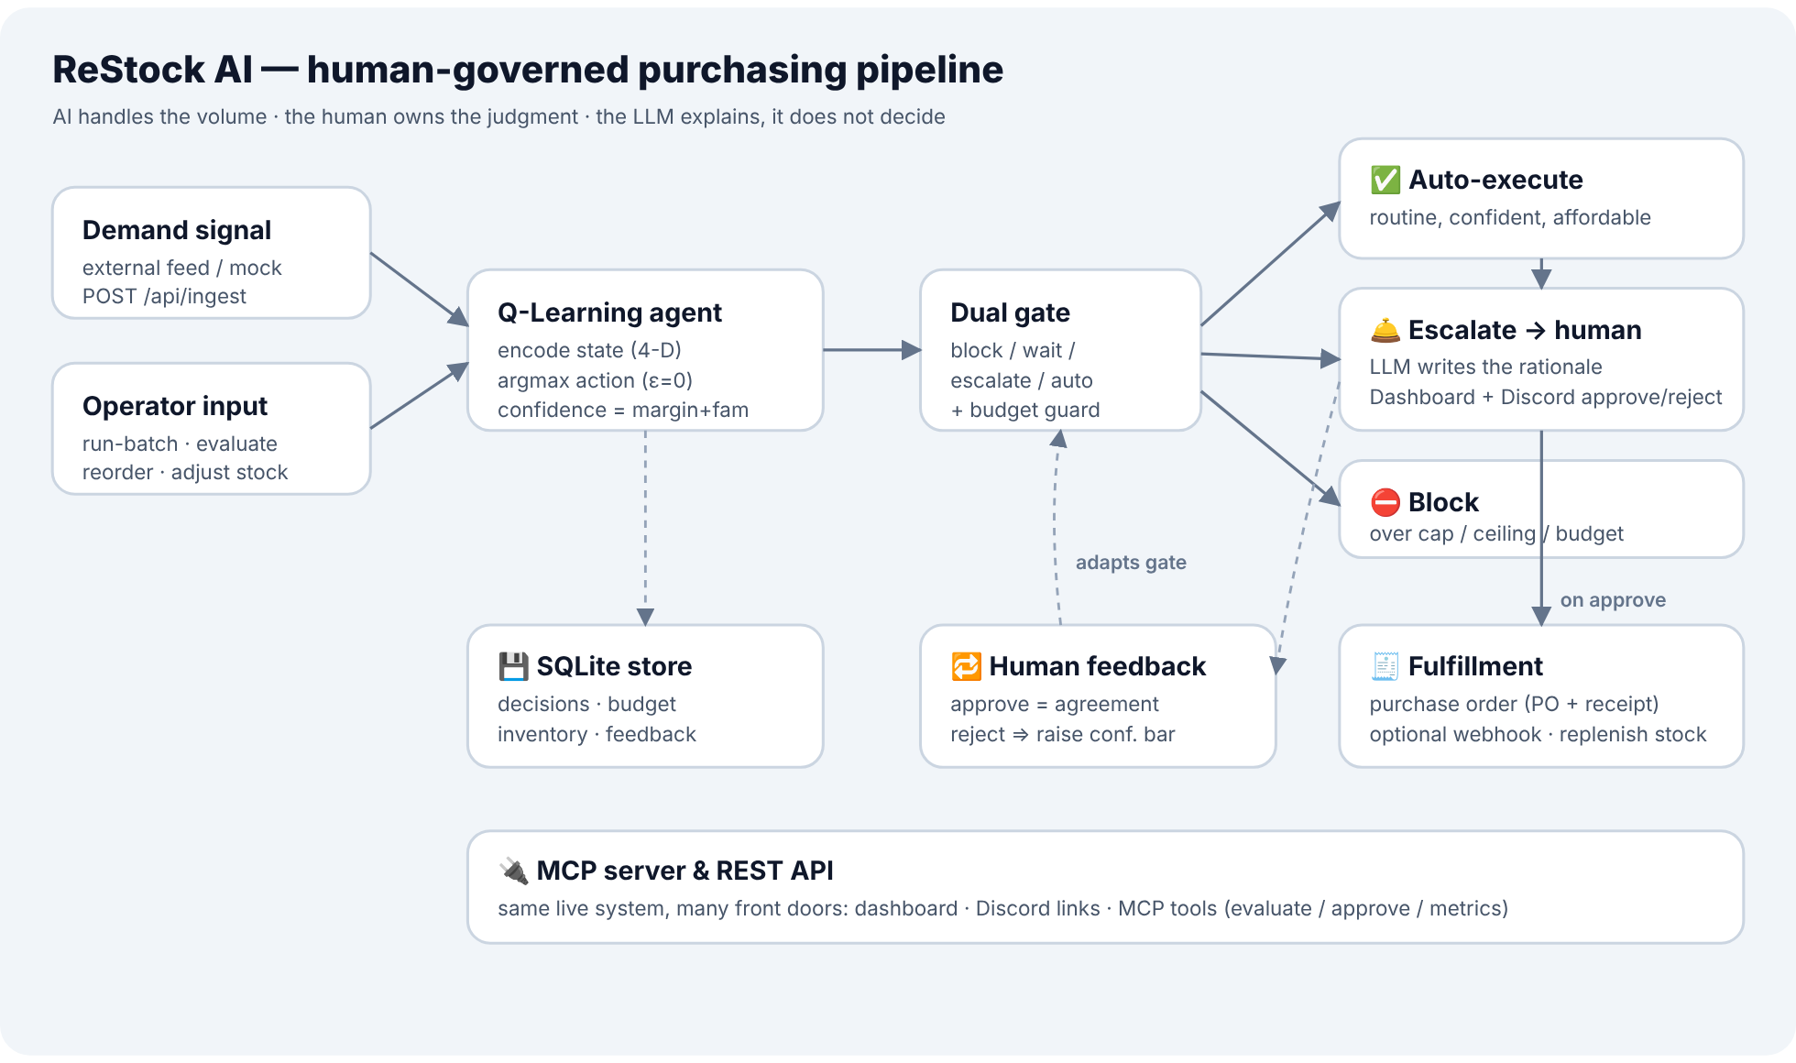
How it works — architecture
One FastAPI service, a Q-Learning core, and four integrations wired around it

Slide 5
The decision flow, end to end
Every situation runs through the same pipeline
1
2
3
4
5
Encode state
Decide
Dual gate
Act
Fulfill
Situation → 4-D state (LOW/MED/HIGH), 81 states
Q-table argmax (ε=0) → action, quantity, confidence
Block · Wait · Escalate · Auto — first match wins
Execute · escalate to human · or block
Issue a PO (+ optional webhook); replenish stock
Confidence = 0.7 × margin + 0.3 × familiarity — margin = how decisively the top action won; familiarity = how well-trained the state is.

Slide 6
The dual gate
First category that matches wins — all applicable reasons are recorded
1
Block
qty > MAX_ORDER_QTY, cost > HARD_LIMIT, or cost > budget
2
Auto-approve
WAIT actions — a safe no-op
3
Escalate
cost > AUTO_LIMIT
4
Escalate
confidence < CONF_THRESHOLD (effective)
5
Escalate
visits < MIN_VISITS_FAMILIAR (unfamiliar)
6
Auto-approve
otherwise — routine, confident, affordable

Slide 7
Human-in-the-loop & the adaptive gate
Escalations wait for a person — on the dashboard or in Discord
Approve
Reject
Order executes, stock replenishes, a PO is issued. Recorded as agreement with the AI.
Order is voided. Recorded as an override of the AI.
Discord sign-off
Adaptive gate
Each escalation is pushed to Discord with one-click Approve / Reject links — decide from your phone.
A run of rejections raises the confidence bar, so the gate escalates sooner. Governance only — the model is never retrained.

Slide 8
Reacting to the real world
POST /api/ingest closes the loop from the outside
Demand signal arrives
Forecasts updated
Agent re-evaluates
Decisions routed
New demand in, decisions out — no human needed for the routine part. The feed can be an external endpoint or a built-in mock, and it degrades gracefully.

Slide 9
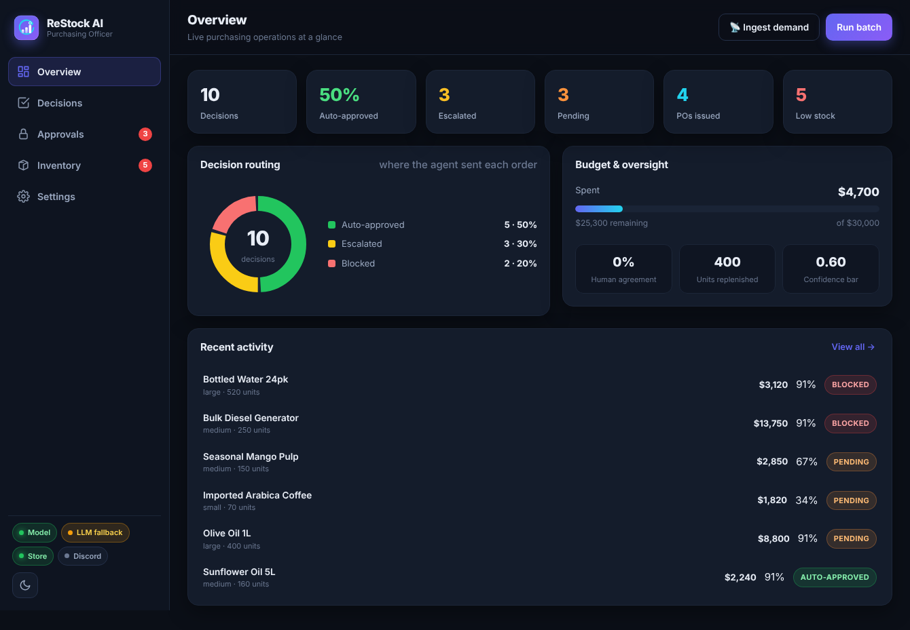
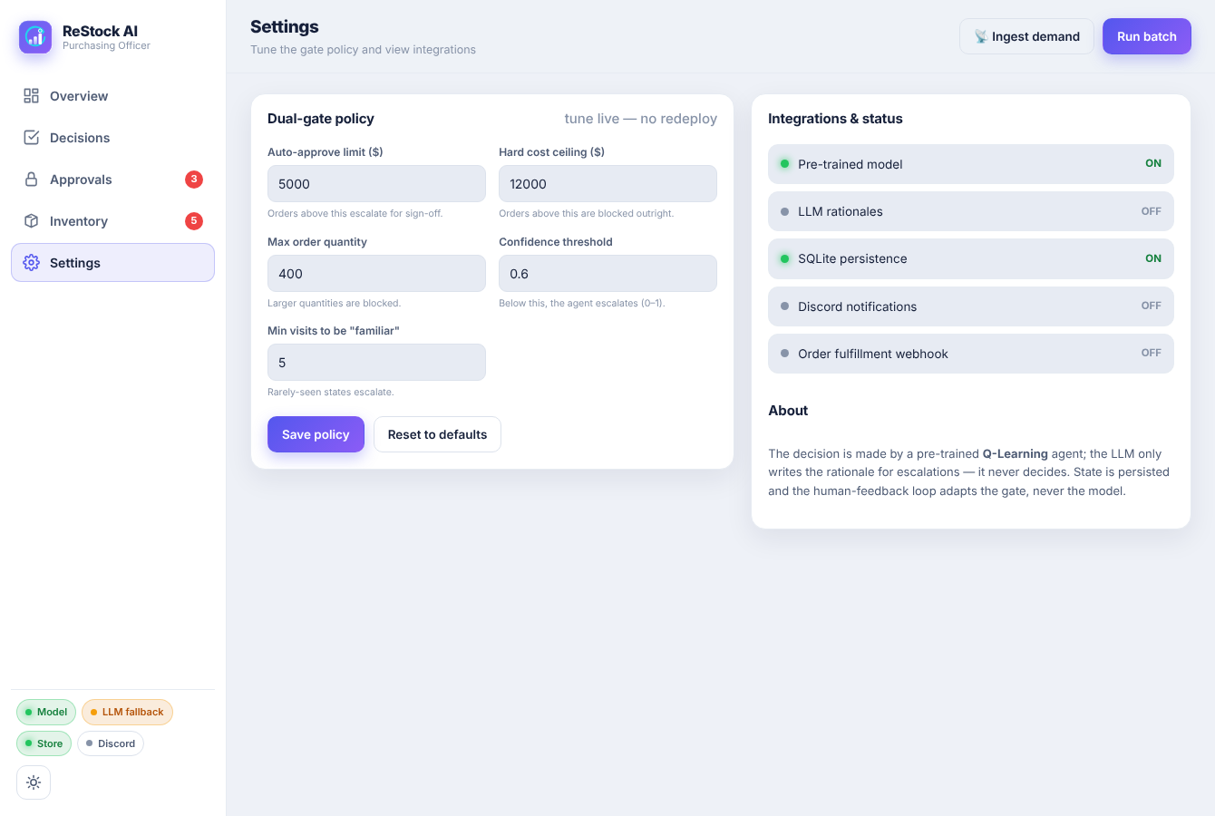
A real app — not a dashboard
Sidebar navigation · five pages · light & dark themes · live counters
Overview — analytics & routing
Settings — live-edit the gate policy

Slide 10
Decision routing at a glance
A typical batch over the seed catalogue
50%
Auto-approved without a human
3
Escalated for human sign-off
2
Blocked — budget protected
100%
Decisions logged & auditable

Slide 11
Integrations & technology
Automation depth, coherently wired — all optional, all graceful
Discord / Slack
Fulfillment webhook
MCP server
Approve or reject escalations from chat
PO receipts POSTed to a downstream system
Drive the live service from any MCP client
SQLite persistence
Demand ingestion
Tested · 24 passing
State survives a redeploy
External feed or mock → reactive loop
Gate, confidence, persistence, API
Python · FastAPI · Q-Learning · SQLite · Docker · deployed on Clouds by Alternate Futures

Slide 12
How it meets the judging rubric
100 points across six criteria
Technical execution & reliability
End-to-end, graceful degradation, 24 tests
25
Usefulness & real-world impact
Replenishment, budget control, real POs
20
Theme alignment
AI volume + human sign-off on risk
15
Creativity & uniqueness
Dual gate, adaptive gate, reactive loop
15
Automation depth & integration
Discord + webhook + MCP + ingestion
15
User experience & presentation
Full app UI, light/dark, charts
10

Slide 13
Honest, deployed, and built to the theme
The Q-table is a synthesised, explainable policy — a drop-in artifact, not a black box.
The feedback loop adapts the gate, never the model.
The LLM explains; the Q-table decides.
Live on Alternate Clouds
alternate-restless-forest-3113-github-app.alternatefutures.ai
github.com/chhuzaifa928/Restocker
Thank you — ReStock AI · Team Chat GPTwo

