Slide 1
Body image in Patients with Cancers Model applied: One-way ANOVA, Turkey Test, Kruskal-Wallis H-test, Wilcoxon test Chi Nguyen

Slide 2
Background
With approximately 19.3 millions new cancer diagnoses and an estimated 9.9 millions of deaths from cancer in 2020, cancer is currently a leading to the global health concern.
Cancer can cause physical changes and affect the satisfaction with patient’s physical appearance, which would strongly impact the quality of life in general.
Study compares satisfaction with body image of patients with different types of cancer with the general population and across sexes and identifies risk factors for diminished body image.

Slide 3
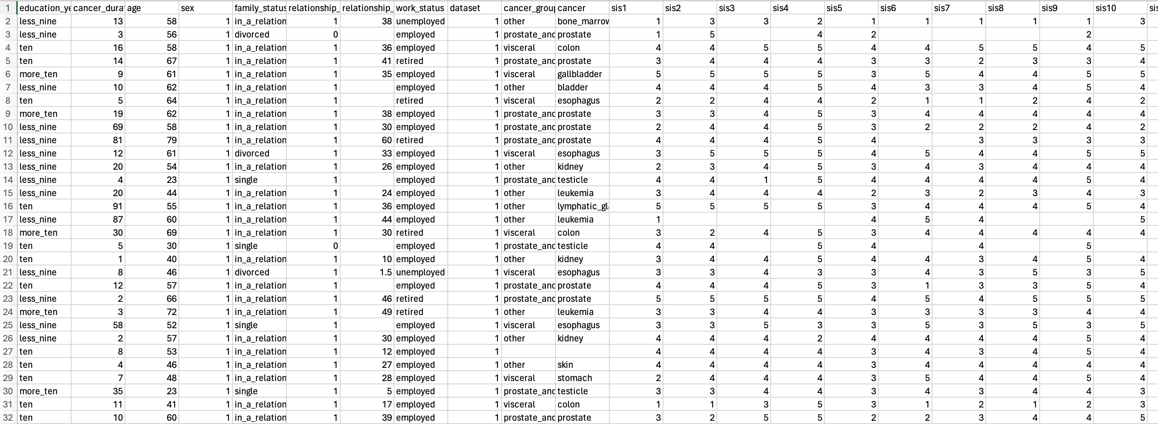
Dataset - acquired from PLOS ONE, published in 2021. - dataset: n= 531, using German Image Scale, with patients voluntarily recruited from 2002 to 2016
Data adjustment: Compute the means for the indicator variables.
Convert Age, Cancer duration, Relationship duration
Delete value of Cancer and Cancer Type Variables
Variables:
Age group. Sex, Family Status. Relationship duration group. Cancer duration group. Work Status, Education Year & German Scale (means) to for measurement, including SIS (self image scale for body image satisfaction), GAD (General Anxiety Disorder), PHQ (Depression Scale), etc.
This project focus on compare different groups of Work Status with the SIS Mean (the self image scale for body image satisfaction) of patients with cancers.

Slide 4
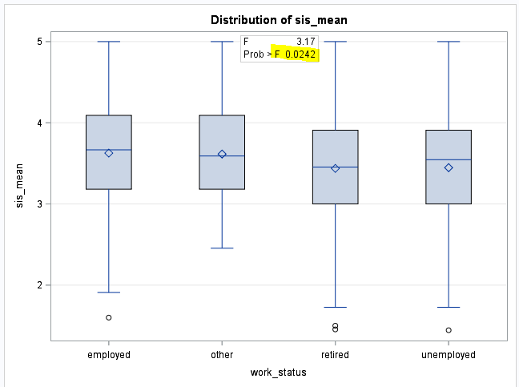
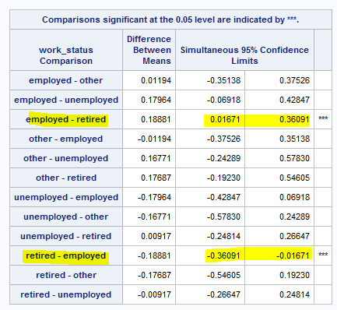

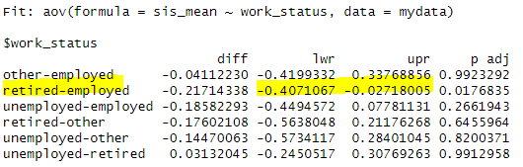
One-Way ANOVA & Turkey Test
One-way ANOVA Conclusion :
At 5% significant level, p-value < alpha, there are significant differences between the Work Status groups being compared with the mean of SIS
Turkey Test:
There is a statistically significant difference between the “Employed” and “Retired” group (the confidence interval (0.01671 to 0.36091) does not include zero)

Slide 5
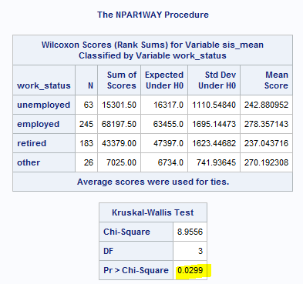

Kruskal Wallis H-test & Wilcoxon Rank Sum Test
Kruskal-Wallis H-test
P-value = 0.0299 < alpha
At 5% significant level, reject H0, and can conclude that all for groups of WORK STATUS (Employed, Unemployed, Retired and Other) have a different SIS mean.
Wilcoxon Rank Sum Test
At 5% significant level, “Employed” & “Retired” have a different mean SIS, whereas the rest of compared pairs have the same mean SIS.

Slide 6
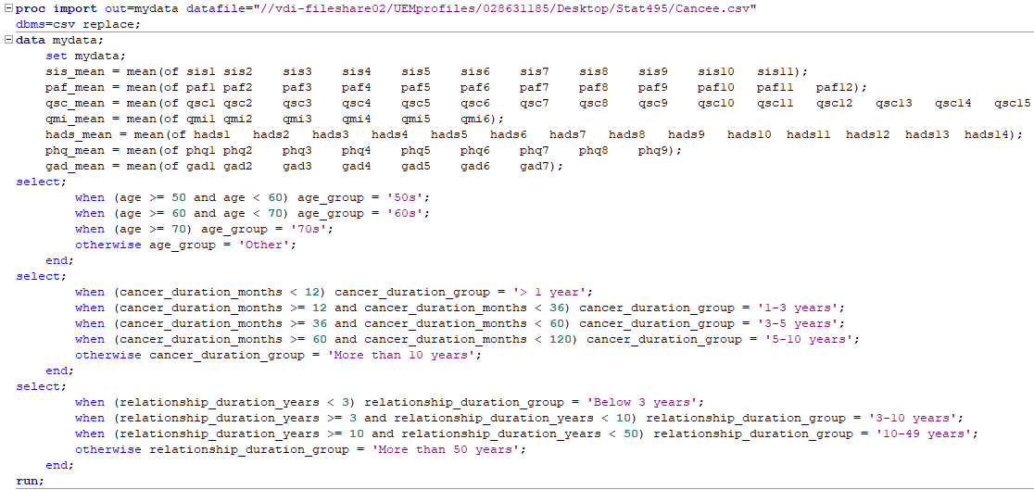
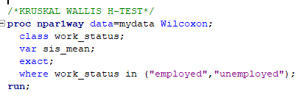
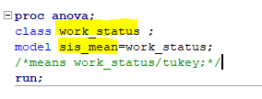
SAS code
ANOVA & Turkey Test
Kruskal-Wallis H-test & Wilcoxon test

Slide 7
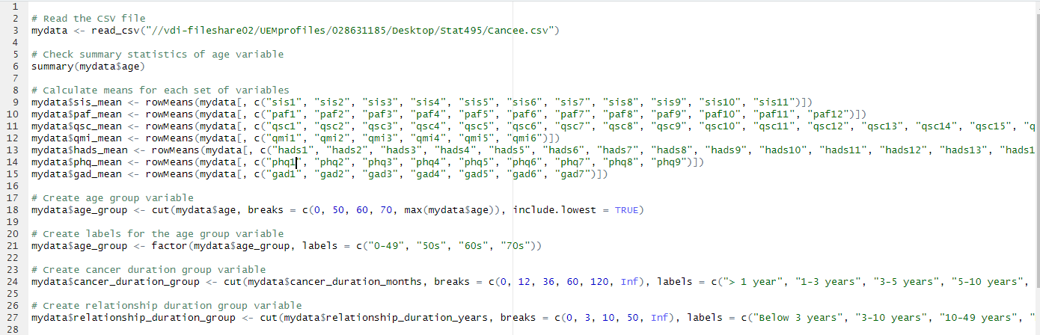
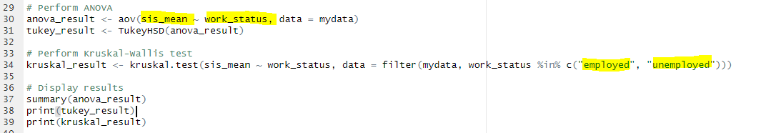
R code

Slide 8
Reference
Brederecke, J., Heise, A., & Zimmermann, T. (2021). Body image in patients with different types of cancer. PLOS ONE, 16(11), e0260602. https://doi.org/10.1371/journal.pone.0260602

Slide 9
THANK YOU
DR.OLGA & STAT495 CLASSMATES

