Slide 1
SeaweedFS
Demo and Test

Slide 2
NỘI DUNG
Architecture and Workflow
Installation on K8s
Testing: HA
Testing: I/O Performance
API Support for File Operations
Backup and Recovery

Slide 3
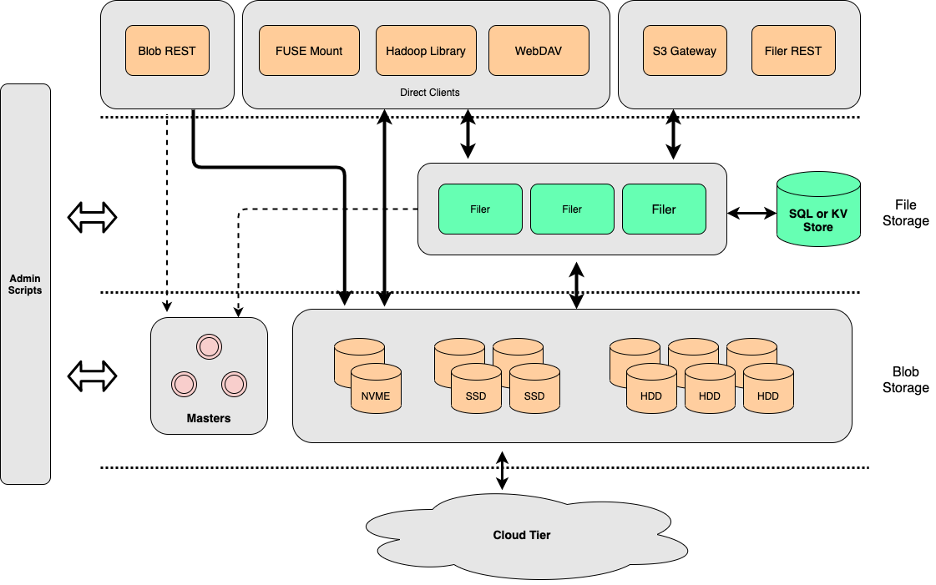
1. Architecture and Workflow
3 thành phần chính:
Filer
Master
Volume

Slide 4
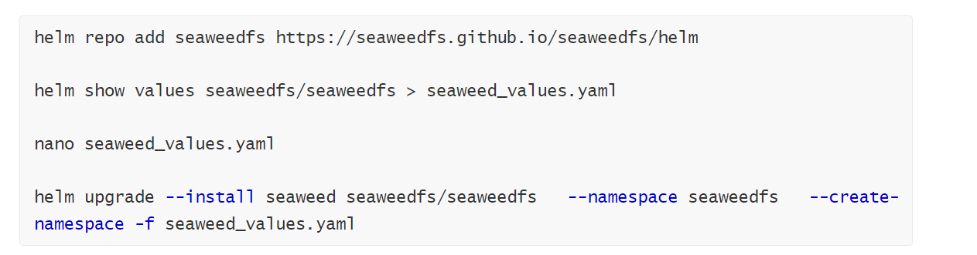
2. Installation on K8s
a. Install SeaweedFS with replicas

Slide 5
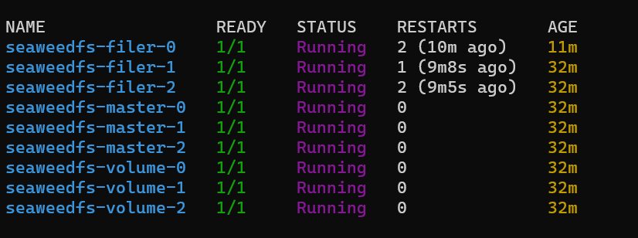
2. Installation on K8s
a. Install SeaweedFS with replicas

Slide 6
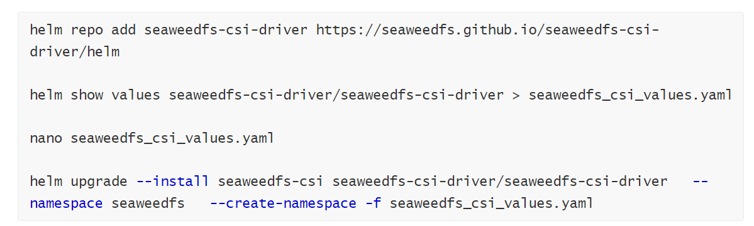
2. Installation on K8s
b. Install SeaweedFS CSI (SeaweedFS installed required)

Slide 7
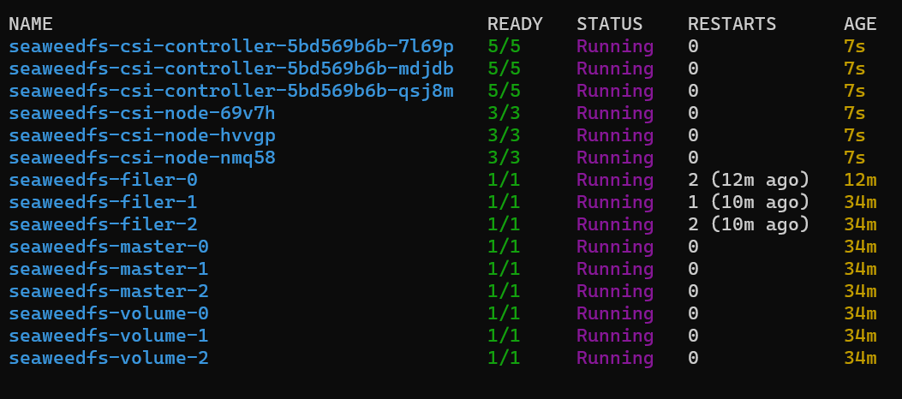
2. Installation on K8s
b. Install SeaweedFS CSI (SeaweedFS installed required)

Slide 8
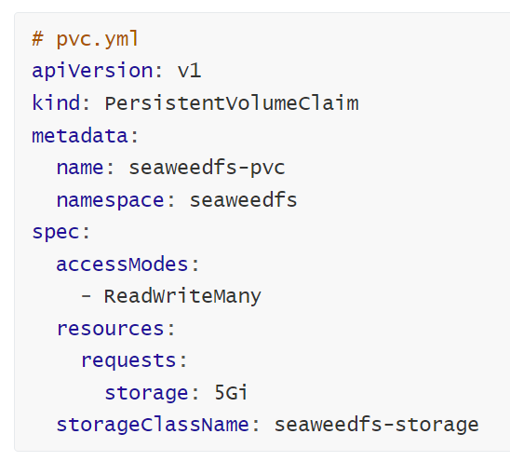
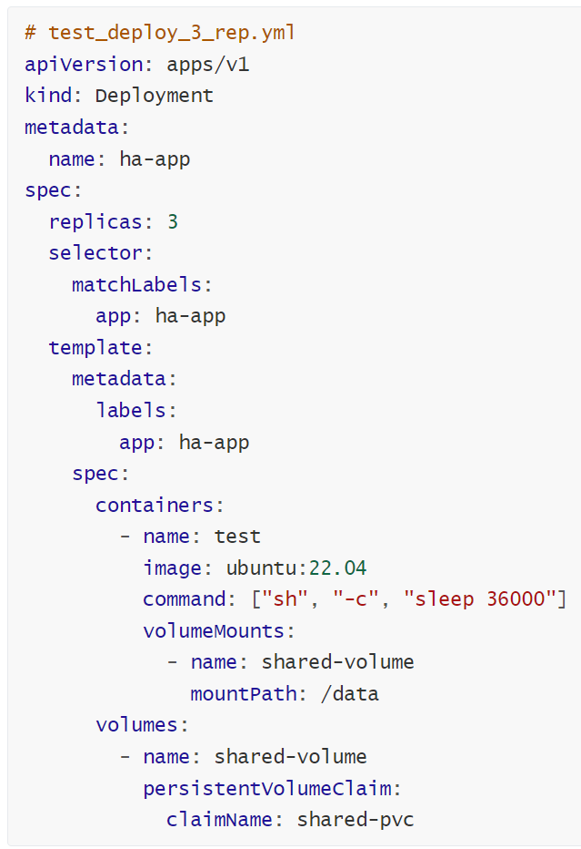
3. Testing: HA
Để đảm bảo HA cần lưu metadata tới filer db khác (default đang là leveldb2 lưu trên local)
Data được phân tán tới 3 volume servers
Mỗi data luôn được đảm bảo có 1 replica (replicationReplacement: “001”)
Cần tối thiểu 2/3 node available nếu không sẽ chặn write operator
Notes:
Data is always distributed to 3 nodes
Each one always has 1 replica (need min 2/3 nodes available)
If there is only 1 node avalable (not enough for replication), seaweedfs will restrict write operator (read-only data) https://github.com/seaweedfs/seaweedfs/discussions/2312
Volume is only used for storing data, the metadata need to be kept in a metadata store (default is local leveldb2 - not good for HA)

Slide 9
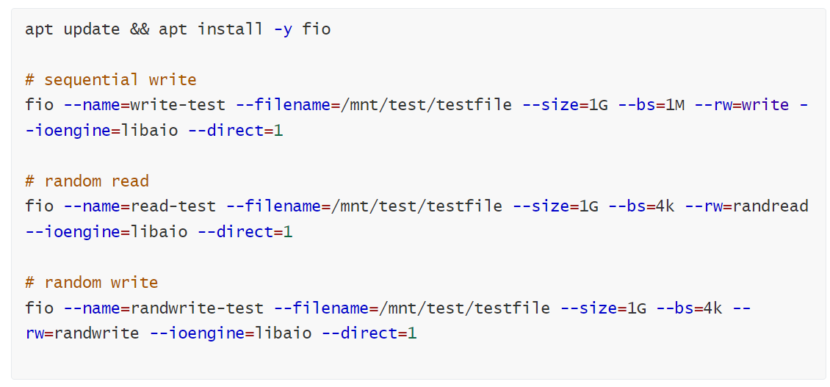
4. Testing: I/O Performance
Với 1 deployment 3 replicas, dung chung 1 pvc 5gb, exec vào 1 pod, sử dụng fio:

Slide 10
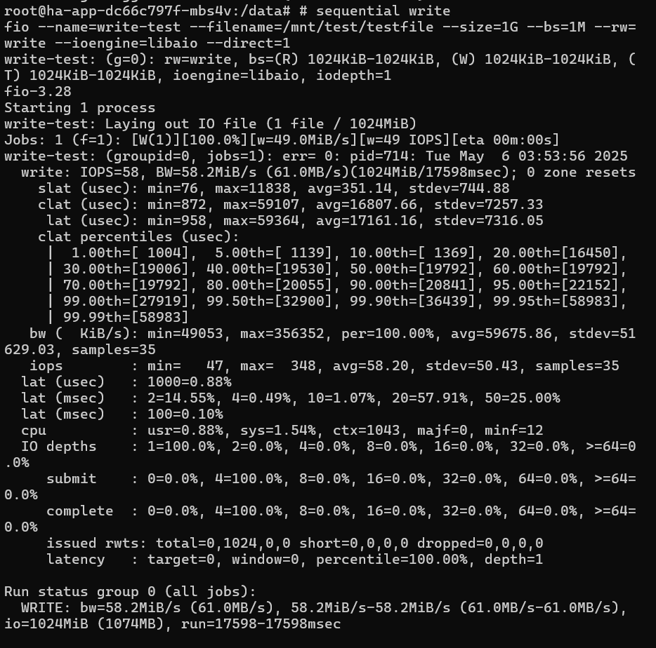
4. Testing: I/O Performance
Sequential write:

Slide 11
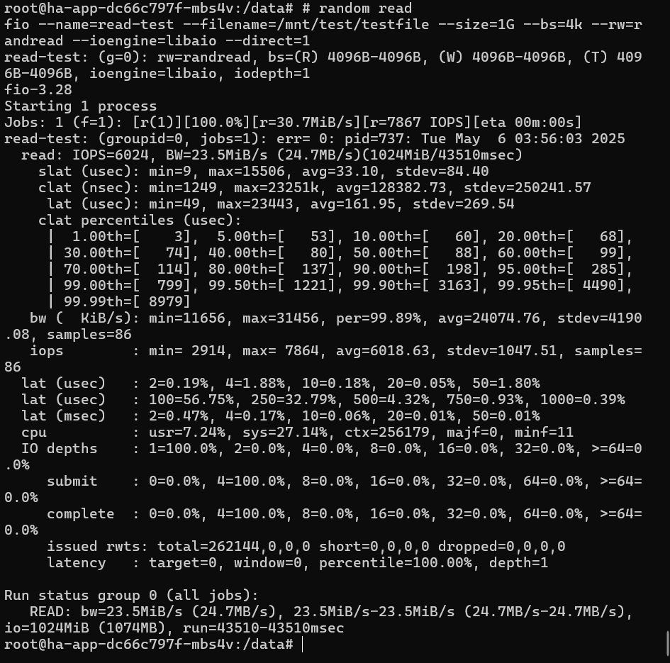
4. Testing: I/O Performance
Random read:

Slide 12
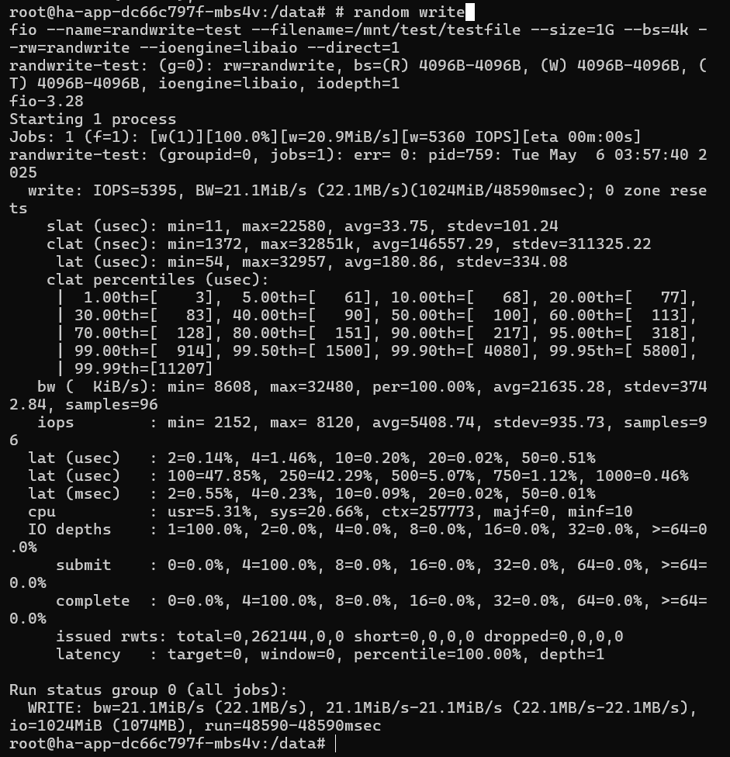
4. Testing: I/O Performance
Random write:

Slide 13
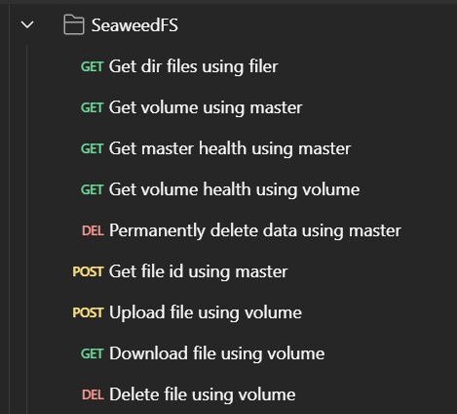
5. API Support for File Operations
Notes:
https://github.com/seaweedfs/seaweedfs/wiki/Master-Server-API
https://github.com/seaweedfs/seaweedfs/wiki/Volume-Server-API
https://github.com/seaweedfs/seaweedfs/wiki/Filer-Server-API

Slide 14
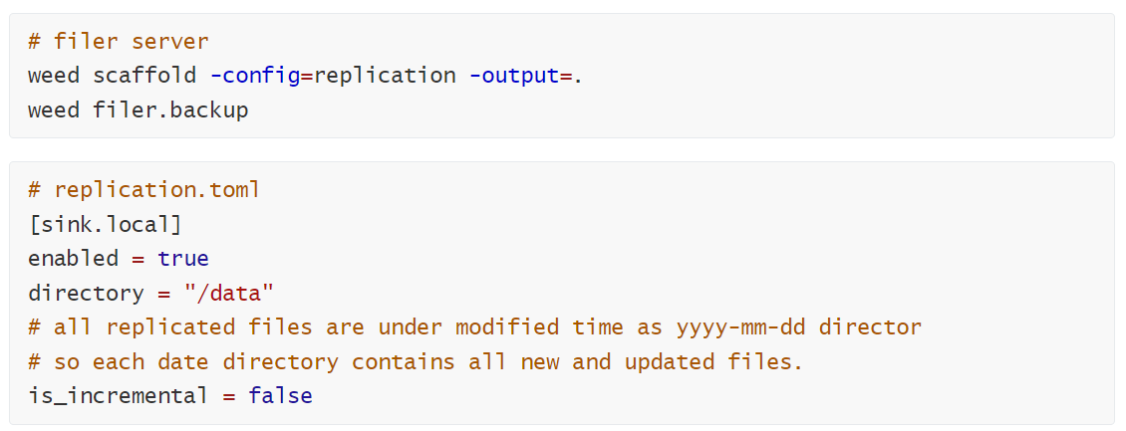
6. Backup and Recovery
Backup folders and files dung weed shell:
Notes:
Backup folders and files under filer dir (including meta data): https://github.com/seaweedfs/seaweedfs/wiki/Async-Backup
Backup filer metadata store: https://github.com/seaweedfs/seaweedfs/wiki/Async-Filer-Metadata-Backup
Backup volume data (manual backup data by volume ID): https://github.com/seaweedfs/seaweedfs/wiki/Data-Backup
Backup PVCs: https://github.com/seaweedfs/seaweedfs/wiki/Kubernetes-Backups-and-Recovery-with-K8up

Slide 15
6. Backup and Recovery
Recovery folders and files dung weed shell:
Có thể dung API để upload nhưng chỉ upload được files!
Notes:
Backup folders and files under filer dir (including meta data): https://github.com/seaweedfs/seaweedfs/wiki/Async-Backup
Backup filer metadata store: https://github.com/seaweedfs/seaweedfs/wiki/Async-Filer-Metadata-Backup
Backup volume data (manual backup data by volume ID): https://github.com/seaweedfs/seaweedfs/wiki/Data-Backup
Backup PVCs: https://github.com/seaweedfs/seaweedfs/wiki/Kubernetes-Backups-and-Recovery-with-K8up

Slide 16
Thank you for listening!

