Slide 1
Robust AIGC detection under JPEG / blur / crop
TikTok TechJam 2026 · Challenge 5 · CLIP-B last-4 0.990 · fuse last4+D3 0.993
Score = 0.50×AUC_clean + 0.50×AUC_robust (not Acc@0.5)
Model ≪ 2B · official val and EvalGEN never trained
1 / 14
Notes:
开场：社交流转后的图会被压、糊、裁。分数是干净 AUC 和 14 档变换 AUC 各一半，不是 0.5 准确率。提交 last-4 或双权重 fuse。

Slide 2
Four sections
Each section is one story, not a dump of ablations.
1 Data — CIFAKE → SID → D3 → D5 → D6; generators, i2i, no-GAN, transforms
2 Model — MLP/FFT → unfreeze / consistency / RGB+freq / 336 → why fuse
3 Eval — official demonstration val, then held-out EvalGEN (Nova)
4 Bad cases — FN cluster in non-photoreal styles + the HTML gallery
2 / 14
Notes:
四页主线。数据讲分布和抉择；模型讲为什么最后 fuse；评估分官方和 EvalGEN；badcase 用画册。

Slide 3
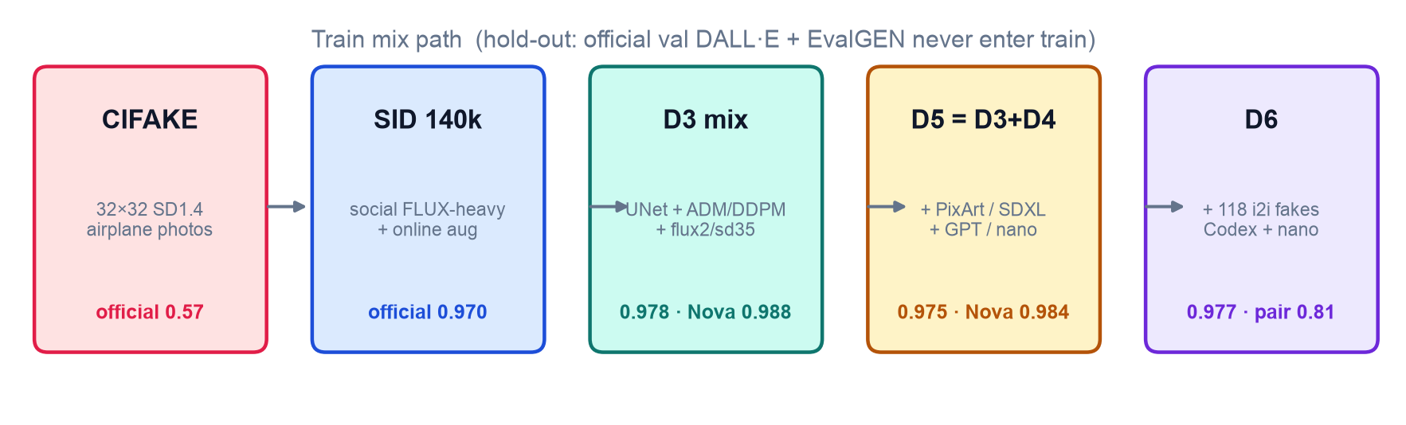
Data path: domain first, then architecture coverage
CIFAKE 32×32 does not transfer. SID is social. Mix-ins replace equal SID FLUX.
D3 is the mix that lifts Nova. D5 = D3 ∪ D4 ≈ D3 on official (0.975 vs 0.978), not a jump.
D6 = D5 + 118 whole-image i2i fakes (no paired reals): official 0.977, pair_acc 0.805. Fuse last4+D6 = 0.9929 vs D3 fuse 0.9930 — do not submit D6.
3 / 14
Notes:
CIFAKE 官方 0.57，换 SID 社交域加 online aug 到 0.970。D3 补 UNet 和 pixel，Nova 起来。D5 并上 PixArt/GPT 官方还略掉。D6 只加 118 张 i2i fake：官方 0.977，pair_acc 0.805，fuse 0.9929，仍提交 last-4 或 last4+D3。

Slide 4
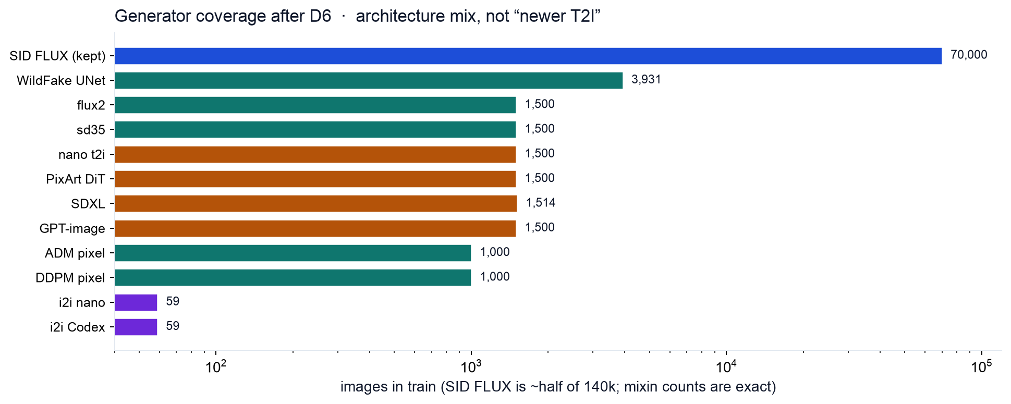
Generator distribution: fill holes, do not stack more FLUX
4 / 14
Notes:
SID 已经是 FLUX 海。mixin 是等权换掉同等数量 FLUX。D3 的 WildFake UNet 4k 和 ADM/DDPM 1k 才是 Nova 的活性成分。D4 的新 T2I 数量看起来均衡，但对 Nova 几乎没贡献。

Slide 5
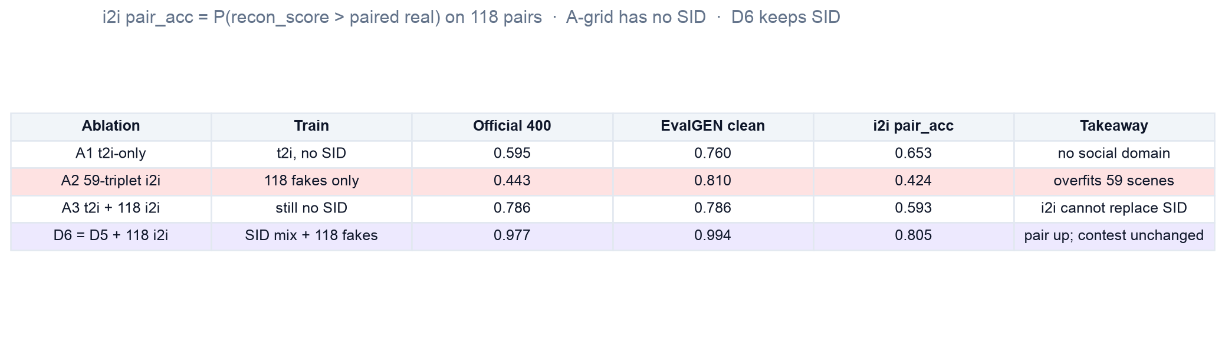
i2i: 59 triplets, not 8k — SID still required
pair_acc = P(recon_score > paired real) on 118 pairs. A-grid has no SID.
A2 i2i-only official 0.443 / pair 0.42: 59 scenes overfit. Whole-image i2i cannot replace SID.
D6 keeps the SID mix and only adds 118 i2i fakes: pair_acc 0.805, official 0.977. Contest submit stays last-4 / last4+D3.
SID tampered (label=2) is a local edit, not whole-image i2i. Do not mine DALL·E / EvalGEN into train.
5 / 14
Notes:
i2i 必须是整图 triplet。A2 只训 59 组会过拟合，官方 0.44。没有 SID 的 A1/A3 官方最高 0.79。D6 在 D5 上加 118 张 fake，pair_acc 到 0.805，官方仍 0.977，不能换提交。GAN 不进训：官方和 EvalGEN 都不是 StyleGAN。

Slide 6
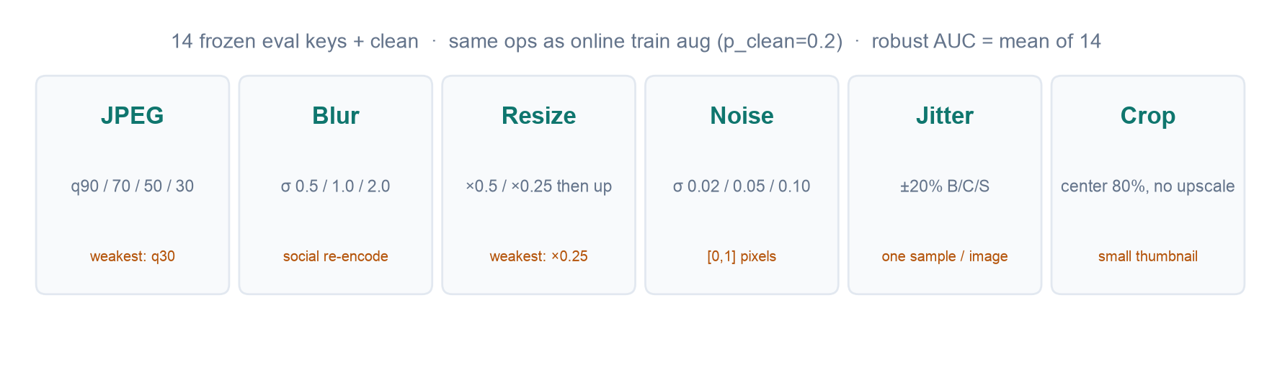
Transforms: one spec for train aug and frozen eval
Pillow + NumPy spec. Crop 80% is not resized back. Jitter is sampled ±20% per image.
Train: online random official ops, p_clean=0.2. Eval: 14 keys frozen, seed = sha1(image|key|v2).
Weakest remaining keys for fuse: JPEG-30 and resize ×0.25 (~0.984) — still far above CIFAKE.
6 / 14
Notes:
变换不是事后补丁：训练就在同样 14 档上随机增强。CIFAKE 那条没做增强，blur/resize 会塌。评测 crop 不放大，和题面 resize then upscale 区分开。

Slide 7
Model: MLP / FFT / pixel-only are dead ends on DALL·E
Same frozen CLIP-B linear unless noted. Contest score is AUROC, not SID-val Acc.
CIFAKE CLIP-B / DINOv2 / MLP probes: official formula 0.50–0.79. Do not pick the backbone here.
C-Pixel (500 ADM + 500 DDPM): full official ~0.65, 1 FP / 8838 FN — never fires on DALL·E.
FFT / high-pass as a second tower (SID dual RGB+HP): no shortcut, but no gain (0.966 vs SID 0.970).
Takeaway: pixel/FFT can be a thin mix-in (D3), not the detector.
7 / 14
Notes:
模型线从 CIFAKE 线性头和 FFT 探针开始，官方 val 接近随机。C-Pixel 在 DALL·E 上几乎全漏。频域双路没踩捷径但也没涨。所以后来只把 ADM/DDPM 当薄 mixin，不当主模型。

Slide 8
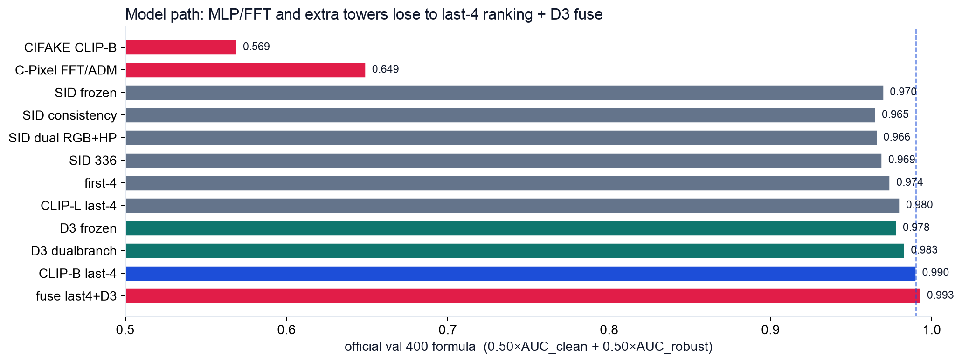
Unfreeze / consistency / dual / 336 — then stop stacking
8 / 14
Notes:
一致性损失是 Acc 口径最干净的涨，但比赛看 AUC：last-4 0.990 远高于 consistency 0.965。336 在小 resize/blur 的 Acc 还掉。first-4 0.974，CLIP-L last-4 0.980，都不如 CLIP-B last-4。D3 dualbranch 0.983 赢冻结 D3，仍输 fuse。

Slide 9
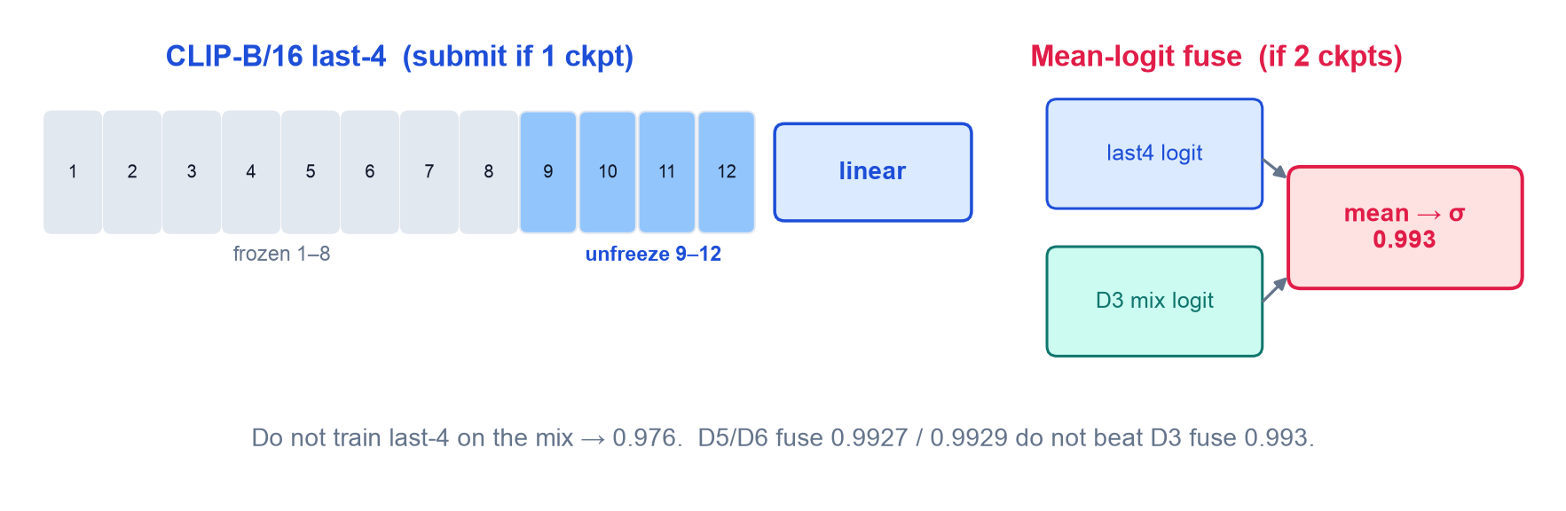
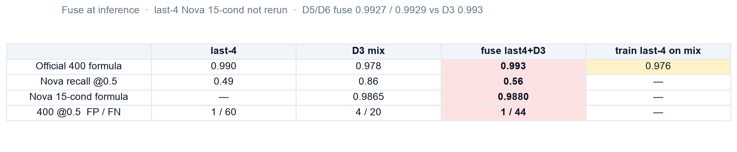
Why fuse: complementary heads, not one bigger net
last-4 ranks DALL·E (0.990) but misses Nova at 0.5 (rec 0.49). D3 is the opposite: Nova rec 0.86, official only 0.978.
Average logits at inference → 0.993. Training last-4 on the mix drops official to 0.976. D5/D6 fuse 0.9927 / 0.9929 do not beat D3.
9 / 14
Notes:
两个头互补：last-4 负责官方 DALL·E 排序，D3 补 Nova 召回。不能把 last-4 再训到 mix 上（0.976）。D5/D6 更多 mixin 的 fuse 没有超过 0.993，所以提交仍是 last4+D3。0.5 召回 fuse 只有 0.56，AUC 才是分数。

Slide 10
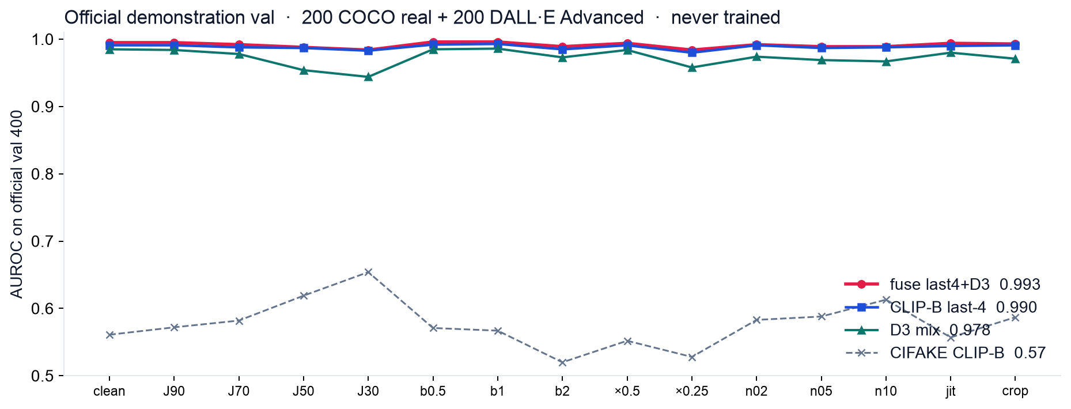
Eval: official demonstration val
400-subset screen (seed 0, 200/200). last-4 full 13,843 = 0.989, same ranking.
10 / 14
Notes:
官方演示集 COCO + DALL·E，训练禁入。400 是日筛，full 验证 last-4 0.989 同序。fuse 每一档都在 0.984 以上。CIFAKE 那条在 0.55 附近，用来说明域不对。

Slide 11
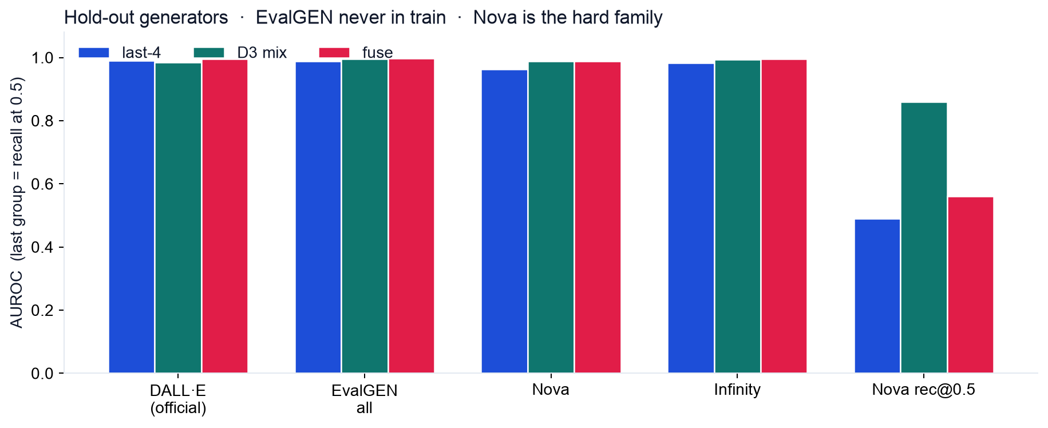
Eval: EvalGEN hold-out (Flux / GoT / Infinity / OmniGen / Nova)
11 / 14
Notes:
EvalGEN 五家都没进训练。GoT/OmniGen 大家接近 1.0，不要当 unseen 代理。Nova 15 档：D3 0.9865，fuse last4+D3 0.9880。last-4 召回 0.49，D3 0.86，fuse 0.56，阈值要讲清楚。

Slide 12
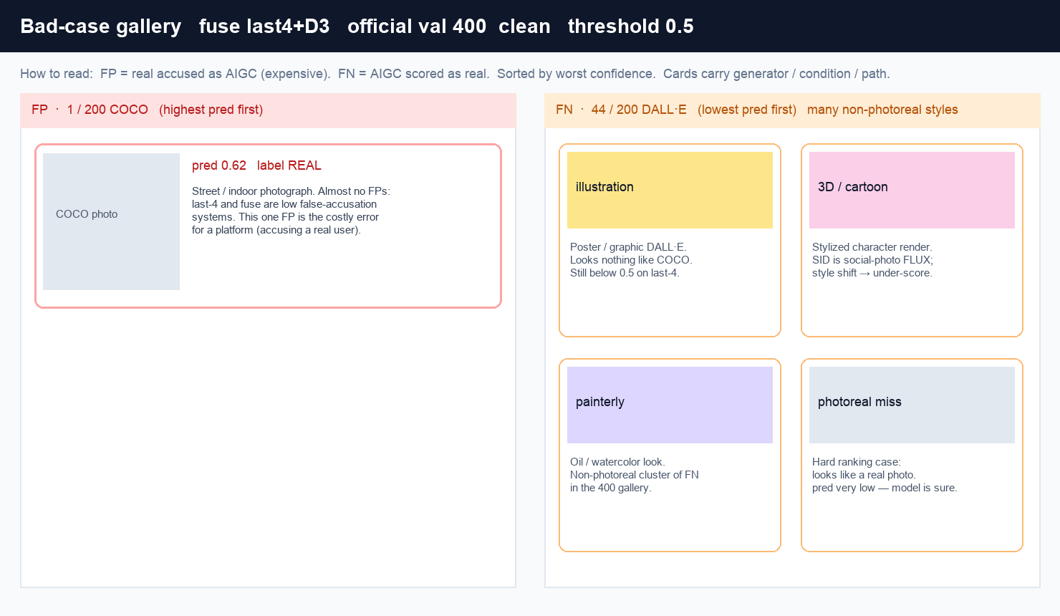
Bad cases: FN are often non-photoreal — not only “perfect fakes”
400 clean @0.5: fuse 1 FP / 44 FN. last-4 1 / 60. D3 4 / 20.
12 / 14
Notes:
画册里 FN 大量是漫画、插画、卡通、绘画风 DALL·E，不是社交实拍目标。SID 是照片级 FLUX，画风一偏分数会过低。平台场景（实拍社交图）同一阈值下漏检预期会少。但仍有 pred 极低的实拍风 DALL·E，不能说漏检会消失。FP 几乎没有，讲平台误杀贵。

Slide 13
Gallery as a tool, not a screenshot dump
scripts/badcase_gallery.py — FP/FN split, sort by worst pred, generator + condition on each card.
400-subset = one HTML. Full val = paged folder (36 thumbs/page). Open index.html locally, not Jupyter.
Pairwise pages: last4 → fuse fixed 16 FN, FP stayed 1. SID-aug → last4 FN 37→60 (AUC up, Acc@0.5 down).
Download outputs/tables/badcase_galleries/ + badcase_compare/. Demo video: open fuse_u4_d3_400_clean.html.
13 / 14
Notes:
录视频时打开本机 HTML：先 FN 插画风，再那一张 FP。对照页证明 fuse 在修漏检而不是新制造误杀。强调 0.5 不是竞赛指标，last-4 解冻后 Acc 掉、AUC 涨。

Slide 14
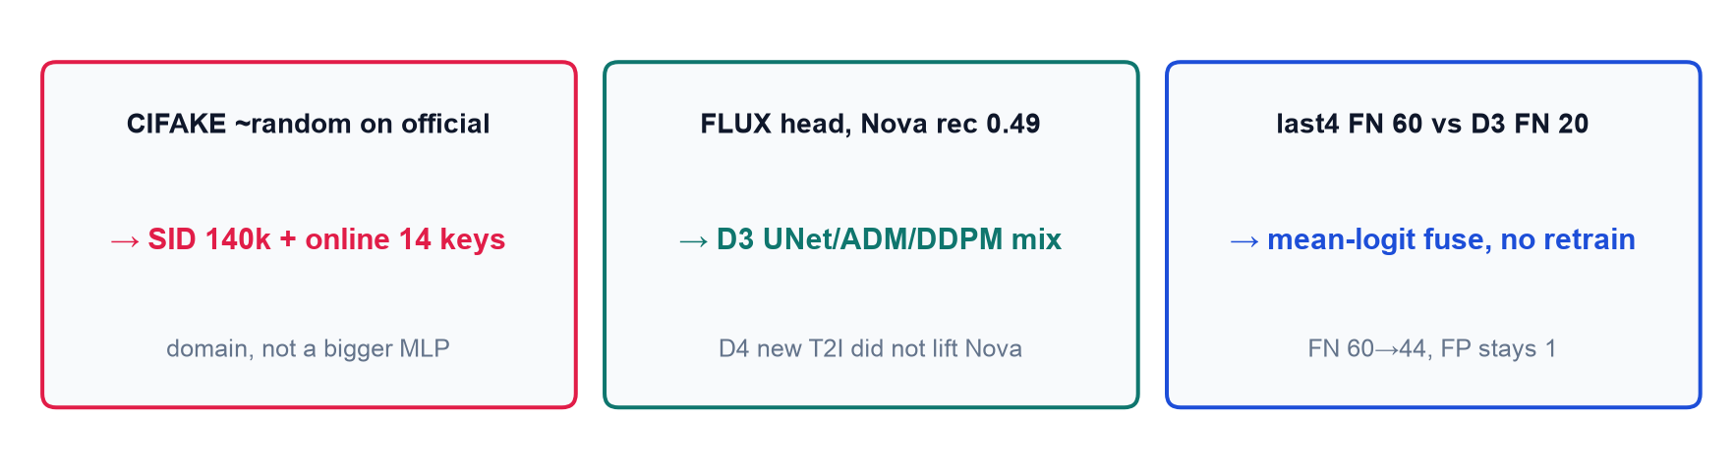
Submit
1 ckpt: experiments/clipb16_linear_sid_unfreeze4/ckpts/best.pt formula 0.990
2 ckpts: mean logit with clipb16_linear_sid_d3_mix formula 0.993
python predict.py <dir> out.json — {image_path, pred=P(AIGC)}
14 / 14
Notes:
收束：域、架构覆盖、互补头。仓库公开，predict.py 一行。不要再念 DINOv2 0.90。

