Slide 1
Robust Detection of AI-Generated Images Under Real-World Transformations
TikTok TechJam 2026
Team Jambuddy
He Tianqi tianqi008@e.ntu.edu.sg
Yu Shenli yxy021104@gmail.com
Zheng Congyun CONGYUN001@e.ntu.edu.sg
Wang Weijie wangweijiejames@163.com
Tan Linyun tanlinyun@126.com
1 / 6
Notes:
0:00–0:25. Hi, we are Team Jambuddy. After a photo is shared, it is JPEG-compressed, blurred, and cropped. The contest score is 0.50 times clean AUC plus 0.50 times the mean AUC under fourteen official transforms — not accuracy at 0.5. Our detector is CLIP-B, about 86 million parameters, well under the 2B cap.

Slide 2
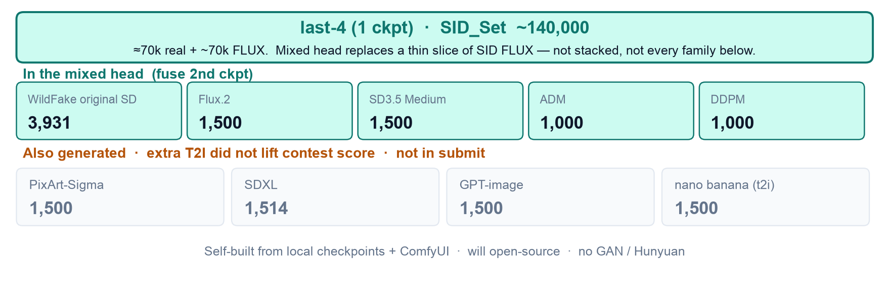
Mixed data
last-4 trains on SID only. We generated the families below; only the architecture mix is in the fused head.
1 ckpt last-4 = SID ~140k + online aug. Extra T2I (PixArt / GPT / SDXL / nano) was built, then dropped.
2 ckpts: fuse last-4 with a mixed head on WildFake SD + Flux.2 + SD3.5 + ADM/DDPM (replace equal SID FLUX).
Self-built from local checkpoints and ComfyUI; we will open-source the mix. No GAN / Hunyuan.
2 / 6
Notes:
0:25–1:10. Most of the training set is still SID_Set: about 140,000 images — 70k real photos and 70k FLUX fakes. The one-checkpoint detector trains on SID only. We also generated other families from local checkpoints and ComfyUI, and we will open-source that mix. If two checkpoints are allowed, we fuse last-4 with a mixed head trained on WildFake original SD, Flux.2, SD 3.5, ADM, and DDPM — replacing an equal number of SID FLUX, not stacking. We further generated PixArt, SDXL, GPT-image, and nano banana. Those extra T2I sets did not lift the contest score, so they are not in the submitted checkpoint. No GAN: contest and EvalGEN are diffusion, flow, and autoregressive.

Slide 3
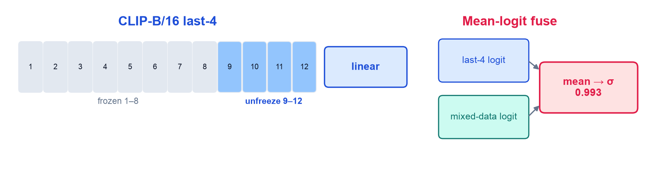
Fuse architecture
CLIP-B last-4 (0.990) beats CLIP-L last-4 (0.980), ResNet SID (0.779), and DINOv2 (0.79).
resize 336, RGB+freq, and first-4 all lose on the contest formula. Mean-logit fuse = 0.993.
3 / 6
Notes:
1:10–1:55. We unfreeze the last four CLIP-B vision blocks. That scores 0.990 on the official 400 screen. A larger backbone does not help: CLIP-L last-4 is 0.980, ResNet SID 0.779, DINOv2 about 0.79. Resize 336, RGB plus frequency, and unfreezing the first four all lose on the contest formula. If two checkpoints are allowed, we average logits of last-4 and a mixed-data head — fuse 0.993. One command: folder in, JSON out, pred = P(AIGC). Official val never enters training.

Slide 4
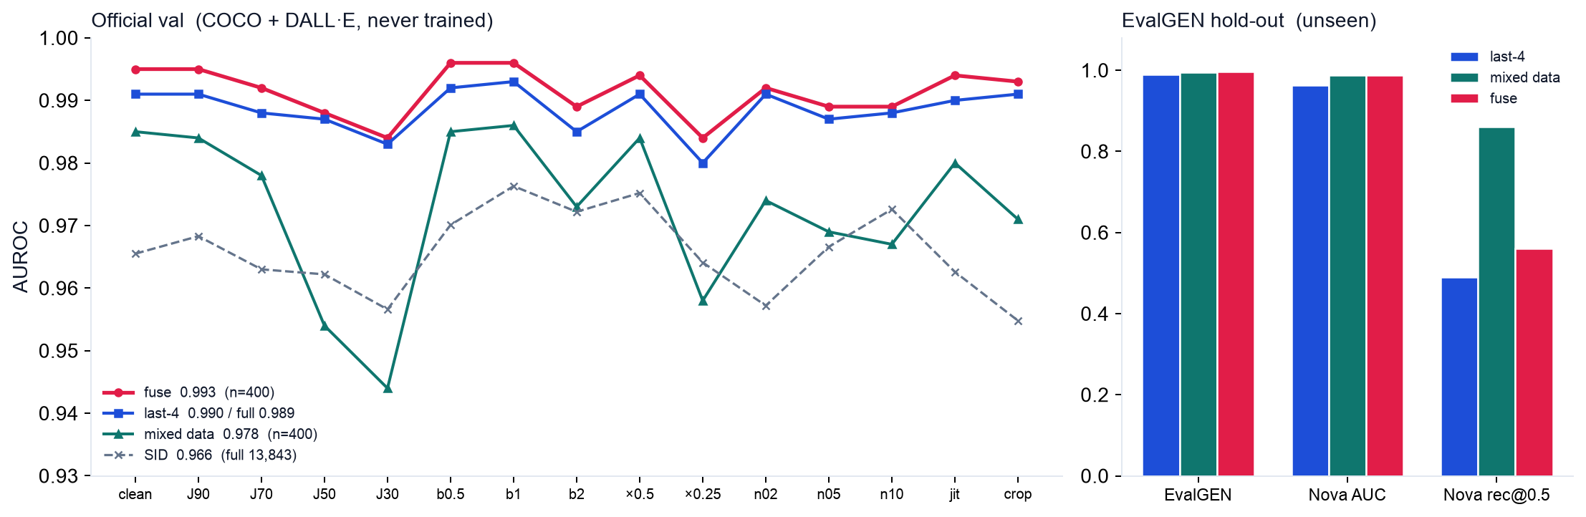
Evaluation
Official val = contest score. EvalGEN is unseen generators (never trained), Nova is the hard family.
Official val = COCO real + DALL·E Advanced. SID full 13,843 formula 0.966; last-4 full 0.989.
EvalGEN (Flux / GoT / Infinity / OmniGen / Nova) tests generator shift. Nova recall: mixed 0.86 vs last-4 0.49.
4 / 6
Notes:
1:55–2:45. Left is the contest score. Official val is COCO reals plus DALL·E Advanced. Frozen SID on the full 13,843 is 0.966; last-4 on that full set is 0.989, same ranking as the 400 screen. Right is EvalGEN: Flux, GoT, Infinity, OmniGen, Nova — never trained. Nova is the hard family. Mixed data lifts Nova recall at 0.5 from 0.49 to 0.86, and Nova AUC to 0.988. Fuse keeps last-4’s DALL·E ranking and the mixed head’s Nova AUC.

Slide 5
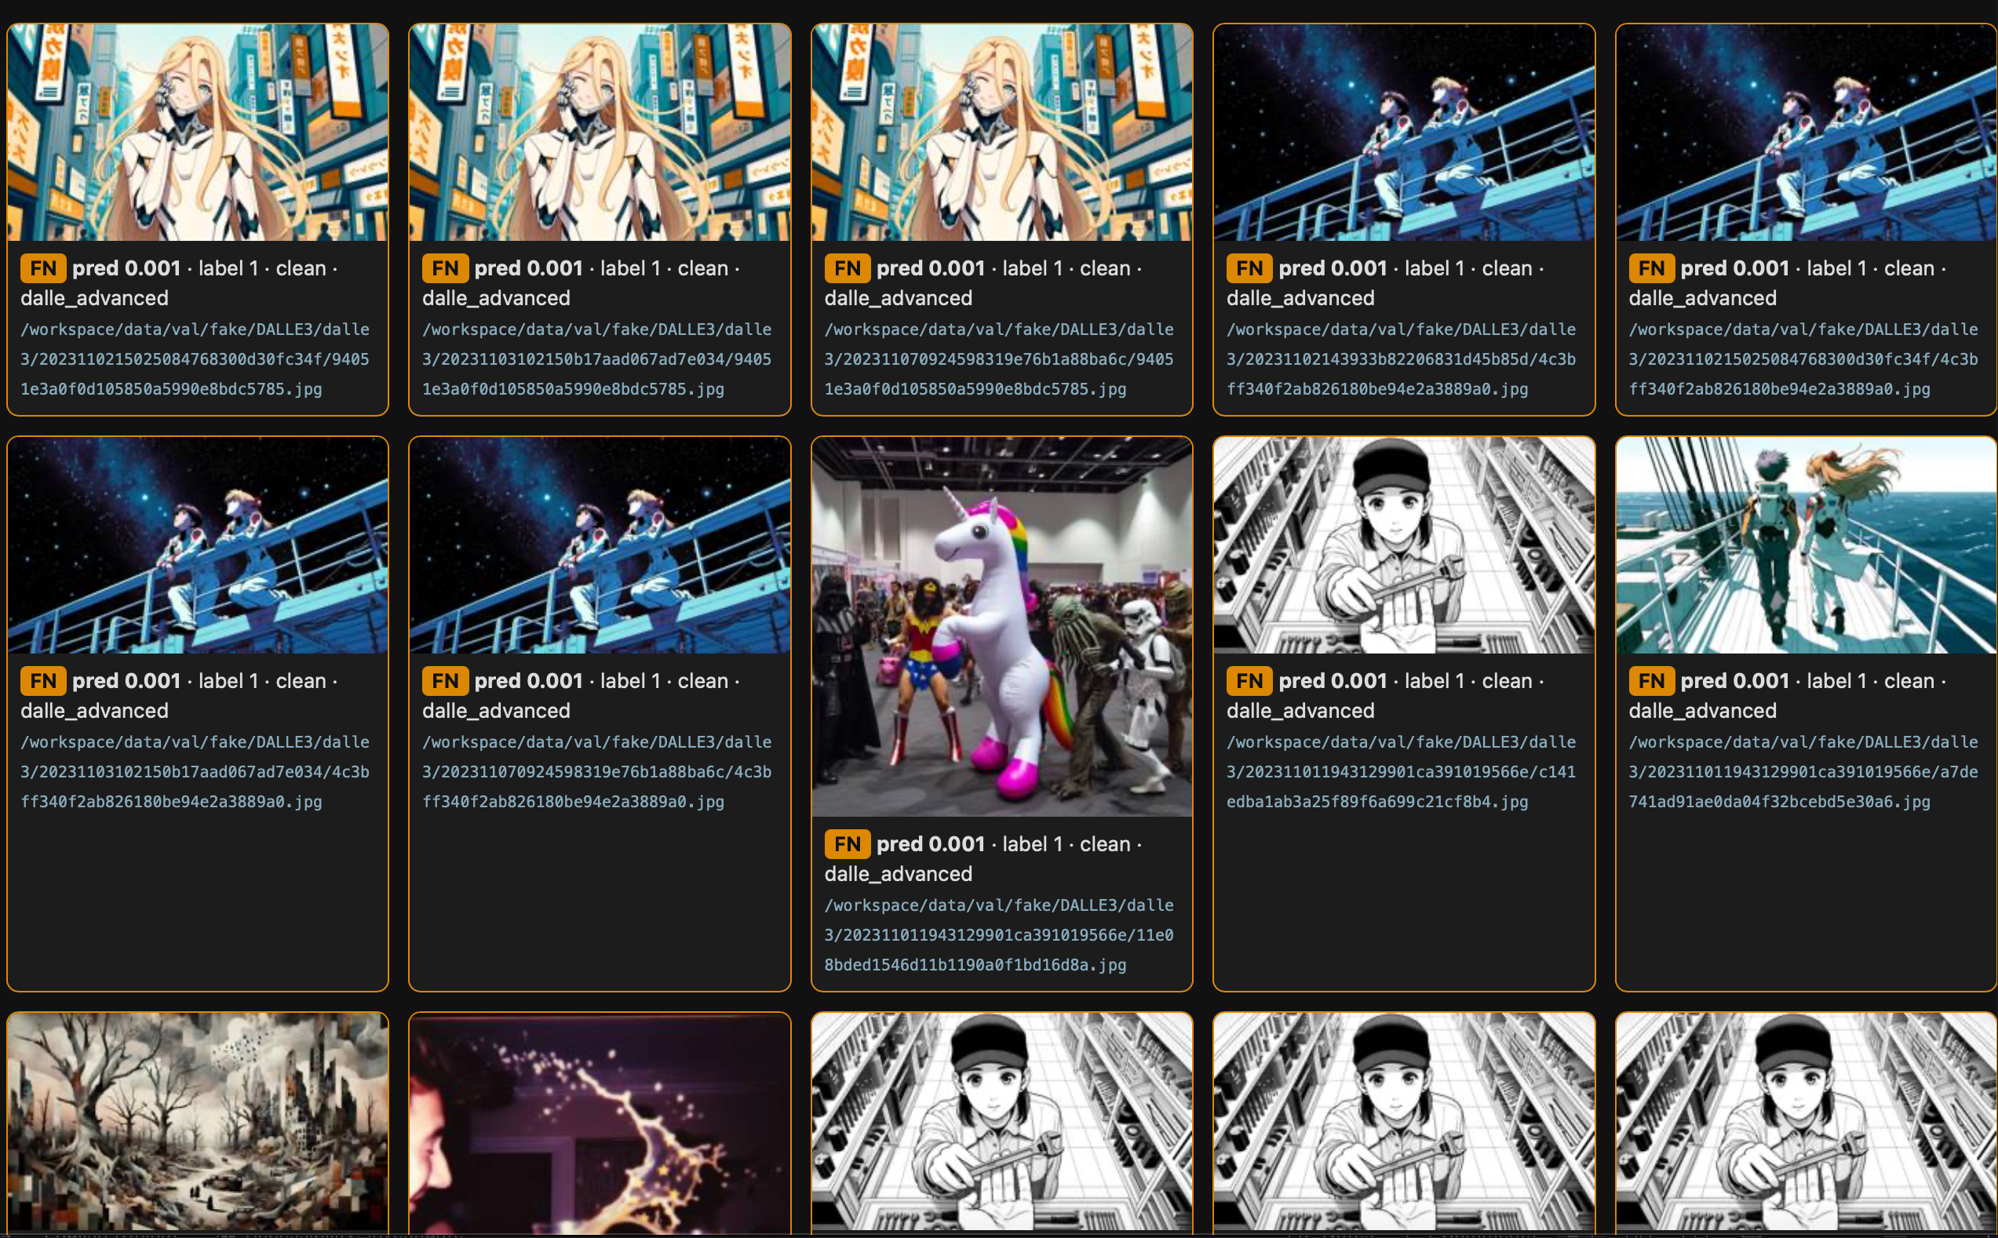
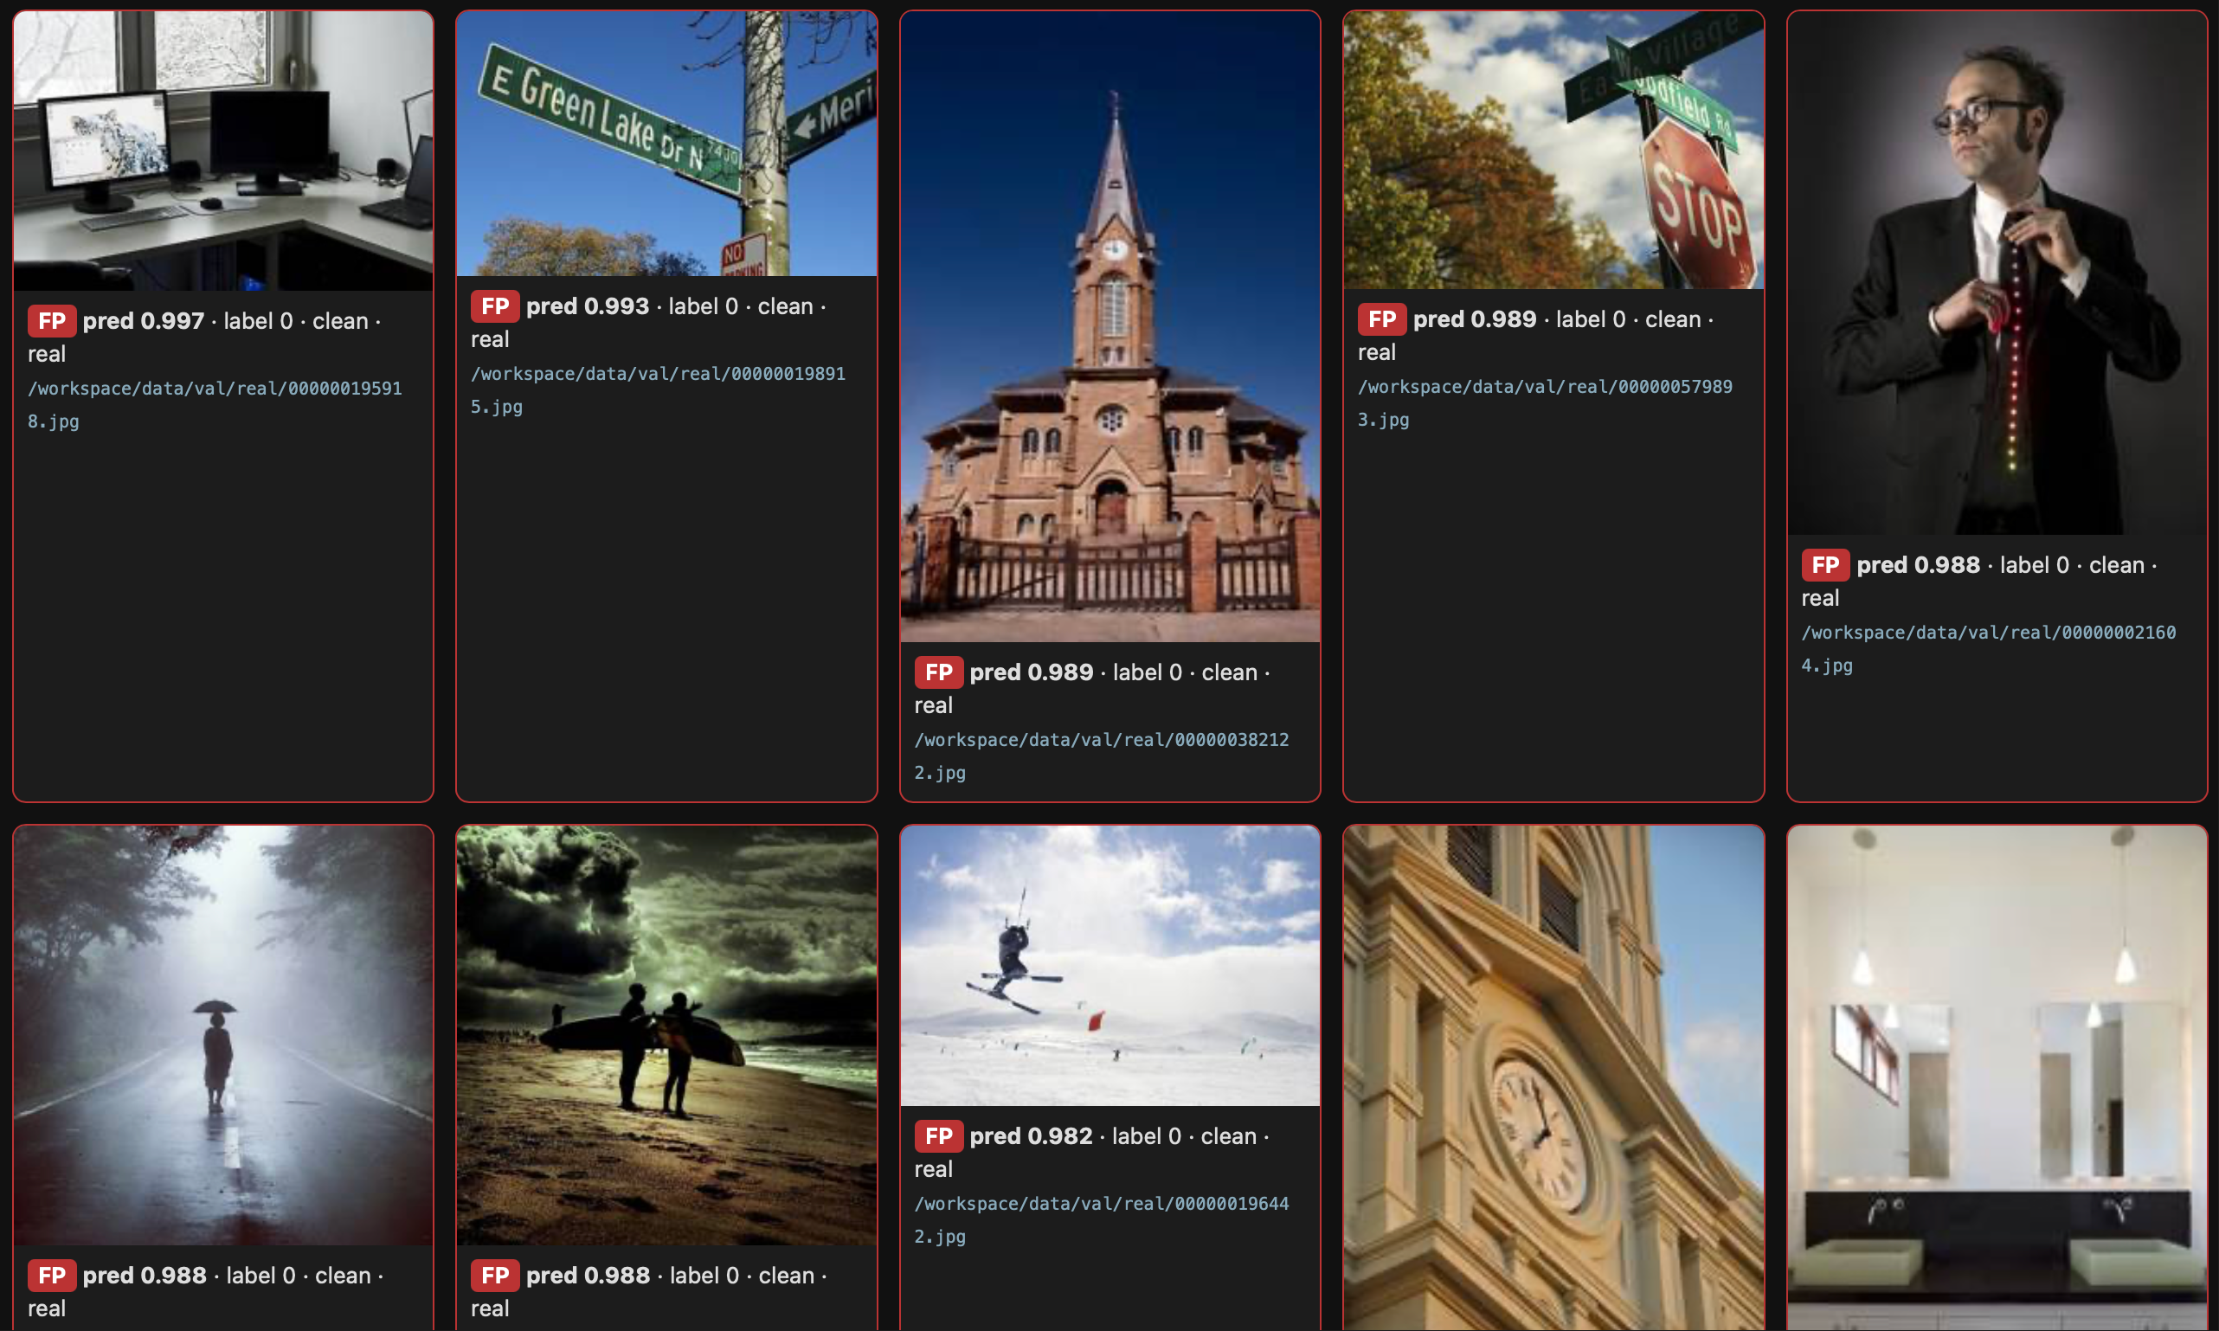
Bad-case gallery
HTML gallery: FP / FN split, sort by worst pred, generator + path on each card. Open locally.
FN Badcases
FP Badcases
Fuse @0.5 on 400: 1 FP / 44 FN — almost never accuses a real photo.
FN cluster: comics / anime / illustration DALL·E (pred ≈ 0.001). Target is social photos, not comics.
Photoreal social AIGC should miss less at the same threshold. Residual: some photoreal DALL·E still score very low.
5 / 6
Notes:
2:45–3:25. HTML gallery: false positives versus false negatives, sorted by worst prediction. At threshold 0.5, fuse on the 400 screen is one false positive and forty-four false negatives — we almost never accuse a real photo. Many misses are non-photoreal DALL·E: comics, anime, illustration, scored near 0.001. That is outside our social-photo target, so on a photoreal social feed we expect fewer misses at the same threshold. Some remaining misses are still photoreal DALL·E, so this is not a free lunch. High AUC does not mean 0.5 is the right operating point.

Slide 6
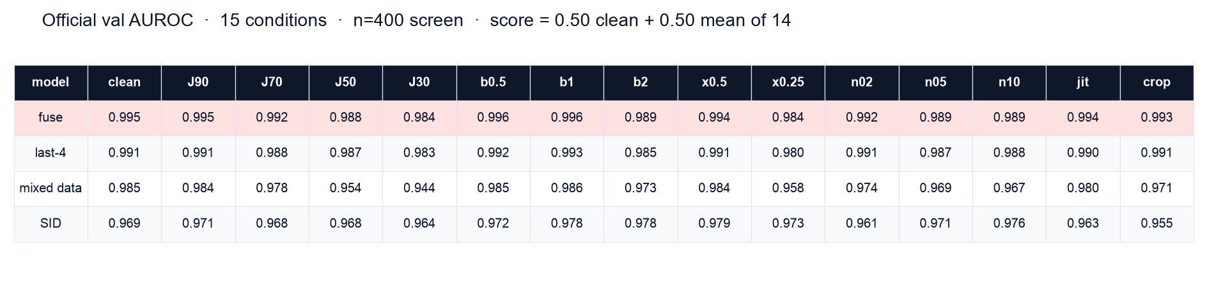
Robustness: 15 official conditions
JPEG / blur / resize / noise / jitter / center-crop. Weakest keys: JPEG-30 and resize ×0.25.
Contest score = 0.50×AUC_clean + 0.50× mean AUROC of the 14 transform keys.
Fuse stays ≥ 0.984 on every key. Mixed data dips on hard JPEG / tiny resize; SID is flatter but lower.
6 / 6
Notes:
3:25–4:00. Contest formula is half clean AUC and half the mean of fourteen transform keys: JPEG, blur, resize, noise, jitter, center crop. Fuse stays at or above 0.984 on every key. Weakest keys: JPEG-30 and resize ×0.25. Mixed data dips there; SID is flatter but lower. The repository is public. Install CLIP-B, load the checkpoint, run predict.py. Thank you.

