Slide 1

Mastering Ethereum: Building Smart Contracts and DApps
Chia James Chang

Slide 2
Agenda
What is Ethereum?
Ethereum Basics
Ethereum Clients
Cryptography
Wallets
Transactions
Smart Contracts and Solidity
Smart Contracts and Vyper
Smart Contract Security
Tokens
Oracles
Decentralized Applications (DApps)
The Ethereum Virtual Machine
Consensus
Miscellaneous
References

Slide 3
1. What is Ethereum?

Slide 4
1. What is Ethereum?
Ethereum is often described as “the world computer.”
Computer science perspective
Deterministic but unbounded state machine
Globally accessible singleton state
Virtual machine
Practical perspective
Open source, globally decentralized
Smart contracts
Blockchain
“Ether” cryptocurrency

Slide 5
Ethereum vs Bitcoin
Common elements
Peer-to-peer (P2P) network.
Byzantine fault-tolerant consensus algorithm (proof-of-work).
Cryptographic primitives: digital signatures and hashes, digital currency (ether).
Different elements
Purpose
Utility currency (ether) vs digital currency payment network.
Construction
Ethereum is a general-purpose vs Bitcion’s script is limited.
Ethereum’s language (Solidity) is Turing complete vs Bitcion’s script is constrained to simple true/false of evaluation of spending conditions.

Slide 6
Components of a Blockchain
Peer-to-peer (P2P) network.
Messages: Transactions.
Consensus rules.
State machine.
Cryptographically secured blockchains.
Consensus algorithm.
Game-theoretically sound incentivization scheme (proof-of-work (PoW), proof-of-stake (PoS)).
Clients (open source software implementations of the above)
Characteristics: open, public, global, decentralized, neural, and censorship-resistant.

Slide 7
The birth of Ethereum
In December 2013, Vitalik Buterin started sharing a whitepaper that outlined the idea behind Ethereum: a Turing-complete, general-purpose blockchain.
In December 2013, Vitalik Buterin and Gavin Wood refined and evolved the idea, together building the protocol layer that became Ethereum.
The Ethereum platform was designed to abstract these details (P2P networks, blockchains, consensus algorithms, etc.) and provide a deterministic and secure programming environment for decentralized blockchain applications.
July 30, 2015, the first Ethereum block wa mined.

Slide 8
Ethereum’s four stages of development
Block #0: Frontier-Initial stage (July 30, 2015 – March 2016).
Block #200,000: Ice Age (hard fork).
Block #1,150,000: Homestead-Second stage (March 2016).
Block #1,192,000: DAO (hard fork) (Ethereum and Ethereum Classic).
Block #2,463,000: Tangerine Whistle (hard fork).
Block #2,675,000: Spurious Dragon (hard fork).
Block #4,370,000: Metropolis Byzantium-Third stage (October 2017).
Byzantium (first hard fork) & Constantinople (second fork).
Final stage of Ethereum’s deployment: Serenity.

Slide 9
Ethereum: a general-purpose blockchain
Ethereum is a distributed state machine.
Ethereum tracks the state transitions of a general-purpose data store (key-value tuple).
Two of the critical differences
Ethereum state changes are governed by the rules of consensus.
The state is distributed globally.
Ethereum answers the question: “What if we could track any arbitrary state and program the state machine to create a world-wide computer operating under consensus?”

Slide 10
Ethereum’s components
P2P network. TCP port 30303 and protocol called DEVp2p.
Consensus rules.
Transactions.
State machine.
Ethereum Virtual Machine (EVM).
EVM programs called “smart contracts” written in Solidity.
Data structures.
Transactions.
System state in serialized hashed data structure called a Merkle Patricia Treee.
Consensus algorithm.
PoW: Bitcoin’s consensus model, Nakamoto Consensus.
PoS: codenamed Casper.
Economic security.
Etheash: PoW algorithm.
Clients.
Go-Ethereum (Geth).
Parity.

Slide 11
From general-purpose blockchains to Decentralized Applications (DApps)
Ethereum started as a general-purpose blockchain. But very quickly, Ethereum’s vision expanded to become a platform for programming DApps.
DApps is, at the very least, a smart contract and a web user interface.
A DApp is a web application that is built on top of open, decentralized, peer-to-peer infrastructure services.
A DApp is composed of:
Smart contracts on a blockchain.
A web frontend user interface.
A decentralized (P2P) storage protocol and platform.
A decentralized (P2P) messaging protocol and platform.

Slide 12
Third age of the Internet (web3)
Web3, the third “version” of the web, was first proposed by Dr. Gavin Wood: decentralization with peer-to-peer protocols into every aspect of a web application.
Ethereum web3.js JavaScript library, which bridges JavaScript applications that run in your browser with the Ethereum blockchain.
Includes an interface to a P2P storage network called Swarm.
A P2P messaging service called Whisper.

Slide 13
Ethereum’s development culture
The mantra is “move fast and break things.”
Ethereum’s development culture is characterized by rapid innovation, rapid evolution, and a willingness to deploy forward-looking improvements, even if this is at the expense of some backward compatibility.
As a developer, you must remain flexible and be prepared to rebuild your infrastructure as some of the underlying assumptions change.

Slide 14
Why learn Ethereum?
Blockchains have a very steep learning curve, as they combine multiple disciplines into one domain:
Programming
Information security
Cryptography
Economics
Distributed systems
Peer-to-peer networks
Ethereum makes this learning curve a lot less steep, so you can get started quickly.
Ethereum is a developer’s blockchain, built by developers for developers.

Slide 15
What this book will teach you
This book dives into Ethereum and examines every component.
You will start with a simple transactions, dissect how it works, build a simple contract, make it better, and follow its journey through the Ethereum system.
You will learn not only how to use Ethereum—how it works—but also why it is designed the way it is.
You will be able to understand how each of the pieces works, and how they fit together and why.

Slide 16
2. Ethereum Basics

Slide 17
2. Ethereum Basics
Start exploring Ethereum
Leaning how to use wallets
How to create transactions
How to run a basic smart contract.

Slide 18
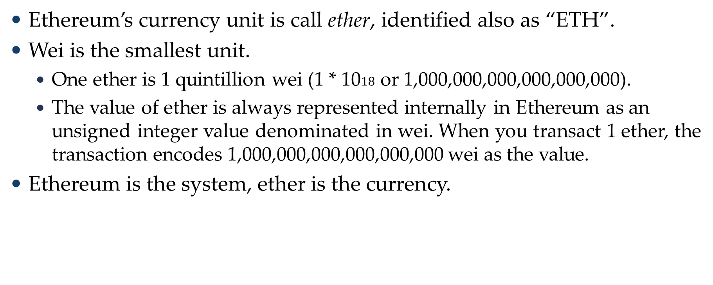
Ether currency units
Ethereum’s currency unit is call ether, identified also as “ETH”.
Wei is the smallest unit.
One ether is 1 quintillion wei (1 * 10$18$ or 1,000,000,000,000,000,000).
The value of ether is always represented internally in Ethereum as an unsigned integer value denominated in wei. When you transact 1 ether, the transaction encodes 1,000,000,000,000,000,000 wei as the value.
Ethereum is the system, ether is the currency.

Slide 19
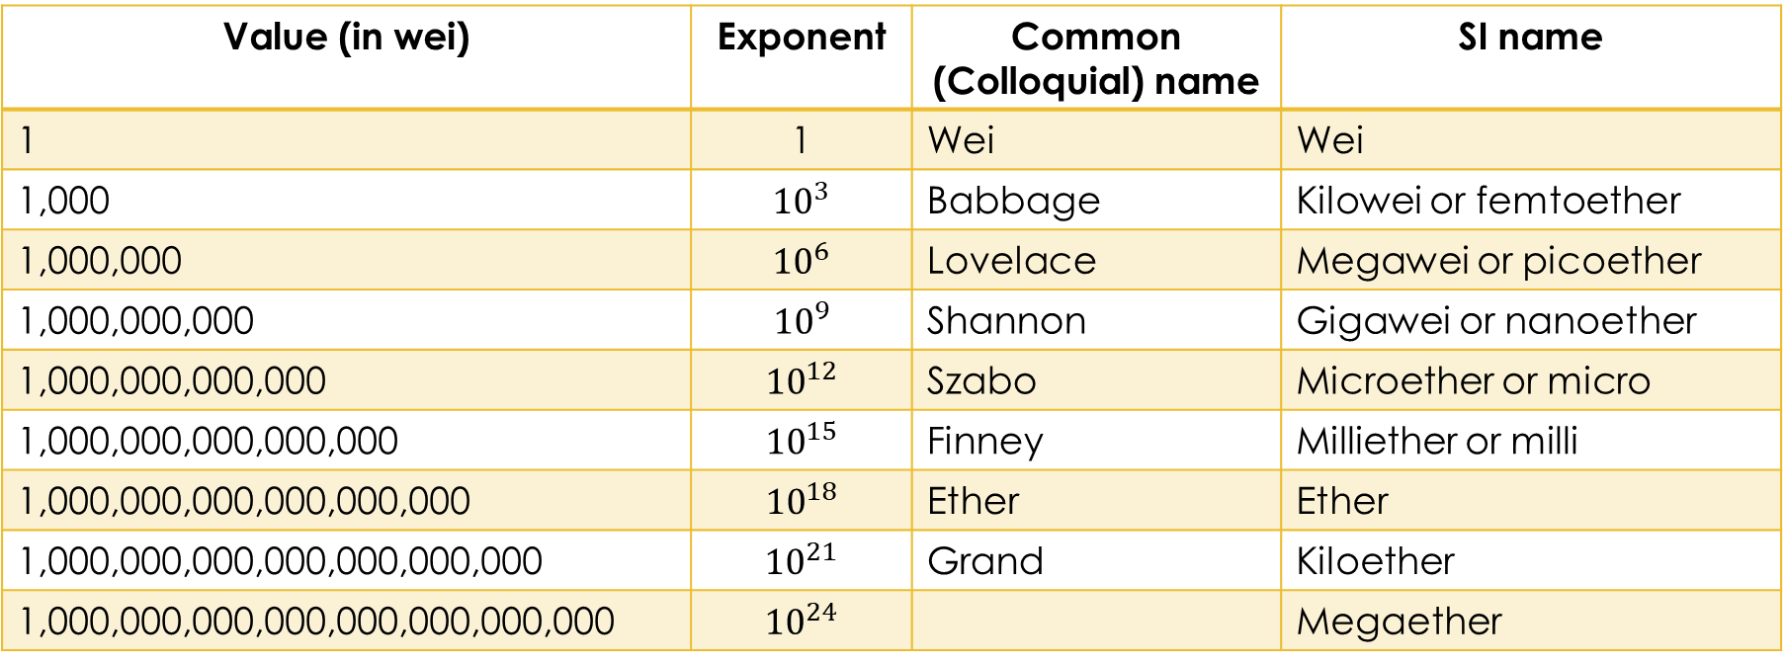
Ether denominations and unit names
Value (in wei) | Exponent | Common (Colloquial) name | SI name
1 | 1 | Wei | Wei
1,000 | $${10}^{3}$$ | Babbage | Kilowei or femtoether
1,000,000 | $${10}^{6}$$ | Lovelace | Megawei or picoether
1,000,000,000 | $${10}^{9}$$ | Shannon | Gigawei or nanoether
1,000,000,000,000 | $${10}^{12}$$ | Szabo | Microether or micro
1,000,000,000,000,000 | $${10}^{15}$$ | Finney | Milliether or milli
1,000,000,000,000,000,000 | $${10}^{18}$$ | Ether | Ether
1,000,000,000,000,000,000,000 | $${10}^{21}$$ | Grand | Kiloether
1,000,000,000,000,000,000,000,000 | $${10}^{24}$$ |  | Megaether

Slide 20
Choosing an Ethereum Wallet
Wallet: a software application that helps you manage your Ethereum account. In short, an Ethereum wallet is your gateway to the Ethereum system.
Wallet holds your keys and can create and broadcast transactions on your behalf.
We’ve selected three different types of wallets to use:
Mobile wallet
Desktop wallet
Web-based wallet
Good starter wallets:
MetaMask
Jaxx
MyEtherWallet (MEW)
Emerald Wallet

Slide 21
Control and responsibility
Each user of Ethereum can—and should—control their own private keys, which are the things that control access to funds and smart contracts.
Do not improvise security.
The more important the account, the higher security measures should be taken.
Never store your private key in plain form, especially digitally.
Private keys can be stored in an encrypted form, as a digital “keystore” file.
Do not store any passwords in digital documents.
When you are prompted to back up a key as a mnemonic work sequence, use pen and paper to make a physical backup.

Slide 22
Control and responsibility
For large transactions, do a small test transaction first.
For a new account, test it first.
Be aware of public block explorers.

Slide 23
Getting started with MetaMask
Open Google Chrome browser and navigate to: https://chrome.google.com/webstore/category/extensions
Search “MetaMask” and verify and download the real MetaMask.
Creating a Wallet
MetaMask will generate a wallet for you and show you a mnemonic backup consisting 12 English words. Back up your mnemonic on papers, twice.
Congratulations! Your have set up your first Ethereum wallet.
To use MetaMask:
Launch Google Chrome browser
Click MetaMask icon and login

Slide 24
Switching Networks
Main Ethereum Network.
The main real public Ethereum blockchain.
Ropsten Test Network.
Ethereum public test blockchain.
Kovan Test Network. Supported by Parity only.
Ethereum public test blockchain: using the Aura consensus protocol with proof-of-authority (federated signing). It is supported by Parity only.
Rinkeby Test Network.
Ethereum public test blockchain: using the Clique consensus protocol with proof-of-authority (federated signing).
Localhost 8545.
Local test Ethereum test blockchain.
Custom RPC.
Allow you to connect MetaMask to any node with a Geth-compatible Remote Procedure Call (RPC) interface.

Slide 25
Getting some test Ether
Switch MetaMask to the “Ropsten Test Network”.
Click DEPOSIT.
From Test Faucet, click GET ETHER.
From MetaMask Ether Faucet, click “request 1 ether from faucet”.

Slide 26
3. Ethereum Clients

Slide 27
3. Ethereum Clients

Slide 28
Development Tools
Ethereum clients
go-ethereum
parity ethereum
Solidity smart contract language
Metamask Chrome extension
Truffle build and test framework
Ganache Ethereum node emulator
Rinkeby test network
Visual Studio Code (text editor)
GitHub source code repository

Slide 29
4. Cryptography

Slide 30
4. Cryptography

Slide 31
5. Wallets

Slide 32
5. Wallets

Slide 33
6. Transactions

Slide 34
6. Transactions

Slide 35
7. Smart Contracts and Solidity

Slide 36
7. Smart Contracts and Solidity

Slide 37
8. Smart Contracts and Vyper

Slide 38
8. Smart Contracts and Vyper

Slide 39
9. Smart Contract Security

Slide 40
9. Smart Contract Security

Slide 41
10. Tokens

Slide 42
10. Tokens

Slide 43
11. Oracles

Slide 44
11. Oracles

Slide 45
12. Decentralized Applications (DApps)

Slide 46
12. Decentralized Applications (DApps)

Slide 47
13. The Ethereum Virtual Machine

Slide 48
13. The Ethereum Virtual Machine

Slide 49
14. Consensus

Slide 50
14. Consensus

Slide 51
Miscellaneous

Slide 52
Miscellaneous

Slide 53
Blockchain for business
Source: "What makes blockchain for business better for business by IBM.
It’s distributed
Shared system of record among business network members.
It’s permissioned
Access privileges and Need-to-know basis.
It’s immutable
Consensus is required and transactions are permanently recorded.

Slide 54
References
Text Book: “Mastering Ethereum: Building Smart Contracts and Dapps, Andreas M. Antonopoulos & Gavin Wood Ph.D, O’Reilly, 2018 “.
Mastering Ethereum @GitHub.
Ethereum website.
Ethereum @GitHub.
J. P. Morgan’s Quorum (Enterprise-focused Ethereum).
Quorum @GitHub.

Slide 55
Sample of Ethereum courses on Udemy
Sample of Ethereum courses on Udemy
Ethereum Developer Masterclass: Build Real World Projects by Thomas Wiesner, Ravinder Deol, Udemy (10H).
Become a Blockchain Developer with Ethereum and Solidity by Sebastien Arbogast and Said Eloudrhiri, Udemy (15H).
Ethereum and Solidity: The Complete Developer's Guide by Stephen Grider, Udemy (24H).
Pass The Certified Blockchain Developer Exam - Ethereum CBDE by Thomas Wiesner, Ravinder Deol, Udemy (5H).

Slide 56
More Resources
What is a blockchain by Microsoft Blockchain
What is blockchain by IBM Blockchain.
What is blockchain?
How Blockchain Will Accelerate Business Performance and Power the Smart Economy by Harvard Business Review.
Ethereum Yellow Paper.
A Prehistory of Ethereum Protocol by Vitalik Buterin, Sep. 14, 2017.

