Slide 1
Learn to Code with Python
Chia James Chang
Microsoft Corp.
Volunteer teacher @TSG of ROLF & ROLCA

Slide 2
Agenda
Introduction
Get Started
Python Crash Course
Basics
Operators and Expressions
Control Flow
Functions and Modules
Data Structures
Inputs & Outputs
Object Oriented Programming
Exceptions
Standard Library
Class Projects
What Next

Slide 3
Resources
python.org. (download, document, community, etc.)
Learn To Code With Python, the website for this course.
Books referenced in the class
A Byte of Python, Swaroop C H.
Allen B. Downey’s "Think Python 2nd Edition by Allen B. Downey" book.
The Quick Python Book 3rd Edition by Naomi Ceder.
Invent Your Own Computer Games with Python 3rd Edition, Al Sweigart, March, 2015.
IDE (Integrated development environment)
Python’s IDLE (part of Python 3 installation).
Visual Studio Code (recommended).
repl.it - Online Python IDE (quick learning).
Basic commands
Windows: 11 basic commands you should know (cd, dir, mkdir, etc.)
How to use the Terminal command line in Mac OS.
Basic Linux/Unix Commands with Examples.

Slide 4
Weekly Schedule
First Week on 11/5/2019
Second Week on 11/12/2019
Third Week on 11/19/2019
Fourth Week on 11/26/2019

Slide 5
First week on 11/5/2019
Python was up and running on both PCs and Macs.
Visual Studio Code was up and running on both PCs and Macs.
Learned how to use the tools, Visual Studio Code and Python console.
Finished the Introduction, 1. First Step, and touched the 2. Basics.
Wrote the first program, "Hello, World!", ran it, and extended it.
Wrote some more tiny programs to get our hands wet.
etc.

Slide 6
Second week on 11/12/2019
Python Crash Course
Write lots of small programs

Slide 7
Third week on 11/19/2019
Review all the subjects covered in the class.
Class Hands-On Projects
Design and develop one or more projects.

Slide 8
Forth week on 11/26/2019
Review all the subjects covered in the class.
Class Hands-On Projects
Design and develop one or more projects.

Slide 9
Introduction

Slide 10
Why Learn Computer Programming?
Programming fosters creativity, reasoning, and problem solving.
Programming is fun and challenging.
“As young people create Scratch projects, they are not just learning how to write computer programs. They are learning to think creatively, reason systematically, and work collaboratively— essential skills for success and happiness in today’s world.” --- Professor Mitchel Resnick, Director, MIT Scratch Team, MIT Media Lab.

Slide 11
Think like a computer scientist
The way of thinking combines some of the best features of:
Mathematicians: formal languages.
Engineers: design, assemble and evaluate.
Scientists: observe, form hypotheses, and test predictions.
Entrepreneur: marketing, ROI.
The single most important skill for a computer scientist is Problem solving: formulate problems, think creatively about solutions, and express a solution clearly and accurately.

Slide 12
What is programming?
Programming means to write programs, code, or instructions that cause a computer to perform some kind of action.

Slide 13
What is a program?
A program, aka code, is a sequence of instructions that specifies how to perform a computation.
Magic:
Math, Logic
Conditional execution
Repetition
Input
Output

Slide 14
The process of compiling and running a Java program
Source: http://greenteapress.com/thinkjava6/html/thinkjava6002.html#sec8

Slide 15
How interpreted languages are executed
Source: http://greenteapress.com/thinkjava6/html/thinkjava6002.html#sec8

Slide 16
What is debugging?
Programming is error-prone. For unusual reasons, programming errors are called bugs and the process of tracking them down is called debugging.
Three kinds of errors can occur in a program:
Syntax errors: syntax refers to the structure of a program and the rules about that structure. For example, parentheses have to come in matching pairs, so (1 + 2) is legal, but 8) is a syntax error.
Runtime errors: the error does not appear until after the program has started running.
Semantic errors: If there is a semantic (meaning or logic) error in your program, it will run successfully without any error but it will no do the right thing.

Slide 17
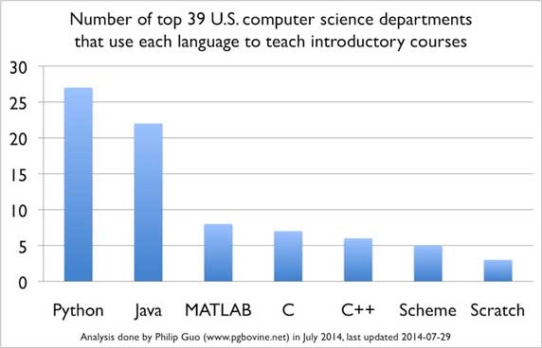
Most Popular Languages Taught in Colleges in USA

Slide 18
Why Python?
Simple/Readable | Interpreted
Easy to Learn & Use | Object Oriented
Free and Open Source | Extensible
High-Level Language | Expressive
Portable/Cross-platform | Complete—”Batteries included”

Slide 19
Why Python?
What Python doesn’t do as well
Python isn’t the fastest language.
Python doesn’t have the most libraries.
Python doesn’t check variable types at compile time.
Python doesn’t have much mobile support.
Python doesn’t use multiple processors well.

Slide 20
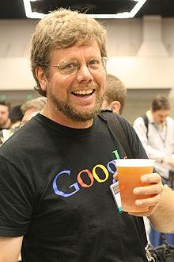
History of Python
Python’s name was came from Monty Python’s Flying Circus of British comedy show first broadcast in the 1970s.
Python was created in 1989 by Guido van Rossum in the Netherlands.
2005-2012: Google
2012: Dropbox
Python 2 released on 2000
Python 3 released on 2008

Slide 21
How to Learn to Code?
Like anything you try for the first time, it’s always best to start with the basics.
Try each of the examples and the programming exercises, so you can see how they work.
The better you understand the basics, the easier it will be to understand more complicated ideas later on.
Break a problem down into smaller pieces.
If that still doesn’t help, sometimes it’s best to just leave it alone for a while. Sleep on it, and come back to it another day.

Slide 22
Have Fun!
Think of programming as a way to create some fun games or applications that you can share with your friends or others.
Learning to program is a wonderful mental exercise and the results can be very rewarding.
Most of all, whatever you do, have fun!

Slide 23
Get Started

Slide 24
Download and Install Tools
Download and install Python.
https://www.python.org/downloads/
Download and install one of the following IDE (Integrated Development Environment).
Download and install Visual Studio Code.
https://code.visualstudio.com/download

Slide 25
Download and Install Python
Python Download URL: https://www.python.org/downloads/

Slide 26
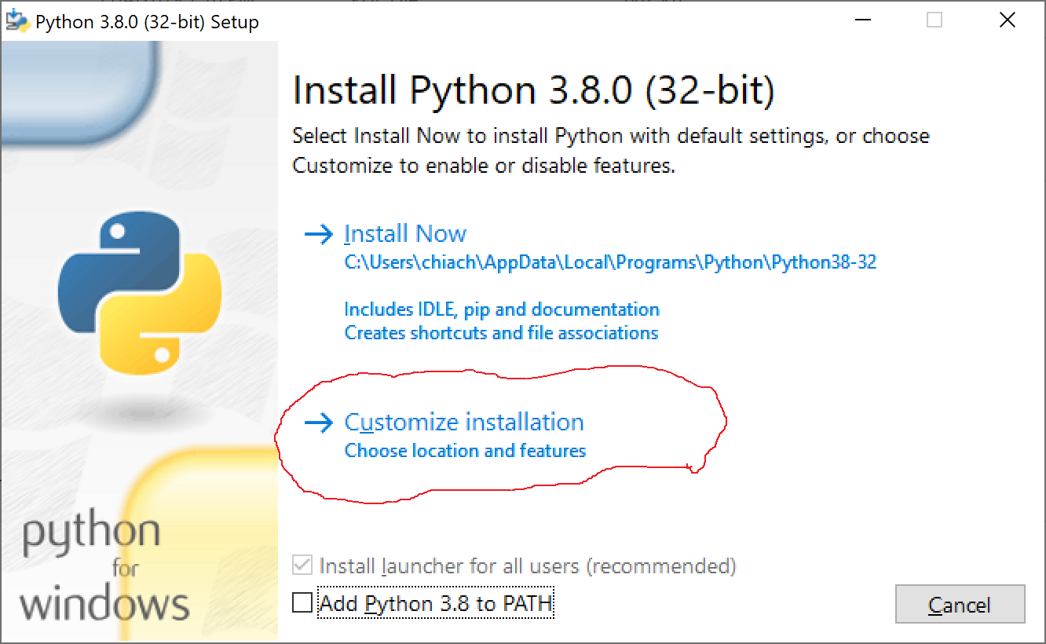
Install Python #1
Select Customize Installation

Slide 27
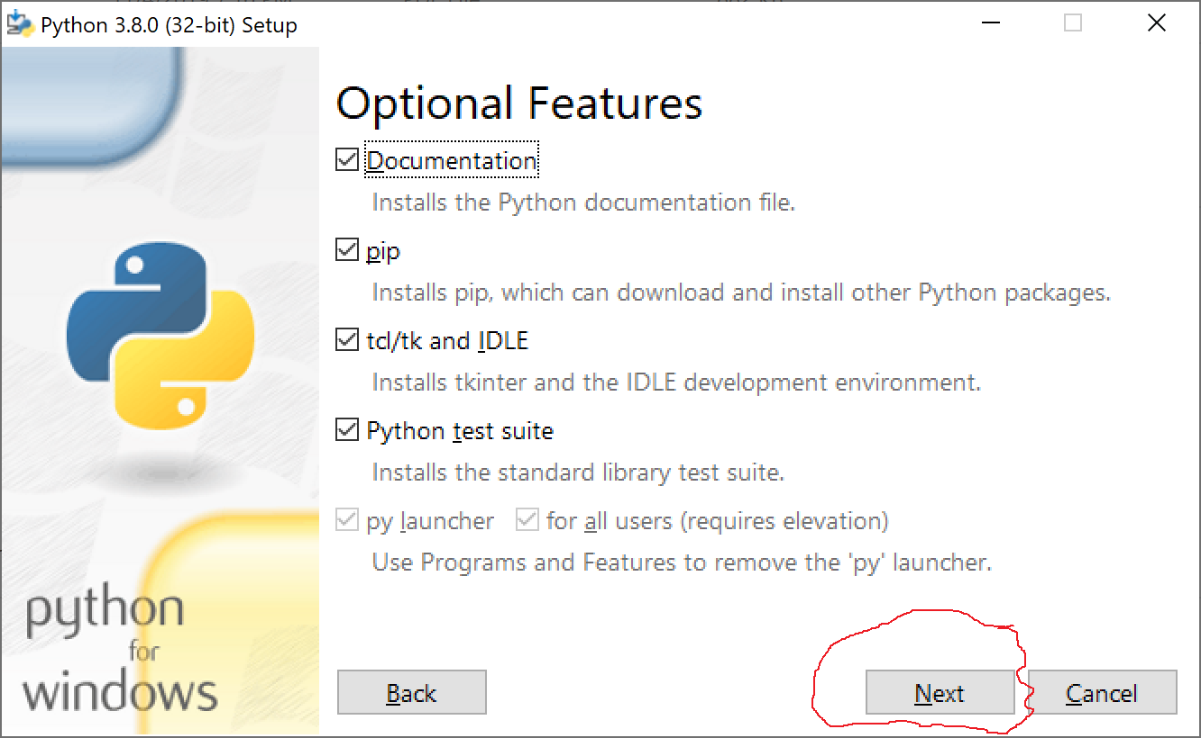
Install Python #2
Optional Features

Slide 28
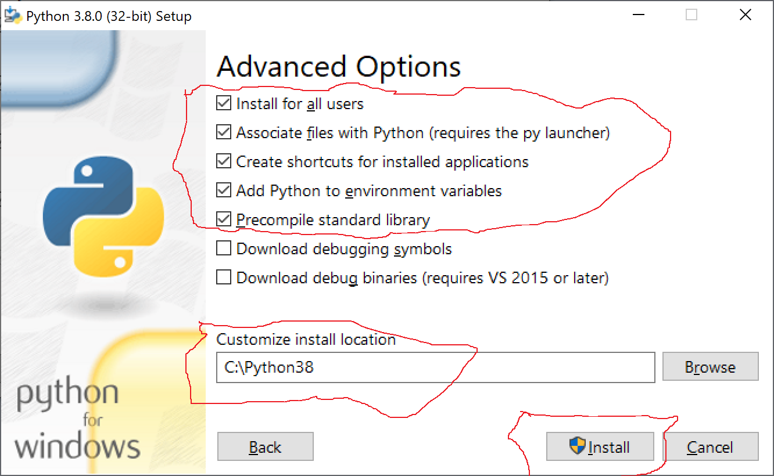
Install Python #3
Advanced Options

Slide 29
Download and Install Visual Studio Code
Visual Studio Code Download URL: https://code.visualstudio.com/download

Slide 30
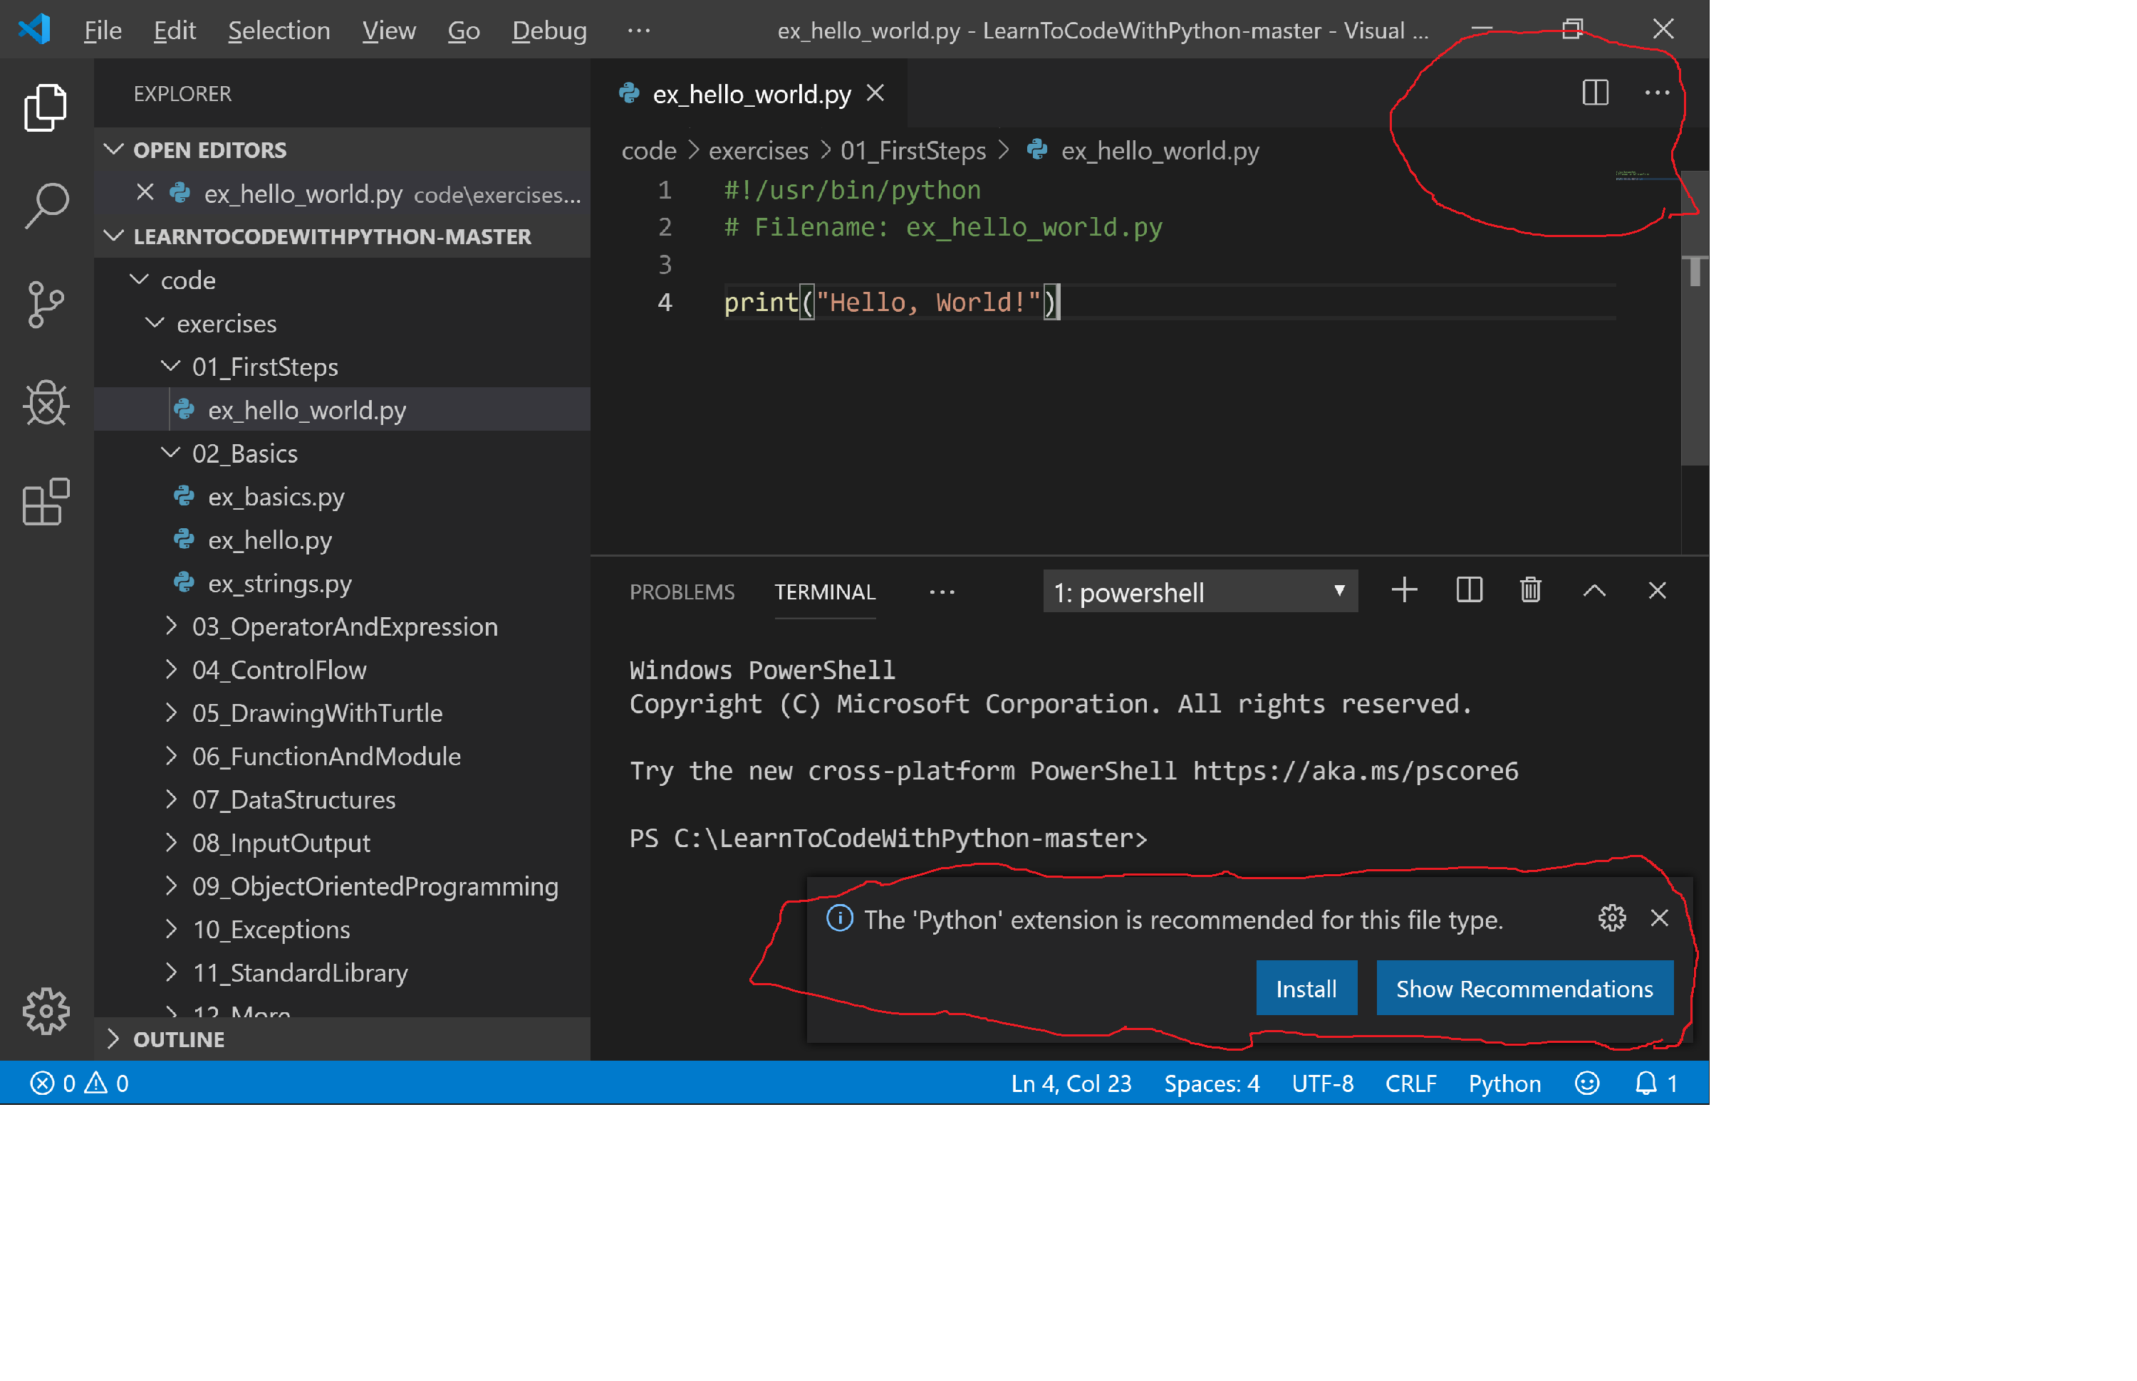
Install Visual Studio Code #1
Install Python Extension

Slide 31
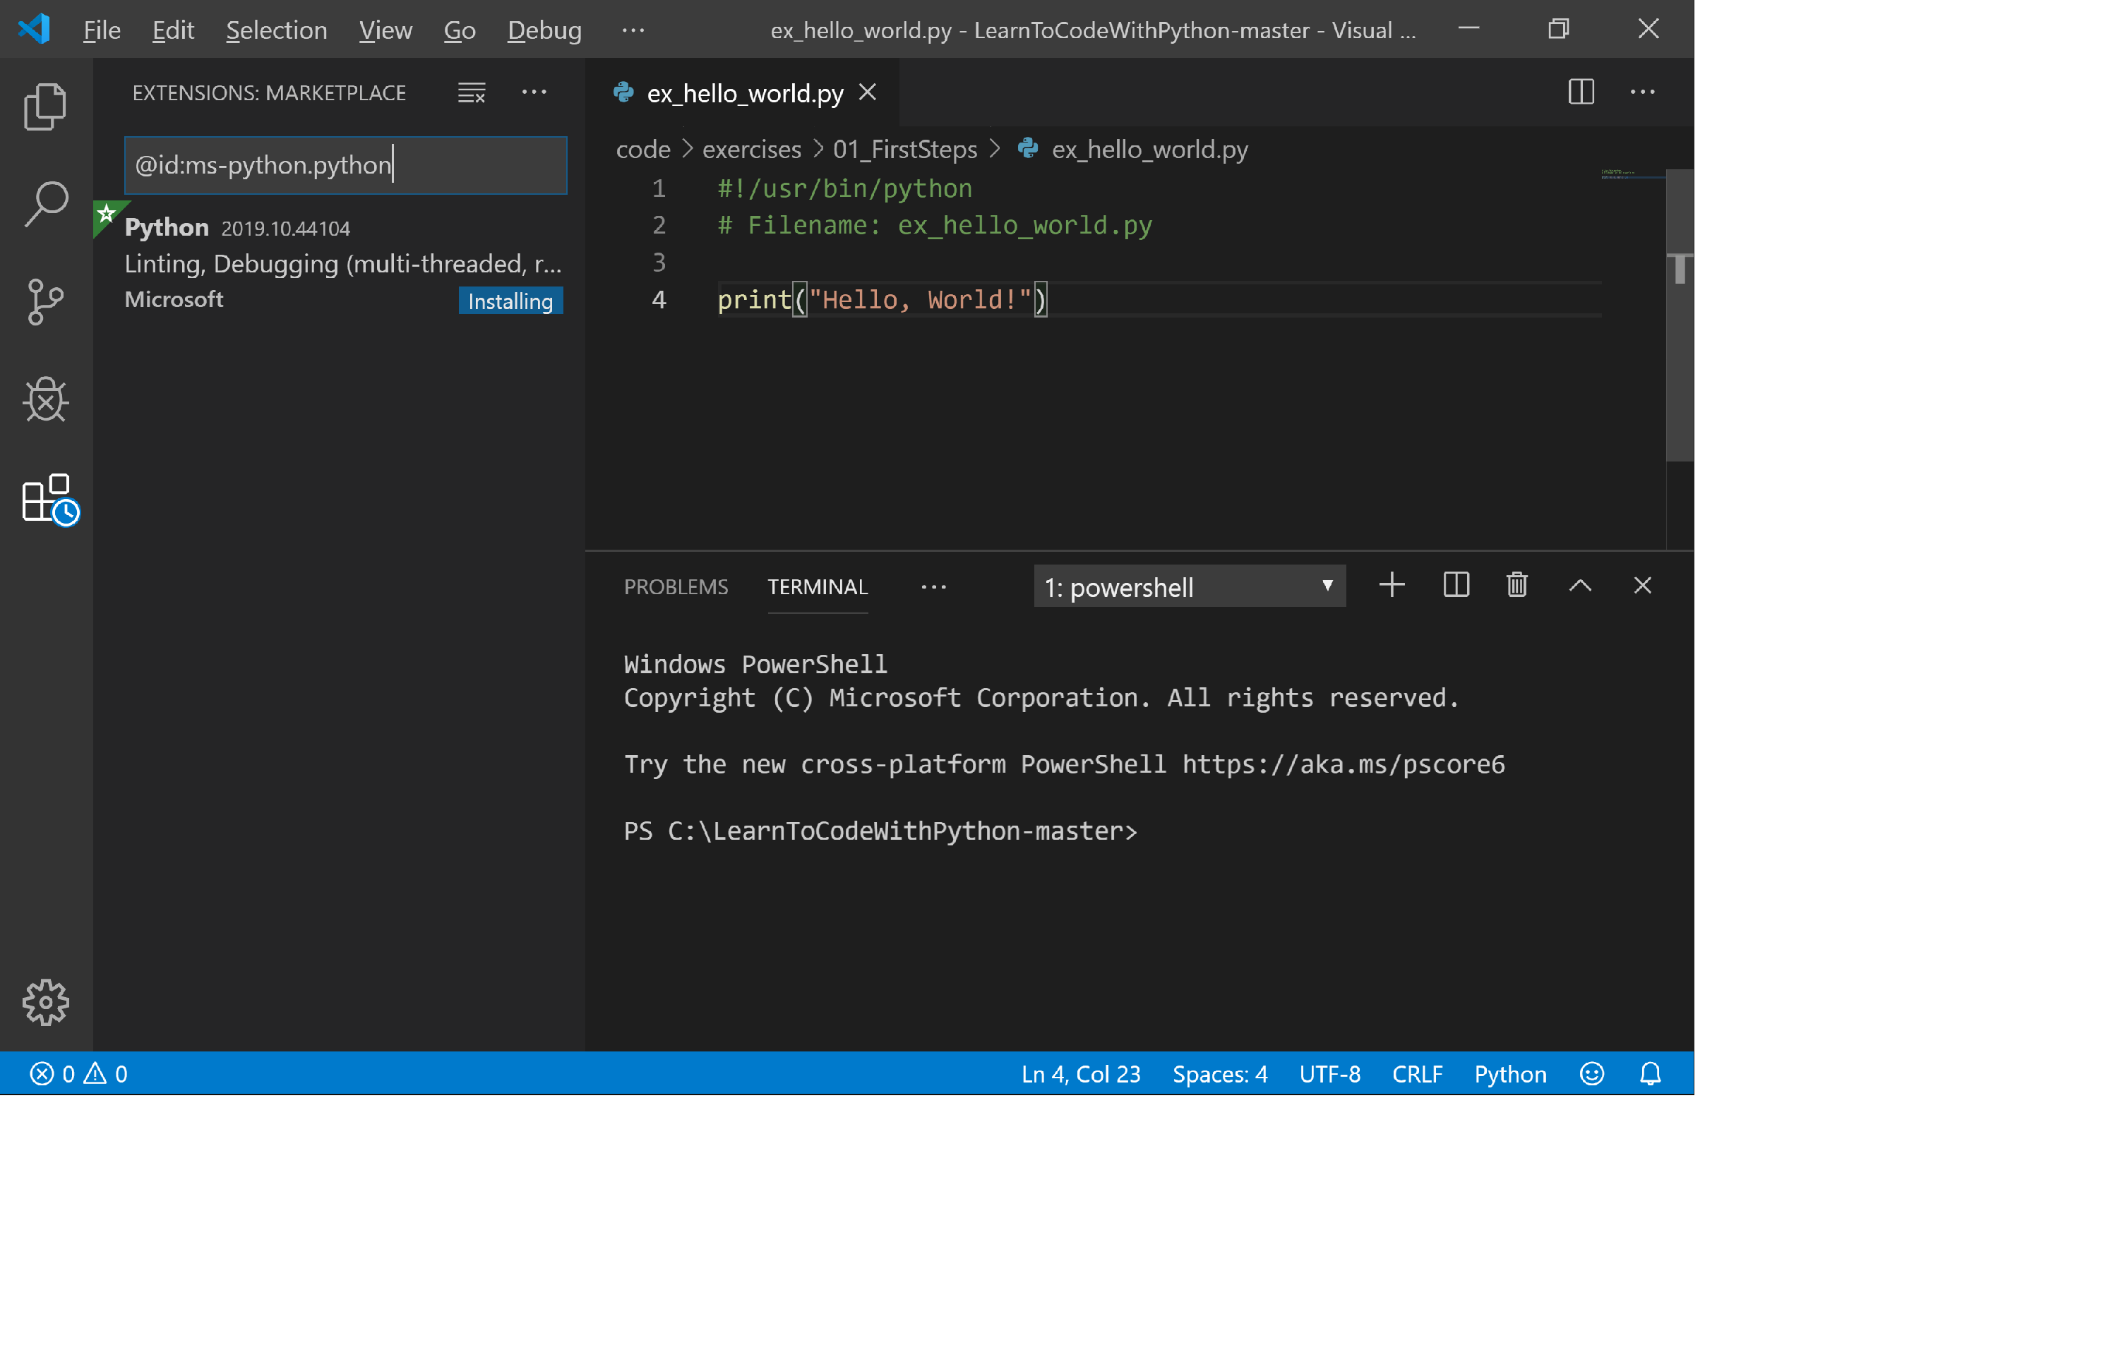
Install Visual Studio Code #2
Run Arrow

Slide 32
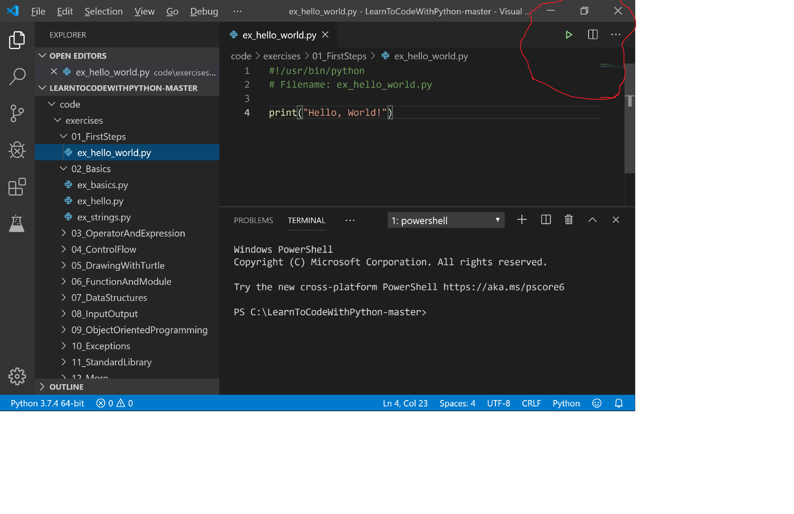
Install Visual Studio Code #3
Install Python Extension

Slide 33
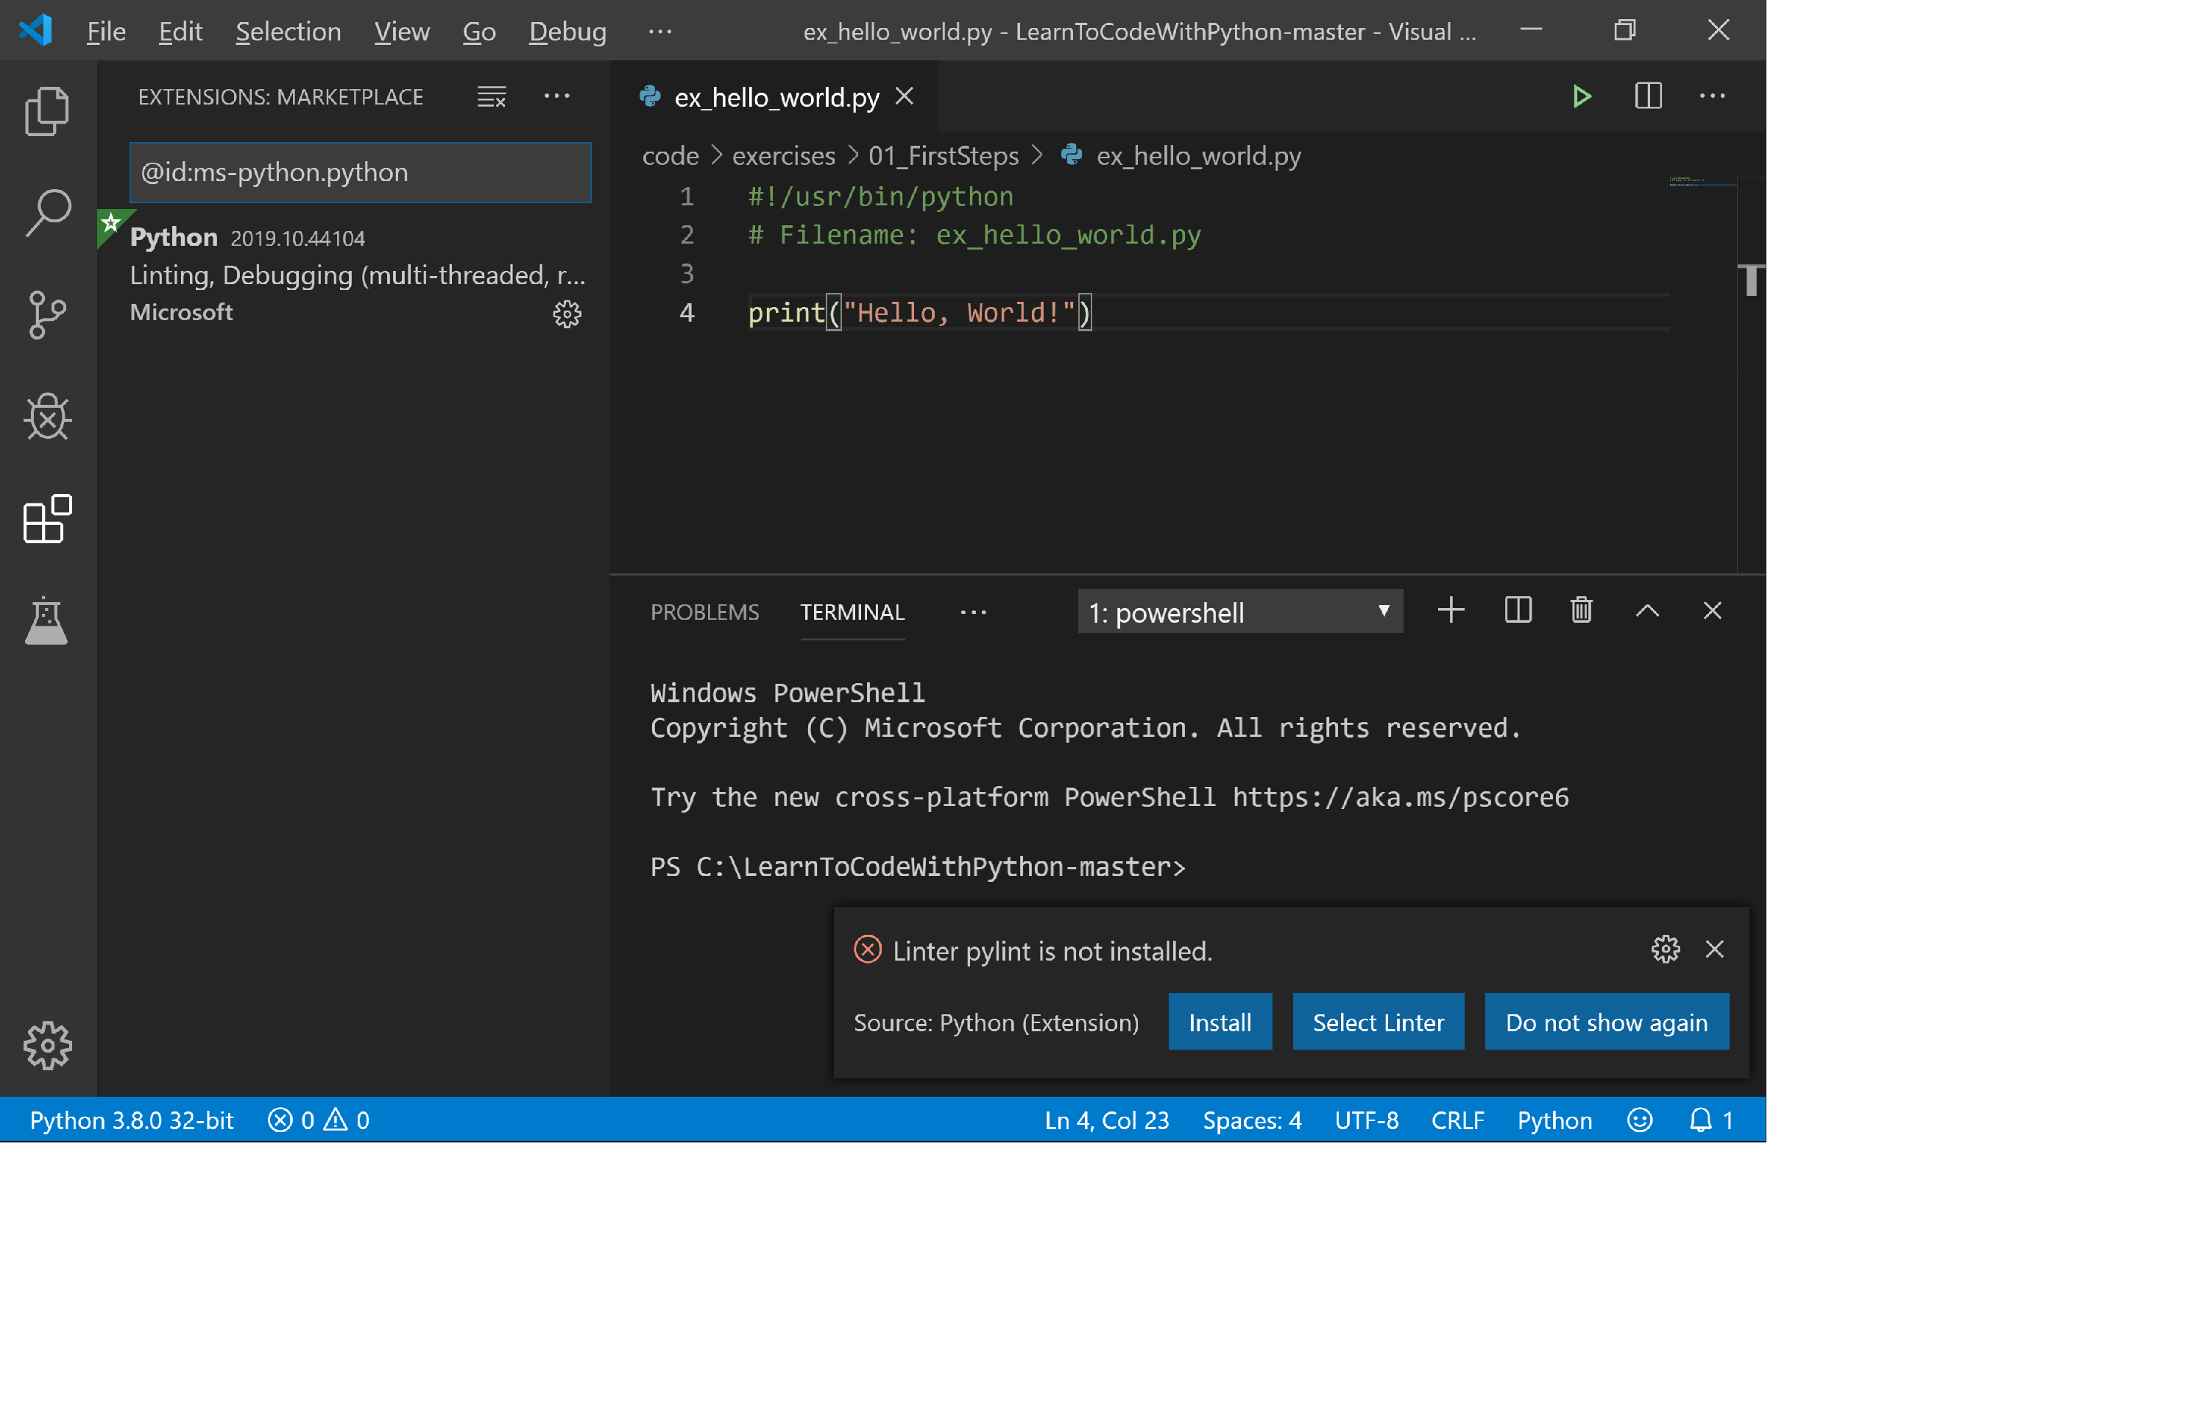
Install Visual Studio Code #4
Install pylint Extension

Slide 34
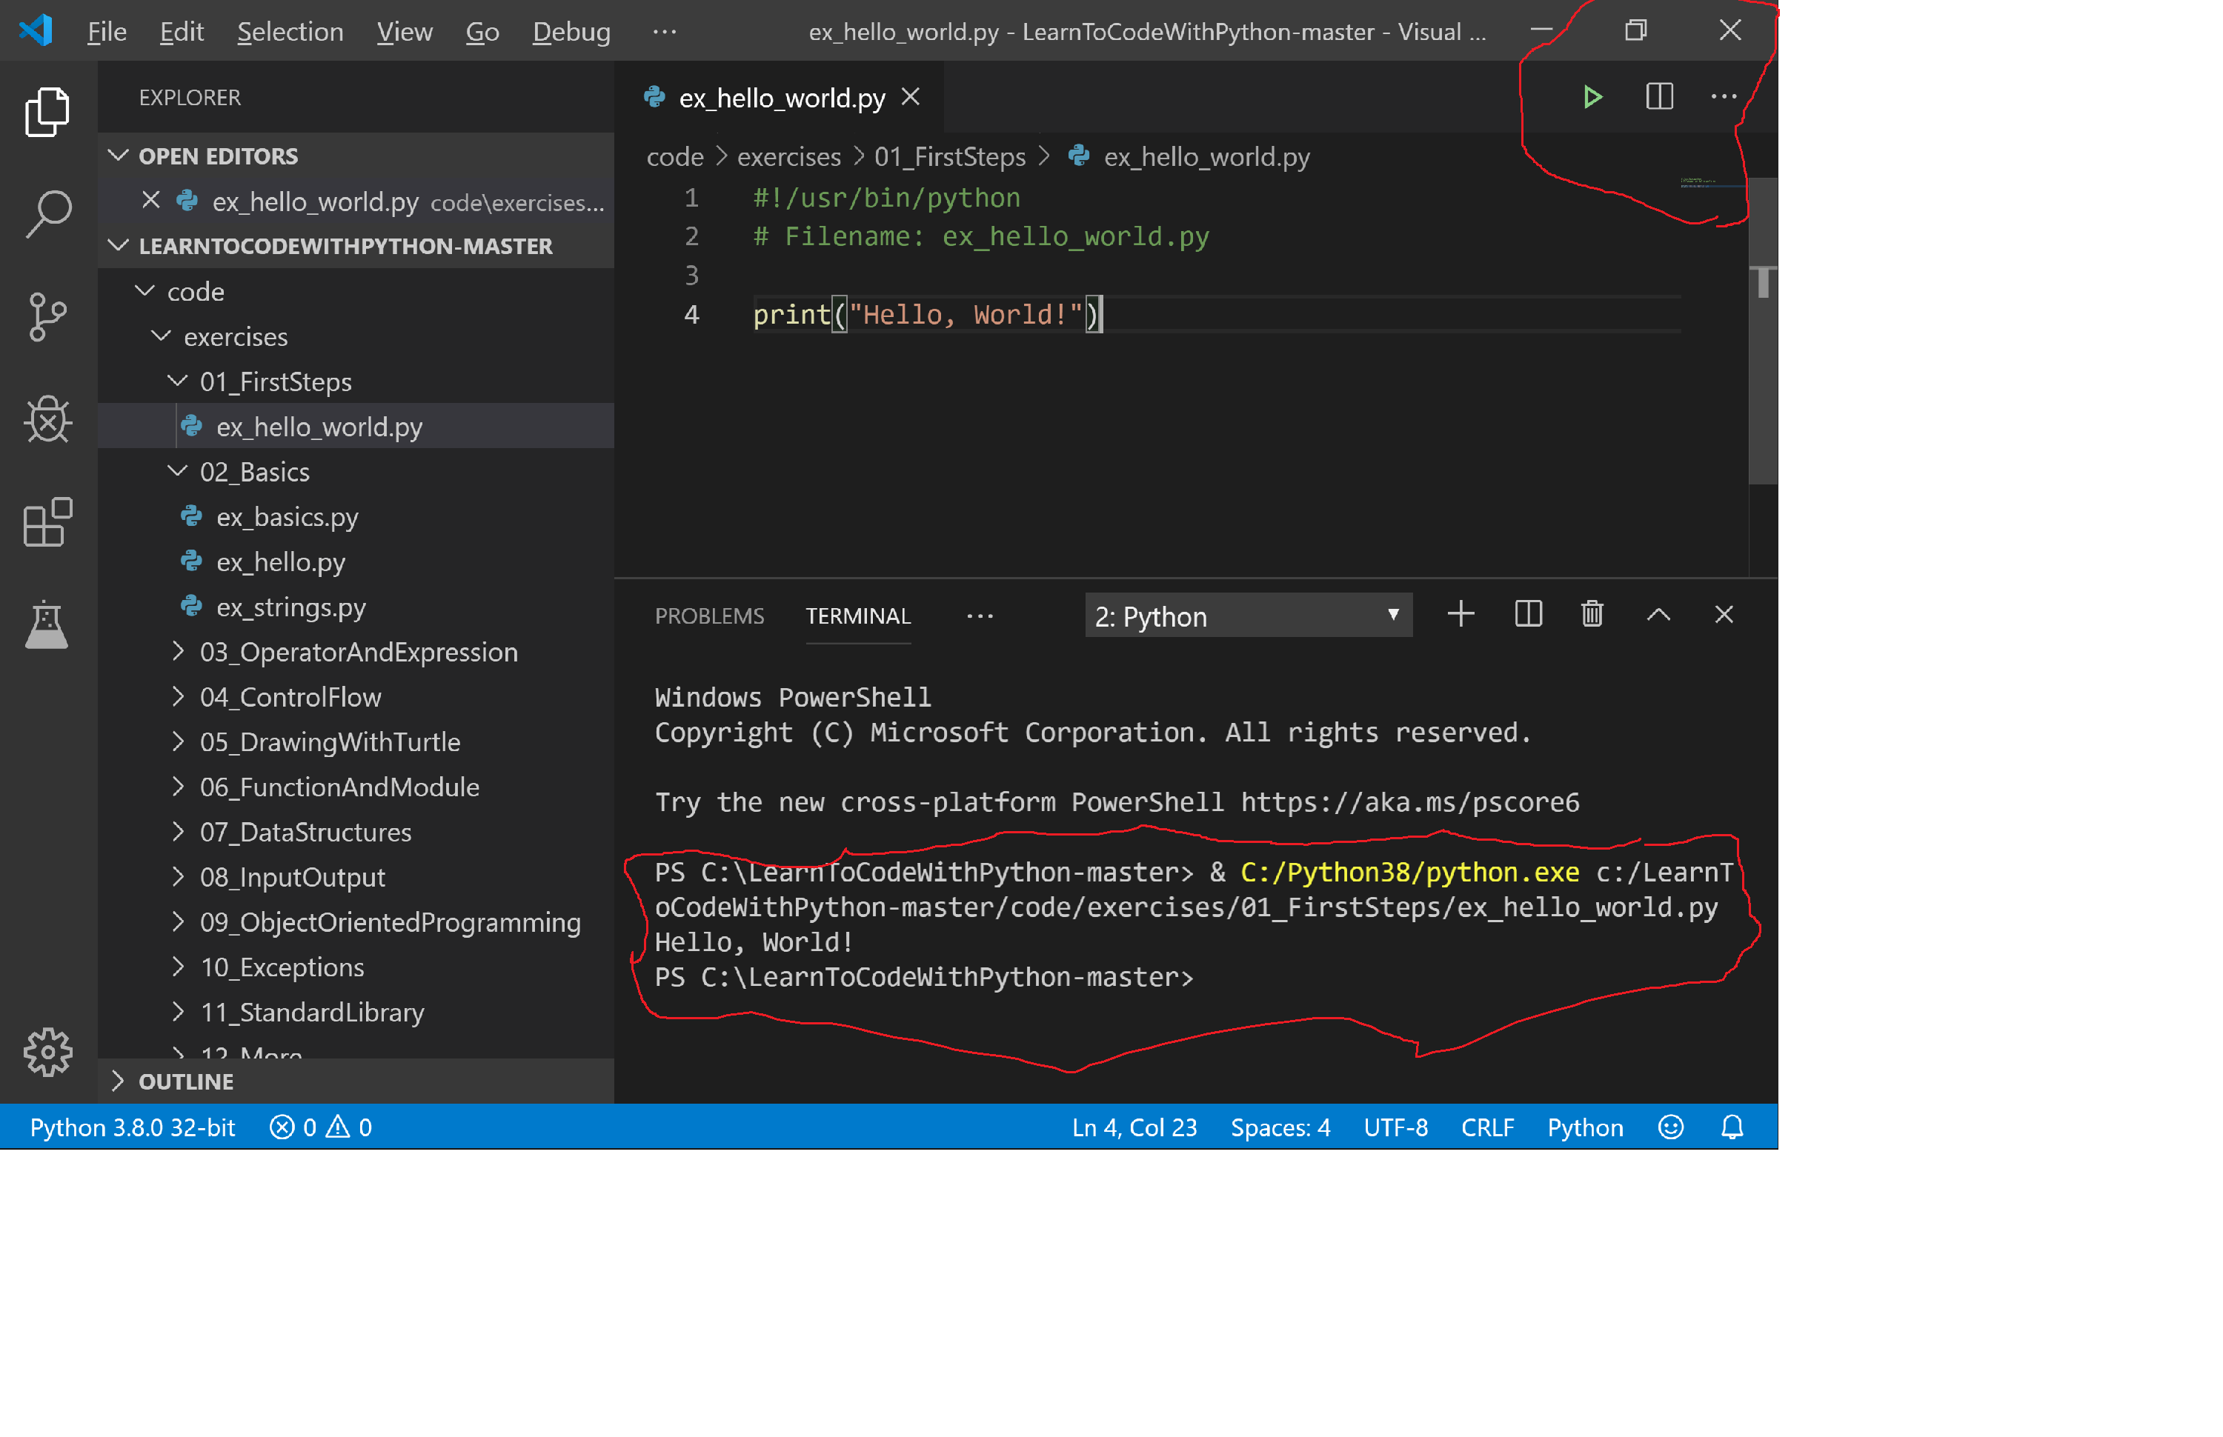
Install Visual Studio Code #5
Run Python program

Slide 35
First Steps
Start python.exe at the command line OR
Using Python Interactive Shell
Windows Key -> type “IDLE (Python …).”
Enter Python statements and press ENTER to run.
print(‘Hello, World!’)
Congratulations! You’ve just created your first Python program!
Getting Help
help(print)

Slide 36
Using a Program Source File
Creating a Program Source File via Python IDLE
File -> New Window then File -> Save
Create a new directory: C:\python\exercises
File name: hello_world.py
#Filename: hello_world.py
print(‘Hello, World!’)
Running the program
Using IDLE
Run -> Run Module or keyboard shortcut F5.
Command line
> python hello_world.py

Slide 37
For Windows Users
Open Terminal
Windows -> Run -> type “cmd”
python -V
Open IDLE
Windows Key -> type “IDLE (Python …).”
Open Visual Studio Code
Windows Key -> type “visual studio code”

Slide 38
For Mac OS X Users
Open Terminal
Open the terminal by pressing Command+Space keys (to open Spotlight search), type Terminal and press enter.
python –V
Open IDE

Slide 39
Getting Familiar with Visual Studio Code
Change Setting: Code->Preferences->Settings
Line Numbers: on
Tab Size->4
Insert Spaces: check
Create Project: File->New Project...
Location: C:\PythonWork
Interpreter: C:\Python38

Slide 40
Python Crash Course

Slide 41
Python Crash Course
Basics
Operators and Expressions
Control Flow
Functions and Modules
Data Structures
Inputs & Outputs
Object Oriented Programming
Exceptions
Standard Library

Slide 42
Basics

Slide 43
Basics Data Types
Built-In types
Numbers
integers: 2
floating point (float): 3.23
complex numbers: (-5+4j)
Literal Constants: use its value literally, it’s constant
number: 5, 1.23, 9.25e-3
String: ‘Hello World!’
Lists: [1, 2, 3, 4, 5]
Tuples: (1, 2, 3, 4, 5)
Dictionaries: { 1: “one”, 2: “two” }
File Objects: f = open(“myfile”, ”w”)…
User defined types using classes and objects

Slide 44
Numbers
# Python’s four number types:
# Integers: 1, 2
# Floats: 3.7
# Complex numbers: 3 + 2j
# Booleans: True, False
X = 5 + 2 – 3 * 2
5 / 2 # float
5 // 2 # truncation
2 ** 8
(3+2j) * (4+9j)
Round(3.49)
X = True

Slide 45
Numbers and Math
Numbers in Python are of three types - integers, floating point and complex numbers.
spam = 10
fp = 10.50
Math
2 + 2
import math
degrees = 45
radians = degrees / 360.0 * 2 * math.pi

Slide 46
Comments
Comment, # symbol: anything to the right of the # symbol is a comment.
# Computer programming is fun! # Python programming is very fun!
# print(2+2)
Block comments
# This is a Block comment
Inline comments
x = 5 + 1 # This is an Inline comment

Slide 47
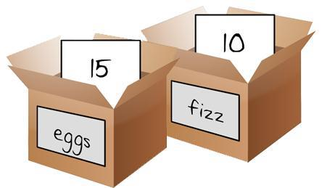
Variables and Types
Variables stores some information and their value can vary.
• Variables and Values
fizz = 10 eggs = 15 print(fizz) spam = fizz + eggs
print(spam)
• Values Have Types
– use the type() function to find out the type
type(spam)
<class 'int'>

Slide 48
Naming Variables
The first character of the identifier must be a letter of the alphabet or an underscore (‘_’).
The rest of the identifier name can consist of letters, underscores (‘_’) or digits (0-9).
Identifier names are case-sensitive. myname and myName are not the same.
Valid identifiers: i, name_23, _my_name

Slide 49
Strings
A string is a sequence of characters enclosed either single or double quote marks. Strings are Immutable.
Single Quotes
msg = 'Quote me on this'
Double Quotes work exactly as single quotes
msg = "What’s your name?"
Triple Quotes (""" or ‘’’)
msg = ‘’’This is the first line. This is the second line. '''

Slide 50
Strings
# String processing is one of Python’s strengths.
# operators (in, +, *), built-in functions (len, max)
“A string”
‘A string’
“””A string”””
‘’’A string```
x = “live and let \t. \t live”
len(x)
x.split()
x.replace(“ let \t. \t live”, “enjoy life”)
print(x)

Slide 51
Escape Sequences
'What\'s your name?’
“Newlines are indicated by \n”
• Raw Strings
r”Newlines are indicated by \n”
R”Newlines are indicated by \n”

Slide 52
Strings Concatenation
Concatenate Strings
'Hello, ' + 'World!’
Two string literals side by side, they are automatically concatenated by Python
'What\'s ' 'your name?’
Multiplying Strings
print(10 * 'a')

Slide 53
Strings Format
The format Method: construct strings from other information
age = 25 name = 'John’
print(name + " is " + age + " years old.")
print(name + " is " + str(age) + " years old.")
print("%s is %d years old." % (name, age))
print("{0} is {1} years old.".format(name, age))

Slide 54
Indentation!!!
Indentation: leading whitespace (spaces or tabs) at the beginning of the statement.
to determine the grouping of statements.
Statements which go together must have the same indentation. Each such set of statements is called a block.
Do not use a mixture of tabs and spaces for the indentation.
Use four spaces or one tab for each indentation level.
while True:
print(‘Hello, World!’)

Slide 55
More About Strings
Strings are also objects and have methods which do everything from checking part of a string to stripping spaces!
The strings that you use in program are all objects of the class str.
For a complete list of such methods,
see help(str).
Code: ex_str_methods.py
name = 'Python’
if name.startswith('Py’):
print('Yes, the string starts with “Py"')

Slide 56
Operators and Expressions

Slide 57
Operators and Expressions
Expression can be broken down into operators and operands.
Operators:
Numerical: +, -, *, /,**, //, %
Bitwise: <<, >>, &, |, ^, ~
Comparison: <, >, <=, >=, ==, !=
Boolean: not, and, or
3 + 5
2 * 3

Slide 58
Order of operations
Order of operations (PEMDAS)
Parentheses: 2 * (3 – 1)
Exponentiation: 3*1**3
Multiplication and Division: 2 * 3 -1; 6 + 4 / 2 – Addition and Subtraction: 2 + 2 - 1
Operators with the same precedence are evaluated from left to right (except exponentiation).
Changing the Order of Evaluation: use parentheses
(2 + 3) * 4

Slide 59
What Will You Get?
2 + 3 * 4 – 6 / 2
(2 + 3) * 4 – 6 / 2
2 + (3 * 4) – (6 / 2)
2 + 3 * (4 – 6) / 2

Slide 60
Control Flow

Slide 61
Booleans
Boolean: True or False
1 == 1
1 == 2
Converting Between Data Types
int(), float(), str()
print(int(3.9))
print(float("Three point two"))

Slide 62
Conditions
Symbol | Definition
== | Equal to
!= | Not equal to
> | Greater than
< | Less than
>= | Greater than or equal to
<= | Less than or equal to

Slide 63
The if Statement
color = 'white’
if color == 'red': color = 'orange'
elif color == 'orange': color = 'yellow'
else:
color = 'red'
Start
Is the
Yes
Set the
color
color orange
red?
No
Is the
Yes
Set the
color
color yellow
orange?
No
Set the color red

Slide 64
The break Statement
Breaking out of a loop statement
while True:
s = (input('Enter something: ‘))
if s == 'quit’:
break
print('Length of the string is ', len(s))

Slide 65
The continue Statement
Skip the rest of statements in the current loop block and continue to the next iteration of the loop.
while True:
s = (input('Enter something: ‘))
if s == 'quit’:
break
if len(s) < 3:
print('Too short: ', len(s))
continue
print('Input is too long: ', len(s))

Slide 66
The while Statement
running = True
while running:
print(“Python is fun!”)
step = 0 while step < 10:
print("%s: Python is awesome!" % step)
step += 1

Slide 67
For Loop 1
Print multiple times:
print('hello’)
print('hello’)
print('hello’)
print('hello’)
print('hello')

Slide 68
For Loop 2
Using for Loops:
for x in range(0, 5):
print('hello')

Slide 69
Functions and Modules

Slide 70
Functions
Functions are reusable pieces of programs.
ex_function.py
Function Parameters
ex_func_param.py
def functionName(params):
block of statements
def printMax(a, b):
if a > b:
print(a, ' is maximum’)
elif a == b:
print(a, ' is equal to', b)
else:
print(b, ' is maximum’)
printMax(3, 4)

Slide 71
Default Argument Values
Parameter name with assignment operator (=) followed by the default value.
def say(message, times = 1):
print(message * times)
#
say('Hello’)
say('World', 5)

Slide 72
Keyword Arguments
def func(a, b=5, c=10):
print('a is ', a, ' and b is ', b, ' and c is ', c)
#
func(1,2,3)
func(3, 7)
func(25, c=24)
func(c=50, a=100)

Slide 73
The return Statement
return from a function, can optionally return a value.
def maximum(x, y):
if x > y: return x
else:
return y
#
print(maximum(2, 3))
The pass statement: an empty block
def someFunction():
pass

Slide 74
Data Structures

Slide 75
Data Structures
Python has built-in, dynamic data structures or collections
You basically never need to define your own
Lists (approx. homogenous arrays)
Tuples (approx. heterogeneous arrays)
Dictionaries (key-value mappings)
Sets (unique values)

Slide 76
Lists are Variable Length, Same Types
List holds an ordered collection of items enclosed in square brackets.
Lists are mutable, and their elements are usually homogeneous and are accessed via iteration.
shoplist = ['apple', 'mango', 'carrot', 'banana'] for item in shoplist:
print(item, end=' ‘)
print('My shopping list is: ', shoplist)
shoplist[0] = 'strawberry'

Slide 77
Lists are Variable Length, Same Types
names = ["Matthew", "Mark", "Luke"]
names.append("John")
# Zero-indexed (but something better is coming up)
names[0]
# Convert other sequences to a list
x = list(y)
x = list(names)

Slide 78
List Arithmetic
list1 = [1, 2, 3, 4]
list2 = ['I ate chocolate', 'and want more’]
list3 = list1 + list2
print(list3)

Slide 79
Tuples are Fixed-Length, Different Types
Tuples are immutable, and their elements are usually heterogeneous and are accessed via unpacking or indexing.
shoptuple = ('apple', 'mango', 'carrot', 'banana') for item in shoptuple:
print(item, end=' ‘)
print('My shopping list is: ', shoptuple)
#shoptuple[0] = 'strawberry'

Slide 80
Tuples are Fixed-Length, Different Types
person = ("Simon", 180.0, 35)
person[0] person[1]
# Convert a sequence to a tuple
x = tuple(y)
x = tuple(person)

Slide 81
Dictionaries Map Keys to Values
Dictionary is like an address-book and pair of key and value.
Key must be unique.
ab = { 'John' : 'jdoe@acme.com', 'Tony' : 'tsmith@acme.com'}
ab['John']
ab['John'] = 'jdoe@live.com'

Slide 82
Dictionaries Map Keys to Values
x = { "Rank": 7, "Score": 93.4 }
"Rank" in x
x["Rank"]
# Try x.keys(), x.values(), and x.items()

Slide 83
Sequences
strings
Lists
Tuples
shoplist = [‘apple’, ‘mango’, ‘carrot’, ‘banana’]
print(shoplist[0])
print(shoplist[-1])
print(shoplist[1:3])
print(shoplist[1:-1])
print(shoplist[2:])
print(shoplist[:])

Slide 84
Sets Contain Unique Values
Sets are unordered collections of simple objects.
x = {1, 3, 3, 5, 7}
# or set([1, 3, 3, 5, 7])
3 in x
x
len(x)

Slide 85
Inputs & Outputs

Slide 86
Input from User
Input from User
something = input('Enter text: ‘)
print(something)

Slide 87
Files
Reading from a file
code: ex_using_file.py
f = open('myinput.py’)
while True:
line = f.readline()
if len(line) == 0: # EOF
break
print(line, end=’’)
f.close()

Slide 88
Writing to a File
Writing to a file
f = open('myoutput.txt', 'w')
f.write('Hello, World!')
f.close()

Slide 89
Object Oriented Programming (OOP)

Slide 90
The Characteristics of OOP
Objects
We live in an object-oriented world.
An object is a structure for incorporating data and methods/functions/procedures for working with that data.
Abstraction
high level of an object
Encapsulation
no direct access to the data is granted
Polymorphism
two different objects have the same methods, e.g., print()
Inheritance
parent and child
Aggregation
an object consists of a composite of other objects

Slide 91
Object Oriented Programming
Object Oriented Programming paradigm: combines data and functionality and wrap it inside something called an object.
Python is strongly object-oriented in the sense that everything is an object including numbers, strings and functions.
Classes and objects are the two main aspects of object oriented programming.

Slide 92
Classes and Objects
A class creates a new type where objects are instances of the class.
Python refers to anything used in a program as an object.
Objects can
store data using variables or fields
instance/object variables: variables belong to each instance/object of the class
class variables: variables belong to the class itself
have functionality by using functions or methods

Slide 93
Classes and Functions
Objects with Classes
class Person():
def __init__(self, name, age):
self.name = name self.age = age
def birthday(self):
self.age = self.age + 1
#
ben = Person("Ben", 10)
print(ben.name, ben.age)

Slide 94
Self
Class methods have only one specific difference from ordinary functions - they must have an extra first name that has to be added to the beginning of the parameter list, but you do not give a value for this parameter when you call the method, Python will provide it.
This particular variable refers to the object itself, and by convention, it is given the name self.

Slide 95
The __init__ Method
The __init__ method is run as soon as an object of a class is instantiated and it does any initialization.
code: ex_person.py

Slide 96
Object Methods
classes/objects can have methods just like functions except that we have an extra self variable.
code: ex_method.py

Slide 97
Class and Object Variables
There are two types of fields (variables):
Class variables: variables belong to the class itself. They are shared and can be accessed by all instances of that class. There is only one copy of the class variable.
Object/Instance variables: variables belong to each instance/object of the class. Each object has its own copy of the field. They are not shared.
code: ex_objvar.py

Slide 98
Inheritance
One of the major benefits of object oriented programming is reuse of code and one of the ways this is achieved is through the inheritance mechanism. Inheritance can be best imagined as implementing a type and subtype relationship between classes.
polymorphism: where a sub-type can be substituted in any situation where a parent type is expected i.e. the object can be treated as an instance of the parent class.
code: ex_inherit.py

Slide 99
Derived Classes Example
Person
Parent
Daughter
Son

Slide 100
Derived Classes Example
Derived Classes
code: ex_parent_child.py
class Parent(Person):
def __init__(self, name, age):
Person.__init__(self,name,age)
self.children = []
def add_child(self,child):
self.children.append(child)
def print_children(self):
print(“The children of “, self.name, “ are:”)
for child in self.children:
print(child.name)

Slide 101
Inheritance Example
SchoolMember
Teacher
Student

Slide 102
Exceptions

Slide 103
Exceptions
Exceptions occur when certain exceptional situations occur in your program.

Slide 104
Errors
Print('Hello World')
print('Hello World')

Slide 105
Handling Exceptions
Handling Exceptions
– code: ex_try_except.py
try:
text = input(‘Enter something: ‘)
except EOFError:
print(‘It was an EOF’)
else:
print(‘You entered {0}’.format(text))

Slide 106
Raising Exceptions
Raising Exceptions
The error or exception that you can raise should be class which directly or indirectly must be a derived class of the Exception class.
code: ex_raising.py
raise EOFError()

Slide 107
Try ..Finally
Try ..Finally
• code: ex_finally.py
try:
# do something
except EOFError:
# process the exception
finally:
# clean up

Slide 108
With Statement
Acquiring a resource in the try block and subsequently releasing the resource in the finally block is a common pattern. Hence, there is also a with statement that enables this to be done in a clean manner.
code: ex_using_with.py
with open(“poem.txt”) as f:
for line in f:
print(line, end=‘’)

Slide 109
Standard Library

Slide 110
Standard Library
The Python Standard Library contains a huge number of useful modules and is part of every standard Python installation.
https://docs.python.org/3/library/index.html
Some of the commonly used modules in the
Python Standard Library
sys
logging
urlib
json

Slide 111
sys module
The sys module contains system-specific functionality.
We have already seen that the sys.argv list contains the command-line arguments.
code: ex_versioncheck.py

Slide 112
logging module
logging module displays debugging messages.
code: ex_use_logging.py

Slide 113
urlib and json modules
Use urllib and json modules to access the web.
code: ex_yahoo_search.py

Slide 114
Special Methods
Special Methods
__init__
__del__
__str__
etc.
Single Statement Blocks
if flag:
print(‘Yes’)

Slide 115
Class Hands-On Projects

Slide 116
Team Members
Three members per team
Team Discussion
Discuss the strategy of solving the problem
Design the solution
Pick the member roles
Member Roles
Developer 1: tell the coder what to write
Developer 2: type in the code and check the code
Tester 1: test the code to ensure the quality

Slide 117
Guess the Number
Guess the Number: http://inventwithpython.com/chapter4.html
You’re going to make a “Guess the Number” game. The computer will think of a random number from 1 to 20, and ask you to guess it. The computer will tell you if each guess is too high or too low. You win if you can guess the number within six tries.
Source code: guess.py

Slide 118
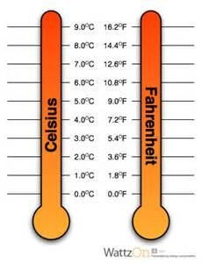
Temperature Converter
Convert Celsius to Fahrenheit
fahrenheit = (celsius * 9 / 5) + 32
Convert Fahrenheit to Celsius
celsius = (fahrenheit - 32) * 5 / 9
Temperature Converter
Enter celsius
output celsius, fahrenheit
Enter celsius
output fahrenheit, celsius
Generic Temperature Converter
Enter “c2f” & celsius, output fahrenheit
nter “f2c” & fahrenheit, output celsius

Slide 119
Drawing the Turtles

Slide 120
Drawing with Turtles
A turtle in Python is sort of like a turtle in the real world.
In the world of Python, a turtle is a small, black arrow that moves slowly around the screen.
The turtle is a nice way to learn some of the basics of computer graphics.
Python has a special module called turtle that we can use to learn how computers draw pictures on a screen.

Slide 121

Using Python’s turtle Module
A module in Python is a way of providing useful code to be used by another program.
Turtle can draw intricate shapes using programs that repeat simple moves.
Turtle graphics for Tk
https://docs.python.org/3/library/turtle.html
tkinter package
import turtle

Slide 122
Using Python’s turtle Module
Pixel is a tiny, square dot on the computer monitor.
t.forward(50) # advance 50 pixels (or backward)
t.left(90) # turn left 90 degrees (or right)
t.reset() # clears the canvas and put the turtle back at the starting position
t.clear() # clears the screen and leaves the turtle where it is
t.up() # pick up the pen and stop drawing
t.down() # put the pen back down and start drawing again

Slide 123
Turtle Program
Show the Turtle
Can you draw a petal?
Can you draw a circle?
Can you draw 4 circles?
Can you draw all 24 petals?

Slide 124
1. Show a Turtle
import turtle
window = turtle.Screen()
t = turtle.Turtle()
window.exitonclick()

Slide 125
2. Can you draw a petal?
#draw a petal
import turtle
window = turtle.Screen()
t = turtle.Turtle()
t.left(15)
t.forward(50)
t.left(157)
t.forward(50)
window.exitonclick()

Slide 126
3. Can you draw a circle?
import turtle
window = turtle.Screen()
t = turtle.Turtle()
t.left(90)
t.forward(100)
t.right(90)
t.circle(10)
window.exitonclick()

Slide 127
4. Can You draw 4 circles?
# Hint: for x in range(0, 3):
import turtle
window = turtle.Screen()
t = turtle.Turtle()
t.left(90)
t.forward(100)
t.right(90)
t.circle(10)
window.exitonclick()

Slide 128
4. Can You draw 4 circles? (with loop)
# Hint: for x in range(0, 3):
import turtle
window = turtle.Screen()
t = turtle.Turtle()
for x in range(0, 4):
t.left(90)
t.forward(100)
t.right(90)
t.circle(10)
t.right(90)
window.exitonclick()

Slide 129
5. Can you draw all 24 petals?
#draw all petals
import turtle
window = turtle.Screen()
t = turtle.Turtle()
for i in range(1,24):
t.left(15)
t.forward(50)
t.left(157)
t.forward(50)
window.exitonclick()

Slide 130
Drawing with Turtle
from turtle import *
color('red', 'yellow’)
begin_fill()
while True:
forward(200)
left(170)
if abs(pos()) < 1:
break
end_fill()
done()

Slide 131
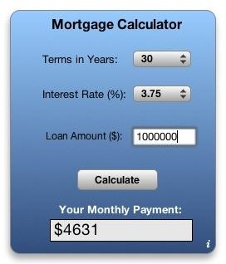
Mortgage Loan Calculator
Mortgage Loan Calculator
M = P [ i (1 + i)^n ] / [ (1 + i)^n – 1]
M: monthly payment
P: principal balance
i: monthly interest rate
n: number of monthly payments
^: power

Slide 132
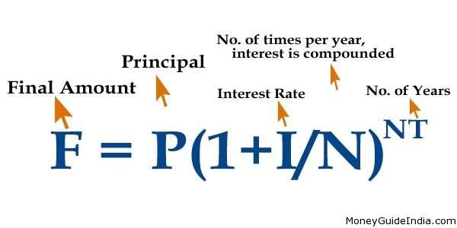
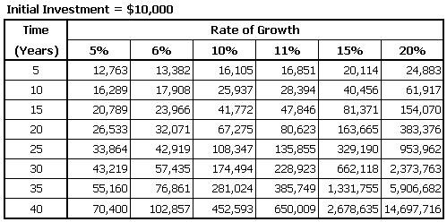
Compound Interest
Compound Interest

Slide 133
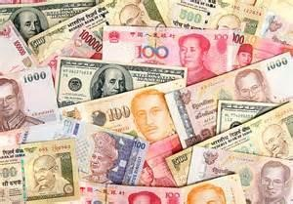
Currency Converter
Currency Converter

Slide 134
Hangman
Hangman:
http://inventwithpython.com/chapter9.html
Flow Chart: http://inventwithpython.com/chapter8.html
Source code: hangman.py
Hangman is a game for two people usually played with paper and pencil. One player thinks of a word, and then draws a blank on the page for each letter in the word. Then the second player tries to guess letters that might be in the word.
If they guess correctly, the first player writes the letter in the proper blank. If they guess incorrectly, the first player draws a single body part of the hanging man. If the second player can guess all the letters in the word before the hangman is completely drawn, they win. But if they can’t figure it out in time, they lose.

Slide 135
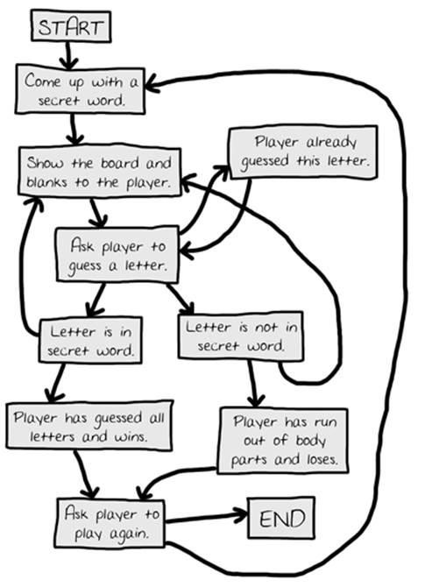
Flow Chart for Hangman
Flow Chart for Hangman

Slide 136
Thank You!
Thanks You!

Slide 137
What Next?

Slide 138
What Next?
PyGame
Raspberry Pi
Minecraft Mods with Python
Web Development with Django
Data analysis, machine learning, etc.
System admin, engineering, finance, etc.
Example Code
The best way to learn a programming language is to write a lot of code and read a lot of code:
The PLEAC project
Python Cookbook is an extremely valuable collection of recipes or tips on how to solve certain kinds of problems using Python. This is a must-read for every Python user.
Microsoft YouthSpark
Find Your Passion
Girls Who Code
AP Computer Science (College Board)
AP Computer Science A
AP Computer Science Principles (coming fall 2016)

Slide 139
Supplemental Materials

Slide 140
Variables and Values
Python has strong, dynamic typing
Values never change type unless you make them
This is the “strong” part
Variables change type whenever you assign to them
This is the “dynamic” part

Slide 141
Keeping Text in Strings
"abcde"[0]
"abcde"[1]
"abcde"[10]
"abcde"[1:3]
"abcde"[:3] "abcde"[3:]
len("abcde") "abc" + "def"

Slide 142
Local Variables
Scope of the variable
ex_func_local.py
x = 50
def func(x):
print('x is ', x)
x = 2
print('Changed local x to ', x)
func(x)
print('Value of x is ', x)

Slide 143
Global Variables
global statement
ex_func_global.py
x = 50
def func():
global x
print('x is ', x)
x = 2
print('Changed local x to ', x)
func(x)
print('Value of x is ', x)

Slide 144
nonlocal Variables
nonlocal scopes are observed when you define functions inside functions.
ex_func_nonlocal.py
def func_outer():
x = 2
print('x is ', x)
def func_inner():
nonlocal x
x = 5
func_inner()
print('Changed local x to ', x)
func_outer()

Slide 145
DocStrings
Python has a nifty feature called documentation strings, usually referred to by its shorter name docstrings.

Slide 146
Modules
How to create modules that contains functions and variables?
create a file with a .py extension
write the modules in the native language
A module can be imported by another program.
import sys

Slide 147
Create a Modules
Create a module named first_module.py
print("Hello World!")
Create another file named first_hello.py
import first_module
Hello World!

Slide 148
Modules
Create a second_module.py
def hello():
print("Hello World!")
Calling the function from hello2.py
import second_module
second_module.hello()
from second_module
import hello
hello()

Slide 149
A module’s __name__
A module’s __name__
Each module has a name and statement in a module can find out the name of its module.
if __name__ = '__main__’:
print('This program is being run by itself')
else:
print('I am being imported from another module')

Slide 150
Lists
x = []
x = [1, 2, 3, 4, 5]
y = [“first”, “second”, “third”]
z = [1, ”two”, 3, [“a”, “b”]] # different types
x[0] # index from the front
x[-1] # index from the back
x[0:3] # slice [m:n]
x[1] = 10 # change
len(x)
x.reverse()

Slide 151
Tuples
# Tuples are similar to lists but are immutable (can’t be changed).
x = ()
# practice with the same examples of lists
x = [1, 2, 3, 4]
tuple(x)
y = (1, 2, 3)
list(y)

Slide 152
Dictionaries
# Dictionaries, maps, or associative array implemented by using hash tables.
# key must be of an immutable type: numbers, strings, and tuples.
x = {1: “one”, 2: “two”} # key, value
x[“first”] = “one”
list(x.keys())
x[1]
x.get(1, “not available”)
x.get(4, “not available”)

Slide 153
Sets
# sets is an unordered (unique) collection of objects.
z = [1, 2, 3, 1, 3, 5]
#x = set([1, 2, 3, 1, 3, 5])
x = set(z)
1 in x
4 in x

Slide 154
References
When you create an object and assign it to a variable, the variable only refers to the object and does not represent the object itself!
shoplist = [‘apple’, ‘mango’, ‘carrot’, ‘banana’]
mylist = shoplist del shoplist[0]
print(‘shoplist is: ‘, shoplist)
print(‘mylist is: ‘, mylist)
#
mylist = shoplist[:] del mylist[0]
print(‘shoplist is: ‘, shoplist)
print(‘mylist is: ‘, mylist)

Slide 155
Pickle
Python provides a standard module called pickle using which you can store any Python object in a file and then get it back later. This is called storing the object persistently.
code: ex_pickling.py

Slide 156
More
Passing tuples Around
def get_error_details():
return(2, ‘second error details’)
errnum, errstr = get_error_details()

Slide 157
Lambda Forms
Lambda Forms: to create new function objects and return them at runtime
def make_repeater(n):
return lambda s: s * n
twice = make_repeater(2)
print(twice(‘word’))
print(twice(5))

