Slide 1
State Farm Distracted Driver Images Classification
Chia Chi Chuang

Slide 2
Image Dataset
22,424 training images
480x640 color image
Each image is 921,600 pixels (480x640x3)
10 different labels
Taken from 26 different drivers

Slide 3
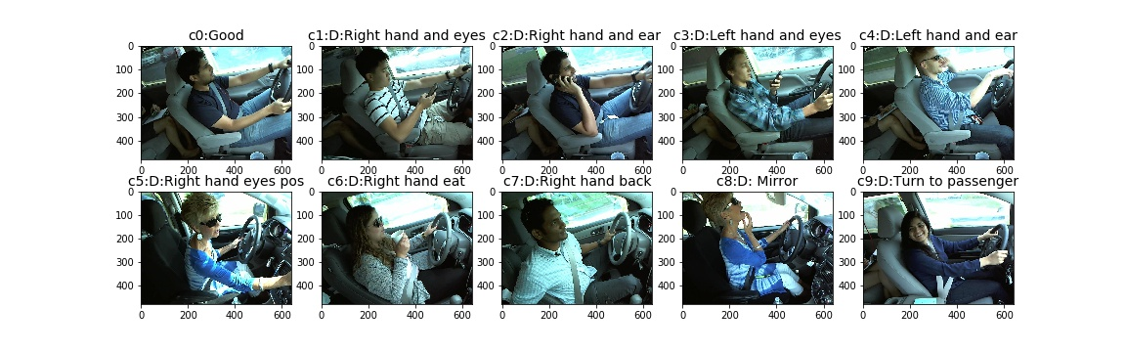
10 different labels

Slide 4
One Week Ago: f1-score
Classifier | F1-score
Decision Tree | 0.44
Naive Bayes | 0.37
Knn | 0.58
Logistic Regression | 0.79

Slide 5
1121 images (5%) as training images
Change image from color to grayscale
PCA components limitation
144 components
0.875 explained variance ratio

Slide 6
This Week
Change image from color to grayscale
Resized to quarter size in each dimension
(480x640x3 => 120x160)
921,600 pixels reduced to 19,200 pixels
15,696 images (70%) as training data
PCA 800 components

Slide 7
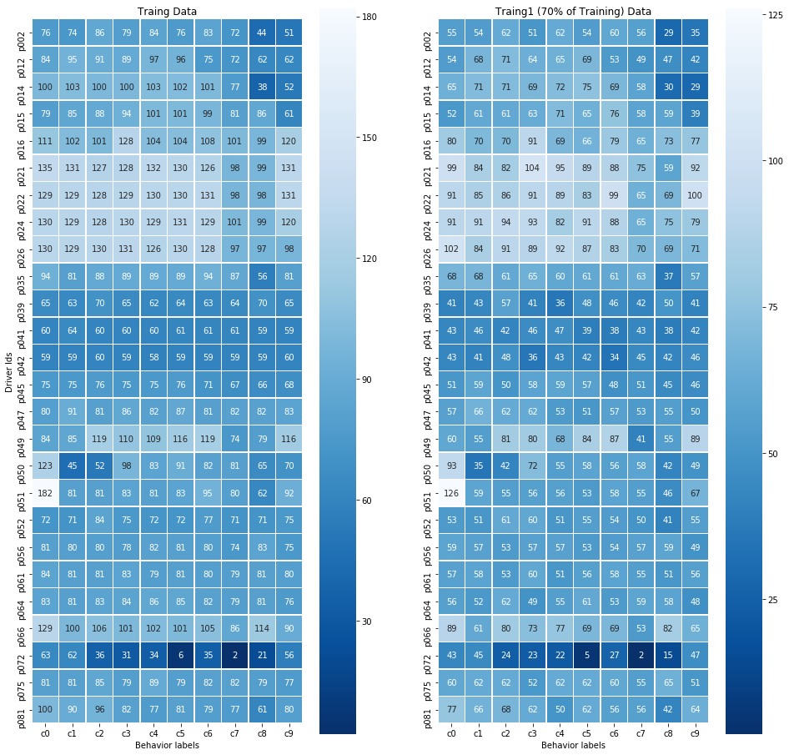

Slide 8
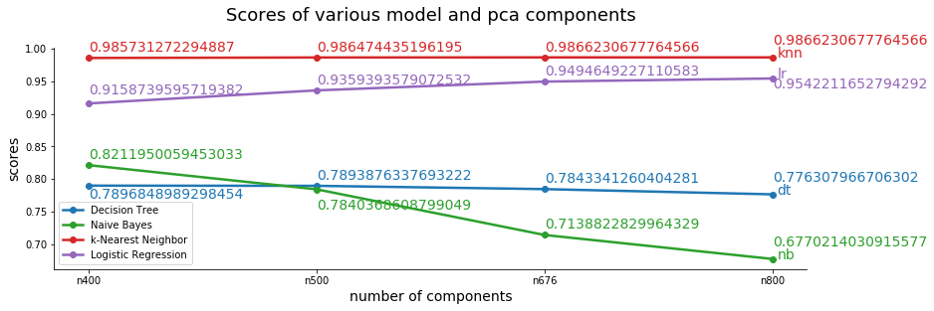

Slide 9
Logistic Regression 0.990487514863258
PCA (n=676, 800) 0.9866230677764566

Slide 10
