Slide 1
Merchant Personas
April 13, 2020
Chia Hou Shen User Experience Design Team Rakuten, Inc.

Slide 2


Motives
User experience design requires a good understanding of user needs.
In order to design an advanced management tool for Rakuten merchants, a study of merchant personas has been conducted, eliciting users pain points and needs for running a successful business on Rakuten.

Slide 3


Method
13 shops were selected and invited to a face-to-face, semi-structured interviews
1. Increase engagement
A structured interview framework
Unstructured questions and flow
2. Elicit more in-depth data
3. Observe body language & facial expression
More reliable and comparable data
New ideas & unexpected findings
Notes:
我們會挑選15家店進行半結構式(semi-conducted)訪談。半結構式訪談為根據研究主題與目的，設計好訪談大綱與重點問題，並可以視實際受訪者的回答狀況調整訪談順序與內容。這可能是唯一一次訪談機會，因此我們希望盡可能涵蓋所有範圍。
採用半結構式訪談原因：
事先準備好的問題，但可以彈性化調整內容，能讓訪談結果既具有比較依據，又更真實可靠。
研究員能和受訪者更深入探討話題並有機會發掘新的觀點。
15家店 → 一種規律 pattern，看到一個規律，提出一個理論

Slide 4
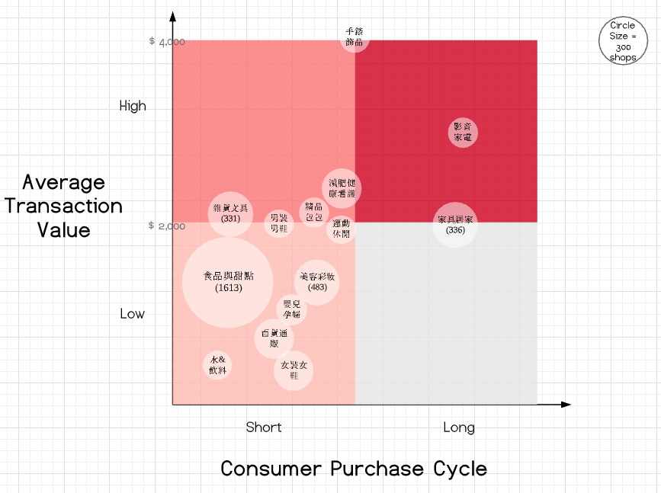
Method
Shop Category Selection
1. Pick the categories containing more than 100 shops
2. Re-classify types of shops: ATV & Consumer Purchase Cycle
 | Category Name | Number of Shops
1 | 食品與甜點 | 1613
2 | 美容與彩妝 | 483
3 | 居家,家具與寢飾 | 336
4 | 廚房,生活雜貨與文具用品 | 331
5 | 百貨・綜合性通販・贈禮 | 259
6 | 流行女裝與女鞋 | 207
7 | 減肥健康與看護 | 205
8 | 水與飲料 | 196
9 | 嬰幼兒與孕婦 | 195
10 | 影音與家電 | 176
11 | 精品,包包與服飾配件 | 154
12 | 流行男裝與男鞋 | 137
13 | 運動,戶外與休閒 | 130
14 | 手錶與流行飾品 | 103
source：OPEReport_190630

Slide 5
Method
Shop Selection
3. Randomly select 2-4 shops whose GMS is between 10k to 4M from each type (Average Transaction Value vs. Consumer Purchase Cycle)
Type | Shop Category
Short CPC + Low ATV | 食品與甜點
 | 美容彩妝
Short CPC + High ATV | 雜貨文具
 | 減肥保健
 | 3C/電腦週邊
Long CPC + High ATV | 居家家具
 | 3C/影音家電
Business Size on Rakuten
GMS < 10k : In the red
GMS 10k – 50k : Small scale
GMS 50k – 500k: Medium-Large scale
GMS 500k – 4M : Large scale
GMS > 4M : Super large scale
Companies that are in the red or super large are excluded from the interview lists, as they are not regarded as the primary users.

Slide 6



Analysis
Identify variables
Identify user personas
Investigate relationship between variables

Slide 7
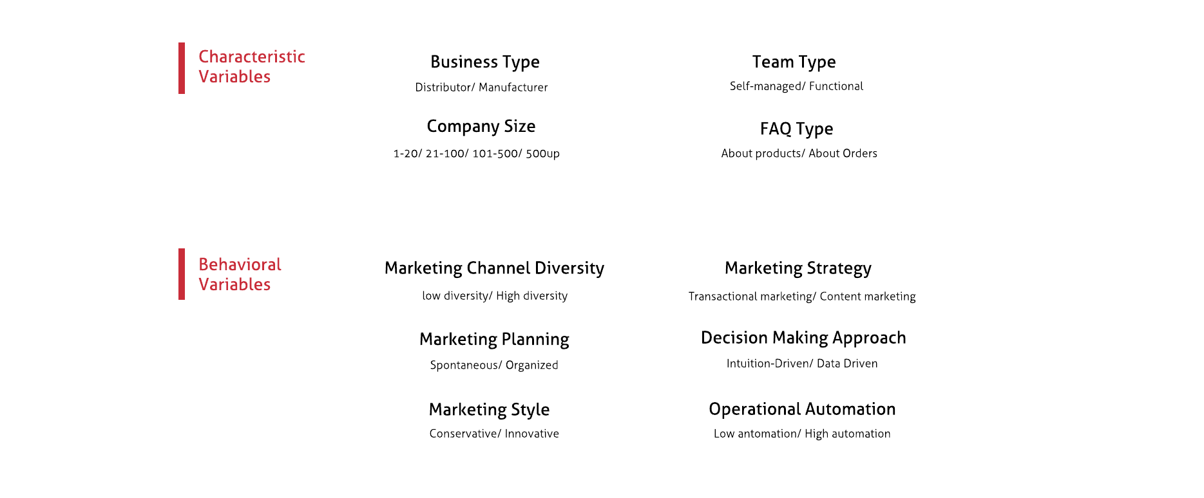
Results: Variable Identification
4 characteristic variables and 6 behavioral variables were identified in the interviews

Slide 8
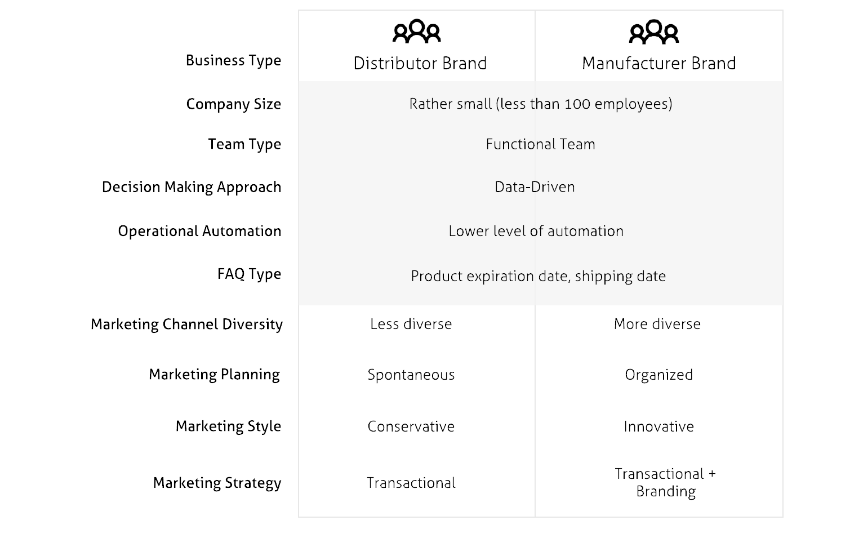
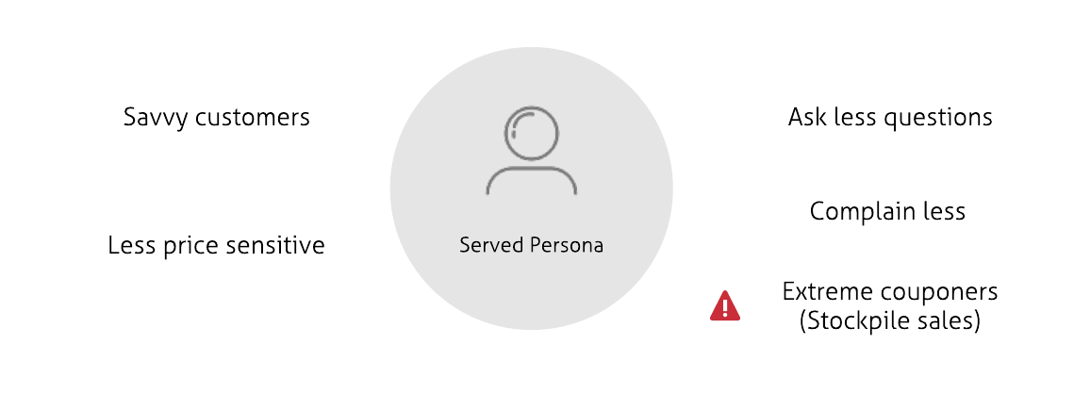
Results: Persona Identification
1
2
We must bear in mind that the interviewees were selected based on the premise stated earlier.
They are shops with a rather promising future and work closely with our ECC.
莫比克 Mallbic （支援蝦皮、雅虎拍賣、雅虎商城、露天拍賣等)

Slide 9
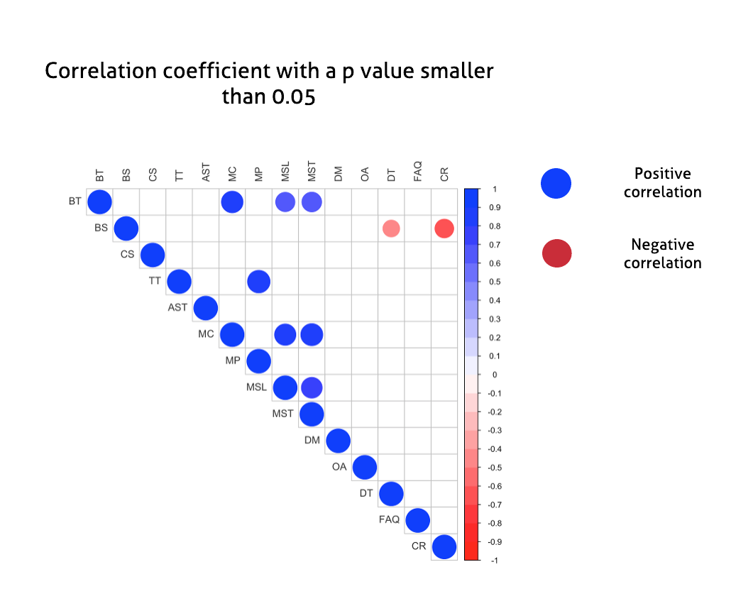
Results: Investigation of Variables Relationship
Notes:
相關係數

Slide 10
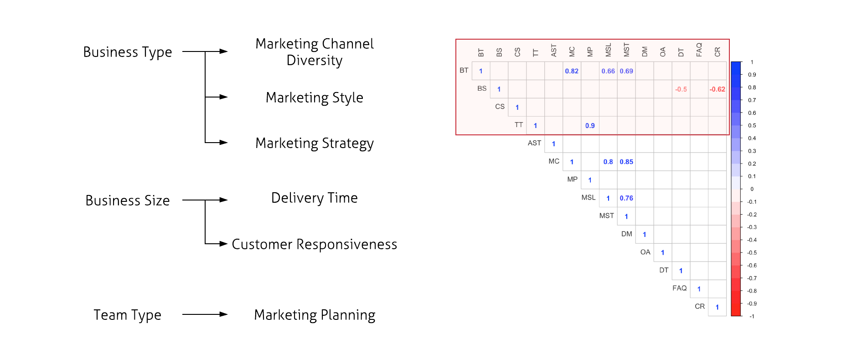
Results: Investigation of Variables Relationship

Slide 11
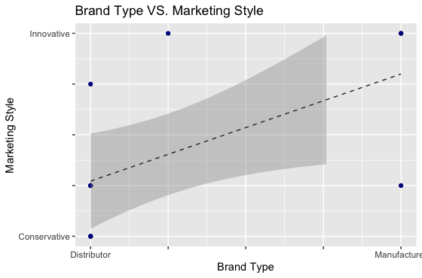
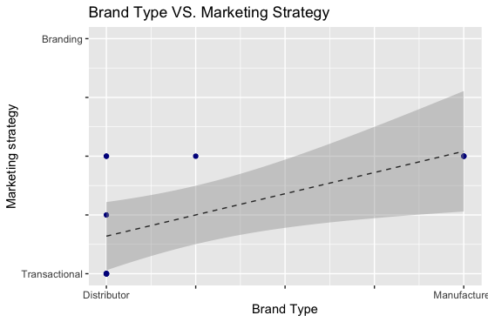
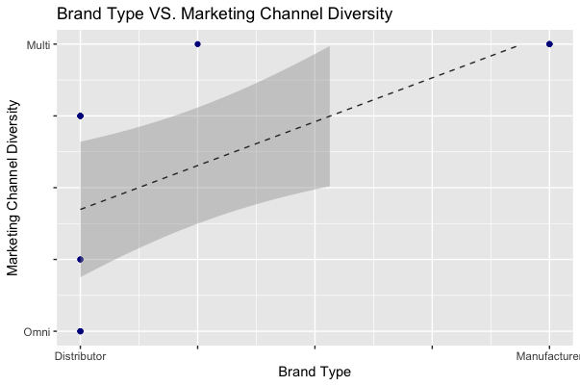
Results: Investigation of Variables Relationship
Correlation does not imply causation. The relationship may be caused by a third variable, complex interactions of several variables or just by chance.

Slide 12
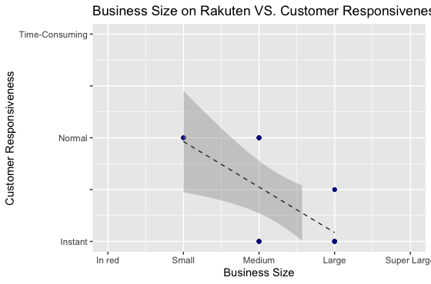
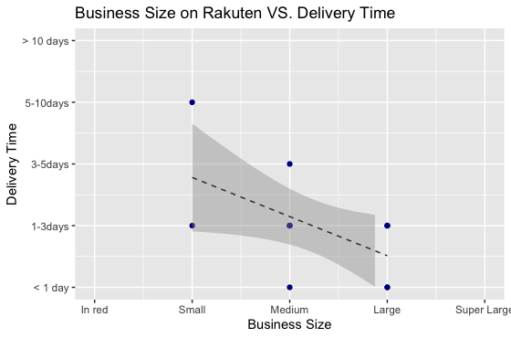
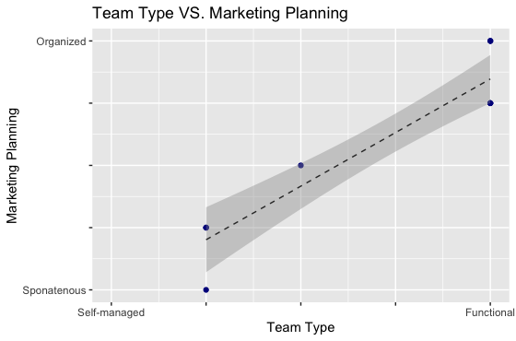
Results: Investigation of Variables Relationship
Correlation does not imply causation. The relationship may be caused by a third variable, complex interactions of several variables or just by chance.
Notes:
大公司 1. 對出貨速度有堅持
2. 員工數多 分工詳細
3. 有庫存可以即時出貨
4. 系統自動化

Slide 13
The End
Thank you for listening!

