Slide 1

SC1015 Project
Health Insurance Cross Sell Prediction
CHIA LU TING
DANIEL LI RUNZE
LAI SHI HONG

Slide 2
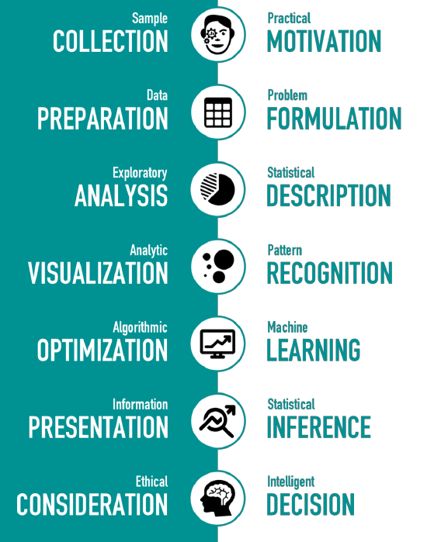
Sample Collection & Practical Motivation
Most people shun insurance agents
People who are already insured might be more inclined to add-on a vehicle insurance

Slide 3
How different variables affect the receptiveness of cross-selling of insurance among existing policyholders?

Slide 4
Variables in the Dataset
Demographics
Gender
Possession of Driving License
Region Code
Age
Possession of a vehicle insurance
Vehicle Age
Vehicle Damage
Vintage
Sourcing Channel
Annual Premium
Vehicle Details
Policy Details

Slide 5
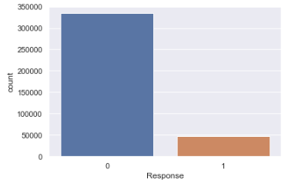
Exploratory Data Analysis

Slide 6
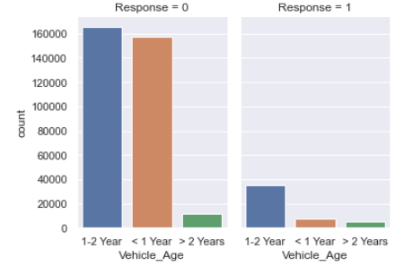
Exploratory Data Analysis

Slide 7
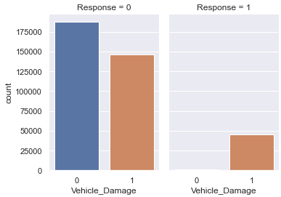
Exploratory Data Analysis

Slide 8
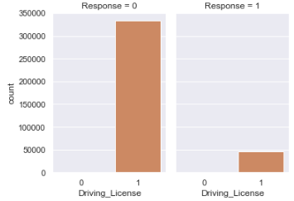
Exploratory Data Analysis

Slide 9
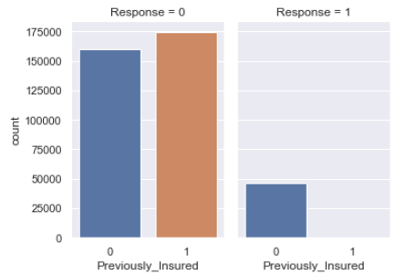
Exploratory Data Analysis

Slide 10
Preliminary Data-Driven Insights
As hypothesized, most people do not want insurance.
Higher receptiveness to purchase vehicle insurance if:
Vehicle_Age is 1-2 years old
Sustained vehicle damage
Own a driving license
No vehicle insurance

Slide 11
Core Analysis
Should insurance companies sell vehicle insurance? If yes, who should they sell to?
Machine learning problems faced:
How do we determine if a customer will get vehicle insurance?
What number of customers will get vehicle insurance?
Technique used: Classification
Decision tree
Random forest
Multi-layer perceptron
XGBoost

Slide 12
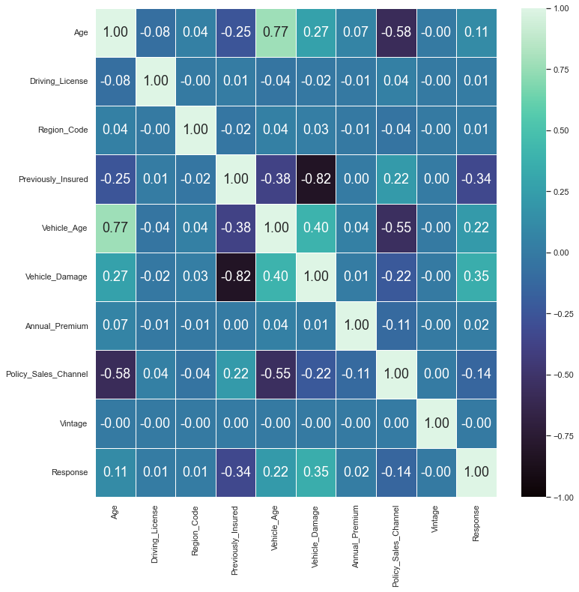
Preprocessing
Variables used in our models
Age
Previously_Insured
Vehicle_Age
Vehicle_Damage
Policy_Sales_Channel
4 of 5 of our variables are categorical

Slide 13
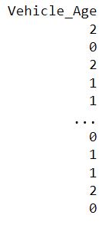
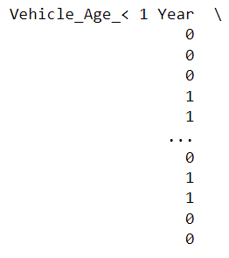
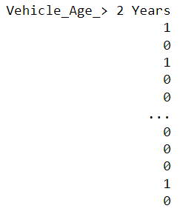
Preprocessing
Categorical variables must be treated before using ML techniques (Categorical encoding)
Label encoding
Each label is assigned a unique integer based on alphabetical ordering
One hot encoding
Creates additional features based on the number of unique values in the categorical feature
Feature Scaling for K-means clustering
Anomaly detection
Label encoding
One hot encoding

Slide 14
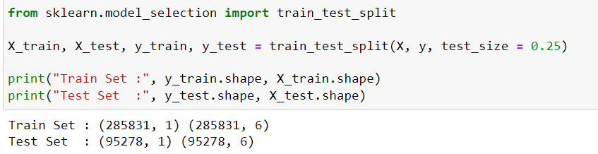
Preprocessing
We split the insurance dataset into train and test using ‘train_test_split’
We are now ready to begin!

Slide 15
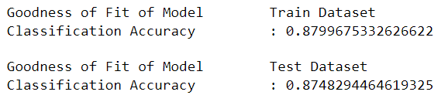
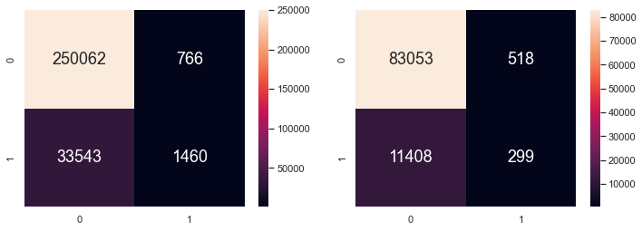
Decision tree
Easy to use
Let’s us get a feel of the data
However, is prone to overfit
Problems faced:
Tends towards ‘not interested’
Low accuracy for ‘interested’
Cost-Sensitive Learning for Imbalanced Classification

Slide 16
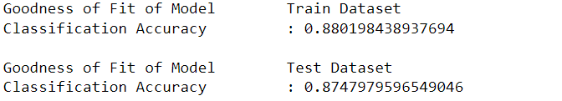
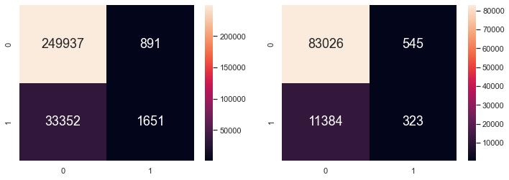
Random forest
Significantly more accurate than most non-linear classifiers
No overfitting issue as it takes the average of all predictions, cancelling out biases
Our new model has improved slightly
However, it still has a poor ‘interested’ accuracy
We will need to do hyperparameter tuning

Slide 17
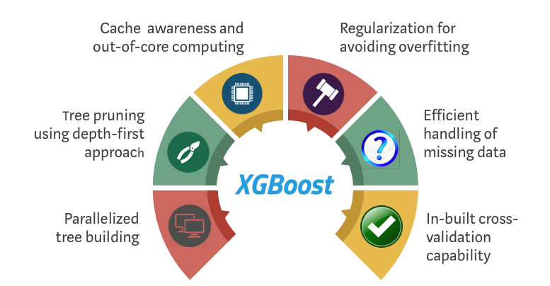
XGBoost
eXtreme Gradient Boosting
Boosting algorithm based on gradient boosted decision trees algorithm
Applies a better regularisation technique to reduce overfitting

Slide 18
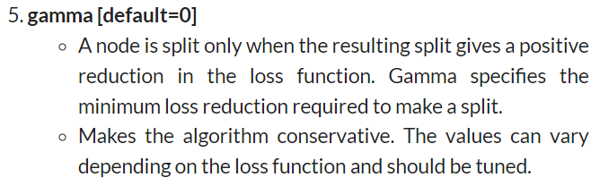
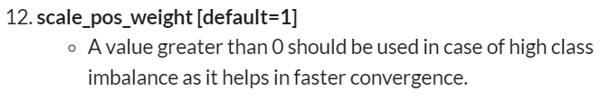
XGBoost
From our previous models, we know that we need to tune the parameters so that our model gives more positives
We increase scale_pos_weight while using an optimisation method to determine ‘gamma’

Slide 19
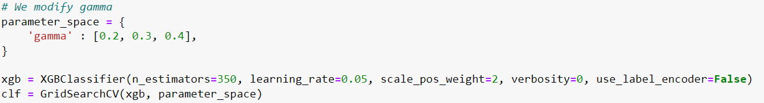
XGBoost
We optimise ‘gamma’ by using GridSearchCV
Exhaustive search over specified parameter values for an estimator

Slide 20
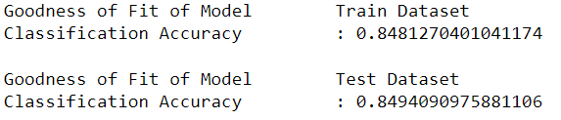
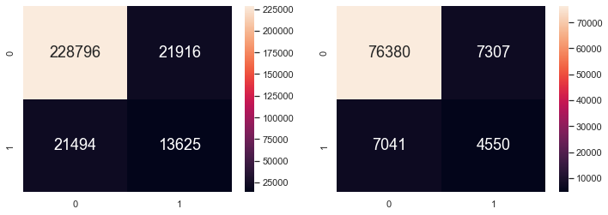
XGBoost
Our new model is now predicting more positives at the cost of some accuracy
Increased accuracy for ‘interested’ while decreasing accuracy for ‘not interested’

Slide 21
Determining if a customer will get vehicle insurance
Random forest
XGBoost
More accurate
Poor ‘positive’ accuracy
Less accurate
Better ‘positive’ accuracy
Conclusion
Companies will benefit more from taking risks (Assuming customer is interested rather than not)
Companies should choose a model that has a higher ‘positive’ accuracy despite a lower overall accuracy
XGBoost with tuned parameters is recommended

Slide 22
Putting everything together
We are provided a dataset, ‘test.csv’, that contains data from more customers
1
We will use this dataset to answer our problem statement
2
Should insurance companies sell vehicle insurance?
3

Slide 23
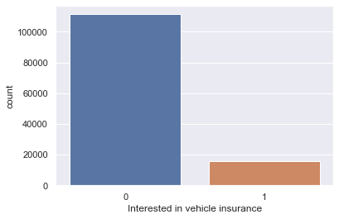
What number of customers will get vehicle insurance
We use the XGBoost model to determine customer segment
An estimated 13-18% of customers will be interested in vehicle insurance
There is a significant customer segment that will be interested
Companies should optimise its business model and revenue accordingly (increase premium for vehicle insurance)

Slide 24
RECOMMENDATION
Problem faced of dataset having a skewed class distribution. Also referred to as imbalanced classification problem
Cost-sensitive learning is a subfield of machine learning that can deal with imbalanced classification
Focused on learning and using models on data that have uneven penalties or costs when making predictions and more
Involves explicitly defining and using costs when training machine learning algorithms

Slide 25

Conclusion
Insurance companies SHOULD sell vehicle insurance as it can still be profitable
Companies should target those who
Faced vehicle damage past/present
Have older vehicles
Are older
A sizable amount of an estimated 13-18% of customers will be interested in vehicle insurance

Slide 26
Advice Insurance Companies:
How much to price premium?
Regression analysis of response = 1

Slide 27
Preprocessing
Clustering
Regression
One-hot encoding
Train test split
Remove outlier
Feature Scaling
K-means Clustering
Linear
Decision tree
Random forest
Transformed Target
Neural Networks

Slide 28
Results
Model | R2-Score | RMSE
LinearRegression | 0.872 | 5583
DecisionTreeRegressor | 0.895 | 5044
RandomForestRegressor | 0.901 | 4896
TransformedTargetRegressor | 0.908 | 4723
MLPRegressor | 0.908 | 4722

Slide 29
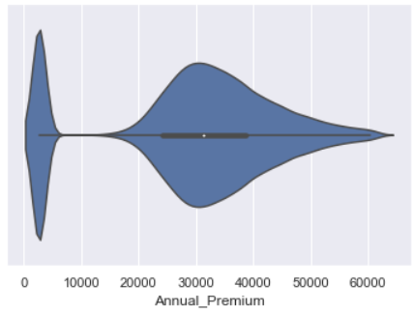
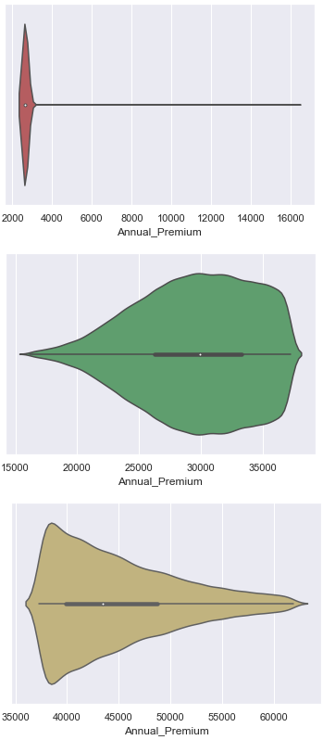
New Insights 1
K-means clustering
3 groups
Bimodal output

Slide 30
New Insights 2
Ensemble Learning
DecisionTree → RandomForest
Bootstrapping and Aggregating

Slide 31
New Insights 3
Neural Networks
2 hidden layers = (6,6,) Solver = LBFGS, Activation = ReLu
ReLu to tackle sparsity
Grid Search for the hyperparameters of NN: learning rate, activation functions, neurons in the hidden layer

Slide 32
Response = 0
Applied the trained model to data from Response = 0
Similar accuracy = Similar pricing strategy
Apply different pricing based on classification

Slide 33
3 main points
13-18% of people are interested in the cross-sell
Company should target people who faced vehicle damage, have older vehicles, or are in the older age groups.
Insufficient data on customer background to conclusively create pricing mechanism for response = 0

Slide 34
Thank You!

