Slide 1
LEARNING DYNAMICAL SYSTEMS WITH SIDE INFORMATION
Review by Yash Lal

Slide 2



Problem
Learn a continuous dynamical system of the form
Given a set of “noisy” trajectories
Minimize a convex loss function
Must generalize well

Slide 3
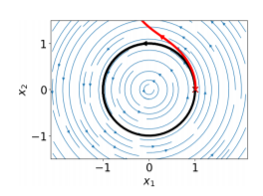



Value of the Approach
Prevent overfitting
Works with limited data

Slide 4
6 Types of Side Information
Interpolation (Interp)
Known values
Equilibrium points
Group Symmetry (Sym)
Even and odd functions
Sign symmetry
Coordinate Nonnegativity (Pos)

Slide 5
6 Types of Side Info (Ct’d)
Coordinate directional monotonicity (Mon)
Coordinate strictly increasing or decreasing on a subset
Invariance of a set (Inv)
All trajectories in a set B are confined to B
Such as [0,1]
Gradient and Hamiltonian systems (Grad, Ham)
Gradient: is the vector field the gradient of a scalar field
Vector field is conservative with some “potential” scalar field
Hamilton: vector field sum of some “potential” and “kinetic” terms
Satisfy Hamiltonian equations

Slide 6

Two Types of Constraints
Affine Constraints
Interp, Sym, Grad, Ham
Linear constraint on the coefficients of our p(x) approximation
Sum of Square Constraints
Pos, Inv, Mon
q(x) derives coefficients from p(x)

Slide 7
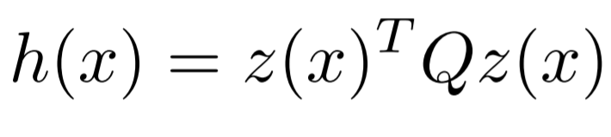
Semidefinite Programming
SOS Polynomials can be found with SDP
Q is symmetric and PSD
z(x): all monomials with degree ≤ d
Implementation: Julia solvers

Slide 8

Example 1:Epidemic (d=3)
Epidemic of STD with x1, x2 being men, women
Loss
Minimize L2 loss between training trajectory and polynomial approximation

Slide 9
Example 1: Side Information
Interp
Origin is equilibrium point
Inv
[0,1] x [0,1] constrains x1, x2
Mon
x2 increases/decreases as x1 increases/decreases and vice versa

Slide 10
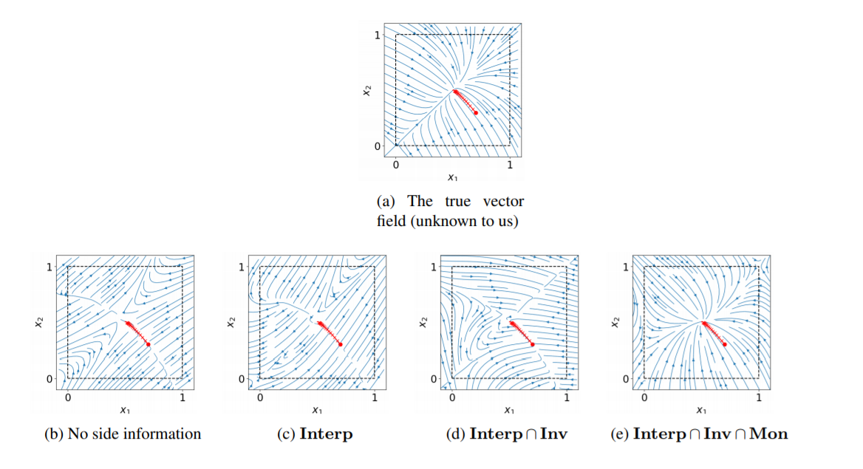
Example 1: Results

Slide 11



Example 2: Pendulum (d=5)
Dynamic of simple pendulum
Sym: sign symmetry
Pos: Gravity pulls downward with angle towards zero
Velocity decreases when angle is positive
Velocity increases when angle is negative
Ham: sum of KE and PE

Slide 12
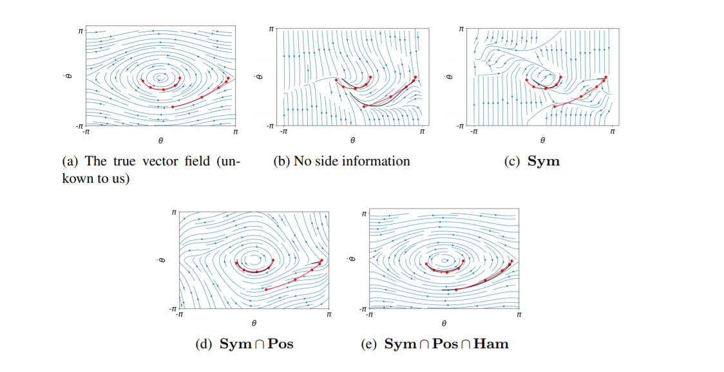
Example 2: Results

Slide 13


Optimal Control in Epidemic
Introduce decision variables representing testing
Associated monetary cost function
Total cost is sum of infection and monetary cost
Compute control laws with side information approach

Slide 14
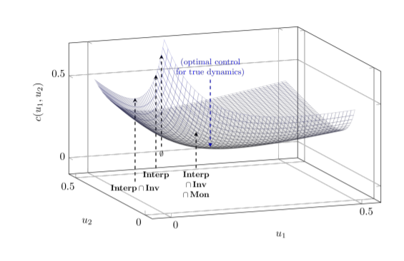
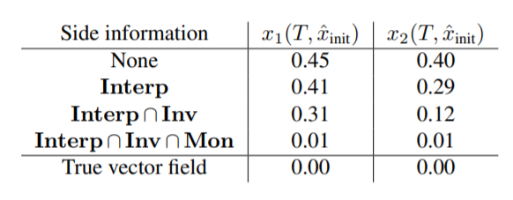
Optimal Control Results
Cost vs decision variables
Table comparing approaches

Slide 15
Proofs
Section 5 has very involved proofs
Main results
We can get sufficiently close to the true vector field while satisfying our desired set of side information over our polynomial approximator

Slide 16
Our Task
Understand the vector field underlaying microbial dynamics
Run DFBA to get a set of training trajectories
Try to extrapolate the entire vector field using side information
With polynomial approximation

Slide 17
Application to Our Task
Inv: All variables confined to [0,1]
Implicit nonnegativity of all variables
If we know how certain microbes behave,
We can add constraints of the Mon form
One microbe increases/decreases the abundance of another under certain conditions
Problem: can we build sufficient constraints?
Question: Does trajectory selection matter?

