Slide 1
GASL: From Claim to Compiled Evidence
Why trust depends on the visible structure of support.
Scientific inference advances when observations are compiled into evidence that can support or revise a hypothesis. GASL is designed to move AI answers toward that same discipline.

Slide 2
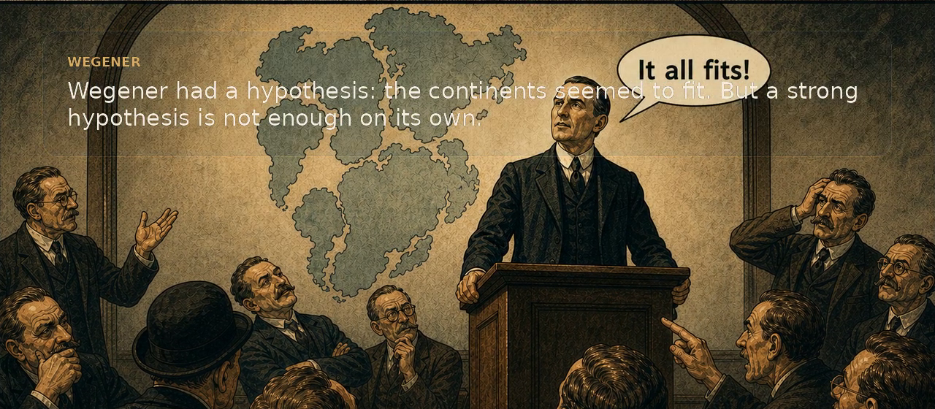
Scientific progress depends on compiled evidence
A strong idea matters. What changes a field is evidence organized into a form that other people can inspect, test, and extend.

Slide 3
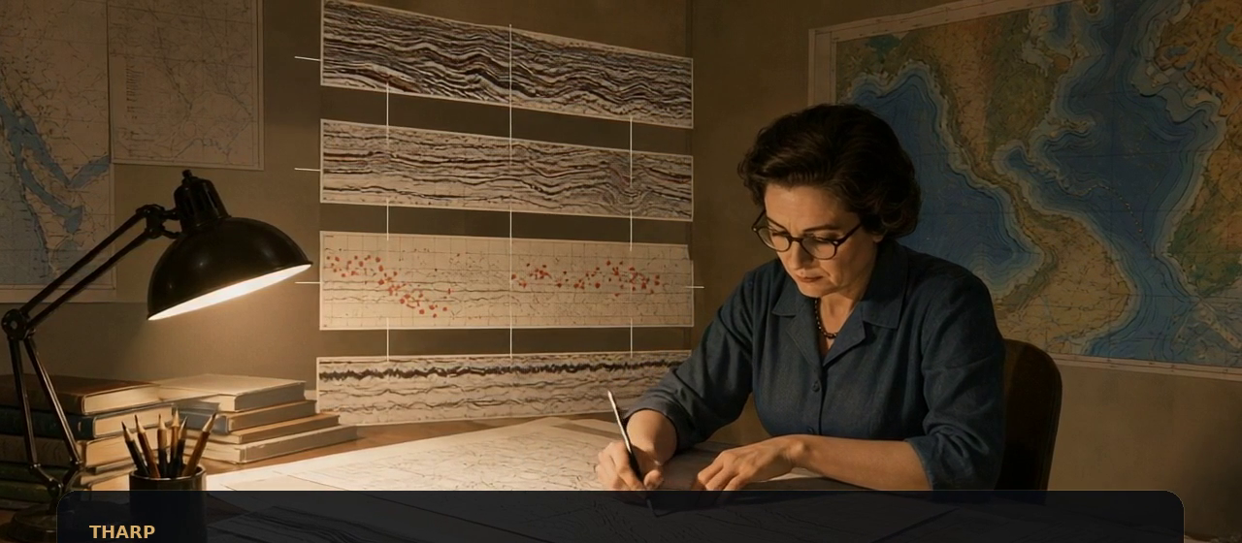
Tharp made the structure legible
Compilation does not amplify the claim. It converts scattered observations into a structure that others can inspect.

Slide 4
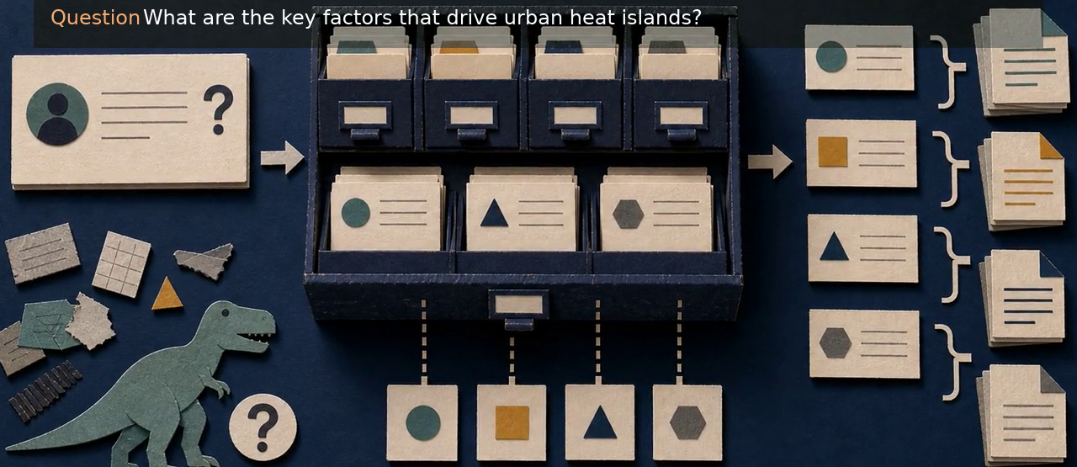
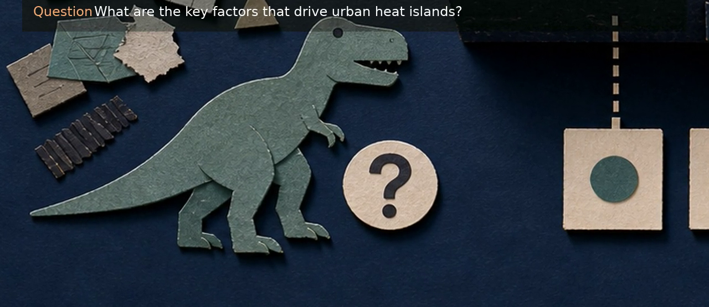
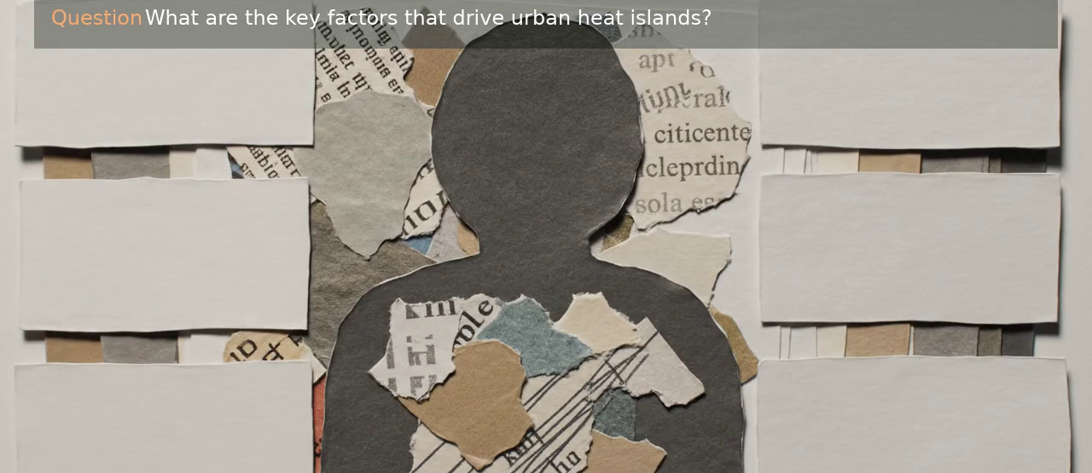
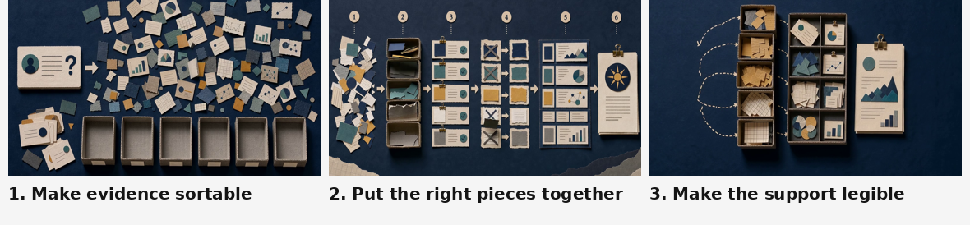
The same question yields different answers as support is assembled differently
Each system answers from the support it can gather, retain, and organize.
Classic system
LLM-only
RAG
GASL

Slide 5
Classical systems are precise when the problem conforms to the schema
They excel when slots are known in advance. They are less effective when the question outruns the available categories.

Slide 6
LLM-only systems can answer before support is assembled
Flexible input is valuable. A coherent answer can still be produced before the supporting evidence has been assembled or inspected.

Slide 7
RAG narrows context, but the retrieved slice can still miss key support
A narrower context is useful, but retrieval still limits what enters the model's field of view.

Slide 8
GASL keeps the support visible while it is organized
Sorting, grouping, and answer views make the supporting evidence inspectable before a final answer is produced.

Slide 9
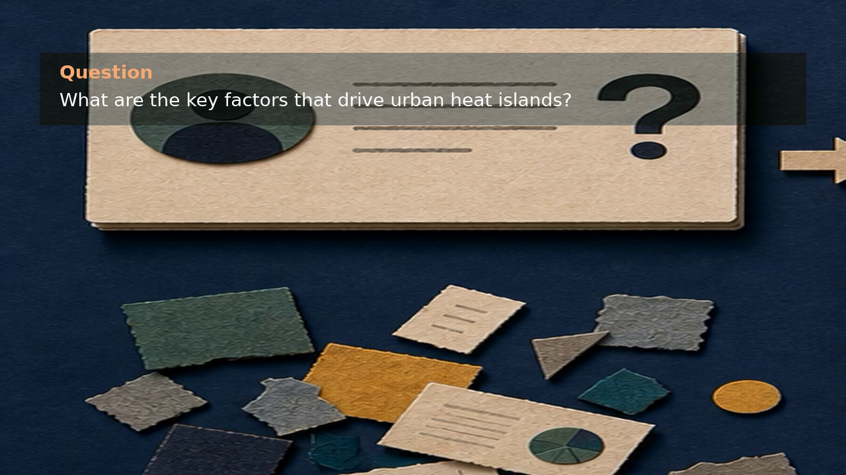
Representative question
What are the key factors that drive urban heat islands?
This example makes the loop visible on one concrete task. The point is the visible build-up of support before the answer.

Slide 10
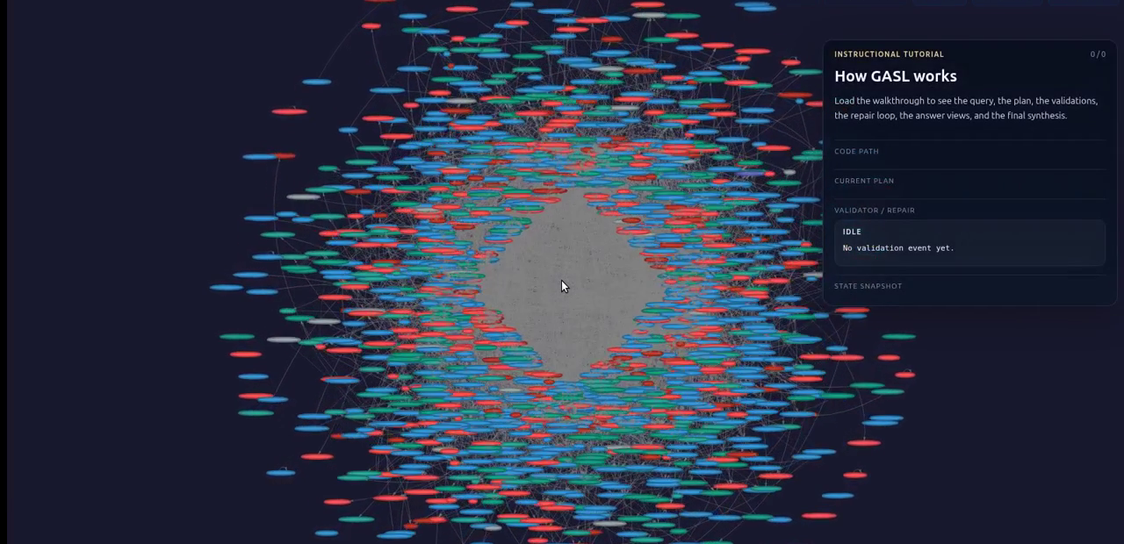
Begin with explicit symbols and a tentative evidence program
GASL first declares the symbols it will carry forward and a tentative sequence for assembling support.

Slide 11
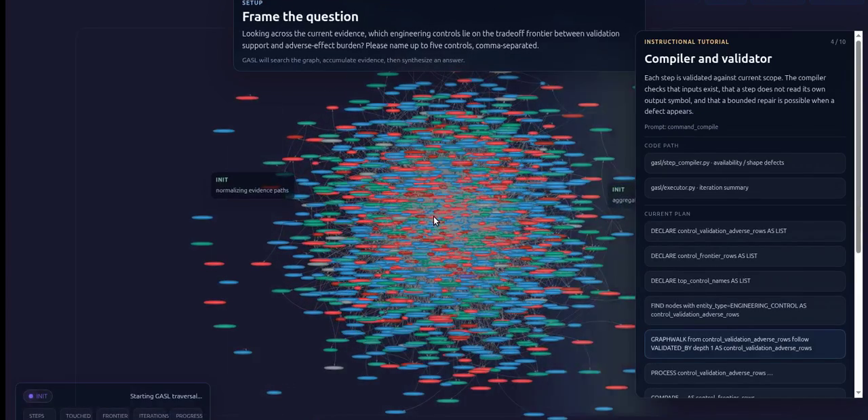
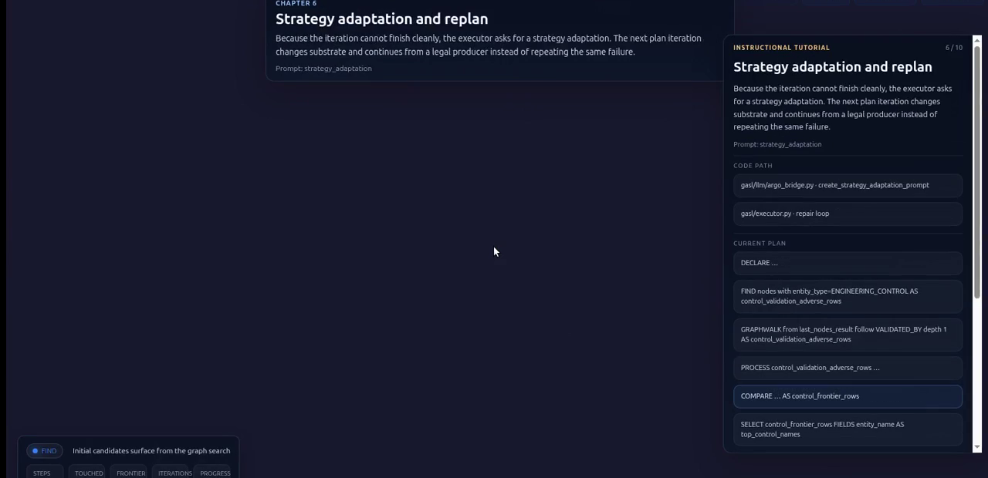
When a step fails, the defect informs the next step
Validate
Repair
Local validation catches a bad move early. The repair loop turns that defect into information for the next attempt.

Slide 12
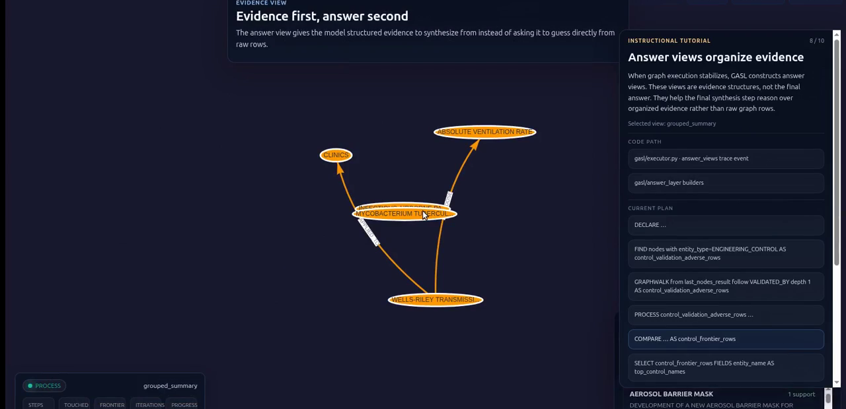
Answer views convert raw results into inspectable evidence
Final synthesis occurs only after raw graph results have been transformed into structured evidence.

Slide 13
Takeaway
Assemble support
Keep evidence legible
Answer from structure
The central idea is simple: assemble support, keep the evidence legible, and answer from that visible structure.

