Slide 1
GASL: From Claim to Compiled Evidence
Why trust depends on the visible structure of support.
Scientific inference advances when observations are compiled into evidence that can support or revise a hypothesis. GASL is designed to move AI answers toward that same discipline.

Slide 2
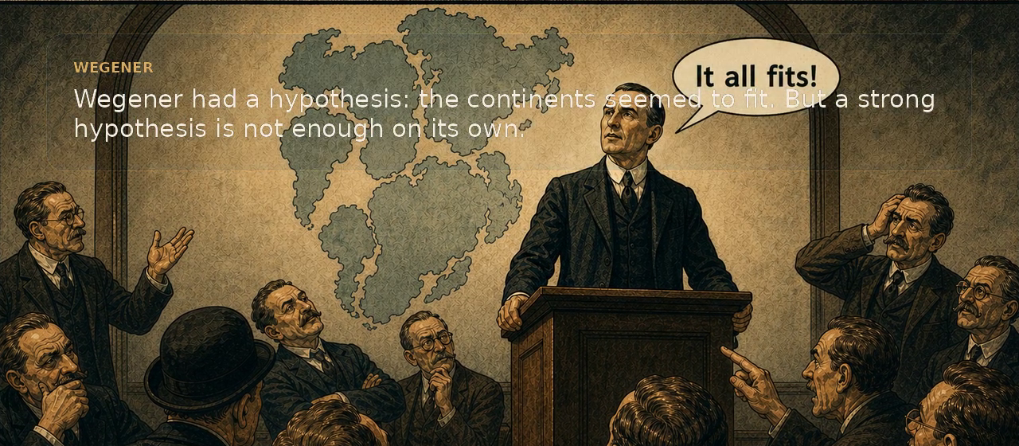
Scientific progress depends on compiled evidence
A strong idea matters. What changes a field is evidence organized into a form that other people can inspect, test, and extend.

Slide 3

Tharp made the structure legible
Compilation does not amplify the claim. It converts scattered observations into a structure that others can inspect.

Slide 4
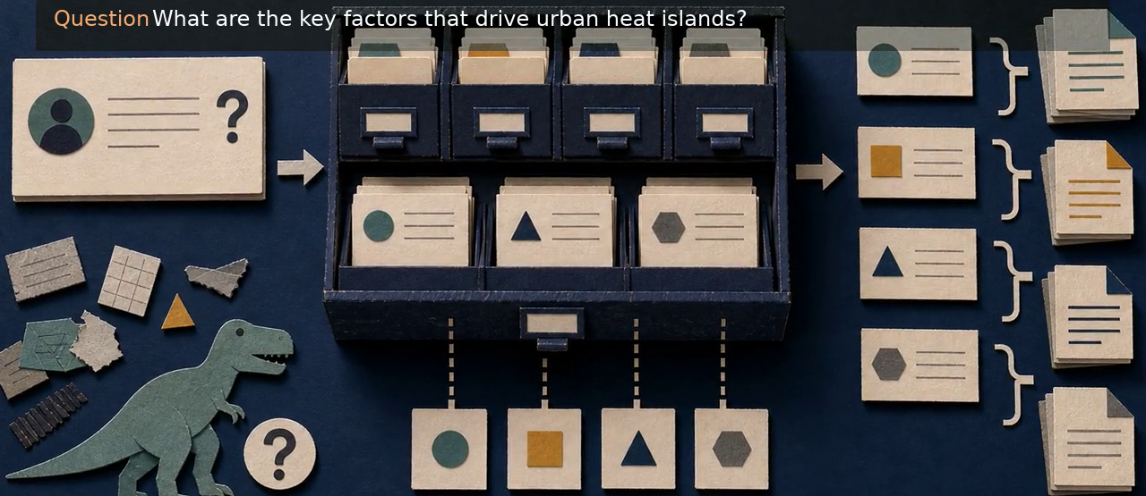
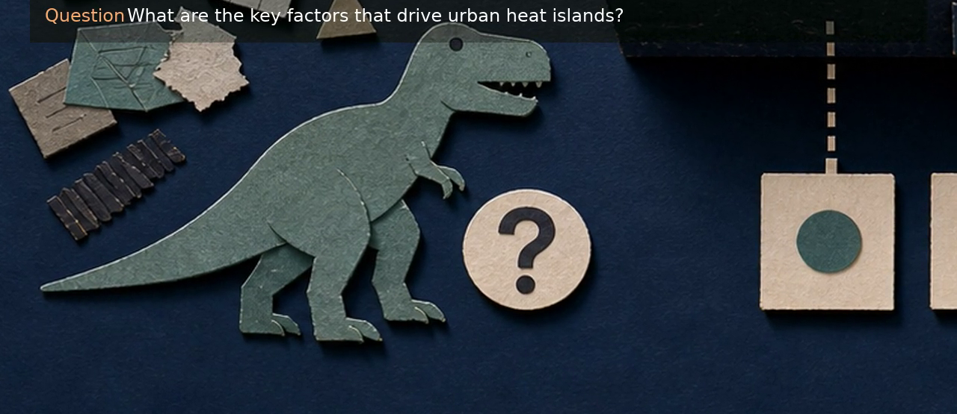


The same question yields different answers as support is assembled differently
Each system answers from the support it can gather, retain, and organize.
Classic system
LLM-only
RAG
GASL

Slide 5
Classical systems are precise when the problem conforms to the schema
They excel when slots are known in advance. They are less effective when the question outruns the available categories.

Slide 6
LLM-only systems can answer before support is assembled
Flexible input is valuable. A coherent answer can still be produced before the supporting evidence has been assembled or inspected.

Slide 7
RAG narrows context, but the retrieved slice can still miss key support
A narrower context is useful, but retrieval still limits what enters the model's field of view.

Slide 8
GASL keeps the support visible while it is organized
Sorting, grouping, and answer views make the supporting evidence inspectable before a final answer is produced.

Slide 9

Representative question
What are the key factors that drive urban heat islands?
This example makes the loop visible on one concrete task. The point is the visible build-up of support before the answer.

Slide 10
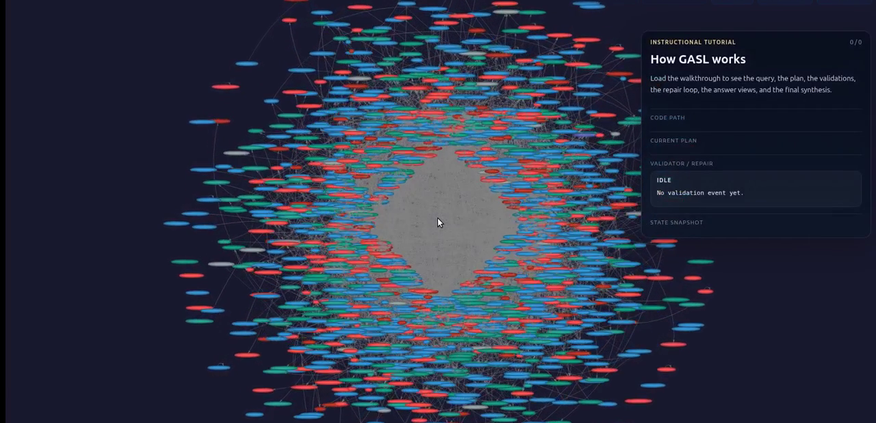
Begin with explicit symbols and a tentative evidence program
GASL first declares the symbols it will carry forward and a tentative sequence for assembling support.
Representative commands
DECLARE controls AS LIST
FIND nodes with entity_type=ENGINEERING_CONTROL AS controls
GRAPHWALK from controls follow VALIDATED_BY depth 1 AS support_rows

Slide 11
Different command families handle different information tasks
Working memory / scope
DECLARE
Create typed symbols for task-specific working memory
Access / retrieval
FIND, GRAPHWALK, SELECT, COUNT
Reach evidence that is not co-located
Assembly / reshaping
PROCESS, PROJECT, JOIN, MERGE, UPDATE
Turn heterogeneous rows into answer-bearing forms
Compilation / comparison
AGGREGATE, COLLAPSE, COMPARE, RANK
Build patterns and support summaries
The commands are not arbitrary. They correspond to different modes of gathering, assembling, and compiling support.

Slide 12
Before execution, each step is compiled against local symbol scope
Step-compiler checks
Availability: materialized_nonempty, materialized_empty, current_output, unavailable
Shape: rows, dict, counter, unknown
Outcome: accept, rewrite, patch_two, upstream_repair_needed, reject
Typical local defect
the proposed rewrite still reads its own output symbol
current_output is write-only at this step
This keeps one illegal local step from silently poisoning the rest of the run.

Slide 13
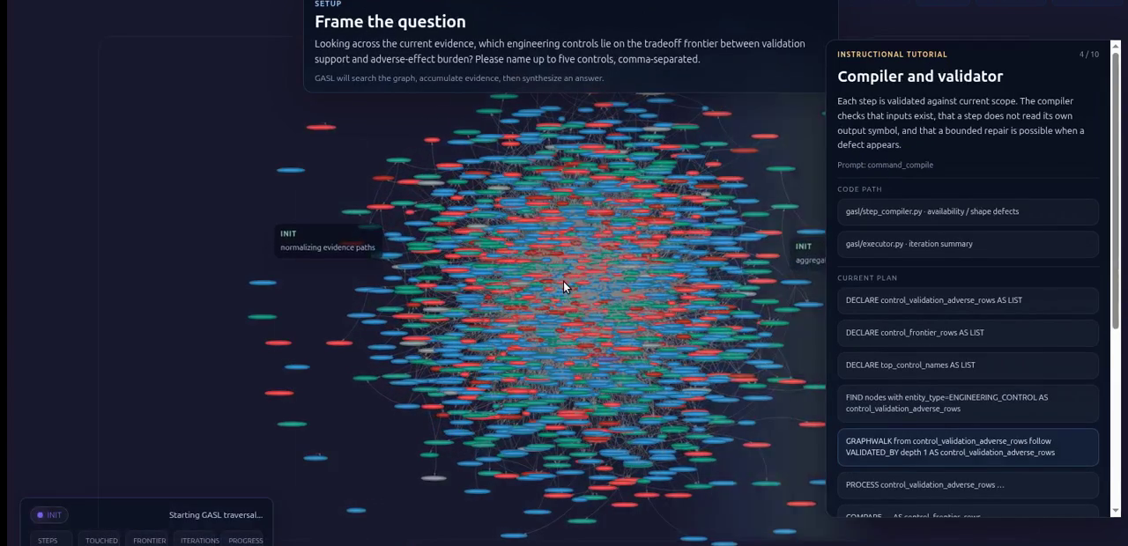
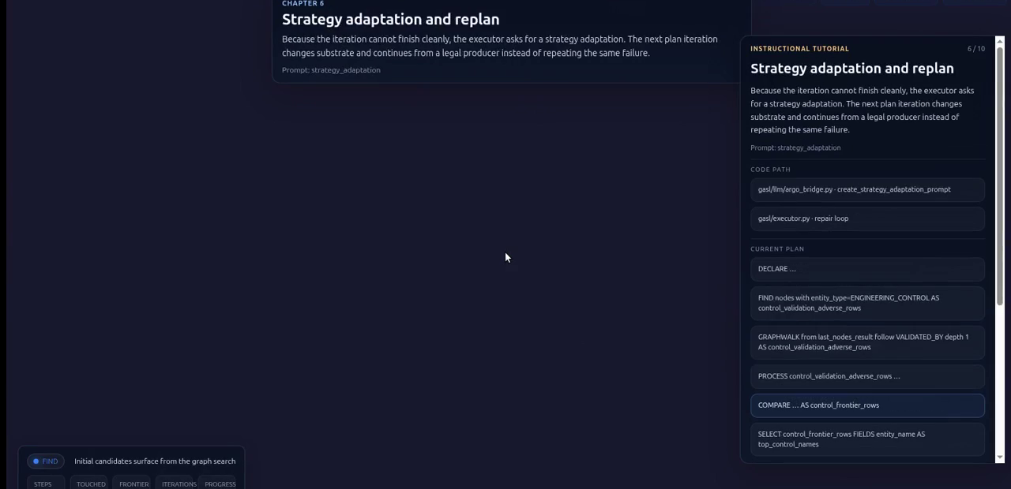
Command failures trigger repair and retry
Validate
Repair
Repair path
Statuses: success, error, empty, partial
replacement_command -> parse -> execute .repair
append provenance: original_command, replacement_command, confidence

Slide 14
If the plan stalls, a plan-iteration agent patches the command list
Plan-iteration patch modes
replace_command -> replacement_command
insert_after_command -> insert_command
delete_command
mode: patch or pass
This is how GASL changes strategy without pretending the first plan was correct.

Slide 15
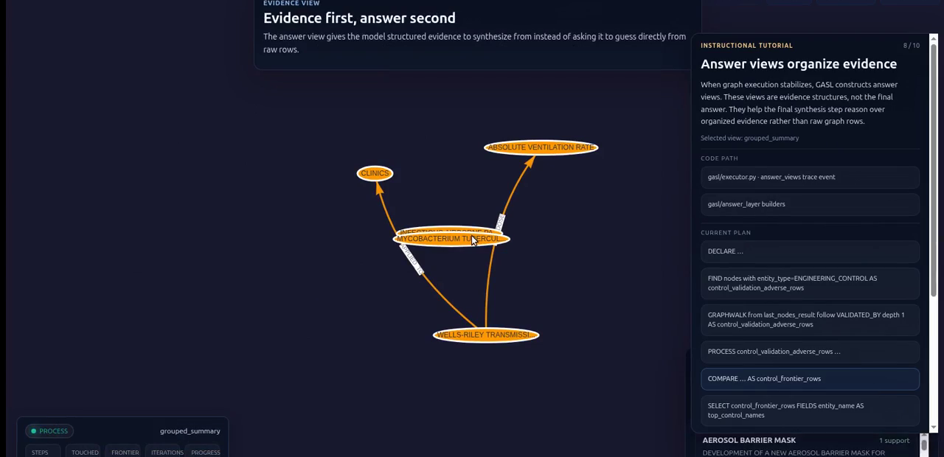
Runtime state and answer-layer compilation turn row variables into answer views
Answer-layer stages
Runtime view = state_variables + context_variables + produced_artifacts + history
evidence_table from row variables
grouped_summary + provenance from sufficient evidence
ranking / distribution / frontier / comparison views
selector chooses the view whose framing best matches the question
Raw results become views only after runtime state has accumulated variables, history, artifacts, and provenance.

Slide 16
Final synthesis answers from organized support, not instead of it
Runtime view
Views built
Best view selected
Final synthesis
Selection and finalization
Selector scores sufficient views by intent, support, and compactness
Optional LLM adjudicator breaks ties between meaningfully different views
Finalizer renders ranking / comparison / frontier / grouped summary / distribution / provenance

Slide 17
Takeaway
Assemble support
Keep evidence legible
Answer from structure
The central idea is simple: assemble support, keep the evidence legible, and answer from that visible structure.

