Slide 1
GASL: From Claim to Compiled Evidence
Why some answers are more trustworthy than others.
Modern science advances by compiling information into evidence that can support or revise a hypothesis. GASL pushes AI answers toward that same discipline.

Slide 2
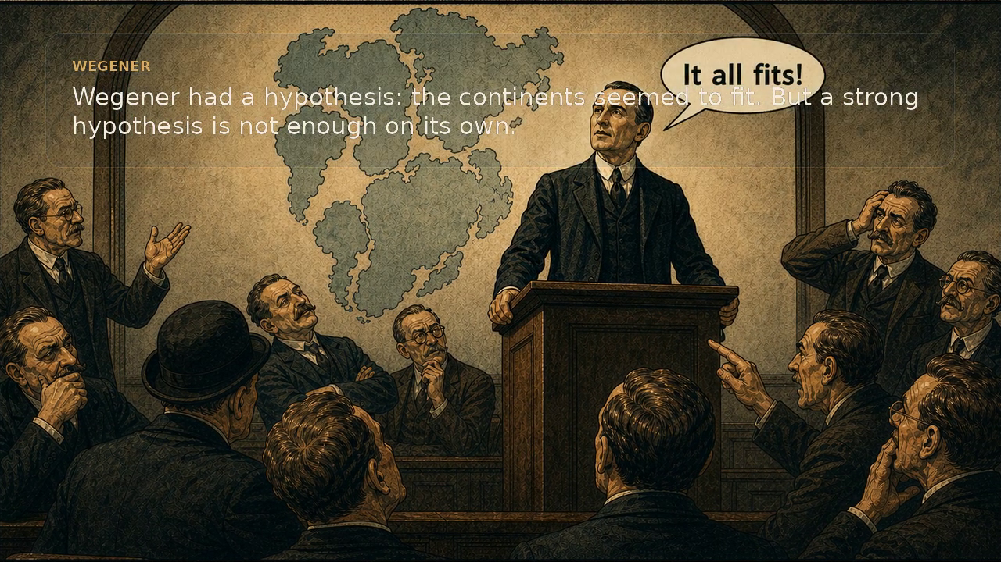
Science progresses by compiling evidence
A strong idea matters. What changes the field is evidence organized into a form other people can inspect and use.

Slide 3
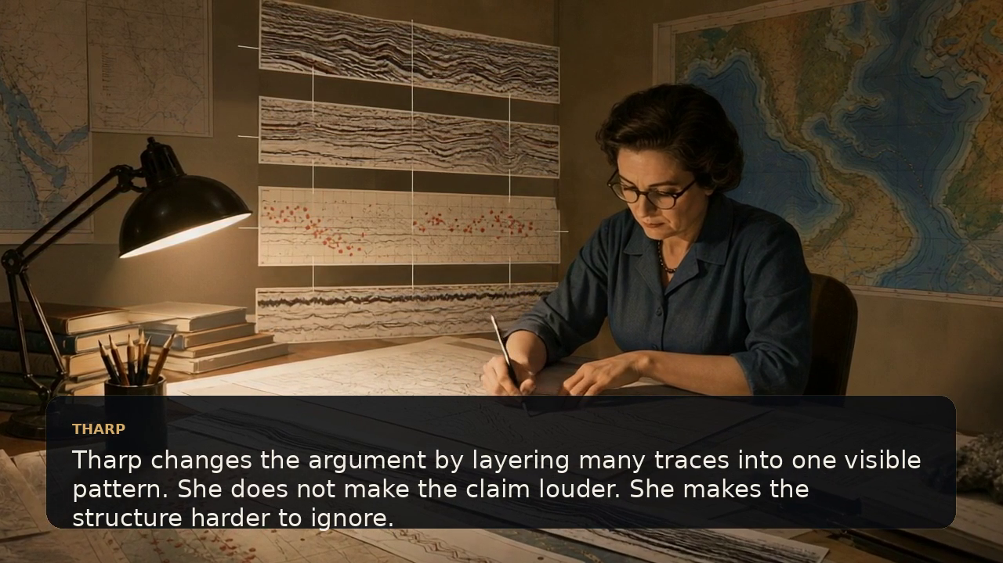
Tharp makes the hidden structure visible
Compilation does not make the claim louder. It makes the support harder to ignore.

Slide 4
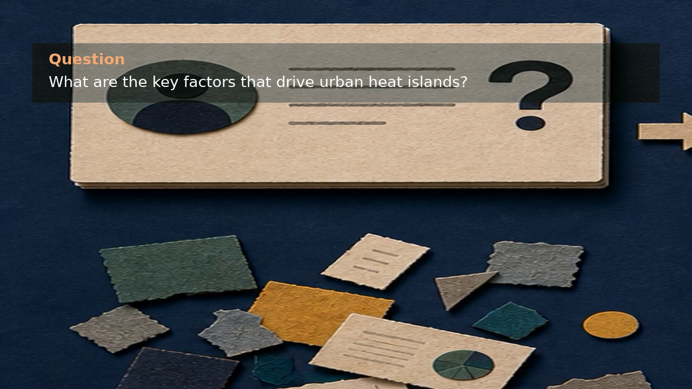
Different systems handle the same question differently
Classic systems, LLM-only, RAG, and GASL each solve a different part of the problem.

Slide 5
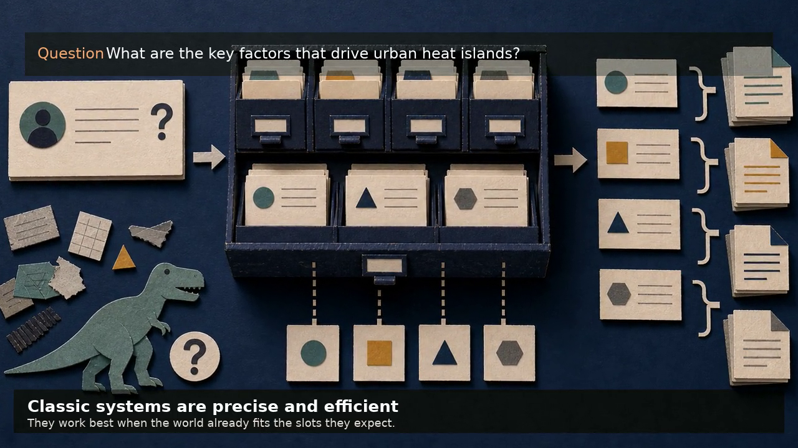
Classic systems are precise when the world fits the schema
They excel when the slots are already known. They struggle when the question outruns the categories.

Slide 6
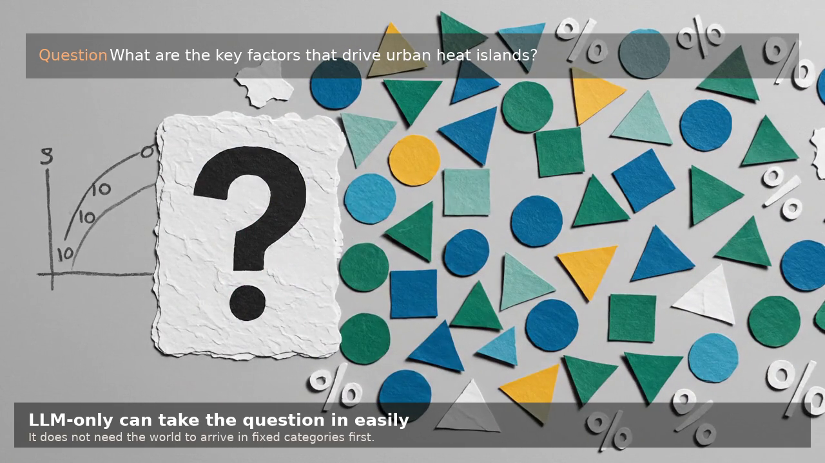
LLM-only accepts uncontrolled input easily
That flexibility is valuable. A polished answer can still hide incomplete support.

Slide 7
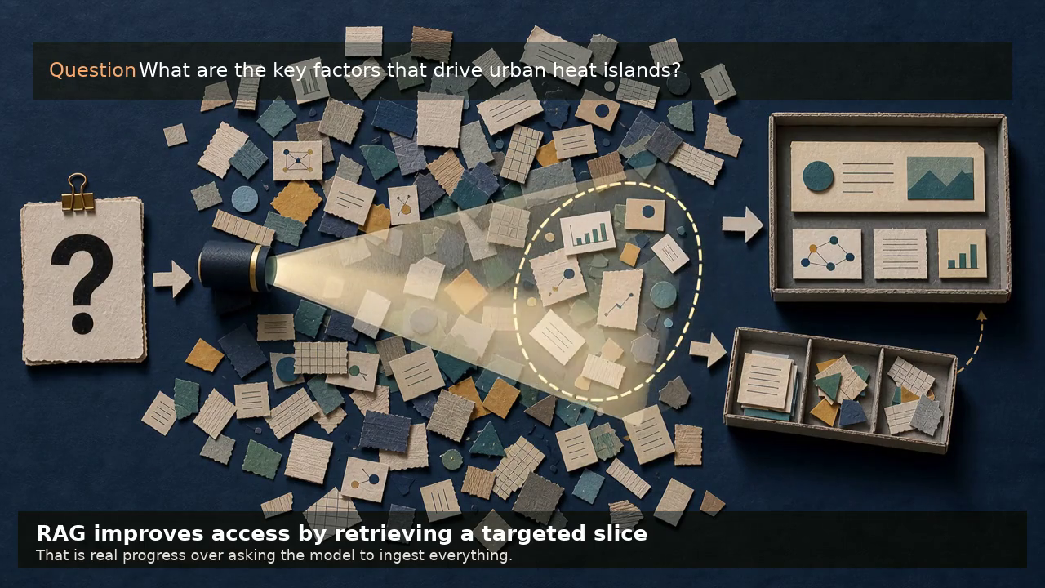
RAG retrieves a useful slice of support
A narrower context is better than no context. A slice can still miss key evidence outside the window.

Slide 8
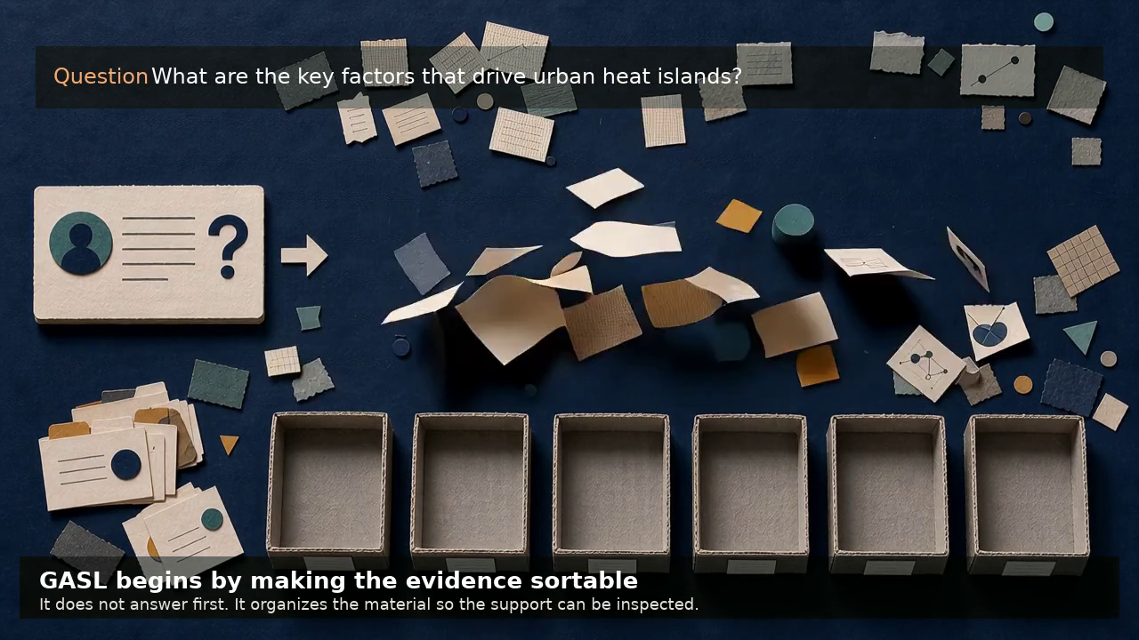
GASL organizes evidence before it answers
The support remains visible as it is sorted. The answer comes after the organization step, not instead of it.

Slide 9
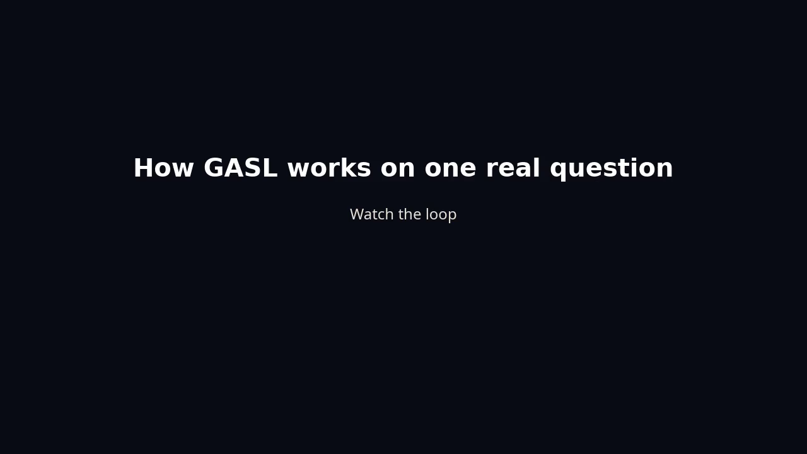
A representative GASL run
The final part slows the system down so the loop can be seen and named.

Slide 10
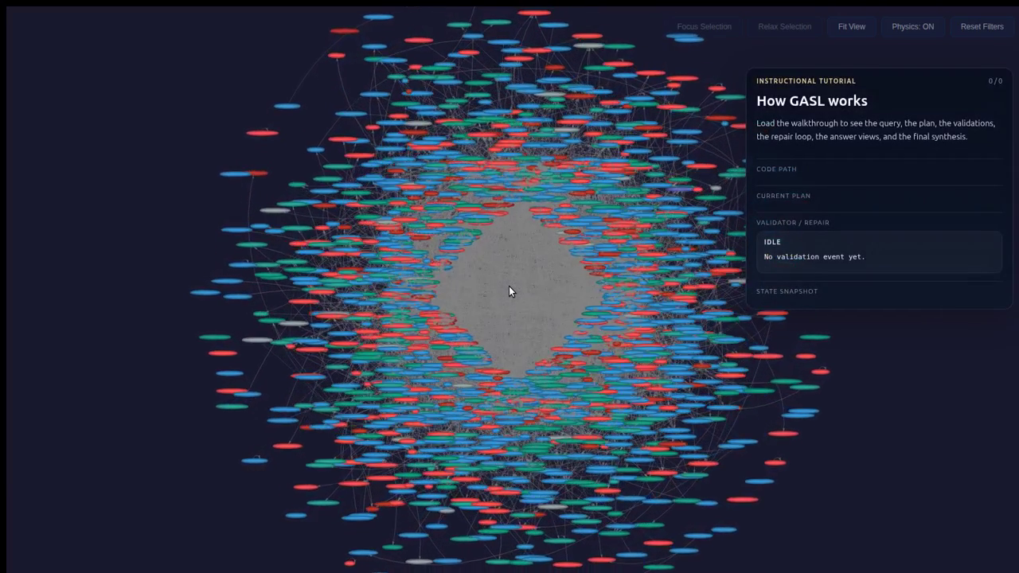
Plan symbols and propose an initial program
The system first declares a compact working memory and a tentative sequence of commands.

Slide 11
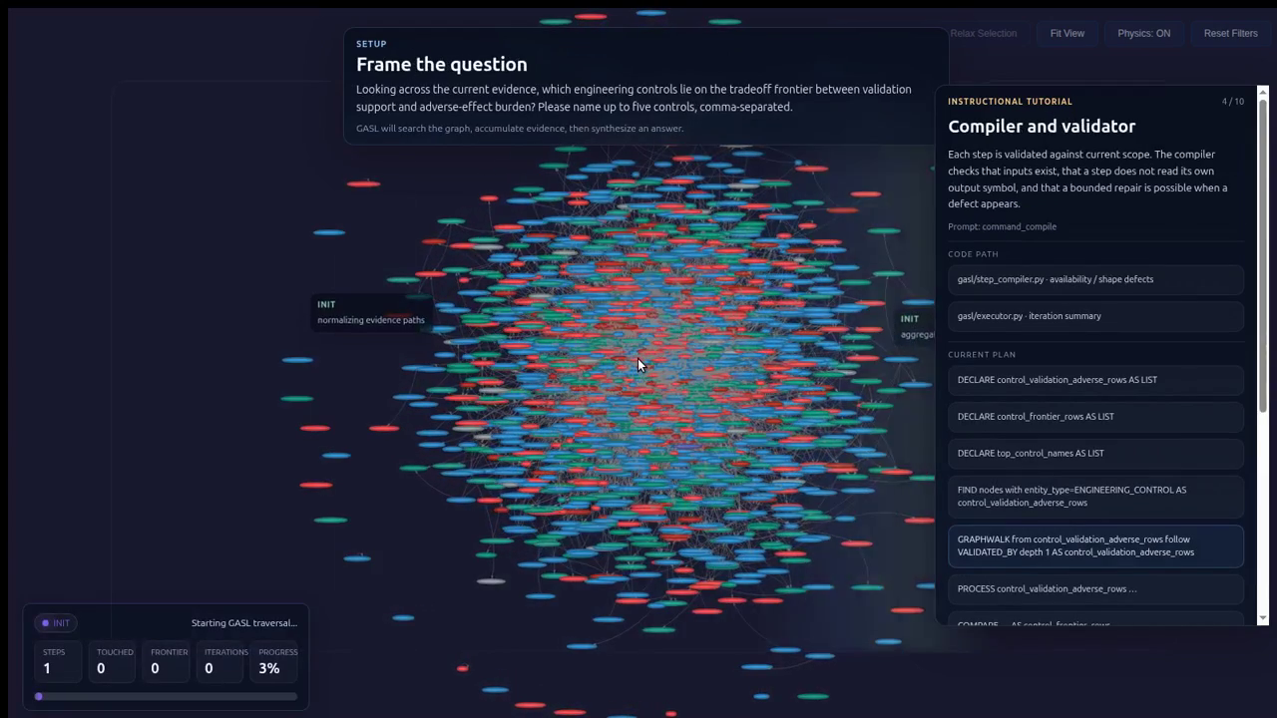
Validate locally, then repair when the plan breaks
A failed step is not wasted. The defect becomes information for the next iteration.

Slide 12
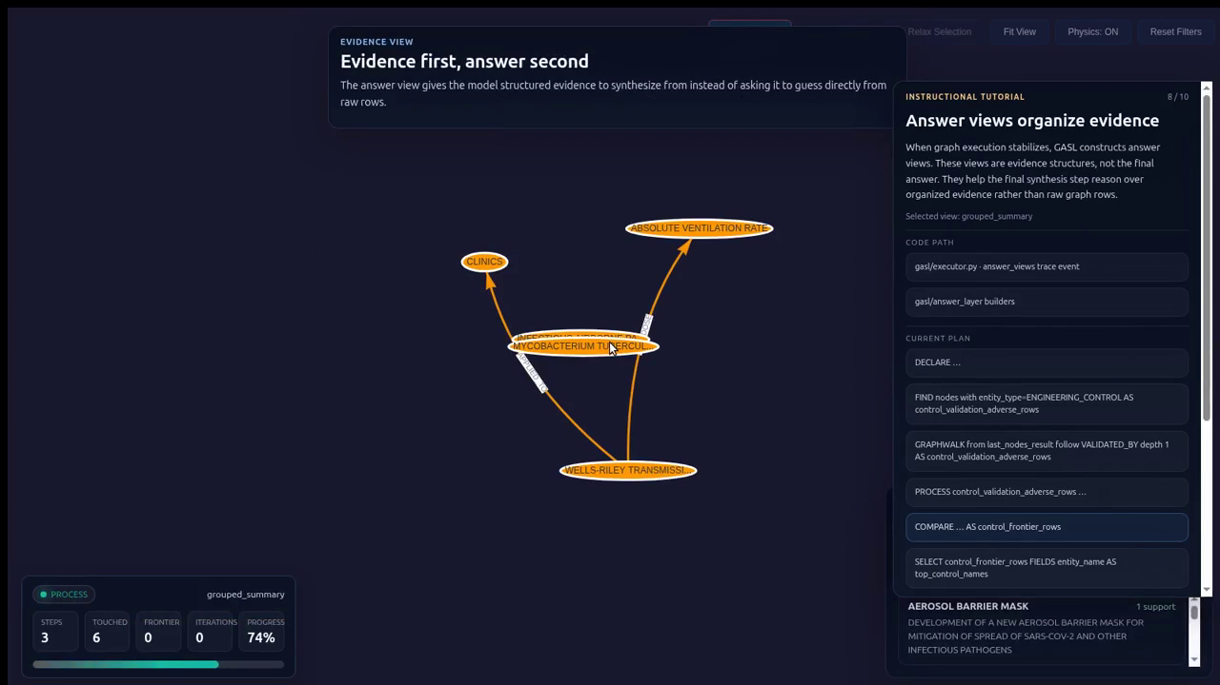
Answer views make the support legible before the answer
Final synthesis happens after raw graph results have been turned into structured evidence.

Slide 13
Takeaway
GASL is a way to make the model behave more like science: assemble support, keep the evidence legible, and answer only after the structure is visible.

