Slide 1
Dapps News
Half rant | Half serious
2/25/20
Notes:
What spicy news you know of?

Slide 2
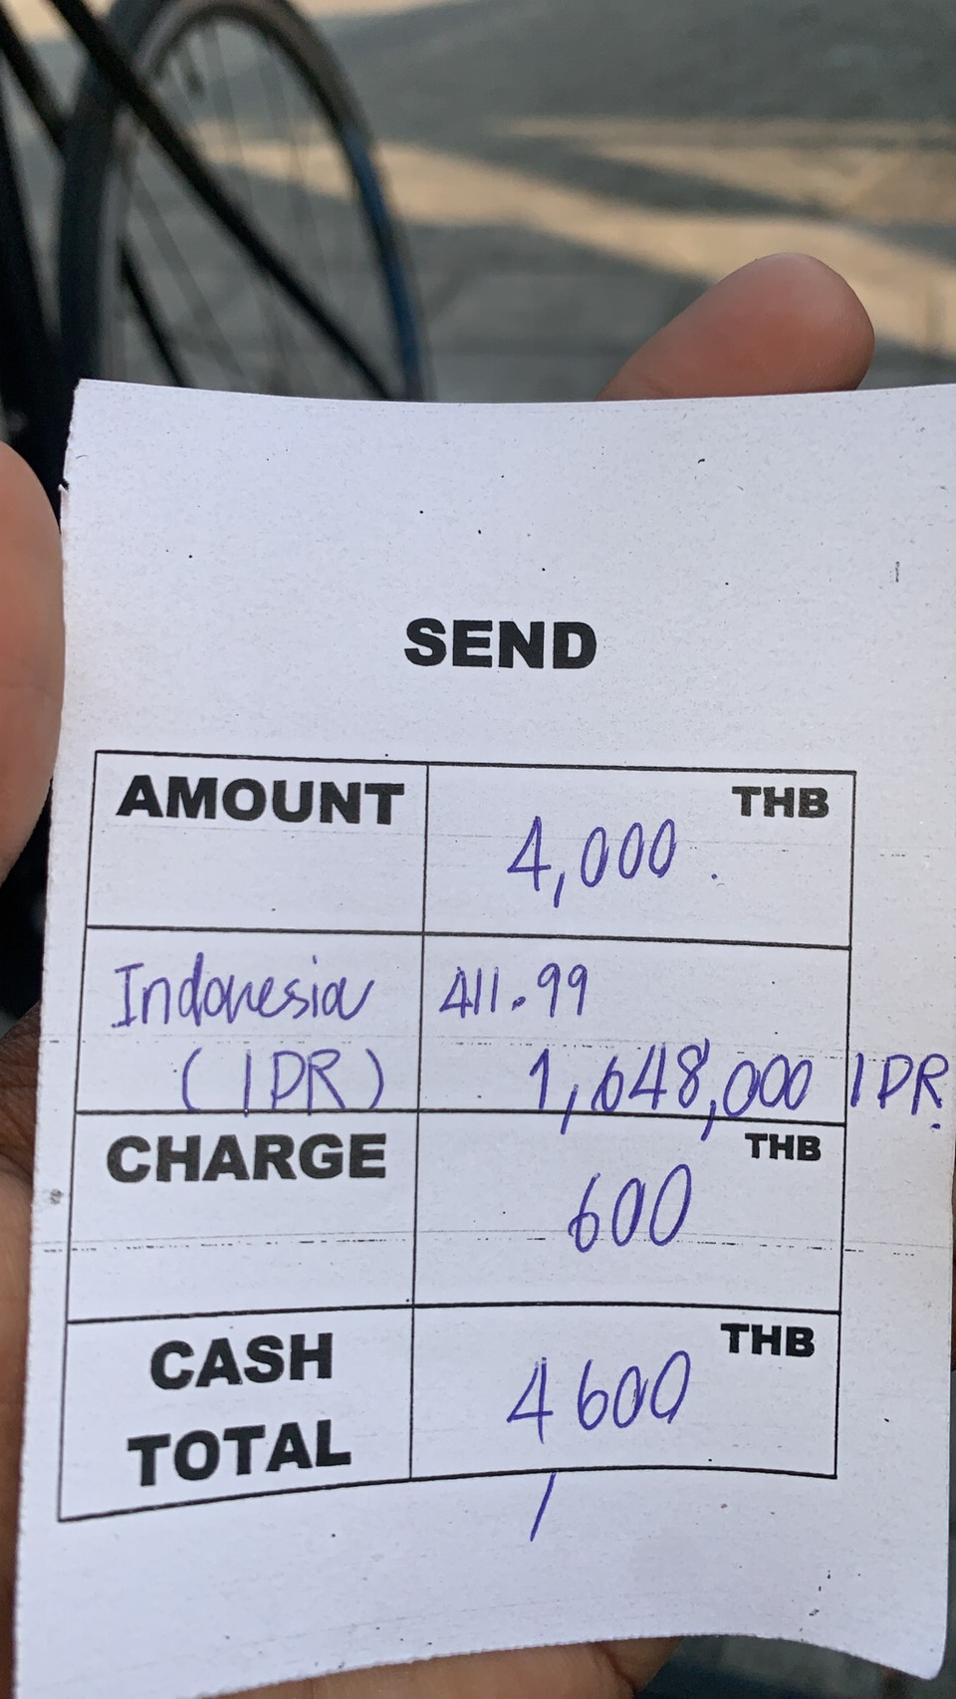
Rant: Western Union really?
Double fuck a customer:
15% fee
411 IDR, (instead of 436 on xe)

Slide 3
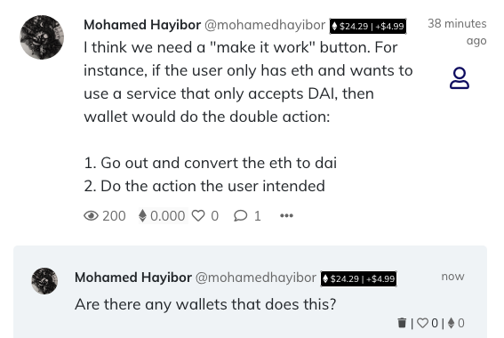
UX friction
Notes:
https://gitcoin.co/townsquare?tab=activity:139202

Slide 4
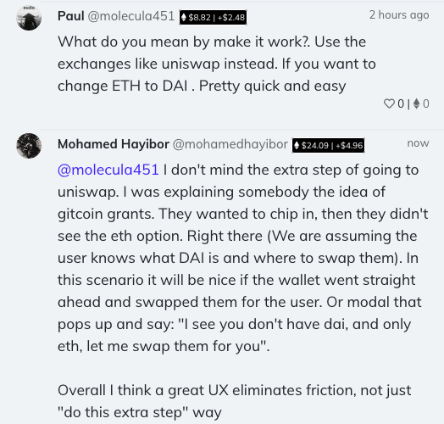

Slide 5
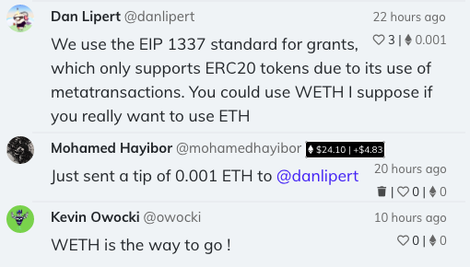
WETH?

Slide 6
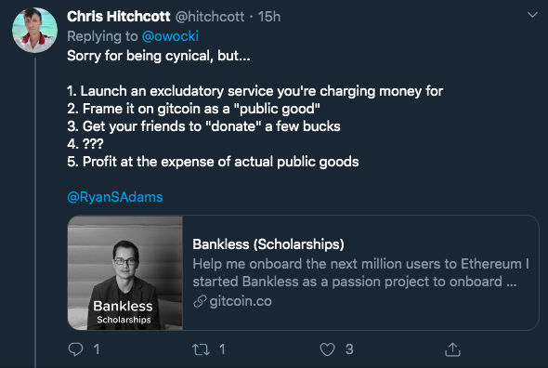
Notes:
https://twitter.com/hitchcott/status/1231583179749781505

Slide 7
ProgPOW
What’s happening?
Notes:
What spicy news you know of?

Slide 8
End of Rant -> Serious

Slide 9
[Frustration] moments
What did you use that was hard to do?
What do you wish to understand tonight?
What do you wish to learn this week?

Slide 10
Browsers can run solidity code [Future - coming]
What are the implications?
What will be obvious in retrospect?
What thing or action will be the most impactful?
> 5 mins self reflection
Notes:
eWASM will allow to execute SCs in browser: https://gitcoin.co/townsquare?tab=activity:135995

Slide 11
Announcements
The meetup has a repos: send upload your slides
Any side projects, share it on telegram.
What other things we can share or host on github?

