Slide 1
Data Science Take-home Project
Eluvio ML Data Science/ML positions
Wen-Hao Chiang
01/15/2021
p.1

Slide 2
Statistics and Problem statements
Data Statistics
Potential informative features to model with:
Titles, time_created, date_created, up_votes, and author
All down_votes are zero. All belong to ‘world_news’ category.
There are only 320 over_18 out of 509,236.
Research Problems:
Popularity prediction
We aim to build a model to predict the # of up_votes for each post
Post clustering
We aim to analyze the posts based on the clustering property
Topic of post recommendation for authors
We aim to recommend authors post of interest based their previous post.
p.2

Slide 3

Popularity Prediction
Binary classification: Popular vs.. Non-relevant posts
Popular vote labeling
# of posts: 509,236 from 2008-01-25 to 2016-11-22
Quick overview for # of post per day Skewed.
Average up_votes per day
Can we use mean as a threshold to determine the popular news?
No. The average up_votes per day is skewed.
Different day has different up_votes range.
Double check ?(next slides)
p.3

Slide 4
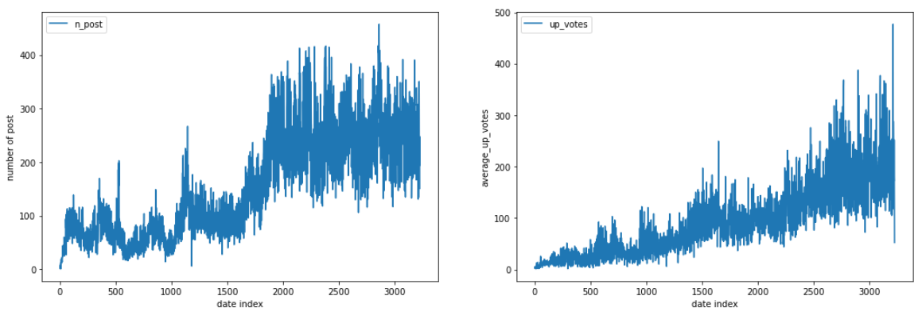
Popular labeling
Number of posts per day
Average up_votes per day
Threshold?
No.
Threshold can’t be average up_votes.
User were growing.
The popularity should reflect the number of users.
How to label relatively popular vote?
p.3

Slide 5
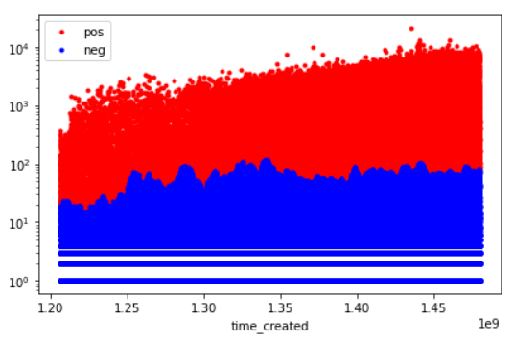
Relative Popularity
A post should be considered popular:
Compared to the previous month and the day of the week.
(remove season and periodical trend effect)
Bin the post and up_votes from previous month and the day of the week
A popular vote is a positive outlier inside that bin
Outlier criteria (Popular): mean + 3 * interquartile range (IQR)
The 3 is changeable and
the difficulty of the classification
problem is defined by the
pattern intensity
and confidence (i.g., 3 ) in the label.
Figure: upvotes and its labels
More reasonable.
up_votes
p.3

Slide 6
Binary Classification Modeling
Approach 1: Bag of words (Tf-Idf)
Text Pre-procssing:
Contractions Mapping
Format words and remove unwanted characters
Remove stop words
Tokenize each word
Lemmatize each token
Stem words: reducing each word to its root or base
We present the examples for titles and bad word in the next slide
Other steps:
Key words and subject preserve
Subjects are important to news title and can be target of interests
p.3

Slide 7
Example of Bag of words
Title | Processes Words
Rightist Gangs Murdering Trade Unionists in Colombia | rightist gang murder trade unionist
Protesters gathered around a mosque in the west of the Afghan capital after Friday prayers chanting death to Denmark , death to the Netherlands, death to America and death to Jews . | protest gather around west afghan prayer chant death jew
car bomb exploded Friday outside a police station in Spain s northern Rioja region | car bomb station northern region
MinnPost - Pent-up hatred unleashed in shocking Lhasa riots | pent unleash shock riot
p.3

Slide 8
Solve Scalability Issues
Dataset Imbalance:
Popular vs Unpopular: 63,003 vs 441,714 (1:7)
Class weight considered during training
In total, there are 11,245 words in vocabulary
K-fold cross validation and report the average metrics
Scalability: Use SGD classifier to train in batch
Dimensionality reduction: direct PCA fail due to high complexity
Solution:
Feature (words) selections by Chi-squared stats
Compute chi-squared stats between each non-negative feature and class
Retain ¼ words and plus its PCA results
further reduce to 1000 dimensions
Chi-squared stats K best words based on label and PCA consider the direction with high variance

Slide 9
Model Comparison Approaches (1/2)
Scalability: Simple SGD Logistic Classifier
Deep Learning fit_generator (Only read each batch from HDD at each iteration)
SGDlogit: Simple SGD logistic regression
SGDlogitPca: Simple SGD logistic with PCA and ChiTest for feature reduction
NN_fit: deep neural network
NN_fitPca: deep neural network with PCA and ChiTest for feature reduction
NN_nnlm_embed: neural network with sentence embedding layer
NN_nnlm_pretrain: neural network with pretrained embedding
NN_gnews_pretrain: neural network with google news pretrained embedding
 | Accuracy | Recall | Precision | F1
SGDlogit | 0.584 | 0.564 | 0.169 | 0.260
SGDlogitPca | 0.588 | 0.524 | 0.178 | 0.264
NN_fit | 0.592 | 0.598 | 0.171 | 0.266
NN_fitPca | 0.608 | 0.628 | 0.178 | 0.278
NN_nnlm_embed | 0.551 | 0.429 | 0.158 | 0.231
NN_nnlm_pretrain | 0.608 | 0.631 | 0.179 | 0.278
NN_gnews_pretrain | 0.592 | 0.599 | 0.172 | 0.267

Slide 10
Model Comparison Approaches (2/2)
Balanced Accuracy: 60.8%
Recall: 63.1%
Precision: 17.9%
F1: 27.8%
The difficulty of the problem is defined by the labeling scheme. A better labeling scheme is required.
Next: Clustering qualities based on Tf-Idf features
 | Accuracy | Recall | Precision | F1
SGDlogit | 0.584 | 0.564 | 0.169 | 0.260
SGDlogitPca | 0.588 | 0.524 | 0.178 | 0.264
NN_fit | 0.592 | 0.598 | 0.171 | 0.266
NN_fitPca | 0.608 | 0.628 | 0.178 | 0.278
NN_nnlm_embed | 0.551 | 0.429 | 0.158 | 0.231
NN_nnlm_pretrain | 0.608 | 0.631 | 0.179 | 0.278
NN_gnews_pretrain | 0.592 | 0.599 | 0.172 | 0.267

Slide 11
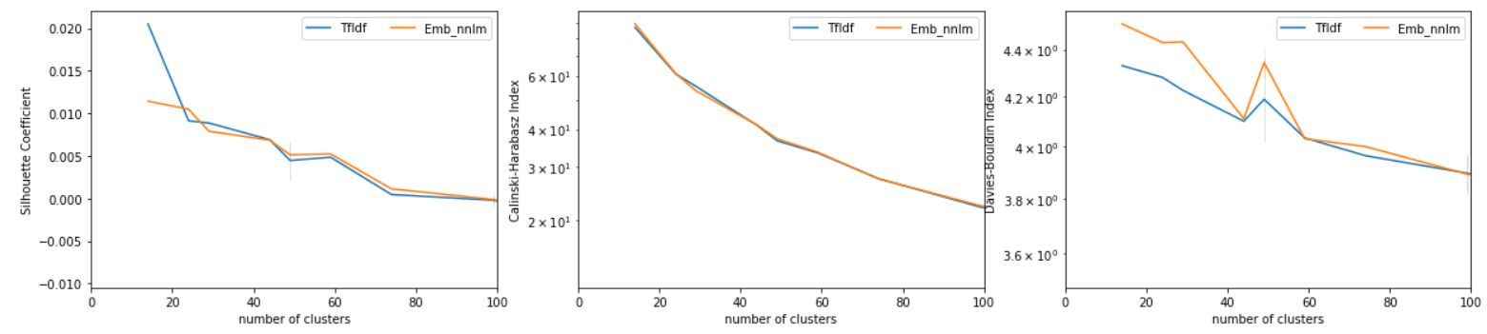
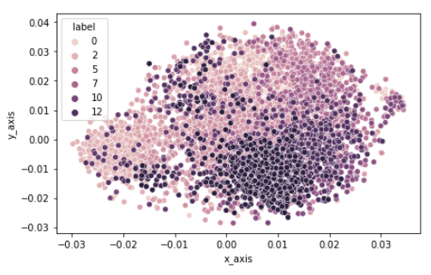
Clustering into Topic and Evaluation Metrics
Clustering qualities and choose the number of clusters
Evaluation metrics: Silhouette Coefficient, Calinski-Harabasz, and Dunn index
elbow method
TSNE: Clustering pattern
Fig: Top-6 clusters
Why clustering?
Build topic recommendation
based on common categories

Slide 12
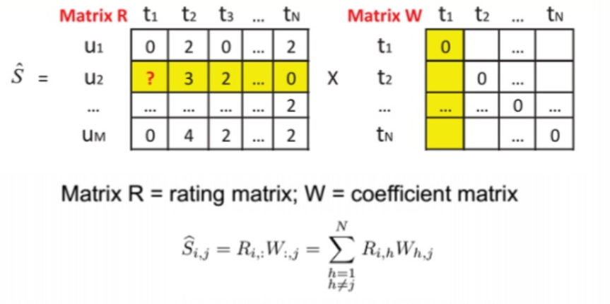
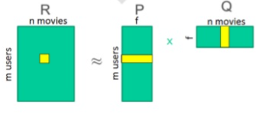
Topic (Clustering) and Post Recommendation
Define Recommendation Problem:
Recommend posts of interest to the authors
Ground Truth: Hold out one post from its author as a post of interest
to the author
Methodology: Clustering posts into different categories (topic of posts)
Recommendation system model based on authors-topic matrix
Recommend post from the model based on K nearest posts.
User-Topic Matrix
Matrix Factorization
Sparse LInear Method
topic
author

Slide 13
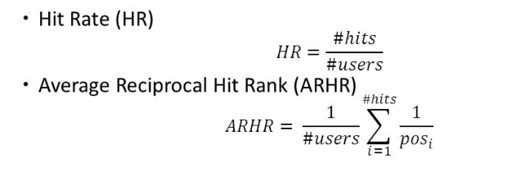
Experimental Setting
Clustering number is decided through the elbow method from silhouette coefficient : n=45
Each cluster is considered as a topic
Retain authors with more than 10 topics to construct a dataset (3,987 authors)
Testing set: hold out one post from each topic for each author
Top-N Recommendation model:
SLIM: Sparse LInear Method
Matrix Factorization
Evaluation: Hit rate@K, ARHR

Slide 14
Recommendation Results
Hold out category recommendation
Hold out topics from each author’s previous post and do topic recommendation
Given previous topic of interest, we can successfully recommend the topics of interest (from hold out posts) for users.
SLIM has better results compared to Matric factorization
 | HitRate@3 | HitRate@5 | HitRate@10 | ARHR@3 | ARHR@5 | ARHR@10
SLIM | 46.75% | 57.06% | 72.33% | 0.3628 | 0.3864 | 0.4067
MF | 32.02% | 44.04% | 63.90% | 0.2328 | 0.2600 | 0.2863

Slide 15
Conclusion
Formulate popular post prediction problem as a binary classification
Compare classification performances including pretrained embedding and tf-Idf
Use chi-test and PCA for feature selection and dimensionality reduction
Evaluate topic clustering qualities
Use fit-generator for Neural Network and SGD classifier to tackle scalability issues
Build topic recommendation models based on the hold- out posts for each author
Evaluate performance for classification, clustering, recommendation.

