Slide 1
GEMMINI

Slide 2
GEMMINI GENERATOR
Rocket Chip SoC generator
RISK-V
Chisel

Slide 3
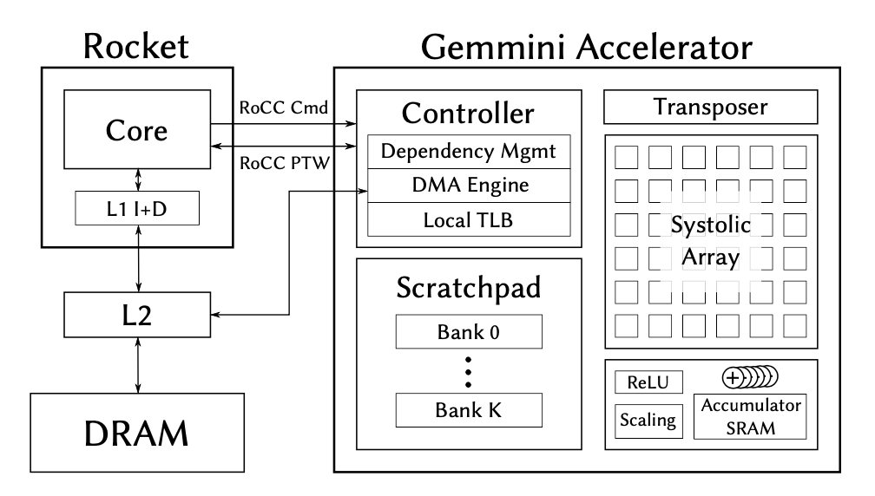
Architecture

Slide 4
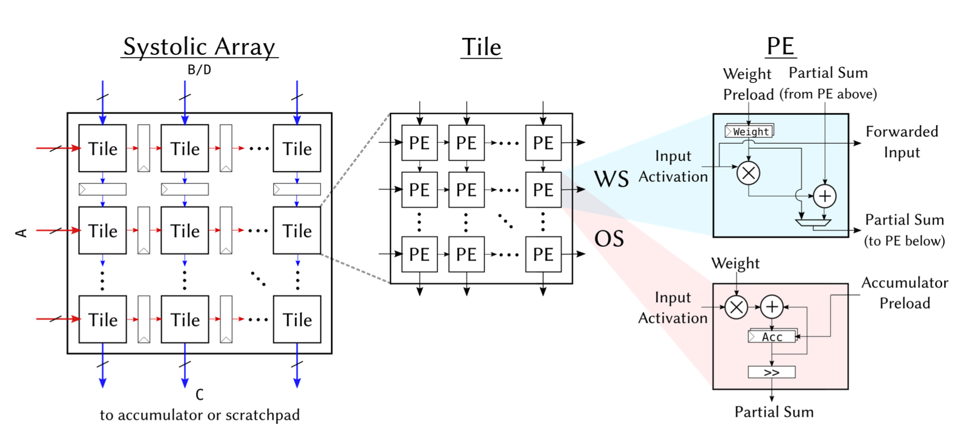
C=A∗B+D

Slide 5
systolic arrays
general matrix multiplications (GEMM)
convolutions

Slide 6
weight stationary
minimizing the energy consumption of accessing weights

Slide 7
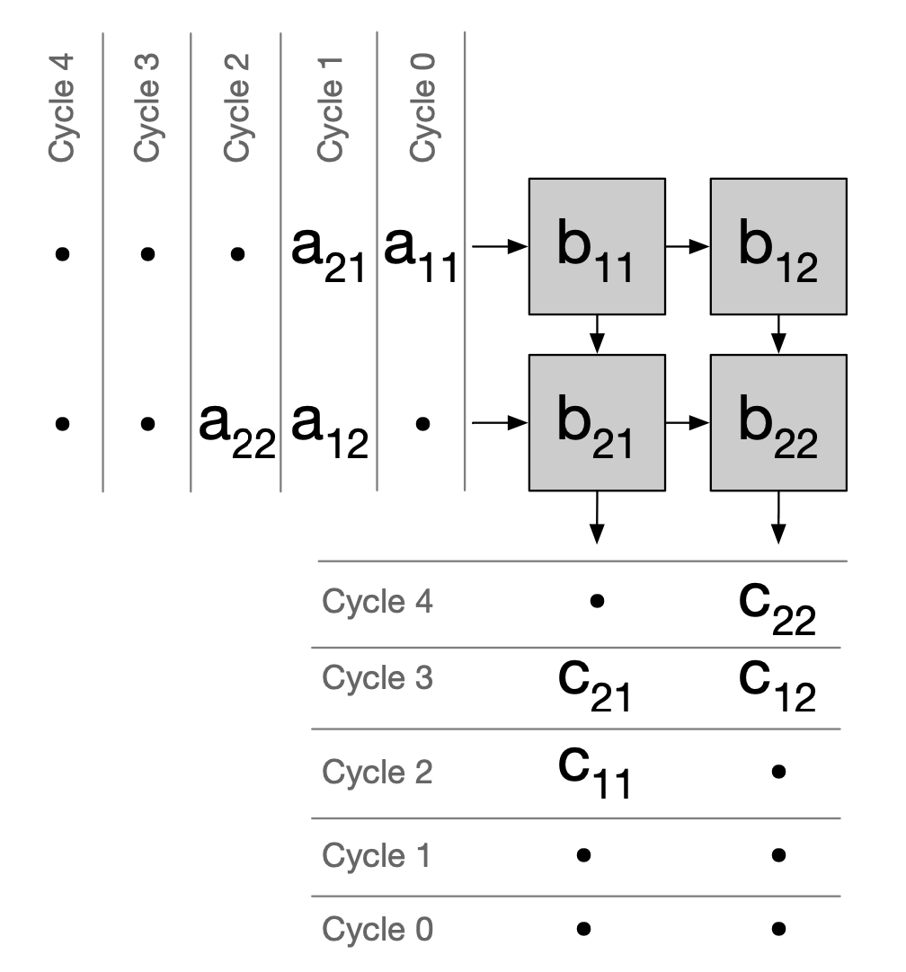

Slide 8
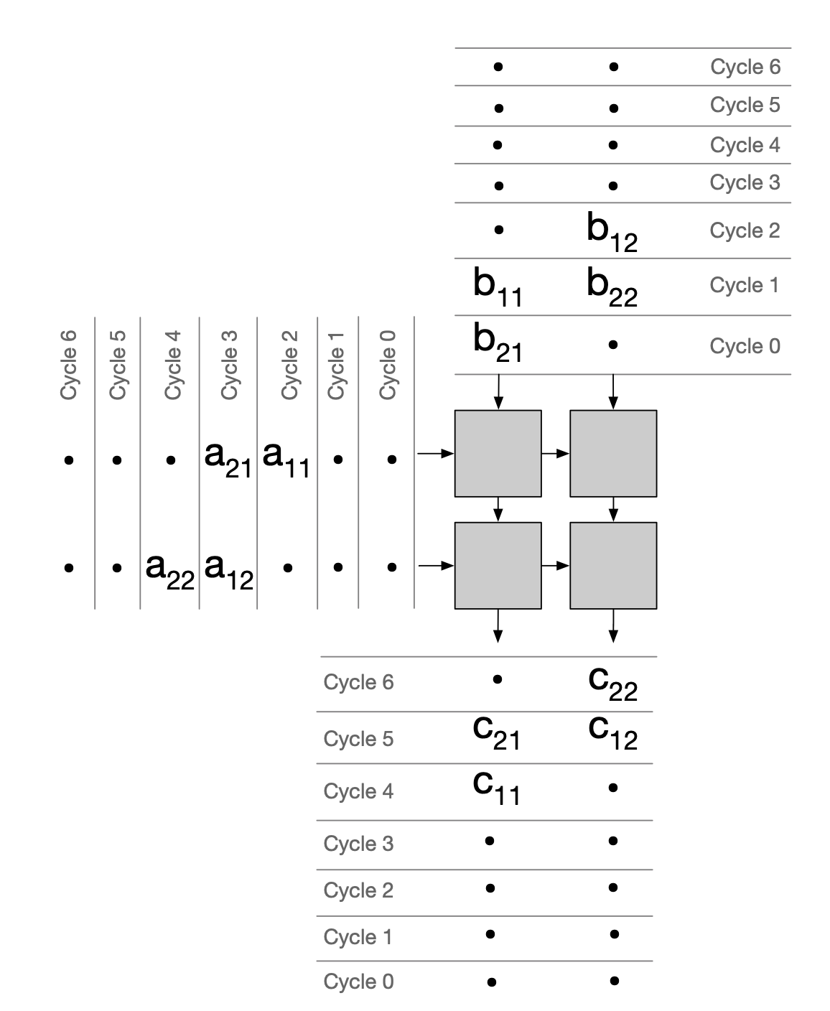

Slide 9
output stationary
minimizing energy consumption of psum movement

Slide 10
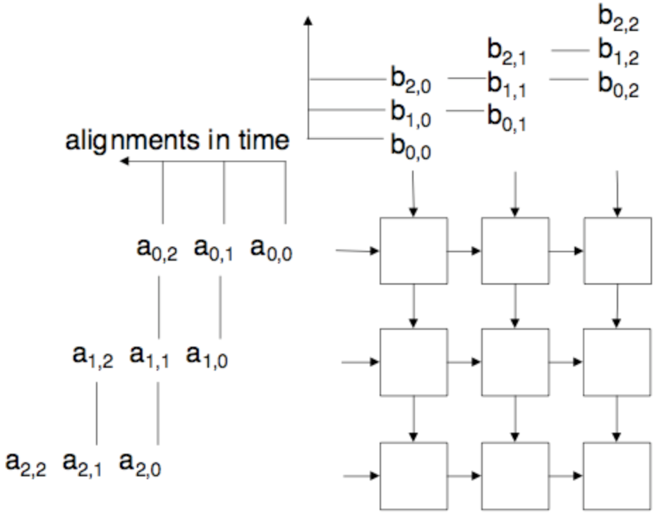
PE1
PE2
PE3
PE4
PE5
PE6
PE7
PE8
PE9
 | t1 | t2 | t3 | t4 | t5
PE1 | a_{0,0}*b_{0,0} | a_{0,0}*b_{0,0}+a_{0,1}*b_{1,0} | a_{0,0}*b_{0,0}+a_{0,1}*b_{1,0}+a_{0,2}*b_{2,0} | -
PE2 |  | a_{0,0}*b_{0,1} | a_{0,0}*b_{0,1}+a_{0,1}*b_{1,1} | a_{0,0}*b_{0,1}+a_{0,1}*b_{1,1}+a_{0,1}*b_{1,1} | -
PE3 |  |  | a_{0,0}*b_{0,2} | a_{0,0}*b_{0,2}+a_{0,1}*b_{1,2} | a_{0,0}*b_{0,2}+a_{0,1}*b_{1,2}+a_{0,2}*b_{2,2}
PE4 |  | a_{1,0}*b_{0,0} | a_{1,0}*b_{0,0}+a_{1,1}*b_{1,0} | a_{1,0}*b_{0,0}+a_{1,1}*b_{1,0}+a_{1,2}*b_{2,0} | -
PE5 |  |  | a_{1,0}*b_{0,1} | a_{1,0}*b_{0,1}+a_{1,1}*b_{1,1} | a_{1,0}*b_{0,1}+a_{1,1}*b_{1,1}+a_{1,2}*b_{2,1}
PE6 |  |  |  | a_{1,0}*b_{0,2} | a_{1,0}*b_{0,2}
PE7 |  |  | a_{0,0}*b_{2,0}+ | a_{0,0}*b_{2,0}+a_{2,1}*b_{1,0}
PE8 |  |  |  | a_{2,0}*b_{0,1} | a_{2,0}*b_{0,1}+a_{2,1}*b_{1,1}
PE9 |  |  |  |  | a_{2,0}*b_{0,2}

Slide 11
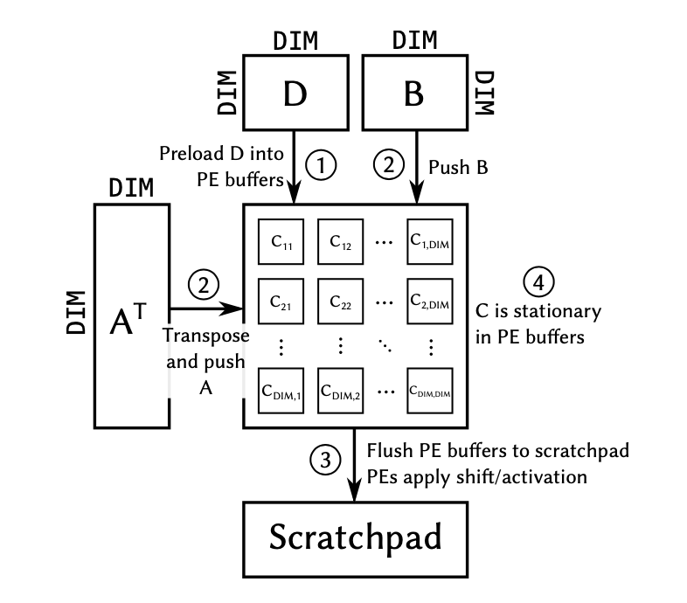
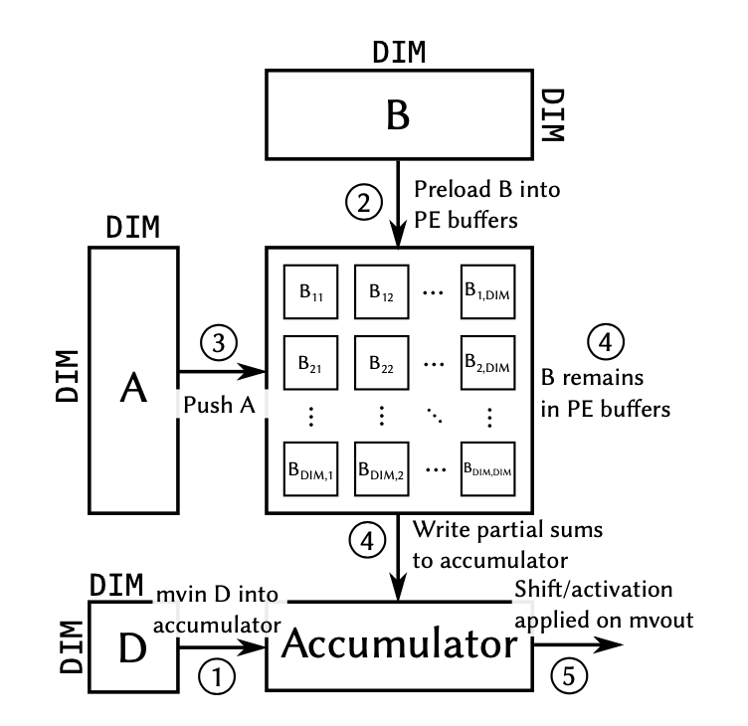
output stationary
weight stationary

Slide 12
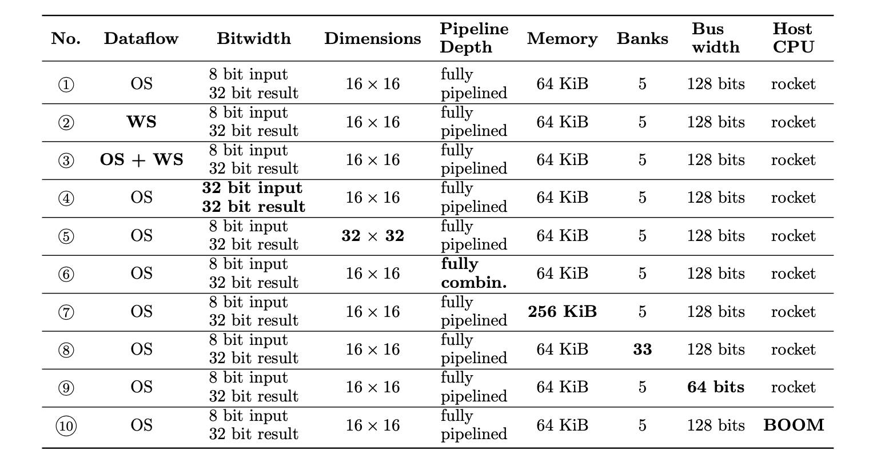

Slide 13
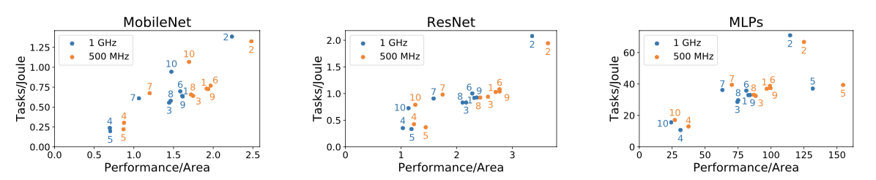
Performance

