Slide 1
DNN Accelerator Architectures

Slide 2
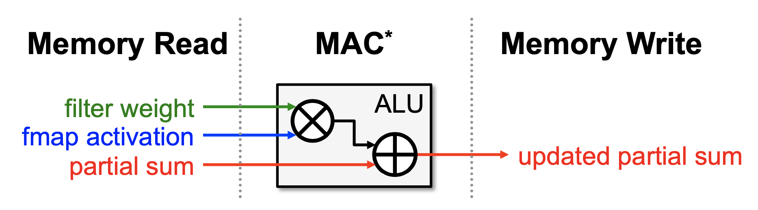
Memory Access is the Bottleneck

Slide 3
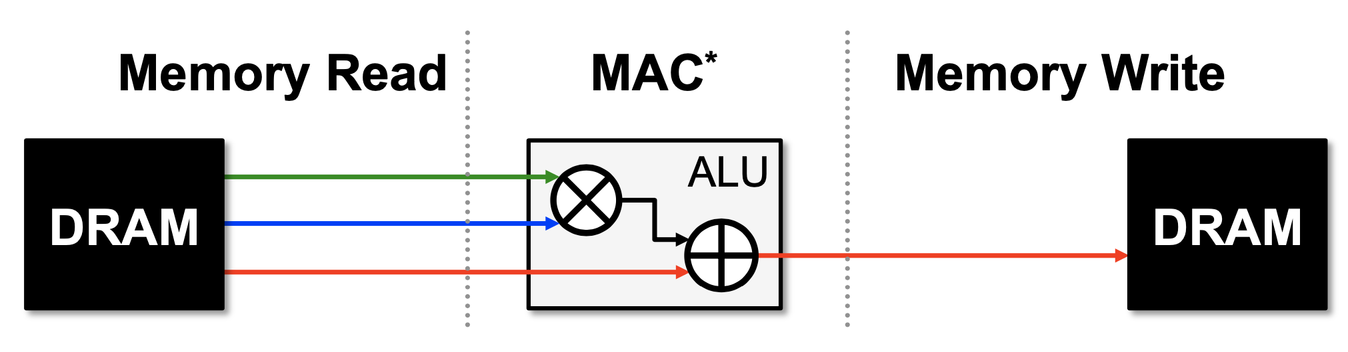
all memory R/W are DRAM accesses => worst case

Slide 4
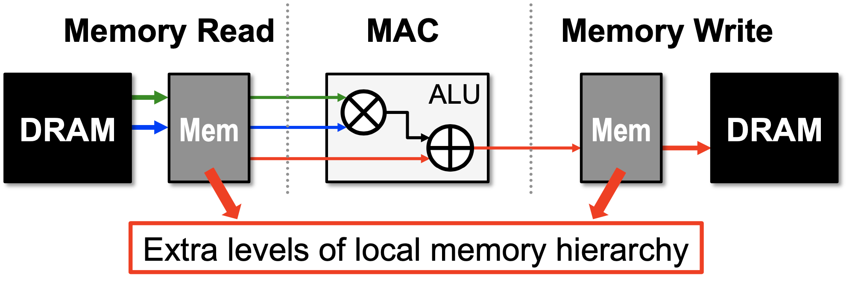
data reuse
local accumulation

Slide 5
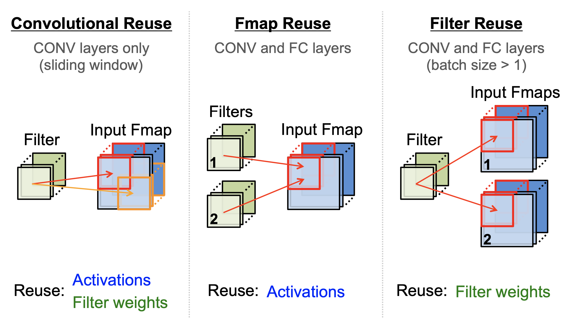
Types of Data Reuse in DNN

Slide 6
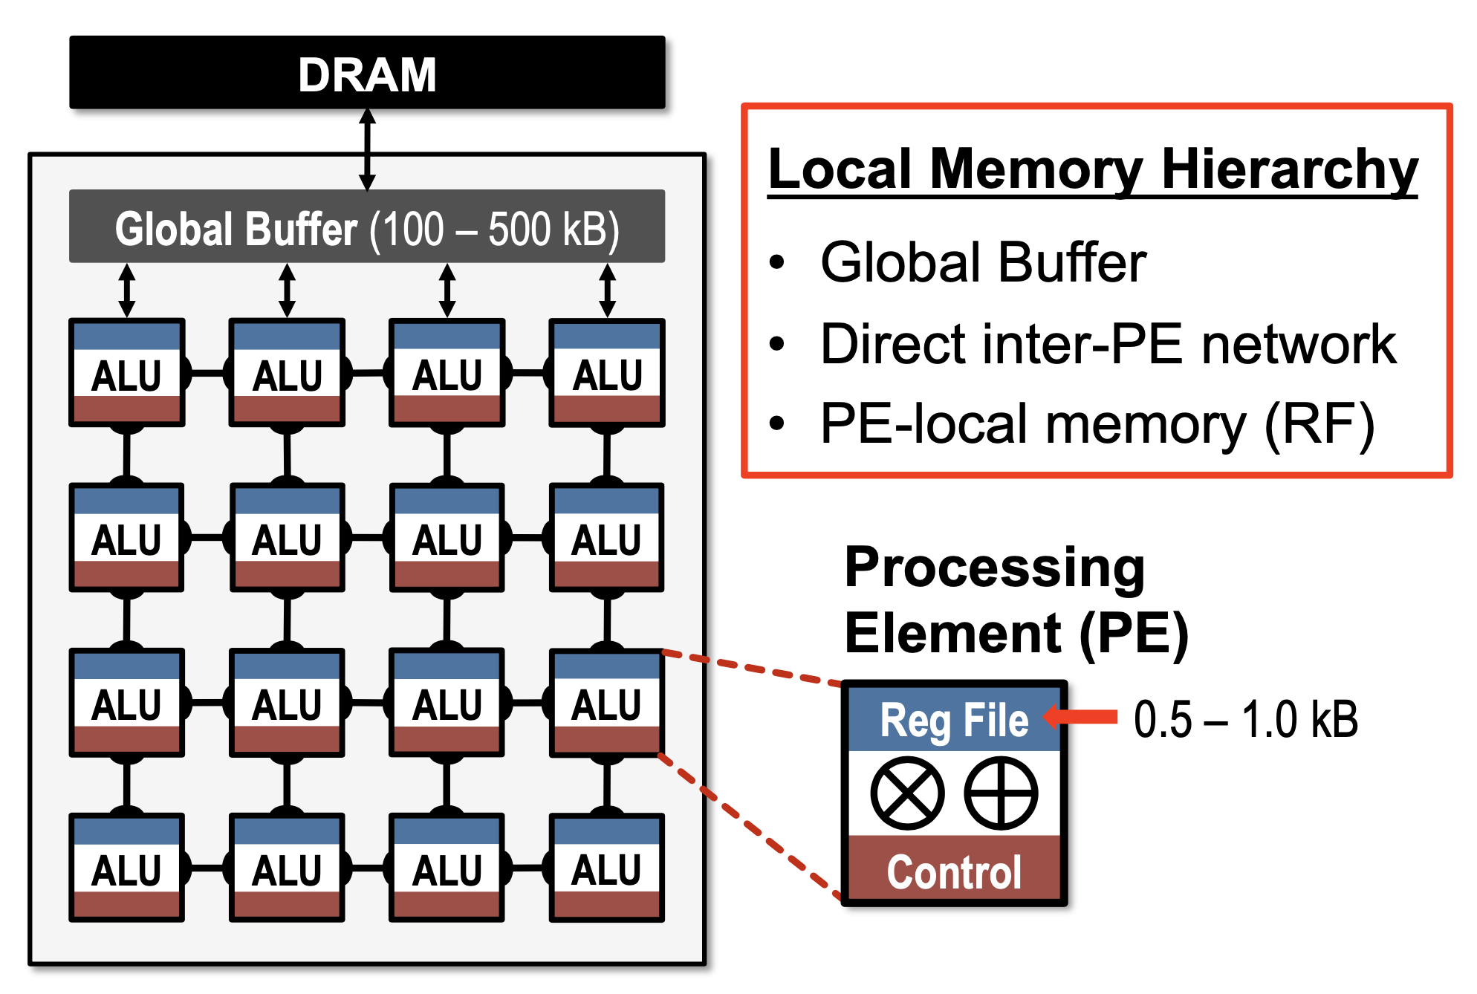
Architecture

Slide 7
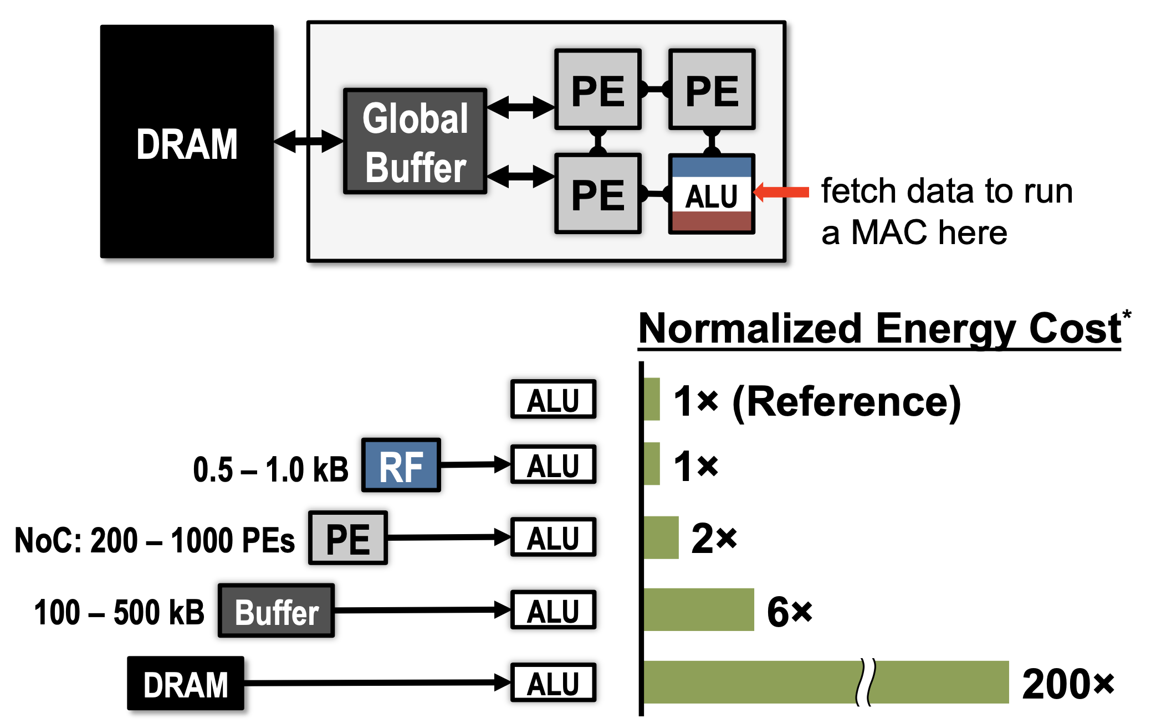

Slide 8
Dataflow Taxonomy
Weight Stationary
Output Stationary
Row Stationary

Slide 9
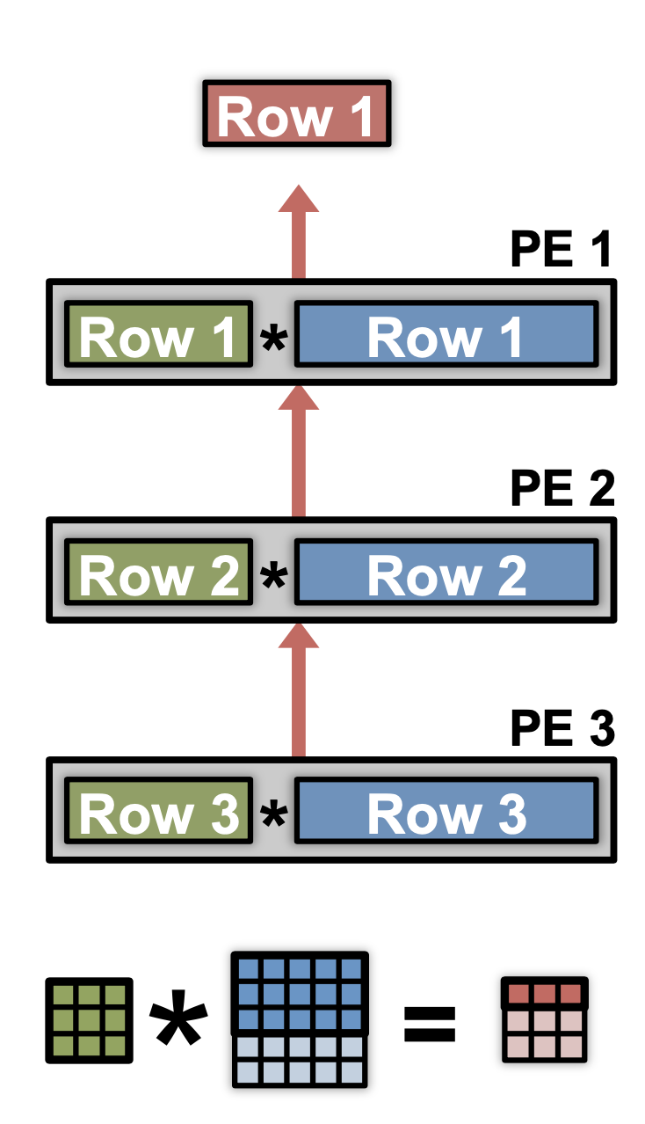
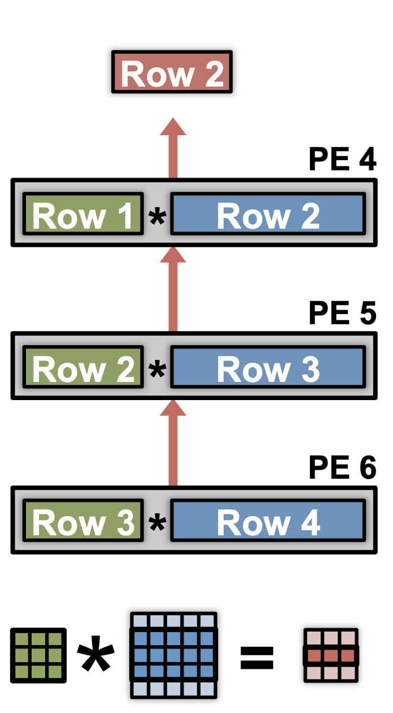
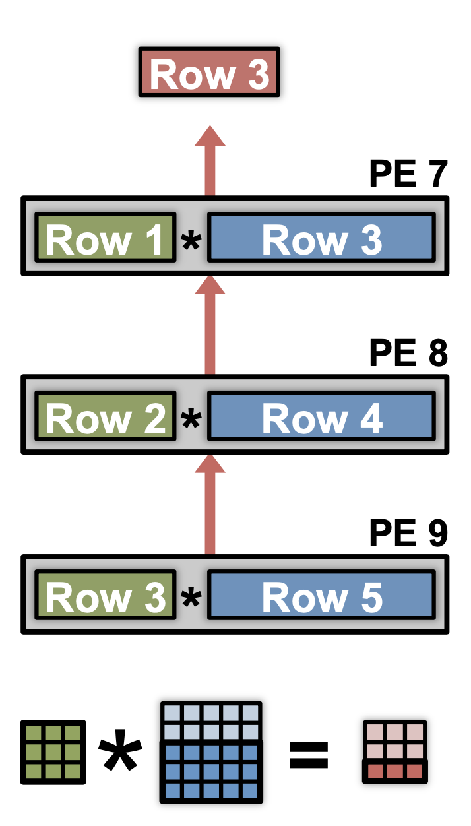
Row Stationary

Slide 10
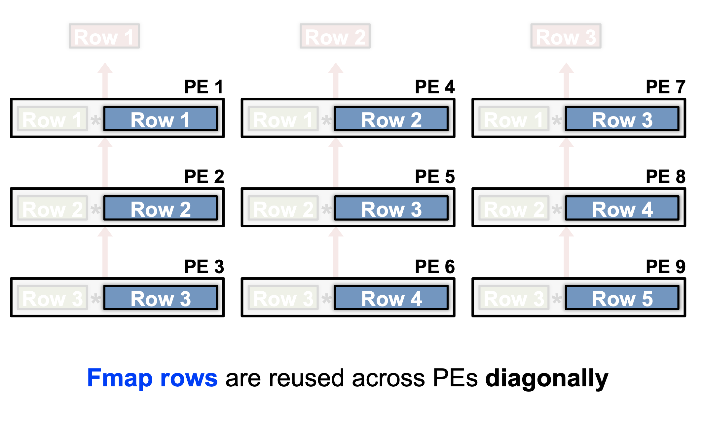
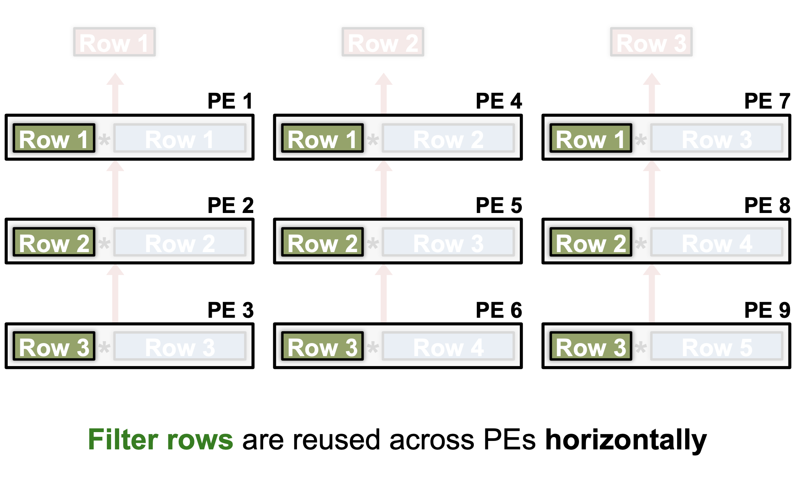
Convolutional Reuse

Slide 11
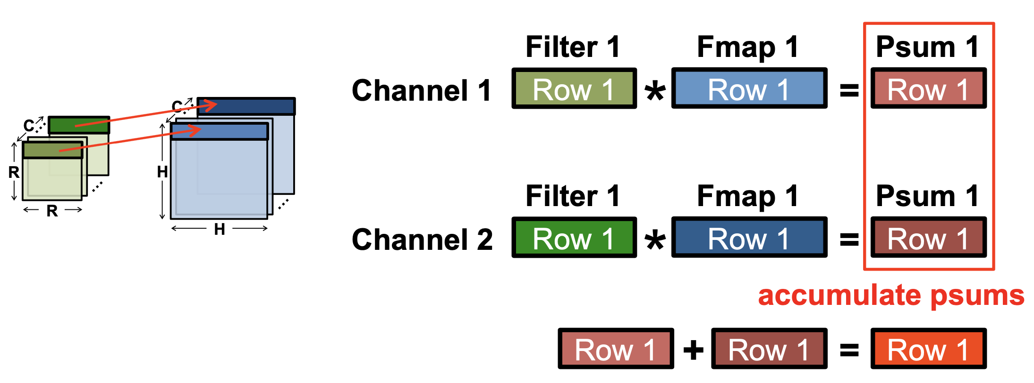
Multiple Channels

Slide 12
Hardware Architecture for RS Dataflow

Slide 13
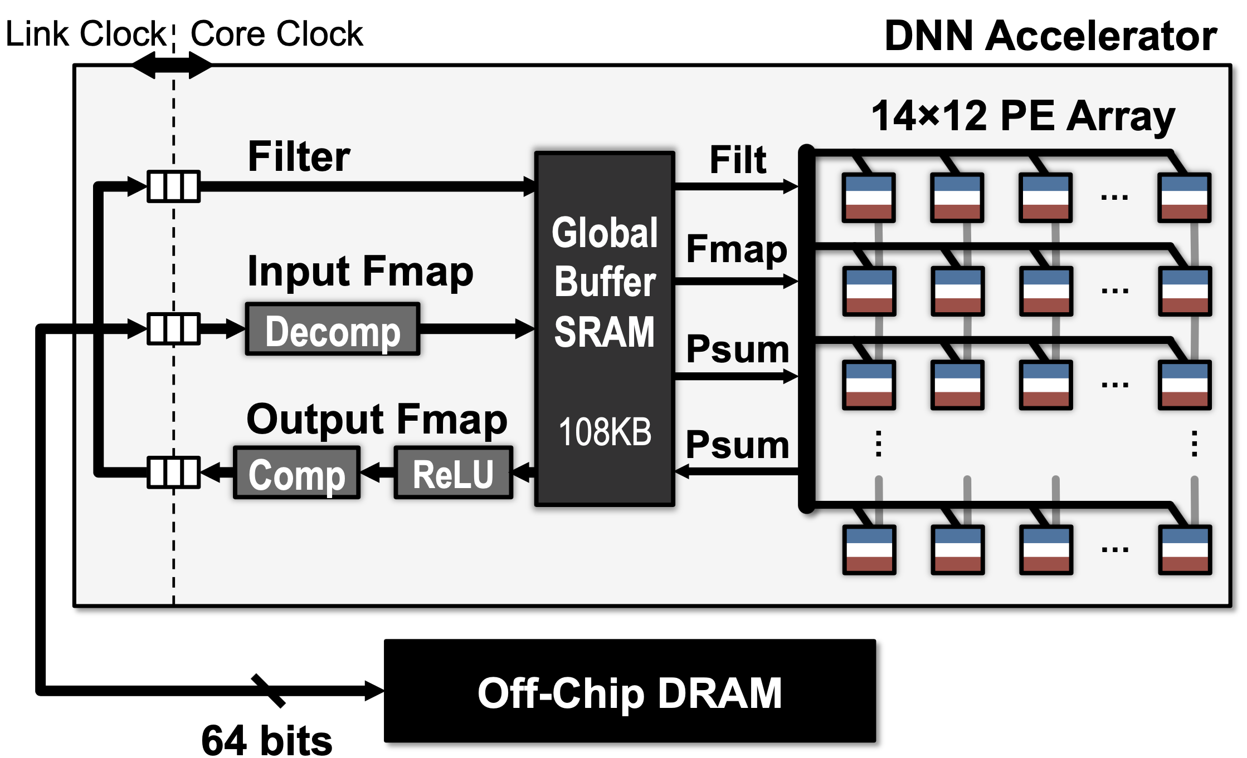

Slide 14
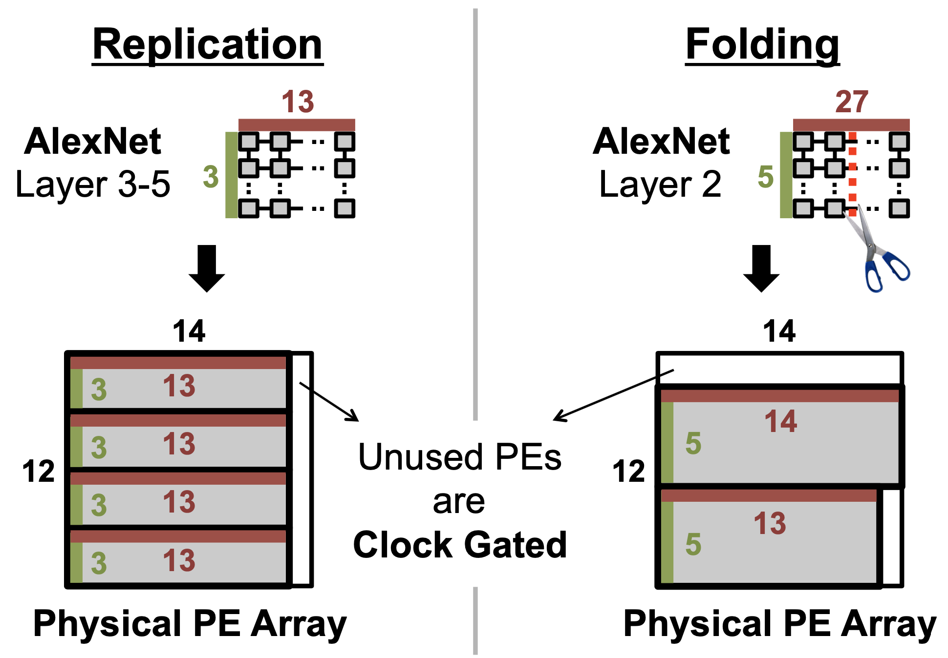
Logical to Physical Mappings

