Slide 1
YOLOv3: An Incremental Improvement
Advisor ：Yeong-kang lai
Reporter：zheng-xun yeh

Slide 2
outline
Bounding Box Prediction
Class Prediction
Predictions Across Scales
Feature Extractor
Reference

Slide 3
outline
Bounding Box Prediction
Class Prediction
Predictions Across Scales
Feature Extractor
Reference

Slide 4
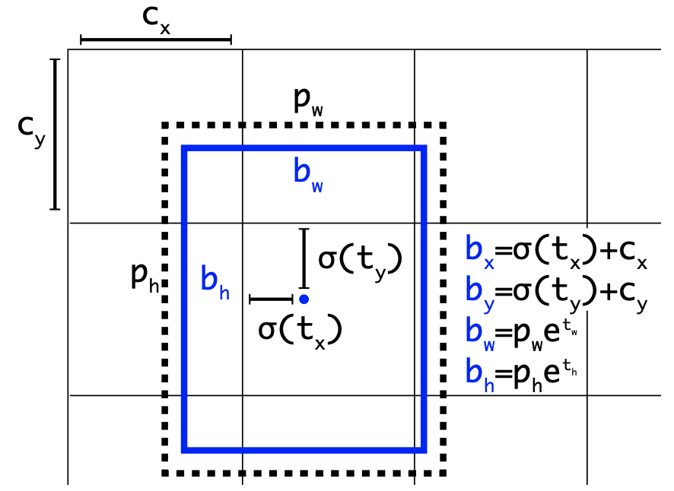
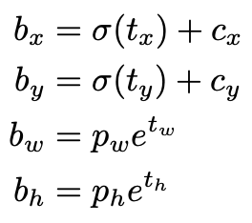
Bounding Box Prediction

Slide 5
outline
Bounding Box Prediction
Class Prediction
Predictions Across Scales
Feature Extractor
Reference

Slide 6
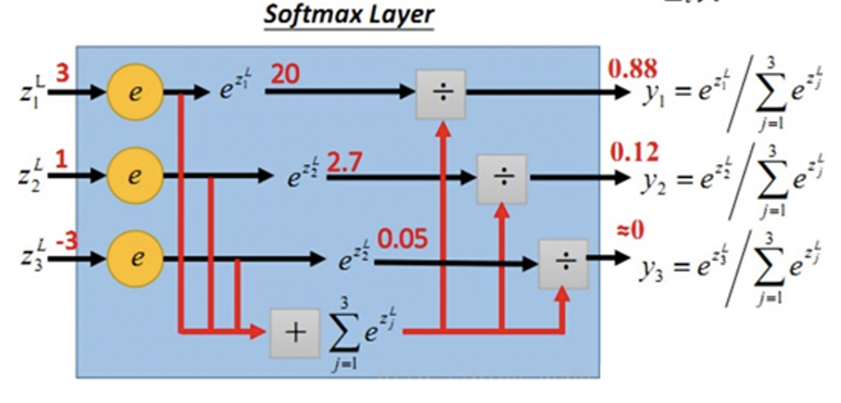
Class Prediction
softmax

Slide 7
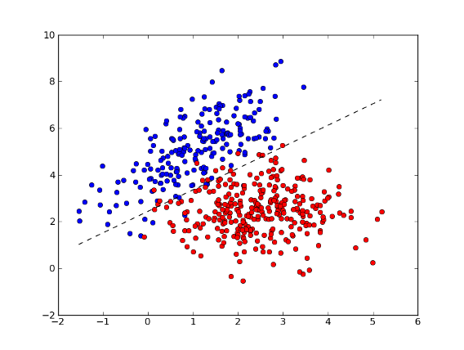
Class Prediction
logistic classifiers

Slide 8
outline
Bounding Box Prediction
Class Prediction
Predictions Across Scales
Feature Extractor
Reference

Slide 9
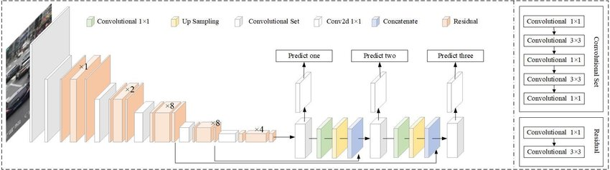
Predictions Across Scales
36
61
79
91
106

Slide 10
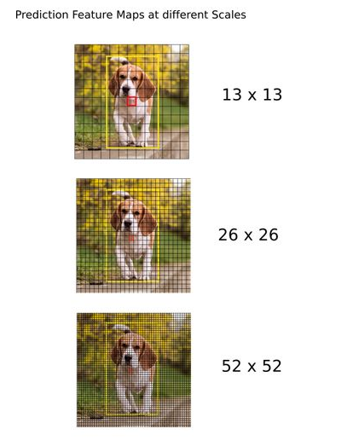
Predictions Across Scales
(10*13); (16*30); (33*23);
(30*61); (62*45); (59*119);
(116*90); (156*198); (373*326)
（13*13+26*26+52*52）*3=10647box

Slide 11
outline
Bounding Box Prediction
Class Prediction
Predictions Across Scales
Feature Extractor
Reference

Slide 12
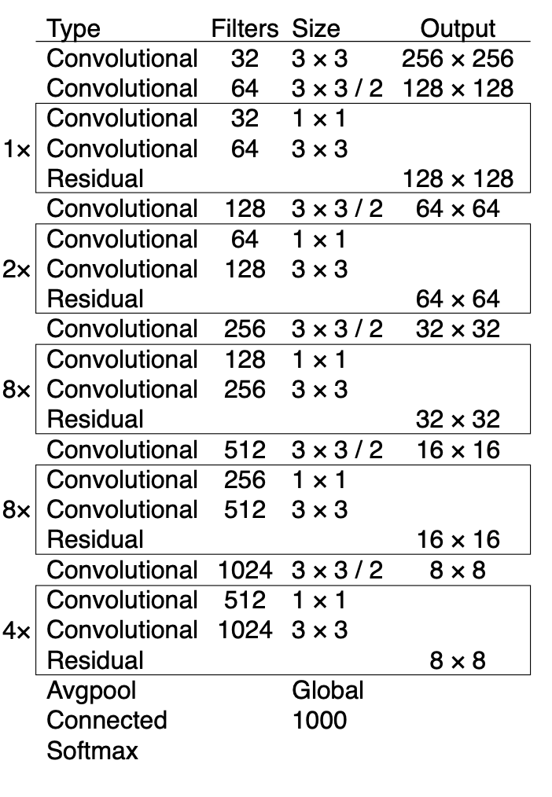
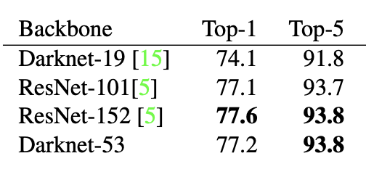
Feature Extractor
Darknet-53
Accuracy

Slide 13
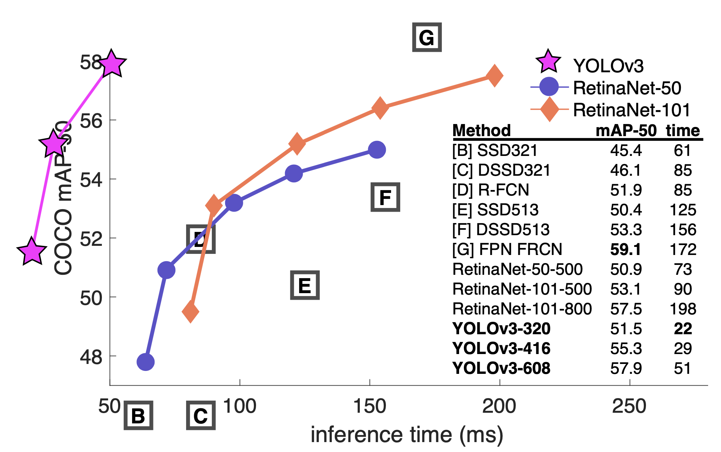

Slide 14
outline
Bounding Box Prediction
Class Prediction
Predictions Across Scales
Feature Extractor
Reference

Slide 15
Reference
J.Redmon , A.Farhadi, Yolov3:Anincrementalimprovement. arXiv, 2018.

