Slide 1
PyLadies Python Bootcamp
An Exploratory Data Analysis With Python On The Deforestation Of The Brazilian Amazon Between 1999 and 2019

Slide 2
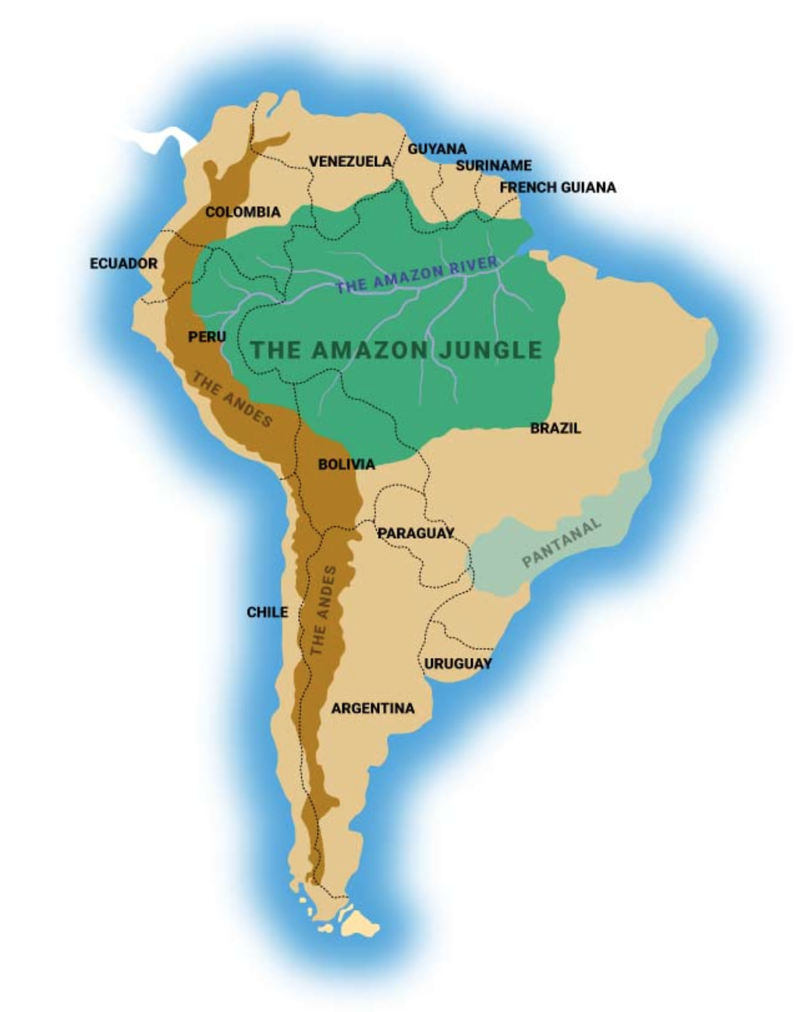
Introduction
Data about the deforestation of the Brazilian Amazon from Kaggle
Included three CSV files (1. Deforestation area, 2. Fire outbreaks, 3. Weather phenomena)
Libraries used to analyze files: pandas, numpy, scipy and matplotlib
There were no null variables – already clean data set
Our Team: Marina, Selin, Chiara

Slide 3
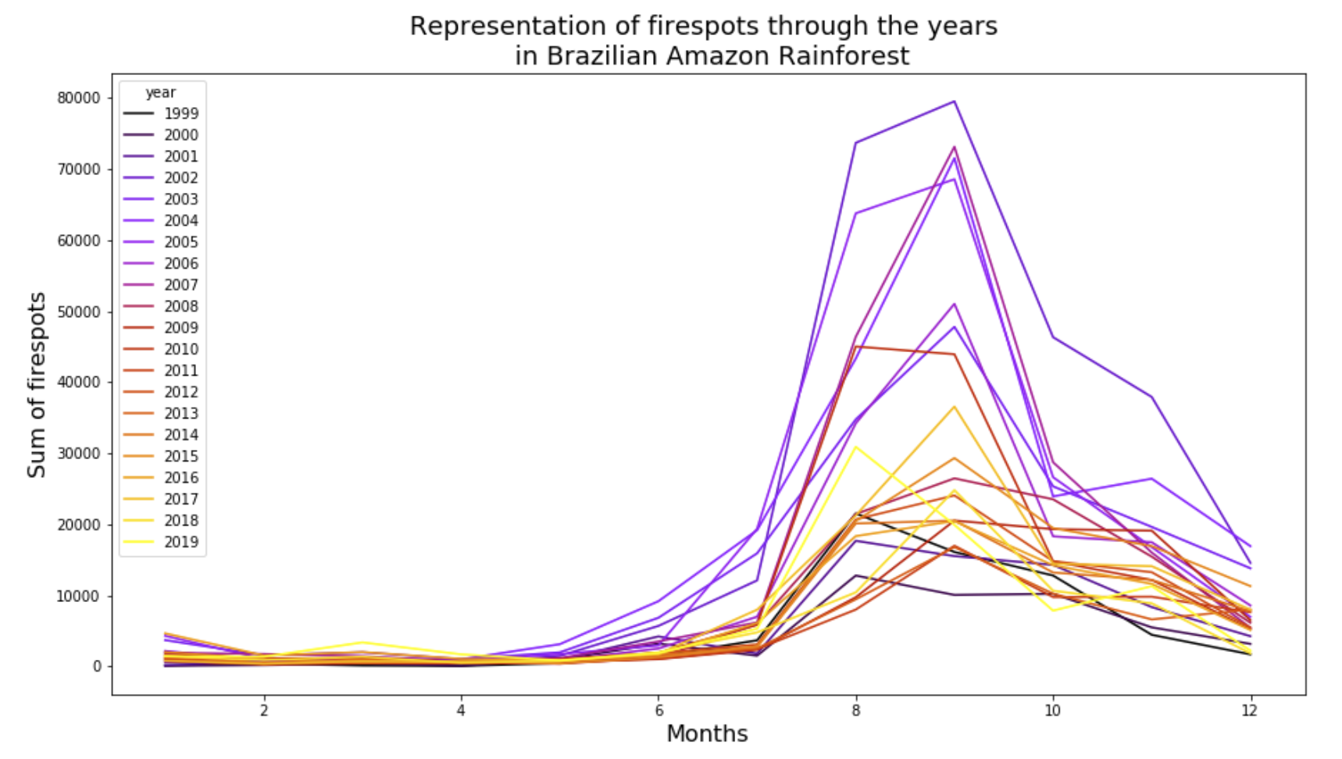
Q1: Was there a decline or rise in the number of fire outbreaks?
The line plot shows the total number of fire outbreaks per month.
Each line represents a year in the period between 1999 to 2019.
We can observe that the highest number of fire outbreaks happened between 2002 and 2010 – this period is coloured by using a Miscellaneous colormap provided by matplotlib.

Slide 4
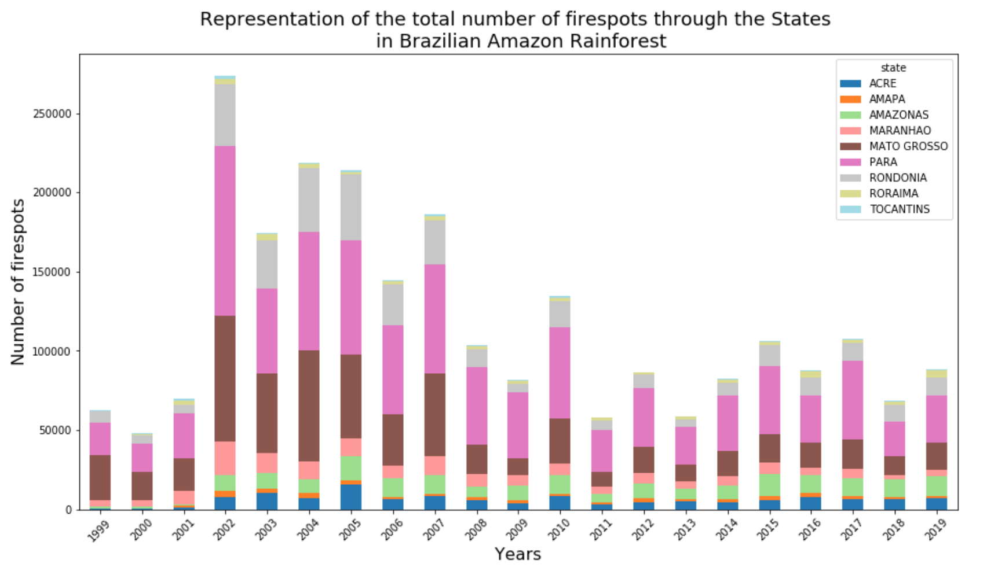
Q2: Which state bears the greatest number of fire outbreaks?
This stacked bar plot shows the number of fire outbreaks per year starting in 1999 until 2019 in all Amazon states.
Two states (Mato Grosso and Para) have the highest occurrence of fire outbreaks throughout the years than other states combined.

Slide 5
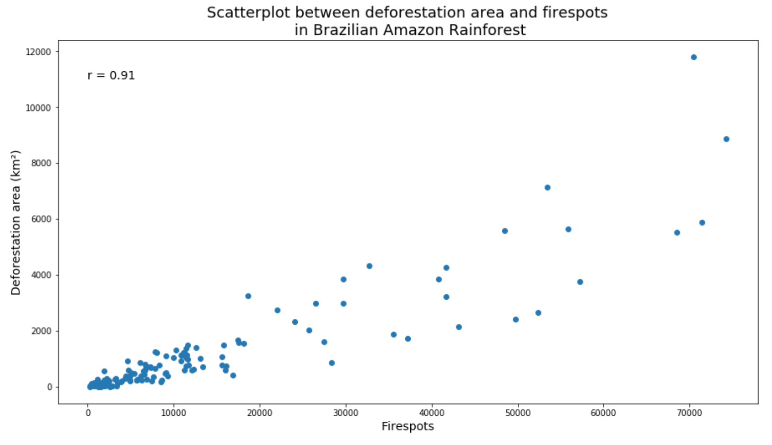
Q3: Is there a correlation between the deforestation area and the number of fire outbreaks?
To answer questions, two CSV files have been merged.
The plot shows a positive correlation of 0.91 between the deforestation area and total number of fire outbreaks per year.

Slide 6
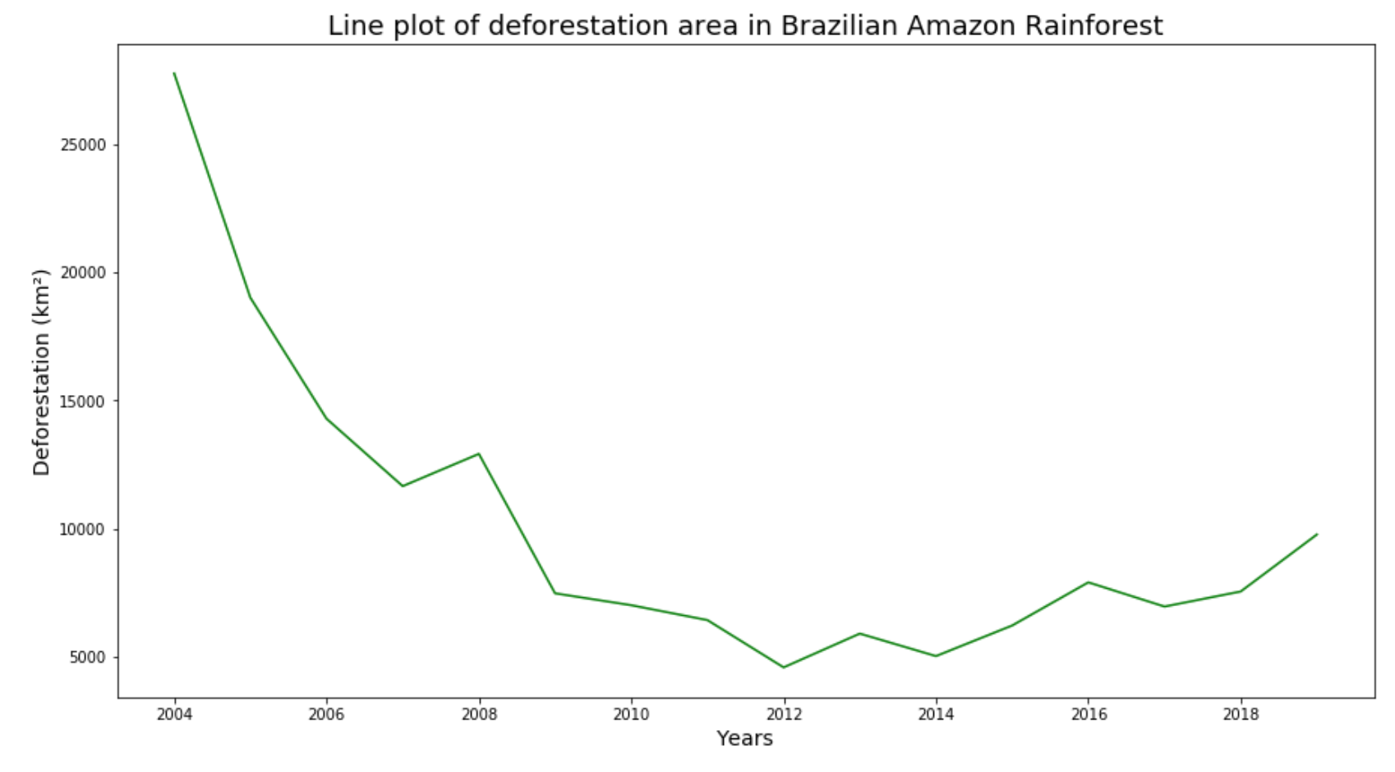
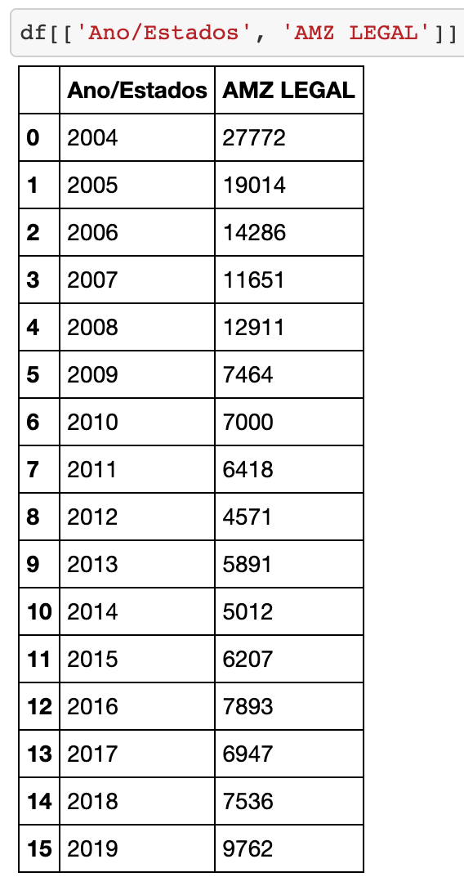
Q4: Is the Amazon deforestation increasing over the years?
As can be seen in the graph, deforestation is again increasing since 2014.
The differences in increase and decrease are mainly due to various changes in politics.
Q4.1: Have there been years in which deforestation declined?
Even though there is a constant decrease in Amazon area, there have also been years in which deforestation either decreased or stopped - years: 2004, 2011, 2013, 2016.

Slide 7
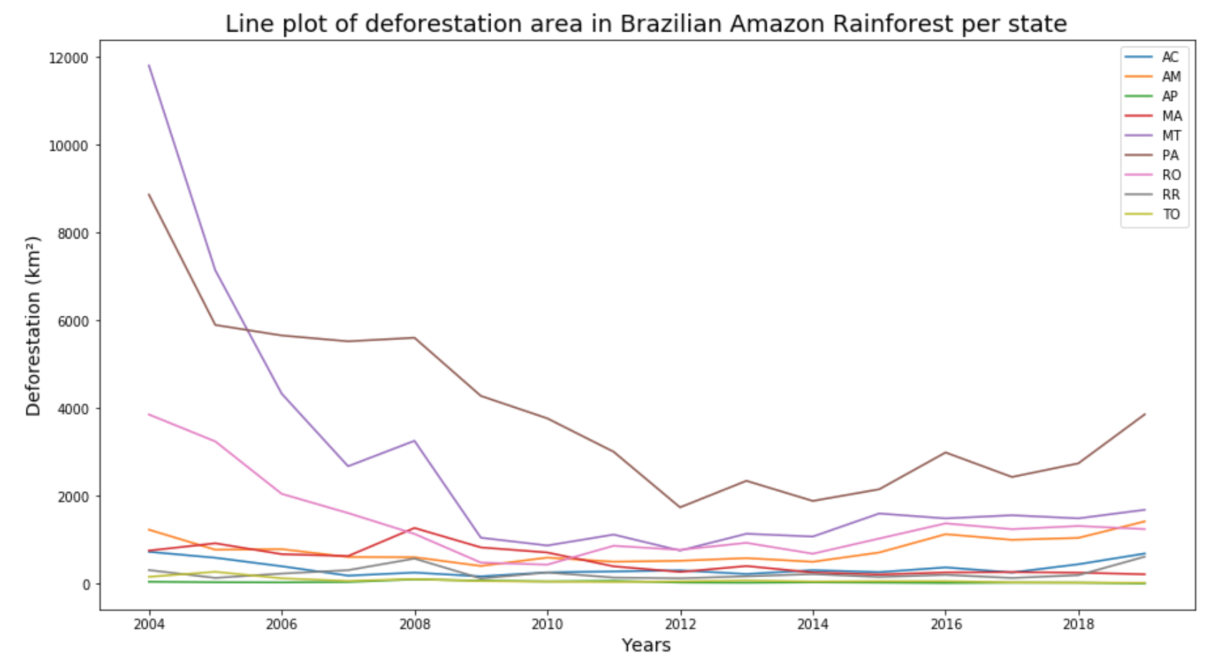
Q5: Which state had the highest increase in deforestation?
Overall, deforestation increased significantly in Para – PA - since 2018.
The Acre - AC - and Amazonas - AM - state both had also high increases since 2017.
In 2007, the Maranhao - MA - state also had an extreme increase in deforestation.
Q5.1: Which states had the lowest deforestation?
In Amapa – AP -, Roraima - RR -, and Tocantins - TO - have been the least deforestation.
In Maranhao deforestation also decreased significantly.

Slide 8
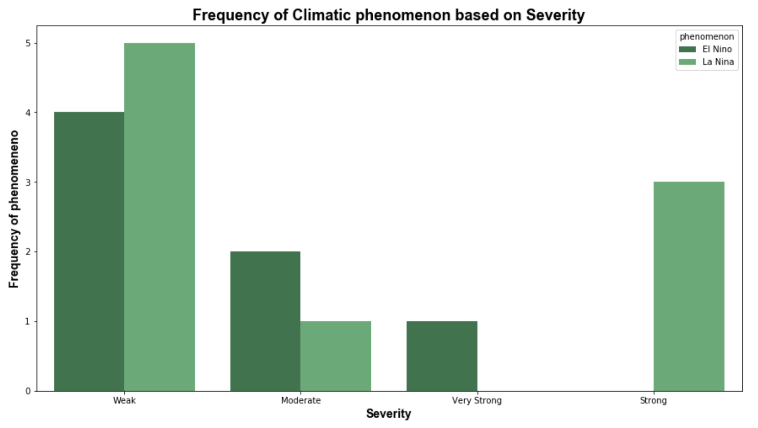
Q6: How frequent based on severity occurred the weather phenomena ‘El Niño’ and ‘La Niña’?
El niño is hot, humid air
La niña are cold trade winds
Both phenomena mostly had severity denoted as Weak and Moderate
In three occasions the phenomena were marked as Strong and Very Strong.
There were two counts for Strong and one count for Very Strong phenomenon for La Niña and El Niño, respectively

Slide 9
Thank You!
GitHub Repository:
https://github.com/chiarabeebyte/capstoneproject8

