Slide 1

Network Automation
Final project presentation
Dipartimento di Elettronica, Informazione e Bioingegneria
Node Failure Detection
Team
Presenters: Alessio Fumagalli, Chiara Draghini, Anuar El Hachimi, Zhengchen Xu
Emails: alessio3.fumagalli@mail.polimi.it, chiara.draghini@mail.polimi.it, anouar.elhachimi@mail.polimi.it, xuzhengchen552@gmail.com
Accademic Year
2022/2023

Slide 2
The Agenda
Introduction - Project objectives
Implementation - First version of the code on Mininet to build the logic - Final version of the code modified after going to the Lab BONSAI
Testing Phase - On the LAB BONSAI SDN Testbed
Results - With no failures - With one switch failure

Slide 3
The Objectives
For a given ring network topology
Save the switch status at each time interval
React to failures
Analyse the results

Slide 4


The Network Topology
In the Mininet emulation
In the Lab BONSAI SDN testbed
Ring topology from Mininet:
Three switches
Three hosts
Host 2
Host 1
2
1
We used this simple topology to build the switch monitoring functions
3
Host 3

Slide 5
The Network Topology
In the Mininet emulation
In the Lab BONSAI SDN testbed
Ring topology from the Testbed:
Six switches
Three hosts
Rasp 6
Rasp 4
1
4
2
We used this topology to test the switch monitoring functions
3
5
6
Rasp 5

Slide 6
Saving the switch status
Original version from the Mininet Implementation
Final version from the Lab BONSAI SDN testbed Implementation
start_switch_status_thread
get_switch_status
@set_ev_cls(event.EventSwitchEnter)
@set_ev_cls(event.EventSwitchLeave)
save_switch_status
switch_enter_handler
get_topology_data
switch_leave_handler
update_topology_data
print_switch_status

Slide 7
Saving the switch status
Original version from the Mininet Implementation
Final version from the Lab BONSAI SDN testbed Implementation
start_switch_status_thread
get_switch_status
@set_ev_cls(event.EventSwitchEnter)
@set_ev_cls(event.EventSwitchLeave)
When a switch enters the network:
we mark its status as “UP”
we learn the topology data
save_switch_status
switch_enter_handler
get_topology_data
switch_leave_handler
update_topology_data
print_switch_status

Slide 8
Saving the switch status
Original version from the Mininet Implementation
Final version from the Lab BONSAI SDN testbed Implementation
start_switch_status_thread
get_switch_status
@set_ev_cls(event.EventSwitchEnter)
@set_ev_cls(event.EventSwitchLeave)
When a switch leaves the network:
we mark its status as “DOWN”
we update the topology data
save_switch_status
switch_enter_handler
get_topology_data
switch_leave_handler
update_topology_data
print_switch_status
We “made” the switch fail with this command on Mininet:
switch <switch name > stop

Slide 9
Saving the switch status
Original version from the Mininet Implementation
Final version from the Lab BONSAI SDN testbed Implementation
start_switch_status_thread
get_switch_status
@set_ev_cls(event.EventSwitchEnter)
Generate a string representation of the current switch status
@set_ev_cls(event.EventSwitchLeave)
save_switch_status
switch_enter_handler
get_topology_data
switch_leave_handler
update_topology_data
print_switch_status

Slide 10
Saving the switch status
Original version from the Mininet Implementation
Final version from the Lab BONSAI SDN testbed Implementation
start_switch_status_thread
get_switch_status
@set_ev_cls(event.EventSwitchEnter)
@set_ev_cls(event.EventSwitchLeave)
Save the switch status to a txt file
save_switch_status
switch_enter_handler
get_topology_data
switch_leave_handler
update_topology_data
print_switch_status

Slide 11
Saving the switch status
Original version from the Mininet Implementation
Final version from the Lab BONSAI SDN testbed Implementation
start_switch_status_thread
get_switch_status
@set_ev_cls(event.EventSwitchEnter)
@set_ev_cls(event.EventSwitchLeave)
save_switch_status
switch_enter_handler
get_topology_data
switch_leave_handler
update_topology_data
print_switch_status
Print the current switch status to the consol

Slide 12
Saving the switch status
Original version from the Mininet Implementation
Final version from the Lab BONSAI SDN testbed Implementation
start_switch_status_thread
When running this version of the code on the Lab BONSAI SDN testbed we found that:
When manually unplugging a switch from either the ring network or the power supply, we couldn’t detect the switch status anymore. In the real scenario, the switch is not able to use the Ryu API to disconnect "gracefully"!
So we made some modifications to the code.
get_switch_status
@set_ev_cls(event.EventSwitchEnter)
@set_ev_cls(event.EventSwitchLeave)
save_switch_status
switch_enter_handler
get_topology_data
switch_leave_handler
update_topology_data
print_switch_status
A thread that outputs the current switch status every 5 seconds

Slide 13
Saving the switch status
Original version from the Mininet Implementation
Final version from the Lab BONSAI SDN testbed Implementation
_keep_alive_loop
@set_ev_cls(ofp_event.EventOFPEchoReply, MAIN_DISPATCHER)
_check_switch_status
def echo_reply_handler
send_keep_alive_message
get_switch_status
@set_ev_cls(ofp_event.EventOFPSwitchFeatures, CONFIG_DISPATCHER)
print_switch_status
def switch_state_change_handler

Slide 14
Saving the switch status
Original version from the Mininet Implementation
Final version from the Lab BONSAI SDN testbed Implementation
_keep_alive_loop
@set_ev_cls(ofp_event.EventOFPEchoReply, MAIN_DISPATCHER)
We created a “keep alive loop” to
check the status of the switches by sending echo request messages from the controller at each time interval
_check_switch_status
def echo_reply_handler
send_keep_alive_message
get_switch_status
@set_ev_cls(ofp_event.EventOFPSwitchFeatures, CONFIG_DISPATCHER)
print_switch_status
def switch_state_change_handler

Slide 15
Saving the switch status
Original version from the Mininet Implementation
Final version from the Lab BONSAI SDN testbed Implementation
If the echo reply message is received from the switch, it is marked as “UP”. If no echo reply is received and the keep alive time out expires, the switch is marked as “DOWN”.
_keep_alive_loop
@set_ev_cls(ofp_event.EventOFPEchoReply, MAIN_DISPATCHER)
_check_switch_status
def echo_reply_handler
send_keep_alive_message
get_switch_status
@set_ev_cls(ofp_event.EventOFPSwitchFeatures, CONFIG_DISPATCHER)
print_switch_status
def switch_state_change_handler

Slide 16
Saving the switch status
Original version from the Mininet Implementation
Final version from the Lab BONSAI SDN testbed Implementation
_keep_alive_loop
@set_ev_cls(ofp_event.EventOFPEchoReply, MAIN_DISPATCHER)
_check_switch_status
def echo_reply_handler
send_keep_alive_message
In the event of a switch state change, we update its status in a “switch status dictionary”
get_switch_status
@set_ev_cls(ofp_event.EventOFPSwitchFeatures, CONFIG_DISPATCHER)
print_switch_status
def switch_state_change_handler

Slide 17
Saving the switch status
Original version from the Mininet Implementation
Final version from the Lab BONSAI SDN testbed Implementation
_keep_alive_loop
@set_ev_cls(ofp_event.EventOFPEchoReply, MAIN_DISPATCHER)
_check_switch_status
def echo_reply_handler
send_keep_alive_message
We kept these functions from the previous version
get_switch_status
@set_ev_cls(ofp_event.EventOFPSwitchFeatures, CONFIG_DISPATCHER)
print_switch_status
def switch_state_change_handler

Slide 18
Reaction to failure
After detecting the switch failure in the ring network, we expect:
to have no packet loss;
to see an increase in arrival time of the first ping after the failure.
This delay will happen only upon a switch going “down”.
Afterwards, the network will automatically reroute the traffic forward the opposite ring path, thanks to the basic functions in the given script handling:
the flows installation in the flow tables;
the MAC address learning.

Slide 19
Testing phase in the Lab BONSAI
Rasp 4 pinging Rasp 5:
All the switches are UP
Rasp 6
Rasp 4
1
2. Switch 5 is DOWN
4
2
We also test the Keep Alive Time Out impact on the delay of the failure detection
3
5
6
Rasp 5

Slide 20
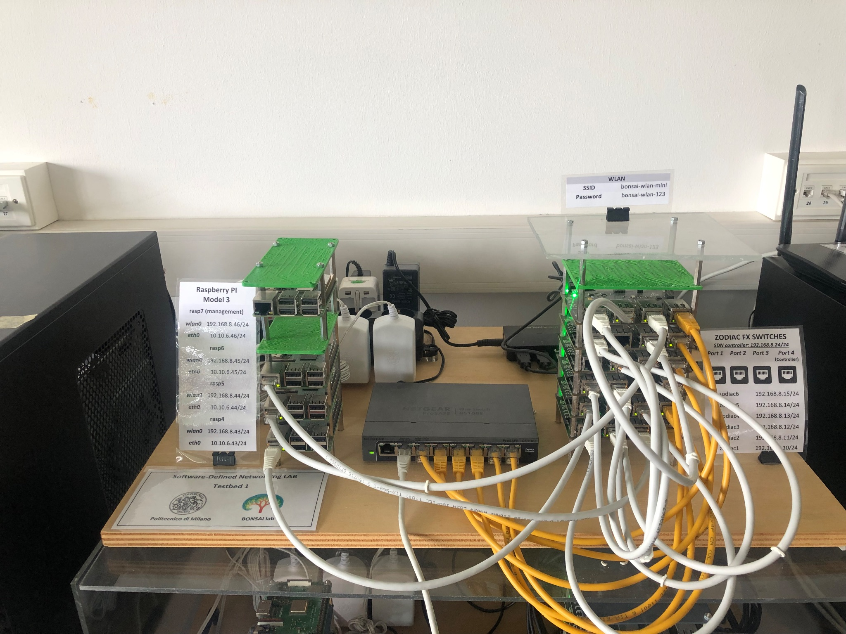
Results from the Lab BONSAI SDN Testbed
Ping | From Rasp 4 to Rasp 5 | From Rasp 4 to Rasp 5
Switches Status | all “UP” | switch 5 “DOWN”
Packets transmitted | 17 | 1079
Packets received | 17 | 1079
Total time [ms] | 16026 | 1079604
RTT min [ms] | 4,497 | 2,399
RTT max [ms] | 17,03 | 232,7
RTT avg [ms] | 6,75 | 15,381
RTT mdev [ms] | 3,709 | 18,683
Picture of the Lab BONSAI SDN Testbed

Slide 21
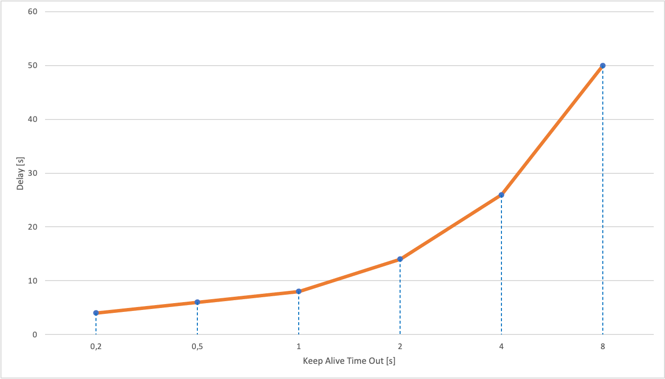
Results from the Lab BONSAI SDN Testbed
Keep Alive Time Out [s] | Delay in Failure Detection [s]
0,2 | 4
0,5 | 6
1 | 8
2 | 14
4 | 26
8 | 50
Delay in Failure Detection vs Keep Alive Time Out

Slide 22
Results from the Lab BONSAI SDN Testbed
Keep Alive Time Out [s] | Delay in Failure Detection [s]
0,2 | 4
0,5 | 6
1 | 8
2 | 14
4 | 26
8 | 50
Delay in Failure Detection vs Keep Alive Time Out
In a real scenario, it would be necessary to find the right trade-off between the Keep Alive Time Out and the maximum tolerable Delay in Failure Detection. Of course, the lower the Keep Alive Time Out, the faster the Failure Detection, but also the more the network would be saturated with echo messages.

Slide 23
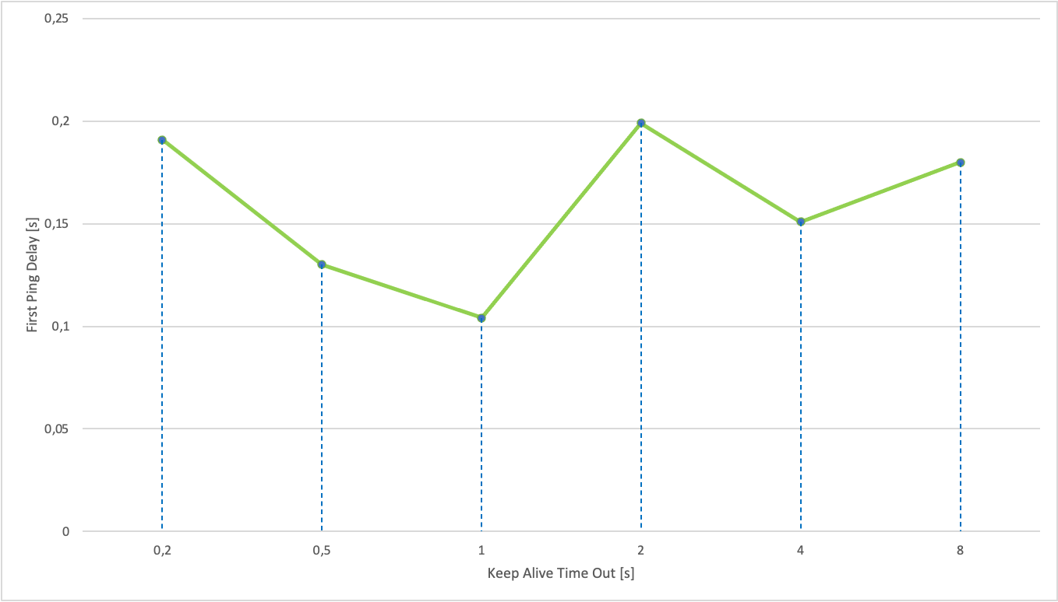
Results from the Lab BONSAI SDN Testbed
Keep Alive Time Out [s] | First Ping Delay [ms]
0,2 | 191
0,5 | 130
1 | 104
2 | 199
4 | 151
8 | 180
First Ping Delay Caused by the Failure vs Keep Alive Time Out
Average = 0,159 s

Slide 24
Results from the Lab BONSAI SDN Testbed
Keep Alive Time Out [s] | First Ping Delay [ms]
0,2 | 191
0,5 | 130
1 | 104
2 | 199
4 | 151
8 | 180
First Ping Delay Caused by the Failure vs Keep Alive Time Out
We didn’t find any significant relationship between the Keep Alive Time Out and the Delay of the First Ping after the Failure of a switch. However, we did observe an Average Delay of 159 ms, which can be interpreted as the reaction time of the network itself to the switch leaving.
Average = 0,159 s

Slide 25
THANK YOU
Dipartimento di Elettronica, Informazione e Bioingegneria
Node Failure Detection
Team
Presenters: Alessio Fumagalli, Chiara Draghini, Anuar El Hachimi, Zhengchen Xu
Emails: alessio3.fumagalli@mail.polimi.it, chiara.draghini@mail.polimi.it, anouar.elhachimi@mail.polimi.it, xuzhengchen552@gmail.com
Accademic Year
2022/2023

