Slide 1
Chiara
Estimating Option Prices with Heston’s Stochastic Volatility
Model

Slide 2










This is us
Chiara
Chiara Lesa
Carlos Rodríguez Truax
Paul Ambroziewicz
Florian Reischl
Project leader
Associate
Analyst
Head of ALGO
BSc. Business, Economics and Social Sciences
BSc. Finance
MSc. QFIN WU
BSc. Math
MSc. QFIN WU
BSc. Economics

Slide 3
Summary
Chiara
Difference between Black-Scholes and Heston
Black-Scholes assumes constant volatility, whereas Heston assumes stochastic volatility.
Estimation of stochastic volatility is difficult but yields precise results. Black-Scholes is favored by many because it allows for fast and simple pricing of European options
Estimation methods for parameters for Heston model
Maximum likelihood estimation finds application in many models and yields unbiased results for large samples. Nontrivial estimation as formula must be derived analytically and requires complex math
Method of moments can be used even if distribution is unknown but cannot estimate all missing parameters
Comparing results of Black-Scholes and Heston
Parameter estimation methods for Heston model have ambiguous performance when compared across time to maturity
Visual comparison shows strength of Heston model when estimating options with low strike price
Heston model, estimated through MOM, yields the most accurate results for long-term (115 days) options
Back test with recent data
Option pricing with Heston yields more precise results compared to Black-Scholes, especially for short time to maturity of 22 days
Based on root-mean-squared-error, Black-Scholes performs best only marginally better than Heston (parameters estimated by method-of-moments)

Slide 4
5-step-plan from data retrieval to implementation and back test of model performance
Florian
Data
Data Retrieval from Yahoo Finance
S&P100
In sample from Jan 2nd, 1991- June 11th, 1997
Black Scholes
Option Price Estimation (BS)
Using the parameters given in the paper to compute option prices
MOM and MLE
Parameter estimation
Method of moments
Maximum likelihood estimation
Heston
Computation of Heston Call Price
using the estimated parameters and given the data
RMSE computation and visualization.
Extension
Data Extension
Estimation with data of S&P500 from 2015-01-01 to 2021-12-01
including Covid-19 Period

Slide 5
Model Comparison for S&P100 during 1991-97

Slide 6
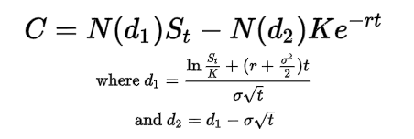
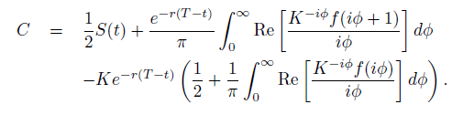
Heston assumes stochastic volatility to price European options
Paul
Black-Scholes
Heston
Most important assumptions
No Transaction Costs, Taxes, Dividends
Prices behave as Brownian Motions
Constant Short Term interest rate r
Options exercised at maturity (European Options)
Constant Volatility (!)
Most important assumptions
No Transaction Costs, Taxes, Dividends
Prices behave as Brownian Motions
Constant Short Term Interest Rate r
Options exercised at maturity (European Options)
Volatility is time changing and stochastic
Pro
Contra
Pro
Contra
Simple
Volatility is not constant
Volatility is stochastic
Difficult to compute (especially volatility)
Fast
Problems with other types of options
More Precise
Not easily interpretable

Slide 7
Two methods for parameter estimation with different pros and cons have been applied
Paul
Method of moments
Estimates of parameters of interest are found by expressing population moments as functions and setting those expressions equal to sample moments
Five Parameters to be estimated:
correlation of Brownian Motions
long term price variance
mean reversion
volatility of the volatility
risk free rate
Pros:
Algebraic and computational simplicity, often machine not required
Used when distribution is unknown
Drawbacks:
Parameter cannot be estimated and must be guessed (negligible weight in equation)
Parameters may not be estimated because not included in moments
Not precise
k
Maximum likelihood estimation
optimizes the parameter estimates such that the data that we observe is the data that we are most likely to observe
Pros:
Applicable to many models
minimum variance unbiased estimators for large samples
approximate N
Drawbacks:
distribution-specific and its formula must be derived analytically (often requires complex math)
estimation is nontrivial
sensitive to parameter initialization
can be biased for small samples
r

Slide 8
Option pricing with Heston yields more precise results compared to Black-Scholes, especially for long maturity
Carlos
Expiration | Stock¹ | Strike | Actual Call | Heston MOM | Heston MLE | Black Scholes
24 | 425.73 | 395 | 30.75 | 32.07 | 30.76 | 32.55
24 | 425.73 | 400 | 25.88 | 25.36 | 25.76 | 27.57
24 | 425.73 | 405 | 21.00 | 21.71 | 20.76 | 22.60
87 | 425.73 | 380 | 46.75 | 46.27 | 45.85 | 52.04
87 | 425.73 | 385 | 42.00 | 42.41 | 40.85 | 47.12
87 | 425.73 | 390 | 37.50 | 37.26 | 35.85 | 42.21
115 | 425.73 | 380 | 47.25 | 46.47 | 45.88 | 54.05
115 | 425.73 | 390 | 28.13 | 36.71 | 35.89 | 44.27
115 | 425.73 | 400 | 29.38 | 28.36 | 25.89 | 34.48
Key insights
As time to maturity increases, MOM² becomes more accurate while MLE³ loses accuracy
MOM increase accuracy in long-run, MLE in the short-run
Black-Scholes overestimates the price when strike price is small and underestimates the price when strike price is large (closer to stock price)
S&P100
Method-of-moments
Maximum-likelihood-estimation

Slide 9
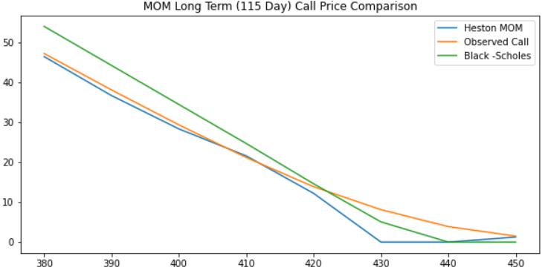
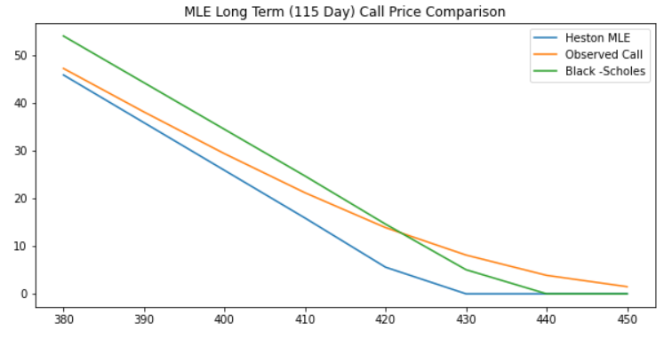
Visual comparison shows strength of Heston model when estimating options with low strike price
Carlos
Key insights
MOM estimates allow for a more accurate option price estimate than MLE when time to maturity is higher
MLE method in the long term underestimates the price and detach from actual price more than MOM
Black-Scholes method overestimates the price when strike price is smaller and underestimates it when strike price is bigger but is the most accurate

Slide 10
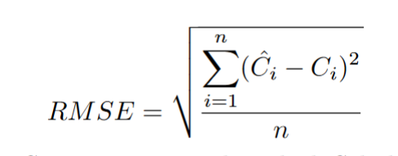
Heston model, estimated through MOM, yields the most accurate results for long-term options
Carlos
Root - Mean - Square Error Results
 | 24 days | 87 days | 115 days
Black Scholes Model | 1.25 | 3.29 | 4.32
Heston Model (MOM) | 1.71 | 3.80 | 3.31
Heston Model (MLE) | 1.48 | 4.20 | 4.99
Key insights
Black-Scholes models produces more accurate results when estimating price for options with 24 and 87 days to maturity. There is no obvious advantage of one or the other parameter estimation method for the Heston model, as both show weak performance with the exception of estimating long-term option price

Slide 11
Analysis Extension and Model Comparison for S&P500 during 2015-21

Slide 12
Option pricing with Heston yields more precise results compared to Black-Scholes, especially for short maturity
Expiration | Stock | Strike | Actual Call | Heston MOM | Heston MLE | Black Scholes
22 | 4511.6 | 2900 | 1608.3 | 1611.71 | 1606.14 | 1611.74
22 | 4511.6 | 3300 | 1210.5 | 1211.72 | 1205.39 | 1211.76
22 | 4511.6 | 3700 | 812 | 811.737 | 804.636 | 811.781
89 | 4511.6 | 2900 | 1619.3 | 1612.03 | 1589.45 | 1612.17
89 | 4511.6 | 3300 | 1229.4 | 1212.09 | 1186.4 | 1212.25
89 | 4511.6 | 3700 | 851.3 | 812.156 | 783.346 | 812.332
120 | 4511.6 | 2900 | 1620.9 | 1612.18 | 1581.7 | 1612.37
120 | 4511.6 | 3300 | 1238.6 | 1212.27 | 1177.58 | 1212.48
120 | 4511.6 | 3700 | 865.4 | 812.351 | 773.467 | 812.586
Key insights
If option is close to Time To Maturity, MOM yields closer prices to the actual ones.
In general, MOM prices are close to BS prices, which could mean that in the considered time period volatility is close to be constant.
For longer maturities MLE appears to deviate from actual price.

Slide 13
Based on root-mean-squared-error, Black-Scholes performs best only marginally better than Heston (MOM)
Carlos
Root - Mean - Square Error Results
 | 24 days | 87 days | 115 days
Black Scholes Model | 5.0568 | 22.5644 | 29.8497
Heston Model (MOM) | 5.0716 | 22.7082 | 30.0413
Heston Model (MLE) | 9.4717 | 47.2872 | 63.185
Key insights
In these cases, Black-Scholes yield close results to actual prices, probably because the market use this method as a standard practice to price European options. Nevertheless, we can see that Heston model with MOM parameters gives a similar RMSE to the Black-Scholes model, regardless of time to maturity

Slide 14
Thank you for your attention!

Slide 15
Appendix

Slide 16
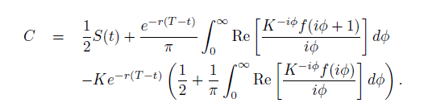

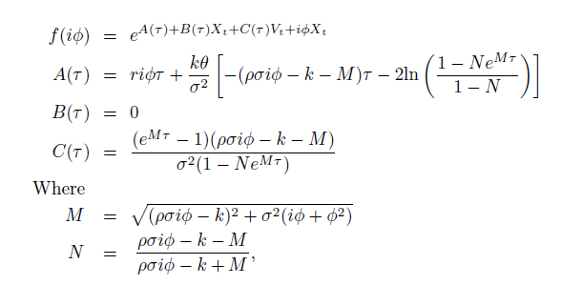
Heston , The Model
European Call Option
Where iis the characteristic function of x.
Assuming X_t is a Brownian Motion, the parameters of the Equation for the Call Option are:

Slide 17
Parameter estimation results for S&P 100
Parameter | MOM | MLE*
r | 0.0007 | 0.0013
k | 2.0541 | 0.0105
 | 0.0001 | 0.0001
 | 0.0051 | 0.0001
 | / | -0.5001
* loglik is 34.76, which is bigger than the one estimated in the paper

Slide 18
Parameter estimation results for S&P 500
Parameter | MOM | MLE*
r | 0.0007 | -0.0311
k | 2.0000 | 0.0004
 | 0.0001 | 0.0027
 | 0.0034 | 0.0001
 | / | -0.9467
* loglik is 34.76, which is bigger than the one estimated in the paper

Slide 19
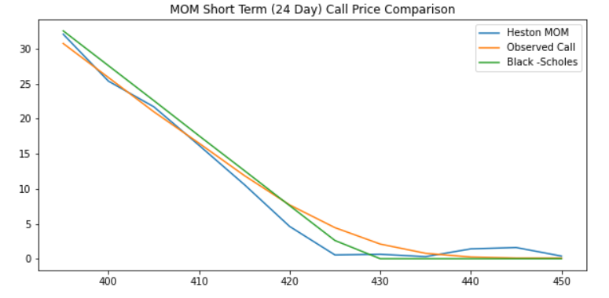
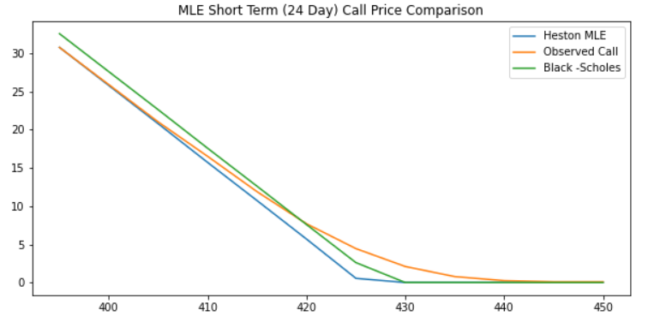
Visual comparison of option estimates
Is that reflected in the top graph? i think so, you see the blue line is positioned higher than green line after strike is 430
Key insights
Heston Model overestimates call price across maturity for MOM as strike price is higher and when time to maturity is small
Only marginal difference in estimation method
In short-term MLE is closer to the actual price than MOM

