Slide 1
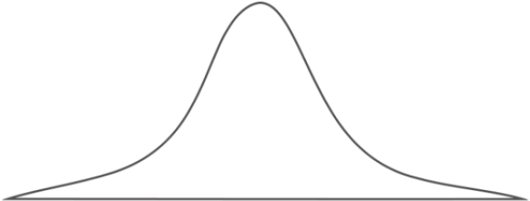
Single channeling
TFT
PIX
TCCP
TCCS

Slide 2
Double channeling
Single channeling
TFT
PIX
TCCP
TCCS

Slide 3
Double channeling
Single channeling
TFT
PIX
TCCP
TCCS

Slide 4
Double channeling
Single channeling
TFT
PIX
TCCP
TCCS

Slide 5
Single channeling
TFT
PIX
TCCP
TCCS
TCCS

