Slide 1
110-2 OR Final Project
CPBL Starting Lineup Selection
經濟四 錢紫翎 B07303129
生傳四 盧家雯 B07610058
經濟四 柯逸萱 B07303045
經濟四 陳宛婷 B07303106

Slide 2
Table of contents
01
02
03
Problem
Data
Model
Introduction
04
05
06
Performance
Analysis
Conclusion
IP
Model

Slide 3
01
Problem

Slide 4
Problem Description
In baseball world, deciding the starting lineup is a crucial part of the game. For each game, optimizing the lineup to have a good balance between players' offensive and defensive abilities is often the important issue for many fans.
In this project, assume we are the manager of a professional team where we are given the schedule and opponent’s starter pitcher of each game. We want to simulate the real-world situation to find the best lineup for our team in each game.
Notes:
排定先發名單是棒球運動中的重要環節，職業球隊常規賽季中通常最多有25人可上場，每場比賽都要煩惱野手的棒次與各守位人選，要如何同時顧及守備及攻擊面找出最佳化陣容先發名單幾乎決定了整場比賽的結果，所以經常是球迷的關注焦點。
因此我們想模擬真實職棒世界的狀況，每場比賽皆給定對手球隊、對方先發投方先發投手的狀況下，找出能同時顧及守備與攻擊的野手先發名單最佳化排法。

Slide 5
02
Data

Slide 6
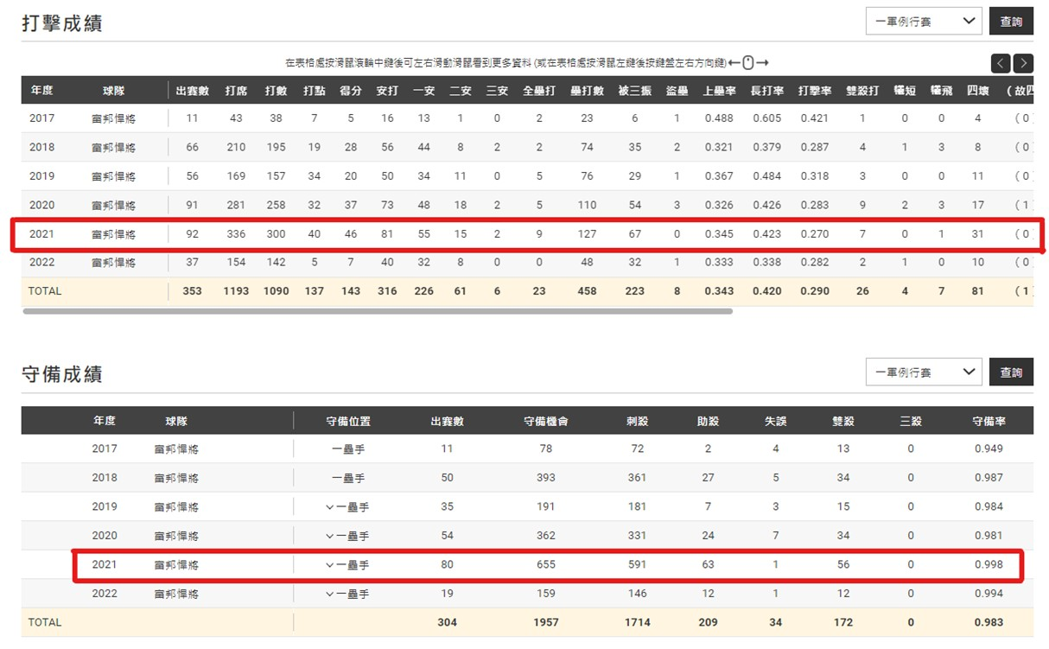
Data: player stats of 2021 season
1. Use a crawler to get player stats of the 2021 season from the CPBL website.

Slide 7
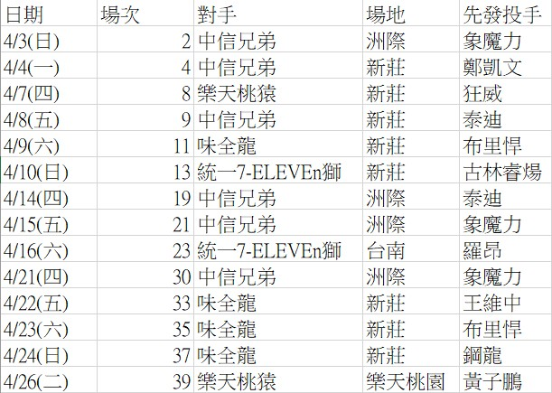
Data: 2022 schedule
2. Get schedule of matches of the 2022 season and the opponent’s starter pitcher from the CPBL website.

Slide 8
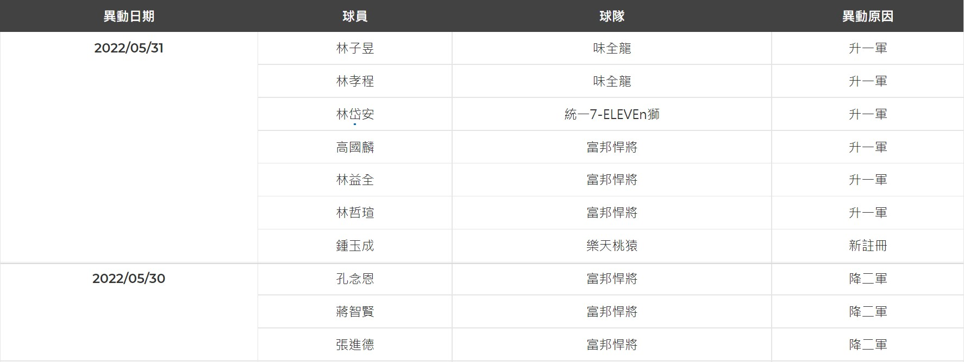
Data: 2022 roster swaps
3. Get roster swaps for each game of the 2022 season from the CPBL website.

Slide 9
03
Model
Introduction

Slide 10
Model Introduction
Our model will be split into 2 stages:
The 1st stage is to choose the best player for each position in each game and maximize the sum of all starting players' score in games of a week.
  We calculate the sum of defensive score and offensive score of each player on each position according to the opponent’s starter pitcher, game field, month of the game and their fielding stats.
  Both formulas for the offensive and defensive score are defined by ourselves.

Slide 11
Model Introduction
Our model will be split into 2 stages:
The 2nd stage is to assign the batter order for the starting lineup from results of 1st stage in each game.
  Lastly, we’ll assign the batting order for the chosen players from the 1st stage by their overall offensive contributions per plate appearance in each batting order.
  With implementation of our model, we’ll be able to get the optimal player lineup for each game for the whole week

Slide 12
04
IP Model

Slide 13
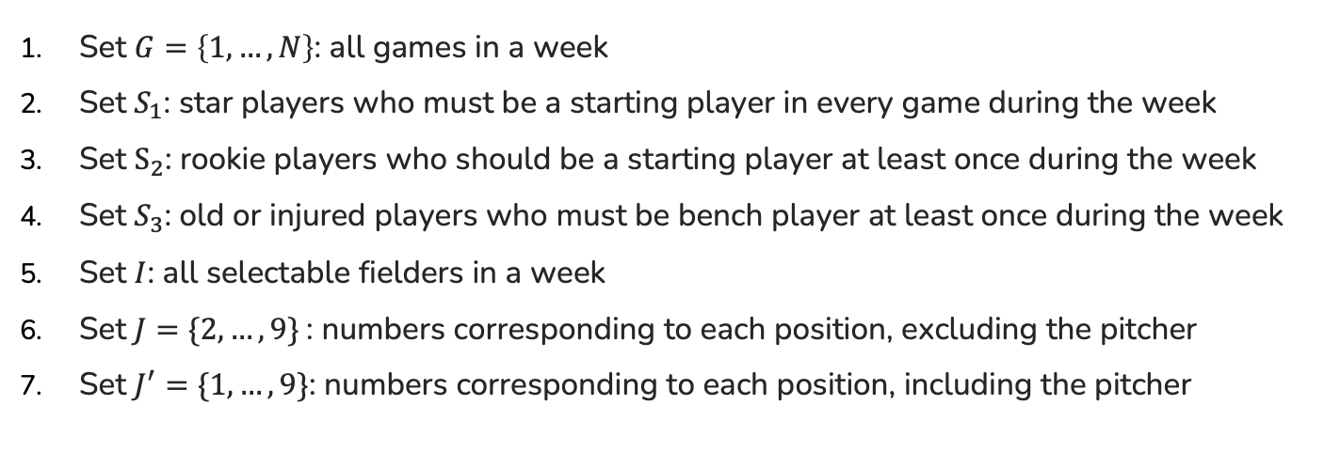
Sets
Set $G=\left\{1, …,N\right\}$: all games in a week
Set $S_{1}$: star players who must be a starting player in every game during the week
Set $S_{2}$: rookie players who should be a starting player at least once during the week
Set $S_{3}$: old or injured players who must be bench player at least once during the week
Set $I$: all selectable fielders in a week
Set $J=\{2,…,9\}$: numbers corresponding to each position, excluding the pitcher
Set $J^{′}=\{1,…,9\}$: numbers corresponding to each position, including the pitcher

Slide 14
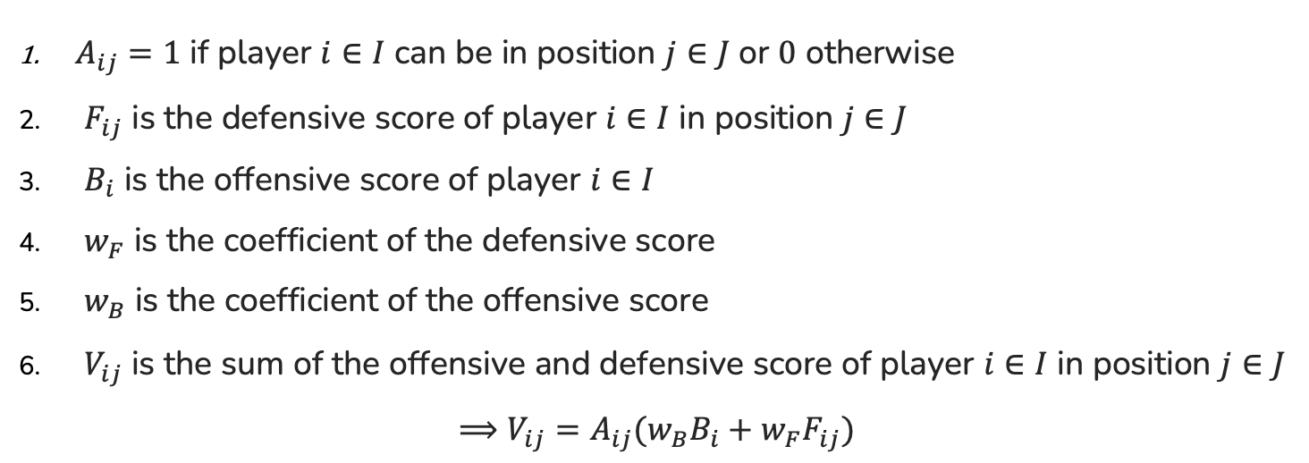
Parameters
$A_{ij}=1$ if player $i∈I$ can be in position $j∈J$ or $0$ otherwise
$F_{ij}$ is the defensive score of player $i∈I$ in position $j∈J$
$B_{i}$ is the offensive score of player $i∈I$
$w_{F}$ is the coefficient of the defensive score
$w_{B}$ is the coefficient of the offensive score
$V_{ij}$ is the sum of the offensive and defensive score of player $i∈I$ in position $j∈J$
$⟹V_{ij}=A_{ij}(w_{B}B_{i}+w_{F}F_{ij})$

Slide 15

Parameters
$P_{jk}$ is the PA (Plate Appearance) of the $k^{th}$ hitter ($k∈K$) of position $j∈J$
$O_{jk}$ wOBA (Weighted On Base Average) of the $k^{th}$ hitter ($k∈K$) of position $j∈J^{′}$
$Z_{g}$ is the weight of game $g∈G$ depending on the opponent team

Slide 16

Self-defined Formulas
Offensive score $B$
$$B=\frac{({OPS\text{+}}_{Season}×{PA}_{Season}+{OPS\text{+}}_{month}×{PA}_{month}+{OPS\text{+}}_{field}×{PA}_{field}+{OPS\text{+}}_{vsp}×{PA}_{vsp})}{{PA}_{season}+{PA}_{month}+{PA}_{field}+{PA}_{vsp}}$$
Offensive Score $F$
$$F=\frac{{FPCT}_{season}}{{FPCT}_{μpos}}$$

Slide 17
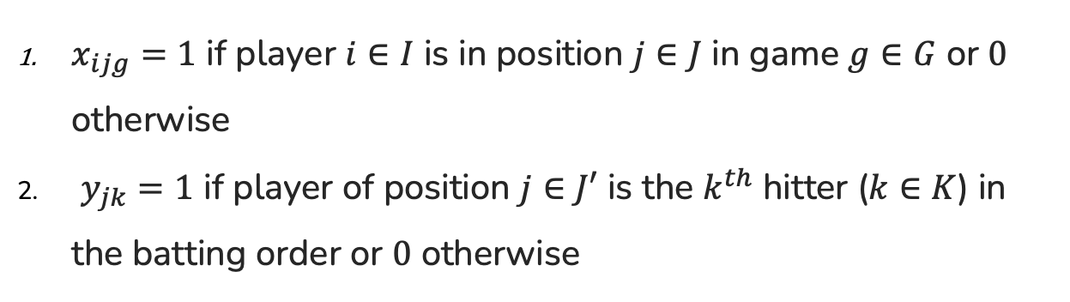
IP Model – Decision Variable
$x_{ijg}=1$ if player $i∈I$ is in position $j∈J$ in game $g∈G$ or $0$ otherwise
$y_{jk}=1$ if player of position $j∈J′$ is the $k^{th}$ hitter ($k∈K$) in the batting order or $0$ otherwise

Slide 18
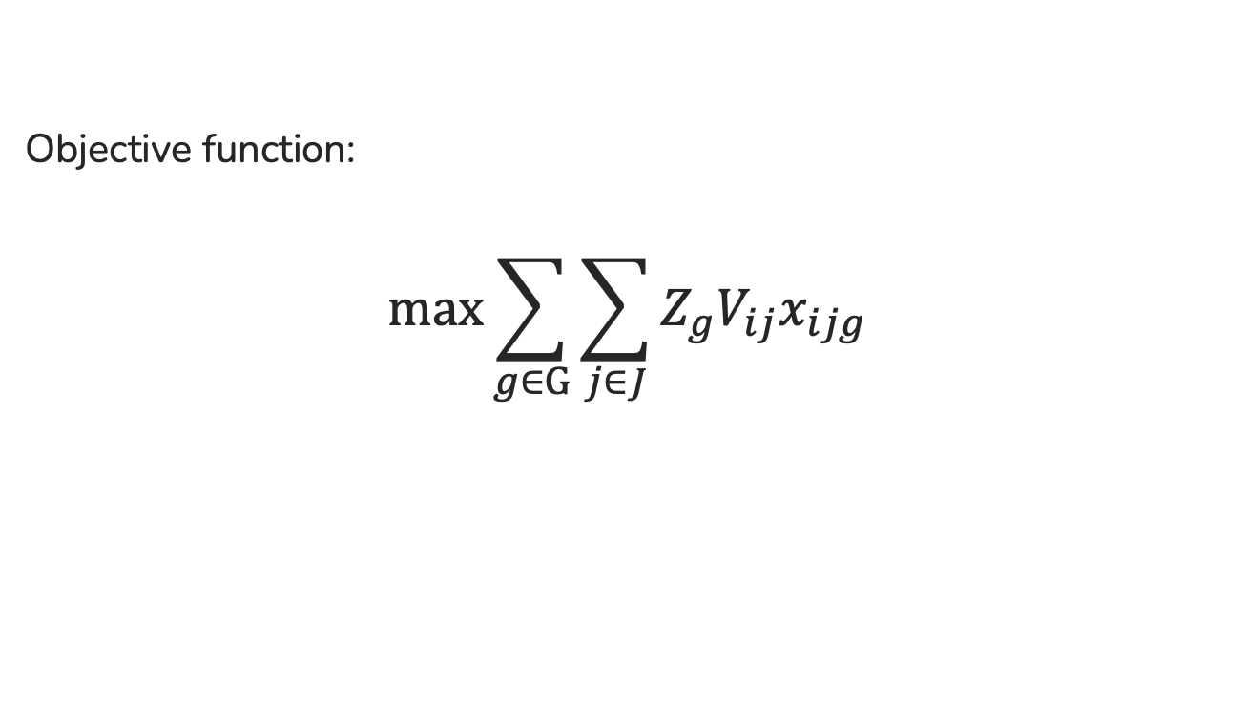
IP Model – Stage 1
Fielding position assignment for a week
Objective function:
$$\max{\sum_{g∈G}{\sum_{j∈J}{Z_{g}V_{ij}x_{ijg}}}}$$

Slide 19

IP Model – Stage 1
Fielding position assignment for a week
Constraints:
$$s.t. \begin{aligned}&\sum_{i∈I}{x_{ijg}}=1 ∀j∈J, g∈G \\ &\sum_{j∈J}{x_{ijg}}≤1 ∀i∈I, g∈G \\ &x_{ijg}≤A_{ij} ∀i∈I, j∈J, g∈G \\ &\sum_{g−n}^{n+k}{x_{i2g}}≤3 ∀i∈I, n∈G, n+k≤N.\end{aligned}$$

Slide 20

IP Model – Stage 1
Fielding position assignment for a week
Constraints:
$$s.t. \begin{aligned}&\sum_{g∈G}{x_{ijg}}=N ∀i∈I, j∈J, if player i∈S_{1} \\ &\sum_{g∈G}{x_{ijg}}≥1 ∀i∈I, j∈J, if player i∈S_{2} \\ &\sum_{g∈G}{x_{ijg}}<N ∀i∈I, j∈J, if player i∈S_{3} \\ &x_{ijg}∈\{0,1\} ∀i∈I, j∈J, g∈G.\end{aligned}$$

Slide 21

IP Model – Stage 2
Batting order assignment of each game
After Stage 1, let the player with the highest offensive score $B_{i}$ among the remaining players be DH (Designated Player)
Generate the batting order for each game by conducting the Stage 2 model $N$ times

Slide 22
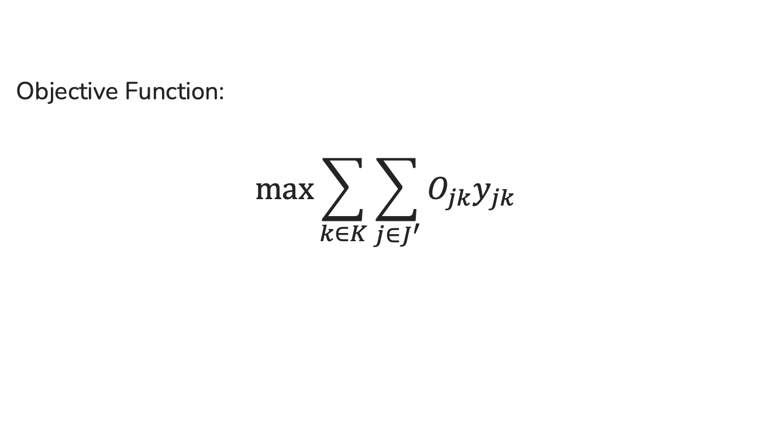
IP Model – Stage 2
Batting order assignment of each game
Objective Function:
$$\max{\sum_{k∈K}{\sum_{j∈J^{′}}{O_{jk}y_{jk}}}}$$

Slide 23
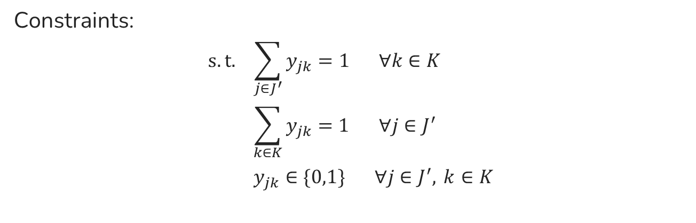
IP Model – Stage 2
Batting order assignment of each game
Constraints:
$$s.t. \begin{aligned}&\sum_{j∈J^{′}}{y_{jk}}=1 ∀k∈K \\ &\sum_{k∈K}{y_{jk}}=1 ∀j∈J^{′} \\ &y_{jk}∈\{0,1\} ∀j∈J^{′}, k∈K\end{aligned}$$

Slide 24
05
Performance
Analysis

Slide 25
Performance Analysis
Ex: Comparison between stimulated results and the actual lineup of 富邦悍將
 | 5/17 |  | 5/18 |  | 5/20
 | Real Version | IP Model | Real Version | IP Model | Real Version | IP Model
1 | 王正棠 2B | 葉竹軒 2B | 王正棠 2B | 申皓瑋 CF | 莊韋恩 2B | 葉竹軒 2B
2 | 董子恩 3B | 范國宸 1B | 董子恩 3B | 林琨笙 C | 董子恩 3B | 蔣智賢 1B
3 | 申皓瑋 CF | 申皓瑋 CF | 申皓瑋 CF | 蔣智賢 1B | 申皓瑋 CF | 申皓瑋 CF
4 | 范國宸 1B | 李宗賢 SS | 范國宸 1B | 葉竹軒 2B | 范國宸 1B | 李宗賢 SS
5 | 蔣智賢 DH | 陳真 LF | 蔣智賢 DH | 董子恩 3B | 蔣智賢 DH | 陳真 LF
6 | 張進德 C | 張進德 C | 陳真 LF | 張進德 DH | 張進德 C | 張進德 C
7 | 陳真 LF | 王正棠 RF | 張進德 C | 李宗賢 SS | 陳真 LF | 范國宸 RF
8 | 孔念恩 RF | 蔣智賢 DH | 孔念恩 RF | 范國宸 RF | 葉竹軒 RF | 張冠廷 DH
9 | 王勝偉 SS | 董子恩 3B | 王勝偉 SS | 陳真 LF | 王勝偉 SS | 董子恩 3B
Stage 2 obj | 2.455 | 3.136 | 2.455 | 3.045 | 2.625 | 3.103

Slide 26
Performance Analysis
Average of our stimulated results and the actual results of 富邦悍將's 2 months games
 | Stage 1 | Stage 1 wAVG | Stage 2
Real Version | 2241.33 | 580.90 | 2.57
IP Model | 2611.57 | 666.45 | 3.14

Slide 27
06
Conclusion

Slide 28
Conclusion
From the results of our IP model, we can see that our algorithm can determine the lineup more efficiently than lineups that are chosen manually without any consideration of player performance.
Any team with complete data can use our model to generate a starting lineup for better reference.
Notes:
排定先發名單是棒球運動中的重要環節，職業球隊常規賽季中通常最多有25人可上場，每場比賽都要煩惱野手的棒次與各守位人選，要如何同時顧及守備及攻擊面找出最佳化陣容先發名單幾乎決定了整場比賽的結果，所以經常是球迷的關注焦點。
因此我們想模擬真實職棒世界的狀況，每場比賽皆給定對手球隊、對方先發投方先發投手的狀況下，找出能同時顧及守備與攻擊的野手先發名單最佳化排法。

Slide 29
Thanks

