Slide 1

NYU Message
Chia-Yen Hung
Tzu-Yen Wang
Ching-Ying Yang

Slide 2
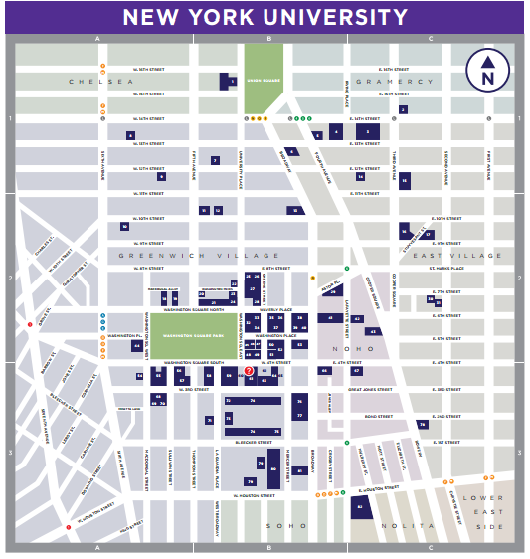
NYU Campus

Slide 3
Channels
What we have now:
Social Networks Platform
Instant Message
NYU Events
Department Website
Mailing List
Phone
Is there a simpler way for NYU students to build connections and share information with each other?
Notes:
https://events.nyu.edu/

Slide 4
NYU Message
For NYU students to report or verify issues on campus.
Also, to share information about the whole campus.
Things about
University reminder, emergency
Facility issues, space availability
Class announcement, after class discussion, cheat sheet
Seminar, performance, meetup, party, club happy hour, free food.
Moods, secrets

Slide 5
NYU Message
BootStrap
Google MAPs API
JQuery
Underscore
Node.js/express
Grunt
MongoDB

