Slide 1
The Effect of Non-Performing Loans: A Threshold Method
University of Birmingham
David Dickinson
Yixin Hou

Slide 2
Abstract
This paper looks into the effect of non-performing loan on bank lending. Using the threshold regression technique on a large panel data set of commercial banks globally, we have found some evidence that non-performing loans have a non-linear negative effect on banks’ lending behaviour.

Slide 3
The Non-Performing Loans
Five-tier Loan classification system (BIS):
Pass
Special Mention
Substandard
Doubtful
Loss
NPLs comprise the last three categories.

Slide 4
Empirical Secification
A Simple Commercial Bank Balance Sheet:
Asset | Liability
Loans | Deposits
Other Earning Assets | Capital
Loan growth is affected by deposit growth, capital
growth and other earning asset growth.

Slide 5
Empirical Sepcification
With the growth of deposits, banks are supposed to increase the lending. However, when NPLs are high, the willingness to expand loans reduces.
Banks are supposed to increase lending with the growth of capital. And the relationship will be distorted under high NPL condition.
Other earning assets are substitutes for loans. With high level of NPLs, such effect may also be distorted.
The relationship between loan and NPLs are negative.

Slide 6
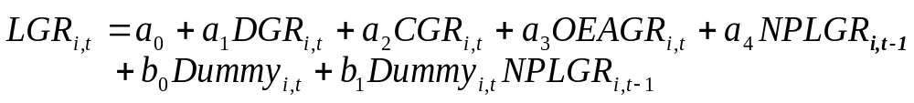
The Role of Capital Requirements
Capital Adequacy
The Risk-Based Capital is viewed as a regulatory tax that is higher on assets in categories that are assigned higher weights. (Berger and Udell, 1994)
The reluctance in the supply of credit is expected to be more significant for capital-deficient banks.
We assume different samples have different effective capital ratio. One target in the empirical test is to find out the trigger capital ratio for each sample.
Dummy_{i,t} = 1 if capital ratio is equal of higher than the effective capital ratio, otherwise, 0.

Slide 7
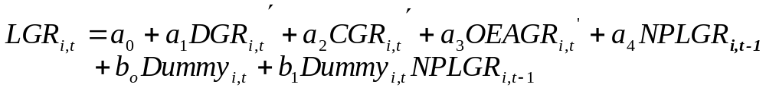
Econometric Issues
The Instrument Variable Method
The variables are potentially endogenous as they are simultaneously determined through bank’s balance constraints.
We apply the method of two-stage least squares using instrumental variables.
We assume banks’ behaviour is continuous and they re-balance the portfolio at each period based on the portfolio of the previous period.
where GDR’, CGR’ and OEAGR’ are the fitted values estimated in the
first stage.

Slide 8
The Threshold Effect
The Threshold Effect of NPLs
Bad loans exist as a natural consequence of lending.
Only high level of NPLs will distort their actions.
It implies that the effect of NPLs is non-linear.
There may be a critical threshold level by NPL to loan rate. Banks make lending decision differently reacting to the NPL rate under or above the threshold. The negative effect starts when NPLs increase to above the threshold.

Slide 9
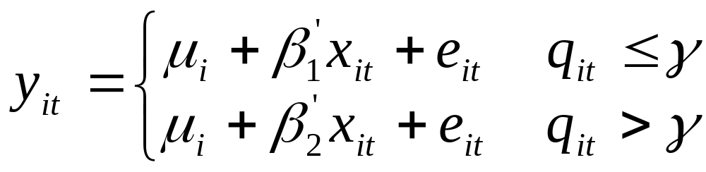
The Threshold Effect
Threshold Method
Threshold regression techniques are used to address the question whether regression functions are identical across all observations in a sample or fall into discrete classes.
Hansen (1999) develops the panel threshold regression methods, and shows that for any given threshold, the slope coefficient can be estimated by OLS.

Slide 10
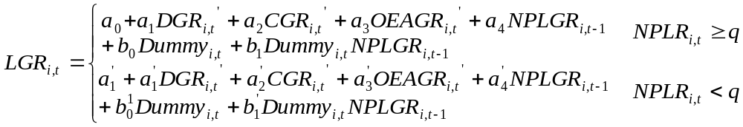
The Threshold Effect
Threshold Method

Slide 11
Data
The bank data are collected from BankScope, which contains commercial bank statistics from 1998 to 2005.
The countries/regions we look into are:
Region | Country | Number of Banks
U.S. | U.S. | 1214
Asian Crisis Countries | Hong Kong | 34
 | Philippines | 30
 | Indonesia | 33
 | Thailand | 14
 | Republic of Korea | 18
Western Europe | France | 39

Slide 12
Data
 | U.S. | Asian Crisis | France
Asset Growth Rate (%) | 13.87 (31.50) | 14.01 (27.64) | 5.73 (21.22)
OEA Growth Rate (%) | 1.93 (39.70) | 7.68 (49.13) | 1.73 (24.57
Loan Growth Rate (%) | 1.12 (15.33) | 1.58 (20.79) | 0.55 (13.33)
Deposit Growth Rate (%) | -0.48 (13.74) | 1.49 (21.43) | 0.53 (10.90)
NPL Growth Rate (%) | 14.86 (90.82) | 9.36 (88.83) | -12.81 (42.19)
Equity* Growth Rate (%) | 2.52 (23.20) | 1.83 (45.35) | 3.77 (48.17)
NPLs to Loans Rate (%) | 0.83 (2.38) | 12.18 (15.71) | 8.75 (9.48)
Capital Ratio (%) | 15.50 (14.61) | 22.30 (17.83) | 11.95 (8.43)
* We use equity as a proxy for the capital.

Slide 13
Data
United States has much lower NPL levels than the rest: its average NPL rate is only 0.83% compared to the highest 12.18% for Asian crisis countries. Although the NPL rates are quite high for French banks, 8.75%, banks are experiencing decreases in NPL growth,
-12.81%.
For the risk-based capital ratio, all the samples have the mean values above the 8% required capital ratio according to Basle Accord II. Compared with other countries, the Asian crisis sample has an especially high capital ratio with the mean value of 22.30%. The increased capital ratio is basically the result of government rescuing actions.

Slide 14
Results: U.S.
The NPL rate threshold is 0.6% and the effective capital ratio is 14.9%.
Dependent Variable: LGR (t)
Variable | Coefficient | Std. Error | Coefficient | Std. Error
 | NPL Rate >= 0.6% |  | NPL rate < 0.6%
Constant | 0.9010** | 0.3560 | 1.3371*** | 0.2228
DGR(t) | 0.2782*** | 0.0203 | 0.0816*** | 0.0193
OEAGR(t) | -0.1008*** | 0.0052 | -0.1494*** | 0.0050
EGR(t) | 0.0546*** | 0.0112 | -0.0003 | 0.0096
NPLGR(t-1) | -0.0089** | 0.0035 | -0.0026 | 0.0021
Dm | -2.8329*** | 1.0287 | 1.0660* | 0.6117
Dm*NPLGR(t-1) | -0.0018 | 0.0060 | -0.0058 | 0.0040
No. of Obs./Group | 2570/807 |  | 3462/988
Overall R-sq: | 0.2388 |  | 0.2861
 | Chi2 = 117.57 | Prob > Chi2 = 0.0 | Chi2 = 235.79 | Prob > Chi2 = 0.0

Slide 15
Results: U.S.
When banks have NPLs less than the threshold, the loan growth rate is higher as suggested by the constant.
Statistically significant negative coefficient associated with NPL growth for banks have NPLs higher than threshold. No significant coefficient when NPLs less than threshold.
Capital dummy has different effects for two cases.
When banks have NPLs below threshold, capital adequacy helps to accelerate growth of loans.
When banks have NPLs above threshold, capital adequacy helps to reduce risky lending.

Slide 16
Results: Asian Crisis Countries
The NPL rate threshold is 5.6% and the effective capital ratio is 13.5%.
Dependent Variable: LGR (t)
Variable | Coefficient | Std. Error | Coefficient | Std. Error
 | NPL Rate >= 5.6% |  | NPL rate < 5.6%
Constant | 4.5449** | 2.1979 | 4.2506* | 2.5045
DGR(t) | -0.0310 | 0.1127 | 0.1595* | 0.0947
OEAGR(t) | -0.2879*** | 0.0708 | -0.2493*** | 0.0717
EGR(t) | 0.0593** | 0.0278 | 0.0561 | 0.0592
NPLGR(t-1) | 0.0078 | 0.0226 | -0.0425 | 0.0333
Dm | -2.7929 | 2.5710 | 1.3652 | 2.4936
Dm*NPLGR(t-1) | -0.0315 | 0.0253 | 0.0237 | 0.0366
No. of Obs./Group | 297/86 |  | 253/74
Overall R-sq: | 0.3548 |  | 0.1813
Prob > Chi2 | Chi2 = 46.88 | Prob > Chi2 = 0.0 | Chi2 = 25.15 | Prob > Chi2 = 0.0003

Slide 17
Results: Asian Crisis
Although this sample has the highest mean NPL rate, the threshold is not relatively high compared with other samples. Most of the banks were severely affected by the financial crisis, so changes in NPLs should greatly impact on their lending.
No significant coefficient associated with NPL growth rate, i.e., NPLs don’t affect banks’ lending.
Equity growth has positive effect on lending growth for banks with NPL rate above threshold.
The effective capital ratio is high and doesn’t have significant impact because government capital injection reduce bank internal risk management incentive.

Slide 18
Results: France
The NPL rate threshold is 5.75% and the effective capital ratio is 9.8%.
Dependent Variable: LGR (t)
Variable | Coefficient | Std. Error | Coefficient | Std. Error
 | NPL Rate >= 5.75% |  | NPL rate < 5.75%
Constant | -0.6065 | 3.3826 | 7.9287 | 8.1714
DGR(t) | -0.2394* | 0.1324 | 0.0787 | 0.1201
OEAGR(t) | -0.2623*** | 0.0695 | -0.0086* | 0.0047
EGR(t) | 0.0245 | 0.0252 | 0.2077** | 0.0833
NPLGR(t-1) | 0.0164 | 0.0495 | 0.5551 | 0.4644
Dm | 3.2989 | 4.7084 | -7.1216 | 8.6426
Dm*NPLGR(t-1) | 0.0519 | 0.0624 | -0.5672 | 0.4652
No. of Obs./Group | 116/32 |  | 47/15
Overall R-sq: | 0.3021 |  | 0.1457
Prob > Chi2 | Chi2 = 23.94 | Prob > Chi2 = 0.0012 | Chi2 = 2.29 | Prob > Chi2 = 0.0655

Slide 19
Results: France
Compared with U.S., France has a threshold much higher.
NPL growth doesn’t have statistically significant effect on loan growth.
For banks with NPL rate above threshold, deposit growth has negative coefficient, and larger negative coefficient for OEA growth. It suggests that banks having higher NPLs switch more to other earning assets.
No significant evidence for capital adequacy.

Slide 20
Conclusion
Results show that non-performing loans have non-linear effects on lending. We have detected some effect that higher level of NPLs reduces banks’ aspiration to increase lending.
Evidence is less clear for Asian Crisis countries may reflect impact of government intervention.
Risk-based capital ratio has played a significant role on banks’ lending behaviour.

