Slide 1
Stat2008/STAT6038
Do, While, If statements and other useful R functions

Slide 2
Functions
if(cond) {statements} else {statements} evaluate condition
for(var in seq) {statements} execute one loop for each var in seq
while(cond) {statements} execute loop as long as condition is true
repeat {statements} execute expression on each loop
break exits loop
print(x) prints object x to screen
stop("...") stop function and print error message
warning("...") generate warning message

Slide 3
Grouping, loops and conditional execution
Control statements
if statements
The language has available a conditional construction of the form
if (expr 1) expr 2 else expr 3
where expr 1 must evaluate to a logical value

Slide 4
Repetitive execution
for loops, repeat and while
for (name in expr 1) expr 2
where name is the loop variable.
expr 1 is a vector expression, (eg a sequence like 1:10)
expr 2 is repeatedly evaluated as name ranges through the values in the vector result of expr 1.

Slide 5
Repetitive execution
Other looping facilities include the
repeat expr statement
while (condition) expr statement.
The break statement - used to terminate any loop
The next statement can be used to discontinue one particular cycle and skip to the “next”.

Slide 6
For
When the same or similar tasks need to be performed multiple times
> for(i in 1:10) {
+ print(i*i)
+ }
[1] 1
[1] 4
[1] 9
[1] 16
[1] 25
[1] 36
[1] 49
[1] 64
[1] 81
[1] 100

Slide 7
For and If
for(i in 10:0) {
if (i==5){
print("Hoorah we are halfway through!!")
}
else
{
print(i)
}
}
[1] 10
[1] 9
[1] 8
[1] 7
[1] 6
[1] "Hoorah we are halfway through!!"
[1] 4
[1] 3
[1] 2
[1] 1
[1] 0
>

Slide 8
While
> i=99
> while(i<=103){
+ print(i)
+ i=i+1
+ }
[1] 99
[1] 100
[1] 101
[1] 102
[1] 103

Slide 9
rnorm
Usage: rnorm(n, mean = 0, sd = 1)
Example:
> x<-rnorm(1,0,1)
> x
[1] -0.4642039
>

Slide 10
Repeat, Break, If
repeat {
x <- rnorm(1, 0, 1)
print(x)
if(x < 0){ break }
}
> repeat {
+ x <- rnorm(1, 0, 1)
+ print(x)
+ if(x < 0){ break }
+ }
[1] 0.2300458
[1] 1.253165
[1] -0.9555578
>

Slide 11
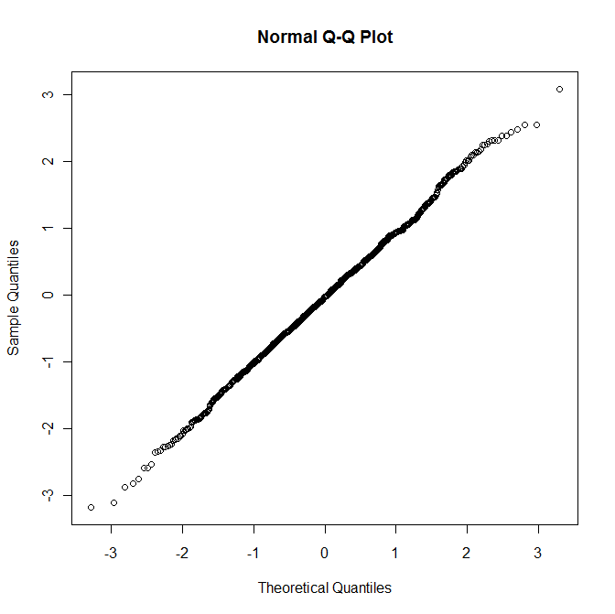
qqnorm
qqnorm is a generic function the default method of which produces a normal QQ plot of the values.
> x <- rnorm(1000, 0, 1)
> qqnorm(x)
>

Slide 12
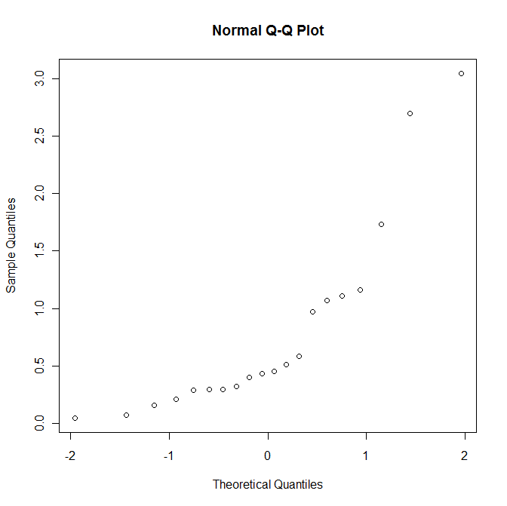
rexp
Density, distribution function, quantile function and random generation for the exponential distribution with rate where mean= 1/rate:
> ex <- rexp(20,1)
> qqnorm(ex)
>

Slide 13
User defined function betachng()
Writing a function that investigates how the slope and intercept of a least-squares regression line change when several user-chosen data points are excluded, and we shall call it betachng().
Such a function will be useful for identifying potential outliers and influential points in a data set.

Slide 14
betachng
> betachng <- function(resp,pred,excl){
+ exc <- unique(excl)
+ if(min(excl)<1) {
+ print("Invalid Point to be Excluded - Index too small") }
+ else if(max(excl)>length(pred)) {
+ print("Invalid Point to be Excluded - Index too large") }
+ else {
+ beta <- lsfit(pred,resp)$coef
+ beta.red <-lsfit(pred[-exc],resp[-exc])$coef
+ beta - beta.red }
+ }

Slide 15
Using the function
betachng(Height,Weight,1)
Intercept X
0.387648288 -0.007282526
What are these numbers?

Slide 16
Homework
Using the help function in R, write a function that includes the stop and warning functions

Slide 17
Homework
Using R help, investigate the difference between using:
else if
Vs
else

