Slide 1
Word2Vector
Speaker : 蘇佳益
Advisor : 陳聰毅
國立高雄科技大學建工校區電子工程系
https://github.com/chiayisu/Artificial_Intelligence_Course

Slide 2
Agenda
Introduction
N-Grams
Introduction to Word Vector
Complexity of Word Vector
Negative Sampling
Hierarchical Softmax
Practical Topics
Results
References

Slide 3
Introduction
N-Grams
Robustness
Simplicity
However: we cannot know similarity between words.
WordVector (Mikolov et al.)
Represent words as dense vector
Able to perform simple algebraic operation
E.g.: Vector(queen) = Vector(king) – Vector(men) + Vector(women)

Slide 4
N-Grams

Slide 5
N-Grams: Introduction
The simplest model to assign probabilities to each sentence
Sequence of N words
N can be any positive number. However: Usually (4-10)
Our example will be N=2 (Bi-Gram)

Slide 6
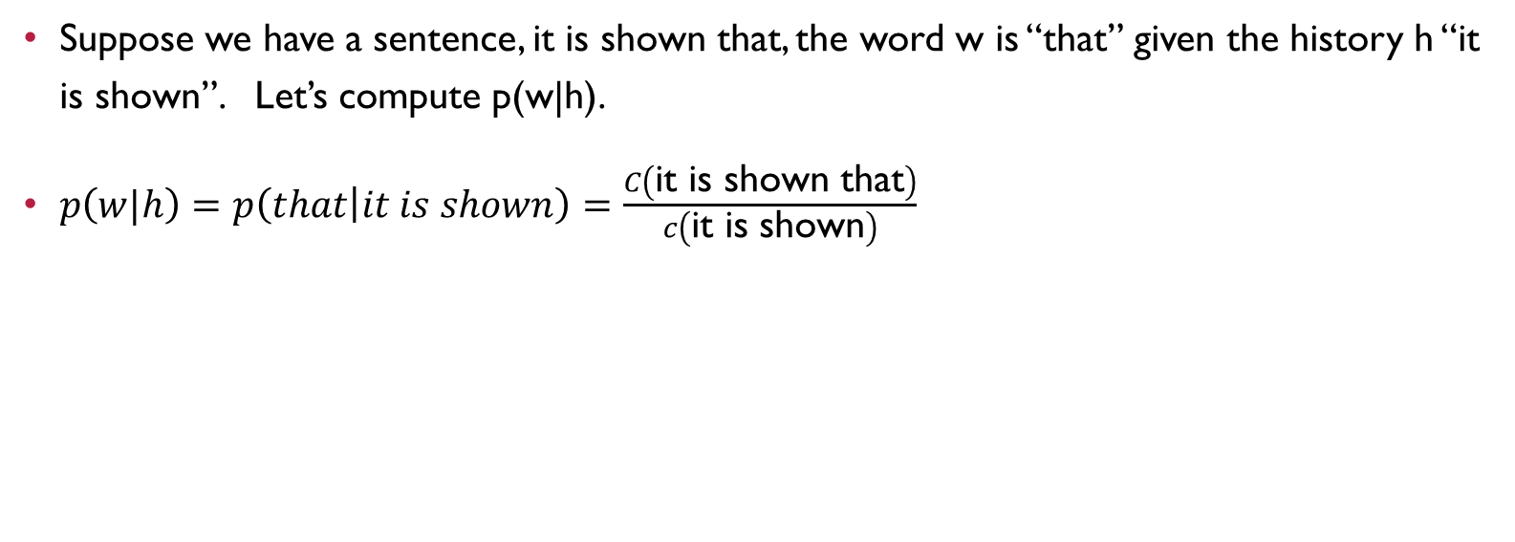
N-Grams: Introduction
Suppose we have a sentence, it is shown that, the word w is “that” given the history h “it is shown”. Let’s compute p(w|h).
$p\left(w|h\right)=p\left(that | it is shown\right)=\frac{C\left(\text{it} \text{is} \text{shown} \text{that}\right)}{c\left(\text{it} \text{is} \text{shown}\right)}$
The computation above is problematic.

Slide 7
N-Grams: Why is it problematic?
As we mentioned in “Introduction Course”, Natural Language often
evolves.
sometimes doesn’t follow grammar.
be equivocal.
We may not find the sentences of the history in our database or web.
Thus, We need to consider few words.

Slide 8
N-Grams: Bi-Grams
According to Markov assumption
we only need to take few words into consideration.
Therefore: in previous example, we only need to calculate p(that | shown) in bi-grams model.
Markov model is that we can predict the future words without looking too far into the past.

Slide 9

N-Grams: Bi-Grams - Estimation
We estimate the probability intuitively by using Maximum Likelihood Estimation. The formula is as follows.
$p\left(w_{n}|w_{n−1}\right)=\frac{C\left(W_{n−1}W_{n}\right)}{\sum_{w}{C\left(W_{n−1}W\right)}}= \frac{C\left(W_{n−1}W_{n}\right)}{C\left(W_{n−1}\right)}$
Let’s walk through an example.

Slide 10
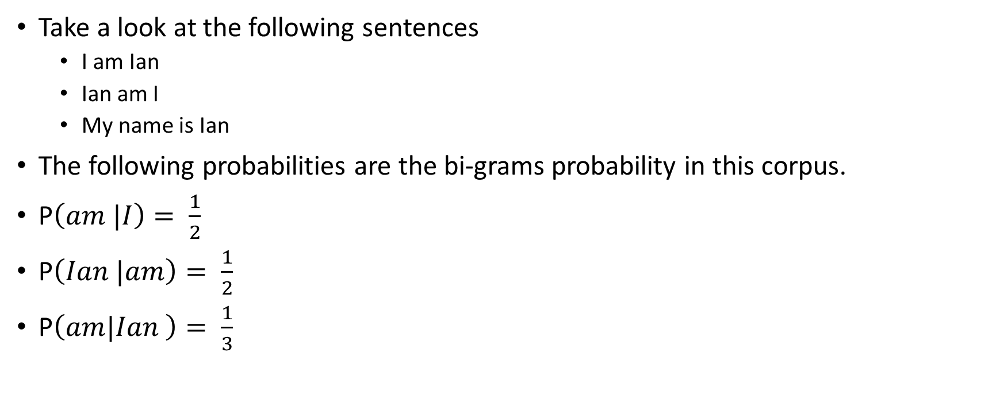
N-Grams: Example
Take a look at the following sentences
I am Ian
Ian am I
My name is Ian
The following probabilities are the bi-grams probability in this corpus.
P$\left(am |I\right)= \frac{1}{2}$
P$\left(Ian |am\right)= \frac{1}{2}$
P$\left(am|Ian \right)= \frac{1}{3}$
Apparently, N-grams still make no sense about similarity.

Slide 11
Introduction to Word Vector

Slide 12
Previous Work
Downside of Previous Model
computational costly
E.g.: NNLM contains
feedforward neural network with a linear projection layer
non-linear hidden layer

Slide 13
Word2Vector Model (Mikolov et al.)
Bag-of-Words model (CBOW)
Continuous Skip-gram model

Slide 14
Complexity of Word Vector

Slide 15
Complexity Notation
The following model’s complexity will be represented as follow.
O = E * T * Q
where E is the number of training epoch, usually 3 - 50, T is the number of words, usually 1billion and Q will be defined depending on the further model.

Slide 16
Complexity of NNLM
NNLM is a language model that consists of input, projection, hidden and output layer. Given the N previous words, it will predict the next word.
Complexity of Projection Layer
N * D, where N is the number of previous words and D is its dimension.
Complexity of Hidden Layer
N * D * H, where N*D is from input layer and H is from Hidden layer.
Complexity of Output Layer
H * V, where H is the number of hidden layer and V is the size of all vocabulary.
Thus, its complexity, in total, is Q = N * D + N * D * H + H * V

Slide 17
CBOW
CBOW Model
Is similar to NNLM
Predicts future words based on given history words
Is also similar to bag-of words model
However: heaviest layer hidden layer in NNLM is removed
Therefore: Its projection layer is shared with all words
Complexity of CBOW
Q = N * D + D * V

Slide 18
Skip-Gram
Skip-Gram model
Is opposite from the CBOW.
Predicts the context based on given word
Complexity of Skip-Gram
Q = C * ( D + D * V), where C is the distance of the word. The size of C is double because it consists of size from history and future.

Slide 19
Complexity: Binary Tree Representation
Complexity of Binary Tree
log(n)
Therefore: the complexity of representing vocabulary as binary tree is log(v)
However: hierarchical Softmax is required instead of Softmax.

Slide 20
Algorithm of CBOW and Skip-Gram

Slide 21
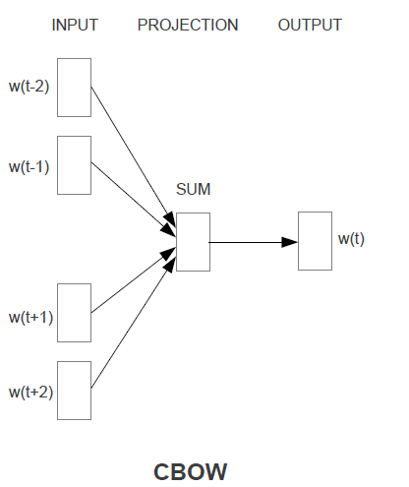
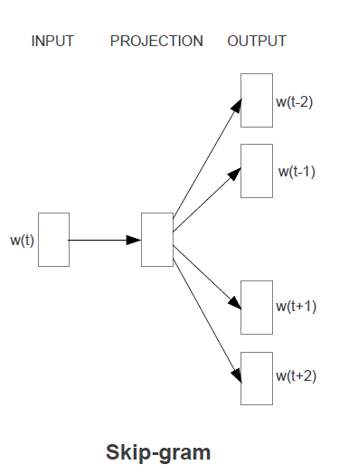
Architecture of CBOW and Skip-Gram

Slide 22
CBOW

Slide 23
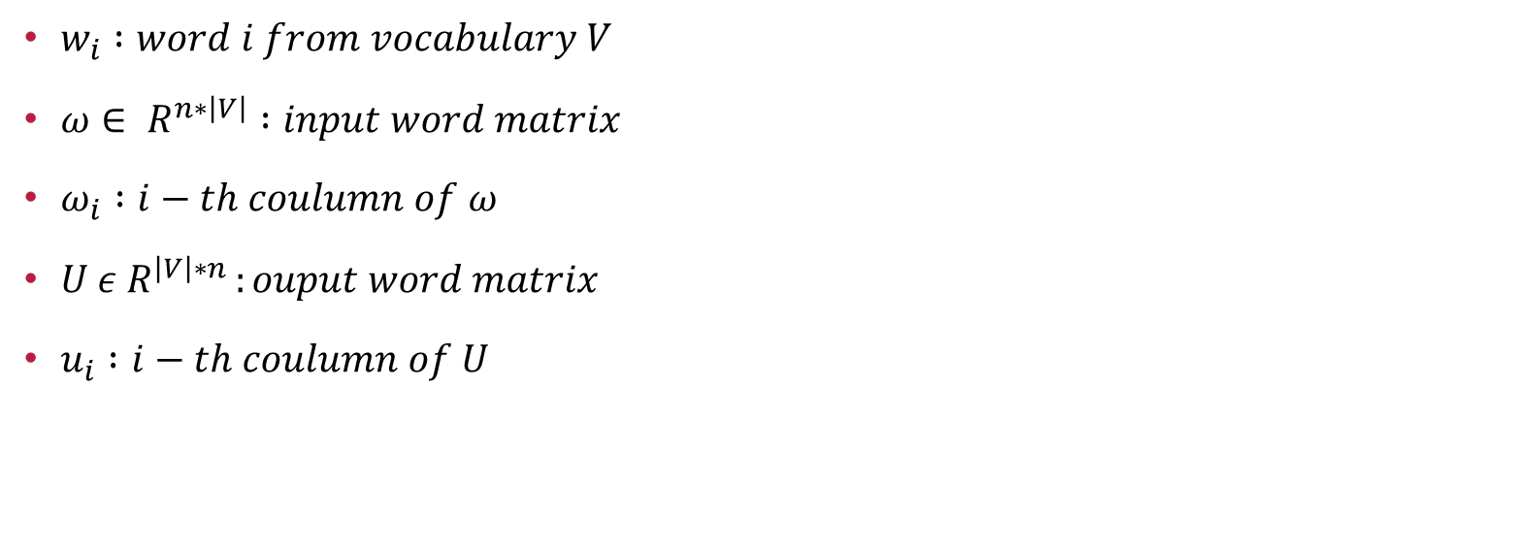
Notation for Algorithm
$w_{i} :word i from vocabulary V$
$ω∈ R^{n∗\left|V\right|} :input word matrix$
$ω_{i} :i−th coulumn of ω$
$U ε R^{\left|V\right|∗n }:ouput word matrix$
$u_{i} :i−th coulumn of U$

Slide 24
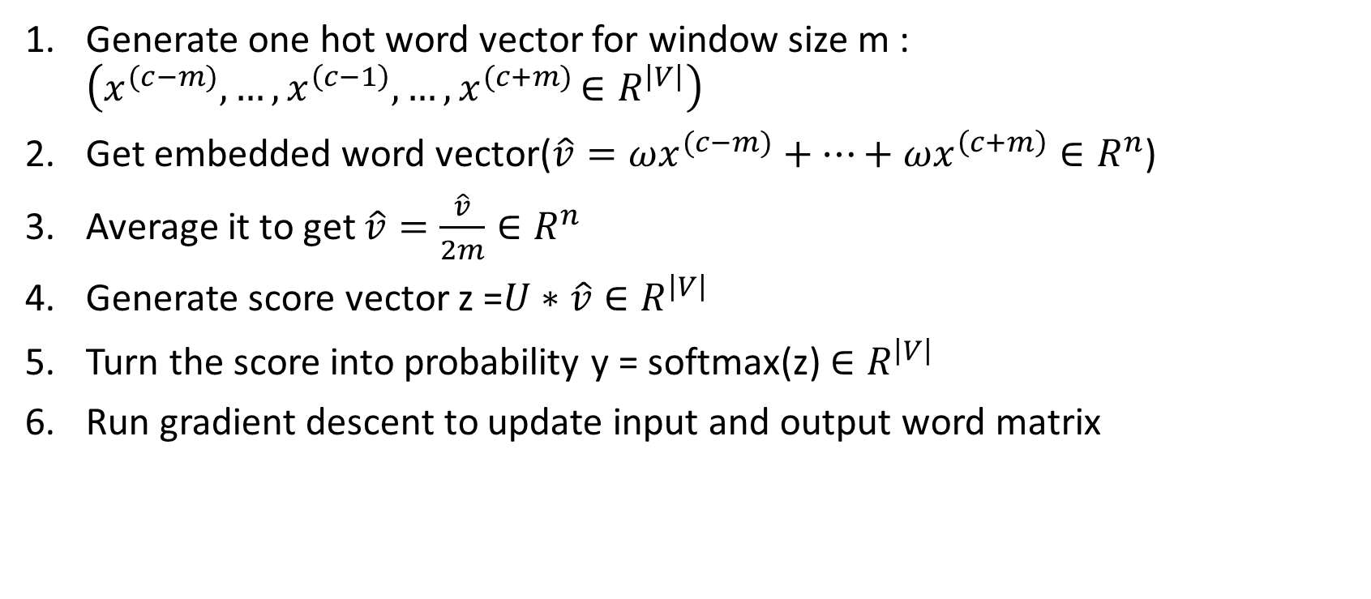
Algorithm of CBOW
Generate one hot word vector for window size m : $\left(x^{(c−m)},…,x^{\left(c−1\right)},…{,x}^{(c+m)}∈R^{\left|V\right|}\right)$
Get embedded word vector$\text{(}\hat{v}=ωx^{(c−m)}+…+ωx^{\left(c+m\right)}∈R^{n}$)
Average it to get $\hat{v}=\frac{\hat{v}}{2m}∈R^{n}$
Generate score vector z =$U∗\hat{v}∈R^{\left|V\right|}$
Turn the score into probability y = softmax(z)${∈R}^{\left|V\right|}$
Run gradient descent to update input and output word matrix

Slide 25
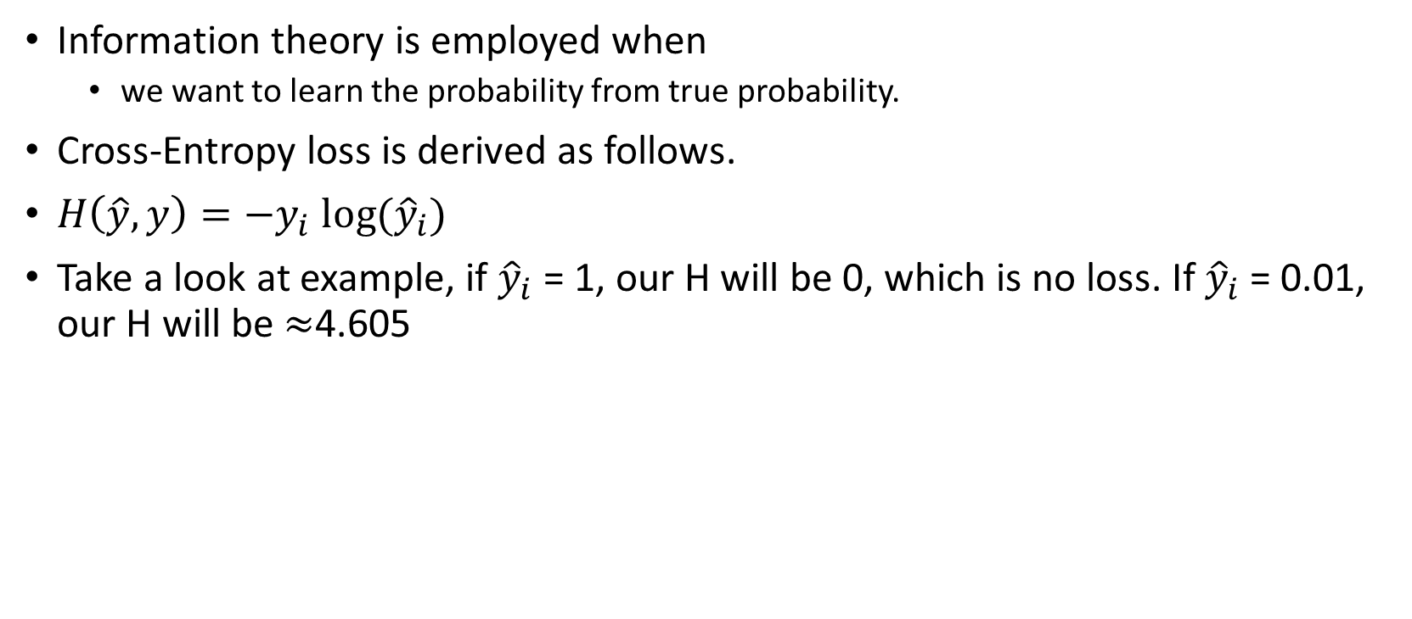
Update Input and Output Word Matrix
Information theory is employed when
we want to learn the probability from true probability.
Cross-Entropy loss is derived as follows.
$H\left(\hat{y},y\right)=−y_{i} log⁡({\hat{y}}_{i})$
Take a look at example, if ${\hat{y}}_{i}$ = 1, our H will be 0, which is no loss. If ${\hat{y}}_{i}$ = 0.01, our H will be $≈$4.605
Notes:
Log base e

Slide 26
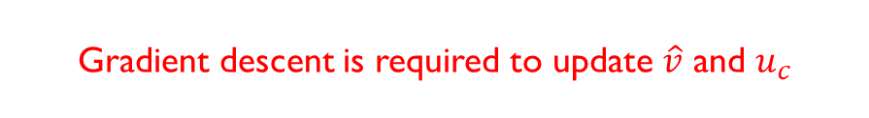

Update Input and Output Word Matrix (CONT.)
Thus, we need to minimize our cross-entropy.
Let J = $−\log{P(}w_{c}\left|w_{c−m},…,w_{c+m}\right)$
= $−logP(u_{c}|\hat{v})$
= $−log\frac{\exp\left(u_{c}^{T}\hat{v}\right)}{\sum_{j=1}^{\left|V\right|}{\exp\left(u_{j}^{T}\hat{v}\right)}}$
=${−u}_{c}^{T}\hat{v}+log⁡\left(\sum_{j=1}^{\left|V\right|}{\exp\left(u_{j}^{T}\hat{v}\right)}\right)$
Gradient descent is required to update $\hat{v}$ and $u_{c}$

Slide 27
Skip-Gram

Slide 28
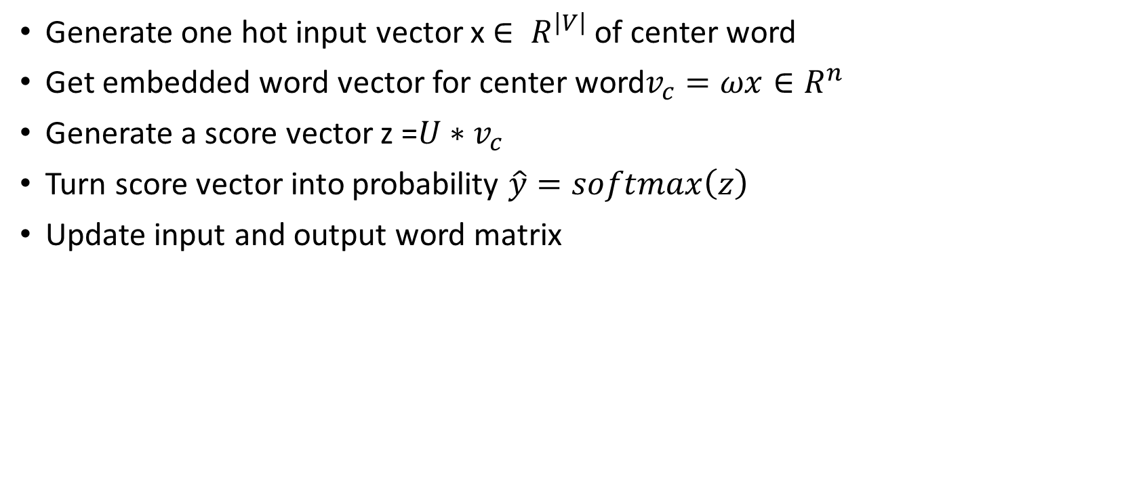
Algorithm of Skip-Gram
Generate one hot input vector x $∈ R^{\left|V\right|}$ of center word
Get embedded word vector for center word$v_{c}=ωx∈R^{n}$
Generate a score vector z =$U∗v_{c}$
Turn score vector into probability $\hat{y}=softmax\left(z\right)$
Update input and output word matrix

Slide 29
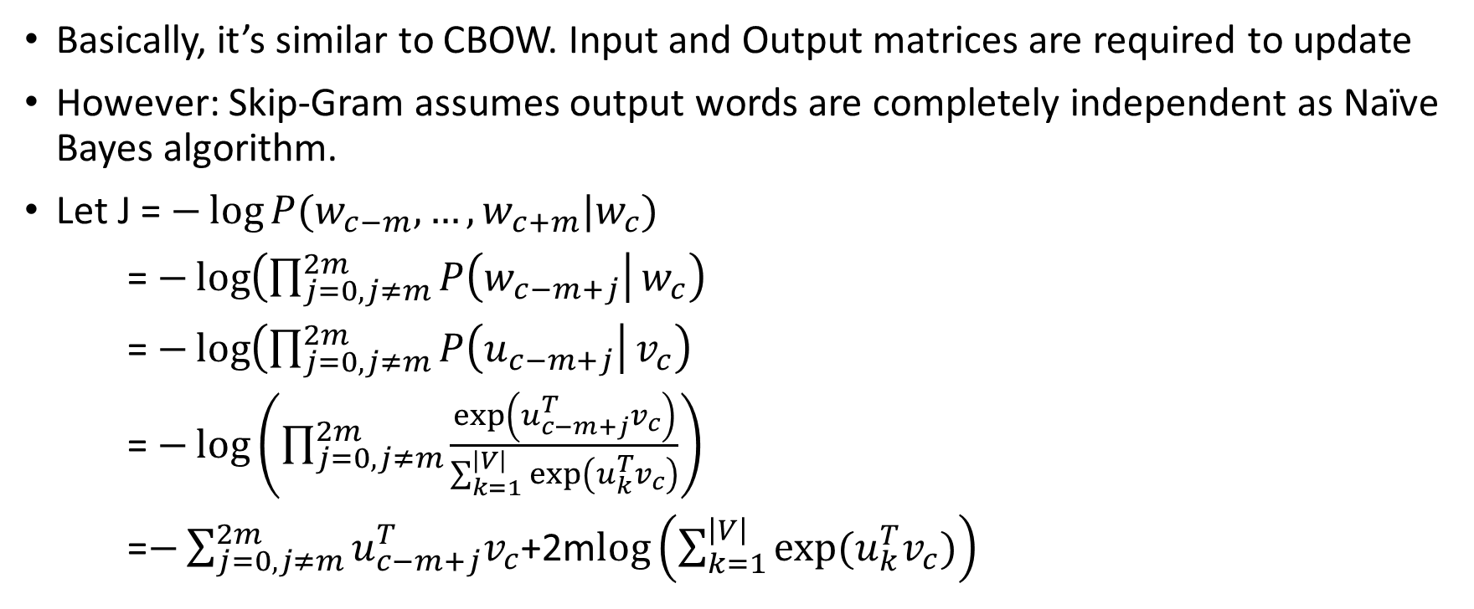
Algorithm of Skip-Gram (cont.)
Basically, it’s similar to CBOW. Input and Output matrices are required to update
However: Skip-Gram assumes output words are completely independent as Naïve Bayes algorithm.
Let J = $−\log{P(w_{c−m},…,w_{c+m}|w_{c}})$
= $−\log\left(\prod_{j=0,j≠m}^{2m}{P\left(w_{c−m+j}\right|}w_{c}\right)$
= $−\log\left(\prod_{j=0,j≠m}^{2m}{P\left(u_{c−m+j}\right|}v_{c}\right)$
= $−\log\left(\prod_{j=0,j≠m}^{2m}{\frac{\exp\left(u_{c−m+j}^{T}v_{c}\right)}{\sum_{k=1}^{\left|V\right|}{\exp\left(u_{k}^{T}v_{c}\right)}}}\right)$
=$−\sum_{j=0,j≠m}^{2m}{u_{c−m+j}^{T}v_{c}}$+2m$log\left(\sum_{k=1}^{\left|V\right|}{exp⁡(u_{k}^{T}v_{c})}\right)$

Slide 30
Negative Sampling

Slide 31

Introduction
Disadvantage of Softmax
Computational Costly
Reason: takes $O\left(\left|V\right|\right)$ time
Negative Sampling
Only needs to loop over noise distribution
Is based on skip-gram model

Slide 32

Objective Function
Let’s denote $\left(w,c\right)$ to word and context, $P\left(D=1|w,c\right)$ to the probability that (w, c) comes from corpus data, and $P\left(D=0|w,c\right)$ vice versa. Therefore, we can model $P\left(D=1|w,c\right)$ with sigmoid function as follows.
$P\left(D=1|w,c,θ\right)=σ\left(v_{c}^{T}v_{w}\right)=\frac{1}{1+e^{−(v_{c}^{T}v_{w})}}$

Slide 33
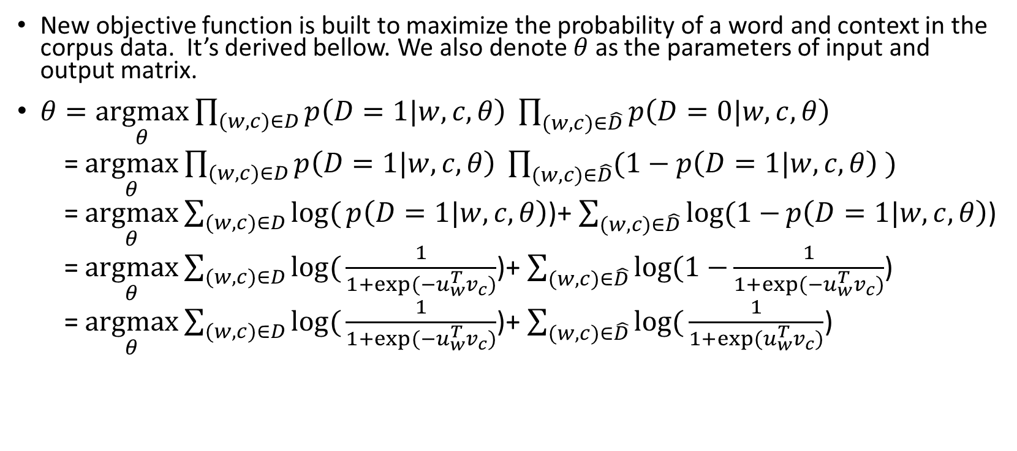
Objective Function (CONT.)
New objective function is built to maximize the probability of a word and context in the corpus data. It’s derived bellow. We also denote $θ$ as the parameters of input and output matrix.
$θ=\underset{θ}{argmax}{\prod_{(w,c)∈D}{p\left(D=1|w,c,θ\right) }\prod_{(w,c)∈\hat{D}}{p\left(D=0|w,c,θ\right) }}$
= $\underset{θ}{argmax}{\prod_{(w,c)∈D}{p\left(D=1|w,c,θ\right) }\prod_{(w,c)∈\hat{D}}{(1−p\left(D=1|w,c,θ\right) )}}$
= $\underset{θ}{argmax}{\sum_{(w,c)∈D}{log⁡(}}p\left(D=1|w,c,θ\right)$)+ $\sum_{(w,c)∈\hat{D}}{log⁡(1−}p\left(D=1|w,c,θ\right)$)
= $\underset{θ}{argmax}{\sum_{(w,c)∈D}{log⁡(}}\frac{1}{1+exp⁡(−u_{w}^{T}v_{c})}$)+ $\sum_{(w,c)∈\hat{D}}{log⁡(1−}\frac{1}{1+exp⁡(−u_{w}^{T}v_{c})}$)
= $\underset{θ}{argmax}{\sum_{(w,c)∈D}{log⁡(}}\frac{1}{1+exp⁡(−u_{w}^{T}v_{c})}$)+ $\sum_{(w,c)∈\hat{D}}{log⁡(}\frac{1}{1+exp⁡(u_{w}^{T}v_{c})}$)

Slide 34

Objective Function (CONT.)
Because maximizing log likelihood is the same as minimizing negative log likelihood, our function will be revised bellow.
$J=−\sum_{\left(w,c\right)∈D}{log⁡(}\frac{1}{1+\exp\left(−u_{w}^{T}v_{c}\right)}\text{)}−\sum_{\left(w,c\right)∈\hat{D}}{log⁡(}\frac{1}{1+\exp\left(u_{w}^{T}v_{c}\right)}) \hat{D} is a false corpus, where unnatural sentenses contain in this corpus.$ $\hat{D}$ can be generated by randomly sampling from word bank.

Slide 35
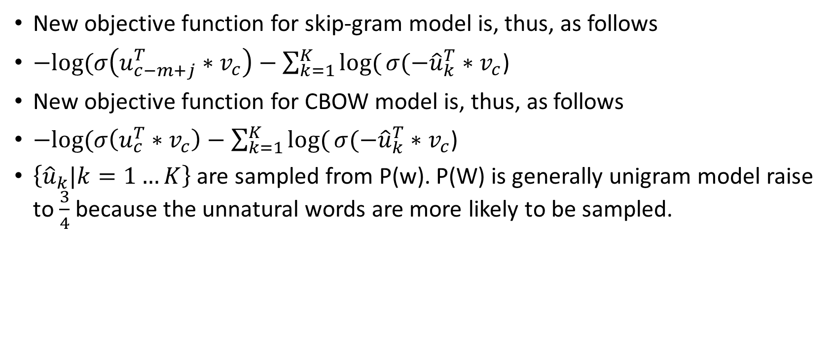
Objective Function (CONT.)
New objective function for skip-gram model is, thus, as follows
$−log⁡(σ\left(u_{c−m+j}^{T}∗v_{c}\right)−\sum_{k=1}^{K}{log⁡(}σ(−{\hat{u}}_{k}^{T}∗v_{c}$)
New objective function for CBOW model is, thus, as follows
$−log⁡(σ\left(u_{c}^{T}∗v_{c}\right)−\sum_{k=1}^{K}{log⁡(}σ(−{\hat{u}}_{k}^{T}∗v_{c}$)
$\left\{{\hat{u}}_{k}|k=1…K\right\}$are sampled from P(w). P(W) is generally unigram model raise to $\frac{3}{4}$because the unnatural words are more likely to be sampled.

Slide 36
Hierarchical Softmax

Slide 37
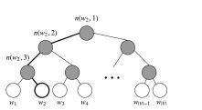
Introduction
Hierarchical softmx
represents all words as binary tree.
Each leaf is a word and each node is a vector that model is going to learn.
Advantage of using hierarchical softmax
Only cost O(log(V))
Disadvantage of using hierarchical softmax
Cannot be parallelized

Slide 38
Notation
L(w) : number of node from root to leaf w
n(w,i) : i-th node on the path
ch(i) : inner node n’s children

Slide 39
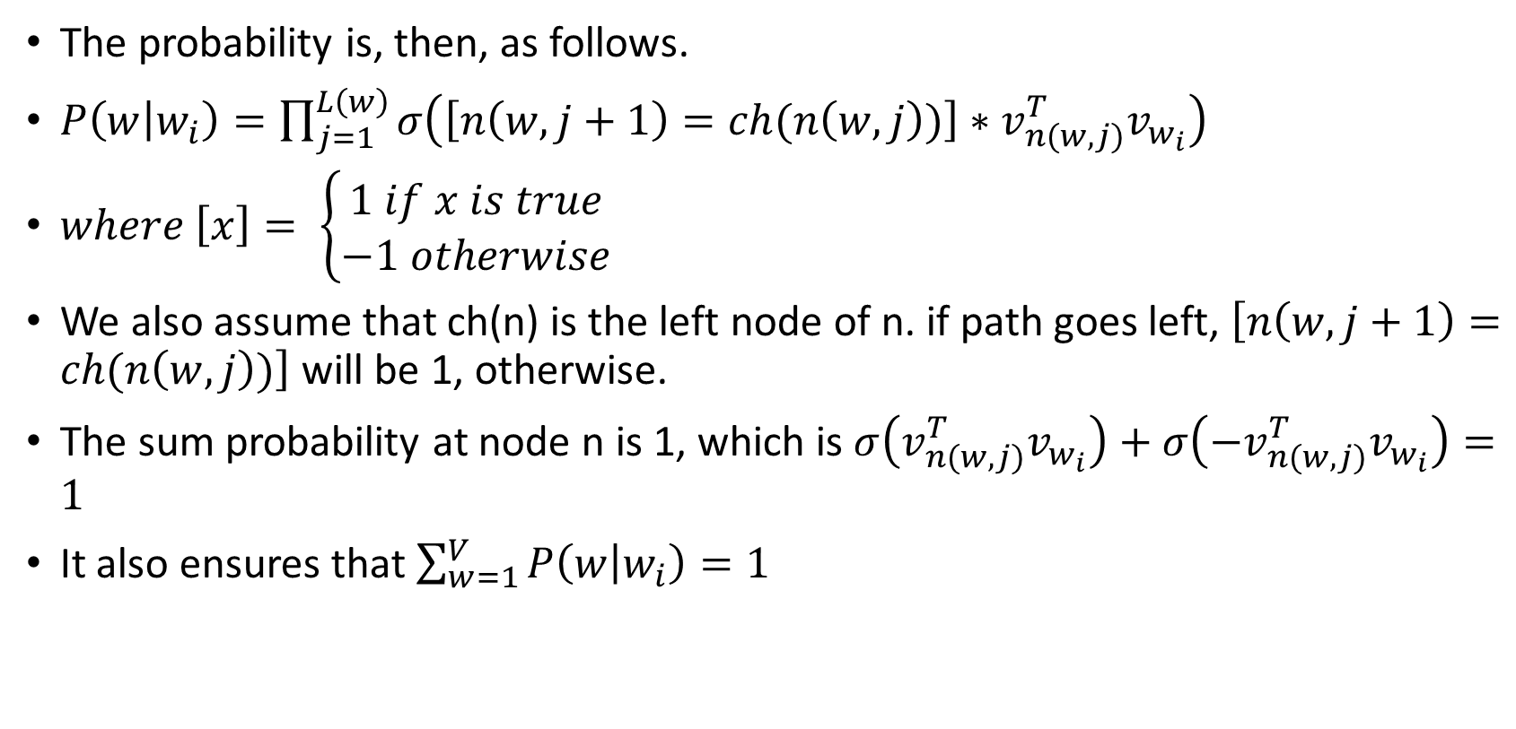
Probability Calculation
The probability is, then, as follows.
$P\left(w | w_{i}\right)=\prod_{j=1}^{L\left(w\right)}{σ\left(\left[n\left(w,j+1\right)=ch(n\left(w,j\right))\right]∗v_{n(w,j)}^{T}v_{w_{i}}\right)}$
$where \left[x\right]= \left\{\begin{aligned}1 if x is true \\ −1 otherwise\end{aligned}\right.$
We also assume that ch(n) is the left node of n. if path goes left, $\left[n\left(w,j+1\right)=ch(n\left(w,j\right))\right]$ will be 1, otherwise.
The sum probability at node n is 1, which is $σ\left(v_{n(w,j)}^{T}v_{w_{i}}\right)+σ\left(−v_{n(w,j)}^{T}v_{w_{i}}\right)=1$
It also ensures that $\sum_{w=1}^{V}{P\left(w | w_{i}\right)=1}$

Slide 40


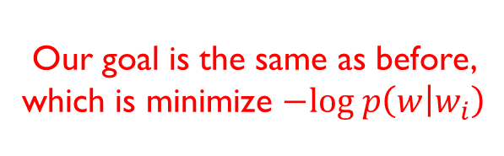
Example
take the graph bellow for example. The approach to calculate $p\left(w_{2} | w_{i}\right)$ is as follows.
$p\left(w_{2} | w_{i}\right)$ = $p\left(n\left(w_{2},1\right),left\right)∗p\left(n\left(w_{2},2\right),left\right)$ * $p\left(n\left(w_{2},3\right),right\right)$
= $σ\left(v_{n\left(w_{2},1\right)}^{T}v_{w_{i}}\right)∗σ\left(v_{n\left(w_{2},2\right)}^{T}v_{w_{i}}\right)$ *$σ\left(−v_{n\left(w_{2},3\right)}^{T}v_{w_{i}}\right)$
Our goal is the same as before, which is minimize $−log p\left(w | w_{i}\right)$

Slide 41
Practical Topics

Slide 42
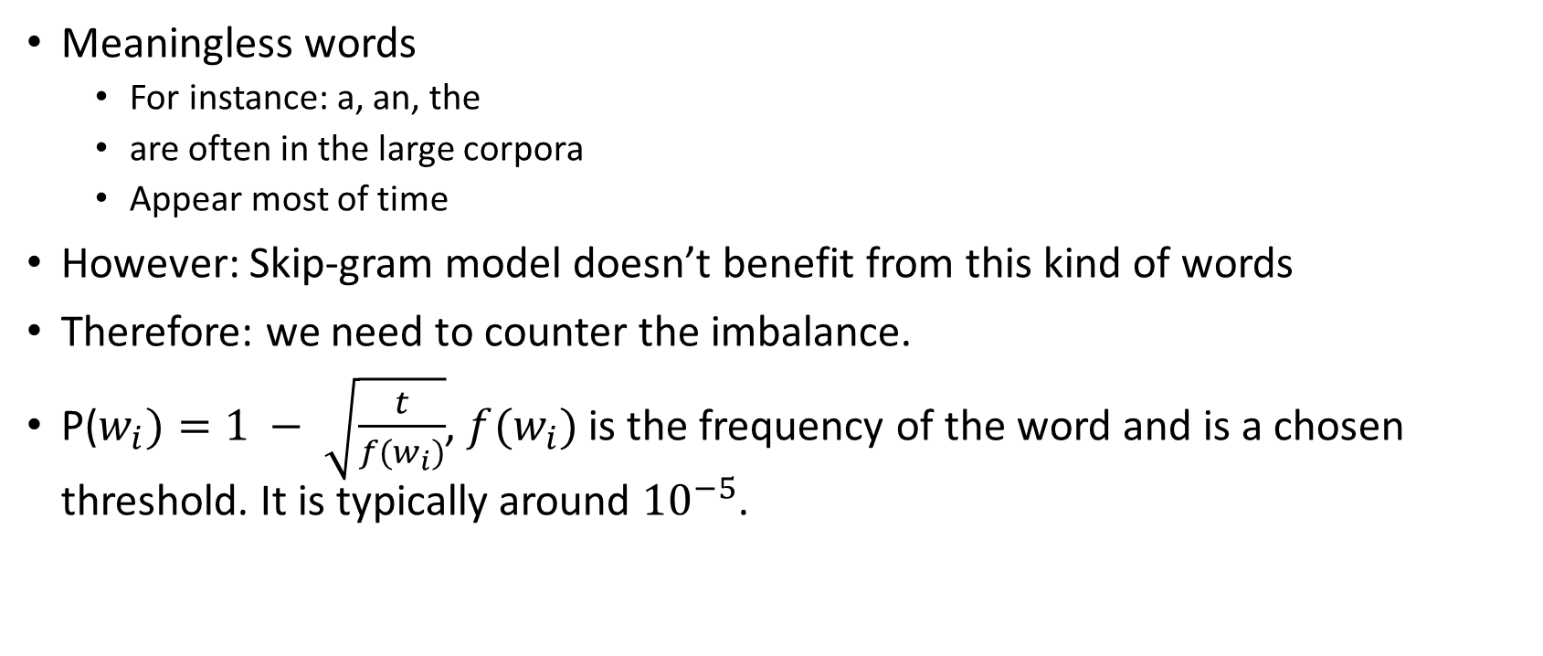
Subsampling of Frequent Words
Meaningless words
For instance: a, an, the
are often in the large corpora
Appear most of time
However: Skip-gram model doesn’t benefit from this kind of words
Therefore: we need to counter the imbalance.
P($w_{i})=1 − \sqrt{\frac{t}{f(w_{i})}}$, $f(w_{i})$ is the frequency of the word and is a chosen threshold. It is typically around ${10}^{−5}$.

Slide 43
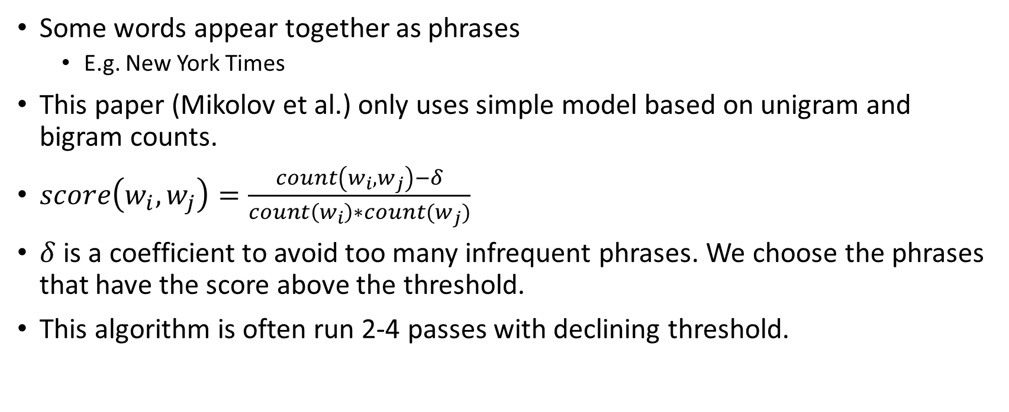
Learning Phrase
Some words appear together as phrases
E.g. New York Times
This paper (Mikolov et al.) only uses simple model based on unigram and bigram counts.
$score\left(w_{i},w_{j}\right)=\frac{count\left(w_{i},w_{j}\right)−δ}{count\left(w_{i}\right)∗count(w_{j})}$
$δ$ is a coefficient to avoid too many infrequent phrases. We choose the phrases that have the score above the threshold.
This algorithm is often run 2-4 passes with declining threshold.

Slide 44
Results

Slide 45
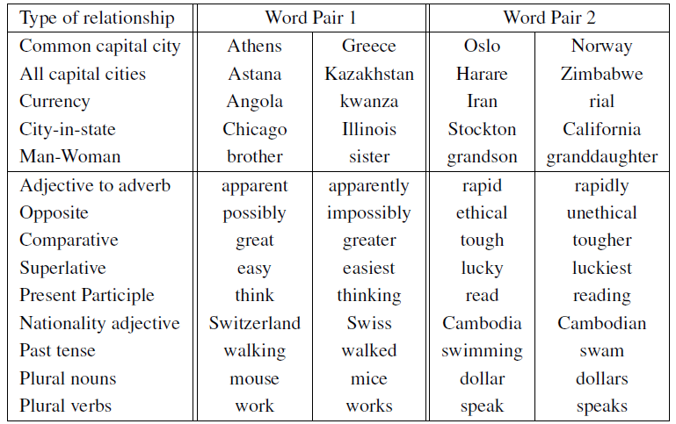
Examples of Semantic and Syntactic Test

Slide 46
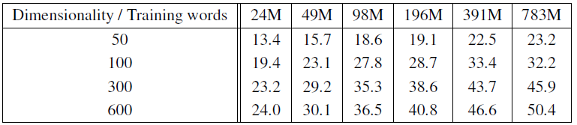
Accuracy on Semantic-Syntactic Word Relationship Test Set with CBOW
The much data and higher dimension we use to train model, The higher accuracy we get.

Slide 47
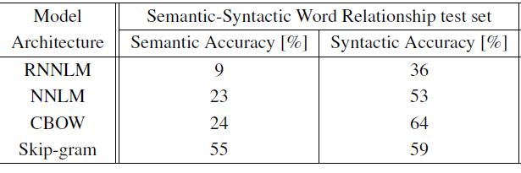
Comparison of Model Trained on Same Data, with 640-Dimensional Word Vectors

Slide 48
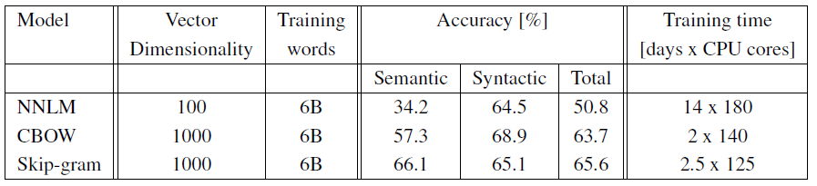
Comparison of Models Using Distbelied Distributed Framework
It takes too long to finishing training 1000 dimension on NNLM model.

Slide 49
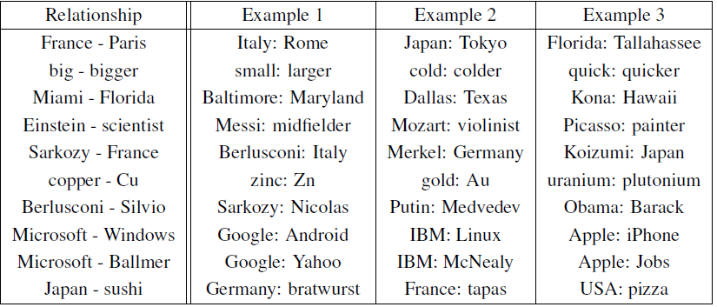
Example of Word Pair Relationships Using Best Skip-Gram Model
According to paper (Tomas Mikolov et al.), it only reaches 60% on accuracy, but it will be improved if we train on larger data sets.

Slide 50
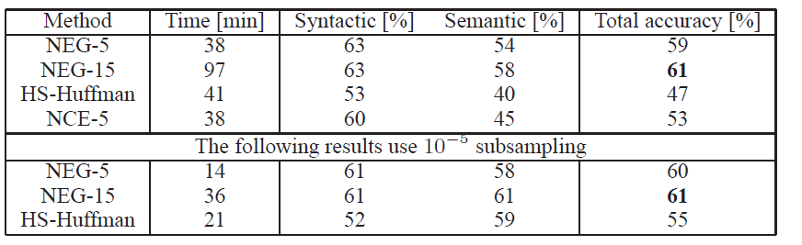
Accuracy of Various 300-Dimensional Skip-Gram Model
NEG-k means Negative Sampling with k negative samples.

Slide 51
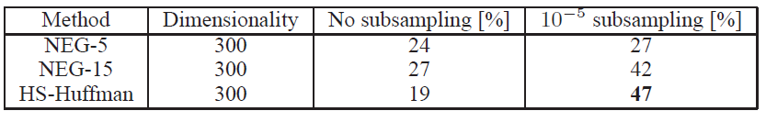
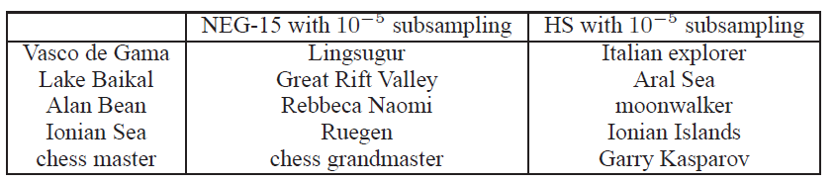
Accuracy of Skip-Gram Models on the Phrase Analogy Dataset
we got the lowest accuracy on HS-Huffman without subsampling, but we reached highest accuracy when we trained with subsampling.
This result reached 72% of accuracy.

Slide 52
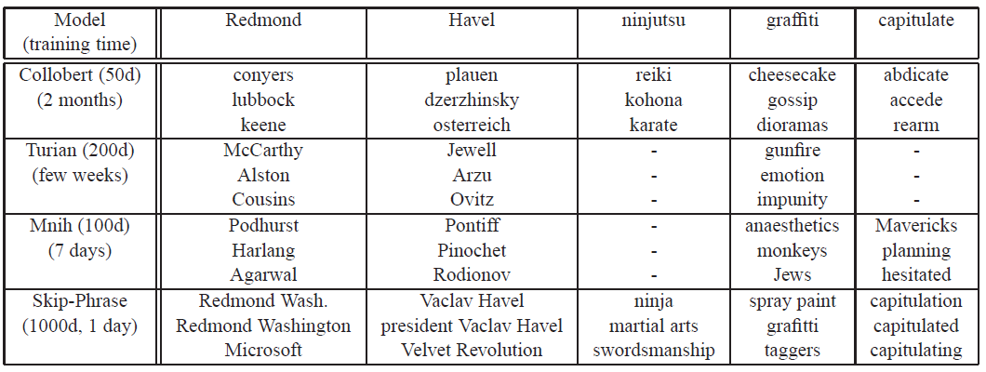
Comparison of Model with Previous Models
Empty means words was not in the vocabulary sets.

Slide 53
References
Mikolov et al., Efficient Estimation of Word Representations in Vector Space
Mikolov et al., Distributed Representation of Words and Phrases and their Compositionality
Manning et al., CS224N WordVector Lecture Note in Stanford University
Alex Minnaar Word2Vec Tutorial Part II: The Continuous Bag-of-Words Model
Jurafsky & Martin, Speech and Language Processing N-grams

