Slide 1
白血病醫學文件分類研究
報告人: 蘇佳益
指導老師: 陳聰毅
國立高雄科技大學建功校區電子工程系
https://github.com/chiayisu/Artificial_Intelligence_Course

Slide 2
Agenda
Introduction
Introduction to Database
Introduction to System
Overview of Dataset
Model Evaluation
Classification Algorithm
Reference

Slide 3
Introduction to Bioinformation
生物資訊所包含的範圍
病理影像
病例
醫學資料
本研究主要利用文本資料分類出白血病的類別

Slide 4
Introduction to the Categories in this Research
AML
ALL
CML
CLL
AML&ALL
AML&CML
ALL&CML
ALL&CLL，其中有四個為有相同的基因表示名稱，也就是說兩個類別有交集，所以將兩個結合成一個類別。在此研究中，分別比較三種演算法，Neural Network、Naïve Bayes、Decision Tree，並探討其效能。

Slide 5
Overview of Leukemia
什麼是白血病?
白血病種類
急性淋巴性白血病(ALL)
好發於小孩，成人約占20%，此類別有可以分成三型。
急性骨隨性白血病(AML)
好發於成年人，此疾病又可分為七型。
慢性淋巴性白血病(CLL)
常發生於50~55歲以上的老年人，此疾病又分為三型。
慢性骨隨性白血病(CML)
源自於造血細胞的一種惡性腫瘤，由於染色體的病變。
Notes:
https://wwwv.tsgh.ndmctsgh.edu.tw/unit/10021/19979

Slide 6
Introduction to Database

Slide 7
PubMed
PubMed 系統簡介
PubMed 查詢法則
自然語言搜尋
MeSH(Medical Subject Headings)
MeSH搜尋結果(以鳥(Bird)為例)
搜尋結果
現今有許多醫學研究都是採用此資料庫
Notes:
http://tul.blog.ntu.edu.tw/archives/7180

Slide 8
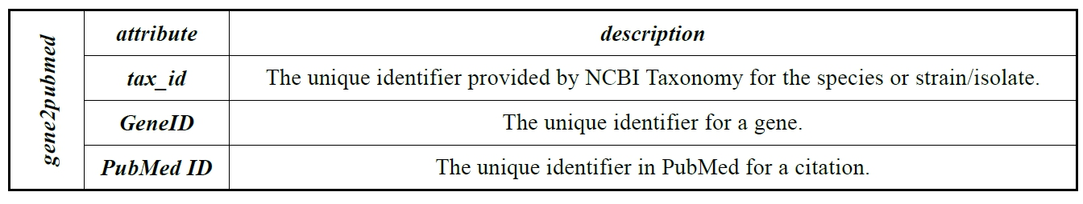
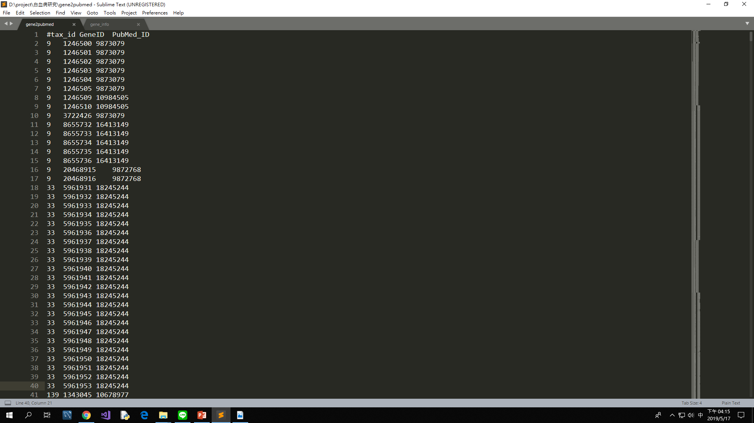
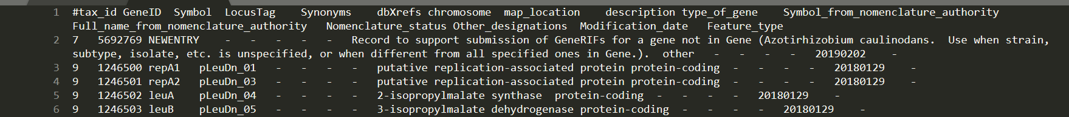
Entrez Gene
What is Entrez Gene?
可以找出與PubMed相對應的ID

Slide 9
Cancer Gene Census
What is Cancer Gene Census?
此研究採用此資料集及Entrez Gene 所提供的gene2pubmed來做特徵選取

Slide 10
Introduction to System

Slide 11
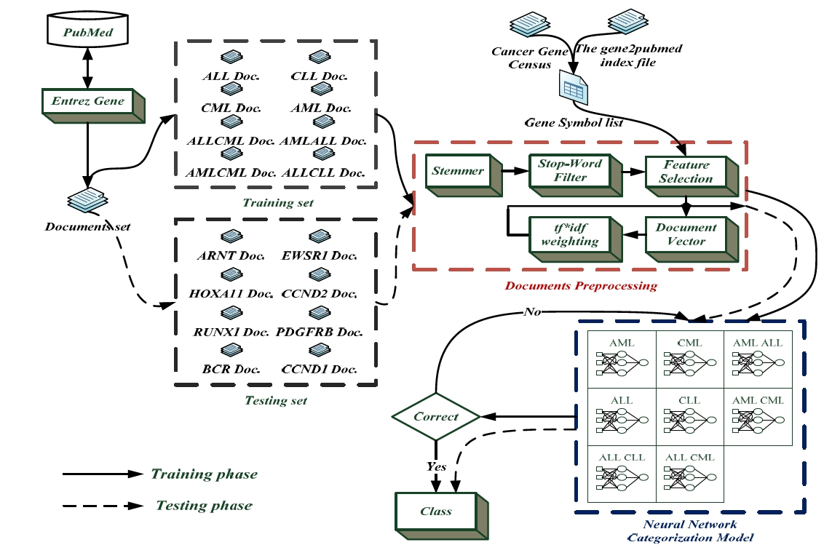
System Architecture

Slide 12
Stemmer
What is Stemmer?
Problem?
The difference between Stemmer and Lemmatization?

Slide 13
Feature Selection
從gene2pubmed 及 Cancer Gene Census 中建立基因表示名稱 並各自建立一個list。
將文件進行編碼並進行統計分析
將基因名稱的list做成參考依據。

Slide 14
Architecture of Feature Selection

Slide 15
Overview of Dataset

Slide 16
Genetic Type List – Single Type

Slide 17
Genetic Type List – Combination

Slide 18
Crude Dataset
quantity of label Documents
quantify of genetic documents
How to deal with this data?

Slide 19
Normalized Dataset
quantity of label documents
quantity of genetic documents

Slide 20
Model Evaluation

Slide 21
Parameters for Evaluation
True Positive(TP) –The ground-truth value is true and the predicted value is true as well.
False Positive(FP) – The ground-truth value is false and the predicted value is true as well.
True Negative(TN) – The ground-truth value is false and the predicted value is false as well.
False Negative(FN) – The ground-truth value is true and the predicted value is false as well.

Slide 22
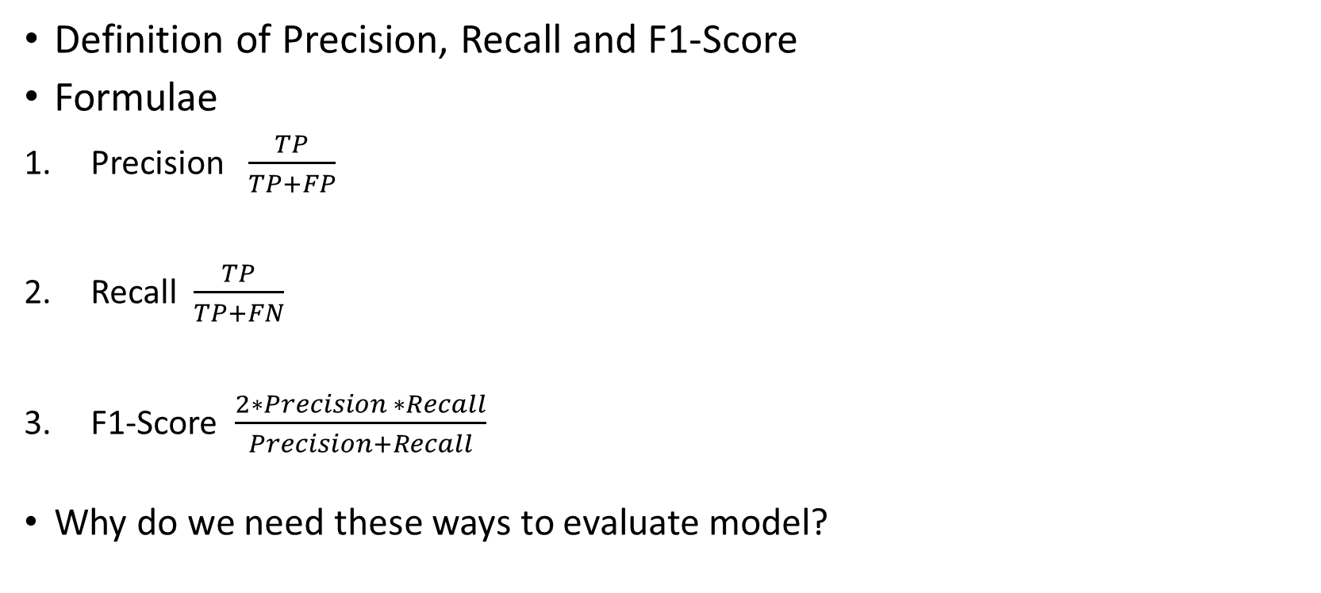
Evaluation Methods
Definition of Precision, Recall and F1-Score
Formulae
Precision $\frac{TP}{TP+FP}$
Recall $\frac{TP}{TP+FN}$
F1-Score $\frac{2∗Precision ∗Recall}{Precision+Recall}$
Why do we need these ways to evaluate model?

Slide 23
Result of the Best Performance

Slide 24
F1-Score in Different TF-IDF

Slide 25
Classification Algorithms

Slide 26
Decision Tree

Slide 27
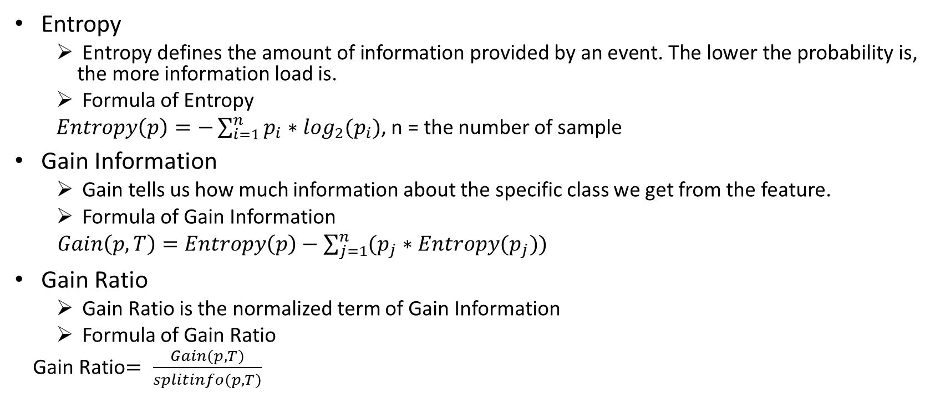
Information Theory
Entropy
Entropy defines the amount of information provided by an event. The lower the probability is, the more information load is.
Formula of Entropy
$Entropy\left(p\right)=−\sum_{i=1}^{n}{p_{i}∗\log_{2}(p_{i})}$, n = the number of sample
Gain Information
Gain tells us how much information about the specific class we get from the feature.
Formula of Gain Information
$Gain\left(p, T\right)=Entropy\left(p\right)−\sum_{j=1}^{n}{(p_{j}∗Entropy(p_{j}))}$
Gain Ratio
Gain Ratio is the normalized term of Gain Information
Formula of Gain Ratio
Gain Ratio$= \frac{Gain(p,T)}{splitinfo(p, T)}$

Slide 28
ID3 Algorithm - Introduction
ID3 is used to construct tree based on information gain.
Suppose we want to classify “whether we should play ball or not”

Slide 29
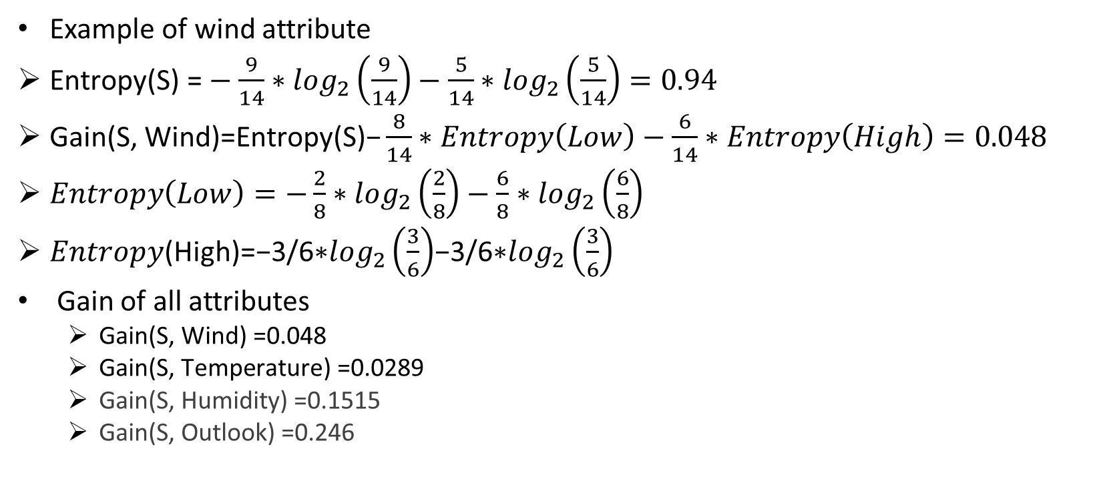
ID3 Algorithm – Example
Example of wind attribute
$\text{Entropy}\text{(}\text{S}\text{) =}−\frac{9}{14}∗\log_{2}\left(\frac{9}{14}\right)−\frac{5}{14}∗\log_{2}\left(\frac{5}{14}\right)=0.94$
$\text{Gain}\text{(}\text{S}\text{, }\text{Wind}\text{)=}\text{Entropy}\text{(}\text{S}\text{)−}\frac{8}{14}∗Entropy\left(Low\right)−\frac{6}{14}∗Entropy\left(High\right)=0.048$
$Entropy\left(Low\right)=−\frac{2}{8}∗\log_{2}\left(\frac{2}{8}\right)−\frac{6}{8}∗\log_{2}\left(\frac{6}{8}\right)$
𝐸𝑛𝑡𝑟𝑜𝑝𝑦(High)=−3/6∗$\log_{2}\left(\frac{3}{6}\right)$−3/6∗$\log_{2}\left(\frac{3}{6}\right)$
Gain of all attributes
$\text{Gain}\text{(}\text{S}\text{, }\text{Wind}\text{) =0.048}$
$\text{Gain}\text{(}\text{S}\text{, }\text{Temperature}\text{) =0.0289}$
$\text{Gain}\text{(}\text{S}\text{, }\text{Humidity}\text{) =0.1515}$
$\text{Gain}\text{(}\text{S}\text{, }\text{Outlook}\text{) =0.246}$
the most largest one

Slide 30
ID3 Algorithm – Result

Slide 31
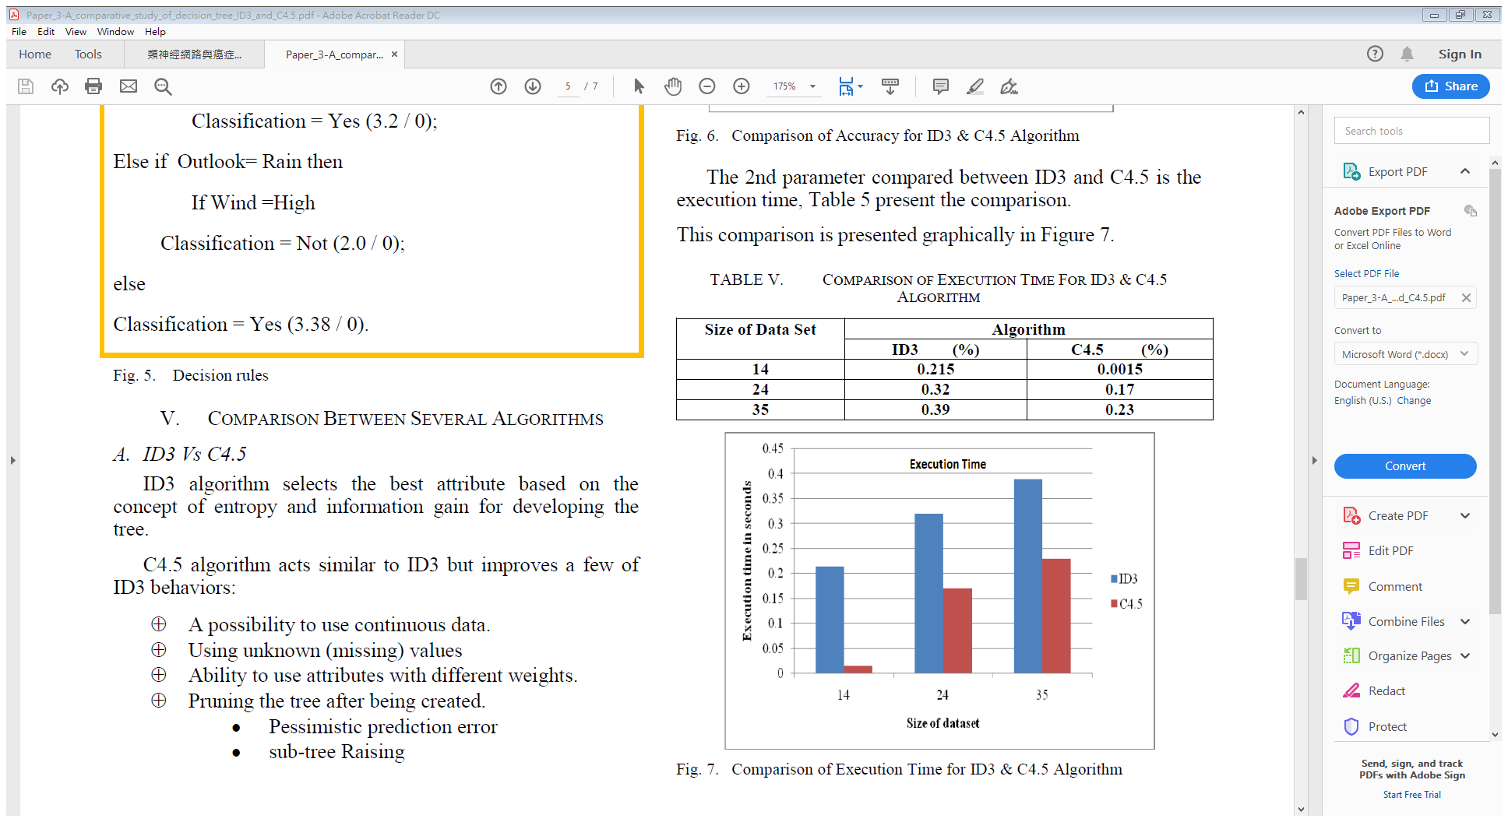
C4.5 Algorithm - Introduction
C4.5 has some improvements on ID3. C4.5 also employs Gain Ratio instead of Gain.
Advantages of C4.5 Algorithm
unknown value
values on continuous interval
reducing overfitting
more accurate and efficient while comparing with ID3

Slide 32
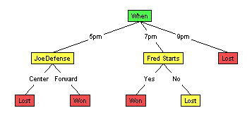
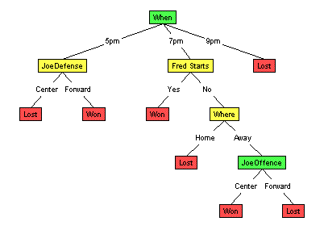
C4.5 Algorithm - Pruning
Pruning is a technique to reduce our tree for avoiding “overfitting”.
Reduced Error Pruning
suppose we have higher accuracy than unpruned tree
it still has many ways to prune our tree. We just easily introduce one way.

Slide 33
Application on Text Classification
Treating every keywords as our attribute
Quantilizing our data e.g. TF, TF-IDF
Calculating the values that we need for decision tree

Slide 34
Naïve Bayes
Based on Bayes Theory
Having i.i.d. assumption
However: It is hard to satisfy this assumption in the real data.
Naïve Bayes still performs very well.
We will discuss Naïve Bayes by using text classification problem.

Slide 35

Posterior Probability
Determining the probability that the sentence belongs which class given a set of words
Formula
$posterior prob\text{ability}\text{ =}$ $\frac{(conditional probability)∗(prior probability)}{evidence}$ $α$ $(conditional prob. )∗(prior prob.$)

Slide 36
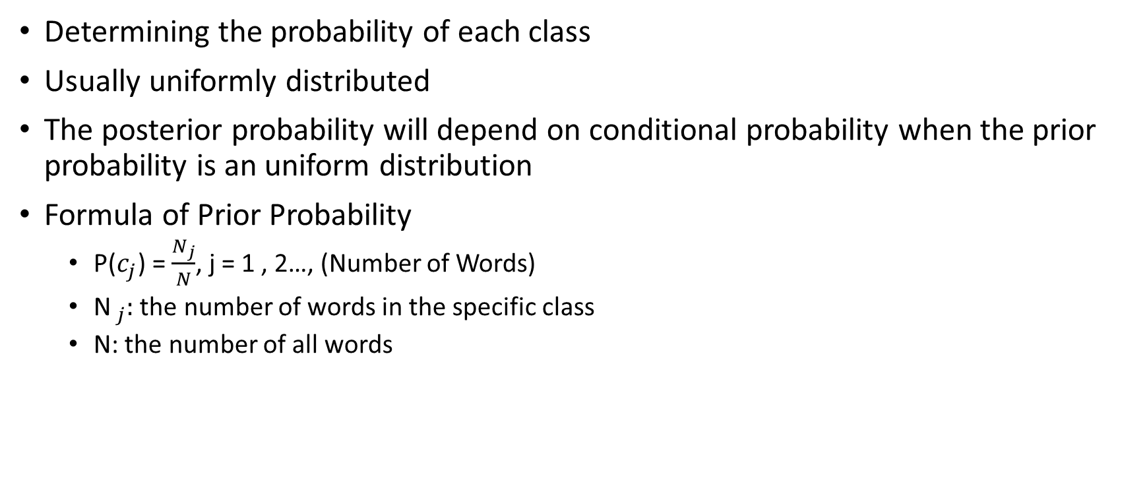
Prior Probability
Determining the probability of each class
Usually uniformly distributed
The posterior probability will depend on conditional probability when the prior probability is an uniform distribution
Formula of Prior Probability
P($c_{j}$) = $\frac{N_{j}}{N}$, j = 1 , 2…, (Number of Words)
${\text{N} }_{j}:$ the number of words in the specific class
N: the number of all words

Slide 37
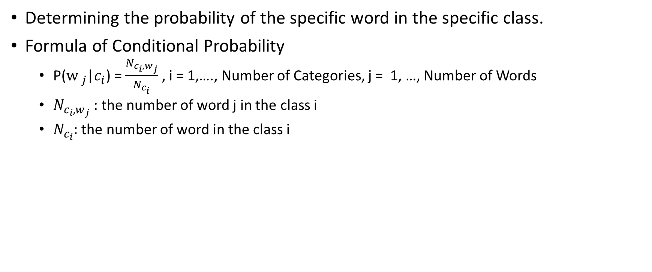
Conditional Probability
Determining the probability of the specific word in the specific class.
Formula of Conditional Probability
P(${\text{w} }_{j}$|$c_{i}$) = $\frac{N_{c_{i},w_{j}}}{N_{c_{i}}}$ , i = 1,…., Number of Categories, j = 1, …, Number of Words
$N_{c_{i},w_{j}}$ : the number of word j in the class i
$N_{c_{i}}:$ the number of word in the class i

Slide 38
Naïve Bayes: Practical Discussion
Problem: The posterior probability will be 0 when the specific word does not appear in the specific class.
Resolution: In order to prevent this situation, we will add smoothing term.
Problem: too many digits after decimal point
Resolution: Using log probability

Slide 39
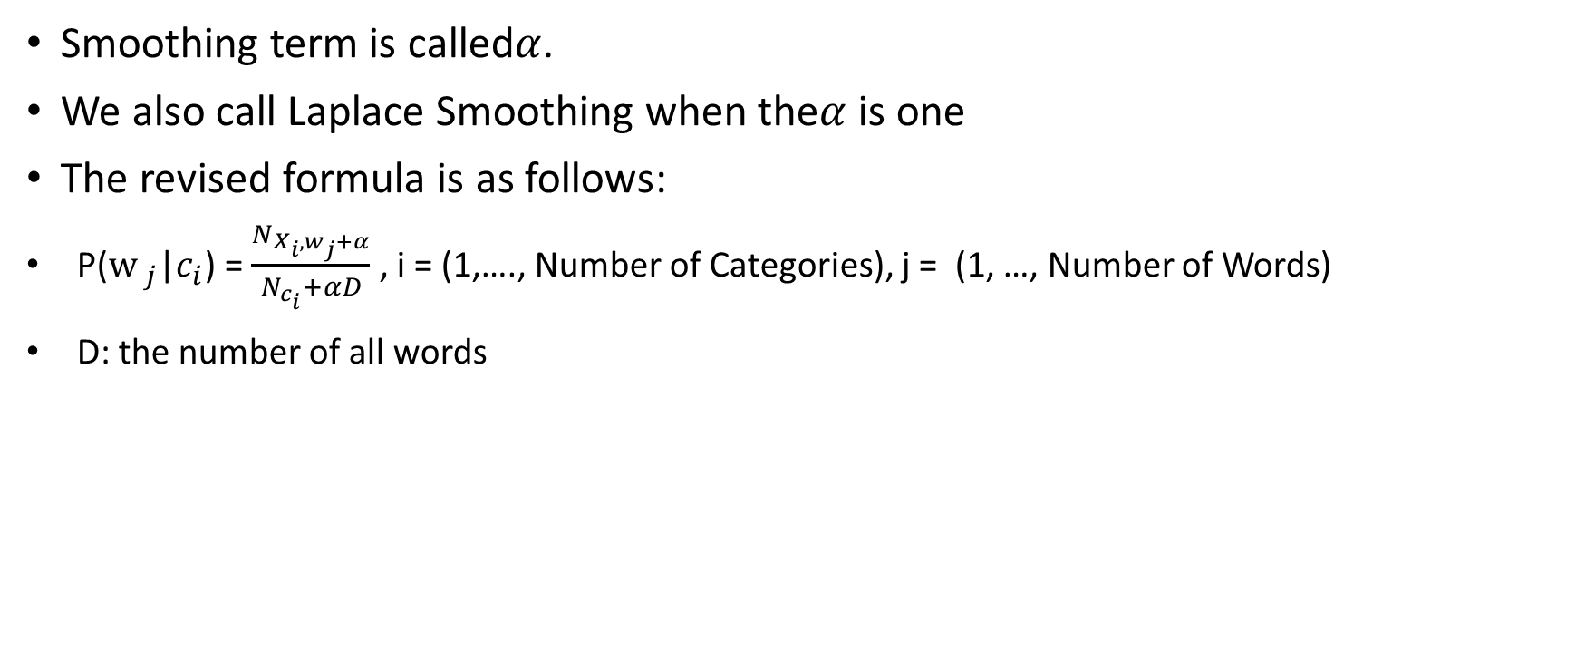
Naïve Bayes: Additive Smoothing
Smoothing term is called$α$.
We also call Laplace Smoothing when the$α$ is one
The revised formula is as follows:
P(${\text{w} }_{j}$|$c_{i}$) = $\frac{N_{X_{i},w_{j}+α}}{N_{c_{i}}+αD}$ , i = (1,…., Number of Categories), j = (1, …, Number of Words)
D: the number of all words

Slide 40
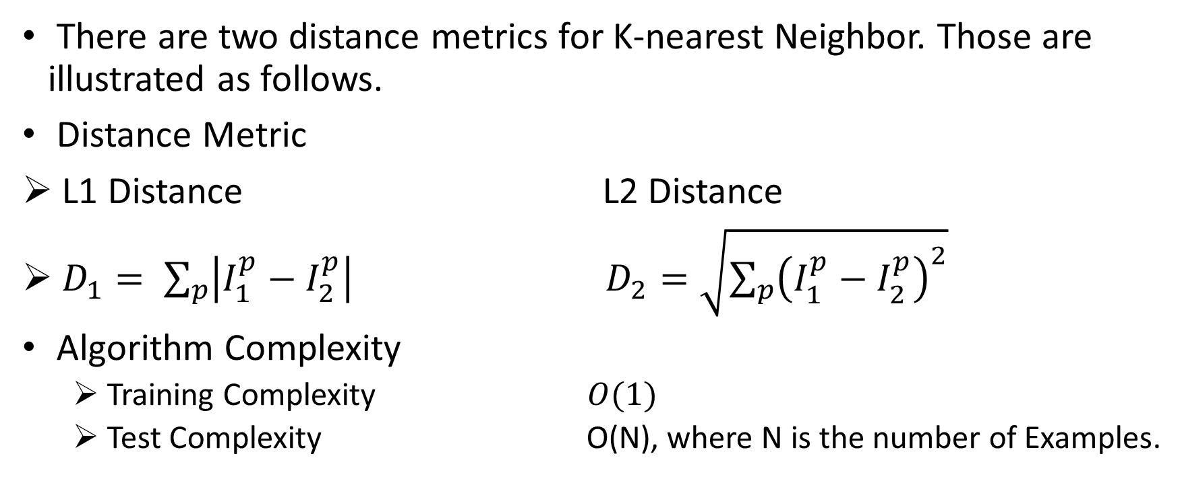
K-nearest Neighbor – Distance Metric
There are two distance metrics for K-nearest Neighbor. Those are illustrated as follows.
Distance Metric
L1 Distance L2 Distance
$D_{1}= \sum_{p}{\left|I_{1}^{p}−I_{2}^{p}\right|}$ $D_{2}=\sqrt{\sum_{p}{{\left(I_{1}^{p}−I_{2}^{p}\right)}^{2}}}$
Algorithm Complexity
Training Complexity $O(1)$
Test Complexity O(N), where N is the number of Examples.

Slide 41
K-nearest Neighbor (CONT.)
Steps of KNN
Store Data
Calculate Distance Metric
Find k nearest neighbor
Find the label that appears the most

Slide 42
Experimental Result

Slide 43
References
李俊宏, 類神經網路與癌症基因統計資訊應用於醫學文件分類研究
Badr HSSINA et al., A comparative study of decision tree ID3 and C4.5
Raschka , Naive Bayes and Text Classification I Introduction and Theory
CS231n: Convolutional Neural Networks for Visual Recognition, Stanford University
Machine Learning Crash Course, Google
Decision Tree Puning
白血病簡介
PubMed
PubMed 規則
Entrez 資料

