Slide 1
Introduction to NLP and Its Applications
Speaker: 蘇佳益
Advisor: 陳聰毅
國立高雄科技大學建工校區電子工程系
https://github.com/chiayisu/Artificial_Intelligence_Course

Slide 2
Agenda
Natural Language Processing
Discussion on Practical Problems
Introduction to Dialog System
Regular Expression
Introduction to API
Reference

Slide 3
Natural Language Processing

Slide 4
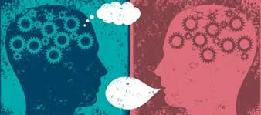
What is NLP?

Slide 5
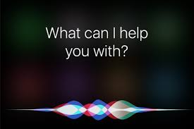
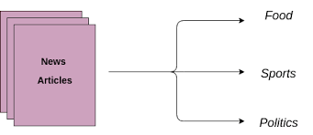
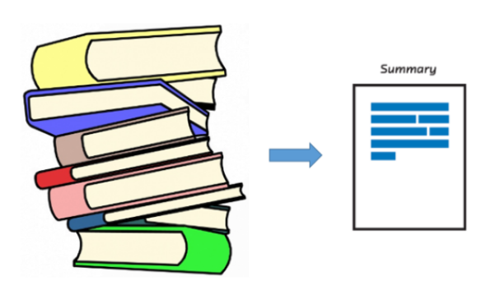


Applications of Natural Language Processing

Slide 6
Evolution of Natural Language Processing
Count-Based Model
Word Representation
Contextual Representation

Slide 7



Evolution of Natural Language Processing
TF & TF-IDF | Co-Matrix | Word2Vec | GPT | BERT | GPT-2 | GPT-3
 |  | Mikolov et al., 2013. | Radford et al., 2018. | Devlin et al., 2018 | Radford et al., 2019 | Brown et al., 2020
Contextual Representation (Transformer)
Word Representation
Statistical Model

Slide 8
Why is NLP hard?
Ambiguity of Natural Language
Polysemy
Formal and Informal Language
Writing Taiwanese in the Chinese Language
SMS Language
Evolution of Language
Difference in Structure
Following the grammar V.S. Not following the grammar

Slide 9
Why is NLP hard? - Example
Ambiguity of Natural Language
88、98、白泡泡（台語：皮膚很白)、水噹噹
你真的是我們的老鼠屎耶!
Steph Curry發火起來可以在一場得40分，非常的強。
Difference in Structure
I am going to watch a movie. < - > I’m ganna watch a movie.
I want to watch a movie. < - > I wanna watch a movie.
https://cdn-images-1.medium.com/max/800/1*gmL2WA-hoXe8HokFZ9wXIA.gif

Slide 10
Corpora Introduction
Corpora
https://github.com/fighting41love/funNLP
https://github.com/InsaneLife/ChineseNLPCorpus
https://github.com/SophonPlus/ChineseNlpCorpus
https://github.com/brightmart/nlp_chinese_corpus
http://asbc.iis.sinica.edu.tw/ - 中研院
Google 自行搜尋
Stop Words
https://github.com/goto456/stopwords

Slide 11
Introduction to JSON
Similar to the dictionary in the programing language
JSON object contains key and value.
JSON Object
{“School”: “NKUST”, “Country” : ”Taiwan”}
JSON Array
{“School”: [“NKUST”, “NTU”], “Country” : ”Taiwan”}
JSON Introduction
https://www.json.org/json-en.html

Slide 12
中研院語料庫DEMO及重要參數說明
Collocation: 統計出與關鍵詞共同出現的機率，可以設定前後幾個字但必須包含關鍵詞以及最高上限為10個詞。
MI值: Mi值愈大表示與關鍵詞同時出現的機率越高
FREQ(x): 關鍵詞在整個語料庫中出現的次數
FREQ(y): 該詞在整個與料庫中出現的次數
FREQ(x,y): 關鍵詞和該詞在限定的範圍內所出現的次數
http://asbc.iis.sinica.edu.tw/
以上參數的重要嗎?

Slide 13
Flow of Natural Language Processing
Sentence Tokenization
Word Tokenization
Part-of-Speech
Text Lemmatize
Stop Word Processing
Encoding
Model Train
Prediction

Slide 14
Tokenization
簡單來說，斷詞是指將句子分成數個有意義的語詞，以便我們做後續的分析。
試著以電腦的角度來思考以下句子及問題
郭台銘創立了鴻海公司。
郭台銘 創立 了 鴻海 公司 。
請問郭台銘公司的名字?
斷詞就像是人在閱讀文章，絕對不是一次看一整篇，而是由詞開始然後理解一整段文章，進而理解這篇文章的意義。

Slide 15
Tokenization Tool for the Chinese Language
中研院斷詞系統
Jieba 斷詞系統

Slide 16
Part-of-Speech
將語詞的結果作詞性的標註
電腦在標註詞性絕對不是用人類的想法來標註。
我們可以經由詞性標註更清楚瞭解句子的意義，如同問你住哪裡，你絕對會去找名詞而不是動詞。
較複雜的自然語言處理問題也會先經過Part-of-Speech來塞選不重要的詞性。
Sequence Label

Slide 17
Text Lemmatize
主要用在英文
將每個意思相同但有變化的單字轉成最原始的單字。
E.g.: Went -> Go

Slide 18
Stop Word Processing
去除比較無意義、詞頻過高、標點符號等等來提升正確率。
停用字會隨著問題不同而增加或減少。
試想以下句子的停用字
欸~現在幾點呢?
我現在住高雄耶!

Slide 19
Term Frequency
計算出語料庫中每個語詞所出現的次數
為何要計算詞頻而不是將所出現的做編碼如0、1、2、就好?這樣不是可以減少運算?程式也更好寫不是嗎?
最近較常使用的方法為將語詞轉換成密度向量。

Slide 20

TF-IDF
Formula of TF-IDF
tf-idf = $tf ∗idf\left(t\right),$where tf is term frequency
idf(t) = $\log\left(\frac{nd}{nd\left(t\right)}\right)$, where nd = number of documents, nd(t) = number of documents that contain the term t

Slide 21
The Design and Implementation of XiaoIce, an Empathetic Social Chatbot
Zhou et al., Computational Linguistics, 2020.

Slide 22

Example: Singing

Slide 23
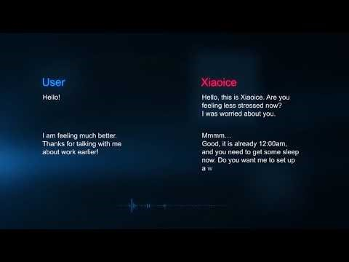
Example: Chat

Slide 24
Measuring Depression Symptom Severity from Spoken Language and 3D Facial Expressions
Haque et al., Arxiv, 2018.

Slide 25
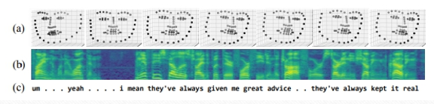
Method
Model
Word-Embedding
C-CNN

Slide 26
Google Assistance

Slide 27

Demonstration

Slide 28

Google Duplex

Slide 29
Recipes for building an open-domain chatbot
Roller et al., Arxiv, 2020.

Slide 30
Demonstration
https://ai.facebook.com/blog/state-of-the-art-open-source-chatbot/

Slide 31
Applications of the GPT-3 Model

Slide 32
HTML Layout Generation
https://twitter.com/i/status/1282676454690451457
Web Generation
https://twitter.com/jsngr/status/1287026808429383680?s=20
https://stripe.com/
Generate & Update the Graph
https://twitter.com/plotlygraphs/status/1286688715167936512
Others
https://github.com/elyase/awesome-gpt3

Slide 33
Introduction to Dialog System

Slide 34
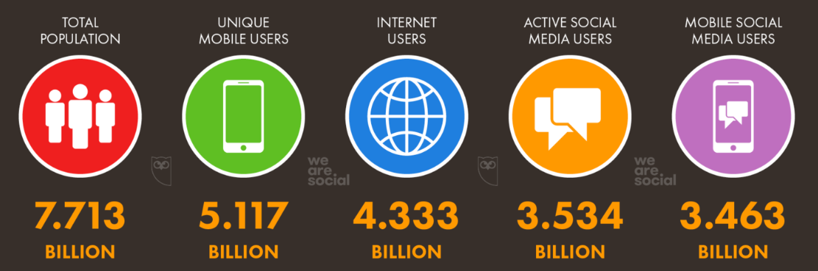
Why Dialog System?
有許多人可能不會操作電腦或是對於操作電腦非常不熟悉。再好的圖形化介面都很難克服這問題，但幾乎人人都會講話，只是語言不同。
Digital Data of July 2019
https://datareportal.com/global-digital-overview

Slide 35
Two Types of Intelligence Assistance
Types of Intelligence Assistance
Reactive Assistance
Proactive Assistance

Slide 36
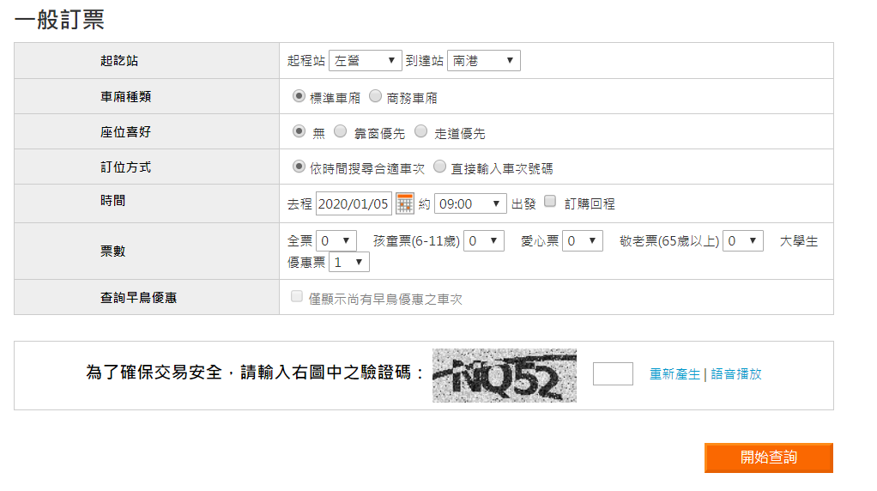
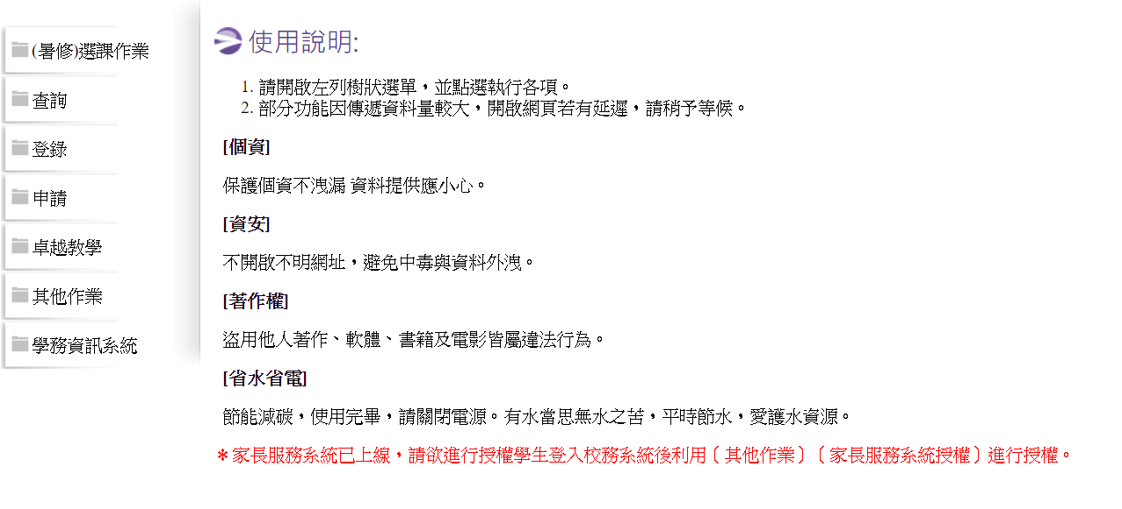
GUI v.s. CUI (Conversational UI)
https://irs.thsrc.com.tw/IMINT/ http://webap.nkust.edu.tw/nkust/f_index.html

Slide 37
Introduction to Dialog System
Types of Dialog System
Chit-Chat Dialog System
Task-Oriented Dialog System
Flow of Dialog System
Domain Classification
Intent Detection
Slot-Filling
Dialog State Tracking
Dialog Policy Making
Output

Slide 38
Dialog System Example
I would like to book a HSR ticket from Kaohsiung to Nangang.
Domain
HSR
Intent
Book a Ticket
Slot-Filling
o o o o o o o o B-Depart I-Depart B-Destination I-Destination
I would like to book a HSR ticket from Kaohsiung to Nangang
Dialog State Tracking
Place
Dialog Policy for Agent Action
We have place but we don’t know the preference of seat, departure time etc. The system may return a question which is “what time do you depart?”

Slide 39
Regular Expression

Slide 40
What is regular expression?
Write a rule to match the words.
There are many editors allowing to search the text by using regular expression.

Slide 41
基本正規表示式介紹
[ ] 匹配在括號裡面的字母
[^] 匹配不包含在[ ]裡面的文字
| 有OR的概念
? 前面的字元式非必要的
* 前面的字元可以出現0次也可以出現多次
+ 前面的字元至少要出現一次
. 不管任何字元都可以匹配
^ 匹配句子的起始位置
$ 匹配句子結尾位置
還有許多規則可以到網路上查

Slide 42
Python Package: RE
Built-in Function of Python
Mainly used to process Regular Expression
It can be used to match and split the string etc.

Slide 43
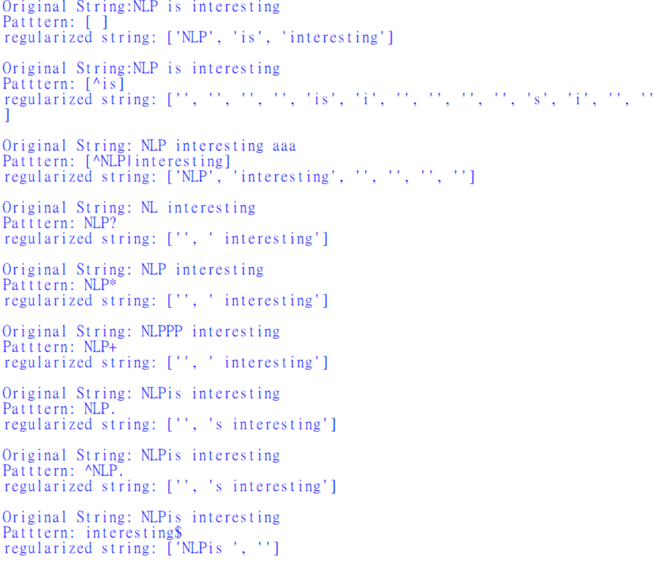
RE Example

Slide 44
Introduction to API

Slide 45
Introduction to API
Scikit-Learn
https://scikit-learn.org/stable/
Pytorch
https://pytorch.org/
TensorFlow
https://www.tensorflow.org/
Google Colab Intro
https://colab.research.google.com/drive/14a6xiBuMtRF8snFYM-33i8BDNfiXBxQD
TensorFlow With GPU
https://colab.research.google.com/drive/1aL_lmD8apPu2YXBxPzGSq0tdrV5btf-b
Numpy
https://numpy.org/
Pandas
https://pandas.pydata.org/

Slide 46
References
D.Mannin et al., Foundations Of Statistical Natural Language Processing
自然語言處理流程
An easy Introduction To Natural Language Processing
中研院語料庫
中研院斷詞
陳縕儂, 對話機器人的腦子與靈魂 Bot's Brain and Soul, PyConTW2017
Dan Jurafsky and Chris Manning, “Natural Language Processing”, Stanford Online
Python RE Package Document

