Slide 1
語言模型及循環神經網路
報告人: 蘇佳益
指導老師: 陳聰毅
國立高雄科技大學建功校區電子工程系
https://github.com/chiayisu/Natural-Language-Processing

Slide 2
Agenda
語言模型
計算圖
循環神經網路 (RNN)
反向傳播及損失函數
演算法複雜度及句子的長度
Text Generation Example
語言模型的評估
RNN Example

Slide 3
語言模型

Slide 4
語言模型介紹
根據前一個語詞預測下一個語詞
他有很多 _____
And many words
錢
書籍
房子

Slide 5

語言模型：公式定義
假設我們有一個序列 ${ x}^{1}…x^{t}$，$x^{t+1}$ 的計算方法如下：
$p\left({{ x}^{t+1}|{ x}^{t},…,x}^{1}\right)$
${ x}^{t+1}$為所有單詞中其中一個語詞
下一個語詞所會出現的機率的運算稱語言模型。

Slide 6

語言模型
語言模型也可以用來產生一段文字的機率
假設我們要產生一段文字${ x}^{1}…x^{T}$，其計算方式如下
$p\left(x^{1},…,x^{T}\right)=p\left(x^{1}\right)∗p\left(x^{2}|x^{1}\right)∗…∗p\left(x^{T}|x^{T−1},…,x^{1}\right)$
$= \prod_{t=1}^{T}{p\left(x^{t}|x^{t−1},…,x^{1}\right)}$

Slide 7
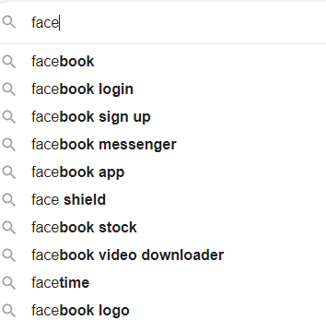

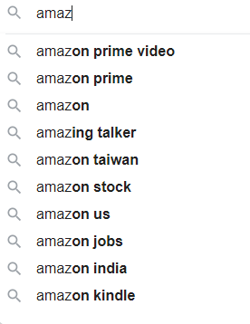
Language model is everywhere and every day.

Slide 8
How to learn a language model?
N-gram (Pre-Deep Learning)
RNN
LSTM
Seq2Seq
GPT
BERT
…

Slide 9
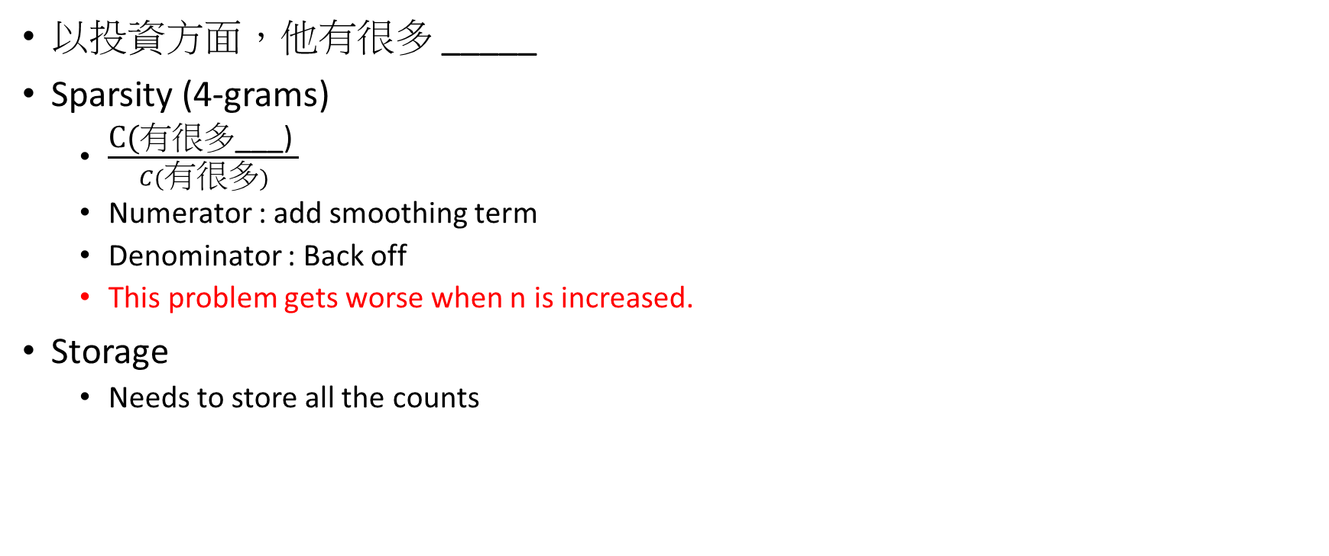
N-gram 語言模型的問題
以投資方面，他有很多 _____
Sparsity (4-grams)
$\frac{\text{C}\text{(}\text{有很多}\text{___) }}{C(\text{有很多})}$
Numerator : add smoothing term
Denominator : Back off
This problem gets worse when n is increased.
Storage
Needs to store all the counts

Slide 10
N-gram 語言模型的實例：路透社語料庫
Today the ___
Probability Distribution
company 0.153
bank 0.153
price 0.077
italian 0.039
emirate 0.039
Have a sparsity problem.
https://nlpforhackers.io/language-models

Slide 11
Tri-Gram 語言模型：文本生成
Today the ___
Probability Distribution
company 0.153
bank 0.153
price 0.077
italian 0.039
emirate 0.039

Slide 12
Tri-Gram 語言模型：文本生成
Today the price ___
Probability Distribution
of 0.308
for 0.050
it 0.046
to 0.046
is 0.031
…

Slide 13
Tri-Gram 語言模型：文本生成
today the price of gold per ton , while production of shoe lasts and shoe industry , the bank intervened just after it considered and rejected an imf demand to rebuild depleted european stocks , sept 30 end primary 76 cts a share .
文法上有些地方合理有些不合理，但是句子間的關聯性不大
n越大，語言模型表現越好
然而，n越大，越難找到相對應的語詞，每個語詞的機率也越小 (Sparsity Problem)

Slide 14
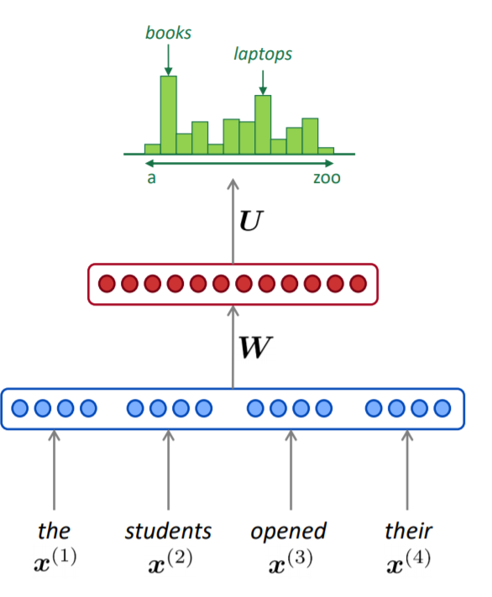
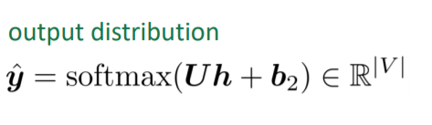
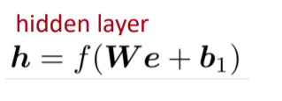
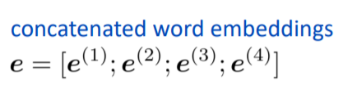

Neural Language Model : Fixed-window
as the proctor started the clock the students opened their ___

Slide 15
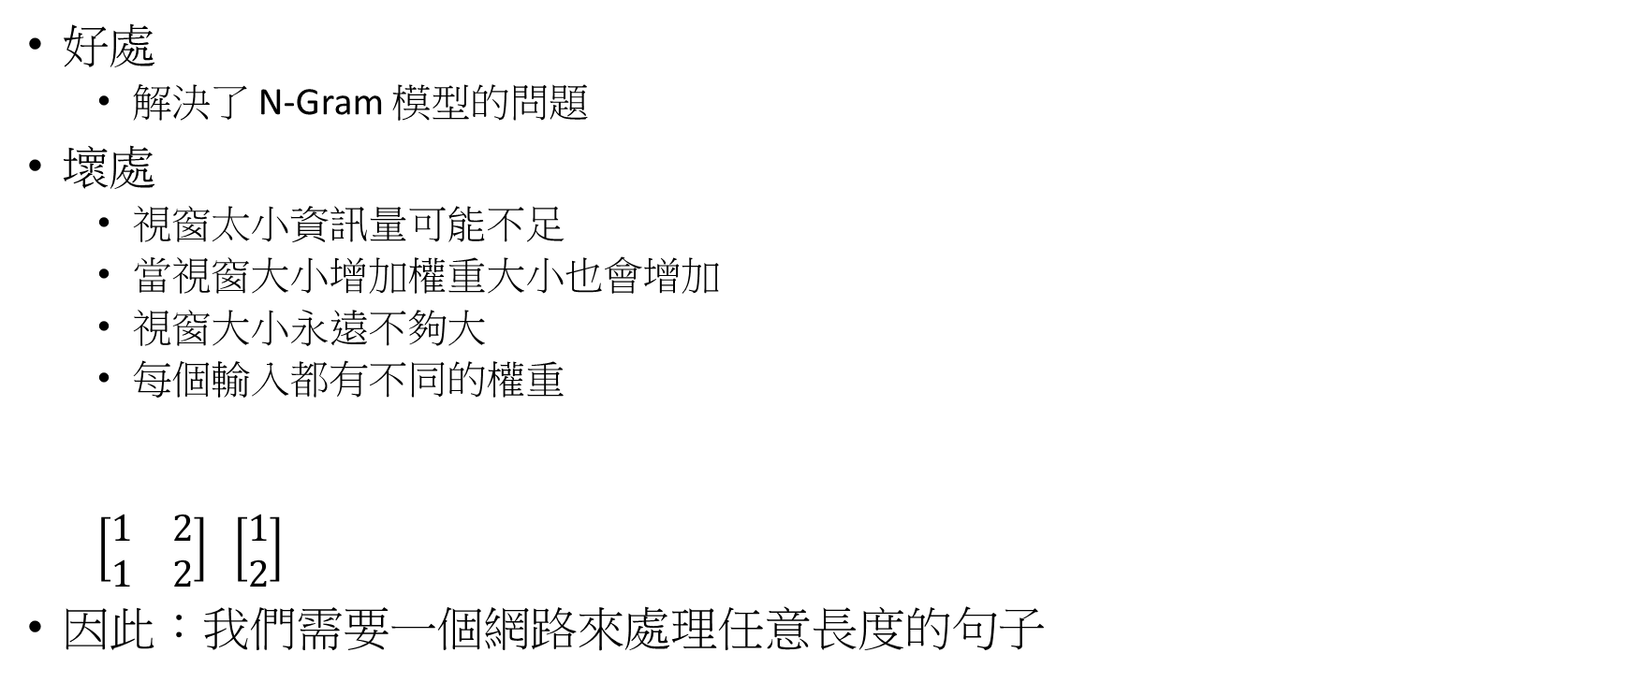
固定視窗大小語言模型的好處及壞處
好處
解決了 N-Gram 模型的問題
壞處
視窗太小資訊量可能不足
當視窗大小增加權重大小也會增加
視窗大小永遠不夠大
每個輸入都有不同的權重
$\left[\begin{matrix}1 & 2 \\ 1 & 2\end{matrix}\right]$ $\left[\begin{matrix}1 \\ 2\end{matrix}\right]$
因此：我們需要一個網路來處理任意長度的句子
w
x

Slide 16
計算圖

Slide 17
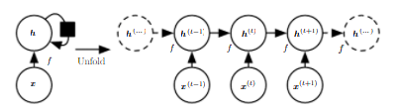
循環圖及展開圖

Slide 18
循環圖與展開圖的比較
循環圖
簡潔
展開圖
較明確
能夠清楚的展示前向及反向傳播的資訊

Slide 19
循環神經網路 (RNN)

Slide 20
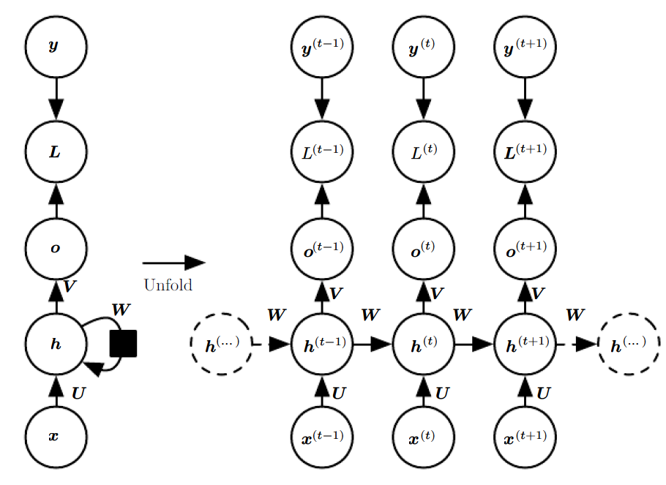
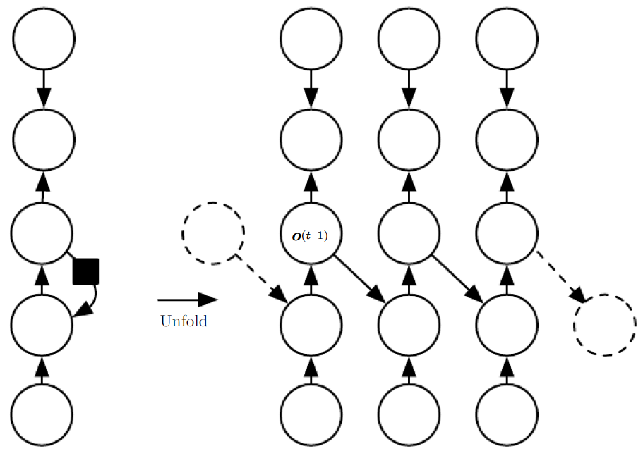
RNN Design Patterns

Slide 21
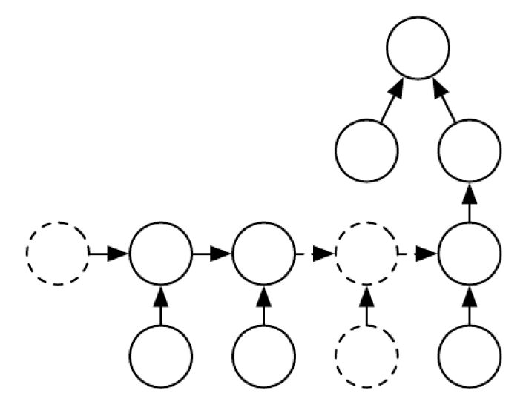
RNN Design Patterns

Slide 22
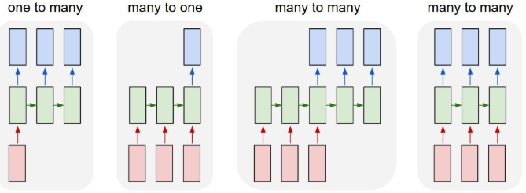
RNN Overview
(1) Image Captioning (2) Sentiment Analysis (3) Machine Translation (4) Video Classification
(1) (2) (3) (4)

Slide 23
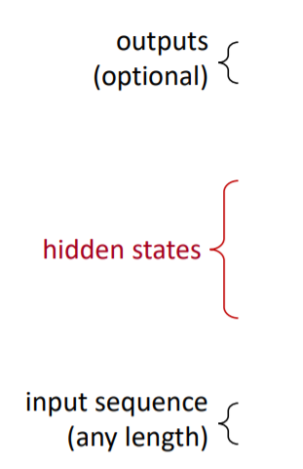
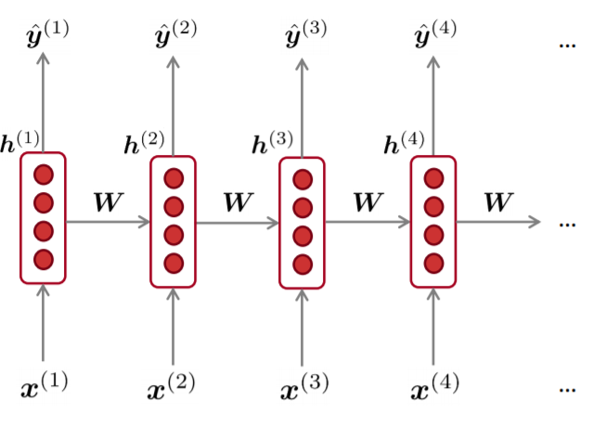
循環神經網路(RNN)
W通常會重複使用
隱含層的計算會採用之前的資訊以及目前所輸入的資訊
輸入的句子可以是任意長度
RNN不一定每個輸入都要有輸出

Slide 24
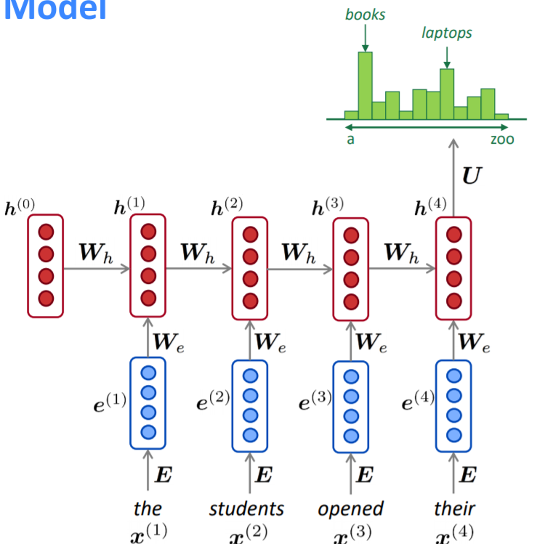
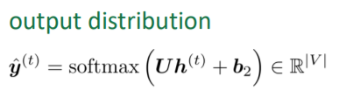
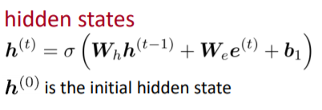


Detail of RNNLM

Slide 25
RNNLM: 好處及壞處
好處:
可以處理任何長度的輸入
理論上可以運用到歷史資訊
當輸入增加時，模型的大小不會跟著增加
因為每個權重的輸入都相同，所以每個輸入的處理過程都相同
壞處
運算速度較慢
實際上無法有效運用歷史資訊 (梯度消失、爆炸)

Slide 26
RNNLM : Training
將語詞序列輸入到RNN；計算出每一個時序的機率分布
計算損失值
將損失值取平均

Slide 27
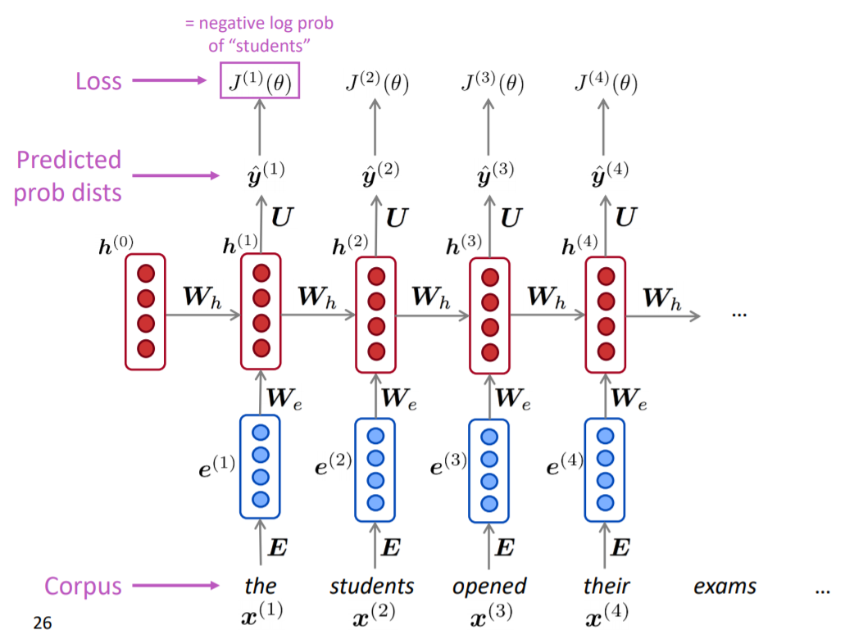
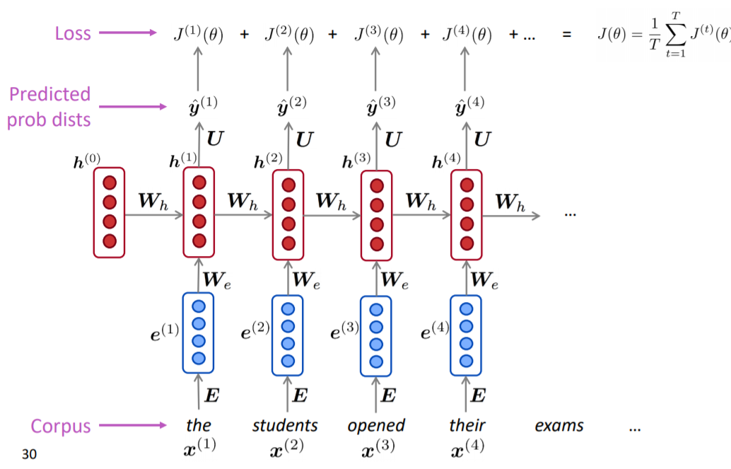
RNNLM : Training

Slide 28
RNNLM : Training
利用整個文本來計算梯度非常消耗資源
因此，通常我們採用小Batch的句子或文本來計算梯度

Slide 29
反向傳播及損失函數

Slide 30
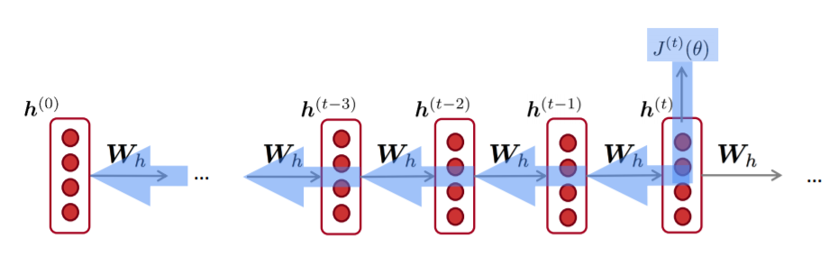

RNN : 反向傳播
$\frac{∂J^{(t)}}{∂W_{h}}=\sum_{i=1}^{t}{\frac{∂J^{(t)}}{∂{\left.W_{h}\right|}_{i}}}$
This is called “backpropagation through time”
How to Calculate?

Slide 31
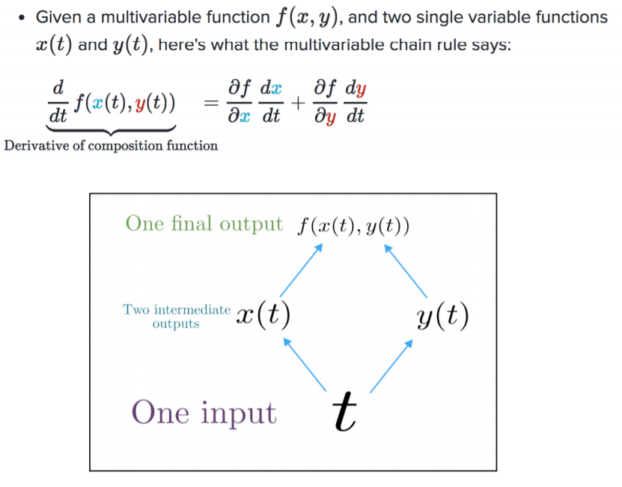
Backpropagation : Multivariable Chain Rule
https://web.stanford.edu/class/archive/cs/cs224n/cs224n.1194/slides/cs224n-2019-lecture06-rnnlm.pdf

Slide 32
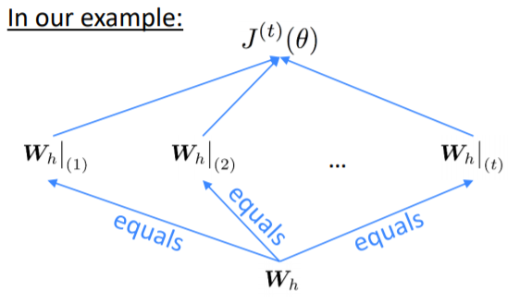

Backpropagation : RNN
$\frac{∂J^{(t)}}{W_{h}}=\sum_{i=1}^{t}{\frac{∂J^{(t)}}{∂{\left.W_{h}\right|}_{i}}}∗\frac{∂W_{h}|_{i}}{∂W_{h}}$
$\frac{dx}{dx}=?$
Timestep is from t to 1.
https://web.stanford.edu/class/archive/cs/cs224n/cs224n.1194/slides/cs224n-2019-lecture06-rnnlm.pdf

Slide 33
RNN : 損失函數
損失函數的選擇會根據不同的任務而不同
如果我們任務是輸出一個機率分布
Cross-Entropy Loss
如果我們的任務為預測下一個語詞
目標將會是最大化Log-Likelihood 或是最小化負的Log-Likelihood

Slide 34
演算法複雜度及句子的長度

Slide 35
如何決定序列的長度?
在文本中加一個特殊符號，當輸出此特殊符號就停止輸出 (Schmidhuer, 2012)
加一個Bernoulli的模型判斷是否繼續輸出 (better and more general)
加一個而外的輸出來預測輸出序列長度 (Goodfellow, 2014d)

Slide 36

RNN : 演算法複雜度
Forward Propagation Runtime (cannot be parallelized)
$O\left(τ\right)$
Forward Propagation Memory Cost
$O\left(τ\right)$
Backward Propagation Runtime
$O\left(τ\right)$
Parameter Complexity
O(1)

Slide 37
Text Generation Example

Slide 38
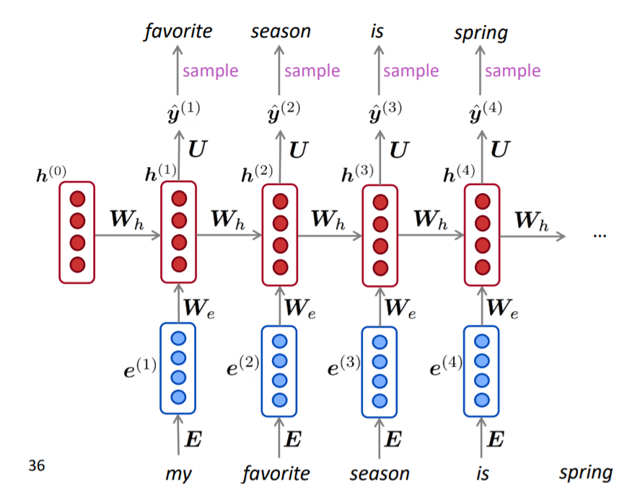
RNNLM : Text Generation

Slide 39
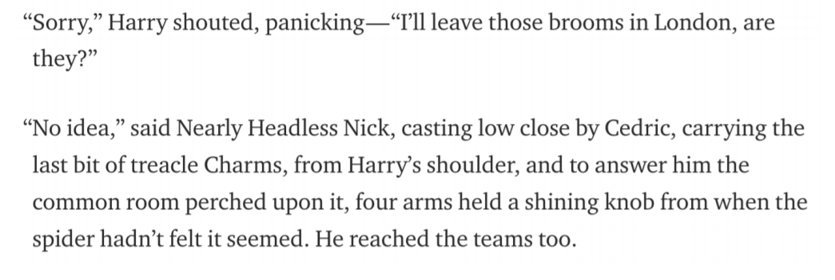
RNNLM trained on Harry Potter
Have the characteristic’s name but still difficult to read. It has run-on sentences.
https://medium.com/deep-writing/harry-potter-written-by-artificial-intelligence-8a9431803da6

Slide 40
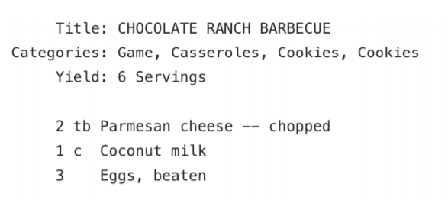
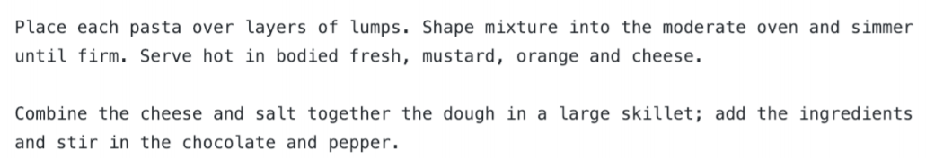
RNNLM trained on Recipes
Challenging task.
Still fluent but nonsensical
https://gist.github.com/nylki/1efbaa36635956d35bcc

Slide 41
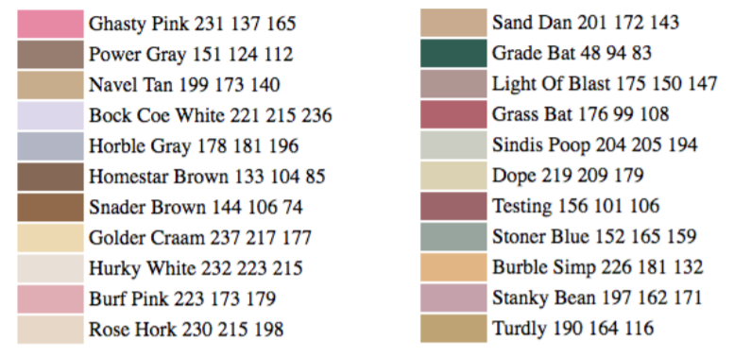
RNNLM trained on Paint Color Name
character lever RNNLM
Trained by using RGB
https://aiweirdness.com/post/160776374467/new-paint-colors-invented-by-neural-network

Slide 42
語言模型的評估

Slide 43

困惑度 (Perplexity)
用來評估語言模型
困惑度越低越佳
困惑度公式如下
$$perplexity= \prod_{t=1}^{T}{{\left(\frac{1}{P\left(x^{(t+1)}|x^{t}…x^{1}\right)}\right)}^{1/T}}$$
$=exp\left(\frac{1}{T}\sum_{t=1}^{T}{−\log{{\hat{y}}_{x_{t+1}}^{(t)}}}\right)=exp⁡(J\left(θ\right))$

Slide 44
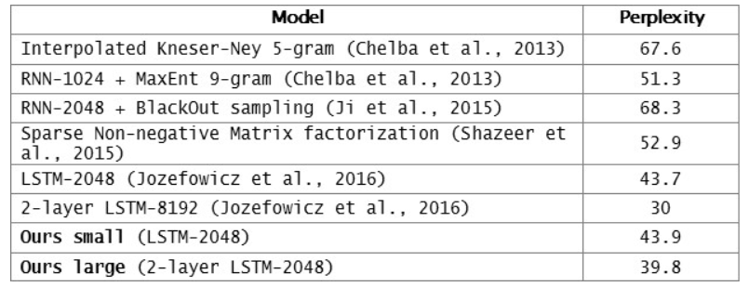
RNNs have greatly improved perplexity
https://research.fb.com/building-an-efficient-neural-language-model-over-a-billion-words/

Slide 45
RNN Example

Slide 46
Why is Language Model important?
Language Model is a benchmark task so it can help us understand how well the computer understands human language.
Language Model is involved in many NLP tasks. E.g.
Predictive Typing
Speech Recognition
Handwriting Recognition
Spelling/Grammar Correction
Authorship Identification
Machine Translation
Summarization
Dialogue

Slide 47
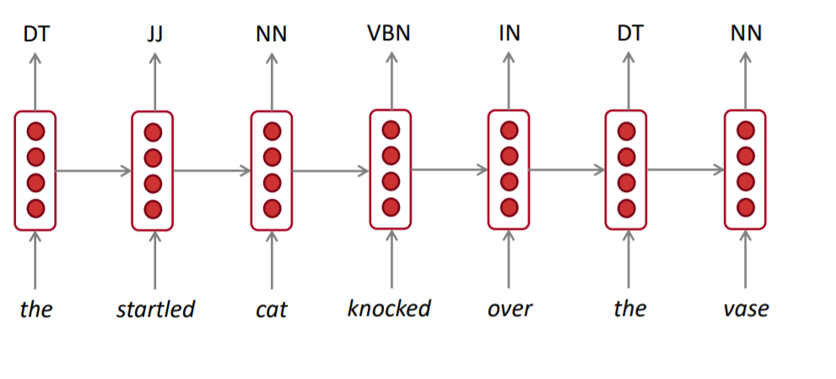
RNN for Tagging
E.g. Part-of-Speech, Name Entity Recognition

Slide 48
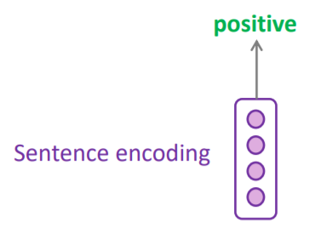
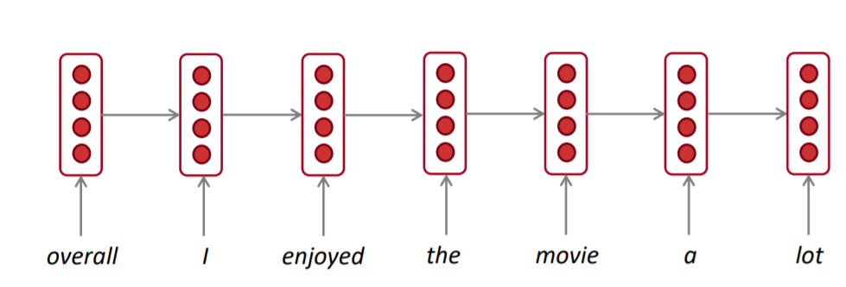
RNN for Sentence Classification
e.g. Sentiment Classification
How to choose encoding?
Final Hidden State
Element-wise max or mean

Slide 49
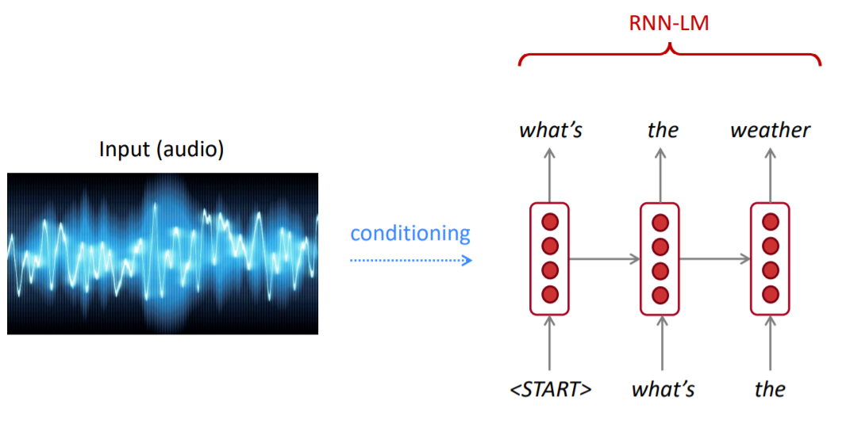
RNN for Text Generation
Speech Recognition, Machine Translation etc.

Slide 50
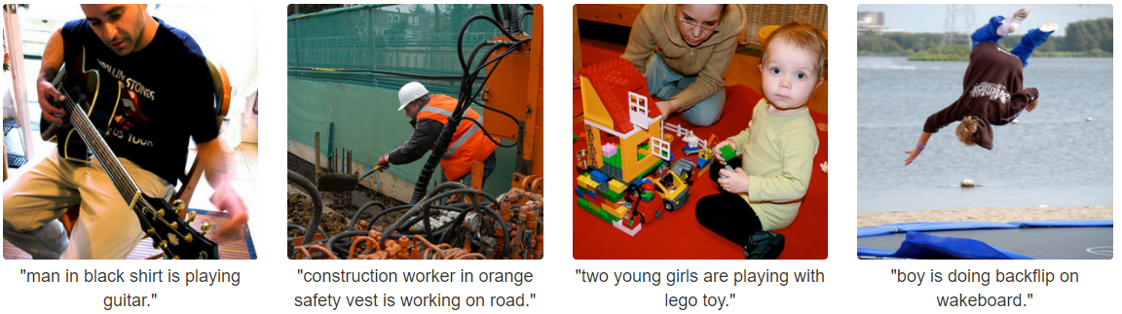
Image Captioning
The task of describing image by using natural language.

Slide 51
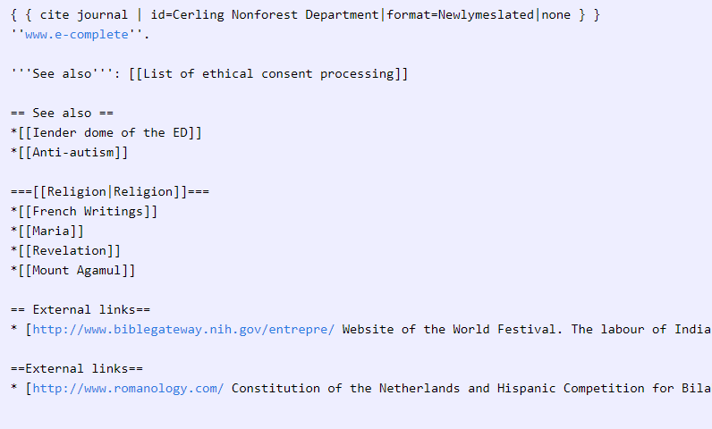
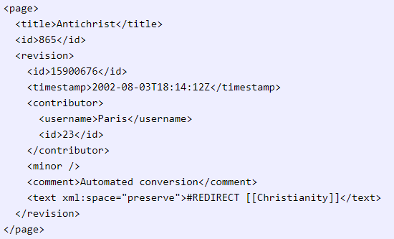
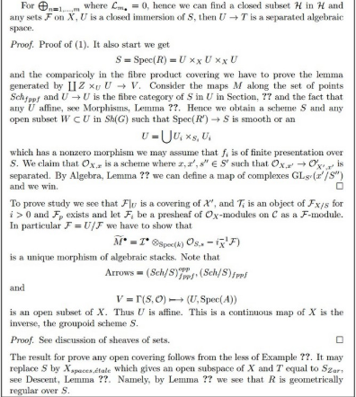
Fun Examples

Slide 52
References
斎藤康毅, Deep Learning 2: 用Python進行自然語言處理的基礎理論實作.
Manning et al., CS224n Natural Language Processing with Deep Learning, Stanford University.
Goodfellow et al., Deep Learning Books, Online Version

