Slide 1
Introduction to Reinforcement Learning
Lecturer: Chia-Yi Su
Advisor: Prof. Tsong-Yi Chen
Department of Electronic Engineering
National Kaohsiung University of Science and Technology
https://chiayisu.github.io/teaching/2022-spring-teaching

Slide 2
Syllabus

Slide 3
Course Outline
Introduction to Reinforcement Learning
Markov Decision Processes
Planning by Dynamic Programming
Model-Free Prediction
Model-Free Control
Neural Network
Value Function Approximation
Policy Gradient
Actor-Critic Algorithm
Dialog System (Including MultiModal Dialog System)

Slide 4
Pre-Requests
Mathematics
Calculus
Partial derivative
Chain rule
Probability
KL divergent
Lagrange multiplier
Taylor expansion
Algorithm
Dynamic programming

Slide 5
Online Courses
Introduction to Reinforcement Learning with David Silver - DeepMind x UCL
https://deepmind.com/learning-resources/-introduction-reinforcement-learning-david-silver
CS 285: Deep Reinforcement Learning – UC Berkeley
http://rail.eecs.berkeley.edu/deeprlcourse/

Slide 6
Textbooks
Deep Learning
Goodfellow et al., Deep Learning.
https://www.deeplearningbook.org/
Zhang et al., Dive into Deep Learning.
https://d2l.ai/
Reinforcement Learning
Sutton and Barto, Reinforcement Learning: An Introduction
http://incompleteideas.net/book/the-book.html
Vitay, Deep Reinforcement Learning
https://julien-vitay.net/deeprl/

Slide 7
Today’s Agenda
Introduction
Reinforcement Learning Agent
Categories of Reinforcement Learning Problems
Applications of Reinforcement Learning

Slide 8
Introduction

Slide 9
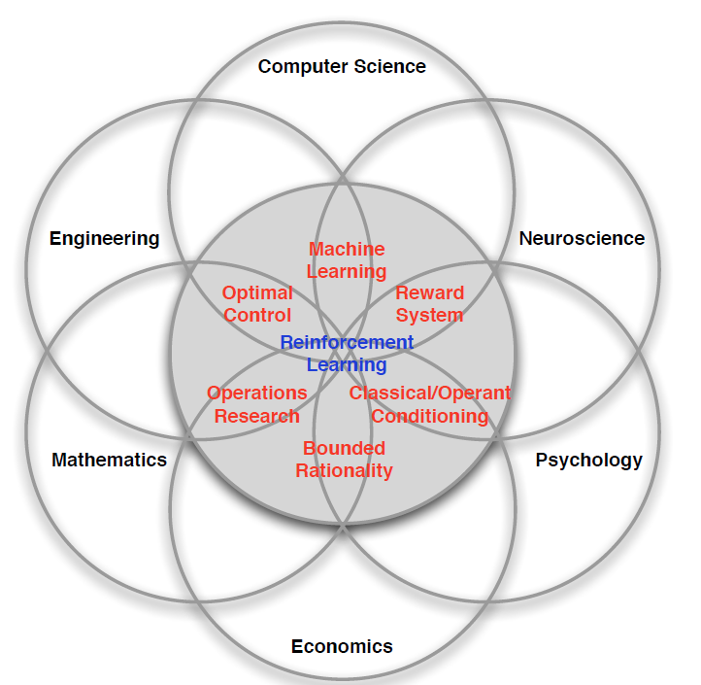
Facets of Reinforcement Learning

Slide 10
Difference between Reinforcement Learning and other Learning Algorithms
No supervisor, only reward signals.
Does not get feedbacks instantaneously.
Data is sequential (not i.i.d. data).
The action of the agent will affect subsequent data that agent receives.

Slide 11
Rewards
A reward
R_{t} is a scalar feedback signal.
Indicates how well an agent is doing at time t.
The goal of an agent is to maximize cumulative reward.

Slide 12
Sequential Decision Making
Goal: Select actions to maximize total future rewards.
Actions may have long-term consequence.
Reward may be delayed.
It may be better to sacrifice instantaneous reward to gain more long-term reward.
E.g.
A Financial Investment
Refueling a Helicopter
Blocking Opponent Moves

Slide 13
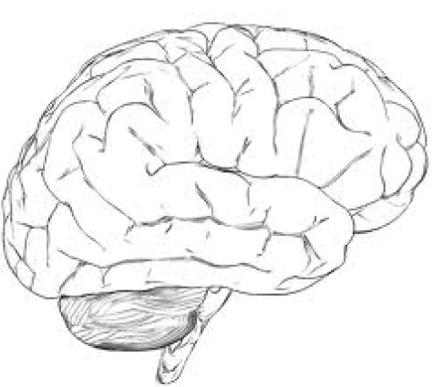
Agent and Environment
Observation
Action
Reward

Slide 14
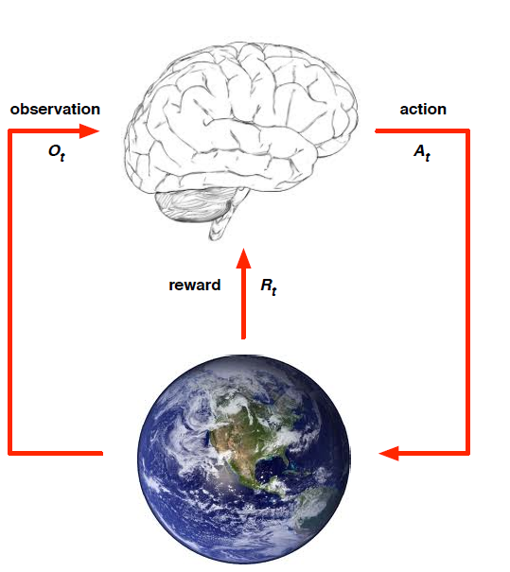
Agent and Environment
An agent at time t:
Executes an action A_{t}
Receives observations O_{t}
Receives a scalar reward R_{t}
An environment:
Receives an action A_{t}
Emits observation O_{t+1}
Emits a scalar reward R_{t+1}

Slide 15
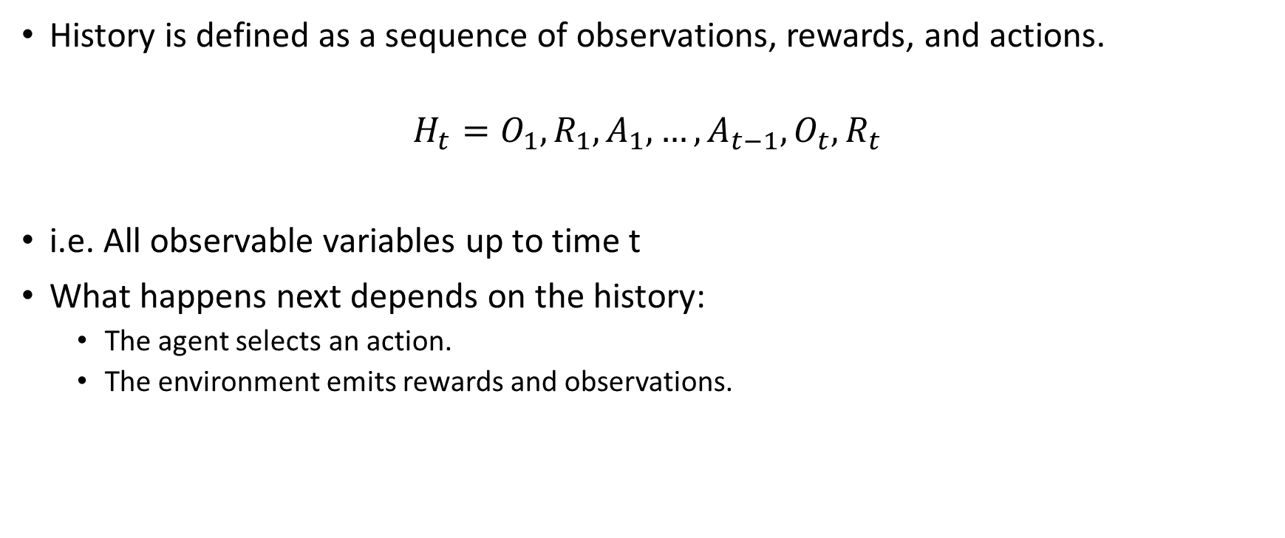
History
History is defined as a sequence of observations, rewards, and actions.
$$H_{t}=O_{1}, R_{1},A_{1},…,A_{t−1}, O_{t},R_{t}$$
i.e. All observable variables up to time t
What happens next depends on the history:
The agent selects an action.
The environment emits rewards and observations.

Slide 16

State
State is used to decide what happens next.
State is the function of the history.
Formally, state can be represented as follows:
$S_{t}={f(H}_{t})$

Slide 17
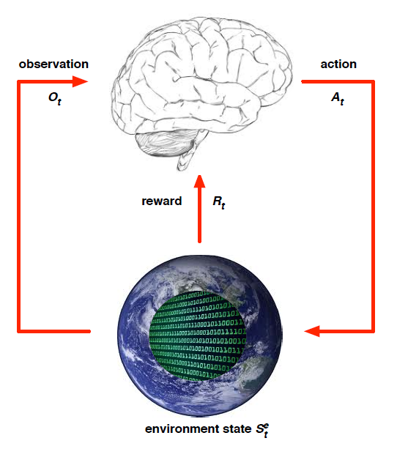
Environment State
The environment state is the information used to determine the next observation and reward.
The environment state is invisible to the agent.
Even the agent can see the environment state, the information is irrelevant.

Slide 18
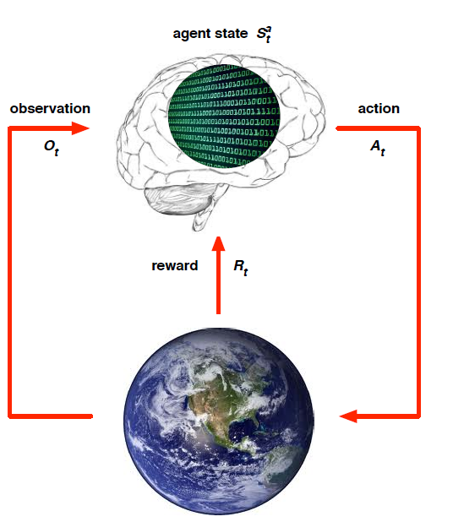
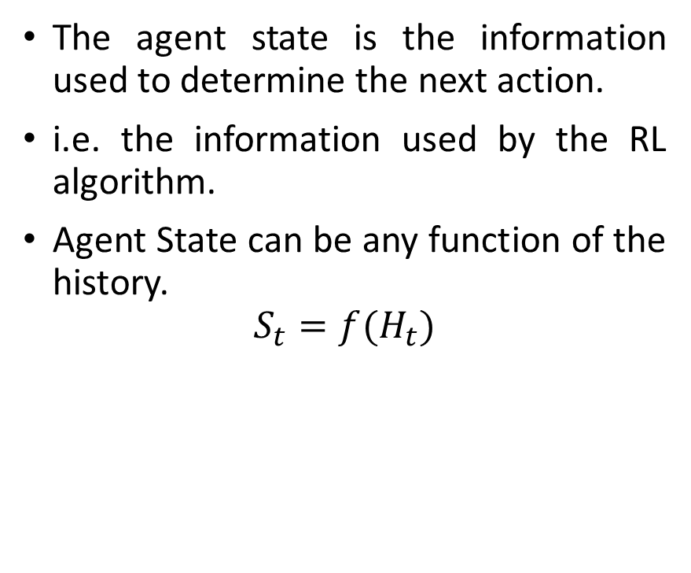
Agent State
The agent state is the information used to determine the next action.
i.e. the information used by the RL algorithm.
Agent State can be any function of the history.
$$S_{t}={f(H}_{t})$$

Slide 19
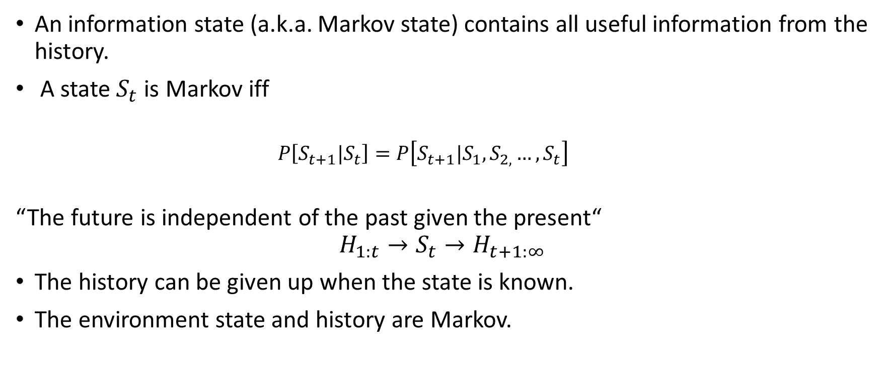
Information State
An information state (a.k.a. Markov state) contains all useful information from the history.
A state $S_{t}$ is Markov iff
$$P\left[S_{t+1}|S_{t}\right]=P\left[S_{t+1}|S_{1},S_{2,}…, S_{t}\right]$$
“The future is independent of the past given the present“
$$H_{1:t}→S_{t}→H_{t+1:∞}$$
The history can be given up when the state is known.
The environment state and history are Markov.

Slide 20
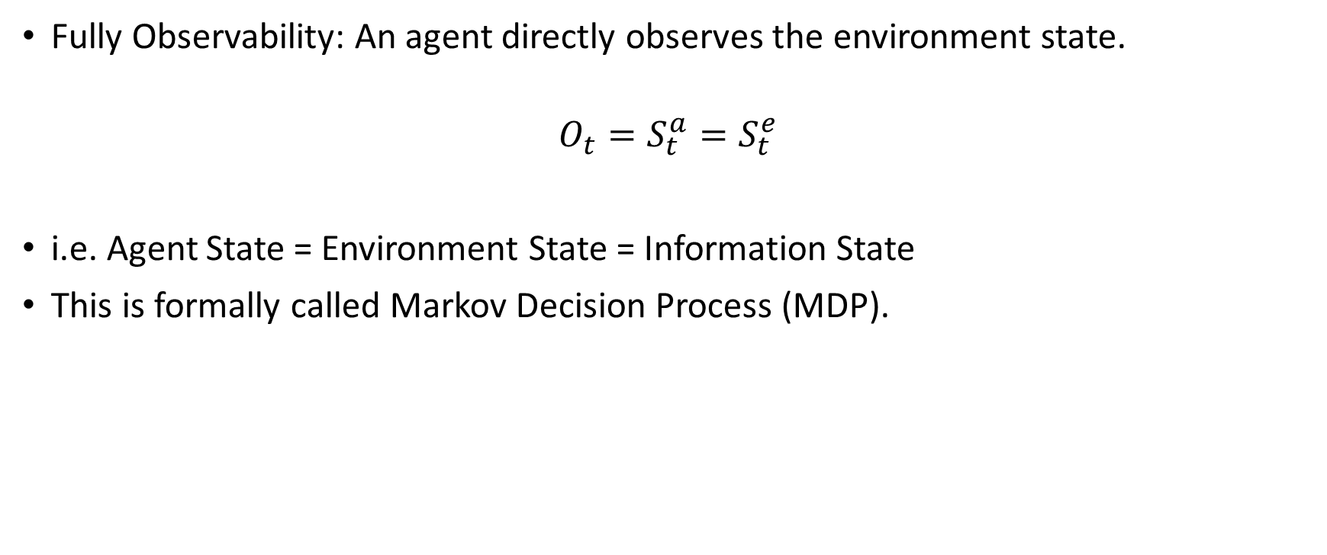
Fully Observable Environments
Fully Observability: An agent directly observes the environment state.
$$O_{t}=S_{t}^{a}=S_{t}^{e}$$
i.e. Agent State = Environment State = Information State
This is formally called Markov Decision Process (MDP).

Slide 21
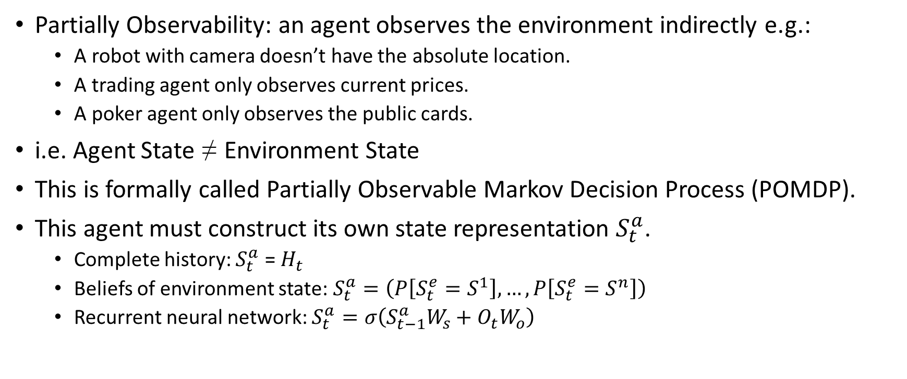
Partially Observable Environments
Partially Observability: an agent observes the environment indirectly e.g.:
A robot with camera doesn’t have the absolute location.
A trading agent only observes current prices.
A poker agent only observes the public cards.
i.e. Agent State ≠ Environment State
This is formally called Partially Observable Markov Decision Process (POMDP).
This agent must construct its own state representation $S_{t}^{a}$.
Complete history: $S_{t}^{a}$ = $H_{t}$
Beliefs of environment state: $S_{t}^{a}=\left(P\left[S_{t}^{e}=S^{1}\right],…, P\left[S_{t}^{e}=S^{n}\right]\right)$
Recurrent neural network: $S_{t}^{a}=σ\left(S_{t−1}^{a}W_{s}+{O_{t}W}_{o}\right)$

Slide 22
Reinforcement Learning Agent

Slide 23
Components of RL Agents
The components that an agent includes are as follows:
Policy: A function to decide the behavior of an agent.
Value Function: A function to decide the goodness of an action.
Model: An agent’s perspective of an environment.
Three components of an RL agents are not always necessary.

Slide 24

Policy
A policy is
A behavior of an agent
Mapping states to action
Two Approaches of Policy Making
Deterministic Policy Making: a = $π\left(s\right)$
Stochastic Policy Making: $π\left(a|s\right)=P\left[A_{t}=a|S_{t}=s\right]$

Slide 25

Value Function
The value function is
Used to calculate the expected total reward of the future.
Formally defined as follows:
$$V_{π}\left(s\right)=E\left[R_{t+1}+{γR}_{t+2}+γ^{2}R_{t+3}+…|{ S}_{t}=s\right]$$

Slide 26

Model
The model predicts what the environment will do next.
The information that model predicts is as follows:
Next state $S_{t+1}^{a}=P\left[S_{t+1}=s^{′}|S_{t}=s,A_{t}=a\right]$
Next reward $R_{t+1}^{a}=P\left[R_{t+1} |S_{t}=s,A_{t}=a\right]$
The model is optional.

Slide 27
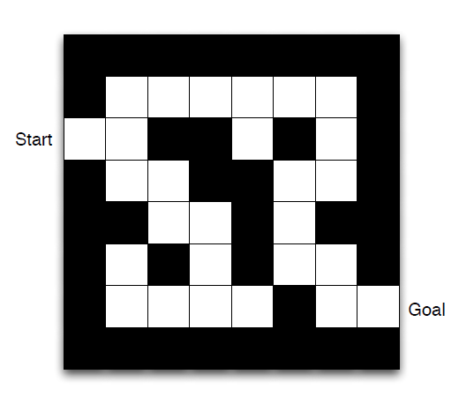
Maze Example
Rewards: -1 each time step
Actions: N, E, S, W
States: Location of an Agent

Slide 28
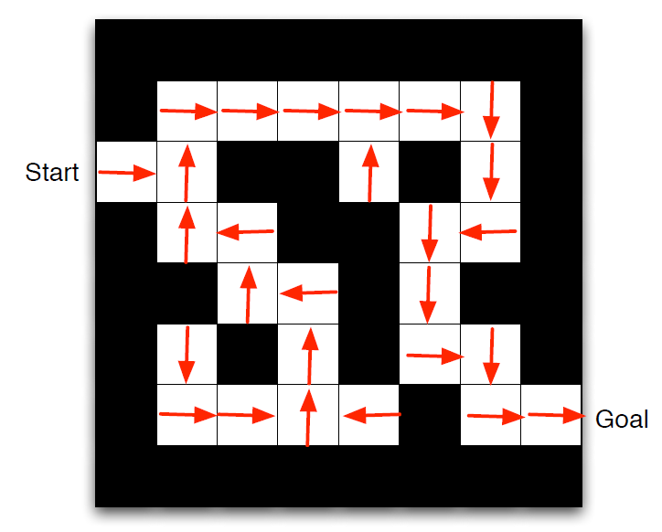
Maze Example: Policy

Slide 29
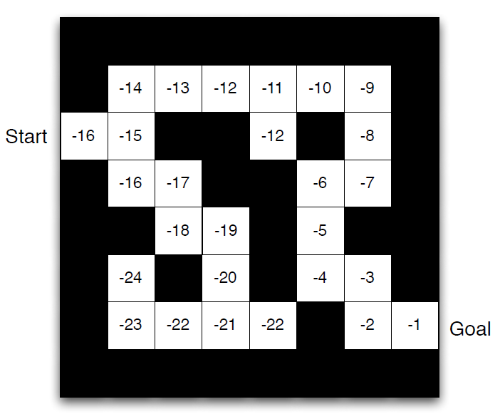
Maze Example: Value Function

Slide 30
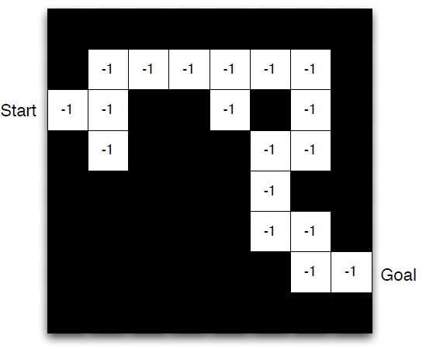
Maze Example: Model

Slide 31
Taxonomies of RL Agents (1)
Value Based
Value Function
Policy Based
Policy
Actor Critic
Value Function
Policy

Slide 32
Taxonomies of RL Agents (2)
Model Free
No Model
Model Based
Policy and/or Value Function
Model

Slide 33
Categories of Reinforcement Learning Problems

Slide 34
Two Problems in Sequential Decision Making
Reinforcement Learning:
The agent needs to explore the environment by itself.
The agent interacts with the environment.
Planning:
The agent does not need to explore the model by itself. a.k.a. the environment is known.
The agent uses this model to make decisions.
Finally, the agent improves its policy.

Slide 35
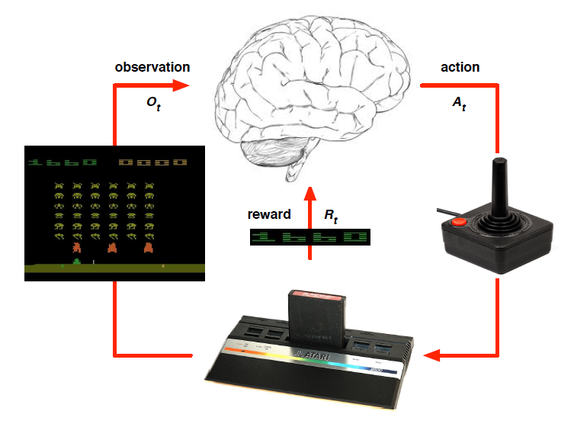
Atari Example: Reinforcement Learning

Slide 36
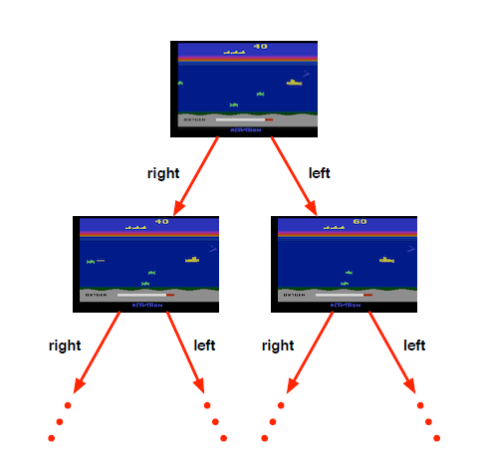
Atari Example: Planning

Slide 37
Exploration and Exploitation: Introduction
Reinforcement Learning is a trial-and-error learning method.
The goal is to maximize rewards.
However: The agent should explore the good policy from the environment by giving up some rewards.

Slide 38
Exploration and Exploitation: Definition
Exploration is to find more information in the environment by giving up some rewards.
Exploitation is to exploit known information to maximize the rewards.
Exploration is equally important as exploitation.

Slide 39
Exploration and Exploitation: Examples
Restaurant Selection
Exploration: Trying a new one
Exploitation: Trying the favorite one
Oil Drilling
Exploration: Drilling the new location
Exploitation: Drilling the best known location
Game Playing
Exploration: Moving toward experimental direction
Exploitation: Moving toward familiar direction

Slide 40
Prediction and Control: Definition
Prediction: Evaluating how well the policy is
Control: Optimizing the policy
i.e. Find the best policy

Slide 41
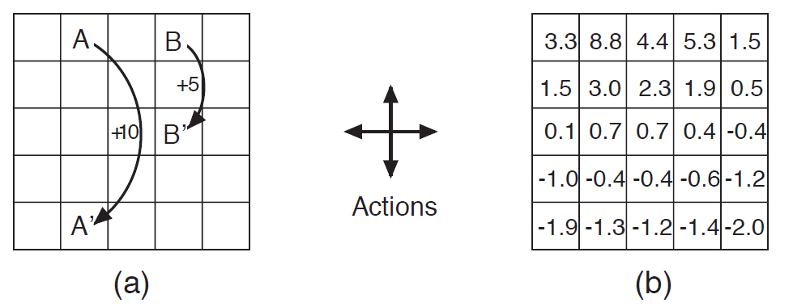
Prediction and Control: Prediction Example

Slide 42
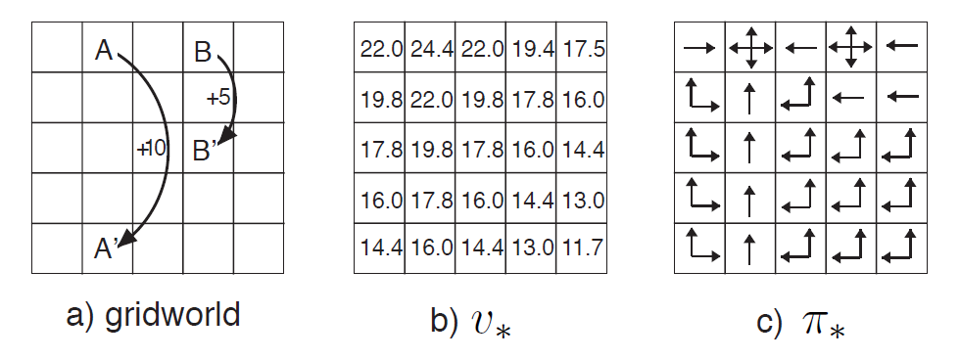
Prediction and Control: Control Example

Slide 43
Learning to Drive in a Day
Kendall et al.

Slide 44
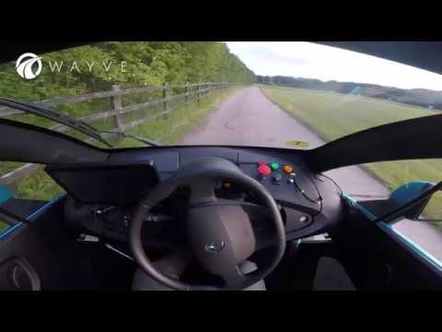
Notes:
https://www.youtube.com/watch?v=eRwTbRtnT1I&t=123s

Slide 45
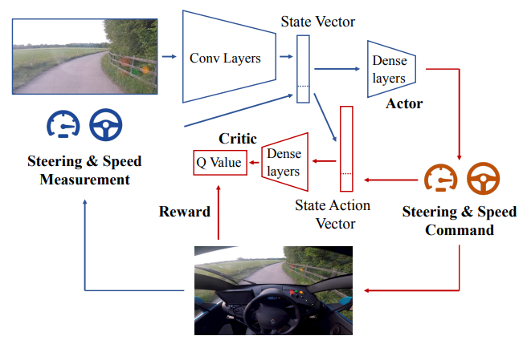
Architecture

Slide 46
Deep Reinforcement Learning for Dialogue Generation
Li et al.

Slide 47
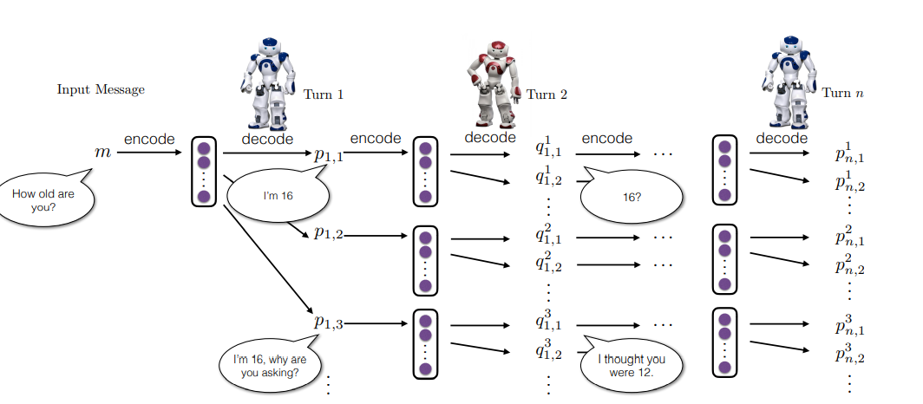

Slide 48
Don’t Until the Final Verb Wait: Reinforcement Learning for Simultaneous Machine Translation
Grissom II et al.

Slide 49
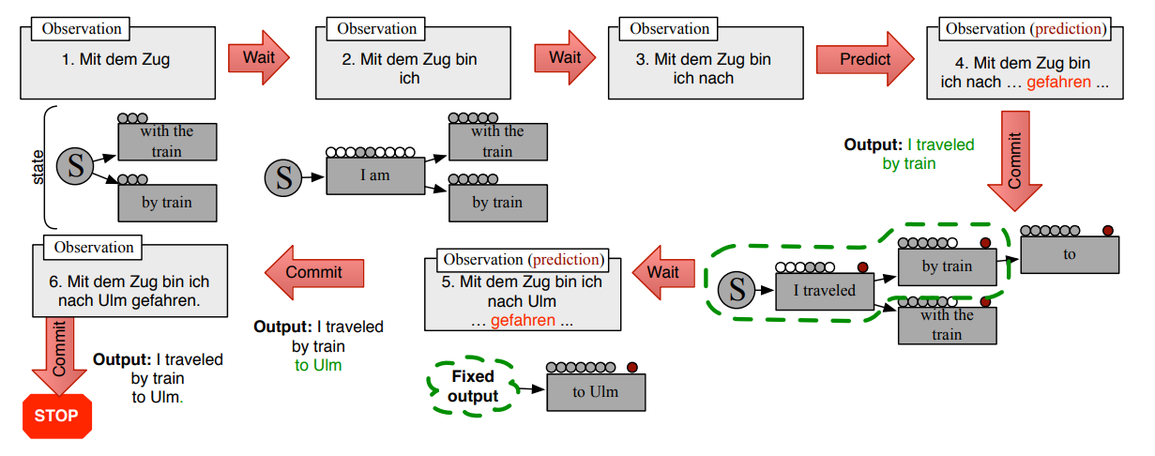
Architecture

Slide 50
QT-Opt: Scalable Deep Reinforcement Learning for Vision-Based Robotic Manipulation
Kalashnikov et al.

Slide 51

Notes:
https://www.youtube.com/watch?v=W4joe3zzglU&t=16s

Slide 52
Human-level control through deep reinforcement learning
Mnih et al., Nature

Slide 53
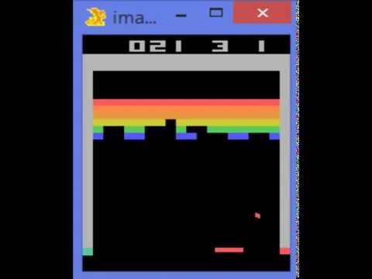
Notes:
https://www.youtube.com/watch?v=V1eYniJ0Rnk

Slide 54
Stanford Autonomous Helicopter

Slide 55

Notes:
https://www.youtube.com/watch?v=0JL04JJjocc

Slide 56
References
Introduction to Reinforcement Learning with David Silver, DeepMind x UCL.

