Slide 1
Distributed Representation of Words
Chia-Yi Su
Department of Electronic Engineering
National Kaohsiung University of Science and Technology

Slide 2
Course Outline
Basic Knowledge on Natural Language Processing
Applications of Natural Language Processing
Word Vector
Neural Network (Including Relative Math Derivation)
Dependency Parsing
Recurrent Neural Network, Variants of Recurrent Neural Network, and Language Model
Machine Translation
Contextual Representation
Dialog System (Including MultiModal Dialog System)

Slide 3
Today‘s Agenda
Thesaurus
Count-Based Methods
Word2Vector
Algorithm Complexity
Algorithms of Word2Vector
Negative Sampling
Hierarchical Softmax
Practical Topics
Results

Slide 4
Thesaurus

Slide 5
Introduction
Classifying the words that have the similar word senses into the same group.
E.g.: Car = Auto = Automobile
The most famous thesaurus is Wordnet.

Slide 6
Problems of Thesaurus
Hard to adapt to the evolution of the language
Crowfunding
Covidiot
LOL
Expensive to maintain
The total amount of English vocabularies is around 10 million. However, the total amount of vocabularies in Wordnet is around 2000 thousand.
Cannot demonstrate the nuance of word senses
Vintage: 過去最好的
Retrospective: 過往的

Slide 7
Count-Based Methods

Slide 8
Introduction
Make computers search the relationship between words automatically
Count-Based Algorithms
Co-Occurrence Matrix
Pointwise Mutual Information

Slide 9
Distribution Hypothesis
The meaning of words is based on its surrounding words.
Example
我想喝飲料。
他想喝果汁。
The state-of-the-art models such as BERT, GPT-1, GPT-2, and GPT-3 does not follow this hypothesis.
Those models emphasize encoding the words by using the whole sentence.
Their performance is much better than the algorithms which follow the distribution hypothesis.
However: The required parameters for those models are much larger. The computation is larger as well.

Slide 10
Context
The words surround the center words.
The size is always symmetric.
We often call it Window Size.
Example
If window size is one, it means we choose one word from the left and one word from the right for the context.
If window size is two, it means we choose two words from the left and two words from the right for the context.
…

Slide 11
Co-Occurrence Matrix
Suppose we have the following sentence:
I like deep learning.
I like NLP.
I enjoy flying.
We will use window size 1. (Usually 5-10)
The co-occurrence matrix is demonstrated as follows.

Slide 12
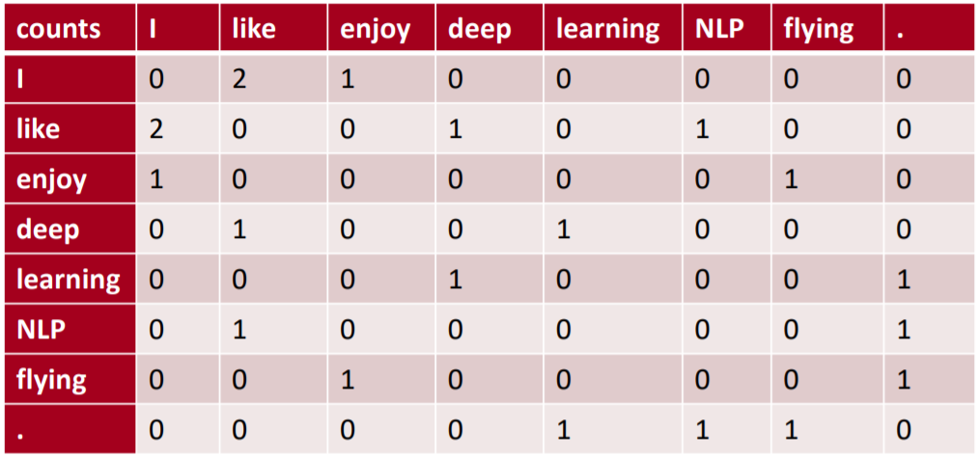
Co-Occurrence Matrix

Slide 13
Downsides of Co-Occurrence Matrix
Vulnerable to the stop words
Example
The
Car
Drive
Therefore: The algorithms which are less vulnerable to the stop words are required.

Slide 14
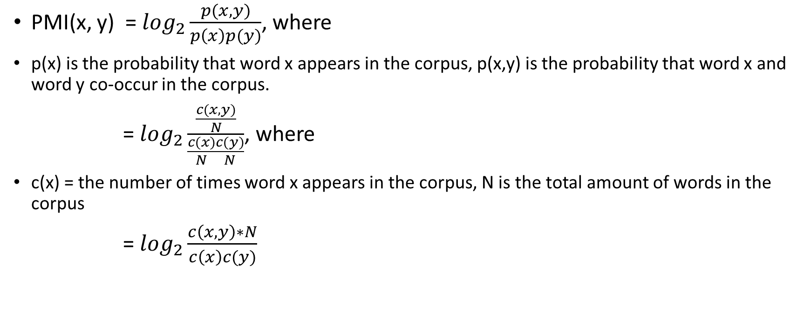
Pointwise Mutual Information (PMI)
PMI(x, y) = $\log_{2}\frac{p(x,y)}{p\left(x\right)p(y)}$, where
p(x) is the probability that word x appears in the corpus, p(x,y) is the probability that word x and word y co-occur in the corpus.
= $\log_{2}\frac{\frac{c(x,y)}{N}}{\frac{c(x)}{N}\frac{c(y)}{N}}$, where
c(x) = the number of times word x appears in the corpus, N is the total amount of words in the corpus
= $\log_{2}\frac{c\left(x,y\right)∗N}{c\left(x\right)c(y)}$

Slide 15

Problem of PMI Algorithm
${\text{PMI}\text{(}\text{x}\text{, }\text{y}\text{)}= log}_{2}\frac{p(x,y)}{p\left(x\right)p(y)}$
The value of log 0 is negative infinity.
Therefore: The formula of PMI is revised as follows
P$\text{PMI}\text{(}\text{x}\text{, }\text{y}\text{)}=max(0,$ $\text{PMI}\text{(}\text{x}\text{, }\text{y}\text{)}$)

Slide 16
Problems of Count-Based Methods
Storage: As vocabulary size increases, we need more storage. Google usually uses 1 billion vocabularies to train the model.
Sparsity: As the matrix shown in last slide, we see many zero elements in the matrix.
Not Robust Enough: The sparsity problem may also make our model not robust.
Solution?
Dimension Reduction. (Still not work well)

Slide 17
Word2Vector
Mikolov et al.

Slide 18
Introduction
Represent words as dense vector
Able to perform simple algebraic operation
E.g.: Vector(queen) = Vector(king) – Vector(men) + Vector(women)

Slide 19
Previous Works
Downside of Previous Models
computational costly
E.g.: NNLM contains
feedforward neural network with a linear projection layer
non-linear hidden layer

Slide 20
Two Categories of Word2Vector Model
Bag-of-Words model (CBOW)
Continuous Skip-gram model (Skip-Gram)

Slide 21
Algorithm Complexity

Slide 22
Complexity Notation
The following model’s complexity will be represented as follows.
O = E * T * Q
where E is the number of training epoch, usually 3 - 50, T is the number of words, usually 1 billion and Q will be defined depending on the further model.

Slide 23
Complexity of NNLM
NNLM is a language model that consists of input, projection, hidden and output layer. Given the N previous words, it will predict the next word.
Complexity of Projection Layer
N * D, where N is the number of previous words and D is its dimension.
Complexity of Hidden Layer
N * D * H, where N*D is from input layer and H is from Hidden layer.
Complexity of Output Layer
H * V, where H is the number of hidden layer and V is the size of all vocabulary.
Thus, its complexity, in total, is Q = N * D + N * D * H + H * V

Slide 24
CBOW
CBOW Model
Is similar to NNLM
Predicts future words based on given history words
However: heaviest layer hidden layer in NNLM is removed
Therefore: Its projection layer is shared with all words
Complexity of CBOW
Q = N * D + D * V

Slide 25
Skip-Gram
Skip-Gram model
Is opposite from the CBOW.
Predicts the context based on given word
Complexity of Skip-Gram
Q = C * ( D + D * V), where C is the distance of the word. The size of C is double because it consists of size from history and future.

Slide 26
Complexity: Binary Tree Representation
Complexity of Binary Tree
log(n)
Therefore: the complexity of representing vocabulary as binary tree is log(v)
However: Hierarchical Softmax is required instead of Softmax.

Slide 27
Algorithms of Word2Vector

Slide 28
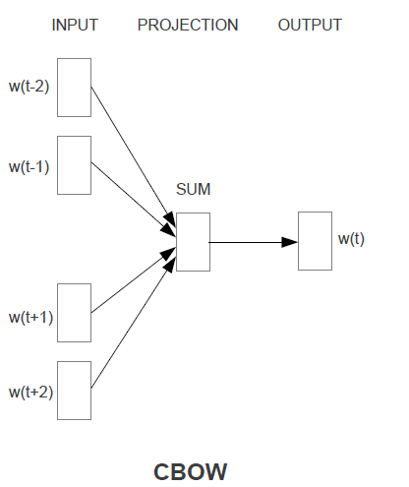
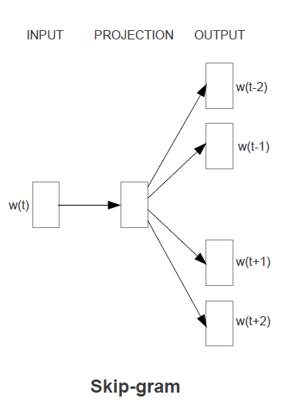
Architecture of CBOW and Skip-Gram

Slide 29
CBOW

Slide 30
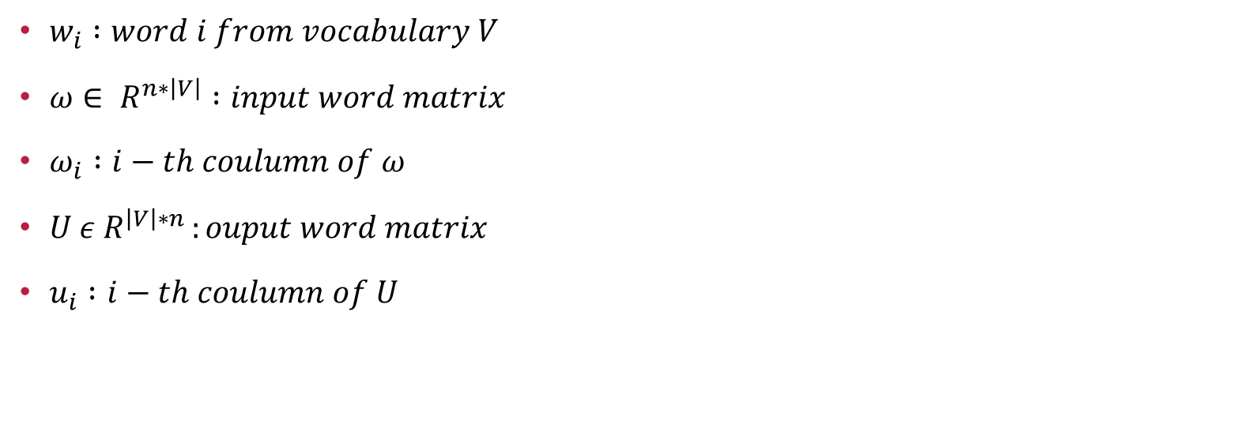
Notation for Algorithm
$w_{i} :word i from vocabulary V$
$ω∈ R^{n∗\left|V\right|} :input word matrix$
$ω_{i} :i−th coulumn of ω$
$U ε R^{\left|V\right|∗n }:ouput word matrix$
$u_{i} :i−th coulumn of U$

Slide 31
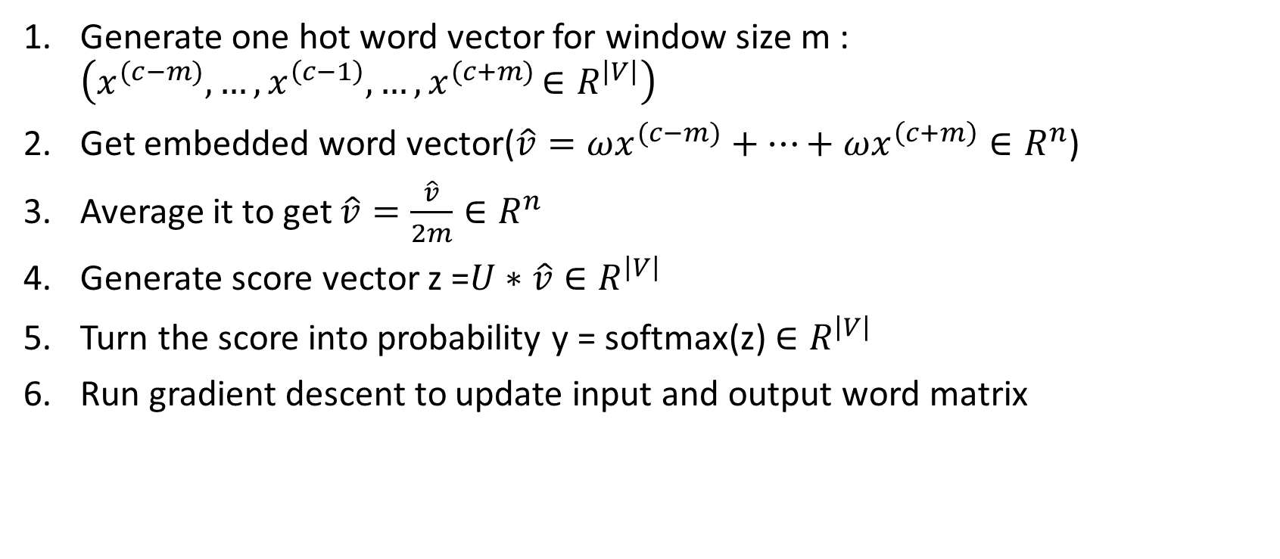
Algorithm of CBOW
Generate one hot word vector for window size m : $\left(x^{(c−m)},…,x^{\left(c−1\right)},…{,x}^{(c+m)}∈R^{\left|V\right|}\right)$
Get embedded word vector$\text{(}\hat{v}=ωx^{(c−m)}+…+ωx^{\left(c+m\right)}∈R^{n}$)
Average it to get $\hat{v}=\frac{\hat{v}}{2m}∈R^{n}$
Generate score vector z =$U∗\hat{v}∈R^{\left|V\right|}$
Turn the score into probability y = softmax(z)${∈R}^{\left|V\right|}$
Run gradient descent to update input and output word matrix

Slide 32
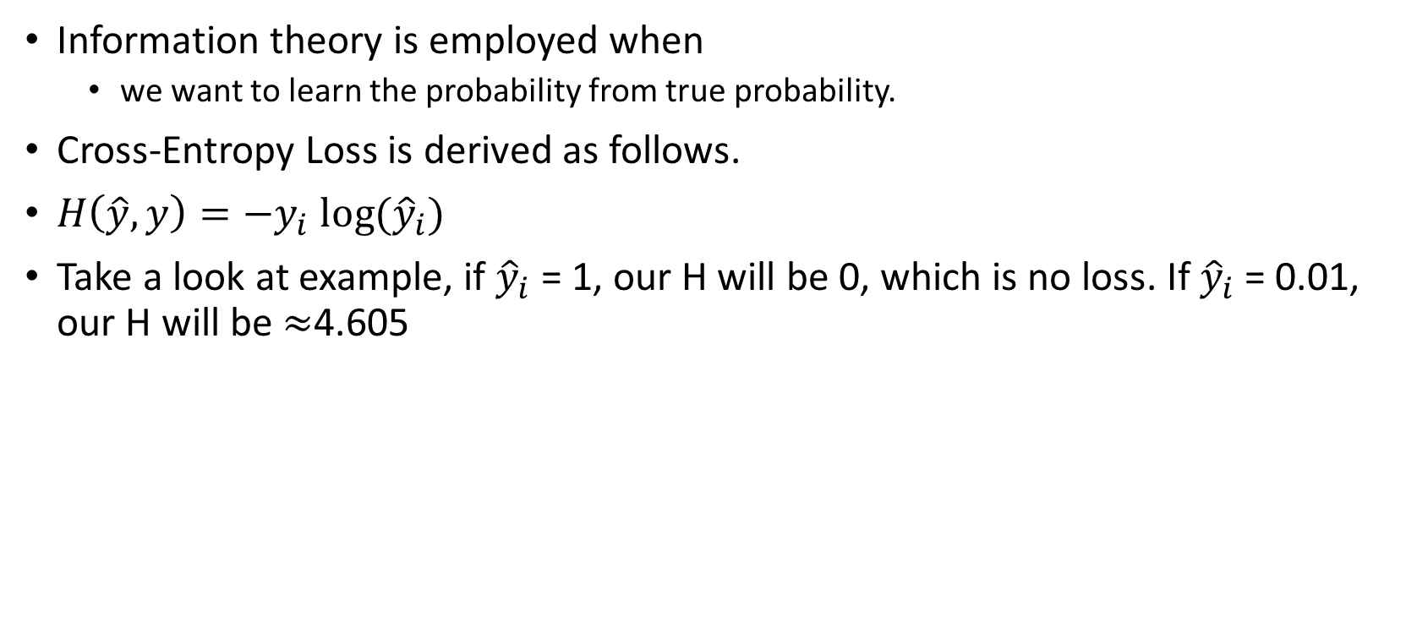
Update Input and Output Word Matrix
Information theory is employed when
we want to learn the probability from true probability.
Cross-Entropy Loss is derived as follows.
$H\left(\hat{y},y\right)=−y_{i} log⁡({\hat{y}}_{i})$
Take a look at example, if ${\hat{y}}_{i}$ = 1, our H will be 0, which is no loss. If ${\hat{y}}_{i}$ = 0.01, our H will be $≈$4.605
Notes:
Log base e

Slide 33
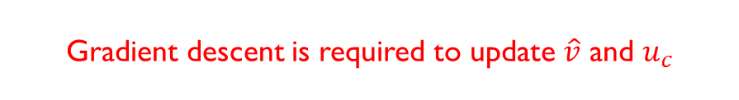

Update Input and Output Word Matrix (CONT.)
Thus, we need to minimize our Cross-Entropy Loss.
Let J = $−\log{P(}w_{c}\left|w_{c−m},…,w_{c+m}\right)$
= $−logP(u_{c}|\hat{v})$
= $−log\frac{\exp\left(u_{c}^{T}\hat{v}\right)}{\sum_{j=1}^{\left|V\right|}{\exp\left(u_{j}^{T}\hat{v}\right)}}$
=${−u}_{c}^{T}\hat{v}+log⁡\left(\sum_{j=1}^{\left|V\right|}{\exp\left(u_{j}^{T}\hat{v}\right)}\right)$
Gradient descent is required to update $\hat{v}$ and $u_{c}$

Slide 34
Skip-Gram

Slide 35
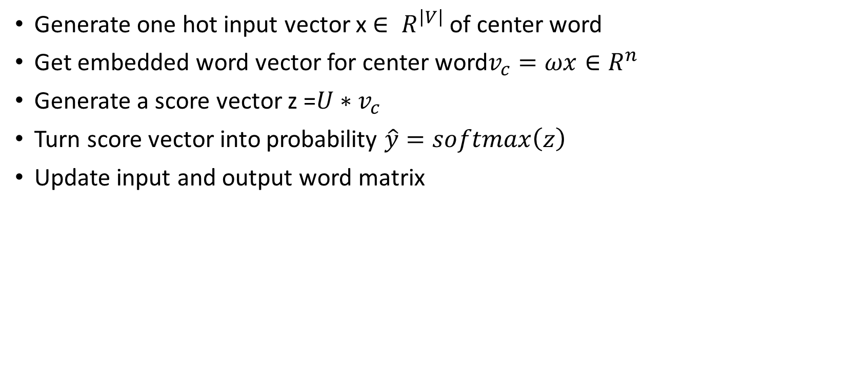
Algorithm of Skip-Gram
Generate one hot input vector x $∈ R^{\left|V\right|}$ of center word
Get embedded word vector for center word$v_{c}=ωx∈R^{n}$
Generate a score vector z =$U∗v_{c}$
Turn score vector into probability $\hat{y}=softmax\left(z\right)$
Update input and output word matrix

Slide 36
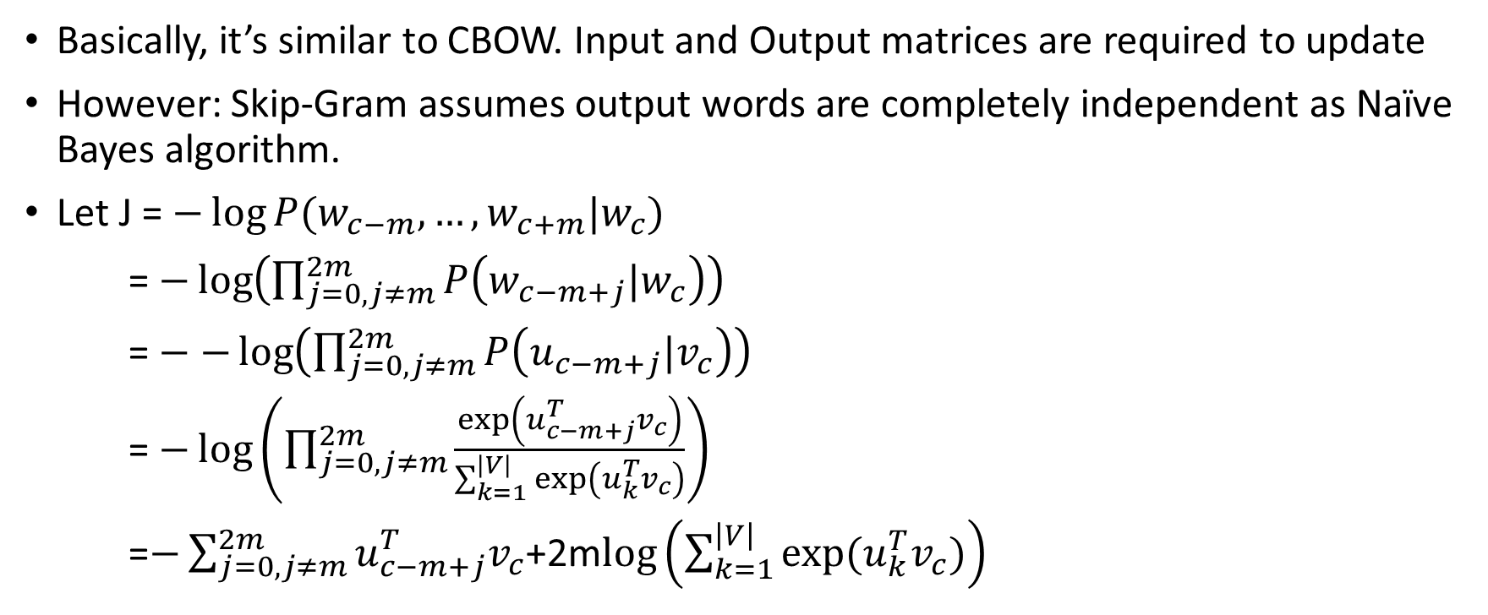
Algorithm of Skip-Gram (cont.)
Basically, it’s similar to CBOW. Input and Output matrices are required to update
However: Skip-Gram assumes output words are completely independent as Naïve Bayes algorithm.
Let J = $−\log{P(w_{c−m},…,w_{c+m}|w_{c}})$
= $−\log\left(\prod_{j=0,j≠m}^{2m}{P\left(w_{c−m+j}|w_{c}\right)}\right)$
= $−−\log\left(\prod_{j=0,j≠m}^{2m}{P\left(u_{c−m+j}|v_{c}\right)}\right)$
= $−\log\left(\prod_{j=0,j≠m}^{2m}{\frac{\exp\left(u_{c−m+j}^{T}v_{c}\right)}{\sum_{k=1}^{\left|V\right|}{\exp\left(u_{k}^{T}v_{c}\right)}}}\right)$
=$−\sum_{j=0,j≠m}^{2m}{u_{c−m+j}^{T}v_{c}}$+2m$log\left(\sum_{k=1}^{\left|V\right|}{exp⁡(u_{k}^{T}v_{c})}\right)$

Slide 37
Negative Sampling

Slide 38

Introduction
Disadvantage of Softmax
Computational Costly
Reason: takes $O\left(\left|V\right|\right)$ time
Negative Sampling
Only needs to loop over noise distribution
Is based on skip-gram model

Slide 39

Objective Function
Let’s denote $\left(w,c\right)$ to word and context, $P\left(D=1|w,c\right)$ to the probability that (w, c) comes from corpus data, and $P\left(D=0|w,c\right)$ vice versa. Therefore, we can model $P\left(D=1|w,c\right)$ with sigmoid function as follows.
$P\left(D=1|w,c,θ\right)=σ\left(v_{c}^{T}v_{w}\right)=\frac{1}{1+e^{−(v_{c}^{T}v_{w})}}$

Slide 40
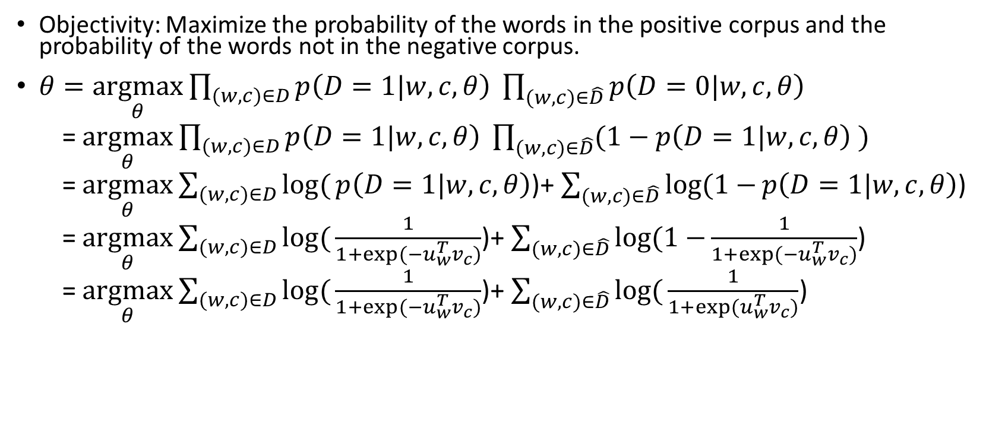
Objective Function (CONT.)
Objectivity: Maximize the probability of the words in the positive corpus and the probability of the words not in the negative corpus.
$θ=\underset{θ}{argmax}{\prod_{(w,c)∈D}{p\left(D=1|w,c,θ\right) }\prod_{(w,c)∈\hat{D}}{p\left(D=0|w,c,θ\right) }}$
= $\underset{θ}{argmax}{\prod_{(w,c)∈D}{p\left(D=1|w,c,θ\right) }\prod_{(w,c)∈\hat{D}}{(1−p\left(D=1|w,c,θ\right) )}}$
= $\underset{θ}{argmax}{\sum_{(w,c)∈D}{log⁡(}}p\left(D=1|w,c,θ\right)$)+ $\sum_{(w,c)∈\hat{D}}{log⁡(1−}p\left(D=1|w,c,θ\right)$)
= $\underset{θ}{argmax}{\sum_{(w,c)∈D}{log⁡(}}\frac{1}{1+exp⁡(−u_{w}^{T}v_{c})}$)+ $\sum_{(w,c)∈\hat{D}}{log⁡(1−}\frac{1}{1+exp⁡(−u_{w}^{T}v_{c})}$)
= $\underset{θ}{argmax}{\sum_{(w,c)∈D}{log⁡(}}\frac{1}{1+exp⁡(−u_{w}^{T}v_{c})}$)+ $\sum_{(w,c)∈\hat{D}}{log⁡(}\frac{1}{1+exp⁡(u_{w}^{T}v_{c})}$)

Slide 41

Objective Function (CONT.)
Because maximizing log likelihood is the same as minimizing negative log likelihood, our function will be revised bellow.
$J=−\sum_{\left(w,c\right)∈D}{log⁡(}\frac{1}{1+\exp\left(−u_{w}^{T}v_{c}\right)}\text{)}−\sum_{\left(w,c\right)∈\hat{D}}{log⁡(}\frac{1}{1+\exp\left(u_{w}^{T}v_{c}\right)}) \hat{D} is a false corpus, where unnatural sentenses contain in this corpus.$ $\hat{D}$ can be generated by randomly sampling from word bank.

Slide 42
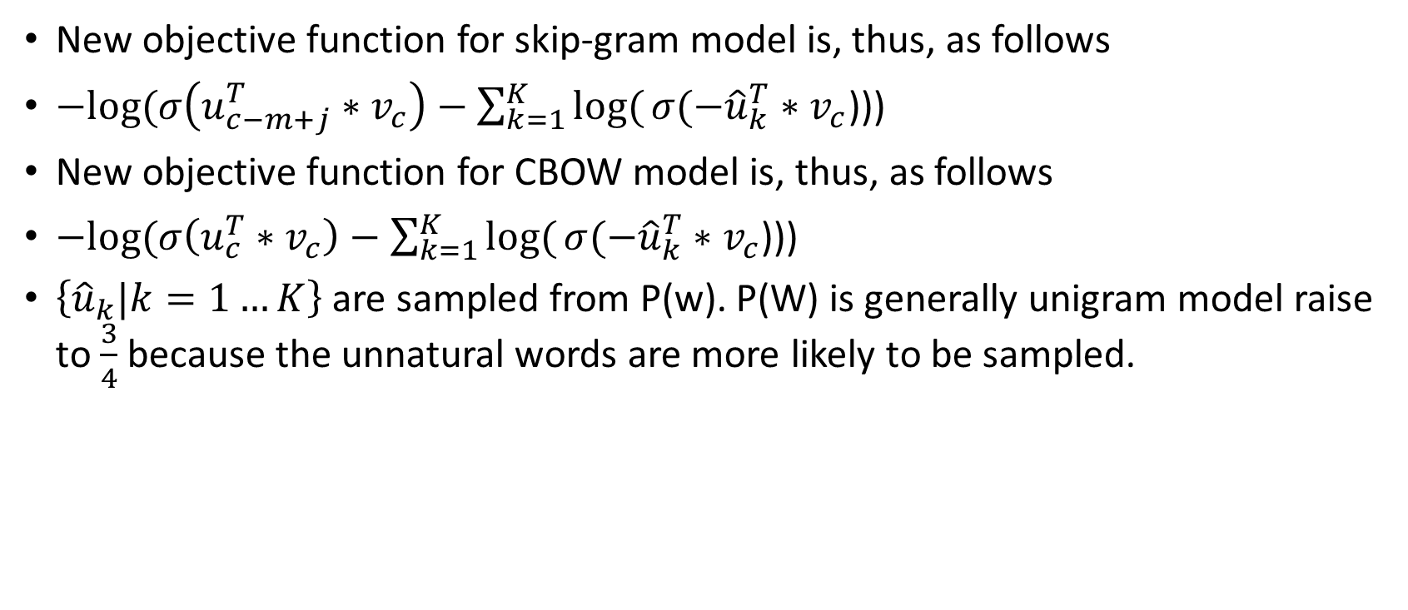
Objective Function (CONT.)
New objective function for skip-gram model is, thus, as follows
$−log⁡(σ\left(u_{c−m+j}^{T}∗v_{c}\right)−\sum_{k=1}^{K}{log⁡(}σ(−{\hat{u}}_{k}^{T}∗v_{c}$)))
New objective function for CBOW model is, thus, as follows
$−log⁡(σ\left(u_{c}^{T}∗v_{c}\right)−\sum_{k=1}^{K}{log⁡(}σ(−{\hat{u}}_{k}^{T}∗v_{c}$)))
$\left\{{\hat{u}}_{k}|k=1…K\right\}$are sampled from P(w). P(W) is generally unigram model raise to $\frac{3}{4}$because the unnatural words are more likely to be sampled.

Slide 43
Hierarchical Softmax

Slide 44
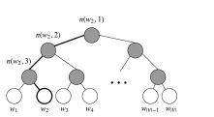
Introduction
Hierarchical softmx
represents all words as binary tree.
Each leaf is a word and each node is a vector that model is going to learn.
Advantage of using hierarchical softmax
Only cost O(log(V))
Disadvantage of using hierarchical softmax
Cannot be parallelized

Slide 45
Notation
L(w): number of node from root to leaf w
n(w,i): i-th node on the path
ch(i): inner node n’s children

Slide 46
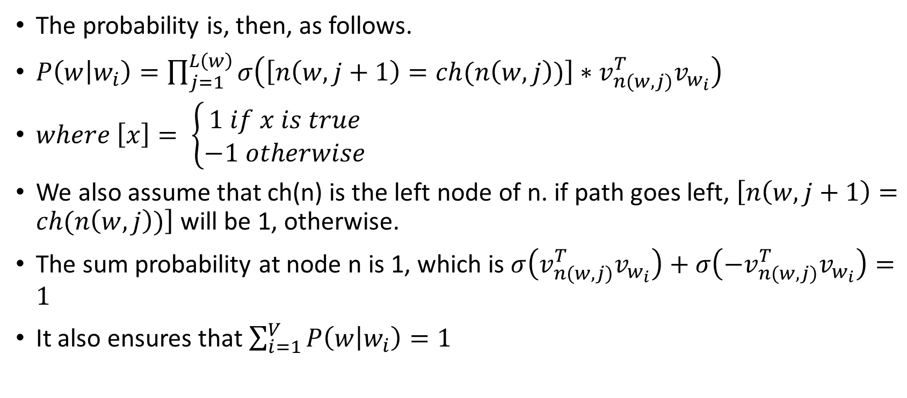
Probability Calculation
The probability is, then, as follows.
$P\left(w | w_{i}\right)=\prod_{j=1}^{L\left(w\right)}{σ\left(\left[n\left(w,j+1\right)=ch(n\left(w,j\right))\right]∗v_{n(w,j)}^{T}v_{w_{i}}\right)}$
$where \left[x\right]= \left\{\begin{aligned}1 if x is true \\ −1 otherwise\end{aligned}\right.$
We also assume that ch(n) is the left node of n. if path goes left, $\left[n\left(w,j+1\right)=ch(n\left(w,j\right))\right]$ will be 1, otherwise.
The sum probability at node n is 1, which is $σ\left(v_{n(w,j)}^{T}v_{w_{i}}\right)+σ\left(−v_{n(w,j)}^{T}v_{w_{i}}\right)=1$
It also ensures that $\sum_{i=1}^{V}{P\left(w | w_{i}\right)=1}$

Slide 47


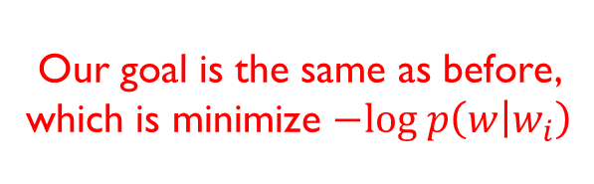
Example
take the graph bellow for example. The approach to calculate $p\left(w_{2} | w_{i}\right)$ is as follows.
$p\left(w_{2} | w_{i}\right)$ = $p\left(n\left(w_{2},1\right),left\right)∗p\left(n\left(w_{2},2\right),left\right)$ * $p\left(n\left(w_{2},3\right),right\right)$
= $σ\left(v_{n\left(w_{2},1\right)}^{T}v_{w_{i}}\right)∗σ\left(v_{n\left(w_{2},2\right)}^{T}v_{w_{i}}\right)$ *$σ\left(−v_{n\left(w_{2},3\right)}^{T}v_{w_{i}}\right)$
Our goal is the same as before, which is minimize $−log p\left(w | w_{i}\right)$

Slide 48
Practical Topics

Slide 49
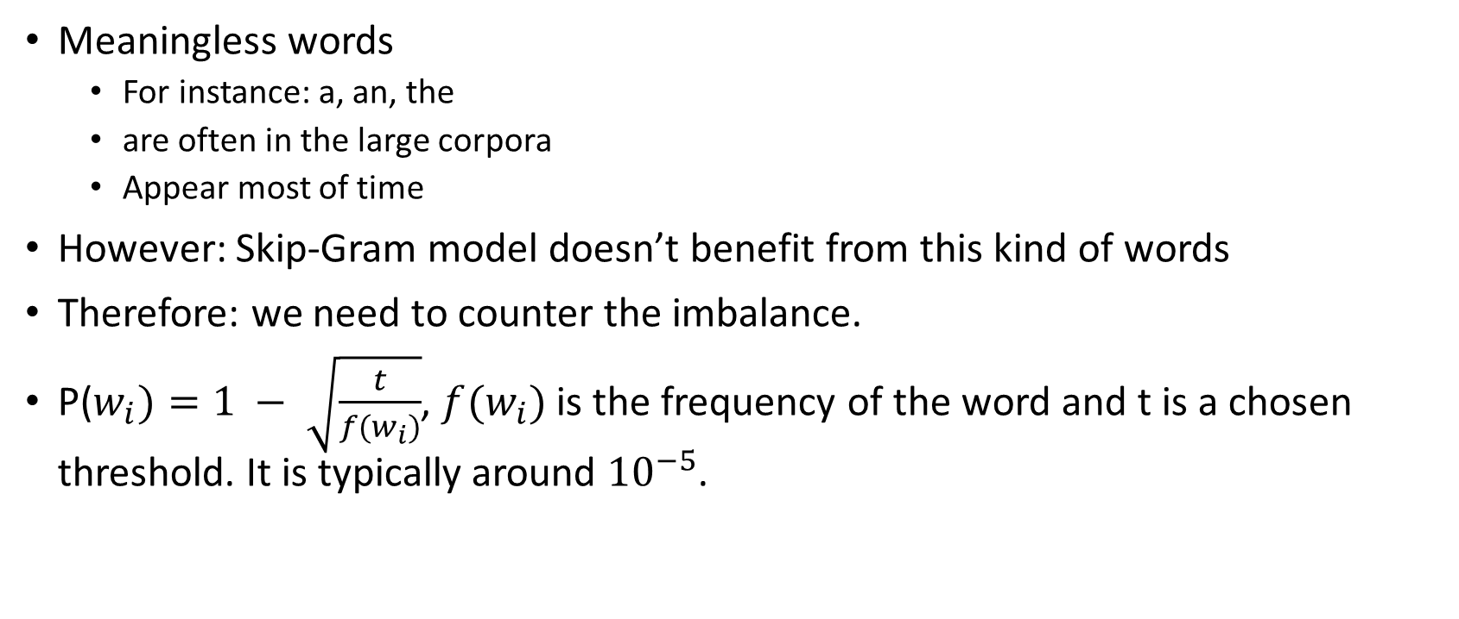
Subsampling of Frequent Words
Meaningless words
For instance: a, an, the
are often in the large corpora
Appear most of time
However: Skip-Gram model doesn’t benefit from this kind of words
Therefore: we need to counter the imbalance.
P($w_{i})=1 − \sqrt{\frac{t}{f(w_{i})}}$, $f(w_{i})$ is the frequency of the word and t is a chosen threshold. It is typically around ${10}^{−5}$.

Slide 50
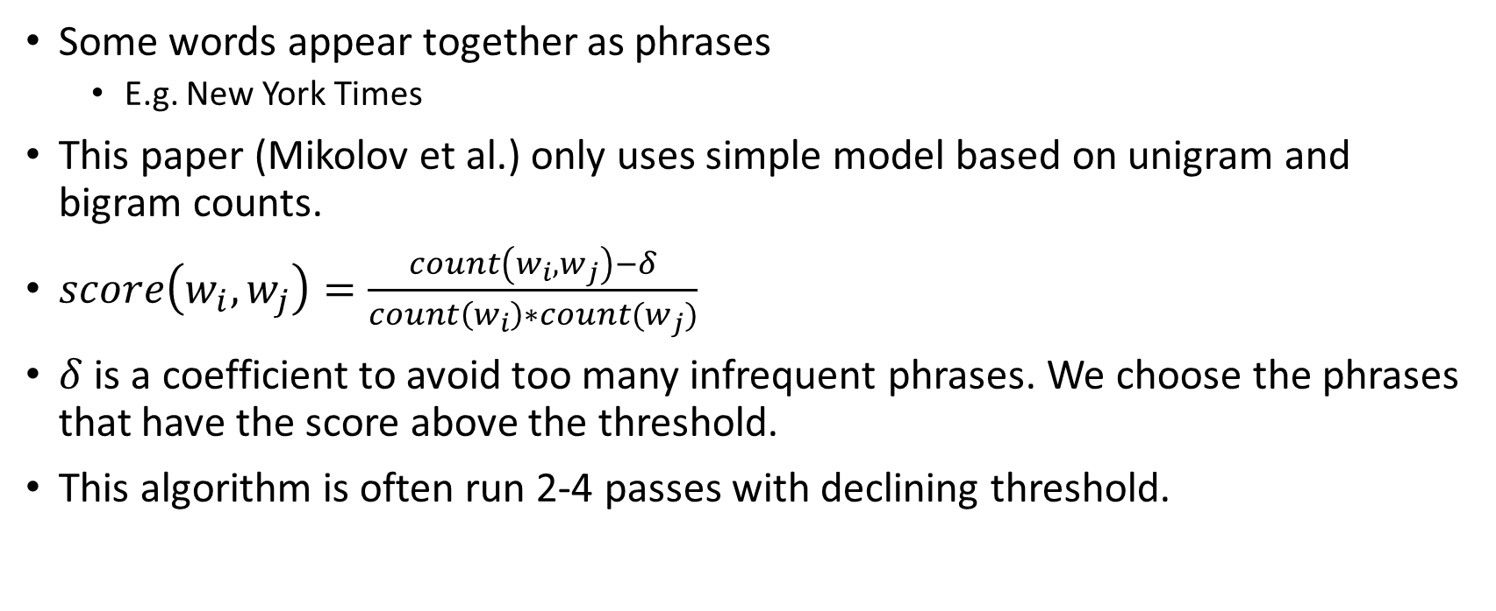
Learning Phrase
Some words appear together as phrases
E.g. New York Times
This paper (Mikolov et al.) only uses simple model based on unigram and bigram counts.
$score\left(w_{i},w_{j}\right)=\frac{count\left(w_{i},w_{j}\right)−δ}{count\left(w_{i}\right)∗count(w_{j})}$
$δ$ is a coefficient to avoid too many infrequent phrases. We choose the phrases that have the score above the threshold.
This algorithm is often run 2-4 passes with declining threshold.

Slide 51
Results

Slide 52
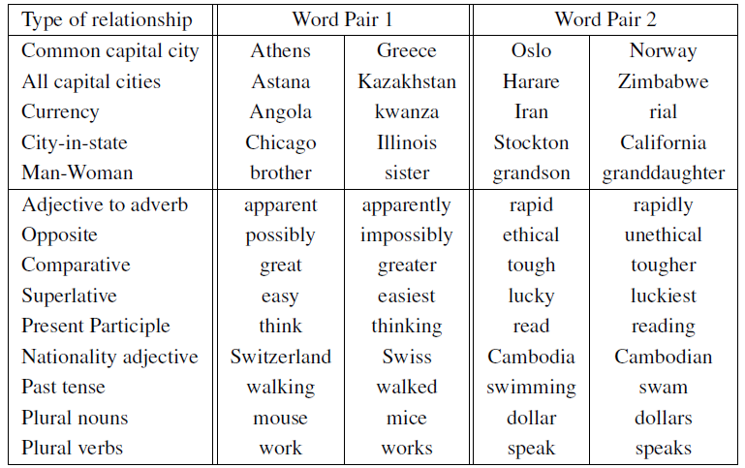
Examples of Semantic and Syntactic Test

Slide 53
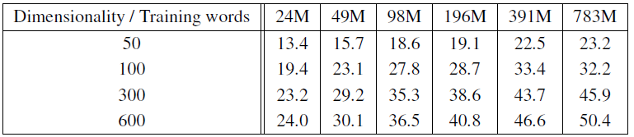
Accuracy on Semantic-Syntactic Word Relationship Test Set with CBOW
The much data and higher dimension we use to train model, The higher accuracy we get.

Slide 54
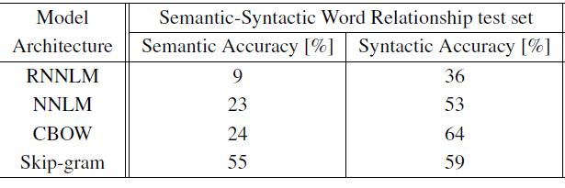
Comparison of Model Trained on Same Data, with 640-Dimensional Word Vectors

Slide 55
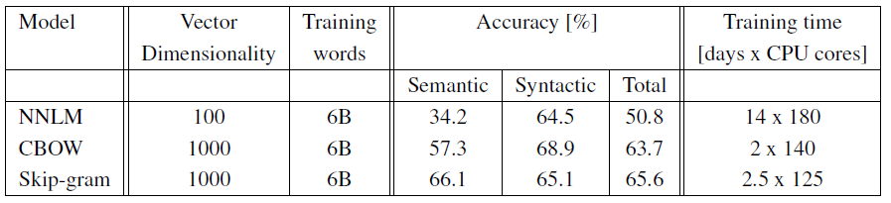
Comparison of Models Using Distbelied Distributed Framework
It takes too long to finishing training 1000 dimension on NNLM model.

Slide 56
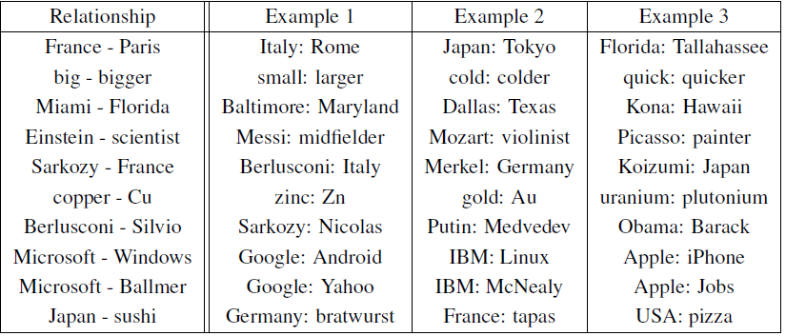
Example of Word Pair Relationships Using Best Skip-Gram Model
According to paper (Mikolov et al.), it only reaches 60% on accuracy, but it will be improved if they train on larger data sets.

Slide 57
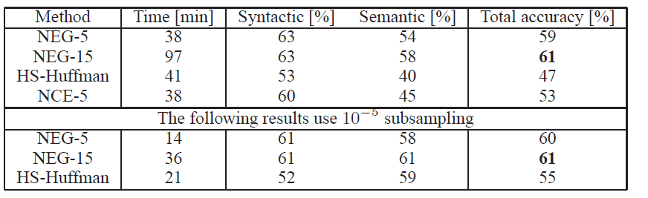
Accuracy of Various 300-Dimensional Skip-Gram Model
NEG-k means Negative Sampling with k negative samples.

Slide 58
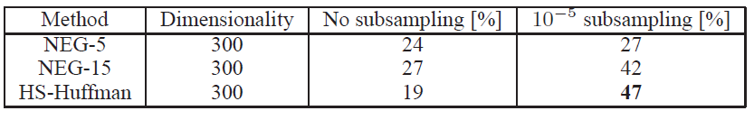
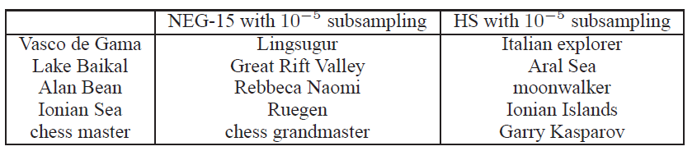
Accuracy of Skip-Gram Models on the Phrase Analogy Dataset
Mikolov et al. got the lowest accuracy on HS-Huffman without subsampling, but they reached highest accuracy when we trained with subsampling.
This result reached 72% of accuracy.

Slide 59
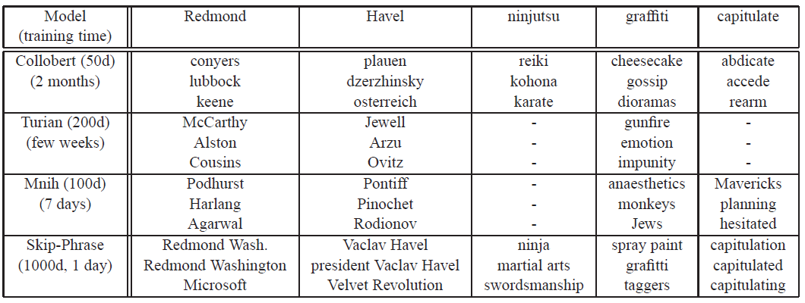
Comparison of Model with Previous Models
Empty means words was not in the vocabulary sets.

Slide 60
Vector Space Model (VSM)

Slide 61
Information Retrieve
Definition of Information Retrieve
The difference between “Structured Data” and “Unstructured Data”
Algorithm for Information Retrieve
Boolean Retrieve
Vector Space Model
What’s the difference between Boolean Retrieve and Vector Space Model?
The Boolean Retrieve only tells us “if the documents contain key words that we type.” The Vector Space Model tells us “the similarity between our documents and query.”

Slide 62
Vector Space Model: Introduction
How do we know the similarity between two documents?
Definition of Vector Space Model
The vector Space Model represents a set of document as vectors in a common vector space.
Application of Vector Space Model
Information Retrieve
Text Classification
Text Clustering
a set of features

Slide 63
Vector Space Model: Cosine Similarity
Cosine Similarity
Formula of Cosine Similarity
$sim\left(d_{1},d_{2}\right)= \frac{\vec{v_{1}} \left(d_{1}\right)∗ \vec{v_{2}}(d_{2})}{\left|\vec{v_{1}} (d_{1})\right| \left|\vec{v_{2}}(d_{2})\right|}$

Slide 64
Vector Space Model: Cosine Similarity
the numerator is known as dot product(inner product). It is defined as follows.
$\vec{x}∗\vec{y}= \sum_{i=1}^{M}{x_{i}y_{i}}$
the denominator is known as Euclidean Length. The Euclidean Length of d is defined as follows.
$\sqrt{\sum_{i=1}^{M}{{\vec{V_{i}}}^{2}(d)}}$
the normalization of Cosine Similarity
We can also normalize $\vec{v_{1}} (d_{1})$to unit vector. Thus, we only need to calculate the dot product for Cosine Similarity. The formula will be as follows.
$sim\left(d_{1},d_{2}\right)$ = $\vec{v_{1}} \left(d_{1}\right)∗\vec{v_{2}}(d_{2})$
the length of unit vector is 1.

Slide 65
References
Mikolov et al., Efficient Estimation of Word Representations in Vector Space
Mikolov et al., Distributed Representation of Words and Phrases and their Compositionality
Manning et al., CS224n Natural Language Processing with Deep Learning, Stanford University.
Alex Minnaar Word2Vec Tutorial Part II: The Continuous Bag-of-Words Model
D.Manning, Introduction of Information Retrieve.

