Slide 1
Backpropagation and Computation Graphs
Chia-Yi Su
Department of Electronic Engineering
National Kaohsiung University of Science and Technology

Slide 2
Course Outline
Basic Knowledge on Natural Language Processing
Applications of Natural Language Processing
Word Vector
Neural Network (Including Relative Math Derivation)
Dependency Parsing
Recurrent Neural Network, Variants of Recurrent Neural Network, and Language Model
Machine Translation
Contextual Representation
Dialog System (Including MultiModal Dialog System)

Slide 3
Today’s Agenda
Stochastic Gradient Decent
Backpropagation
Tricks and Tips on Neural Network

Slide 4
Stochastic Gradient Decent

Slide 5
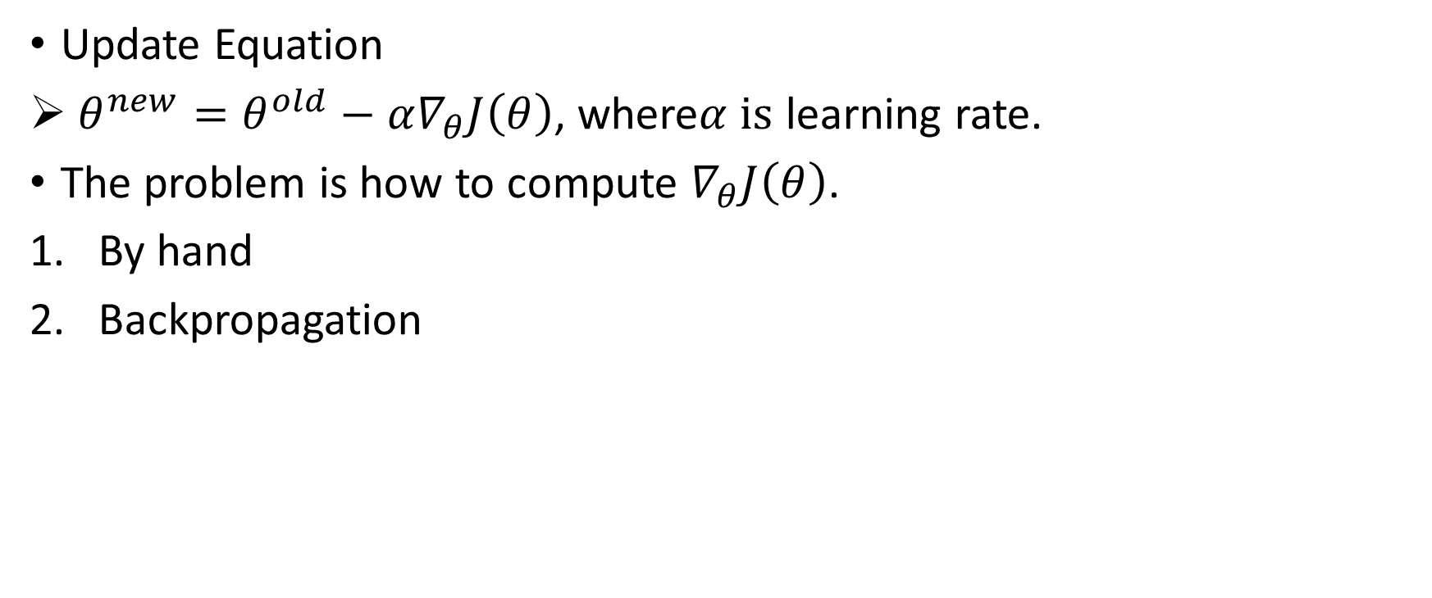
Stochastic Gradient Decent
Update Equation
$θ^{new}=θ^{old}−α∇_{θ}J\left(θ\right)$, where$α is$ learning rate.
The problem is how to compute $∇_{θ}J\left(θ\right)$.
By hand
Backpropagation
We will introduce tons of calculus later.

Slide 6
Calculus Review

Slide 7
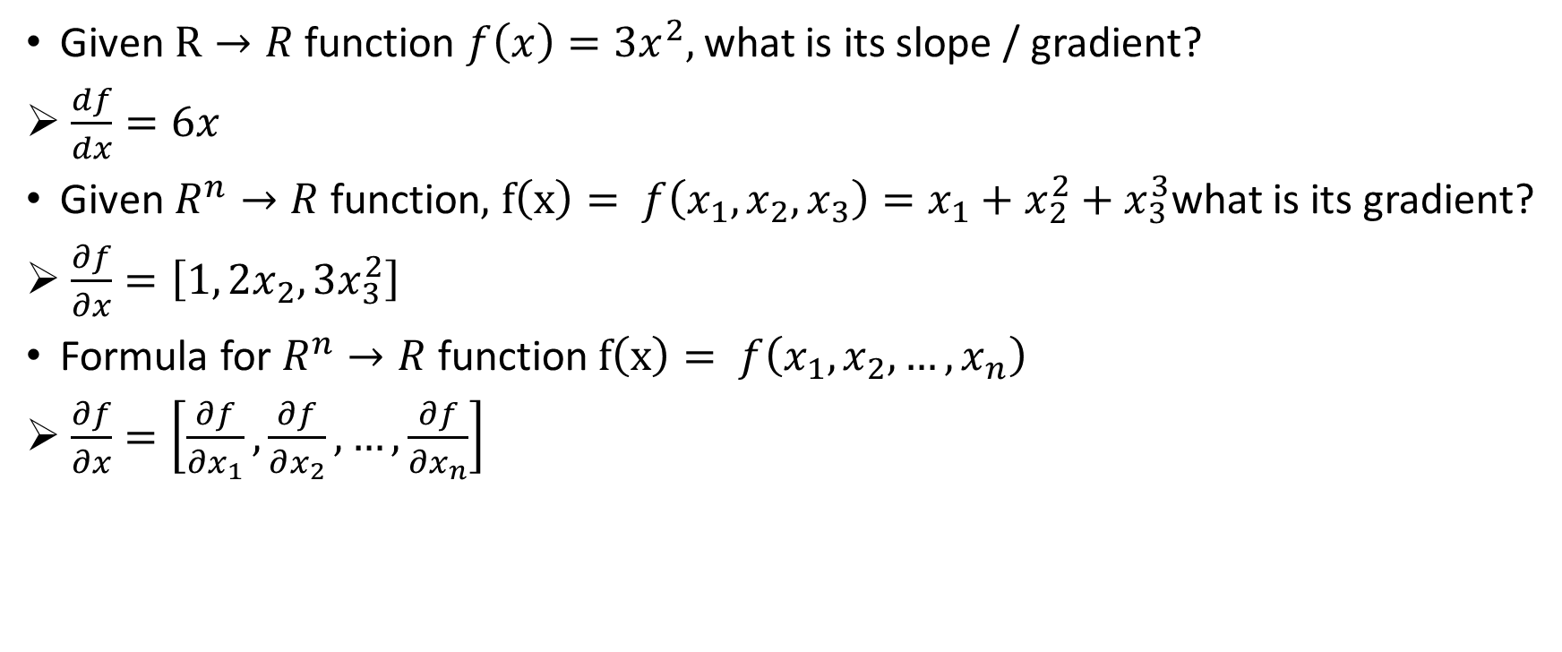
Review of Calculus
Given $R→R$ function ${f\left(x\right)=3x}^{2},$ what is its slope / gradient?
$\frac{df}{dx}=6x$
Given $R^{n}→R$ function$,$ $f\left(x\right)= f\left(x_{1},x_{2},x_{3}\right)={x_{1}+x}_{2}^{2}+x_{3}^{3}$what is its gradient?
$\frac{∂f}{∂x}=\left[1, 2x_{2},{3x}_{3}^{2}\right]$
Formula for $R^{n}→R$ function$f\left(x\right)= f\left(x_{1},x_{2},…,x_{n}\right)$
$\frac{∂f}{∂x}=\left[\frac{∂f}{∂x_{1}},\frac{∂f}{∂x_{2}},…,\frac{∂f}{∂x_{n}}\right]$

Slide 8
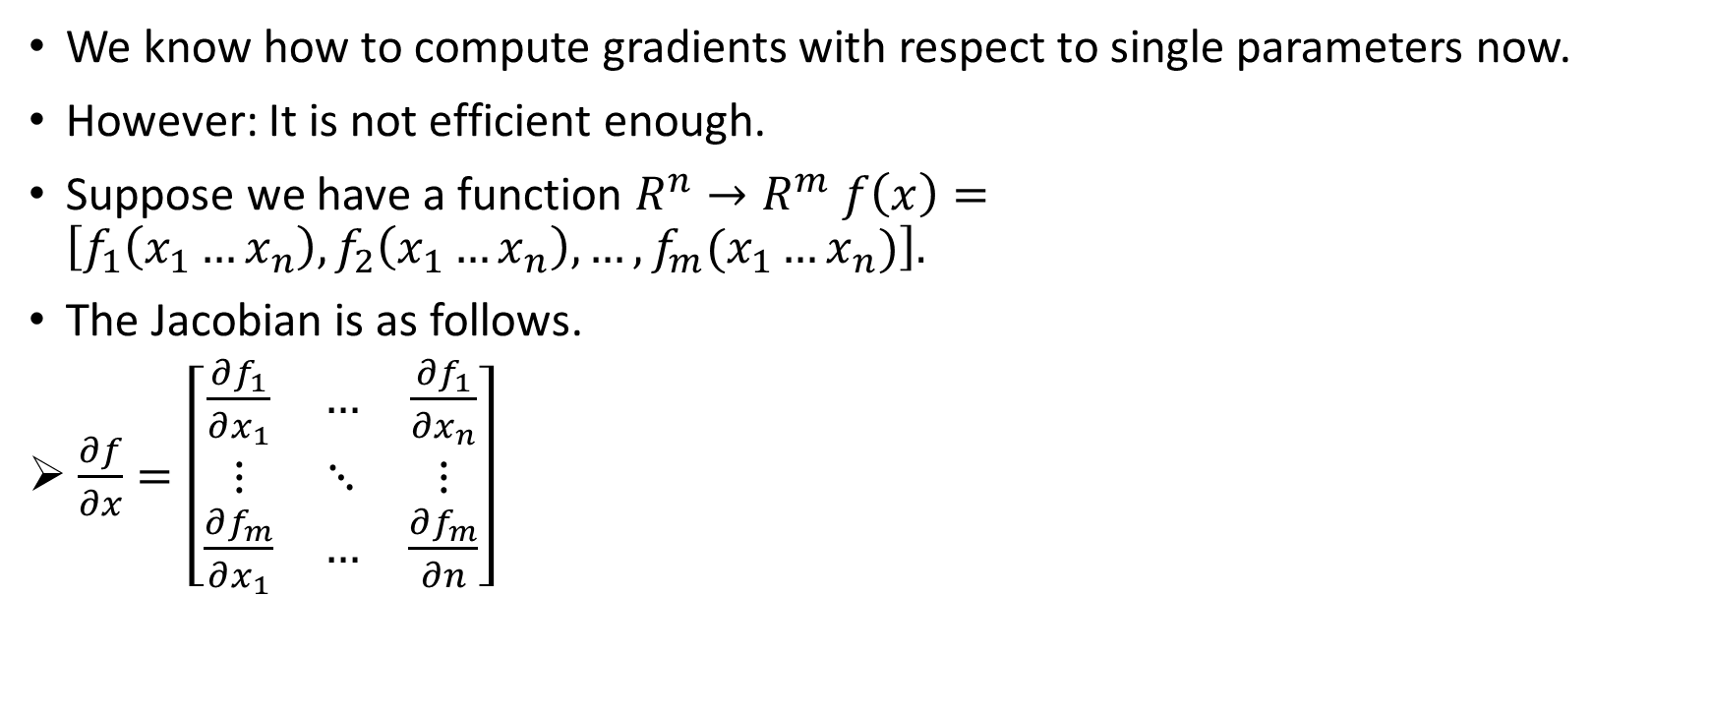
Jacobian Matrix: Vectorized Gradients
We know how to compute gradients with respect to single parameters now.
However: It is not efficient enough.
Suppose we have a function $R^{n}→R^{m} f\left(x\right)=\left[f_{1}\left(x_{1}…x_{n}\right),f_{2}\left(x_{1}…x_{n}\right), …,f_{m}(x_{1}…x_{n})\right].$
The Jacobian is as follows.
$\frac{∂f}{∂x}=\left[\begin{matrix}\frac{∂f_{1}}{∂x_{1}} & … & \frac{∂f_{1}}{∂x_{n}} \\ ⋮ & ⋱ & ⋮ \\ \frac{∂f_{m}}{∂x_{1}} & … & \frac{∂f_{m}}{∂n}\end{matrix}\right]$

Slide 9

Chain Rule
The dot product of Jacobian Matrix
Suppose we have $h=f∘g$, where $∘$ is a composition operator.
Its derivative is as follows.
$J_{h(x)}=J_{f\left(g\left(x\right)\right)}∙J_{g(x)}$

Slide 10
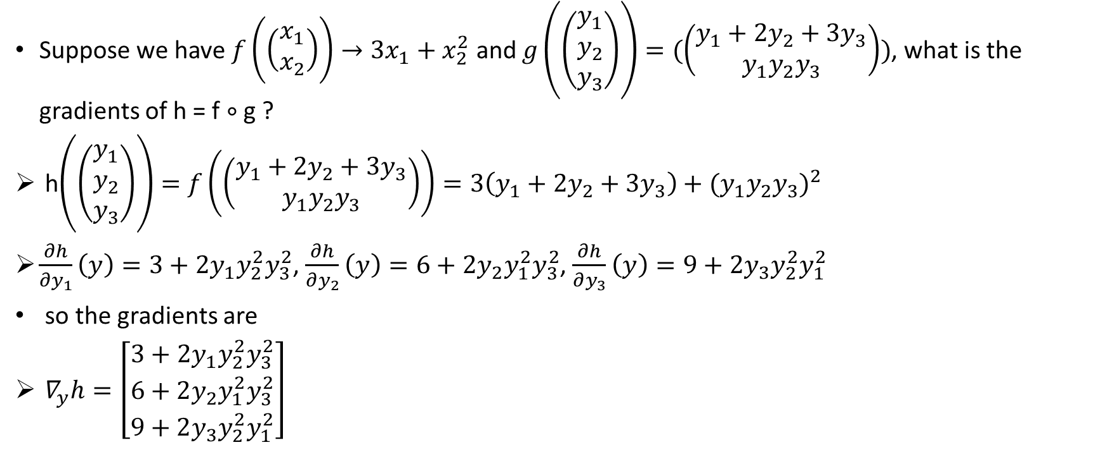
Conventional Chain Rule
Suppose we have $f\left(\left(\begin{matrix}x_{1} \\ x_{2}\end{matrix}\right)\right)→{3x}_{1}+x_{2}^{2}$ and $g\left(\left(\begin{matrix}y_{1} \\ y_{2} \\ y_{3}\end{matrix}\right)\right)=(\left(\begin{aligned}y_{1}+{2y}_{2}+{3y}_{3} \\ y_{1}y_{2}y_{3}\end{aligned}\right))$, what is the gradients of h = f $∘$ g ?
h$\left(\left(\begin{matrix}y_{1} \\ y_{2} \\ y_{3}\end{matrix}\right)\right)=f\left(\left(\begin{aligned}y_{1}+{2y}_{2}+{3y}_{3} \\ y_{1}y_{2}y_{3}\end{aligned}\right)\right)=3\left(y_{1}+{2y}_{2}+{3y}_{3}\right)+{(y_{1}y_{2}y_{3})}^{2}$
$\frac{∂h}{∂y_{1}}\left(y\right)=3+2y_{1}y_{2}^{2}y_{3}^{2}$, $\frac{∂h}{∂y_{2}}\left(y\right)=6+2y_{2}y_{1}^{2}y_{3}^{2}$, $\frac{∂h}{∂y_{3}}\left(y\right)=9+2y_{3}y_{2}^{2}y_{1}^{2}$
so the gradients are
$∇_{y}h=\left[\begin{matrix}3+2y_{1}y_{2}^{2}y_{3}^{2} \\ 6+2y_{2}y_{1}^{2}y_{3}^{2} \\ 9+2y_{3}y_{2}^{2}y_{1}^{2}\end{matrix}\right]$

Slide 11
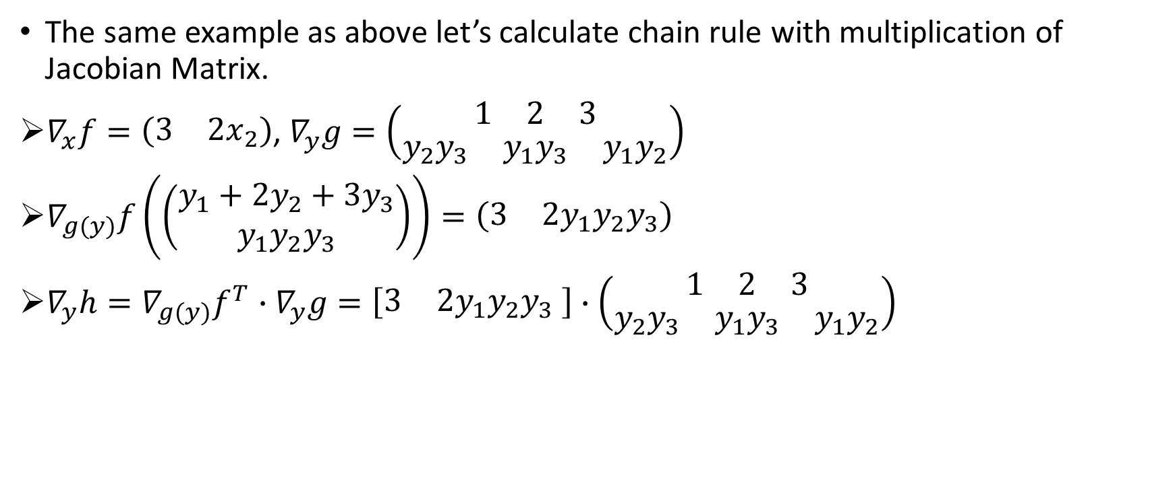
Multiplication of Jacobian Matrix Chain Rule
The same example as above let’s calculate chain rule with multiplication of Jacobian Matrix.
$∇_{x}f=\left(\begin{matrix}3 & {2x}_{2}\end{matrix}\right)$, $∇_{y}g=\left(\begin{matrix}\begin{matrix}1 & 2 & 3\end{matrix} \\ \begin{matrix}y_{2}y_{3} & y_{1}y_{3} & y_{1}y_{2}\end{matrix}\end{matrix}\right)$
$∇_{g(y)}f\left(\left(\begin{aligned}y_{1}+{2y}_{2}+{3y}_{3} \\ y_{1}y_{2}y_{3}\end{aligned}\right)\right)=\left(\begin{matrix}3 & 2y_{1}y_{2}y_{3}\end{matrix}\right)$
$∇_{y}h={∇_{g(y)}f}^{T}∙∇_{y}g=\left[\begin{matrix}3 & 2y_{1}y_{2}y_{3}\end{matrix} \right]$ $∙\left(\begin{matrix}\begin{matrix}1 & 2 & 3\end{matrix} \\ \begin{matrix}y_{2}y_{3} & y_{1}y_{3} & y_{1}y_{2}\end{matrix}\end{matrix}\right)$

Slide 12
Useful Identities for Neural Network

Slide 13

Matrix Times Column Vector w.r.t. Column Vector
z = Wx, what is $\frac{∂z}{∂x}$ ? W $ε R^{n∗m}$, x $ε R^{m}$
z = $\left[\begin{matrix}W_{11}x_{1}+W_{12}x_{2}+…+W_{1m}x_{m} \\ ⋮ \\ W_{n1}x_{1}+W_{n2}x_{2}+…+W_{nm}x_{m}\end{matrix}\right]$
$\frac{∂z}{∂x}=\left[\begin{matrix}W_{11} & … & W_{1m} \\ ⋮ & ⋱ & ⋮ \\ W_{n1} & … & W_{nm}\end{matrix}\right]$ = W – (1)

Slide 14

Row Vector Times Matrix w.r.t. Row Vector
z = xW, what is $\frac{∂z}{∂x}$ ? W $ε R^{n∗m}$, x $ε R^{1∗n}$
z = $\left[\begin{matrix}{x_{1}W}_{11}+{x_{2}W}_{21}+…+{x_{n}W}_{n1} \\ ⋮ \\ {x_{1}W}_{1m}+{x_{2}W}_{2m}+…+{x_{n}W}_{nm}\end{matrix}\right]$
$\frac{∂z}{∂x}=\left[\begin{matrix}W_{11} & … & W_{n1} \\ ⋮ & ⋱ & ⋮ \\ W_{1m} & … & W_{nm}\end{matrix}\right]$ = $W^{T}$ – (2)

Slide 15

A Vector w.r.t. Itself
z = x, what is $\frac{∂z}{∂x}$ ?
z = $\left[\begin{matrix}\begin{aligned}x_{1} \\ x_{2}\end{aligned} \\ ⋮ \\ x_{m}\end{matrix}\right]$
$\frac{∂z}{∂x}$ = $\left[\begin{matrix}\begin{aligned}10⋯0 \\ 0 1⋯0\end{aligned} \\ ⋮ \\ 00⋯1\end{matrix}\right]$ = I
Thus, $\frac{∂z}{∂x}$ = I, which is an identity matrix. – (3)

Slide 16

Elementwise Function
z = f(x), what is $\frac{∂z}{∂x}$ ?
$\text{z}\text{ = }\left[\begin{matrix}\begin{aligned}{f(x}_{1}) \\ {f(x}_{2})\end{aligned} \\ ⋮ \\ {f(x}_{m})\end{matrix}\right]$
$\frac{∂z}{∂x}$ = $\left[\begin{matrix}\begin{aligned}f^{′}(x_{1}) \\ f^{′}(x_{2})\end{aligned} \\ ⋮ \\ f^{′}(x_{m})\end{matrix}\right]$
Thus, $\frac{∂z}{∂x}$ = diag($f^{′}(x)$) – (4)

Slide 17
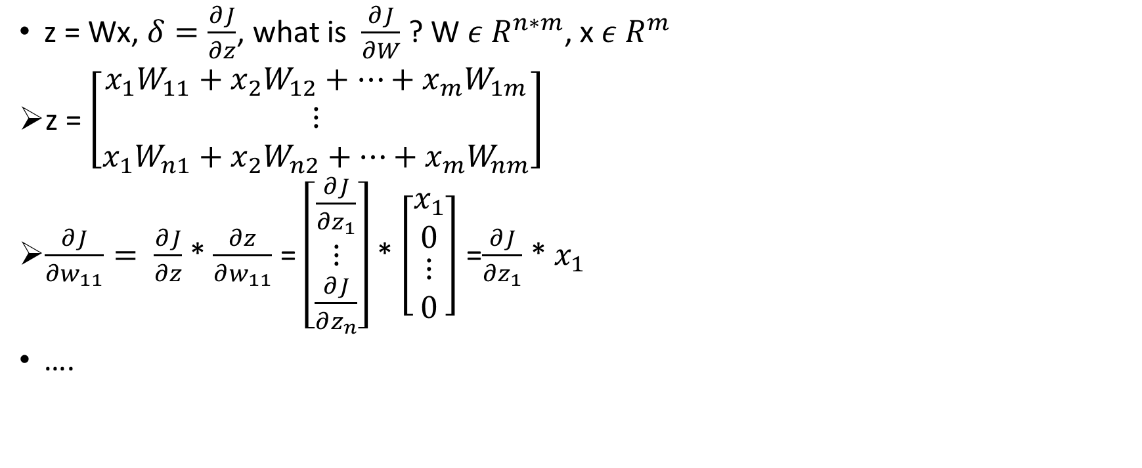
Matrix Times Column Vector w.r.t Matrix
z = Wx, $δ=\frac{∂J}{∂z}$, what is $\frac{∂J}{∂W}$ ? W $ε R^{n∗m}$, x $ε R^{m}$
z = $\left[\begin{matrix}{x_{1}W}_{11}+{x_{2}W}_{12}+…+{x_{m}W}_{1m} \\ ⋮ \\ {x_{1}W}_{n1}+{x_{2}W}_{n2}+…+{x_{m}W}_{nm}\end{matrix}\right]$
$\frac{∂J}{∂w_{11}}= \frac{∂J}{∂z}$ * $\frac{∂z}{∂w_{11}}$ = $\left[\begin{matrix}\frac{∂J}{∂z_{1}} \\ ⋮ \\ \frac{∂J}{∂z_{n}}\end{matrix}\right]$ * $\left[\begin{matrix}\begin{aligned}x_{1} \\ 0\end{aligned} \\ ⋮ \\ 0\end{matrix}\right]$ =$\frac{∂J}{∂z_{1}}$ * $x_{1}$
….
m - 1

Slide 18

Matrix Times Column Vector w.r.t Matrix
Therefore, $\frac{∂J}{∂W}$ = $\left[\begin{matrix}\frac{∂J}{∂z_{1}}\text{ ∗ }x_{1} ,\frac{∂J}{∂z_{1}}\text{ ∗ }x_{2},…,\frac{∂J}{∂z_{1}}\text{ ∗ }x_{m} \\ ⋮ \\ \frac{∂J}{∂z_{n}}\text{ ∗ }x_{1} ,\frac{∂J}{∂z_{n}}\text{ ∗ }x_{2},…,\frac{∂J}{∂z_{n}}\text{ ∗ }x_{m}\end{matrix}\right]$ = $\left[\begin{aligned}\frac{∂J}{∂z_{1}} \\ ⋮ \\ \frac{∂J}{∂z_{n}}\end{aligned}\right]$ [$x_{1}$, $…$, $x_{m}$] =$δ$ $x^{T}$

Slide 19

Derivative of Cross-Entropy Loss w.r.t x
J = $−\log\left(p\left(y | x\right)\right)=−log⁡\left(\frac{\exp\left(W_{y}x\right)}{\sum_{c=1}^{C}{{exp⁡(W}_{c}x)}}\right)$, what is $\frac{∂J}{∂x}?$
J = -$W_{y}x$ + $log⁡\left(\sum_{c=1}^{C}{{exp⁡(W}_{c}x)}\right)$
$\frac{∂J}{∂x}$= -$W_{y}$+$\frac{\exp\left(W_{y}x\right)}{\sum_{c=1}^{C}{{exp⁡(W}_{c}x)}}W_{y}$
Identity 1

Slide 20

Derivative of Cross-Entropy Loss
J = $−log⁡\left(\frac{\exp\left(z_{i}\right)}{\sum_{c=1}^{C}{{exp⁡(z}_{c})}}\right)$, what is $\frac{∂J}{∂z_{i}}?$
J = -$z_{i}$+ $log⁡\left(\sum_{c=1}^{C}{{exp⁡(z}_{c})}\right)$
$\frac{∂J}{∂z_{i}}$ = -1 + $\frac{\exp\left(z_{i}\right)}{\sum_{c=1}^{C}{{exp⁡(z}_{c})}}$
= -1 + softmax($z_{i}$)

Slide 21

Derivative of Sigmoid Function
f(z) = $\frac{1}{1−\exp{(−z)}}$, what is $\frac{∂f}{∂z}?$
$\frac{∂f}{∂z}=\frac{−exp⁡(−z)}{{\left[1−\exp{(−z)}\right]}^{2}}$
= $\frac{−\exp\left(−z\right)+1 −1}{{\left[1−\exp{(−z)}\right]}^{2}}$
= $\frac{1}{1−\exp{(−z)}}$ * $\frac{−\exp\left(−z\right)+1 −1}{1−\exp{(−z)}}$
= $\frac{1}{1−\exp{(−z)}}∗\left[1+\left(\frac{−1}{1−\exp{(−z)}}\right)\right]$
= $σ\left(z\right)∗\left[1−σ\left(z\right)\right]$

Slide 22

Derivative of ReLU Function
ReLU(x) = max(0,x), 求 ReLU 的微分
${ReLU}^{′}\left(x\right)=\left\{\begin{aligned}1, ifx>0 \\ 0, otherwise\end{aligned}\right.$

Slide 23
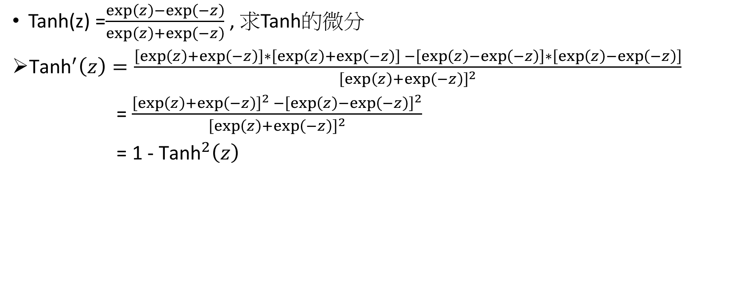
Derivative of Tanh Function
Tanh(z) =$\frac{\exp\left(z\right)−\exp\left(−z\right)}{\exp\left(z\right)+\exp\left(−z\right)}$ , 求Tanh的微分
${\text{Tanh}}^{′}\left(z\right)=\frac{\left[\exp\left(z\right)+\exp\left(−z\right)\right]∗\left[\exp\left(z\right)+\exp\left(−z\right)\right] −\left[\exp\left(z\right)−\exp\left(−z\right)\right]∗\left[\exp\left(z\right)−\exp\left(−z\right)\right]}{{\left[\exp\left(z\right)+\exp\left(−z\right)\right]}^{2}}$
= $\frac{{\left[\exp\left(z\right)+\exp\left(−z\right)\right]}^{2} −{\left[\exp\left(z\right)−\exp\left(−z\right)\right]}^{2}}{{\left[\exp\left(z\right)+\exp\left(−z\right)\right]}^{2}}$
= 1 - ${\text{Tanh}}^{2}\left(z\right)$

Slide 24
Backpropagation

Slide 25
Introduction
Derivative
Chain rule
In order to minimize computation, we also reuse the derivative from higher layer.

Slide 26
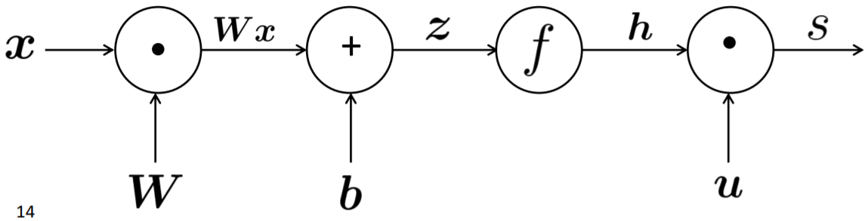

Computational Graph and Forward Propagation
Forward Propagation
x (input)
z = Wx + b
h = f(z)
s = $uh$

Slide 27
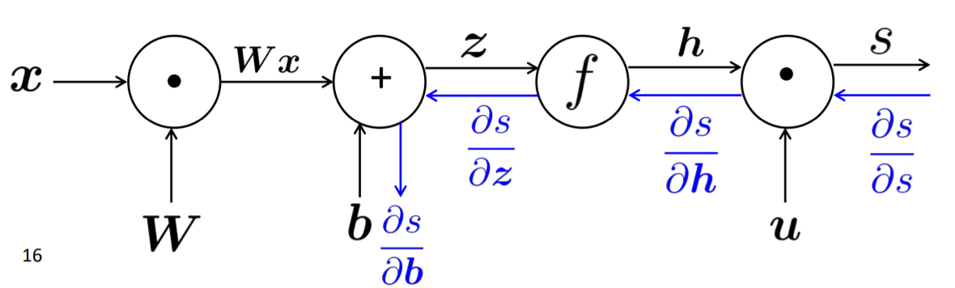

Computational Graph and Back Propagation
Forward Propagation
x (input)
z = Wx + b
h = f(z)
s = $u^{T}h$

Slide 28
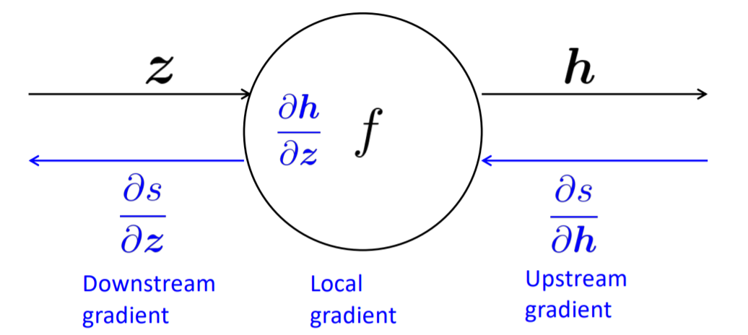
Backpropagation on Single Node
Each node
receives the upstream gradient
has a local gradient

Slide 29

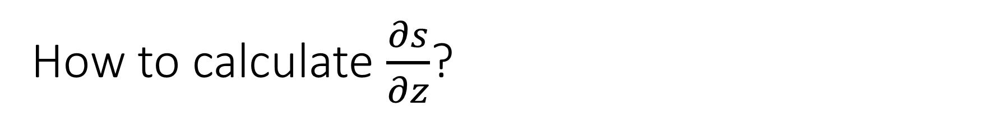
How to calculate $\frac{∂s}{∂z}$?
$\frac{∂s}{∂z}=$ $\frac{∂s}{∂h} \frac{∂h}{∂z}$
(downstream gradient) = (upstream gradient) (local gradient)

Slide 30
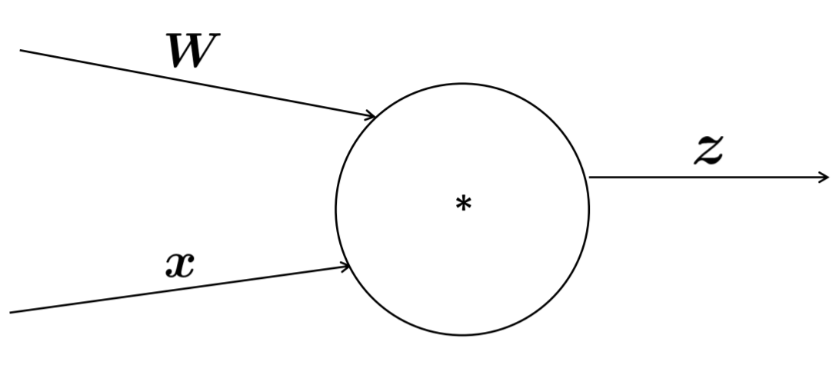





Single Node with Multiple Inputs
z = Wx
Multiple Inputs multiple local gradients
$$\frac{∂s}{∂W}=\frac{∂s}{∂z}\frac{∂z}{∂W}$$
$$\frac{∂z}{∂W}$$
$$\frac{∂z}{∂x}$$
$$\frac{∂s}{∂z}$$
$$\frac{∂s}{∂x}=\frac{∂s}{∂z}\frac{∂z}{∂x}$$

Slide 31
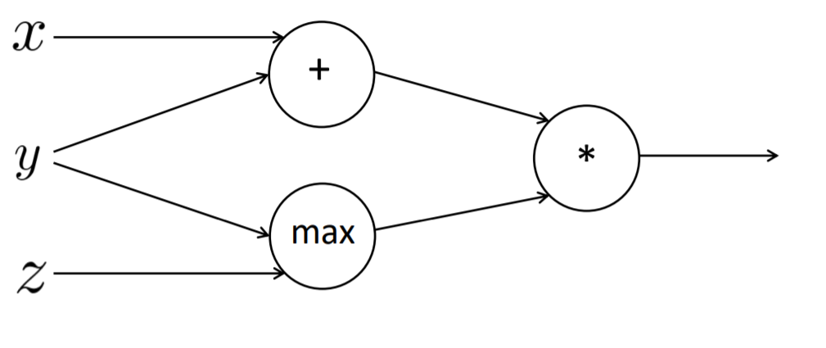








Example
Forward Propagation
a = x + y = 3
b = max(y, z) = 2
f = ab = 6
x = 1, y = 2, z = 0
$\frac{∂f}{∂x}=2$
$\frac{∂f}{∂y}=2+3=5$
$\frac{∂f}{∂z}=0$
1
$$\frac{∂f}{∂x}=2∗1$$
3
2
$$\frac{∂f}{∂y}=2∗1$$
$$\frac{∂f}{∂a}=1∗2$$
6
2
$$\frac{∂f}{∂f}=1$$
$$\frac{∂f}{∂y}=3∗1$$
2
$$\frac{∂f}{∂b}=1∗3$$
0
$$\frac{∂f}{∂z}=1∗0$$

Slide 32
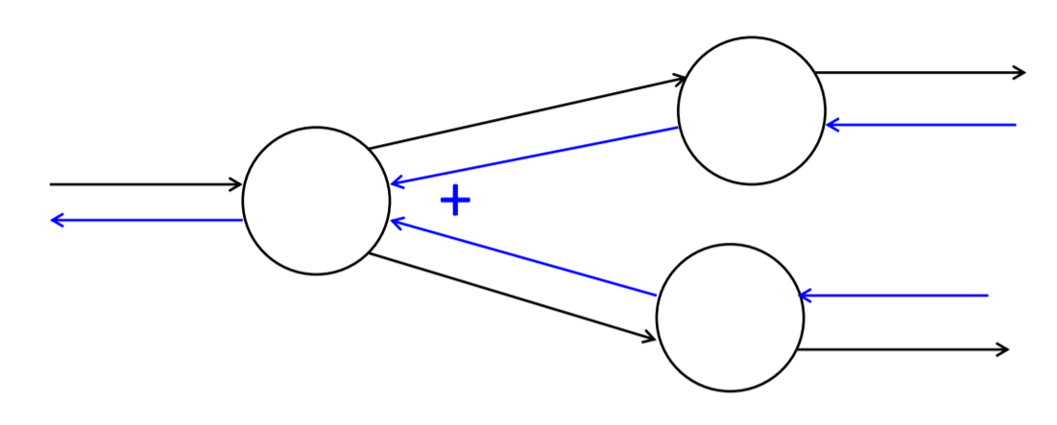
Sum up the Gradients at outward Branches

Slide 33
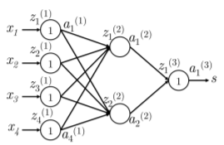


Real Network Example
We will calculate $\frac{∂s}{∂W_{ij}^{(1)}}$
$\frac{∂s}{∂W_{ij}^{(1)}}=\frac{∂W^{(2)}a^{(2)}}{∂W_{ij}^{(1)}}=\frac{∂W_{i}^{(2)}a^{(2)}}{∂W_{ij}^{(1)}}=W_{i}^{(2)}\frac{∂a^{(2)}}{∂W_{ij}^{(1)}}$
${=W}_{i}^{(2)}\frac{∂a^{(2)}}{∂W_{ij}^{(1)}}=W_{i}^{(2)}\frac{∂a^{(2)}}{∂z_{i}^{(2)}}\frac{∂z_{i}^{(2)}}{∂W_{ij}^{(1)}}$
$=W_{i}^{(2)}\frac{∂{f(z}_{i}^{(2)})}{∂z_{i}^{(2)}}\frac{∂z_{i}^{(2)}}{∂W_{ij}^{(1)}}$
$$δ_{i}^{(2)}$$

Slide 34
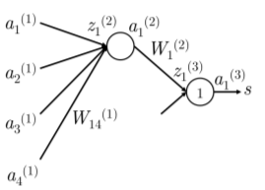

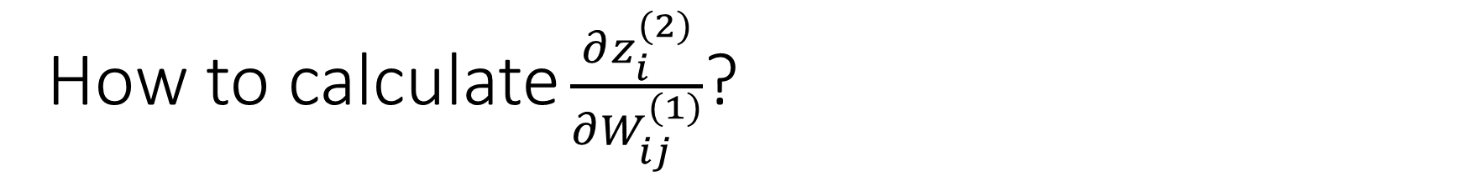
How to calculate $\frac{∂z_{i}^{(2)}}{∂W_{ij}^{(1)}}$?
$\frac{∂z_{i}^{(2)}}{∂W_{ij}^{(1)}}=\frac{∂}{∂W_{ij}^{(1)}}\left(a_{1}^{(1)}W_{i1}^{(1)}+a_{2}^{(1)}W_{i2}^{(1)}+a_{3}^{(1)}W_{i3}^{(1)}+a_{4}^{(1)}W_{i4}^{(1)}\right)$
=$\frac{∂}{∂W_{ij}^{(1)}}\left(\sum_{k}{a_{k}^{(1)}W_{ik}^{(1)}}\right)$
=$a_{j}^{(1)}$

Slide 35
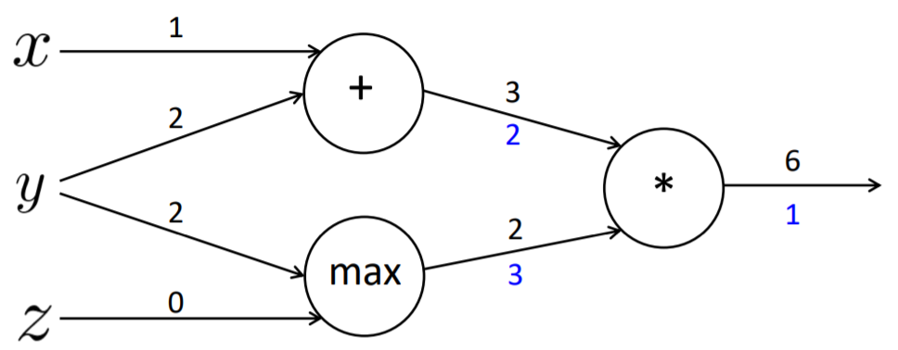
Node Intuition
Upstream gradient is distributed when the node is “+”
Upstream gradient is routed when sign of node is “max”
Upstream gradient is switched when sign of node is ”*”

Slide 36
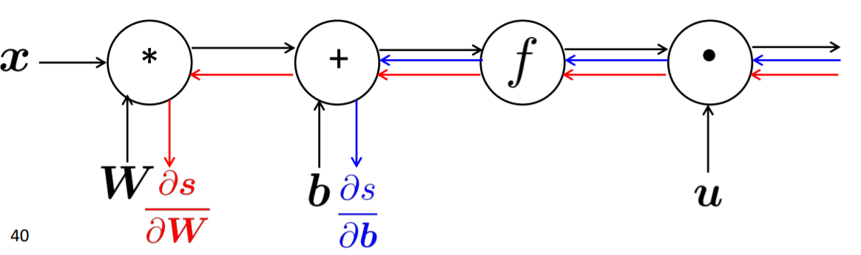
Efficient Gradient Computation
Incorrect Way to Compute backprop
Compute backprop without reusing the term that has already calculated

Slide 37
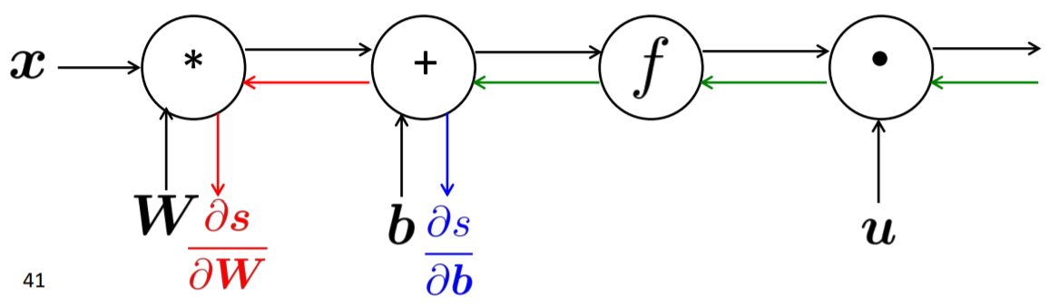
Efficient Gradient Computation
Right way to compute backprop
Reuse the gradients which we have already calculated.

Slide 38
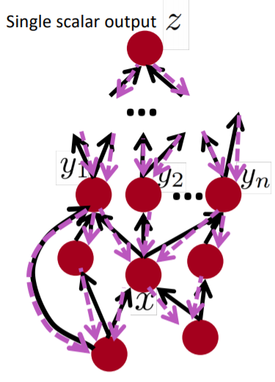
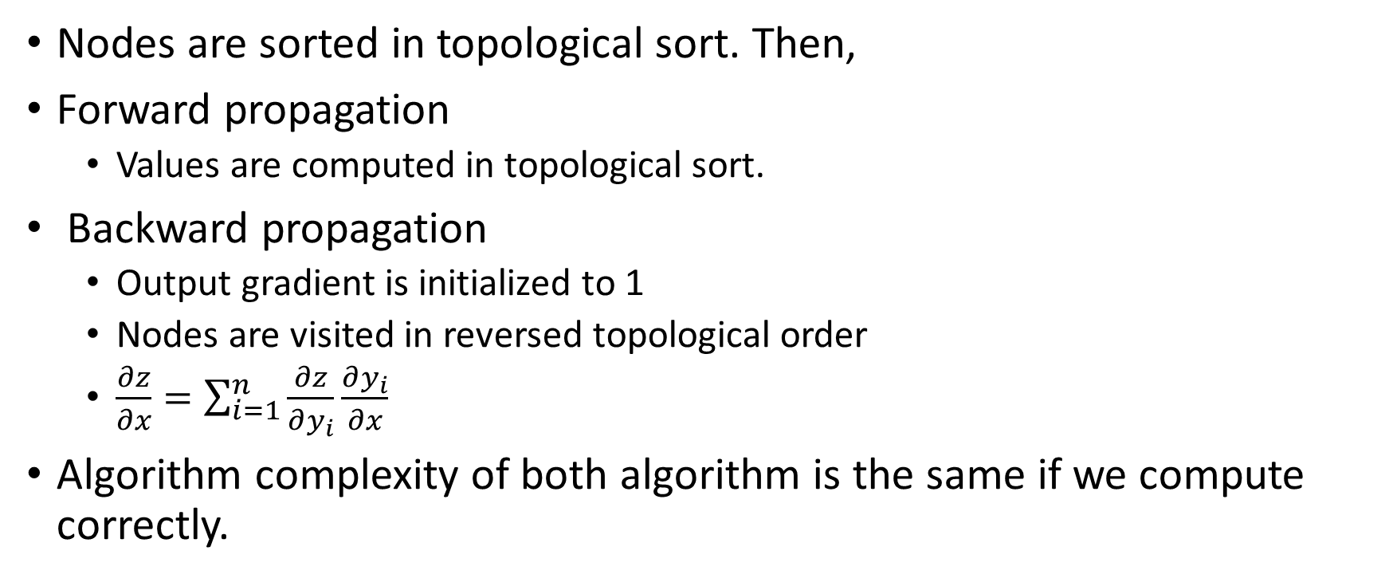
Backprop in Computational Graph
Nodes are sorted in topological sort. Then,
Forward propagation
Values are computed in topological sort.
Backward propagation
Output gradient is initialized to 1
Nodes are visited in reversed topological order
$\frac{∂z}{∂x}=\sum_{i=1}^{n}{\frac{∂z}{∂y_{i}}\frac{∂y_{i}}{∂x}}$
Algorithm complexity of both algorithm is the same if we compute correctly.

Slide 39
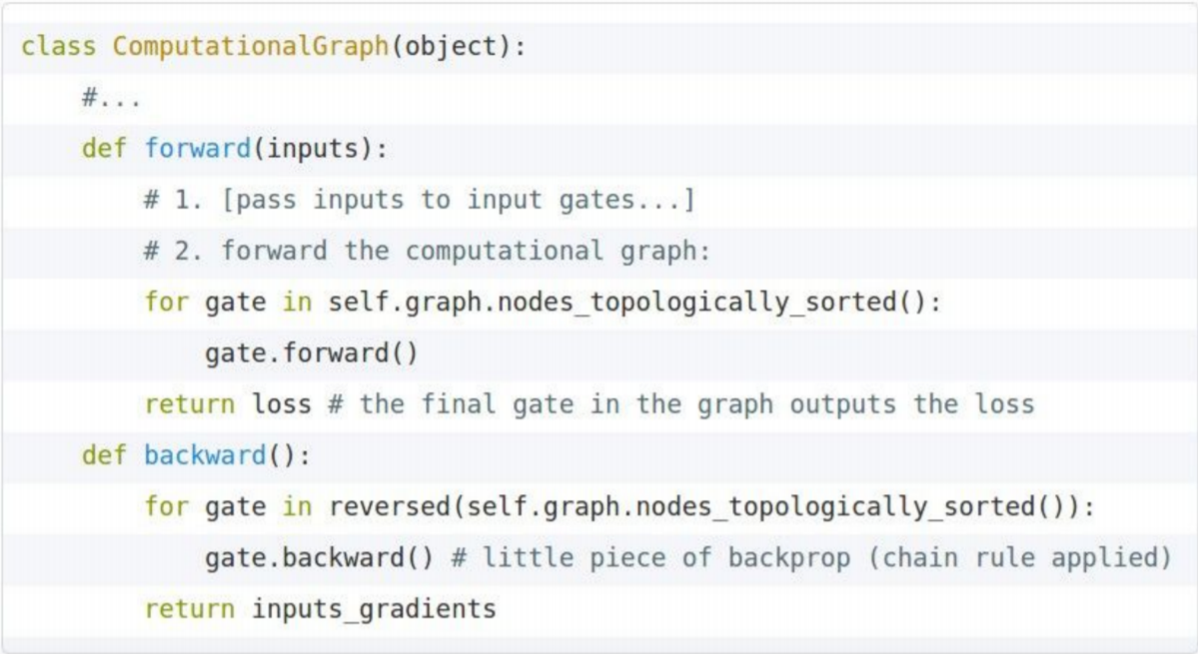
Implementation of Back-Prop

Slide 40
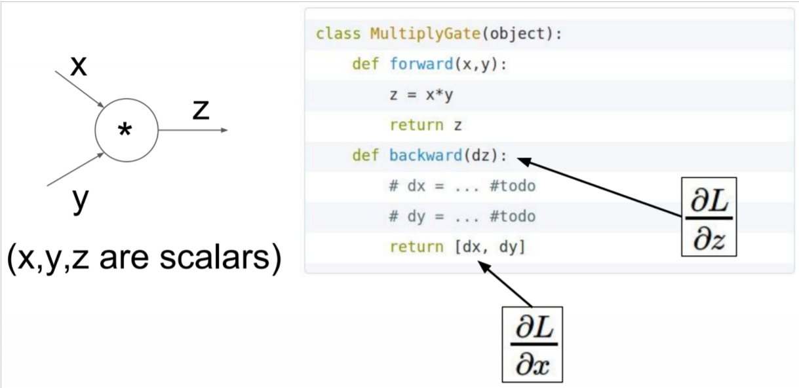
Implementation of Forward/Backward API

Slide 41
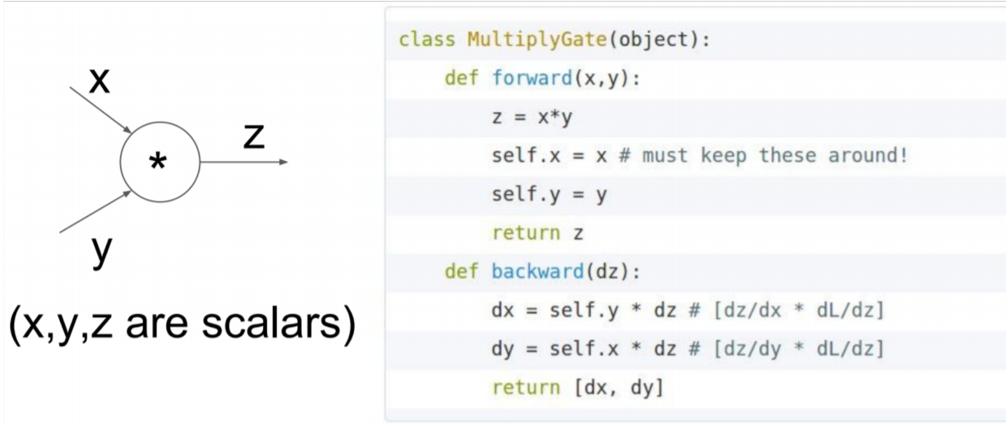
Implementation of Forward/Backward API

Slide 42
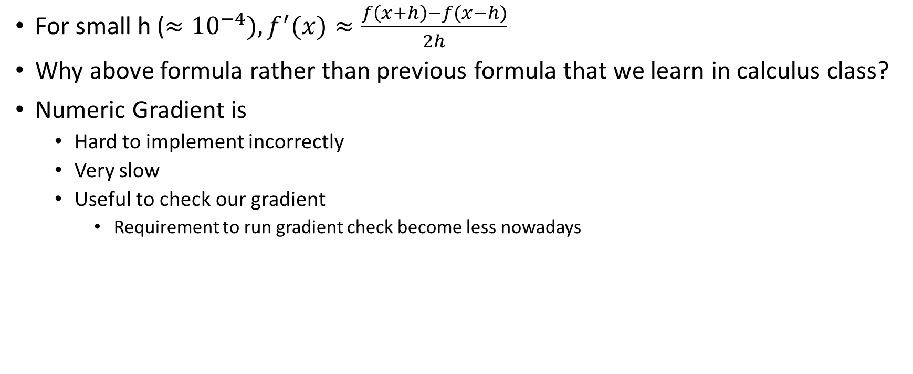
Numeric Gradient for Gradient Check
For small h ($≈{10}^{−4}), f^{′}(x)≈\frac{f\left(x+h\right)−f(x−h)}{2h}$
Why above formula rather than previous formula that we learn in calculus class?
Numeric Gradient is
Hard to implement incorrectly
Very slow
Useful to check our gradient
Requirement to run gradient check become less nowadays

Slide 43
Summary
For now we have learnt
Neural network
Core technology of neural network (backpropagation, partial derivative, chain rule, Jacobian, computational graph)
But why should we learn it?
Know how to debug when our neural nets don’t run correctly
Know how it works so that we can do further research
Spot dead network (ReLU)
Vanish gradient

Slide 44
Tricks and Tips on Neural Network

Slide 45
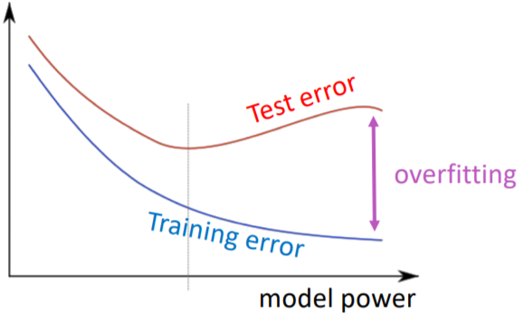
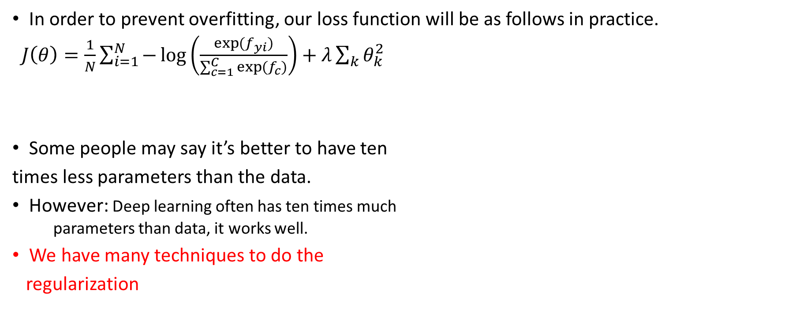
Regularization
In order to prevent overfitting, our loss function will be as follows in practice.
$J\left(θ\right)=\frac{1}{N}\sum_{i=1}^{N}{−\log\left(\frac{\exp{(f_{yi})}}{\sum_{c=1}^{C}{\exp{(f_{c})}}}\right)}+λ\sum_{k}{θ_{k}^{2}}$
Some people may say it’s better to have ten
times less parameters than the data.
However: Deep learning often has ten times much
parameters than data, it works well.
We have many techniques to do the
regularization
L2 Regularization
Hyper-Parameter

Slide 46


$$\text{Regularization}: λ$$
If$λ$ is
Too high: training step will be trivial because almost all of weights are 0.
Too Low: model will be overfitting again since it’s similar to no regularization.
$λ$ is a hyper-parameter that is required fine-tune.

Slide 47
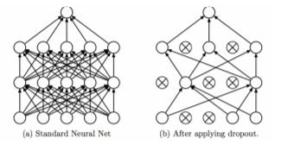
Dropout
A powerful and effective regularization technique.
Training Step: Only probability p number of neurons are activated.
Test Step: Full neurons are activated.

Slide 48
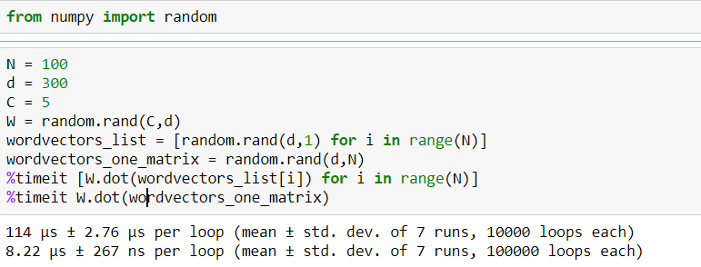
Vectorization
This code is only run by using CPU. However, GPU can be faster.

Slide 49

Non-Linearity: Sigmoid
It was commonly used in early 80’s and 90’s.
Its output gives us a probability because its
rank is between 0 and 1.
Since it doesn’t work well, we seldom use it
nowadays. This non-linearity is employed when
we want our output to be a probability.

Slide 50

Non-Linearities: tanh and hard tanh
tanh(z) =2 sigmoid(2z)-1
None of above non-linearities are default choices for training neural network.

Slide 51


Better Non-Linearity
ReLU = max(z,0)
Computational efficiency
Dead network sometimes
Leaky ReLU and Parametric ReLU
It’s better to try ReLU first.

Slide 52

Non-Linearity: Maxout
$maxout=max⁡(w_{1}^{T}x+b_{1},w_{2}^{T}x+b_{2})$
Advantage
Doesn’t have dying ReLU
Disadvantage
Double the parameter

Slide 53


Non-Linearity: Soft Sign
softsign(z) = $\frac{z}{1+\left|z\right|}$

Slide 54


Derivative of Non-Linearities
tanh(z)=$\frac{\exp\left(z\right)−exp⁡(−z)}{\exp\left(z\right)+exp⁡(−z)}$
$hardtanh\left(z\right)=\left\{\begin{aligned}−1 :z<−1 \\ z :−1<z<1 \\ 1 :z>1\end{aligned}\right.$
$softsign\left(z\right)=\frac{z}{1+\left\lfloor z\right\rfloor }$
ReLU(z) =max(z,0)
Leaky ReLU(z) = max(z,k*z)
$\tanh^{′}\left(z\right)=1−\tanh^{2}(z)$
${hardtanh}^{′}\left(z\right)=\left\{\begin{aligned}1 :−1<z<1 \\ 0 :otherwise\end{aligned}\right.$
${softsign}^{′}\left(z\right)=\frac{1}{{(1+z)}^{2}}$
${rect}^{′}\left(z\right)=\left\{\begin{aligned}1 :z>0 \\ 0 :otherwise\end{aligned}\right.$
${leaky}^{′}\left(z\right)=\left\{\begin{aligned}1 :z>0 \\ k :otherwise\end{aligned}\right.$

Slide 55
Data Preprocessing
Mean Subtraction
Calculate the mean in training data and subtract this mean from input.
Although mean is only calculated in training set, this mean is subtracted from training, test, and validation sets.
Normalization
Normalization, which features are divided by the standard deviation calculated by using training sets, scales range between input data in order to equalize the importance of all features.

Slide 56

Parameter Initialization
In order to avert symmetries, weights are initialized to small random values.
Bias terms are initialized to 0 and makes the network learn itself.
Xavier initialization suggests that we can randomly initialize the weights with the following uniform distribution.
Xavier lower the error rate and converge faster.
$$W\sim U\left[−\sqrt{\frac{6}{n_{in}+n_{out}}},\sqrt{\frac{6}{n_{in}+n_{out}}}\right]$$

Slide 57
Optimizer
Result of plain SGD is usually fine although it requires to hand-tuning the learning rate
Other optimizer that adjusts the parameter automatically.
Adagrad
RMSprop
Adam
SparseAdam
…
It’s good to begin with Adam optimizer.

Slide 58


Learning Rate
Magnitude of Learning Rate
Too big: will not converge
Too small: train like a baby
It’s common to try power of 10.
It’s better to diminish the learning rate when we train the model. There are some ways decreasing learning rate. They’re illustrated as follows.
By hand: to halve the learning rate each k epochs
By formula: lr=${lr}_{0}e^{−kt}$, for epoch t, k is a hyper-parameter
By formula: lr$=\frac{{lr}_{0}τ}{max⁡(t,τ)}$,$τ$ is a hyper-parameter
Cyclic Learning Rate
Fancier optimizer will shrink the learning. Hence, it’s better to start high such as 0.1.

Slide 59
References
Manning et al., CS224n Natural Language Processing with Deep Learning, Stanford University
Li et al., CS231n Convolutional Neural Networks for Visual Recognition, Stanford University
Guillaume Genthial, Review of differential calculus theory, Stanford University
Kevin Clark, Computing Neural Network Gradients, Stanford University

