Slide 1
Dependency Parsing
Chia-Yi Su
Department of Electronic Engineering
National Kaohsiung University of Science and Technology

Slide 2
Course Outline
Basic Knowledge on Natural Language Processing
Applications of Natural Language Processing
Word Vector
Neural Network (Including Relative Math Derivation)
Dependency Parsing
Recurrent Neural Network, Variants of Recurrent Neural Network, and Language Model
Machine Translation
Contextual Representation
Dialog System (Including MultiModal Dialog System)

Slide 3
Today’s Agenda
Introduction
Dependency Parsing Methods
A Fast and Accurate Dependency Parser using Neural Networks
Better Results

Slide 4
Introduction

Slide 5
Introduction to Linguistic Structure
Two categories of linguistic structure
Phrase Structure (mainly taught in any linguistic class)
Dependency Structure (dominant in computational linguistics and will be taught in this class)

Slide 6
Phrase Structure Grammar = Context-Free Grammar
The words are put into nested constitution called phrase structure.
Phrases are the combination of words.
Words: book, the, in, a, desk, heavy
Phrase: a heavy book
Longer phrase: a heavy book in the desk
…

Slide 7
Phrase Structure Grammar = Context-Free Grammar
Det. | N. | Adj. | V. | Prep.
a | desk | heavy | look | in
the | book |  |  | up
a book NP -> det. + N.
a heavy book NP -> det. + (adj.) + N.
in the desk PP -> prep. + NP
look up VP -> v. + prep.
So we can have longer sentences.
E.g. look up a book in the desk in front of the computer

Slide 8
Dependency Structure
The demonstration of words is dependent on which other words called dependency structure.
Read a book in the desk in front of the computer

Slide 9
Dependency Structure : Rule
Modified Word
modifier

Slide 10
Why do we need sentence structure?
For now, we have only learnt
Meaning of word (word vector)
Human being always coveys complex ideas by using sentences – composition of words.
Sentence structure can help us or computer understand sentences correctly.
E.g. which word modifies which other words.
We will show some interesting examples.

Slide 11

Prep. Phrase Ambiguity
警察用刀子砍了一個Guy
一個Guy有刀

Slide 12
Pronunciation of San Jose
https://youglish.com/pronounce/san%20jose/english/us?

Slide 13
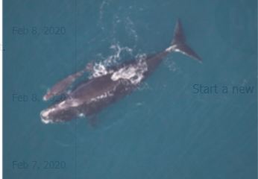
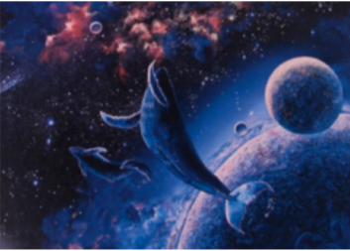
Prep. Phrase Ambiguity
Scientists count whales from space
科學家在太空數鯨魚
科學家從空中數鯨魚
科學家在一個空間數鯨魚
科學家數太空的鯨魚

Slide 14
Prep. Phrase Ambiguity
The board approved [its acquisition]
[by R.T. Ltd.]
[of Toronto]
[for $27 a share]
[at its monthly meeting].
Your Turn
NKUST is a school in Kaohsiung.

Slide 15

Number of Dependencies for Prep. Phrase
Catalan Number: $C_{n}=\frac{\left(2n\right)!}{\left(n+1\right)!n!}$
Catalan number grows exponentially.

Slide 16
More Ambiguous Sentence
[Shuttle veteran and longtime NASA executive] [Fred Gregory] appointed to board
[Shuttle veteran] and [longtime NASA executive Fred Gregory] appointed to board

Slide 17

Adjectival Modifier Ambiguity

Slide 18

VP Ambiguity

Slide 19

Dependency Grammar and Dependency Structure
Dependencies, asymmetric arrow, are the relations between lexical items.
count
scientists whales space
from

Slide 20
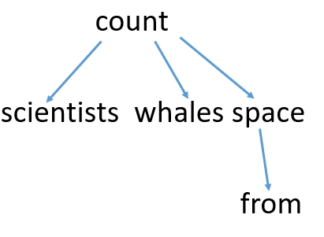
Dependency Grammar and Dependency Structure
Arrows are sometimes typed with their grammatical relations e.g. subject.
If interested, refer to Universal Dependencies website. It contains the dependencies and tags of many languages.
nsubj
nmod
nobj
Prep.

Slide 21
Dependency Grammar and Dependency Structure
Root Scientists count whales from space
A fake Root is added to make each word to be dependent of other word.
There are different way drawing arrow.
However: We draw from head to dependent.

Slide 22
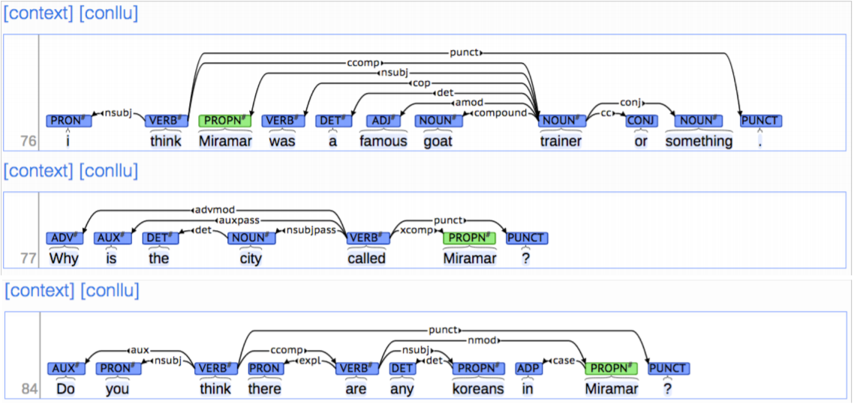
Universal Dependencies Treebank

Slide 23
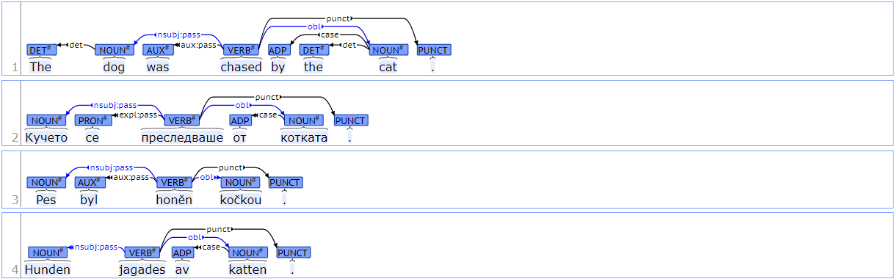
Universal Dependencies: English, Bulgarian, Czech and Swedish
https://universaldependencies.org/introduction.html

Slide 24
Grammar and TreeBank
Why TreeBank?
Reusability – each linguistics may build their own grammar.
Help to deal with ambiguous sentences – machine learning

Slide 25
Dependency Parsing
Each words needs to have the head.
Constraints of Dependency Parsing
Root can only be a head of one word
cycle is not preferable (prefer tree)
Projective Sentence and Non-Projective Sentence
ROOT I ’ll give a talk tomorrow on bootstrapping
ROOT I ’ll give a talk on bootstrapping tomorrow

Slide 26
Dependency Parsing Methods

Slide 27
Methods of Dependency Parsing
Dynamic Programming
Graph Algorithms
Constraint Satisfaction
Transition-Based Parsing

Slide 28
Transition-Based Parser
Transition-based parser is similar to shift-reduce parser.
Parser has
Stack σ – start with ROOT
Buffer β – start with input sentence
A set of dependency arcs – initialized to empty sets
Algorithm will stop when buffer is empty and the stack has ROOT only.

Slide 29
Example: I study at NKUST
Stack
ROOT
ROOT I (shift)
ROOT I study (left-arc) - > ROOT study
ROOT study at (shift)
ROOT study at NKUST (left-arc) - > ROOT study NKUST
ROOT study NKUST (right-arc) - > ROOT study
ROOT study (right-arc) -> ROOT
Buffer
I study at NKUST
study at NKUST
at NKUST
NKUST
EMPTY
EMPTY
EMPTY
study -> I
NKUST->at
study->NKUST
ROOT->study

Slide 30
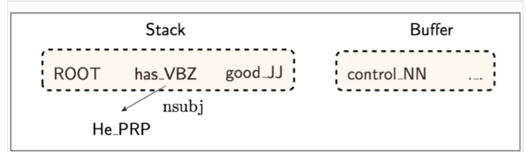
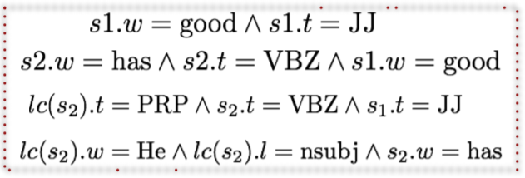
MaltParser
How to know what next action we should take?
Each action is predicted by classifier
Number of label will be 3 or |R|*2 + 1
Features: top of stack word, POS; first in buffer word, POS;
No search requirement (although more accuracy)
Linear Time
However: Conventional feature representation is complex.

Slide 31
Problems of Conventional Method
Sparse and Incomplete
Expensive to compute
Almost all of the computation is spent on feature computation.

Slide 32
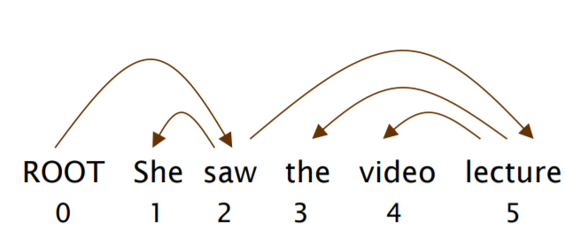
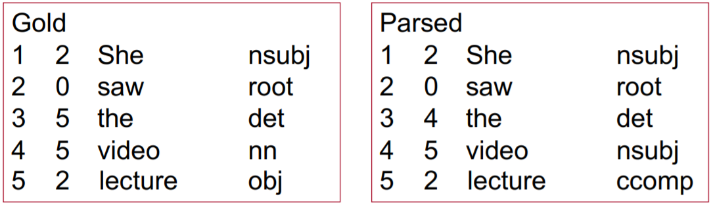
Evaluation of Dependency
We have unlabeled attachment score (UAS), head, and labeled attachment score (LAS), head and label, to evaluate the dependency.
UAS : 80 % (4/5)
LAS : 40 % (2/5)

Slide 33
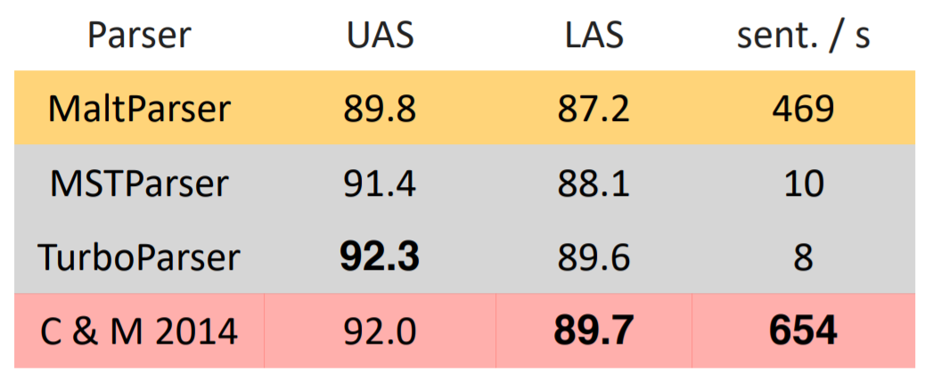
Neural Dependency Parser (Chen and Manning 2004)

Slide 34
A Fast and Accurate Dependency Parser using Neural Networks
Chen et al., ACL, 2014.

Slide 35
Introduction
Neural Network Based Classifier
Solve the problems that previously have
Work Fast
only small numbers of dense vector are used
2% improvement on both evaluation methods
Both English and Chinese

Slide 36
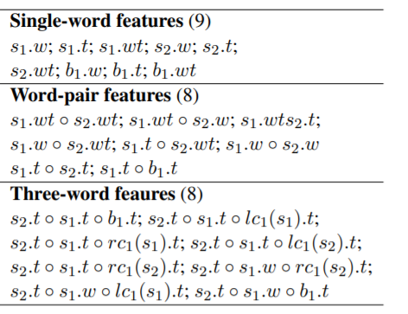
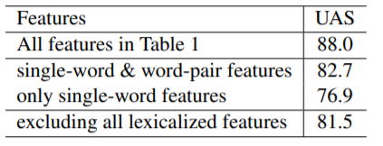
Sparsity of Previous Model
According to the following study, we found
Importance of lexicalized features
Both word-pair features and three-word features are very important

Slide 37
Incompleteness and Expensive Computation
Incompleteness
Unavoidable issue even though we discuss with expertise
Possible to ignore some dependencies
Expensive Computation
Look up huge feature table (millions of features)
Spend 95% of time on feature computation (according to experiment)

Slide 38
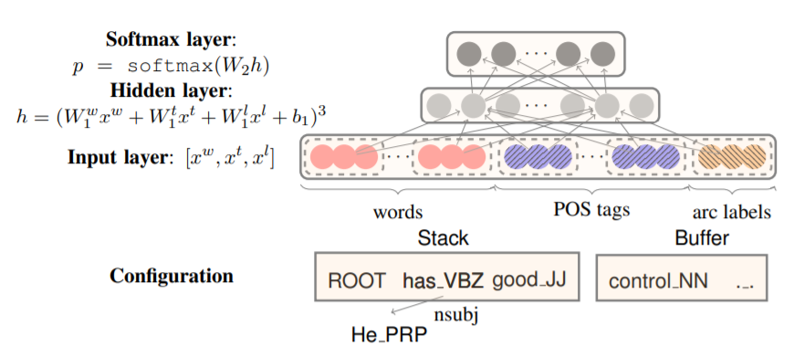
Model Architecture

Slide 39
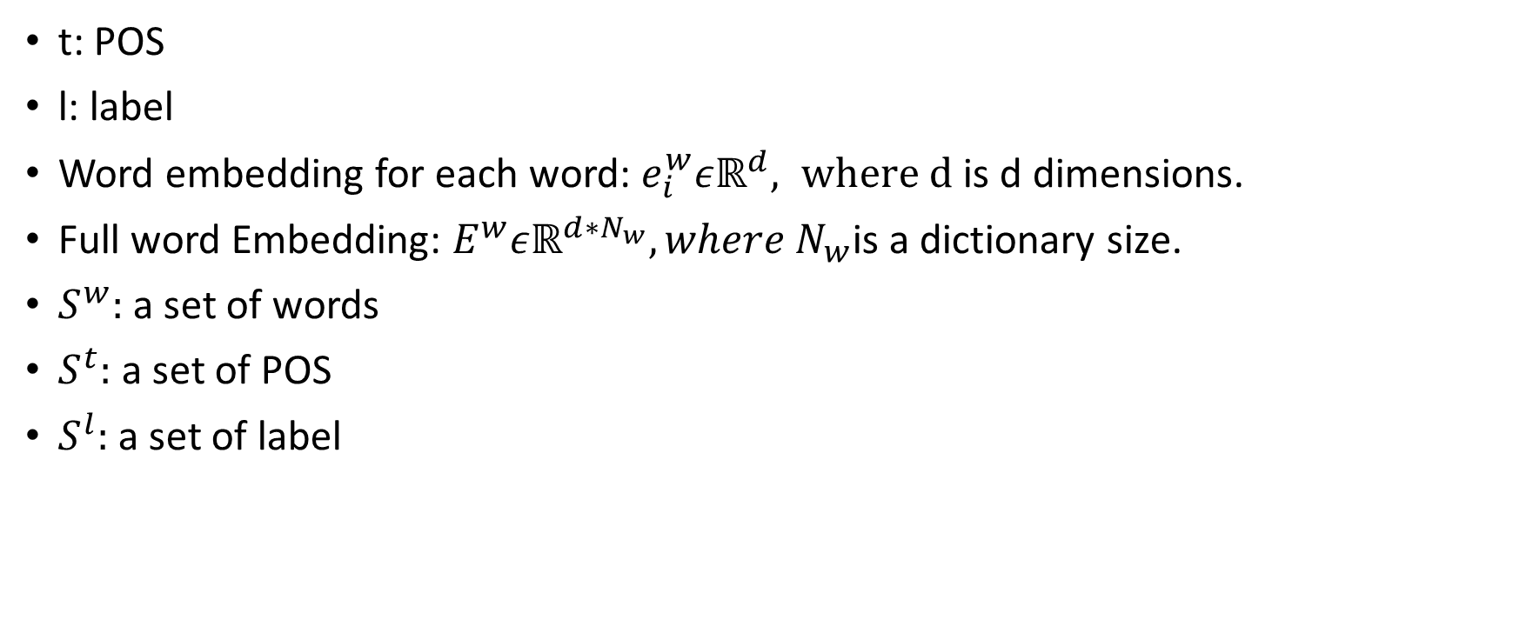
Notation in the Model
t: POS
l: label
Word embedding for each word: $e_{i}^{w}εℝ^{d}, where d$ is d dimensions.
Full word Embedding: $E^{w}εℝ^{d∗N_{w}}, where N_{w}$is a dictionary size.
$S^{w}:$a set of words
$S^{t}:$a set of POS
$S^{l}:$a set of label

Slide 40
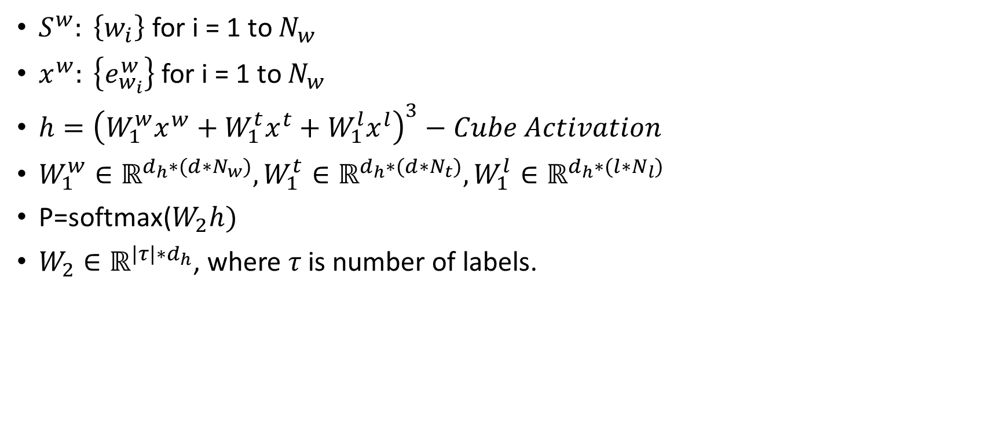
Notation in the Model
$S^{w}: \left\{w_{i}\right\}$ for i = 1 to $N_{w}$
$x^{w}: \left\{e_{w_{i}}^{w}\right\}$ for i = 1 to $N_{w}$
$h={\left(W_{1}^{w}x^{w}+W_{1}^{t}x^{t}+W_{1}^{l}x^{l}\right)}^{3}−Cube Activation$
$W_{1}^{w}∈ℝ^{d_{h}∗{(d∗N}_{w})}, W_{1}^{t}∈ℝ^{d_{h}∗{(d∗N}_{t})},W_{1}^{l}∈ℝ^{d_{h}∗{(l∗N}_{l})}$
P=softmax($W_{2}h)$
$W_{2}∈ℝ^{{|τ|∗d}_{h}}$, where 𝜏 is number of labels.

Slide 41
POS and Label Embedding
Although we only have small sets of POS and label tags, some are still prone to be closer to the other.
Singular Noun -> Plural Noun
Adj. Modifier -> Numeric Modifier e.g. 15000 is large.

Slide 42

Cube Activation Function
$g\left(w_{1}x_{1}+…+w_{m}x_{m}+b\right)=\sum_{i,j,k}{{(w}_{i}w_{j}w_{k})x_{i}x_{j}x_{k}}+…$
Require to verify theoretically

Slide 43
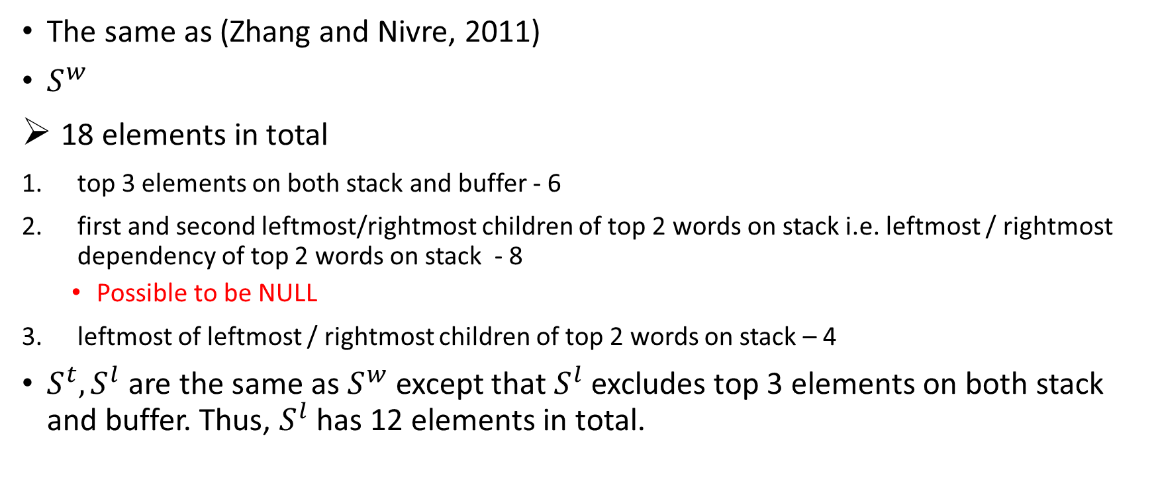

Choice of $S^{w},S^{t},S^{l}$
The same as (Zhang and Nivre, 2011)
$S^{w}$
18 elements in total
top 3 elements on both stack and buffer - 6
first and second leftmost/rightmost children of top 2 words on stack i.e. leftmost / rightmost dependency of top 2 words on stack - 8
Possible to be NULL
leftmost of leftmost / rightmost children of top 2 words on stack – 4
$S^{t},S^{l}$ are the same as $S^{w}$except that $S^{l}$ excludes top 3 elements on both stack and buffer. Thus, $S^{l}$ has 12 elements in total.

Slide 44
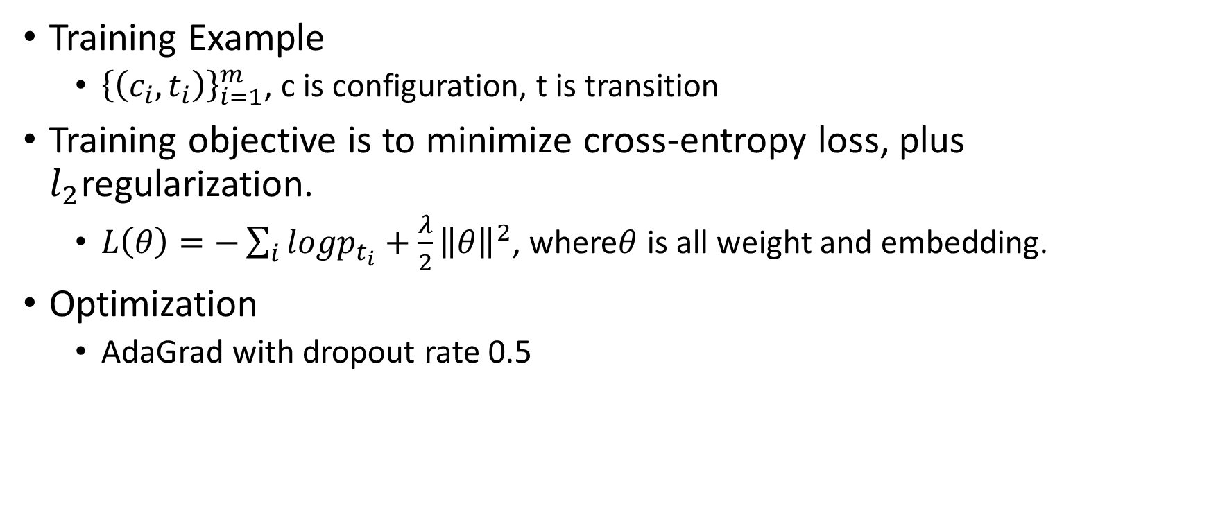
Training
Training Example
${\left\{\left(c_{i},t_{i}\right)\right\}}_{i=1}^{m}$, c is configuration, t is transition
Training objective is to minimize cross-entropy loss, plus $l_{2}$regularization.
$L\left(θ\right)=−\sum_{i}{logp_{t_{i}}}+\frac{λ}{2}{\left\|θ\right\|}^{2}$, where$θ$ is all weight and embedding.
Optimization
AdaGrad with dropout rate 0.5

Slide 45
Training: Parameter Initialization
English
Pre-trained word embedding (Collobert et al., 2011) for word embedding
Random initialization whose range is between (-0.01, 0.01) for POS embedding and label embedding
Chinese
Self-trained word2vector (Mikolov et al., 2013)

Slide 46
Parsing
Neural Dependency Model
Doesn’t need to compute the conjunction features
Doesn’t need to look up in a large table
Speed up
Pre-compute matrix multiplication on top 10000 frequent words
Pre-compute matrix multiplication on all POS and label
Eightfold – tenfold increase

Slide 47
Datasets
Two Datasets
English Penn Treebank (PTB)
Chinese Penn Treebank (CTB)
Dependency Parsing (English)
CoNLL Syntactic Dependencies (CD) (Johansson and Nugues, 2007)
Stanford Basic Dependences (SD) (de Mareffe et al.,2006)
Dependency Parsing (Chinese)
Using Pen2Malt with head-finding rule (Zhang and Clark, 2008)

Slide 48
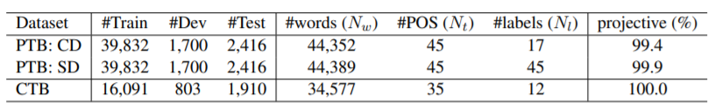
Datasets: Statistics
More than 99 % of data are projective.

Slide 49

Results: Parameters
Embedding size: 50 dimensions
Hidden layer size: 200
Regularization parameter: ${10}^{−8}$
Learning rate of Adagrad: 0.01

Slide 50
Results: Accuracy and Speed
Hardware: Intel core i7 2.7GHz CPU with 16GB RAM
It outperforms on all of datasets in terms of speed and accuracy.
MaltParser is highly optimized.
Our parser means this paper’s (Chen and Manning, 2014) parser.

Slide 51
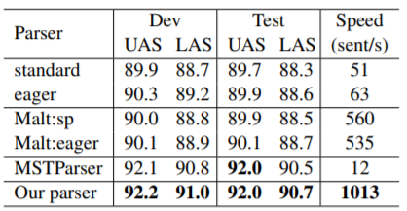
Accuracy and Speed: PTB + CoNLL

Slide 52
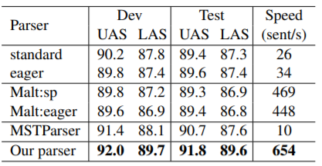
Accuracy and Speed: PTB + Stanford Dependency Parsing

Slide 53
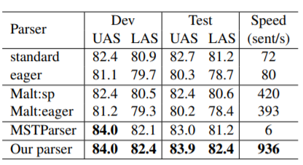
Accuracy and Speed: CTB

Slide 54
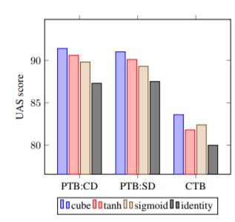
Effects: Cube Activation
Achieve 0.8% ~ 1.2 % improvement in UAS
It’s only verifies empirically.

Slide 55
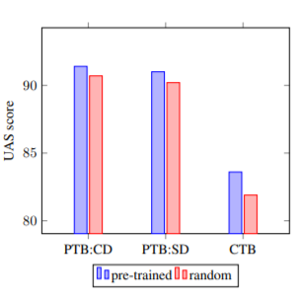
Effects: Initialization of Pre-trained Word Embedding
Compared with random initialization, pre-trained word vector obtains 0.7 % improvement on PTB and 1.7% improvement on CTB.

Slide 56
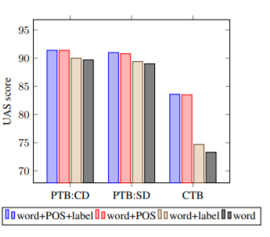
Effects on POS and Arc Label Embedding
POS embedding has 1.7% improvement on PTB and 10% on CTB.
However: Arc label embedding yields small improvement when POS embedding is present.
This may be because POS embedding has
already captured label information.

Slide 57
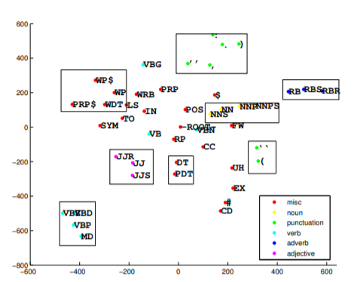
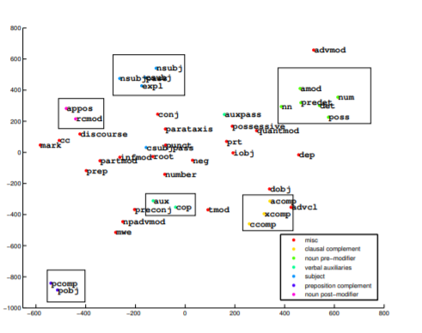
Model Analysis: What do POS and label embedding capture?
The following visualizations are called t-SNE.
Similar tags or labels are grouped together.

Slide 58
Model Analysis: What do weights capture?
This experiment chooses the weight whose absolute value is greater than 0.2.
Phenomena is concluded as follows.
Most weights come from POS tags. Therefore, the importance of POS tags cannot be ignored.
Neural network can automatically encode different information.
Neural network also extract the information that doesn’t appear on previous feature table.

Slide 59
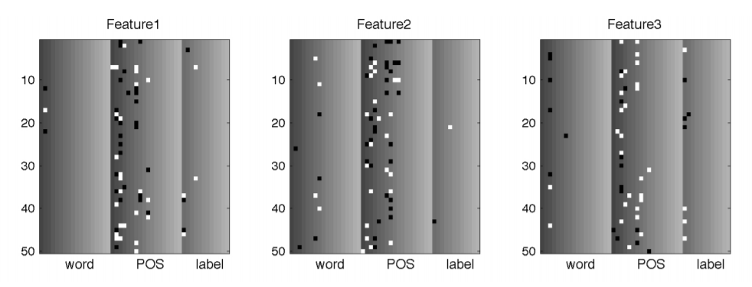
Visualization of Three Features

Slide 60
Better Results

Slide 61
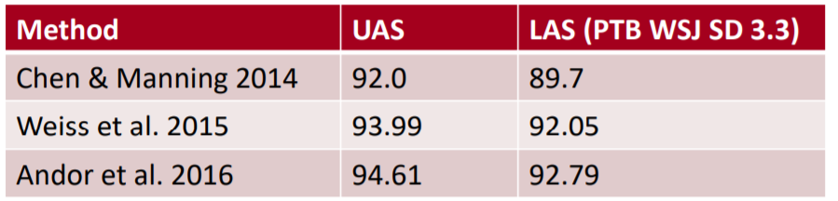
Better Results
Bigger, deeper and spend much time fine-tuning hyperparameter
Beam Search
Global, conditional random field (CRF)-style inference over the decision sequence.

Slide 62
References
Manning et al., CS224n Natural Language Processing with Deep Learning, Stanford University
Chen et al., A Fast and Accurate Dependency Parser using Neural Networks

