Slide 1
Vanishing Gradients and Fancy RNNs
Chia-Yi Su
Department of Electronic Engineering
National Kaohsiung University of Science and Technology

Slide 2
Course Outline
Basic Knowledge on Natural Language Processing
Applications of Natural Language Processing
Word Vector
Neural Network (Including Relative Math Derivation)
Dependency Parsing
Recurrent Neural Network, Variants of Recurrent Neural Network, and Language Model
Machine Translation
Contextual Representation
Dialog System (Including MultiModal Dialog System)

Slide 3
Today’s Agenda
Vanishing Gradient
Linear Algebra : Eigen-Decomposition
Problems of Vanishing / Exploding Gradients
Gradients Clipping
LSTM
GRU
LSTM & GRU Comparison
Direct Connection
Bidirectional RNN
Multi-layer RNN

Slide 4
Vanishing Gradient

Slide 5
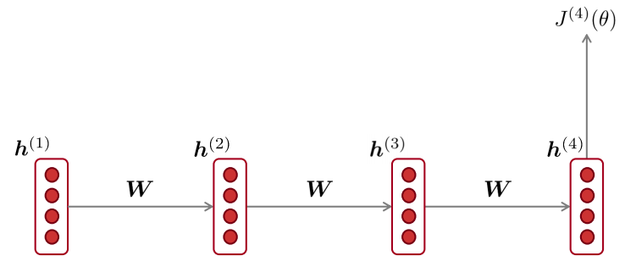

Vanishing Gradient Intuition
$\frac{∂J^{(4)}}{∂h^{(1)}}=$ $\frac{∂h^{(2)}}{∂h^{(1)}}$ * $\frac{∂h^{(3)}}{∂h^{(2)}}$ * $\frac{∂h^{(4)}}{∂h^{(3)}}$ * $\frac{∂J^{(4)}}{∂h^{(4)}}$
What if these values are small?

Slide 6
Idea: Vanishing Gradient
Suppose we have three values 0.1, 0.01, 0.01 and we multiply these values.
0.1 * 0.01 * 0.01 = 0.00001
Therefore: If this happens when we apply backpropagation, our gradients will become smaller and smaller.

Slide 7
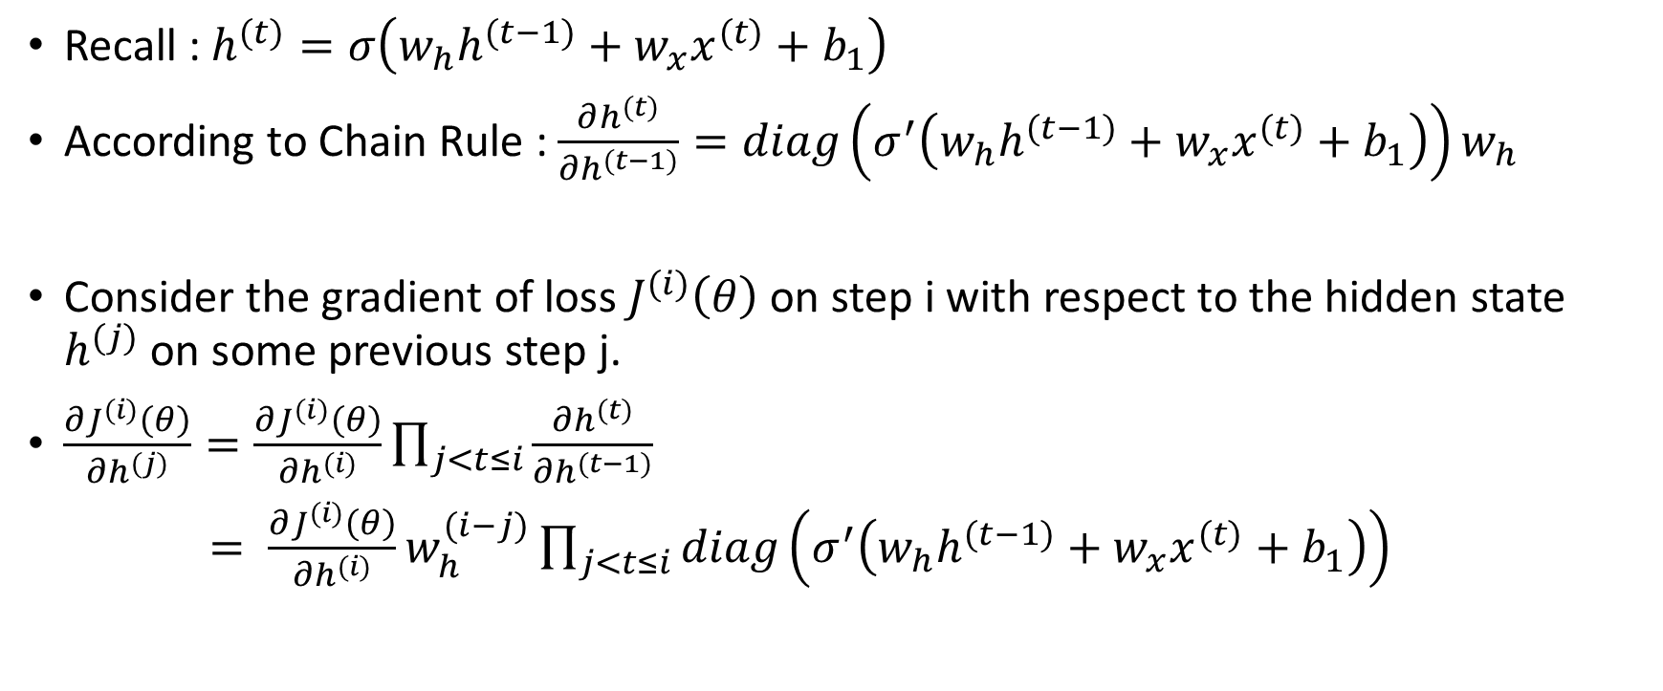
Theory: Vanishing Gradient
Recall : $h^{(t)}=σ\left(w_{h}h^{(t−1)}+w_{x}x^{(t)}+b_{1}\right)$
According to Chain Rule : $\frac{∂h^{(t)}}{{∂h}^{(t−1)}}=diag\left(σ^{′}\left(w_{h}h^{(t−1)}+w_{x}x^{(t)}+b_{1}\right)\right)w_{h}$
Consider the gradient of loss $J^{(i)}\left(θ\right)$on step i with respect to the hidden state $h^{(j)}$ on some previous step j.
$\frac{∂J^{(i)}\left(θ\right)}{{∂h}^{(j)}}=\frac{∂J^{(i)}\left(θ\right)}{{∂h}^{(i)}}\prod_{j<t≤i}{\frac{{∂h}^{(t)}}{{∂h}^{(t−1)}}}$
$= \frac{∂J^{(i)}\left(θ\right)}{{∂h}^{(i)}}w_{h}^{(i−j)}\prod_{j<t≤i}{diag\left(σ^{′}\left(w_{h}h^{(t−1)}+w_{x}x^{(t)}+b_{1}\right)\right)}$
This becomes vanishingly small when i and j get further apart

Slide 8
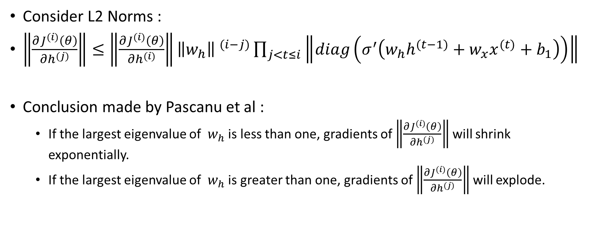
Theory: Vanishing Gradient
Consider L2 Norms :
$\left\|\frac{∂J^{(i)}\left(θ\right)}{{∂h}^{(j)}}\right\|≤\left\|\frac{∂J^{(i)}\left(θ\right)}{{∂h}^{(i)}}\right\|{\left\|w_{h}\right\| }^{(i−j)}\prod_{j<t≤i}{\left\|diag\left(σ^{′}\left(w_{h}h^{(t−1)}+w_{x}x^{(t)}+b_{1}\right)\right)\right\|}$
Conclusion made by Pascanu et al :
If the largest eigenvalue of $w_{h}$ is less than one, gradients of $\left\|\frac{∂J^{(i)}\left(θ\right)}{{∂h}^{(j)}}\right\|$ will shrink exponentially.
If the largest eigenvalue of $w_{h}$ is greater than one, gradients of $\left\|\frac{∂J^{(i)}\left(θ\right)}{{∂h}^{(j)}}\right\|$ will explode.

Slide 9
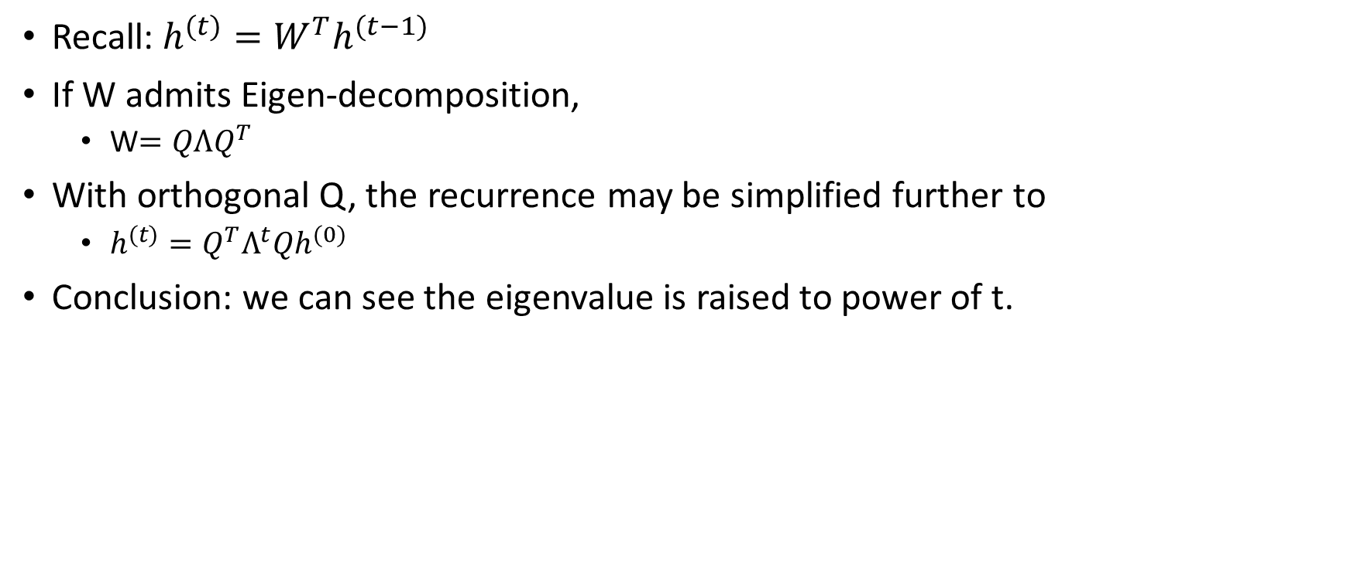
Vanishing Gradient: Another Approach
Recall: $h^{(t)}=W^{T}h^{(t−1)}$
If W admits Eigen-decomposition,
W$=QΛQ^{T}$
With orthogonal Q, the recurrence may be simplified further to
$h^{(t)}=Q^{T}Λ^{t}Qh^{(0)}$
Conclusion: we can see the eigenvalue is raised to power of t.

Slide 10
Linear Algebra: Eigen-Decomposition

Slide 11
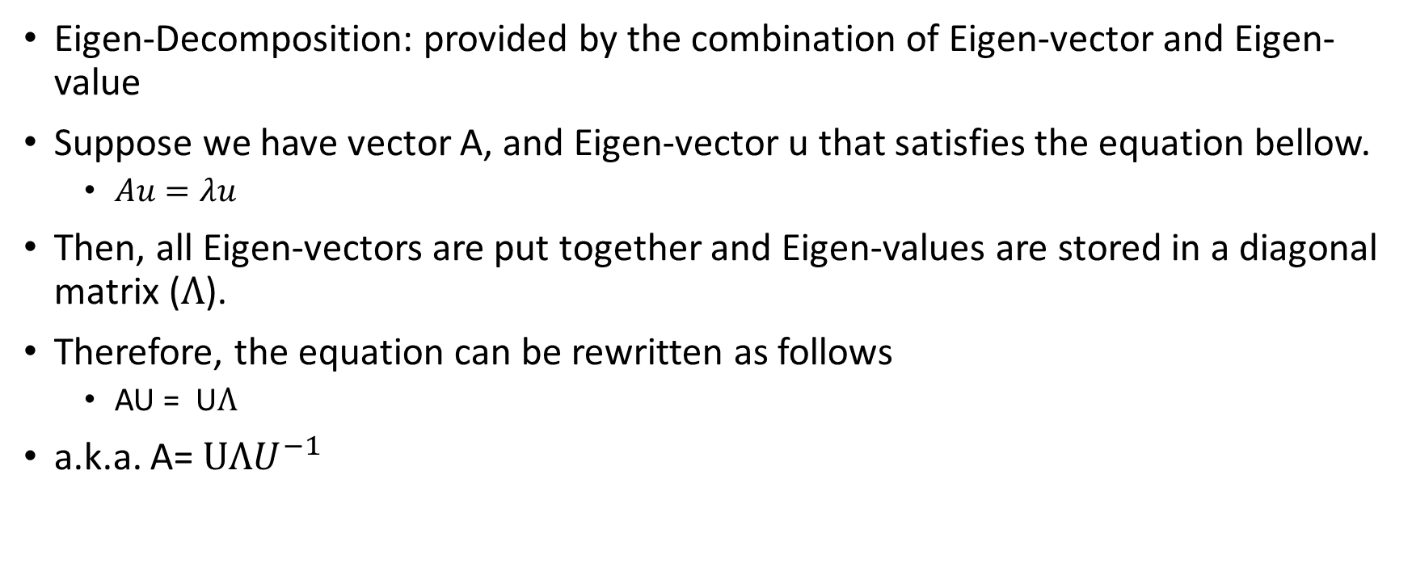
Eigen-Decomposition
Eigen-Decomposition: provided by the combination of Eigen-vector and Eigen-value
Suppose we have vector A, and Eigen-vector u that satisfies the equation bellow.
$Au=λu$
Then, all Eigen-vectors are put together and Eigen-values are stored in a diagonal matrix ($Λ$).
Therefore, the equation can be rewritten as follows
AU = U$Λ$
a.k.a. A= $UΛU^{−1}$

Slide 12
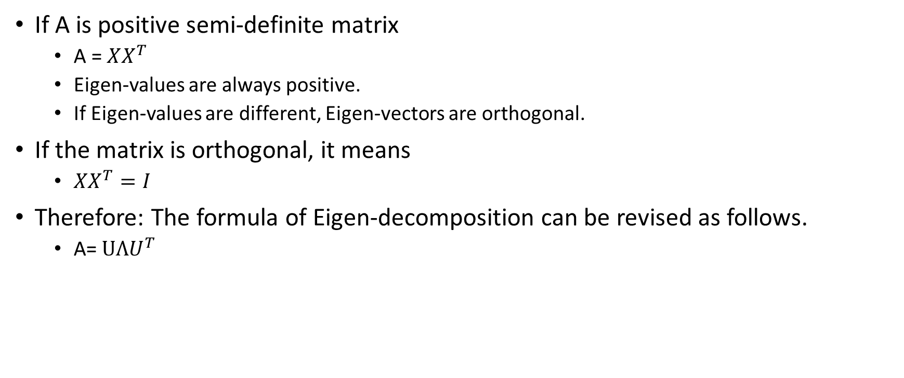
Positive Semi-Definite Matrix A
If A is positive semi-definite matrix
A = $XX^{T}$
Eigen-values are always positive.
If Eigen-values are different, Eigen-vectors are orthogonal.
If the matrix is orthogonal, it means
$XX^{T}=I$
Therefore: The formula of Eigen-decomposition can be revised as follows.
A= $UΛU^{T}$

Slide 13
Problems of Vanishing / Exploding Gradients

Slide 14
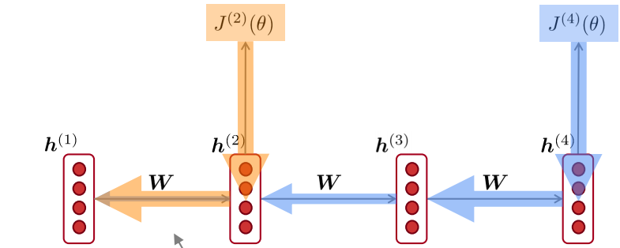
Why is vanishing gradient a problem?
The gradient signal will be:
Much larger from close-by signal
Much smaller from faraway signal
Model only consider near effects instead of long term effects.

Slide 15
Why is vanishing gradient a problem?
If vanishing gradient problems between step t and step t+n come up, it’s hard for us to know whether:
The dependency between step t and step t + n doesn’t exist.
The true dependency is captured by wrong parameters.

Slide 16
Vanishing Gradients: Effects on RNNLM
LM task: When she tried to print her tickets, she found that the printer was out of toner. She went to the stationery store to buy more toner. It was very overpriced. After installing the toner into the printer, she finally printed her ________
當她要列印票劵的時候，她發現列表機沒有墨水夾。她去文具店買了非常貴的墨水夾。在她把墨水夾裝進去之後，她終於印出她的____。
In order to predict “tickets” correctly, the model needs to learn the dependency between first “tickets” and the “tickets” at the end.
However: If vanishing gradients problems come up, the model cannot learn this dependency.
Therefore: It’s unable to predict this long-distance word.

Slide 17
Vanishing Gradients: Effects on RNNLM
LM task: The writer of this books ___
The writer of this books is … (Correct Answer)
Syntactic recency : The writer of this books is - Correct
Sequential recency : The writer of this books are – Incorrect
According to Linzen et al., RNN is prone to make the sequential recency error because of vanishing gradients problems.

Slide 18

Why is exploding gradients a problem?
$θ^{new}=θ^{old}−α∇_{θ}J\left(θ\right)$
Recall : What if our learning rate too large?
The worst case is the loss becomes infinity.

Slide 19
Gradients Clipping

Slide 20
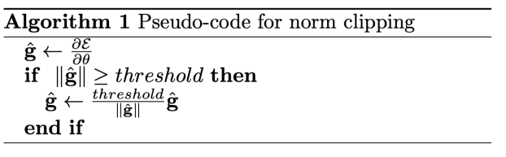
Gradient Clipping: Solution for Exploding Gradients
Gradient Clipping
If the norm of the gradients is greater than some threshold, scale it down before applying SGD.
Although its value decreases, the direction is still the same.

Slide 21
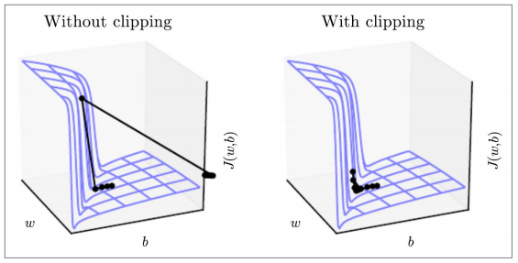
Gradient Clipping: Solution for Exploding Gradients
On the left, gradients are too large. Therefore, it shoots off to the right.
On the right, gradients are reduced by using gradient clipping. Therefore, the effect is less dramatic.

Slide 22
Long Short-Term Memory (LSTM)

Slide 23

Vanishing Gradient: LSTM Motivation
The main problem of RNN is that it cannot learn to preserve information over many timesteps.
The hidden state is constantly being rewritten in RNN.
$h^{(t)}=σ\left(w_{h}h^{(t−1)}+w_{x}x^{(t)}+b_{1}\right)$
How about a RNN with a separate memory?

Slide 24
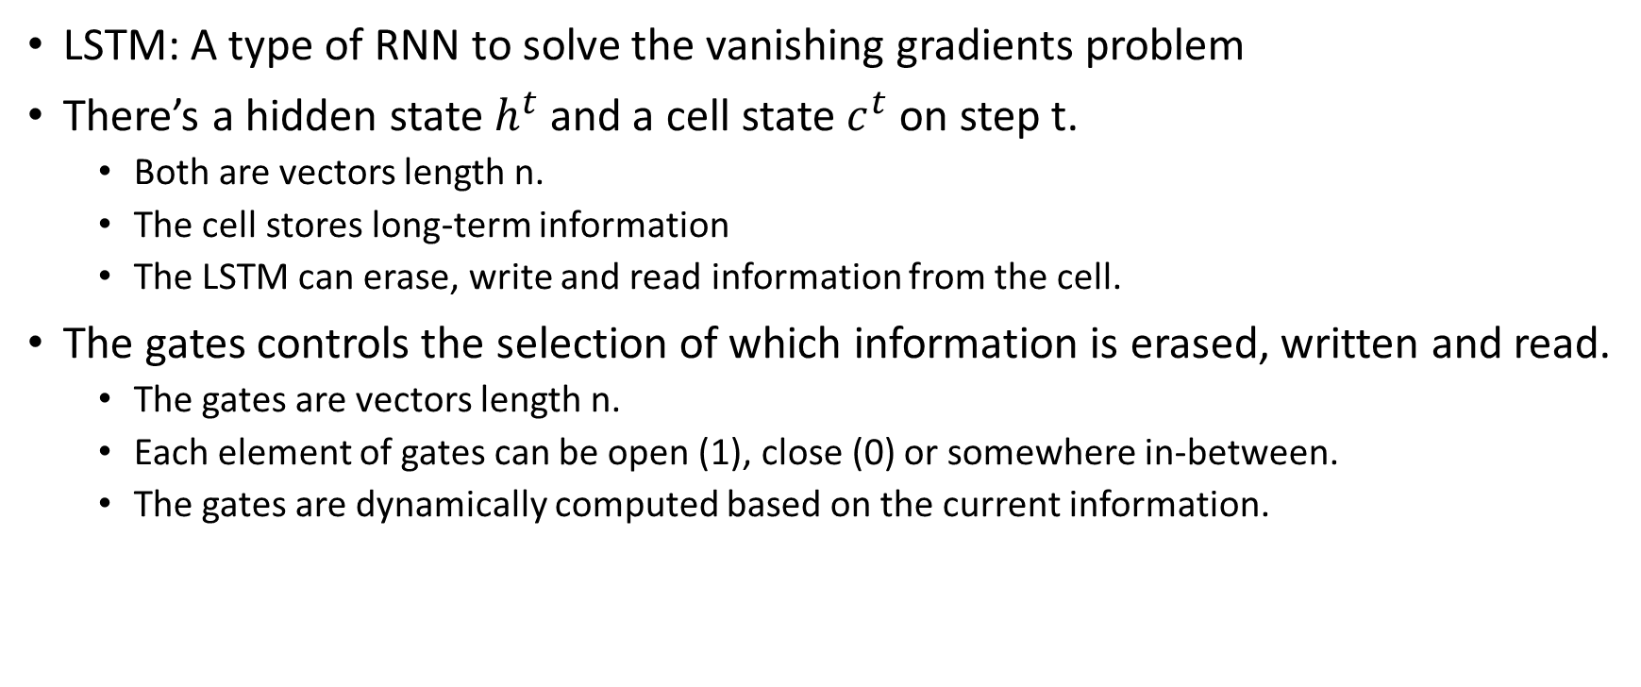
Long Short-Term Memory (LSTM)
LSTM: A type of RNN to solve the vanishing gradients problem
There’s a hidden state$h^{t}$ and a cell state $c^{t}$ on step t.
Both are vectors length n.
The cell stores long-term information
The LSTM can erase, write and read information from the cell.
The gates controls the selection of which information is erased, written and read.
The gates are vectors length n.
Each element of gates can be open (1), close (0) or somewhere in-between.
The gates are dynamically computed based on the current information.

Slide 25
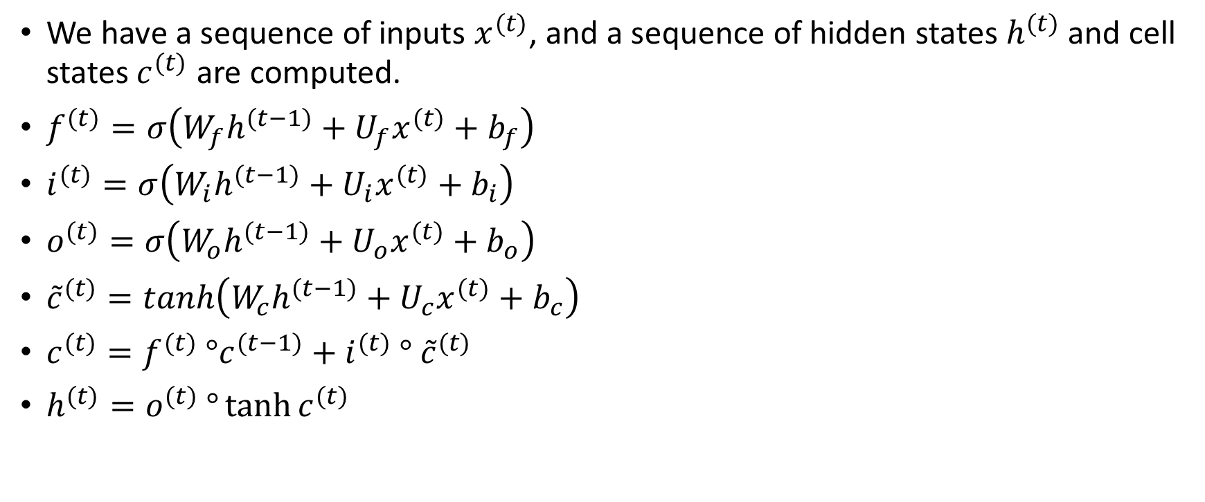
LSTM: Equations
We have a sequence of inputs $x^{(t)}$, and a sequence of hidden states $h^{(t)}$ and cell states $c^{(t)}$ are computed.
$f^{(t)}=σ\left(W_{f}h^{(t−1)}+U_{f}x^{(t)}+b_{f}\right)$
$i^{(t)}=σ\left(W_{i}h^{(t−1)}+U_{i}x^{(t)}+b_{i}\right)$
$o^{(t)}=σ\left(W_{o}h^{(t−1)}+U_{o}x^{(t)}+b_{o}\right)$
${\tilde{c}}^{(t)}=tanh\left(W_{c}h^{(t−1)}+U_{c}x^{(t)}+b_{c}\right)$
$c^{(t)}=f^{(t)} °c^{(t−1)}+i^{(t)}$ $° {\tilde{c}}^{(t)}$
$h^{(t)}=o^{(t)} °\tanh{c^{(t)}}$
Forget Gate
Input Gate
Output Gate
New Cell Content
Cell State
Hidden State

Slide 26
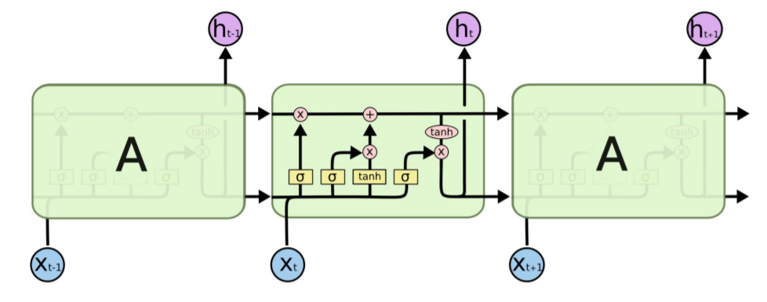
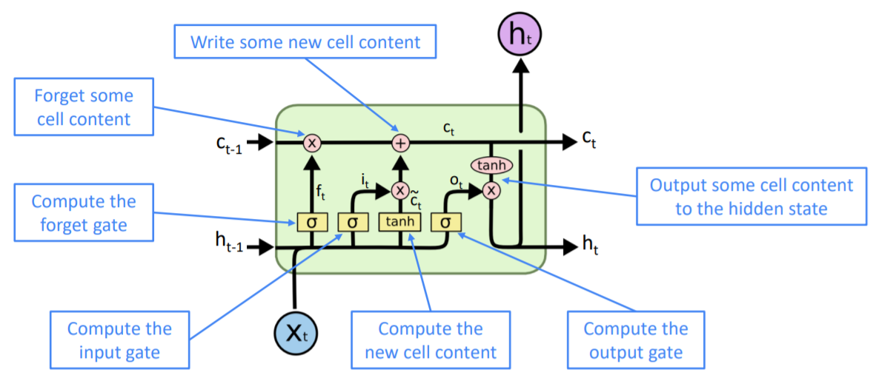
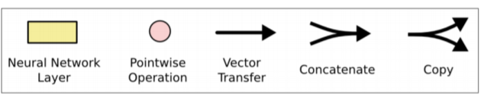
LSTM: Diagram
LSTM equation can be visualized as follows.

Slide 27
How does LSTM solve vanishing gradients?
It’s easier to preserve information over many timesteps by using LSTM architecture.
LSTM may still have vanishing gradients problem.
However: It provides an easier way to long-distance dependencies.

Slide 28
LSTM: Real-World Success
The art-of-state-results that LSTM achieves (2013-2015)
Hang-writing recognition
Speech Recognition
Machine Translation
Parsing
Image Captioning
However: Other approaches (Transformer) become more dominant in 2019.
E.g. WMT conference
In WMT 2016, RNN related papers contain 44 times.
In WMT 2018, RNN only appears 9 times. However, Transformer has 63 times.

Slide 29
Gated Recurrent Unit (GRU)

Slide 30
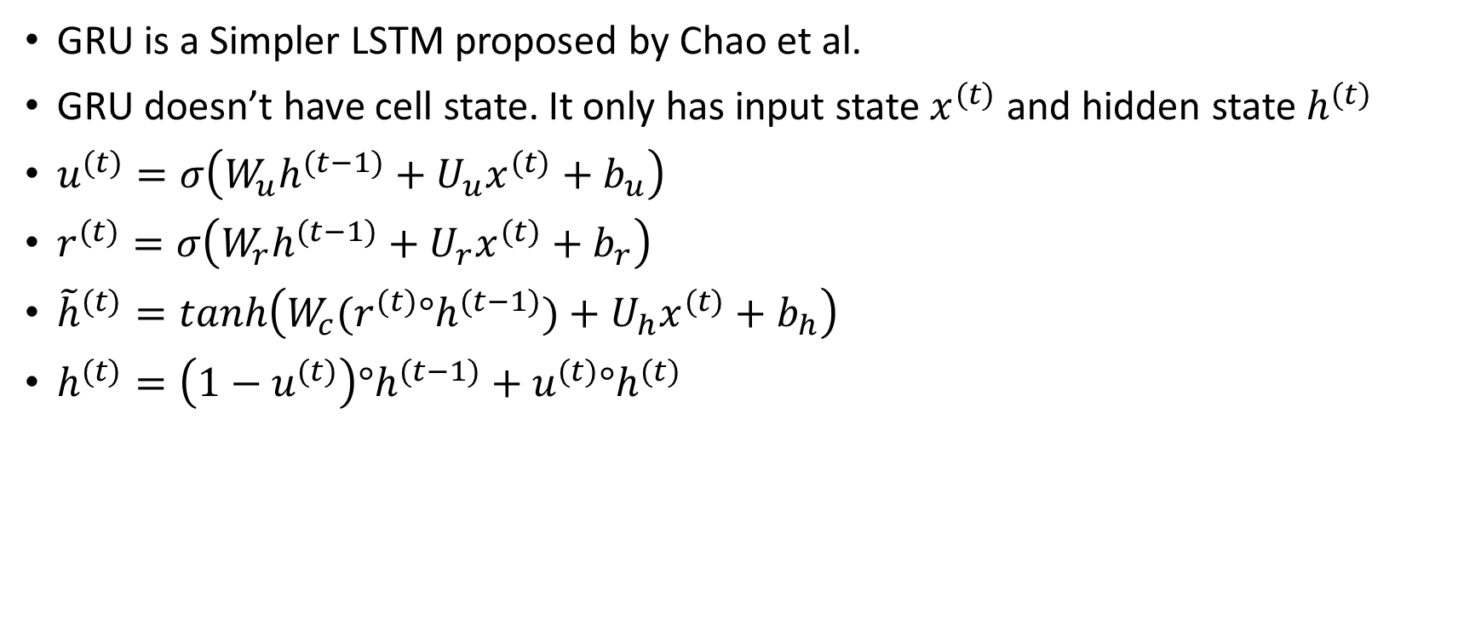
Gated Recurrent Unit (GRU)
GRU is a Simpler LSTM proposed by Chao et al.
GRU doesn’t have cell state. It only has input state $x^{(t)}$ and hidden state $h^{(t)}$
$u^{(t)}=σ\left(W_{u}h^{(t−1)}+U_{u}x^{(t)}+b_{u}\right)$
$r^{(t)}=σ\left(W_{r}h^{(t−1)}+U_{r}x^{(t)}+b_{r}\right)$
${\tilde{h}}^{(t)}=tanh\left(W_{c}{(r^{(t)}°h}^{(t−1)})+U_{h}x^{(t)}+b_{h}\right)$
$h^{(t)}=\left(1−u^{(t)}\right)°h^{(t−1)}+$ ${u^{(t)}°h}^{(t)}$
Update Gate
Reset Gate
New Hidden State Content
Hidden State

Slide 31
LSTM & GRU Comparison

Slide 32
LSTM V.S. GRU
Although LSTM and GRU are the most widely used architecture, many gated RNNs have been proposed by researchers.
The biggest difference between LSTM and GRU is computation and parameters. GRU is faster and less parameter than LSTM.
The conclusion about which one is better has not been made.
Rule of Thumb: Start with LSTM, and switch to GRU if you suffer from computational problem.

Slide 33
Direct Connection

Slide 34
Is a vanishing / exploding gradients just RNN problems?
Other neural architectures such as feed-forward and convolutional also have this problem.
When backpropagation starts, gradient can become vanishingly small because of chain rule and the choice of non-linearity function.
Lower layers learnt very slowly.
Solution: Add more direct connections

Slide 35
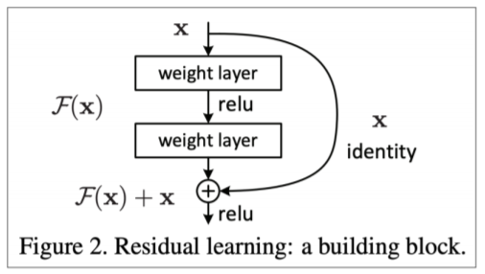
Example: Residual Connection
a.k.a. “ResNet” and skip-connections
Identity connection preserves default information
Network will be easier to train if this method is applied

Slide 36
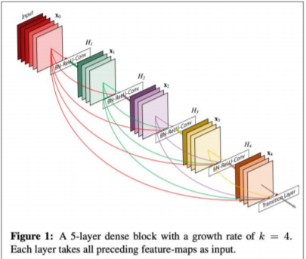
Example: Dense Connection
a.k.a. “DenseNet”
Everything is connected directly.

Slide 37
Example: Highway Connection
a.k.a. “HighwayNet”
It’s similar to ResNet although the identity connection vs. transformation layer is controlled by dynamic gate.
An idea inspired by LSTM but applied to feed-forward and convolutional networks.

Slide 38
Conclusion
General problem
Happen on RNN more frequently
Reason: RNN multiplies same weights repeatly.

Slide 39
Bidirectional RNN

Slide 40
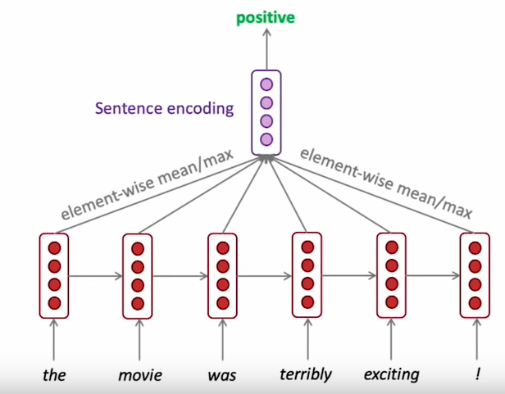
Bidirectional RNNs: Motivation
Terribly can have two kinds of meaning.

Slide 41
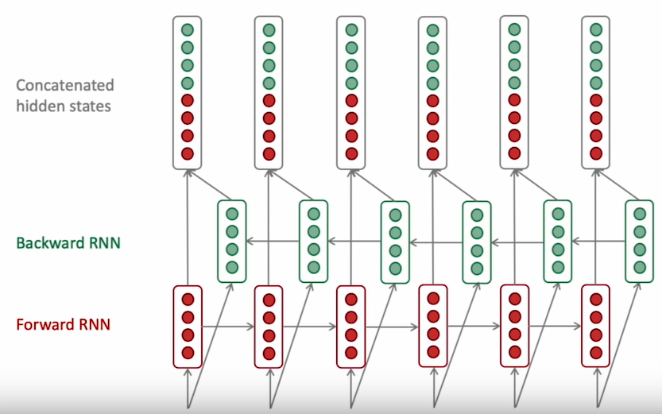
Bidirectional RNN

Slide 42

Bidirectional RNN
On time t
Forward RNN: ${\vec{h}}^{(t)}= {RNN}_{FW}\left({\vec{h}}^{(t−1)},x^{(t)}\right)$
Backward RNN: ${\overset{⃐}{h}}^{(t)}= {RNN}_{BW}\left({\vec{h}}^{(t−1)},x^{(t)}\right)$
Concatenated hidden state : $h^{(t)}=\left[{\vec{h}}^{(t)},{\overset{⃐}{h}}^{(t)}\right]$

Slide 43
Bidirectional RNN
Assumption
Assume we have entire sentence
It’s not applicable to language model
Bidirectional RNN is a good default network because of its bidirectionality.

Slide 44
Multi-layer RNN

Slide 45
Multi-layer RNNs
RNNs are already “deep” on one dimension.
RNNs can also be “deep” on another dimension when we apply multiple RNNs.
Network can have more complex representations when multiple RNNs are applied.
That is, Lower RNN computes lower-level features whereas higher-level features are computed by higher RNN.
Multi-layer RNN is also called stacked RNN.

Slide 46
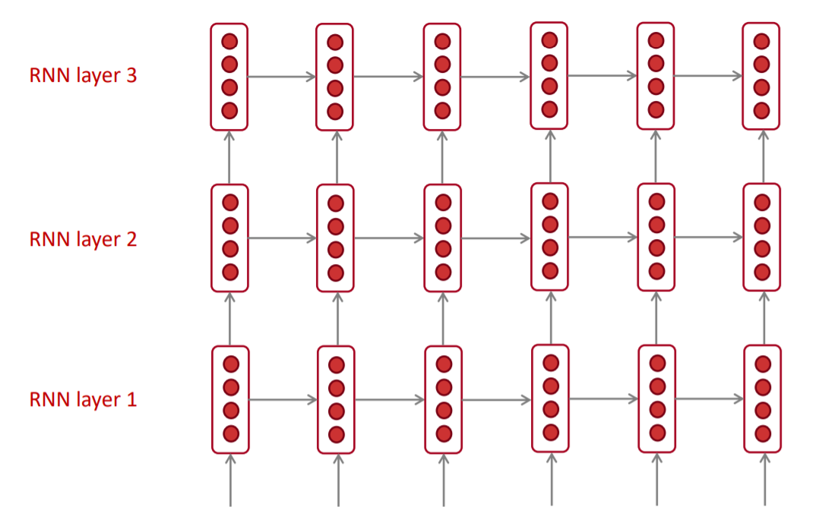
Multi-layer RNNs

Slide 47
Multi-layer RNN in Practice
High-performance RNNs are often multi-layer.
However: These don’t as deep as other networks such as convolutional network.
In 2017, Britz et al. found 2 to 4 layers are the best for encoder and 4 layers are the best for decoder in machine translation.
However: Deeper layer of RNNs are required to apply Skip / dense connections.

Slide 48
References
Manning et al., CS224n Natural Language Processing with Deep Learning, Stanford University
Hervé Abdi, The Eigen-Decomposition: Eigenvalues and Eigenvectors
Goodfellow et al., Deep Learning Books, Online Version

